Slide 1
Nepal Election Sentiment Analysis
& Result Visualization
Machine Learning / Data Science Internship Project
Pramikshya Pokharel

Slide 2
Data Collection
Collected election‑related comments from online public discussions
Sources: Nepali news portals, YouTube news comments, social media discussions
Total dataset size: 1000+ text samples
Languages included: Nepali and English
Data stored in CSV format for analysis

Slide 3
Sentiment Analysis Model
Text preprocessing: removed URLs, symbols, emojis and normalized text
Feature extraction using TF‑IDF vectorization
Machine Learning algorithm: Logistic Regression, Navies Bays & SVM
Train/Test split used for model training
Model evaluation: Accuracy, Confusion Matrix, Classification Report

Slide 4
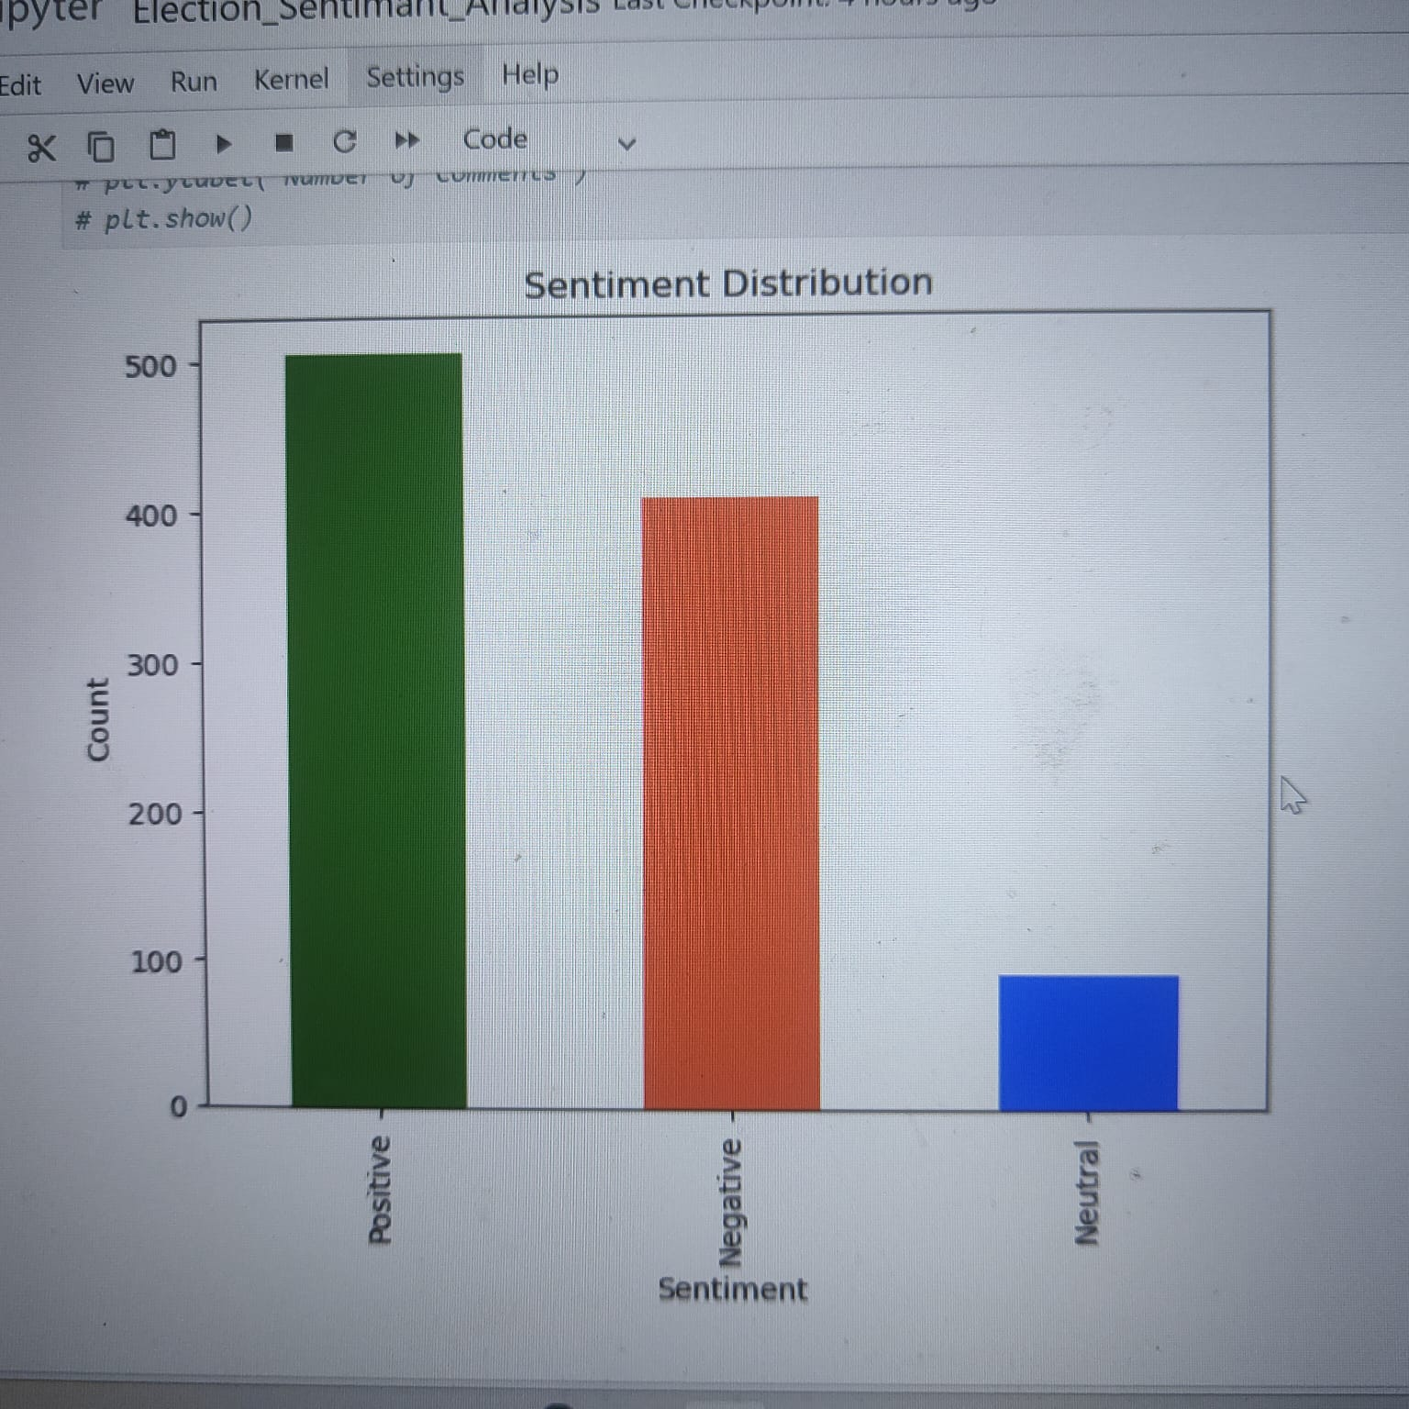
Sentiment (Positive, Negative, Neutral)Visualization
Distribution of sentiments using bar-chart(Positive, Negative, Neutral)

Slide 5
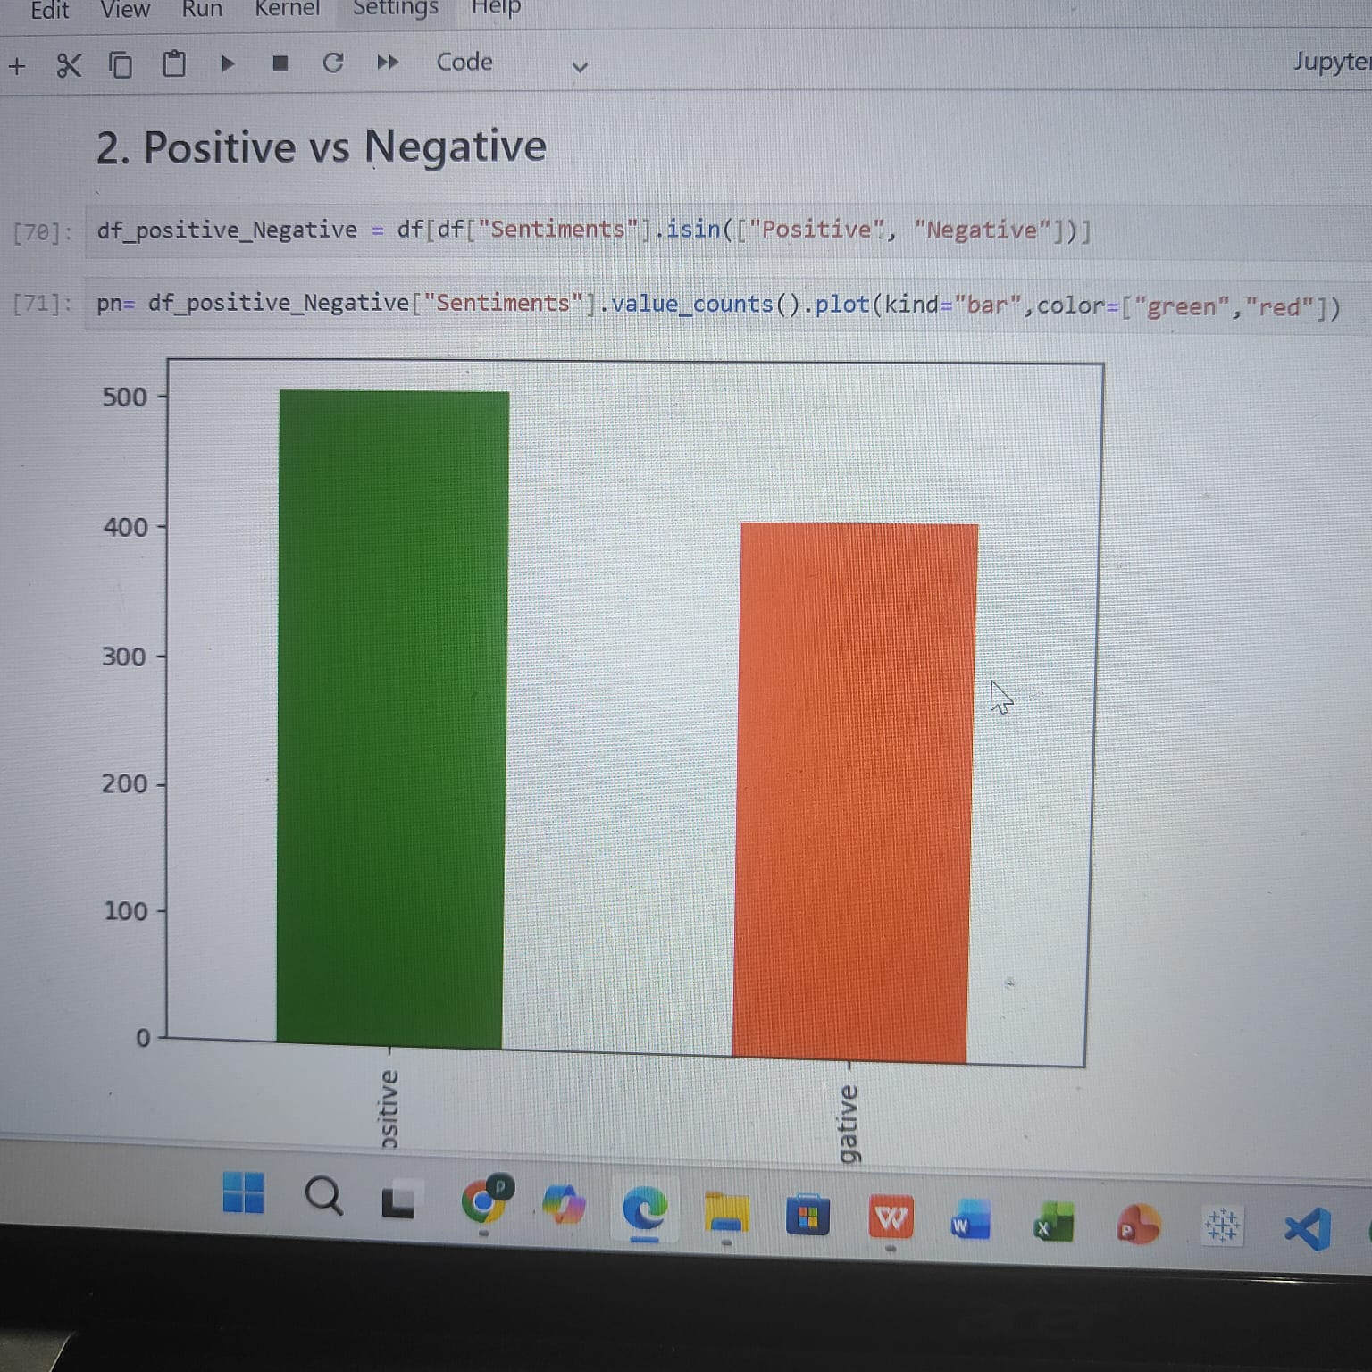
Positive vs Negative Comments Comparison
Bar chart comparison of sentiment categories(Positive & Negative)
It helps to show what is the Positive & negative Comments status about election.

Slide 6
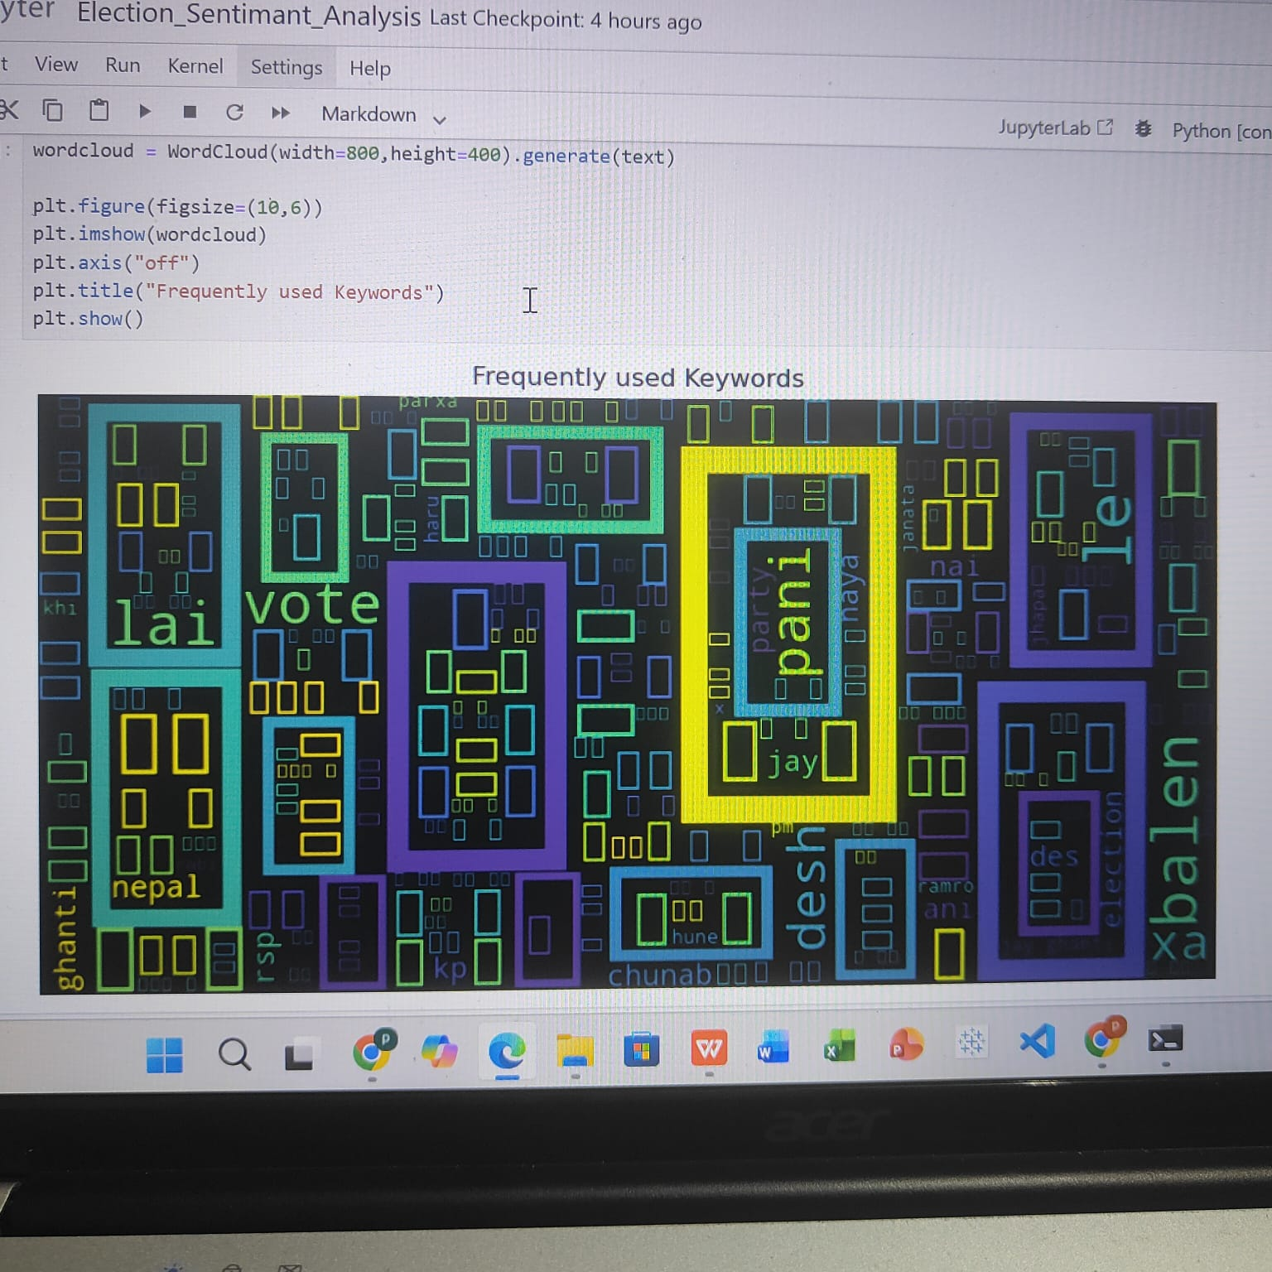
Frequently used words or keywords
WordiCloud visualization for frequently used keywords.
It helps to understand , which keywords in frequently appears in the election datasets.

Slide 7
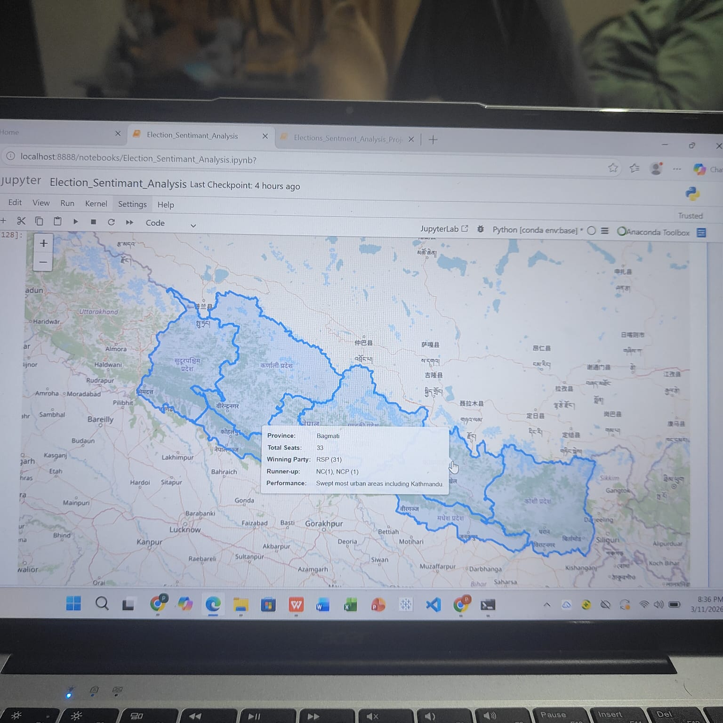
Nepal Election Map Visualization
Used Nepal GeoJSON map data for geographic visualization

Slide 8
Nepal election map Conclusion
Election results displayed by province.
Provience shows according to winning political party and rest status too.
Interactive visualization created using Plotly / GeoPandas
Provides geographic insight into election outcomes

