Slide 1
Capstone Project – Predicting crime rate in SF
Submitted by – Pramil Jain

Slide 2
Agenda
Project Background
Exploratory data analysis
Models
Application of the model

Slide 3
Project background
San Francisco Crime Classification
After moving to San Francisco last year, I have always heard that I should avoid going to some areas at certain time they are not that safe. I used to wonder is there a way we actually can know how risky/safe different areas in San Francisco are?
Then, while looking for a capstone project for my “Foundations of Data Science” course with Springboard, I stumble upon a Kaggle competition about predicting crime in San Francisco. And I took this opportunity to answer my curious mind
In this problem, we are provided with nearly 12 years of crime reports from across all of San Francisco's neighborhoods. Using time and location, we have to predict the type of crime occurred.
I have also tried to explore different applications of my project which would make San Francisco and world a safer place

Slide 4
Data sets and variables
In this problem, dataset contains incidents derived from SFPD Crime Incident Reporting system. The data ranges from 1/1/2003 to 5/13/2015. The training set and test set rotate every week, meaning week 1,3,5,7... belong to test set, week 2,4,6,8 belong to training set
Below is the high level description of all the dependent variables -
Time
Timestamp (Date and Time) of the crime incident
Day of week when the crime occurred
Location
Name of the Police Department District where crime occurred
Approximate street address of the crime incident
Longitude and Latitude of the crime incident
Using the above dependent variable we have to predict the probability of occurrence of 39 different categories of crimes

Slide 5
Agenda
Project Background
Exploratory data analysis
Models
Application of the model

Slide 6
Through exploratory data analysis, I created some new variables which might help us to create a better model
Location
related variables
Latitudes and Longitudes
Longitude (X)
Latitude (Y)
PD district
We had data for 10 different police station districts
Address
Intersection – derived from address information
Time related variables
Date
Month – derived directly from Date
Year – derived directly from Date
Season (fall, summer, spring and winter) – derived by clubbing months
Time
Hours – derived directly from Date
Night (1:00 am to 9:00 am) vs Day – derived by clubbing hours
Day of Week
Day of Week (DoW)
Workday (Monday, Tuesday, Wednesday and Friday) vs. Non-workday (Friday, Saturday and Sunday) – derived by clubbing DoW
I came up with the above derived variables through EDA, please refer to the following slides for details

Slide 7
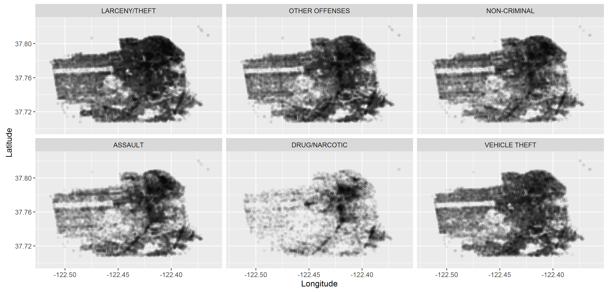
Variation of crime by Longitude and Latitude
Location
related variables
Crime density by co-ordinates
Observations –
Clear variation of overall crime rate and crime rate by category was observed with longitude and latitude, we should definitely include PD district into our model
Drug/ Narcotic related crimes were more common in the north east area of SF
We have graphical analyzed top 6 type of crimes only, which are ~66% of the total crimes
For better visualization we have clubbed similar points, 1 point shown in charts is equivalent to 20 similar points

Slide 8
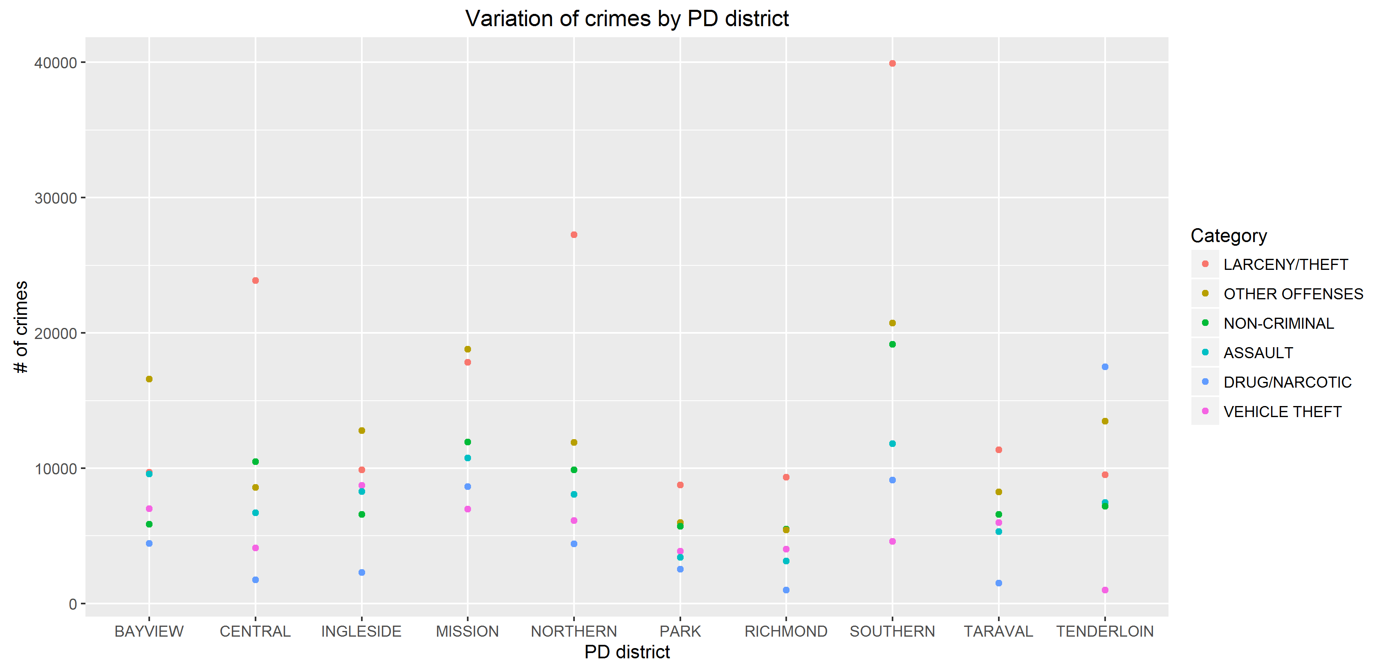
Variation of crime by District
Location
related variables
Observations –
Drugs/ Narcotics is the most common crime in Tenderloin; Larceny/ theft very common in Sothern, Northern and Central PD districts
Clear variation of overall crime rate and crime rate by category was observed with PD district, we should definitely include PD district into our model
Given the nature of variables X/Y and PD district, they would be highly related. We should try eliminating inter dependency of these variables from the model
We have graphical analyzed top 6 type of crimes only, which are ~66% of the total crimes

Slide 9
Variation of crime by Address
Location
related variables
Observations –
While observing addresses we noticed that some addresses were on intersections of two streets and some were in a block; to analyze this we created a new flag for intersections
Clear distinction of type of crime can be observed with intersections. As expected, crimes like Theft and Assault are less common on intersections. This can be a good variable to include in the model
We have graphical analyzed top 6 type of crimes only, which are ~66% of the total crimes

Slide 10
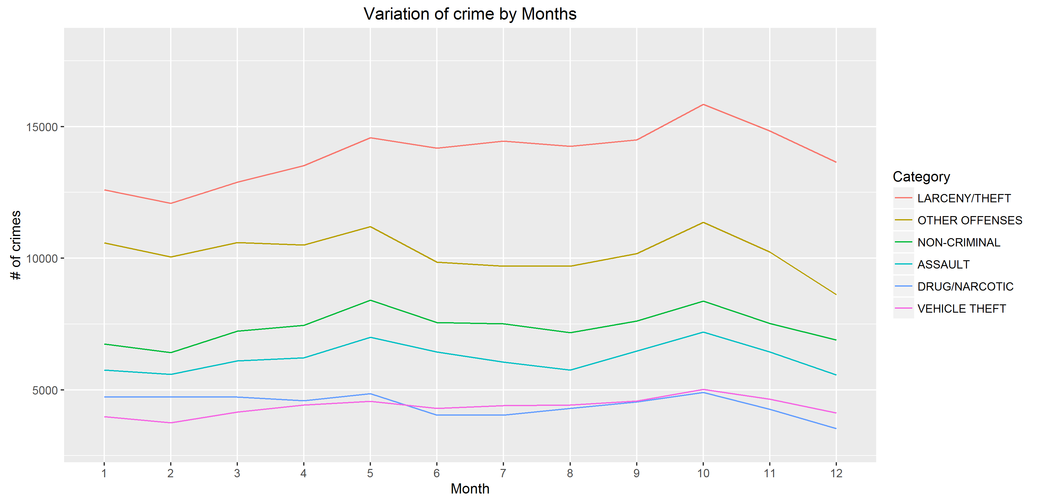
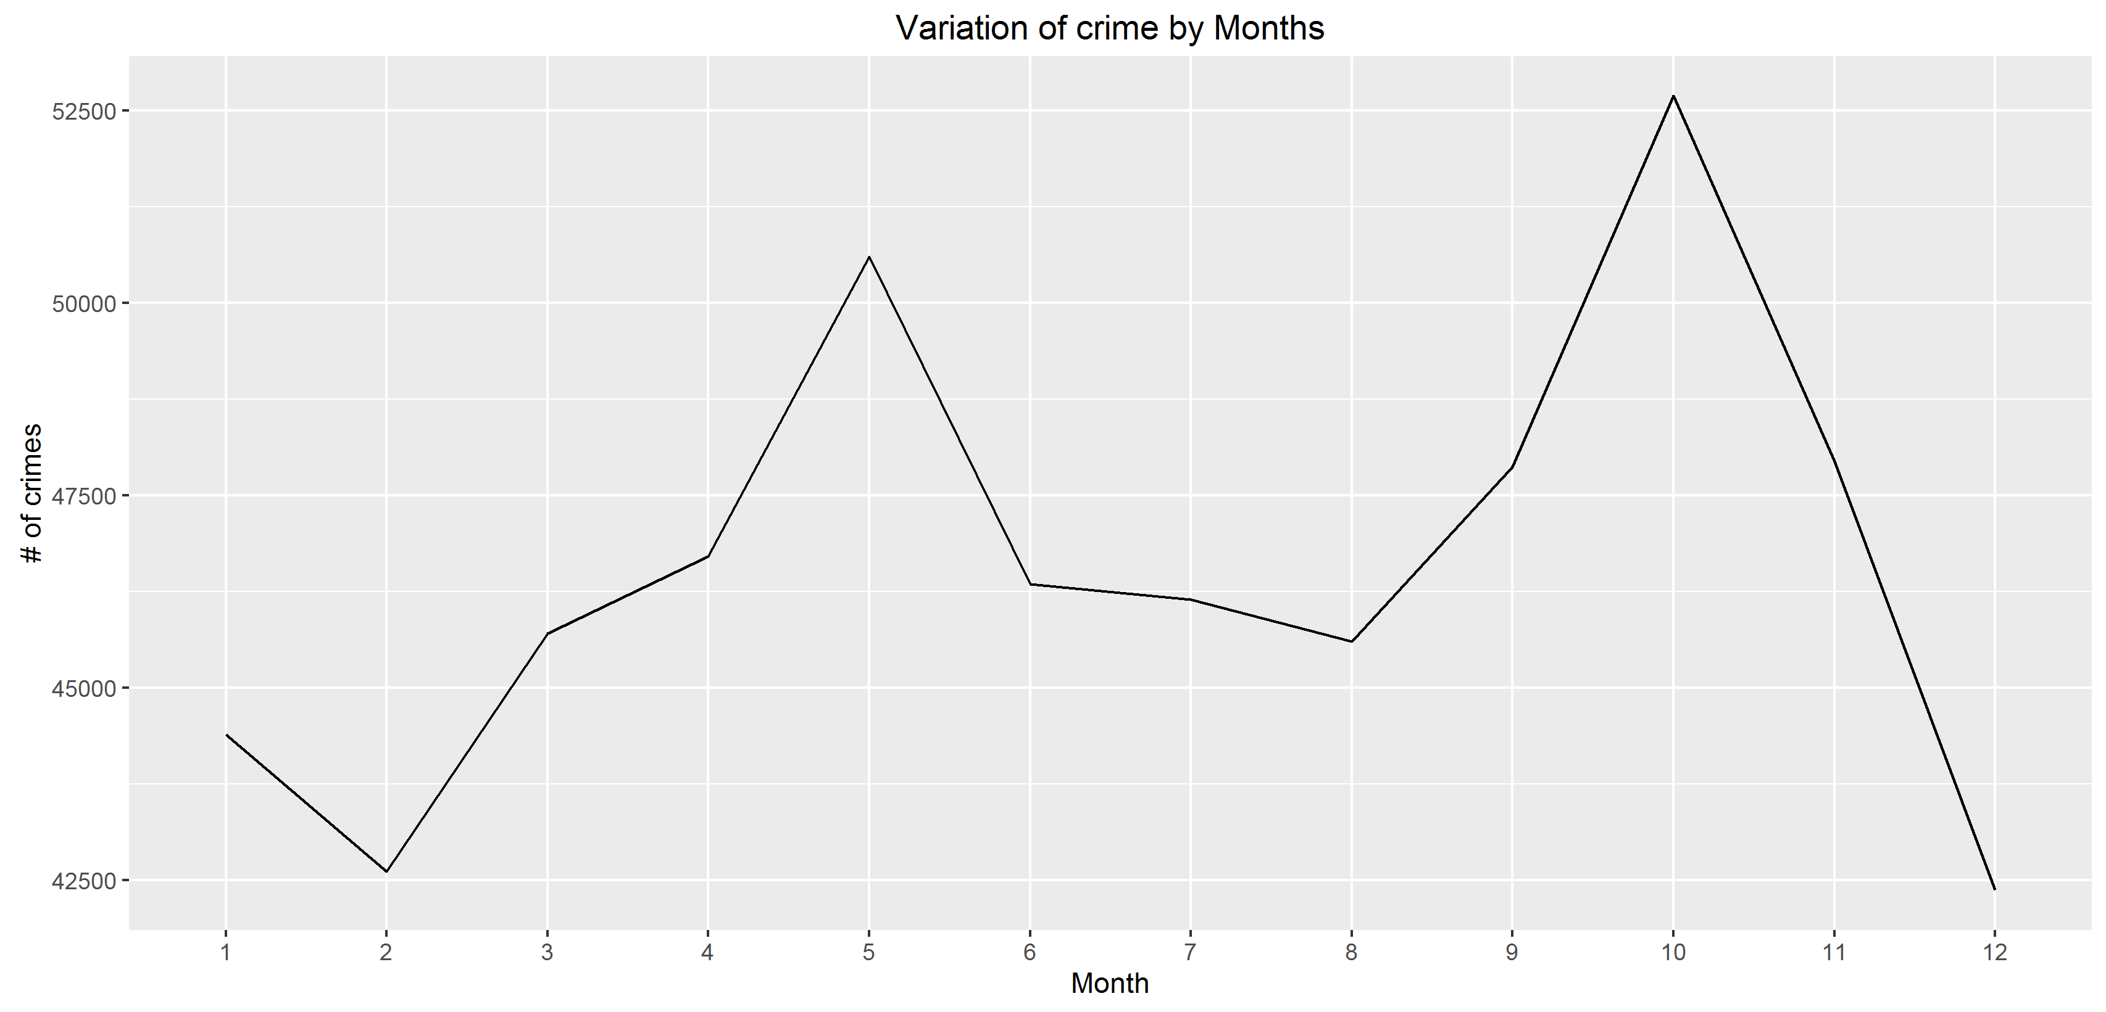
Variation of crime by Months
Time related variables
October
May
Winter
Observations –
Very similar trends were observed across all the crime categories, So, month might not play a significant role in identifying/ predicting the type of crime
Peaks were observed in couple of months – May and October. This can possibly due to vacations (Memorial day and Thanksgiving's respectively).
Crime rate was in very low from December to February (Winters), we would create a “Season” flag to analyze this in more depth
We have graphical analyzed top 6 type of crimes only, which are ~66% of the total crimes
Since we were having 2015 data till May only, we have excluded 2015 data in this analysis

Slide 11
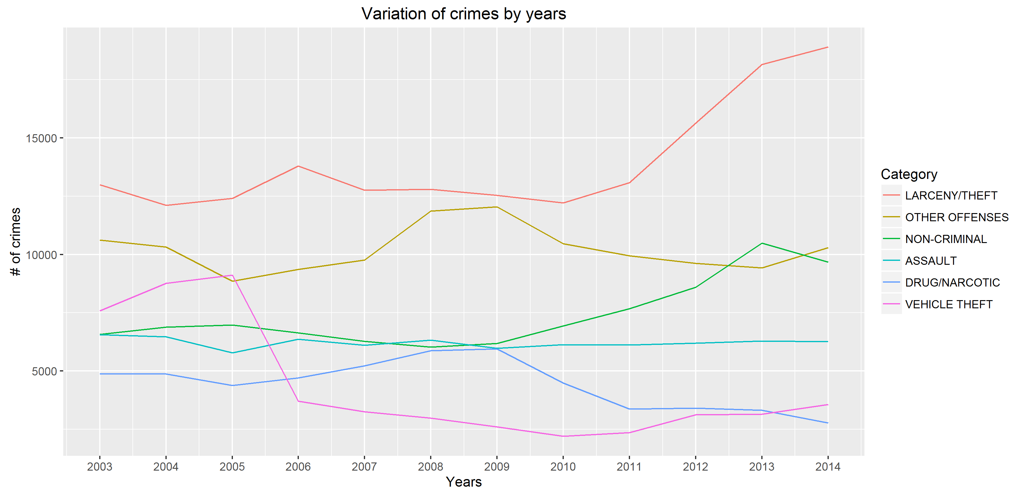
Variation of crime by Years
Time related variables
Observations –
In the recent years, while cases of Larceny/ theft and Non criminal crimes has increased, cases of “Drugs/ Narcotics” and “Vehicle theft” has decreased
Years would be an important factor for this problem, where we are predicting crimes between 2003-2015
For future crime predictions, we need to continuously update the model to take into account such variations
We have graphical analyzed top 6 type of crimes only, which are ~66% of the total crimes
Since we were having 2015 data till May only, we have excluded 2015 data in this analysis

Slide 12
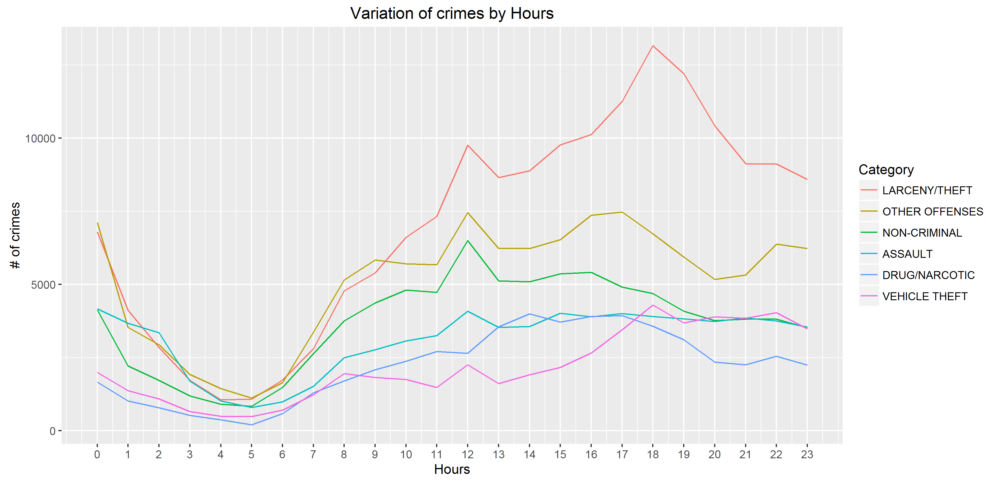
Variation of crime by Hours
Time related variables
Observations –
Clear variation of overall crime rate and crime rate by category was observed with time of day, we should definitely include Hours into our model
Comparatively low crime rate was observed from 1:00 am to 9:00 am, will create a “Night/ Day” flag to analyze this in more details. But this trend was common across all categories and hence creating this new flag might not help our model`
We have graphical analyzed top 6 type of crimes only, which are ~66% of the total crimes

Slide 13
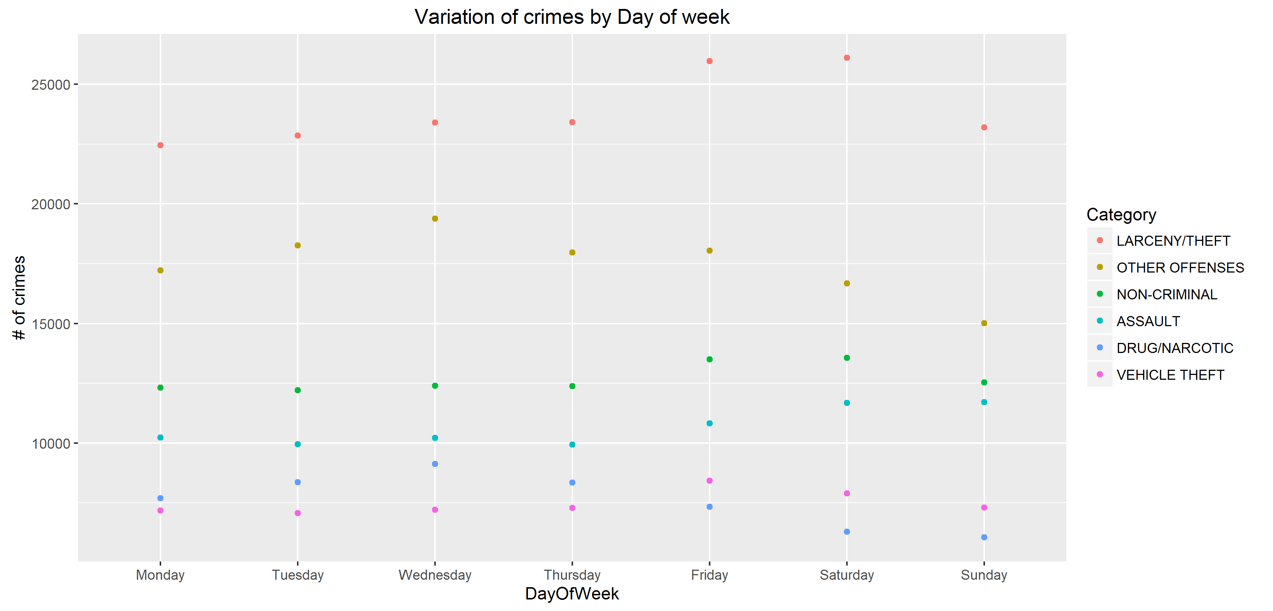
Variation of crime by Day of Week
Time related variables
Observations –
Larceny/ Theft and Vehicle theft are more common on Friday and Saturday; Assault is more common on Saturday and Sunday; Surprisingly Drugs/ Narcotics is most common on Wednesdays
Clear variation of overall crime rate and crime rate by category was observed, with day of weel, we should definitely include day of week into our model
We have graphical analyzed top 6 type of crimes only, which are ~66% of the total crimes

Slide 14
Agenda
Project Background
Exploratory data analysis
Models
Application of the model

Slide 15
Statistical techniques used
CART (Classification and Regression tree)
Using all variables
Using removing PD district
Logistic regression
Using all variables
Using rolled up variables
Using all variables except X & Y
Using all variables except PD district
CART + Logistic regression
Using all variables
Removing Intersection from LR
Removing PD district from LR
Highlighted are the models with highest accuracy for each technique; we will be discussing these three models in the upcoming slides

Slide 16
CART – Cart predicted Intersection and PD district as the most important variables to predict crime
Is intersection?
Pros:
Very easy model to understand
If slightly modified, might yield highly actionable insights
Can be combined with more complex models to attain better results
Cons
Only two major crime categories were predicted
This model alone is not sufficient
No
Yes
Larceny/ Theft
Check PD district
Is Central, Northern, Central, Park, Richmond and Southern
Is Bayview, Ingleside, Mission, Taraval and Tenderloin
Larceny/ Theft
Other Offences
These results are very much align to our EDA where we saw high variation of crime rate and type of crime by intersection and PD district

Slide 17
Logistic regression ran on the three separate data sets created using results from CART had the highest accuracy
Is intersection?
No
LR-1
Pros:
Comparatively easy model to understand
Predicted probability for all crime categories, not just two or three crimes as in CART
Took into consideration variation due to all dependent variables
Cons
Sometimes, length of data set becomes hard to handle
Final predictions
Is intersection?
Yes
+
PD district in
Central, Northern, Central, Park, Richmond and Southern
LR-2
Is intersection?
Yes
+
PD district in
Bayview, Ingleside, Mission, Taraval and Tenderloin
LR-3
We can combine simple techniques like CART with more advanced techniques like SVM to get more accurate results

Slide 18
Agenda
Project Background
Exploratory data analysis
Models
Application of the model

Slide 19
Application of the crime predictor model
Create a crime predictor app
Police department can leverage this app to reduce crime by intervening before they are even committed
This app can warn users about the crimes before they are committed; Swiss Police has already tested a similar app called “PRECOBS”
Integrate with existing apps
Result from the model can be integrated with popular apps like google maps; and if a user is planning to go through region which is not safe, he should be appropriately notified
Increase public awareness
Public awareness can be increased by sharing results (through posters, bulletins etc.) in public areas like Caltrans, Barts etc.
This can help people to avoid travel through risky areas

Slide 20
Appendix

Slide 21
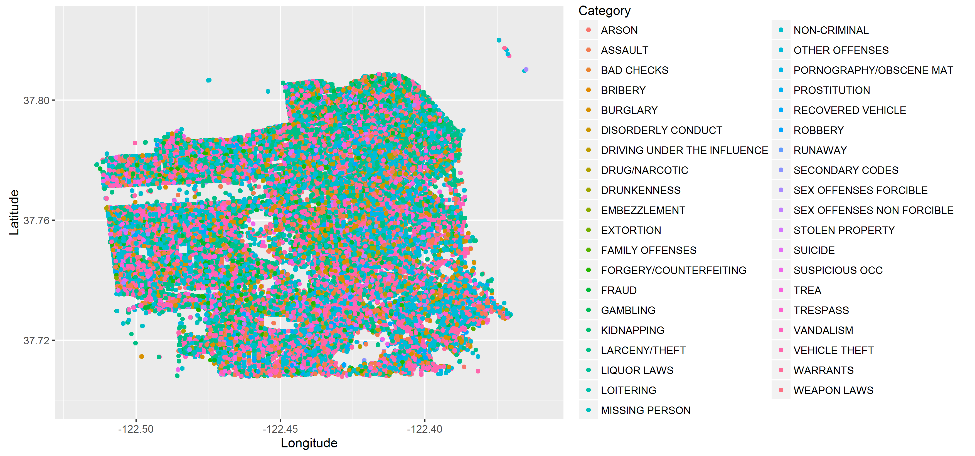
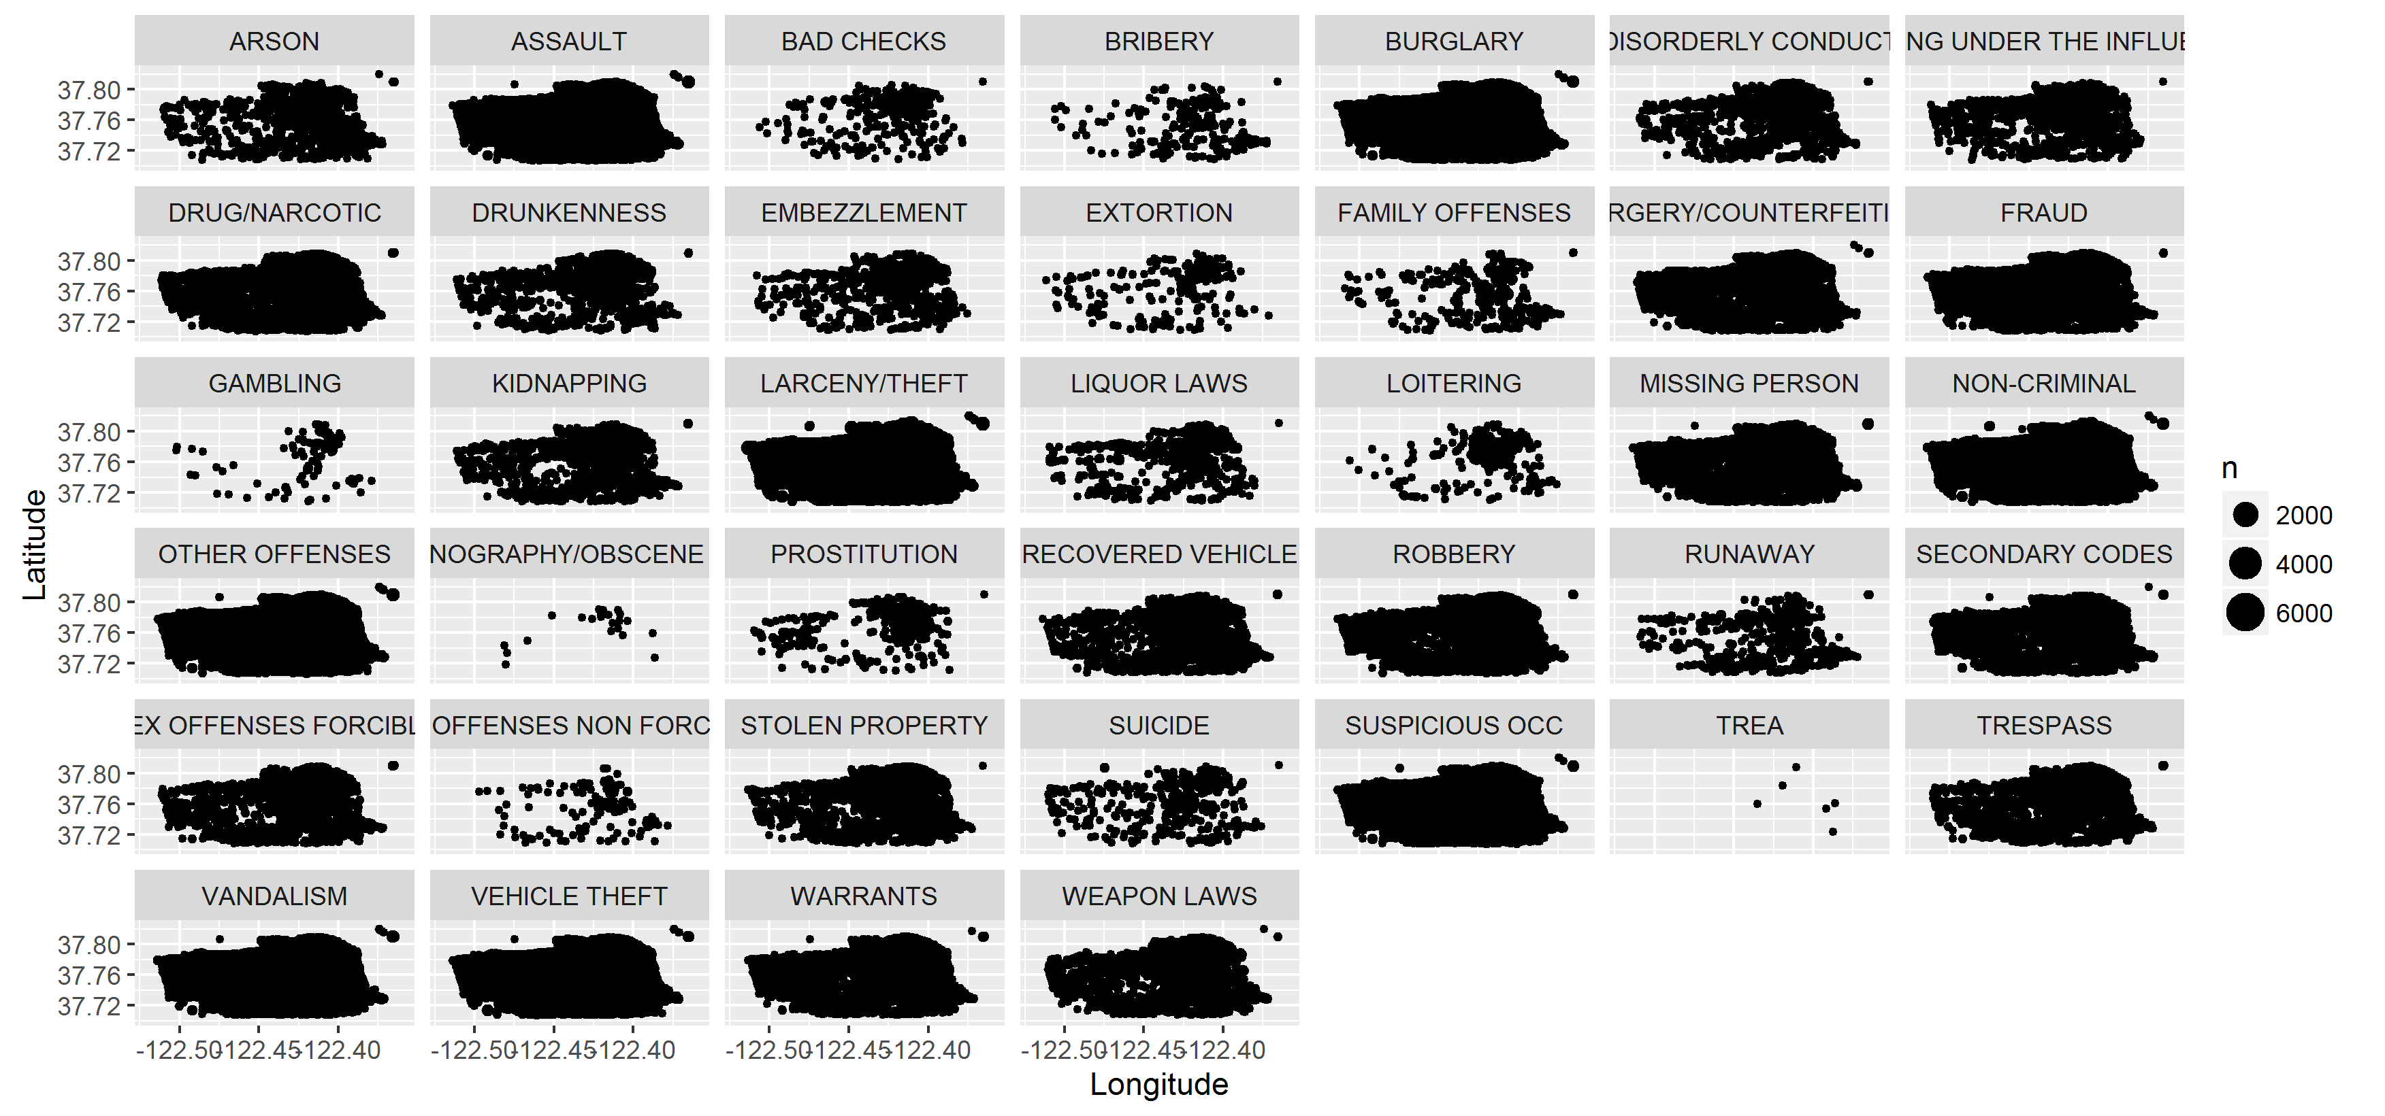
Variation of crime by Location (All categories of crime)

