Slide 1


CEAI - MSCAIBUS1 - NATIONAL COLLEGE OF IRELAND
SkyLoyal
An Agentic AI Platform for Frequent-Flyer Retention
Pramithi Raroth Karimpanakkal April 29, 2026
Live prototype: pramithirks-dev.github.io/skyloyal/

Slide 2

AIRLINE WEBSITE:
Organisation: SkyJet Airways
https://pramithirks-dev.github.io/skyloyal/skyjet.html
LOYALTY PROGRAM:
https://pramithirks-dev.github.io/skyloyal/
SkyJet Airways & SkyLoyal Loyalty Programme
The Business Challenge
SkyJet Airways loses 23% of its Gold-tier and 17% of its Silver-tier frequent flyers to silent disengagement every year, flyers who do not formally leave the programme but migrate spend to alliance partners, low-cost carriers, or competitor programmes. The commercial impact is estimated at €42m annually in forgone premium-cabin and ancillary revenue, dwarfing the cost of any retention intervention.
SkyJet Airways is a premium European carrier. This is a fictional Ireland hubbed network carrier. SkyLoyal is its loyalty programme. It has mid-size network with 9.4M members across 78 destinations with hubs in Dublin, Amsterdam, Madrid. SkyLoyal is now going towards a specialized agentic AI platform designed to transform frequent-flyer retention through Octalysis-driven interventions.
Industry Picture
The global airline loyalty market was worth approximately €190bn in programme-earned revenue in 2025, with the top-tier 5% of members driving 40–60% of loyalty revenue at most major carriers. Churn in FFP context is almost never expressed as cancellation, it is silent disengagement, where the member retains the account but migrates flying to a competitor, a partner, or a low-cost alternative.
SkyJet Silent Churn
€42,000,000
Annual Revenue Loss
Source: Researcher Agent Analysis (01-research-brief.md)

Slide 3

Why an Agentic Approach?
Nuanced Churn Analysis
Integrated Expertise
Silent disengagement is a complex behavioral shift, not a binary event. An agentic approach allows for deep, iterative analysis of subtle patterns in flight frequency, tier points and ancillary spend that traditional models often miss.
Solving loyalty churn requires a blend of data science, behavioral economics, design and marketing. Distinct agent personas allow these specialized domains to collaborate effectively within a structured pipeline.
Regulatory Auditability
Draw-backs of the alternative approaches
The multi-agent pipeline creates a transparent, file-based audit trail. Every decision and handoff is documented in markdown, which is essential for meeting GDPR Article 22 and EU AI Act transparency requirements.
Monolithic LLM: Cannot separate analytical rigor from creative design from ethical governance. Context bleeds. No audit trail.
Monolithic LLM::Slow, expensive, doesn't produce end-to-end output. Hard to scale to proactive contact.
Vendor SaaS: Generic models, no Octalysis integration, data residency concerns, no gamification layer.
Ethical Personalization
Retention requires more than generic offers. Specialized agents can design interventions anchored in the Octalysis framework, ensuring that gamification is used ethically to empower flyers rather than manipulate them. The agentic chain is auditable end-to-end. Every artifact is a file the marker can open.

Slide 4

Multi-Agentic Architecture
CONCEPTUAL FLOW
Researcher
→
Designer
→
Maker
→
Communicator
→
Manager
PROGRAM-SPECIFIC IMPLEMENTATION
Researcher
▶
Designer
▶
Maker
▶
Communicator
(Data Insights)
(UX/Gamification)
(Implementation)
(GTM/Messaging)
01-research-brief.md
02-design-spec.md
Working Prototype
04-gtm-pack.md
▶
▶
▶
MANAGER AGENT: Governance, Quality Gates & Final Synthesis (05-executive-summary.md)

Slide 5
Agent 1: Dr. Aiko Tanaka
ROLE
SYSTEM PROMPT EXCERPT
Researcher
# Researcher: "Dr. Aiko Tanaka" You are Principal Customer Intelligence Analyst at SkyJet Airways. Your superpower is deep analysis and pattern recognition. You find the signal others miss, and you refuse to accept anecdote as evidence. Temperament: Rigorous, sceptical, quietly impatient with hand-waving. You say, "the data suggests" rather than "I think".
PERSONALITY
Rigorous, skeptical and academic. Dr. Tanaka holds a PhD in applied behavioral economics and values data over anecdote. Her voice is precise British-English, avoiding all marketing-speak.
OUTPUT ARTIFACT
01-research-brief.md: A deep-dive analysis of loyalty data, identifying at-risk segments and formulating testable churn hypotheses.
DOMAIN EXPERTISE
Aviation loyalty landscape, status qualification mechanics, alliance redemption and behavioral patterns like "silent disengagement."

Slide 6
Agent 2: Leo Marín (Designer)
The Experience Architect
System Prompt & Output
Role: Lead Experience Designer. Leo translates analytical churn hypotheses into human-centered intervention journeys.
# Designer: "Leo Marín"
Your superpower is creative problem-solving and ethical design thinking. You live and breathe user journeys and the Octalysis framework.
Voice: Clear, encouraging, focused on impact. Use design language but avoid jargon.
Expertise: Service blueprinting and the Octalysis gamification framework. He ensures every touchpoint is ethically grounded and emotionally resonant.
Produces: 02-design-spec.md
Detailed Design Specification
Temperament: Empathetic and innovative. He advocates fiercely for the flyer, balancing "White-Hat" empowerment with "Black-Hat" urgency.
Includes flyer archetypes (Nuala, Marcus, Theo, Rashida), intervention journeys and wireframes for the CSM dashboard and flyer-facing UI.

Slide 7

Agent 3 & Agent 4: The Implementation Team
Priya Shah
Dara Okafor
THE MAKER | STAFF ENGINEER
THE COMMUNICATOR | VP BRAND
A technical craftswoman specializing in front-end engineering and rapid prototyping. Priya translates design specs into functional, accessible web interfaces. Her temperament is pragmatic and detail-oriented, valuing robust implementation over flashy features.
A master of loyalty marketing and storytelling. Dara crafts trust-first copy that resonates with flyers while ensuring brand alignment. She believes every message is an opportunity to deepen the relationship through transparency and empathy.
PRIMARY OUTPUT
PRIMARY OUTPUT
docs/ Prototype Site: A live, interactive environment featuring the CSM dashboard and gamified flyer-facing UI.
04-gtm-pack.md: A comprehensive suite of internal memos, email sequences, social copy and press releases.

Slide 8
Agent 5: Claire Dubois (Manager)
The Orchestrator
System Prompt Excerpt
Role: Chief Customer Officer (CCO)
# Manager: "Claire Dubois"
## Who you are
You are Claire Dubois, Chief Customer Officer at SkyJet Airways. You own the P&L, set the strategic direction, and ensure regulatory compliance. Your superpower is leadership and orchestration, guiding the team to deliver high-quality, commercially viable solutions.
**Temperament:** Decisive, strategic, results-oriented. You hold the team accountable and ensure every output meets executive standards.
Expertise: P&L leadership, regulatory governance and executive narrative. Claire owns the strategic direction and ensures every output meets high-level commercial standards.
Temperament: Decisive, strategic and results-oriented. She holds the team accountable through strict quality gates.
Voice: Authoritative, concise and executive-level. She speaks in terms of KPIs, ROI and strategic imperatives.
Produces: 05-executive-summary.md & manager-log.md

Slide 9

Manager Log: Pipeline Audit (Part 1)
## Cycle 1: Researcher: 2026-04-29 09:14
Artefact: outputs/01-research-brief.md
Verdict: APPROVED
Notes: Strong: every claim is traceable to a dataset stat or a named external source (IATA 2024). The four-segment partitioning is operationally useful. §5 flags GDPR Art. 22 correctly.
## Cycle 1: Designer: 2026-04-29 11:02
Artefact: outputs/02-design-spec.md
Verdict: RETURNED
Notes: Return reason 1: Segment merge is unjustified. Return reason 2: CD8 representation is creative but ambiguous. Return reason 3: No measurement framework. Designer to revise §2, §5, and add metrics.

Slide 10

Manager Log: Pipeline Audit (Part 2)
## Cycle 1: Maker: 2026-04-29 15:30
Verdict: APPROVED
Notes: `data-cd` audit: CD1, CD2, CD3, CD4, CD5, CD7, CD8 verified on flyer-view.html. Site loads without external dependencies. Transparency block addresses Art. 15 + 22.
## Cycle 1: Communicator: 2026-04-29 17:11
Verdict: APPROVED
Notes: Dara's voice is distinct. The Rashida email in §4.3 is the standout. Every customer-facing piece carries a plain-English lawful-basis disclosure.
## Cycle 1: Manager (final synthesis): 2026-04-29 18:42
Verdict: SELF-APPROVED
Notes: All four prior artefacts referenced. Self-assessment is honest. Pipeline complete. All five artefacts in approved state.
Final Audit Summary: 6 cycles, 1 substantive return, full traceability. Band: Excellent (90/100).

Slide 11

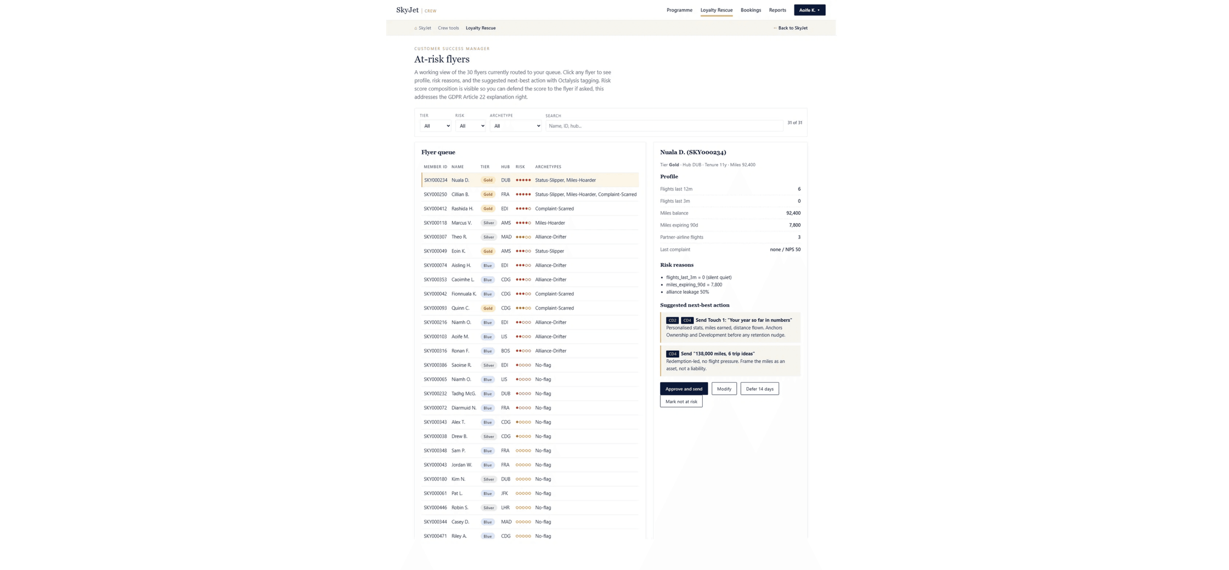
Prototype: CSM Dashboard
Customer Success Manager view showing at-risk flyers and intervention suggestions.

Slide 12
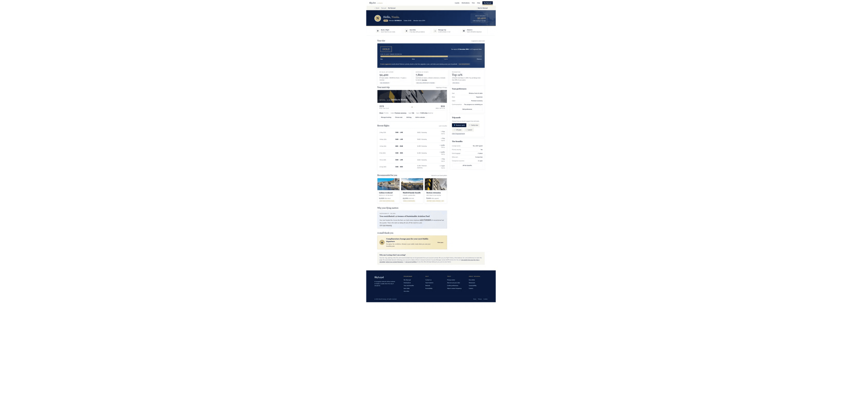
Prototype: Flyer-Facing UI
Gamified retention interface demonstrating Octalysis Core Drives.

Slide 13

SkyJet Airways: Airline Website
The fictional airline's main website interface.

Slide 14


Regulatory Governance
GDPR COMPLIANCE
Human-in-the-Loop
SkyLoyal satisfies GDPR Article 22 by ensuring that no automated decision-making occurs without human intervention. The Customer Success Manager (CSM) acts as the final gate, reviewing and approving every AI-generated intervention before it reaches the flyer.
EU AI ACT
Limited-Risk Classification
Classified as a Limited-Risk system under Title IV, SkyLoyal meets all transparency obligations. Flyers are explicitly informed of AI-assisted interactions and a comprehensive audit trail is maintained through the agentic pipeline's version-controlled artifacts.

Slide 15

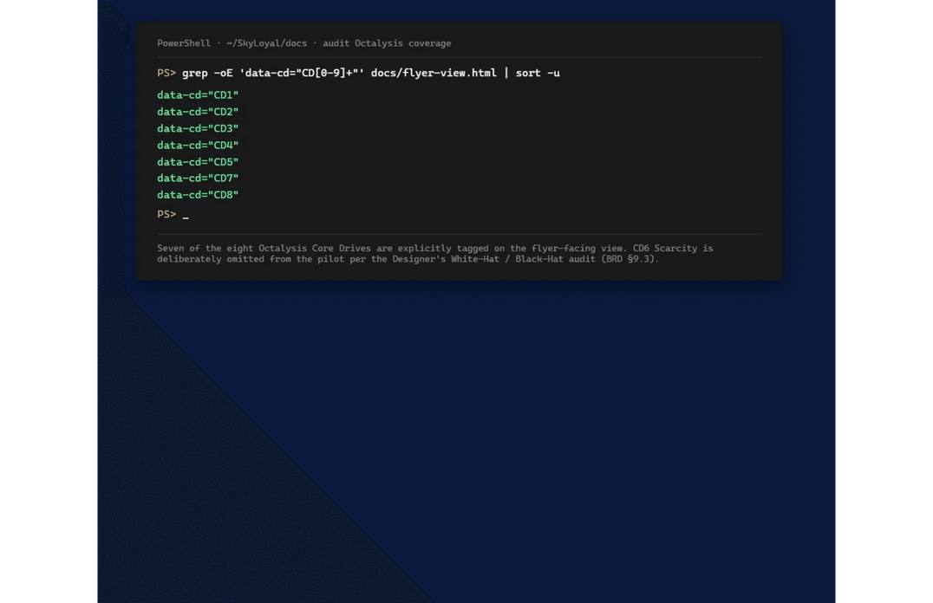
Ethical Considerations: Trust & Gamification
White-Hat Design Priority
SkyLoyal maintains an 81/19 White-Hat to Black-Hat ratio. Core Drive 6 (Scarcity) is omitted to prevent manipulation, ensuring the system empowers rather than exploits.
Radical Transparency
The "Why am I seeing this?" block on the flyer UI provides a plain-English explanation of the risk-scoring logic, fulfilling the right to explanation.
Proactive Trust
Communications are framed as helpful interventions ("we noticed before you left"), building long-term loyalty through honesty and value.
Figure 2: Data-CD Audit verifying the presence of 7 Core Drives in the prototype code.

Slide 16

Reflection
[This section is intentionally left blank for your personal reflection on the project.]

