Slide 1
Proportion of Main Colours in an Image
Problem: Find the proportion of main colours in a picture, with the aim to practice handling images and pixels, NumPy arrays, and unsupervised clustering.
Approach:
Data Pre-processing: Check for the image format to make sure image shape is compatible to analyse pixels. Reshape the array to have a flat list of pixels.
NumPy Arrays: Leveraged NumPy arrays to efficiently handle image data, which allows for streamlined data manipulation.
NumPy image_array
0 | 1 | 2 | 3 | 4 | 5
6 | 7 | 8 | 9 | 10 | …
.. | .. | .. | .. | .. | …

Slide 2
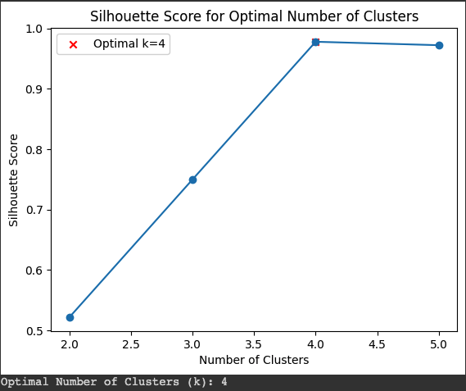

Silhouette Score: Calculated Silhouette scores for the image to find optimal number of clusters within a set min/max range.
Unsupervised Clustering: Used K-Means clustering as an unsupervised clustering techniques to group similar colours together and identify the main colours in the image and their proportions.

Slide 3
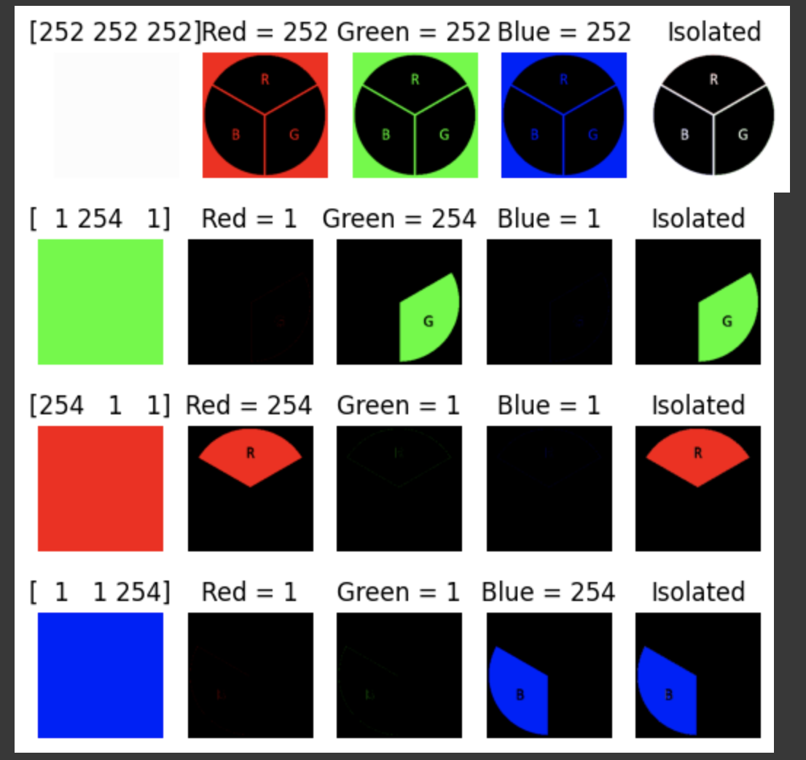
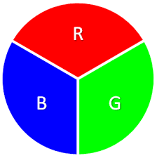


Result:
Image Analysis: Successfully identified and quantified the proportion of main colours present in the sample image.
Visual Interpretation: Presented a visual representation of the main colours extracted from the sample image, aiding in the interpretation of results.
Main colours

Slide 4
Finding Similarity Between Texts
Problem Description: Find the similarity between two sentences or paragraphs. Gain familiarity with NLP functionalities such as tokenization, stemming, and word embeddings
Approach: Using BERT(Bidirectional Encoder Representations from Transformers)
Tokenization: Tokenization is implemented using the SentenceTransformer library, which includes BERT-based tokenization capabilities. Input sentences are tokenized into their respective word pieces or tokens by calling the model.encode(sentences_list) method.
Pre-processing: The code leverages the pre-trained BERT model to ensure standardized and consistent text representation.
Word Embeddings: The BERT model captures contextual information and represents words as dense vectors in a continuous vector space.
Sentence Vectorization: Sentence vectorization is performed by calling the model.encode(sentences_list) method. This process combines individual word embeddings to obtain a single vector representation for each sentence in the sentences_list.
Calculate Similarity using Cosine Similarity: Cosine similarity is calculated using the cosine_similarity function from sklearn.metrics.pairwise. Specifically, the code computes cosine similarity scores between pairs of sentence embeddings by comparing embeddings[0:1] with embeddings[1:3] for different sentence pairs. Higher cosine similarity scores indicate greater similarity between sentence pairs.

Slide 5
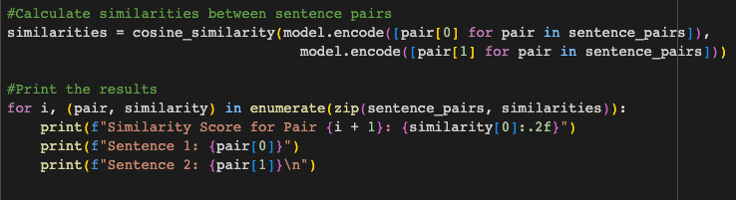
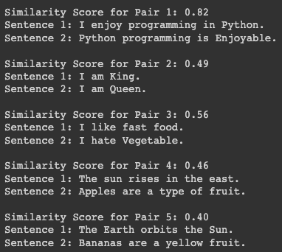
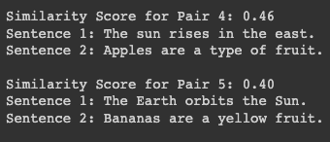
Results:

