Slide 1
AN ATM WITH AN EYE

Slide 2
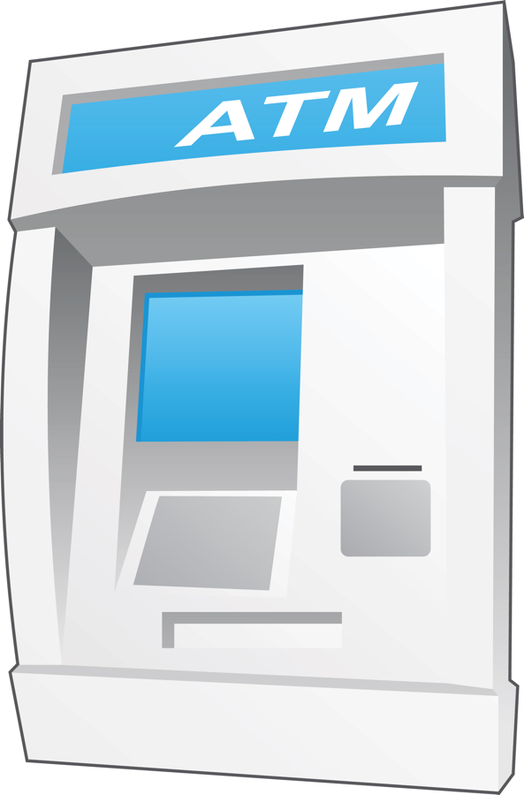

AN ATM WITH AN EYE THE FUTURE’S TECHNOLOGY

Slide 3
ABSTRACT
ATM is an EMBEDDED SYSTEM which is playing a major role in our society, which made money transactions easy for customers to bank at 24 hours of time. This system invites fraudulent attempts through stolen cards. So, there is an urgent need for improving security in banking region. With the advent of ATM through banking became a lot easier it even became a vulnerable.
This technique purposes an automatic teller machine security model that would combine a physical access card, a PIN and ELECTRONIC FACIAL RECOGNITION. By forcing the ATM to match a live image of a customer’s face with an image stored in a bank database that is associated with the account number, the damage to the caused by stolen cards and PINs is affectively neutralized. So, by only when the matches the account and the live image and stored image match would a user be considered fully verified

Slide 4
OUTLINE
ATM
CARD FRAUD
TECHNIQUES
ATM WITH AN EYE
IRIS RECOGNITION AND ITS PROPERTIES
WORKING
CAMERA INSTALLATION ON ATM
ADVANTAGES
DISADVANTAGES
APPLICATIONS

Slide 5
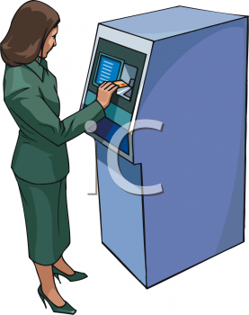
An automated teller machine (ATM) or automatic banking machine (ABM) is a computerized telecommunications device that provides the clients of a financial institution with access to financial transactions in a public space without the need for a cashier, human clerk or bank teller.

Slide 6
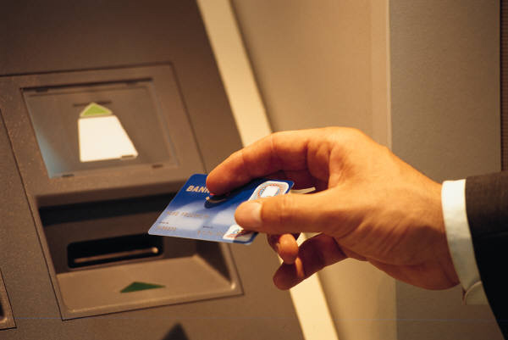
On most modern ATMs, the customer is identified by inserting a plastic ATM card with a magnetic stripe or a plastic smart card with a chip, that contains a unique card number and some security information such as an expiration date or CVVC (CVV). Authentication is provided by the customer entering a personal identification number (PIN).

Slide 7
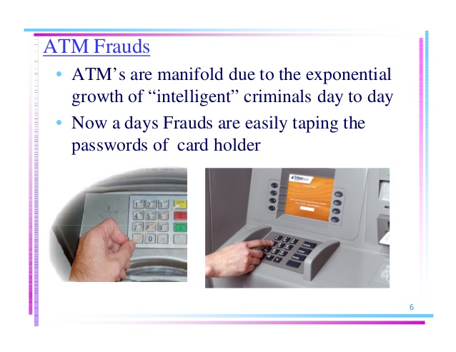

Slide 8
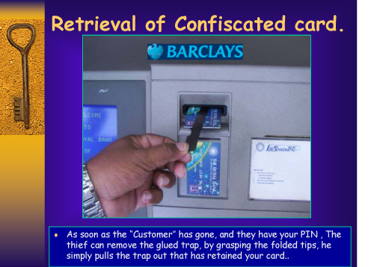

Slide 9
TECHNIQUES Biometric Identification Techniques
Finger Printing
Retina Scanning
Facial Recognition
Iris Recognition

Slide 10
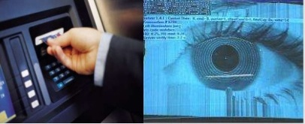
An ATM with an Eye
The chances of misuse of this much hyped ‘insecure’ product(ATM) are manifold due to the exponential growth of ‘intelligent’ criminal day by day.
There is an urgent need for improving security in banking region. With the advent of ATM though banking became a lot easier it even became a lot vulnerable.
Provide a cordless, pass word-free way to get their money out of an ATM

Slide 11


Iris Recognition Properties of the iris
Has highly distinguishing texture
Right eye differs from left eye
Twins have different iris texture
Not trivial to capture quality image

Slide 12
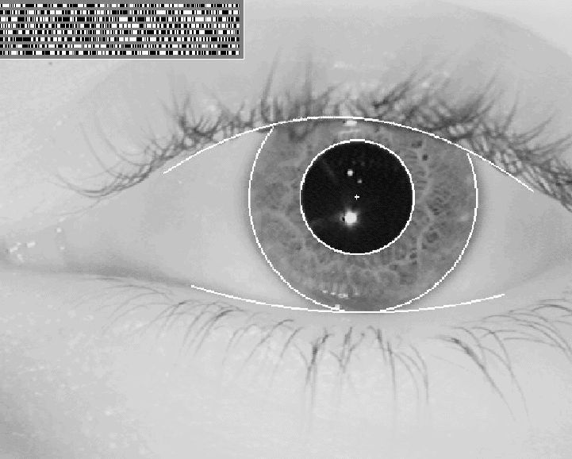
Represent iris texture as a binary vector of 2048 bits
Representation of iris and also of a person
Textured region is unique for a person

Slide 13
STEPS OF IRIS WORKING
Taking the photo/ picture
Localisation of the iris
Determination of outer and inner borders of the iris
Filtering of the usable structures for the analysis
Determination of the vectors of the usable structures
Calculation of the iris code

Slide 14
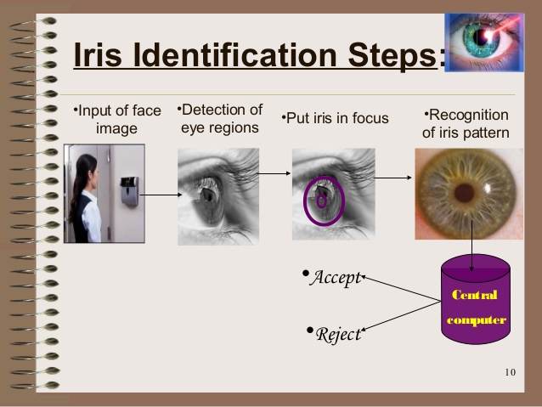

Slide 15

How it work
A camera based in a machine will
Detect the pattern in second
Compare it with one store in a central computer
Or encode on to the cash card
A sensor system examines the randomly
Formed features of the iris of the eye as unique as a fingerprint

Slide 16
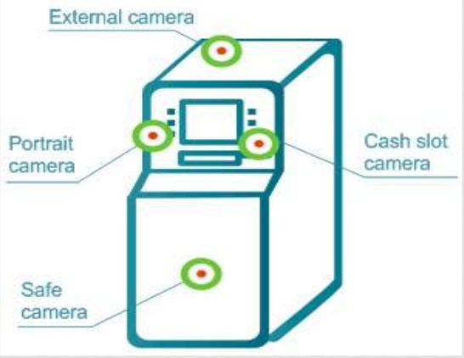
Camera installation on ATM Machine

Slide 17
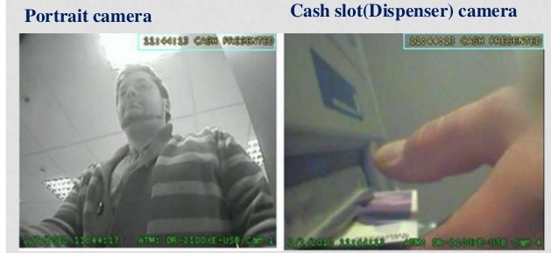
Camera Snapshots

Slide 18
ADVANTAGES
Highly accurate
Easy process
Provide both privacy and identity security
It provides environmental concern

Slide 19
DISADVANTAGES
Costly
The person should be present at the spot
Small target (1cm) to acquire from a distance (2m)
Some times false acceptations and rejections

Slide 20
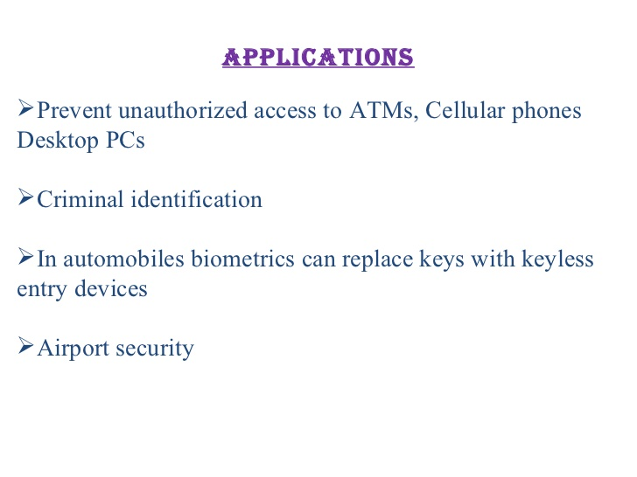

Slide 21

CONCLUSION
We thus Develop An ATM Model That is
More reliable in providing security by using facial recognition software
By keeping the time elapsed in the verification process to a negligible amount
Try to maintain the efficiency of this ATM system

Slide 22
FUTURE SCOPE
Embedded into ATM’S.
Used into space craft’s as they are very lighter and smaller.
Embedded into digital lockers.

Slide 23
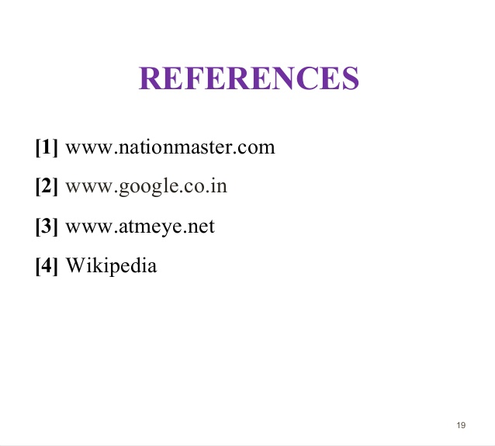

Slide 24

.

Slide 25

ANY QUERIES

