Slide 1

Spam Detection On Short Message Service Performance Using FP-Growth and Naive Bayes Classifier
PRC-2
Guided by: Presented by:
Mrs .M.Jyothsna B.Meghana
Assistant Professor 20251D6502

Slide 2
Contents
Abstract
Literature survey
Objectives
Implementation procedure
Advantages and Disadvantages
Expected Results
Conclusion
References

Slide 3
Abstract
Spam detection system is proposed which will classify the data into spam and ham. The process of spam detection is based on the assumption that the content of the spam is different than the ham.
Spam is also referred to as junk and is unsolicited messages sent in bulk by spamming.
Spammers collect email addresses from chat rooms, websites, customer lists, newsgroups, and viruses that harvest users address books.
Spam e-mails can be not only annoying but also dangerous to consumers.
Spam e-mails can be defined as :
1. Anonymity
2. Mass Mailings
3. Unsolicited

Slide 4
Spam e-mail are message randomly sent to multiple addressees by all sorts of groups, but mostly lazy advertisers and criminals who wish to lead you to phishing sites. It is very useful to classify the e-mails properly
The precision and recall of this method is known to be very effective.
On top of mocking up delivery and storing the results you also need to have human analysis of the accuracy of filtering (flagging as spam, deleting, filing to a “junk-E-mail” folder, etc).
The SMS tariff reduction leads to the increase of SMS spam, as used by some people as an alternative to advertise and fraud. Therefore, it becomes an important issue as it can bug and harm the users and one of its solutions is with automatic SMS spam filtering.

Slide 5
Literature Survey
Paper 1:
One of most challenging in SMS spam filtering is its accuracy.
In this research we proposed to enhance SMS spam filtering performance by combining two of data mining task association and classification.
FP-growth in association is utilized for mining frequent pattern on SMS and Naive Bayes Classifier is used to classify whether SMS is spam or ham.

Slide 6
Training data was using SMS spam collection from previous research. The result of using collaboration of Naive Bayes and FP-Growth performs the highest average accuracy of 90%.
FP-Growth for dataset SMS Spam Collection and improves the precision score; thus, the classification result is more accurate.

Slide 7
Objectives
To study and design a system that would correctly identify the spam e-mails.
To perform a machine learning model to discriminate between spam or Ham.
To Evaluate a different machine learning algorithms and be able to identify the best suited algorithm for the defined purpose.

Slide 8
Implementation Procedure
Algorithm For SMS Spam Classification
Step 1: Retrieving the data
1a. Gather the data from data Sources to retrieve the input data.
1b. Perform Tokenization on input data to form Term Document Matrix.
Step 2: Preparing the data
2a. Apply pre-processing techniques-Stopping, Stemming and Homoglyphing in SMS.
2b. Rank the attributes according to its frequency.
Step 3: Feature selection
Apply one of feature selection technique (Chi-Squarecand Information gain ) to select the
attributes.
Step 4: Classification
Apply classification technique ( Navie Bayes ) to classify messages into spam and
Nonspam(ham).
Step 5: Evaluation of Result
Evaluate the results using performance parameters like Accuracy, Precision, Recall and
Fmeasure.

Slide 9
WORKING THEORY OF SPAM DETECTION
Naive Bayes Classifier is one of the simple and most effective classification algorithms which helps in building the fast machine learning models that can make quick predictions.It is a probablistic classifier,which means,it predicts on the basis of the probability of an object.
Want to find p(spam/ham)
Use Bayes Rule:
To find the probability
1.P(spam/yes)=p(yes/spam)*p(yes)
p(spam)
2.p(spam/no)=p(no/spam)*p(no)
p(no)
Assume independence: probability of each word independent of others
⮚ A Navie Baye’s Classifier is an algorithm that uses Baye’s theorem to classify objects.
⮚ Navie Bayes is called navie because it assumes that each input variable is independent.
⮚ This is a strong Assumption and unrealistic for real data. However, the technique is very effective on a large range of complex problems.
⮚ Popular uses of Navie Bayes Classifiers include spam filters, text analysis and medical diagnosis.
⮚ For eg: An collection of Shapes.

Slide 10
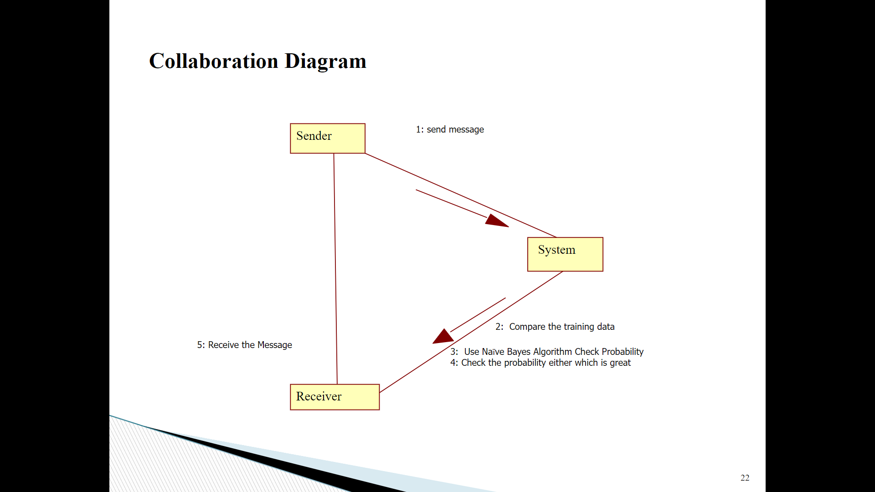
Block diagram

Slide 11
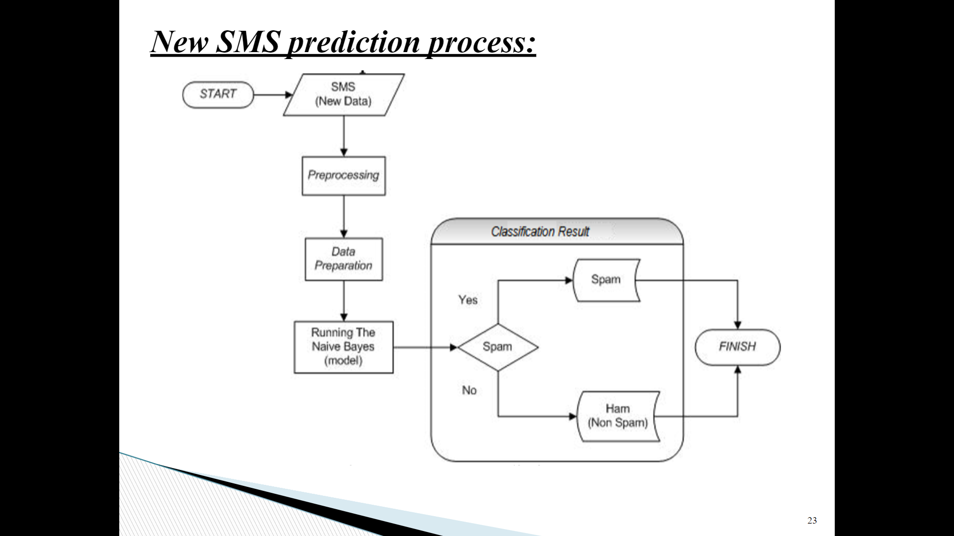

Slide 12
Project Analysis
Existing System:
Now a day’s true caller is that existing system which can block these senders message
whose messages are annoying you but we have a control over the sender but not ones the type of messages.
➢ So, we need such technology/system which can block the particular kind of
messages
Dis-Advantages:
⮚ Suppose it a user don’t want any promotional message and it he know which all users can send him these kinds of messages then he/she can block these senders.
⮚ But if these blocked users any informational message to the user then user will not be able to receive the message.

Slide 13
Proposed System:
➢ We are using Machine Learning algorithm (Naïve Bayes Algorithm) to eradicate such problem. In this algorithm model will train the machine by its 70% and 30% of dataset.
➢ Through this 70% data our machine will be trained enough to decide which is the SPAM message or which is the HAM message.
Advantages:
⮚ we can easily block the unnecessary messages compare to existing system. Then the proposed system will distinguish between SPAM & HAM.
we are not supposed to block the users we can just oppose or block that type of least important message without blocking the user. So, the users can send any important message.

Slide 14
Accuracy:
The most common definition of accuracy used in marketing anti-spam products is the total number of correctly identified messages divided by the total number of messages. Formally, that is: ( s + h) /( S + H) or, in this case 99.27%. 99.27% sounds pretty good when marketing, but this figure is meaningless.
Accuracy=( s + h) / ( S + H)
Precision:
Precision is the fraction of results classified as positive, which are indeed positive. Recall is the fraction of all positive results which were detected. My purpose is to reduce the number of Normal accounts which is labelled as "Spam". This means you want to maximize the precision of Spam and
recall of Not spam.
Precision= True Positive/True Positive + False Positive
Recall:
Precision is the fraction of results classified as positive, which are indeed positive. Recall is the fraction of all positive results which were detected.
Recall=True Positive/True Positive + False Negative
F1 Score:
Our spam filter with 0.93 precision and 0.88 recall has an F1 score of 0.90 . F1 is one when a classifier has perfect precision and recall, and goes to zero for classifiers which have either low precision or recall (or both).
F1=2*(Precision*Recall)/(Precision+Recall)

Slide 15
Advantages:
⮚ It is easy and fast to predict the class of the test data set. FP-Growth in Association is utilized for mining frequent pattern on SMS and Navie Baye’s classifier is used to classify whether SMS is Spam or Ham.
⮚ Training data was using SMS Spam collection from Previous Research. The result of using Collaboration of Navie Bayes and FP-Growth performs the highest Average Accuracy.
Disadvantages:
A subtle issue with Navie Bayes Classifier is that if you have no occurrences of a class label and a certain attribute value together then the frequency-based probability estimation will be ‘zero’.
⮚ A big data set is required for making reliable predictions of the probability of each class

Slide 16
Expected Result
Using special techniques to establish relation between the textual content and the category SPAM or HAM like, primarily based on length of message, word depend, unique keywords. Then construct class fashions the use of one-of-a-kind strategies to differentiate spam SMS.
we will compare with different algorithms and checks which algorithm gives the better accuracy whether the message contains HAM or SPAM.

Slide 17
Conclusion
Based on the analysis of the tests performed in this research, it can be concluded that:
The performance of both methods is equally well for SMS classification with average of the accuracy above 90%.The use of collaboration methods, Naïve Bayes and FP-Growth is superior to the average accuracy for each dataset.
The use of datasets with training data is agreeable to be applied by using the FP-Growth. By implementing the FP-Growth for feature extraction, it can elevate the score of precision.
We are able to classify the emails as spam or non-spam. With high number of emails lots if people using the system it will be difficult to handle all possible mails.

Slide 18
References
1. Anju Radhakrishnan, Vaidhehi V, “Email Classification Using Machine Learning Algorithms”, International Journal of Engineering and Technology (IJET), Vol.9, No.2, pp 335-340, 2017.
2. Shafi’i Muhammad Abdulhamid, Maryam Shuaib, Oluwafemi Osho, Idris Ismaila and John K. Alhassan, “Comparative Analysis of Classification Algorithms for Email Spam Detection”, International Journal of Computer Network and Information Security, pp 60-67, 2018.
3. Ghulam Mujtaba, Liyana Shuib, Ram Gopal Raj, Nahdia Majeed and Mohammed Ali Al-Garadi, “Email Classification Research Trends: Review and Open Issues”, IEEE Access, Vol.5, pp 9044-9064, 2017.
4. Dr. V. T. Meenatchi Dr. M. Thangaraj Dr. V.Gayathri Dr. S.Gnanambal, “Comparative Study and Analysis of Classification Algorithms through Machine Learning”, International Journal of Computer Engineering and Applications, Vol.XII, Issue.I, pp 247-252, 2018.

Slide 19


