Slide 1

C
By Pramod Nikam
Technology Specialist, Cognizant

Slide 2
Introduction
The C programming language was designed by Dennis Ritchie at Bell Laboratories in the early 1970s
Influenced by
ALGOL 60 (1960),
CPL (Cambridge, 1963),
BCPL (Martin Richard, 1967),
B (Ken Thompson, 1970)
Traditionally used for systems programming, though this may be changing in favor of C++, Java and more
Traditional C:
The C Programming Language, by Brian Kernighan and Dennis Ritchie, 2nd Edition, Prentice Hall
Referred to as K&R

Slide 3
Elements of a C Program
A C development environment includes
System libraries and headers: a set of standard libraries and their header files. For example see /usr/include and glibc.
Application Source: application source and header files
Compiler: converts source to object code for a specific platform
Linker: resolves external references and produces the executable module
User program structure
there must be one main function where execution begins when the program is run. This function is called main
int main (void) { ... },
int main (int argc, char *argv[]) { ... }
UNIX Systems have a 3rd way to define main(), though it is not POSIX.1 compliant int main (int argc, char *argv[], char *envp[])
additional local and external functions and variables

Slide 4
A Simple Hello World C Program
Create example file: try.c
Compile using gcc: gcc –o try try.c
The standard C library libc is included automatically
Execute program ./try
Note, I always specify an absolute path
Normal termination: void exit(int status);
calls functions registered with atexit()
flush output streams
close all open streams
return status value and control to host environment
/* you generally want to
* include stdio.h and
* stdlib.h
* */
#include <stdio.h>
#include <stdlib.h>
int main (void)
{
printf(“Hello World\n”);
exit(0);
}

Slide 5
Tokens in C
Keywords
These are reserved words of the C language. For example int, float, if, else, for, while etc.
Identifiers
An Identifier is a sequence of letters and digits, but must start with a letter. Underscore ( _ ) is treated as a letter. Identifiers are case sensitive. Identifiers are used to name variables, functions etc.
Valid: Root, _getchar, __sin, x1, x2, x3, x_1, If
Invalid: 324, short, price$, My Name
Constants
Constants like 13, ‘a’, 1.3e-5 etc.

Slide 6
Tokens in C
String Literals
A sequence of characters enclosed in double quotes as “…”. For example “13” is a string literal and not number 13. ‘a’ and “a” are different.
Operators
Arithmetic operators like +, -, *, / ,% etc.
Logical operators like ||, &&, ! etc. and so on.
White Spaces
Spaces, new lines, tabs, comments ( A sequence of characters enclosed in /* and */ ) etc. These are used to separate the adjacent identifiers, kewords and constants.

Slide 7
Basic Data Types
Integral Types
Integers are stored in various sizes. They can be signed or unsigned.
Example Suppose an integer is represented by a byte (8 bits). Leftmost bit is sign bit. If the sign bit is 0, the number is treated as positive. Bit pattern 01001011 = 75 (decimal). The largest positive number is 01111111 = 2⁷ – 1 = 127. Negative numbers are stored as two’s complement or as one’s complement. -75 = 10110100 (one’s complement). -75 = 10110101 (two’s complement).
Notes:
C is strongly typed. The variables and constants etc have a certain data types. All variables could have been double type, but then multiplying double numbers is very expensive. So the various data types have been provided for the reason of efficiency and ease of handling.

Slide 8
Basic Data Types
Integral Types
char Stored as 8 bits. Unsigned 0 to 255. Signed -128 to 127.
short int Stored as 16 bits. Unsigned 0 to 65535. Signed -32768 to 32767.
int Same as either short or long int.
long int Stored as 32 bits. Unsigned 0 to 4294967295. Signed -2147483648 to 2147483647
Notes:
C guarantees only following:
Sizeof(short) <= sizeof(int) <= sizeof(long).

Slide 9
Basic Data Types
Floating Point Numbers
Floating point numbers are rational numbers. Always signed numbers.
float Approximate precision of 6 decimal digits .
Typically stored in 4 bytes with 24 bits of signed mantissa and 8 bits of signed exponent.
double Approximate precision of 14 decimal digits.
Typically stored in 8 bytes with 56 bits of signed mantissa and 8 bits of signed exponent.
One should check the file limits.h to what is implemented on a particular machine.

Slide 10
Constants
Numerical Constants
Constants like 12, 253 are stored as int type. No decimal point.
12L or 12l are stored as long int.
12U or 12u are stored as unsigned int.
12UL or 12ul are stored as unsigned long int.
Numbers with a decimal point (12.34) are stored as double.
Numbers with exponent (12e-3 = 12 x 10⁻³ ) are stored as double.
12.34f or 1.234e1f are stored as float.
These are not valid constants:
25,000 7.1e 4 $200 2.3e-3.4 etc.

Slide 11
Constants
Character and string constants
‘c’ , a single character in single quotes are stored as char. Some special character are represented as two characters in single quotes. ‘\n’ = newline, ‘\t’= tab, ‘\\’ = backlash, ‘\”’ = double quotes. Char constants also can be written in terms of their ASCII code. ‘\060’ = ‘0’ (Decimal code is 48).
A sequence of characters enclosed in double quotes is called a string constant or string literal. For example “Charu” “A” “3/9” “x = 5”

Slide 12
Variables
Naming a Variable
Must be a valid identifier.
Must not be a keyword
Names are case sensitive.
Variables are identified by only first 32 characters.
Library commonly uses names beginning with _.
Naming Styles: Uppercase style and Underscore style
lowerLimit lower_limit
incomeTax income_tax

Slide 13
Declarations
Declaring a Variable
Each variable used must be declared.
A form of a declaration statement is
data-type var1, var2,…;
Declaration announces the data type of a variable and allocates appropriate memory location. No initial value (like 0 for integers) should be assumed.
It is possible to assign an initial value to a variable in the declaration itself.
data-type var = expression;
Examples
int sum = 0;
char newLine = ‘\n’;
float epsilon = 1.0e-6;

Slide 14
Global and Local Variables
Global Variables
These variables are declared outside all functions.
Life time of a global variable is the entire execution period of the program.
Can be accessed by any function defined below the declaration, in a file.
/* Compute Area and Perimeter of a circle */
#include <stdio.h>
float pi = 3.14159; /* Global */
main() {
float rad; /* Local */
printf( “Enter the radius “ );
scanf(“%f” , &rad);
if ( rad > 0.0 ) {
float area = pi * rad * rad;
float peri = 2 * pi * rad;
printf( “Area = %f\n” , area );
printf( “Peri = %f\n” , peri );
}
else
printf( “Negative radius\n”);
printf( “Area = %f\n” , area );
}

Slide 15
Global and Local Variables
Local Variables
These variables are declared inside some functions.
Life time of a local variable is the entire execution period of the function in which it is defined.
Cannot be accessed by any other function.
In general variables declared inside a block are accessible only in that block.
/* Compute Area and Perimeter of a circle */
#include <stdio.h>
float pi = 3.14159; /* Global */
main() {
float rad; /* Local */
printf( “Enter the radius “ );
scanf(“%f” , &rad);
if ( rad > 0.0 ) {
float area = pi * rad * rad;
float peri = 2 * pi * rad;
printf( “Area = %f\n” , area );
printf( “Peri = %f\n” , peri );
}
else
printf( “Negative radius\n”);
printf( “Area = %f\n” , area );
}

Slide 16
Operators
Arithmetic Operators
+, - , *, / and the modulus operator %.
+ and – have the same precedence and associate left to right.
3 – 5 + 7 = ( 3 – 5 ) + 7 ≠ 3 – ( 5 + 7 )
3 + 7 – 5 + 2 = ( ( 3 + 7 ) – 5 ) + 2
*, /, % have the same precedence and associate left to right.
The +, - group has lower precendence than the *, / % group.
3 – 5 * 7 / 8 + 6 / 2
3 – 35 / 8 + 6 / 2
3 – 4.375 + 6 / 2
3 – 4.375 + 3
-1.375 + 3
1.625

Slide 17
Operators
Arithmetic Operators
% is a modulus operator. x % y results in the remainder when x is divided by y and is zero when x is divisible by y.
Cannot be applied to float or double variables.
Example
if ( num % 2 == 0 )
printf(“%d is an even number\n”, num)’;
else
printf(“%d is an odd number\n”, num);

Slide 18
Type Conversions
The operands of a binary operator must have a the same type and the result is also of the same type.
Integer division:
c = (9 / 5)*(f - 32)
The operands of the division are both int and hence the result also would be int. For correct results, one may write
c = (9.0 / 5.0)*(f - 32)
In case the two operands of a binary operator are different, but compatible, then they are converted to the same type by the compiler. The mechanism (set of rules) is called Automatic Type Casting.
c = (9.0 / 5)*(f - 32)
It is possible to force a conversion of an operand. This is called Explicit Type casting.
c = ((float) 9 / 5)*(f - 32)

Slide 19
Automatic Type Casting
char and short operands are converted to int
Lower data types are converted to the higher data types and result is of higher type.
The conversions between unsigned and signed types may not yield intuitive results.
Example
float f; double d; long l;
int i; short s;
d + f f will be converted to double
i / s s will be converted to int
l / i i is converted to long; long result
Hierarchy
Double
float
long
Int
Short and char

Slide 20
Explicit Type Casting
The general form of a type casting operator is
(type-name) expression
It is generally a good practice to use explicit casts than to rely on automatic type conversions.
Example
C = (float)9 / 5 * ( f – 32 )
float to int conversion causes truncation of fractional part
double to float conversion causes rounding of digits
long int to int causes dropping of the higher order bits.

Slide 21
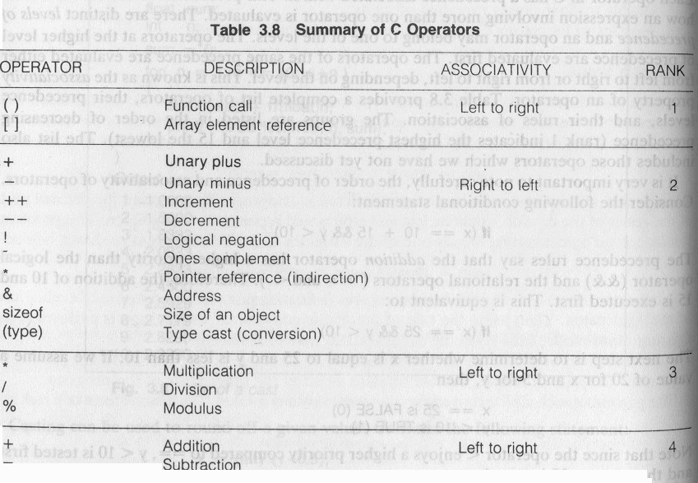
Precedence and Order of evaluation

Slide 22
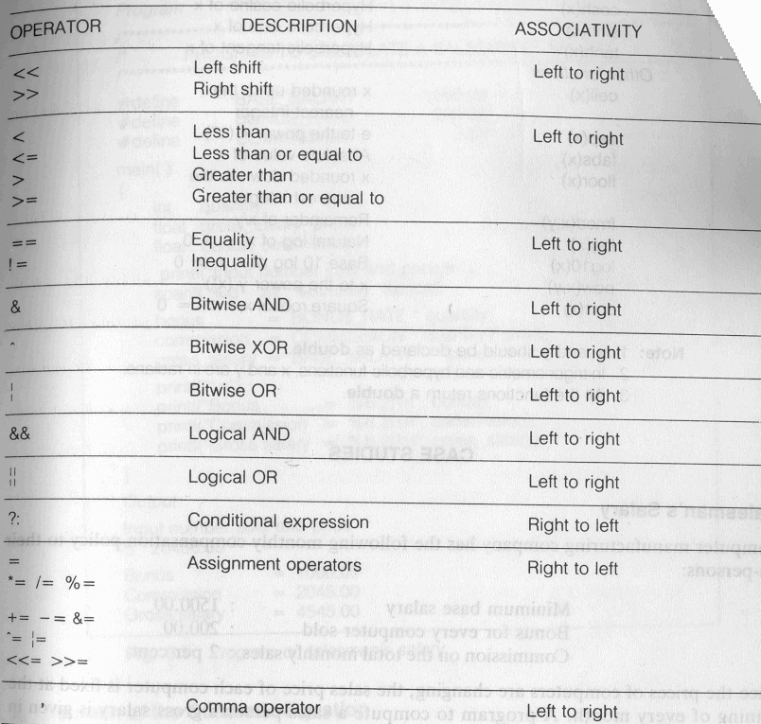
Precedence and Order of evaluation

Slide 23
Operators
Relational Operators
<, <=, > >=, ==, != are the relational operators. The expression
operand1 relational-operator operand2
takes a value of 1(int) if the relationship is true and 0(int) if relationship is false.
Example
int a = 25, b = 30, c, d;
c = a < b;
d = a > b;
value of c will be 1 and that of d will be 0.

Slide 24
Operators
Logical Operators
&&, || and ! are the three logical operators.
expr1 && expr2 has a value 1 if expr1 and expr2 both are nonzero.
expr1 || expr2 has a value 1 if expr1 and expr2 both are nonzero.
!expr1 has a value 1 if expr1 is zero else 0.
Example
if ( marks >= 40 && attendance >= 75 ) grade = ‘P’
If ( marks < 40 || attendance < 75 ) grade = ‘N’

Slide 25
Operators
Assignment operators
The general form of an assignment operator is
v op= exp
Where v is a variable and op is a binary arithmetic operator. This statement is equivalent to
v = v op (exp)
a = a + b can be written as a += b
a = a * b can be written as a *= b
a = a / b can be written as a /= b
a = a - b can be written as a -= b

Slide 26
Operators
Increment and Decrement Operators
The operators ++ and –- are called increment and decrement operators.
a++ and ++a are equivalent to a += 1.
a-- and --a are equivalent to a -= 1.
++a op b is equivalent to a ++; a op b;
a++ op b is equivalent to a op b; a++;
Example
Let b = 10 then
(++b)+b+b = 33
b+(++b)+b = 33
b+b+(++b) = 31
b+b*(++b) = 132

Slide 27
Floating Point Arithmetic
Representation
All floating point numbers are stored as
such that d₁ is nonzero. B is the base. p is the precision or number of significant digits. e is the exponent. All these put together have finite number of bits (usually 32 or 64 bits ) of storage.
Example
Assume B = 10 and p = 3.
23.7 = +0.237E2
23.74 = +0.237E2
37000 = +0.370E5
37028 = +0.370E5
-0.000124 = -0.124E-4

Slide 28
Conditional Statements : if statement
#include <stdio.h>
int main()
{
int age; /* Need a variable... */
printf( "Please enter your age" ); /* Asks for age */
scanf( "%d", &age ); /* The input is put in age */
if ( age < 100 )
{ /* If the age is less than 100 */
printf ("You are pretty young!\n" ); /* Just to show you it works... */
}
else if ( age == 100 )
{ /* I use else just to show an example */
printf( "You are old\n" );
}
else
{
printf( "You are really old\n" ); /* Executed if no other statement is*/
}
return 0;
}

Slide 29
Loops(for)
#include <stdio.h>
int main()
{
int x;
/* The loop goes while x < 10, and x increases by one every loop*/
for ( x = 0; x < 10; x++ )
{
/* Keep in mind that the loop condition checks
the conditional statement before it loops again.
consequently, when x equals 10 the loop breaks.
x is updated before the condition is checked. */
printf( "%d\n", x );
}
return 0;
}

Slide 30
Loops(while)
#include <stdio.h>
int main()
{
int x = 0; /* Don't forget to declare variables */
while ( x < 10 )
{ /* While x is less than 10 */
printf( "%d\n", x );
x++; /* Update x so the condition can be met eventually */
}
return 0;
}

Slide 31
Loops(do while)
#include <stdio.h>
int main()
{
int x;
x = 0;
do
{
/* "Hello, world!" is printed at least one time
even though the condition is false*/
printf( "%d\n", x );
x++;
} while ( x != 10 );
return 0;
}

Slide 32
Loops(break and continue)
#include <stdio.h>
int main()
{
int x;
for(x=0;x<10;x++)
{
if(x==5)
{
continue;
}
printf("%d\n",x);
}
return 0;
}
#include <stdio.h>
int main()
{
int x;
for(x=0;x<10;x++)
{
if(x==5)
{
break;
}
printf("%d\n",x);
}
return 0;
}
0
1
2
3
4
6
7
8
9
0
1
2
3
4

Slide 33
Multiple Selection with if-else
if (day == 0 ) {
printf (“Sunday”) ;
} else if (day == 1 ) {
printf (“Monday”) ;
} else if (day == 2) {
printf (“Tuesday”) ;
} else if (day == 3) {
printf (“Wednesday”) ;
} else if (day == 4) {
printf (“Thursday”) ;
} else if (day == 5) {
printf (“Friday”) ;
} else if (day = 6) {
printf (“Saturday”) ;
} else {
printf (“Error - invalid day.\n”) ;
}
This if-else structure is more efficient than the corresponding if structure. Why?

Slide 34
The switch Multiple-Selection Structure
switch ( integer expression )
{
case constant₁ :
statement(s)
break ;
case constant₂ :
statement(s)
break ;
. . .
default: :
statement(s)
break ;
}

Slide 35
switch Statement Details
The last statement of each case in the switch should almost always be a break.
The break causes program control to jump to the closing brace of the switch structure.
Without the break, the code flows into the next case. This is almost never what you want.
A switch statement will compile without a default case, but always consider using one.

Slide 36
Functions
Functions
Modularize a program
All variables declared inside functions are local variables
Known only in function defined
Parameters
Communicate information between functions
Local variables
Benefits of functions
Divide and conquer
Manageable program development
Software reusability
Use existing functions as building blocks for new programs
Abstraction - hide internal details (library functions)
Avoid code repetition

Slide 37
Function Definitions
Function definition format
return-value-type function-name( parameter-list ) { declarations and statements }
Function-name: any valid identifier
Return-value-type: data type of the result (default int)
void – indicates that the function returns nothing
Parameter-list: comma separated list, declares parameters
A type must be listed explicitly for each parameter unless, the parameter is of type int

Slide 38
Function Definitions
Function definition format (continued)
return-value-type function-name( parameter-list ) { declarations and statements }
Declarations and statements: function body (block)
Variables can be declared inside blocks (can be nested)
Functions can not be defined inside other functions
Returning control
If nothing returned
return;
or, until reaches right brace
If something returned
return expression;

Slide 39
Functions in C
resultType functionName(type₁ param1, type₂ param2, …) {
…
body
…
}
If no result, resultType should be void
Warning if not!
If no parameters, use void between ()
Notes:
39

Slide 40
Functions in C
It is good style to always end a function with a comment showing its name
resultType functionName(type₁ param1, type₂ param2, …) {
…
body
…
} // functionName
If no result, resultType should be void
Warning if not!
If no parameters, use void between ()
Notes:
40

Slide 41
Using Functions
Let int f(double x, int a) be (the beginning of) a declaration of a function.
Then f(expr₁, expr₂) can be used in any expression where a value of type int can be used – e.g.,
N = f(pi*pow(r,2), b+c) + d;

Slide 42
Using Functions (continued)
This is a parameter
Let int f(double x, int a) be (the beginning of) a declaration of a function.
Then f(expr₁, expr₂) can be used in any expression where a value of type int can be used – e.g.,
N = f(pi*pow(r,2), b+c) + d;
This is also an argument
This is an argument

Slide 43
Definitions
Parameter:– a declaration of an identifier within the '()' of a function declaration
Used within the body of the function as a variable of that function
Initialized to the value of the corresponding argument.
Argument:– an expression passed when a function is called; becomes the initial value of the corresponding parameter

Slide 44
Using Functions (continued)
Let int f(double x, int a) be (the beginning of) a declaration of a function.
Then f(expr₁, expr₂) can be used in any expression where a value of type int can be used – e.g.,
N = f(pi*pow(r,2), b+c) + d;
The second argument expression is evaluated, convrted to int, and assigned t parameter a
The first argument expression is evaluated, converted to double, and assigned to parameter x

Slide 45
Using Functions (continued)
Let int f(double x, int a) be (the beginning of) a declaration of a function.
Then f(expr₁, expr₂) can be used in any expression where a value of type int can be used – e.g.,
N = f(pi*pow(r,2), b+c) + d;
Sum is ssigned to N

Slide 46
Arrays in C
All elements of same type – homogenous
Unlike Java, array size in declaration
int array[10];
int b;
array[0] = 3;
array[9] = 4;
array[10] = 5;
array[-1] = 6;
Compare: C: int array[10];
Java: int[] array = new int[10];
First element (index 0)
Last element (index size - 1)
No bounds checking!
Allowed – usually causes no obvious error
array[10] may overwrite b

Slide 47
Array Representation
Homogeneous → Each element same size – s bytes
An array of m data values is a sequence of m×s bytes
Indexing: 0th value at byte s×0, 1st value at byte s×1, …
m and s are not part of representation
Unlike in some other languages
s known by compiler – usually irrelevant to programmer
m often known by compiler – if not, must be saved by programmer
0x1008
a[2]
0x1004
a[1]
int a[3];
0x1000
a[0]

Slide 48
Array Representation
char c1;
int a[3];
char c2;
int i;
0x1014
i
0x1010
c2
0x100C
a[2]
Could be optimized by making these adjacent, and reducing padding (by default, not)
0x1008
a[1]
0x1004
a[0]
0x1000
c1
Array aligned by
size of elements

Slide 49
Multi-Dimensional Arrays
0x1014
matrix[1][2]
0x1010
matrix[1][1]
int matrix[2][3];
matrix[1][0] = 17;
0x100C
matrix[1][0]
0x1008
matrix[0][2]
0x1004
matrix[0][1]
0x1000
matrix[0][0]
Recall: no bounds checking
What happens when you write:
matrix[0][3] = 42;
“Row Major”
Organization

Slide 50
Variable-Length Arrays
int
function(int n)
{
int array[n];
…
New C99 feature: Variable-length arrays
defined within functions
Global arrays must still have fixed (constant) length

Slide 51
Memory Addresses
Storage cells are typically viewed as being byte-sized
Usually the smallest addressable unit of memory
Few machines can directly address bits individually
Such addresses are sometimes called byte-addresses
Memory is often accessed as words
Usually a word is the largest unit of memory access by a single machine instruction
CLEAR’s word size is 8 bytes (= sizeof(long))
A word-address is simply the byte-address of the word’s first byte

Slide 52
Pointers
Special case of bounded-size natural numbers
Maximum memory limited by processor word-size
2³² bytes = 4GB, 2⁶⁴ bytes = 16 exabytes
A pointer is just another kind of value
A basic type in C
int *ptr;
The variable “ptr” stores a pointer to an “int”.

Slide 53
Pointer Operations in C
Creation
& variable Returns variable’s memory address
Dereference
* pointer Returns contents stored at address
Indirect assignment
* pointer = val Stores value at address
Of course, still have...
Assignment
pointer = ptr Stores pointer in another variable

Slide 54
Using Pointers
int i1;
int i2;
int *ptr1;
int *ptr2;
i1 = 1;
i2 = 2;
ptr1 = &i1;
ptr2 = ptr1;
*ptr1 = 3;
i2 = *ptr2;
0x1014
…
0x1000
0x1010
ptr2:
0x100C
…
0x1000
0x1008
ptr1:
i2:
2
0x1004
3
i1:
3
0x1000
1

Slide 55
Using Pointers (cont.)
int int1 = 1036; /* some data to point to */
int int2 = 8;
int *int_ptr1 = &int1; /* get addresses of data */
int *int_ptr2 = &int2;
*int_ptr1 = int_ptr2;
*int_ptr1 = int2;
What happens?
Type check warning: int_ptr2 is not an int
int1 becomes 8

Slide 56
Using Pointers (cont.)
int int1 = 1036; /* some data to point to */
int int2 = 8;
int *int_ptr1 = &int1; /* get addresses of data */
int *int_ptr2 = &int2;
int_ptr1 = *int_ptr2;
int_ptr1 = int_ptr2;
What happens?
Type check warning: *int_ptr2 is not an int *
Changes int_ptr1 – doesn’t change int1

Slide 57
Data Structures (struct)
Arrays require that all elements be of the same data type. Many times it is necessary to group information of different data types. An example is a materials list for a product. The list typically includes a name for each item, a part number, dimensions, weight, and cost.
C and C++ support data structures that can store combinations of character, integer floating point and enumerated type data. They are called a structs.
Notes:
Instructor:
Often multiple variables must be passed from one function to another, and often these variables have different data types. Thus it is useful to have a container to store various types of variables in. Structs allow the programmer to do just that.

Slide 58
Structures (struct)
A struct is a derived data type composed of members that are each fundamental or derived data types.
A single struct would store the data for one object. An array of structs would store the data for several objects.
A struct can be defined in several ways as illustrated in the following examples:
Notes:
Structs can contain variables of any variable type previously mentioned as well as more structs. Thus a hierarchical tree can be created out of the user’s data via structs.

Slide 59
Declaring Structures (struct)
Does Not Reserve Space
struct my_example
{
int label;
char letter;
char name[20];
} ;
/* The name "my_example" is called a structure tag */
Reserves Space
struct my_example
{
int label;
char letter;
char name[20];
} mystruct ;
Notes:
Instructor:
A structure can be defined in two ways. The first method gives the compiler the layout or structure of the struct, but does not actually create one for use. This is useful when the programmer wishes to create global definitions for structs that he or she wishes to use later. The second method varies only in that a variable name now exists after the closing brace of the structure. This variable is now a struct which contains all the variables within the struct definition. Accessing the data in this variable will be discussed in a few slides.

Slide 60
User Defined Data Types (typedef)
The C language provides a facility called typedef for creating synonyms for previously defined data type names. For example, the declaration:
typedef int Length;
makes the name Length a synonym (or alias) for the data type int.
The data “type” name Length can now be used in declarations in exactly the same way that the data type int can be used:
Length a, b, len ;
Length numbers[10] ;
Notes:
Instructor:
Typedef acts as a macro for data types. In the given example, whenever the alias Length appears in code, the compiler automatically knows to replace this with int, thus effectively giving length the type definition of int.

Slide 61
Accessing Struct Members
Individual members of a struct variable may be accessed using the structure member operator (the dot, “.”):
mystruct.letter ;
Or , if a pointer to the struct has been declared and initialized
Some_name *myptr = &mystruct ;
by using the structure pointer operator (the “->“):
myptr -> letter ;
which could also be written as:
(*myptr).letter ;
Notes:
Instructor:
The most common method of accessing a struct is with the structure member operator as shown. Pointers can also be used with structs. The structure pointer operator must then be used to access struct members. Another method is to first dereference the structure pointer and then use the structure member operator to access the members.

Slide 62
Sample Program With Structs
/* This program illustrates creating structs and then declaring and using struct variables. Note that struct personal is an included data type in struct "identity". */
#include <stdio.h>
struct personal //Create a struct but don’t reserve space.
{ long id;
float gpa;
} ;
struct identity //Create a second struct that includes the first one.
{ char name[30];
struct personal person;
} ;
Notes:
Instructor:
This program shows simple definitions and operations on structures. The struct identity contains the struct personal and a string name. One can see how structures and variable can be mixed during declaration.

Slide 63
Sample Program With Structs (cont.)
int main ( )
{
struct identity js = {"Joe Smith"}, *ptr = &js ;
js.person.id = 123456789 ;
js.person.gpa = 3.4 ;
printf ("%s %ld %f\n", js.name, js.person.id,
js.person.gpa) ;
printf ("%s %ld %f\n", ptr->name, ptr->person.id,
ptr->person.gpa) ;
}
Notes:
Instructor:
In the main() function when the struct “js” is created with the structure “identity” a default value for the variable name[30] in the struct “identity” is given. The programmer knows this value will be assigned to name[30] since it is the first and only basic data type in the top-level structure. Following this, a struct pointer is assigned the address of the struct “js.”
The program then shows how values can be assigned and used in multi-level structs given both the struct and a pointer to the struct.

Slide 64
Structs with Union
/* The program on the next 3 slides creates a union and makes it a member of struct personal which is, in turn, a member of struct identity. The union uses the same memory location for either rank or a character string (deg) depending on the answer to the prompt for student status in main( ) */
Notes:
Instructor:
When structures become large, it may be necessary to take memory usage into account. Some defined structures may not always use all variables inside of the structure depending on what function or subsection of code is currently using the structure. Thus a way of allowing variables to “share” memory and reduce struct size is with a union. The struct definition is given on the next slide.

Slide 65
Structs with Union (cont.)
#include <stdio.h>
union status
{
int rank ;
char deg[4] ;
} ;
struct personal
{
long id ; float gpa ;
union status level ;
} ;
struct identity
{
char name[30] ;
struct personal student ;
} ;
Notes:
Instructor:
Here a multi-level struct is defined. Within the struct personal is a union level with the type status. In the union status is a series of variables, one of type int and one of type char. As pointed out on the previous slide the variables in this union use the same memory. When using unions it is important to be sure the variables in the union won’t be required at the same time, otherwise data will be overwritten.

Slide 66
Structs with Union (cont.)
int main( )
{ struct identity jb = {"Joe Brown"}, *ptr = &jb;
char u_g;
jb.student.id = 123456789 ;
jb.student.gpa = 3.4 ;
printf ("Enter student status - u or g\n");
scanf ("%c", &u_g);
if (u_g == 'u')
{ printf ("Enter rank -- 1, 2, 3, 4 or 5\n");
scanf ("%d", &jb.student.level.rank);
printf ("%s is level %d\n” , jb.name ,
jb.student.level.rank);
} /* End of if statement */
Notes:
Instructor:
This program simulates the entering of student information for both undergrad and graduate students. Undergrad students require a rank, which is an integer from 1 to 5. Grad students require the degree sought (MS or PhD) instead of a rank. Since a student cannot be both undergrad AND grad at the same time only the rank OR deg (degree) variable will be used at any one time. Thus this set of data is a perfect candidate for a union.
The structure is defined in the same manner as the previous example, but this time depending on the user’s input the undergrad or grad (on the next slide) input code will be executed. Notice the undergrad code requires the input of jb.person.level.rank, and one can see on the next slide the input of jb.person.level.deg instead.

Slide 67
Structs with Union (cont.)
else
{ printf ("Enter degree sought -- ms or phd\n");
scanf ("%s", &jb.student.level.deg);
printf ("%s is a %s candidate\n”,
jb.name , jb.student.level.deg );
} /* End of else statement */
printf ("%s %ld %f\n” , jb.name , jb.student.id ,
jb.student.gpa );
printf ("%s%ld %f\n” , ptr->name , ptr->student.id ,
ptr->student.gpa );
} /* End of program */
Notes:
Instructor:
The grad section requires the input of jb.person.level.deg instead of jb.person.level.rank of the undergrad section on the previous slide. The program finally ends printing out the rest of the the information in the structure using both the struct variable and pointer to the struct.

Slide 68
Enumeration
Enumeration is a user-defined data type. It is defined using the keyword enum and the syntax is:
enum tag_name {name_0, …, name_n} ;
The tag_name is not used directly. The names in the braces are symbolic constants that take on integer values from zero through n. As an example, the statement:
enum colors { red, yellow, green } ;
creates three constants. red is assigned the value 0, yellow is assigned 1 and green is assigned 2.
Notes:
Instructor:
Enumeration is essentially a method of creating a numbered list. It allows the user to assign names to numbers which can then be used as indices in an array. An example is given on the next two slides.

Slide 69
Enumeration
/* This program uses enumerated data types to
access the elements of an array */
#include <stdio.h>
int main( )
{
int March[5][7]={{0,0,1,2,3,4,5},{6,7,8,9,10,11,12},
{13,14,15,16,17,18,19},{20,21,22,23,24,25,26},
{27,28,29,30,31,0,0}};
enum days {Sunday, Monday, Tuesday,
Wednesday, Thursday, Friday, Saturday};
Notes:
Instructor:
Another two-dimensional calendar array is created similar to previous array examples, and then the days of the week are enumerated.

Slide 70
Enumeration
enum week {week_one, week_two, week_three,
week_four, week_five};
printf ("Monday the third week "
"of March is March %d\n",
March [week_three] [Monday] );
}
Notes:
Instructor:
The weeks are also enumerated with simple identifiers. These enumerations then allow these text values to be used instead of integer indices in the printf shown. This creates code that is simpler for a human to read and functions identical to standard integer indices.

Slide 71

Any Doubts or Questions or Concerns?

