Slide 1
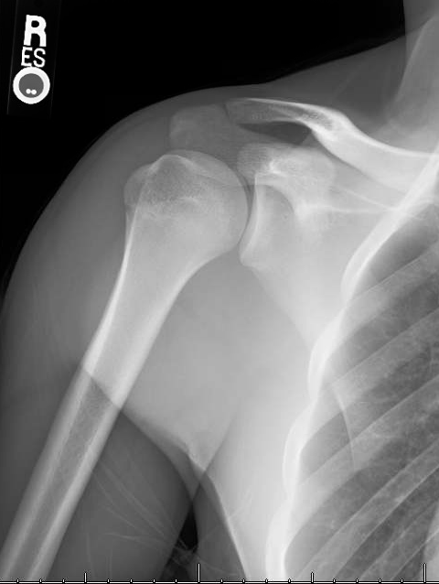
Answer the following questions related to the pictured radiograph.
What type of radiograph is pictured?
What view is pictured?

Slide 2
Answer the following questions related to the pictured radiograph.
What type of radiograph is pictured?
X-ray
What view is pictured?
AP View

Slide 3
Answer the following questions related to the pictured radiograph.
Palpate the indicated landmark.
Identify the indicated landmark.
A.
B.

Slide 4
Answer the following questions related to the pictured radiograph.
Palpate the indicated landmark.
Acromion
Identify the indicated landmark.
Greater Tubercle
A.
B.

Slide 5
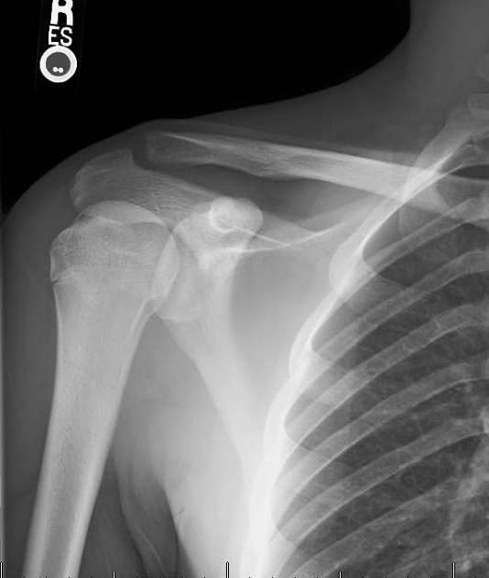
Answer the following questions related to the pictured radiograph.
What type of radiograph is pictured?
What view is pictured?

Slide 6
Answer the following questions related to the pictured radiograph.
What type of radiograph is pictured?
X-ray
What view is pictured?
AP View

Slide 7
Answer the following questions related to the pictured radiograph.
Identify the boney landmark.
Name 1 muscle that produces Internal Rotation of the indicated bone.
A.
B.

Slide 8
Answer the following questions related to the pictured radiograph.
Identify the boney landmark.
Coracoid Process
Name 1 muscle that produces Internal Rotation of the indicated bone.
Subscapularis, Teres Major, Latissiumus Dorsi, or Pectoralis Major
A.
B.

Slide 9
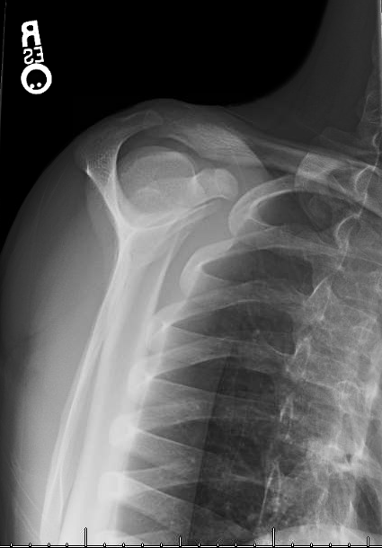
Answer the following questions related to the pictured radiograph.
What type of radiograph is pictured?
What view is pictured?

Slide 10
Answer the following questions related to the pictured radiograph.
What type of radiograph is pictured?
X-ray
What view is pictured?
Scapular-Y View

Slide 11
Answer the following questions related to the pictured radiograph.
Identify the indicated landmark.
Name a muscle that produces protraction of the indicated bone.
A.
B.

Slide 12
Answer the following questions related to the pictured radiograph.
Identify the indicated landmark.
Acromion
Name a muscle that produces protraction of the indicated bone.
Serratus Anterior, pectoralis minor
A.
B.

Slide 13
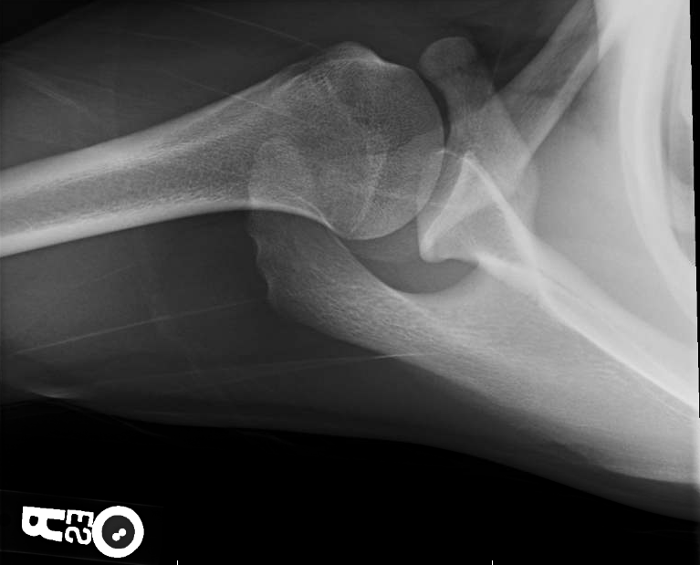
Answer the following questions related to the pictured radiograph.
What type of radiograph is pictured?
What view is pictured?

Slide 14
Answer the following questions related to the pictured radiograph.
What type of radiograph is pictured?
X-ray
What view is pictured?
SI, Axillary View

Slide 15
Answer the following questions related to the pictured radiograph.
A.
Name the nerve that wraps this landmark.
Identify the indicated landmark.
B.

Slide 16
Answer the following questions related to the pictured radiograph.
A.
Name the nerve that wraps this landmark.
Axillary Nerve
Identify the indicated landmark.
Glenoid Cavity
B.

Slide 17
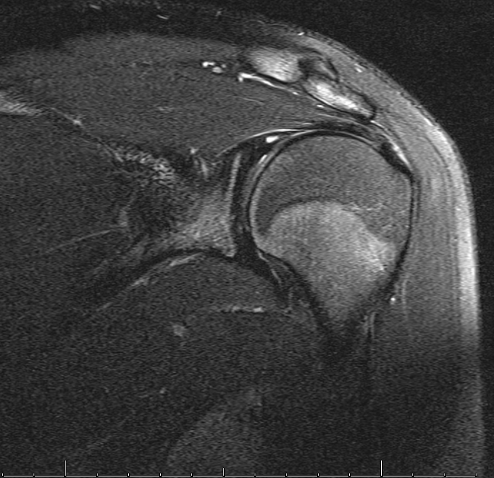
Answer the following questions related to the pictured radiograph.
What type of radiograph is pictured?
What view is pictured?

Slide 18
Answer the following questions related to the pictured radiograph.
What type of radiograph is pictured?
T2 MRI
What view is pictured?
Coronal View

Slide 19
Answer the following questions related to the pictured radiograph.
A.
Identify the indicated joint.
Name another muscle innervated by the same nerve that innervates the indicated muscle.
B.

Slide 20
Answer the following questions related to the pictured radiograph.
A.
Identify the indicated joint.
AC Joint
Name another muscle innervated by the same nerve that innervates the indicated muscle.
Teres Minor (indicated muscle is the deltoid)
B.

Slide 21
Answer the following questions related to the pictured radiograph.
A.
Perform a special test that would check for involvement of the indicated muscle.
………………………………..
Perform a test that checks the stability of the indicated joint.
B.

Slide 22
Answer the following questions related to the pictured radiograph.
A.
Perform a special test that would check for involvement of the indicated muscle.
Hawkins-Kennedy, Empty Can, Neer
Perform a test that checks the stability of the indicated joint.
Apprehension tests, Drawer (glide) tests
B.

Slide 23
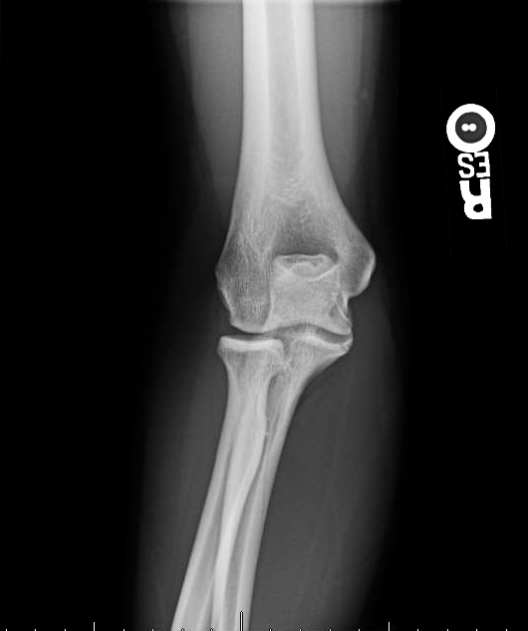
Answer the following questions related to the pictured radiograph.
What type of radiograph is pictured?
What view is pictured?

Slide 24
Answer the following questions related to the pictured radiograph.
What type of radiograph is pictured?
What view is pictured?

Slide 25
Answer the following questions related to the pictured radiograph.
What type of radiograph is pictured?
X-ray
What view is pictured?
AP View

Slide 26
Answer the following questions related to the pictured radiograph.
Identify the indicated landmark.
What nerve courses posteriorly to the indicated landmark?
What ligament wraps the bone just distal to the indicated landmark?
A.
B.
C.

Slide 27
Answer the following questions related to the pictured radiograph.
Identify the indicated landmark.
Lateral Epicondyle
What nerve courses posteriorly to the indicated landmark?
Ulnar Nerve
What ligament wraps the bone just distal to the indicated landmark?
Annular Ligament
A.
B.
C.

Slide 28
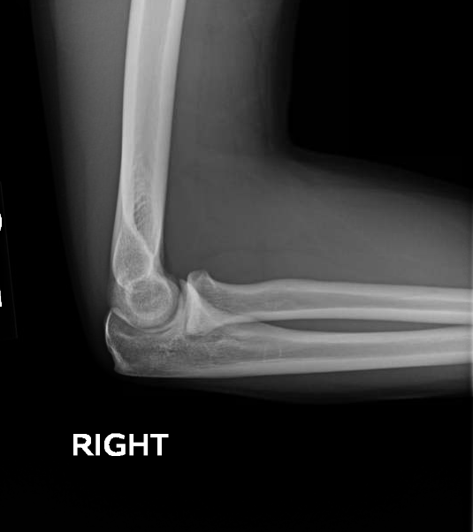
Answer the following questions related to the pictured radiograph.
What bone is indicated?
What view is pictured?
A.

Slide 29
Answer the following questions related to the pictured radiograph.
What bone is indicated?
Radius
What view is pictured?
Lateral View
A.

Slide 30
Answer the following questions related to the pictured radiograph.
Extension of the indicated joint tests what myotome level?
Identify the indicated landmark.
A.
B.

Slide 31
Answer the following questions related to the pictured radiograph.
Extension of the indicated joint tests what myotome level?
C7
Identify the indicated landmark.
Olecranon
A.
B.

Slide 32
Answer the following questions related to the pictured radiograph.
What nerve wraps inferior to the indicated structure?
Identify the indicated landmark.
A.
B.

Slide 33
Answer the following questions related to the pictured radiograph.
What nerve wraps inferior to the indicated structure?
Ulnar nerve (Medial epicondyle)
Identify the indicated landmark.
Trochlea
A.
B.

