Slide 1

TOPSOE AMMONIA PROCESS
Group - 1
APE - I

Slide 2
Processes Involved
Preheating
Desulphurization
Reforming
Shift conversion
CO2 removal
Methanation
Compression
Storage
Waste Recovery/Recycle

Slide 3
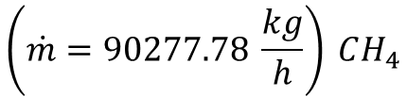

Process 1
Preheating
Desulphurization
Steam H20 (g)
T = 623 K
P = 30*10^5 Pa
T = 623 K
P = 30*10^5 Pa
Hydrogenator
H₂S Absorber
Adiabatic Reformer
$$\left(\dot{m}=90277.78 \frac{kg}{h}\right) CH_{4}$$
Natural Gas
T = 373 K
P = 30*10^5 Pa
Natural Gas, H2, S-compounds
$$\left({\dot{m}}_{r_{1}}\right)H_{2}S$$
Natural Gas is heated to High Temp
Sulphur Impurities are removed as H2S
Methane is obtained
Change in Enthalpy is found by integrating Specific Heat Capacity over the temperature using MATLAB.
CH4 – 90277.78 kg/hr
Natural Gas – 650000 ton/yr
del H (Preheater) = 11576.08 J/mol

Slide 4


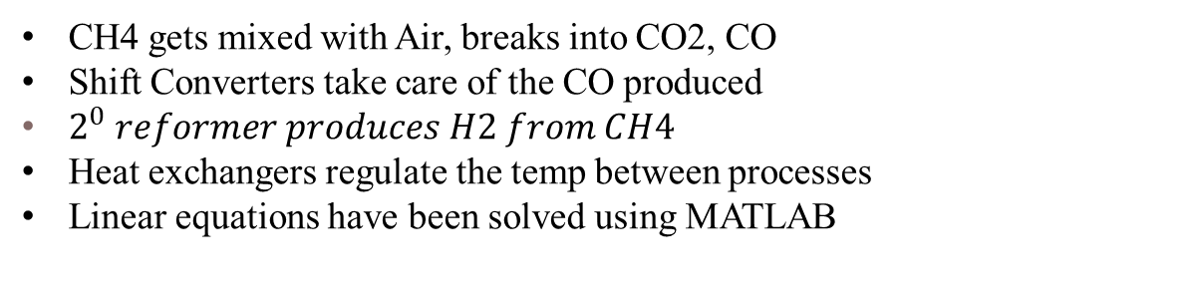


Air
${\dot{m}}_{a1 }=$600000 kg Air/h
T = 573 K
P = 25*10^5 Pa
T = 473 K
P = 20 bar
T = 1073 K
P = 25*10^5 Pa
x_a1 – N2; x_a2 – H2
L.T.S.C
T = 473 K
P = 20*10^5 Pa
$$\left(\dot{m1}=90277.78 \frac{kg}{h}\right)CH_{4}$$
T = 623 K
P = 30 * 10^5 Pa
conv = 95%
H.T.S.C
T = 1323 K
P = 25*10^5 Pa
$${\dot{m}}_{2}$$
T = 673 K
P = 24*10^5 Pa
x1 – CH4; x4 – H2
x2 – CO2
x3 – CO
x1 – CH4; x4 – H2
x2 – CO2; x5 – O2
x3 – CO; x6 – N2
${\dot{m}}_{s1}$ = 128472.22 kg/h H2O
Process 2
Reforming
Shift Conversion
CH4 gets mixed with Air, breaks into CO2, CO
Shift Converters take care of the CO produced
$2^{0} reformer produces H2 from CH4$
Heat exchangers regulate the temp between processes
Linear equations have been solved using MATLAB

Slide 5
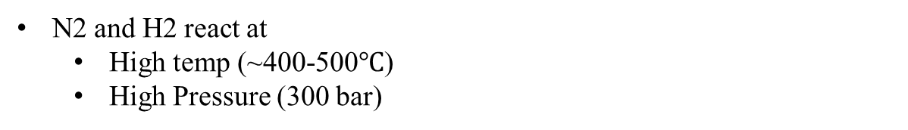
Separator
BFW to Steam drum
Methanator
Steam
GV Solution
T = 323 K
P = 20 bar
T = 473 K
P = 20*10^5 Pa
NH₃ Synthetic Converter
Hot HE
T = 323 K
P = 20 bar
BFW
Preheater
WHB
Condensed Water
CO₂ Absorber
T = 323 K
P = 20 bar
BFW
T = 573 K
P = 20 bar
x1 – CH4; x4 – H2
x2 – CO2; x5 – O2
x3 – CO; x6 – N2
x1 – N2; x2 – H2
x3 – CH4; x4 – H2O
Process 3
CO2 removal
Methanation
Heat exchange
CO2 is absorbed
Remaining CO, CO2 are trapped as CH4
Pressure difference varies slightly (Reactor constraints)
Methanator produces N2 and H2 (nearly pure)
Change in Enthalpy is found by integrating Specific Heat Capacity over the temperature using MATLAB.
N2 and H2 react at
High temp (~400-500$℃$)
High Pressure (300 bar)

Slide 6
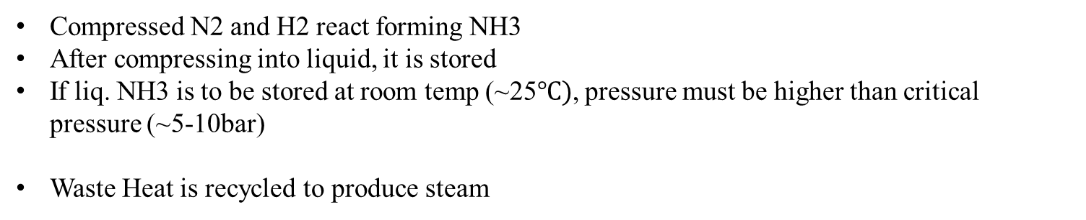
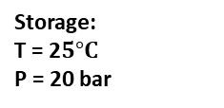
NH₃ (g)
Condenser
Off gas to boiler
Flash Vessel
NH₃ separator
Storage:
T = 2$5°C$
P = 20 bar
NH₃(g)
Absorber
Liquid NH₃
NH₃ Refrigeration Compressor
Accumulator
NH₃ Chiller 1
NH₃ Chiller 2
T = 373 K
P = 300 bar
Distillation column
Let Down Vessel
Compressed N2 and H2 react forming NH3
After compressing into liquid, it is stored
If liq. NH3 is to be stored at room temp (~25$℃)$, pressure must be higher than critical pressure (~5-10bar)
Waste Heat is recycled to produce steam
Process 4
Compression
Storage of NH3
Waste Recycle

Slide 7
Overall Process Flowsheet
Secondary Reformer
Primary Reformer
Air
Hydrogenator
H₂S Absorber
Adiabatic Reformer
Feed Stock heat absorber
Naphtha
FG
FG
BFW to Steam drum
Steam
NH₃ Synthetic Converter
WHB
BFW Preheater
BFW

Slide 8
L.T.S.C
Separator
Methanator
H.T.S.C
GV Solution
Off gas to boiler
NH₃ (g)
Let Down Vessel
Absorber
Condensed Water
CO₂ Absorber
NH₃(l)
Synthetic Gas
NH₃(g)
NH₃
NH₃ Chiller 1
NH₃ Chiller 2
NH₃ separator
Condenser
Hot HE
NH₃(g)
Flash Vessel
NH₃(l)
NH₃ Refrigeration Compressor
Distillation column
Liquid NH₃
Accumulator

Slide 9
Comparison Table:
Process | Catalyst | Energy Consumption (GJ/t) | Energy Loss (%) | Energy Produced (GJ/t) | Shutdown Time (days/year) | Total Energy (GJ/t) | Feedstock Type | By-products
Topsoe | Iron-based | ~7-10 | 20 | 1.5 | ~15-20 | 9.0 | Natural gas, air | Hydrogen, nitrogen
Haber-Bosch | Iron-based (Fe2O3) | ~7-10 | 25 | 2.0 | ~20-30 | 10.5 | Natural gas, air | Trace gases, heat
Linde | Ruthenium (Ru) | ~6-9 | 12 | 2.5 | ~10-15 | 8.5 | Natural gas, air | Minimal
Krupp Uhde | Iron or Ruthenium | ~6.8-9 | 17 | 2.0 | ~15-25 | 9.0 | Natural gas, air | Minimal
KBR | Iron-based | ~7.2-9 | 22 | 2.0 | ~20-25 | 9.5 | Natural gas, air | Trace gases, water

Slide 10
Topsoe
Thank You
From Group - 1

