Slide 1

JobLens Agent
AI-Powered Recruitment Intelligence
A comprehensive end-to-end recruitment platform designed to transform your hiring pipeline through intelligent automation

Slide 2






Core Functional Modules
JobLens Agent streamlines the entire recruitment process with seven integrated AI modules:
Job Description Input
Resume Processing
Multi-input system with NLP extraction of key requirements and real-time validation
Bulk PDF/DOCX parsing of candidate information with real-time progress tracking
ATS Scoring
Video Interviews
AI-powered matching between resumes and job descriptions with gap analysis
Automated invitations, unique links, and AI analysis of candidate responses
Communication
Shortlisting
Auto-generated emails with tracking and template management capabilities
Checkbox-based candidate selection with automated staff notifications
All modules integrate seamlessly with our Results Dashboard featuring tabular summaries, visual indicators, and data export options

Slide 3

Development Roadmap
1
Job Description Analysis
NLP processing to extract key requirements and qualifications
2
Resume Processing
Automated parsing and data extraction from candidate documents
3
ATS Computation
Algorithm development for accurate resume-to-JD matching
4
Interview Question Generation
AI-driven creation of relevant assessment questions
5
Avatar Interview System
Virtual interviewer with video capture capabilities
6
Response Analysis
Sentiment, confidence, and content evaluation of answers
7
Business Logic Implementation
Configurable thresholds, workflows, and audit logging

Slide 4

Project Resources
Live Demo
GitHub Repository
Access our demonstration environment at:
View and contribute to our codebase:
joblens.prama-ai.com
github.com/pramod-prama/Joblens
Experience the full recruitment workflow from job description input to candidate shortlisting
Includes all components and modules following our modular development approach
Dashboard Entry
Additional components are available in the source code:
JobInput.tsx, ResumeUpload.tsx, and other modular components under src/components/

Slide 5

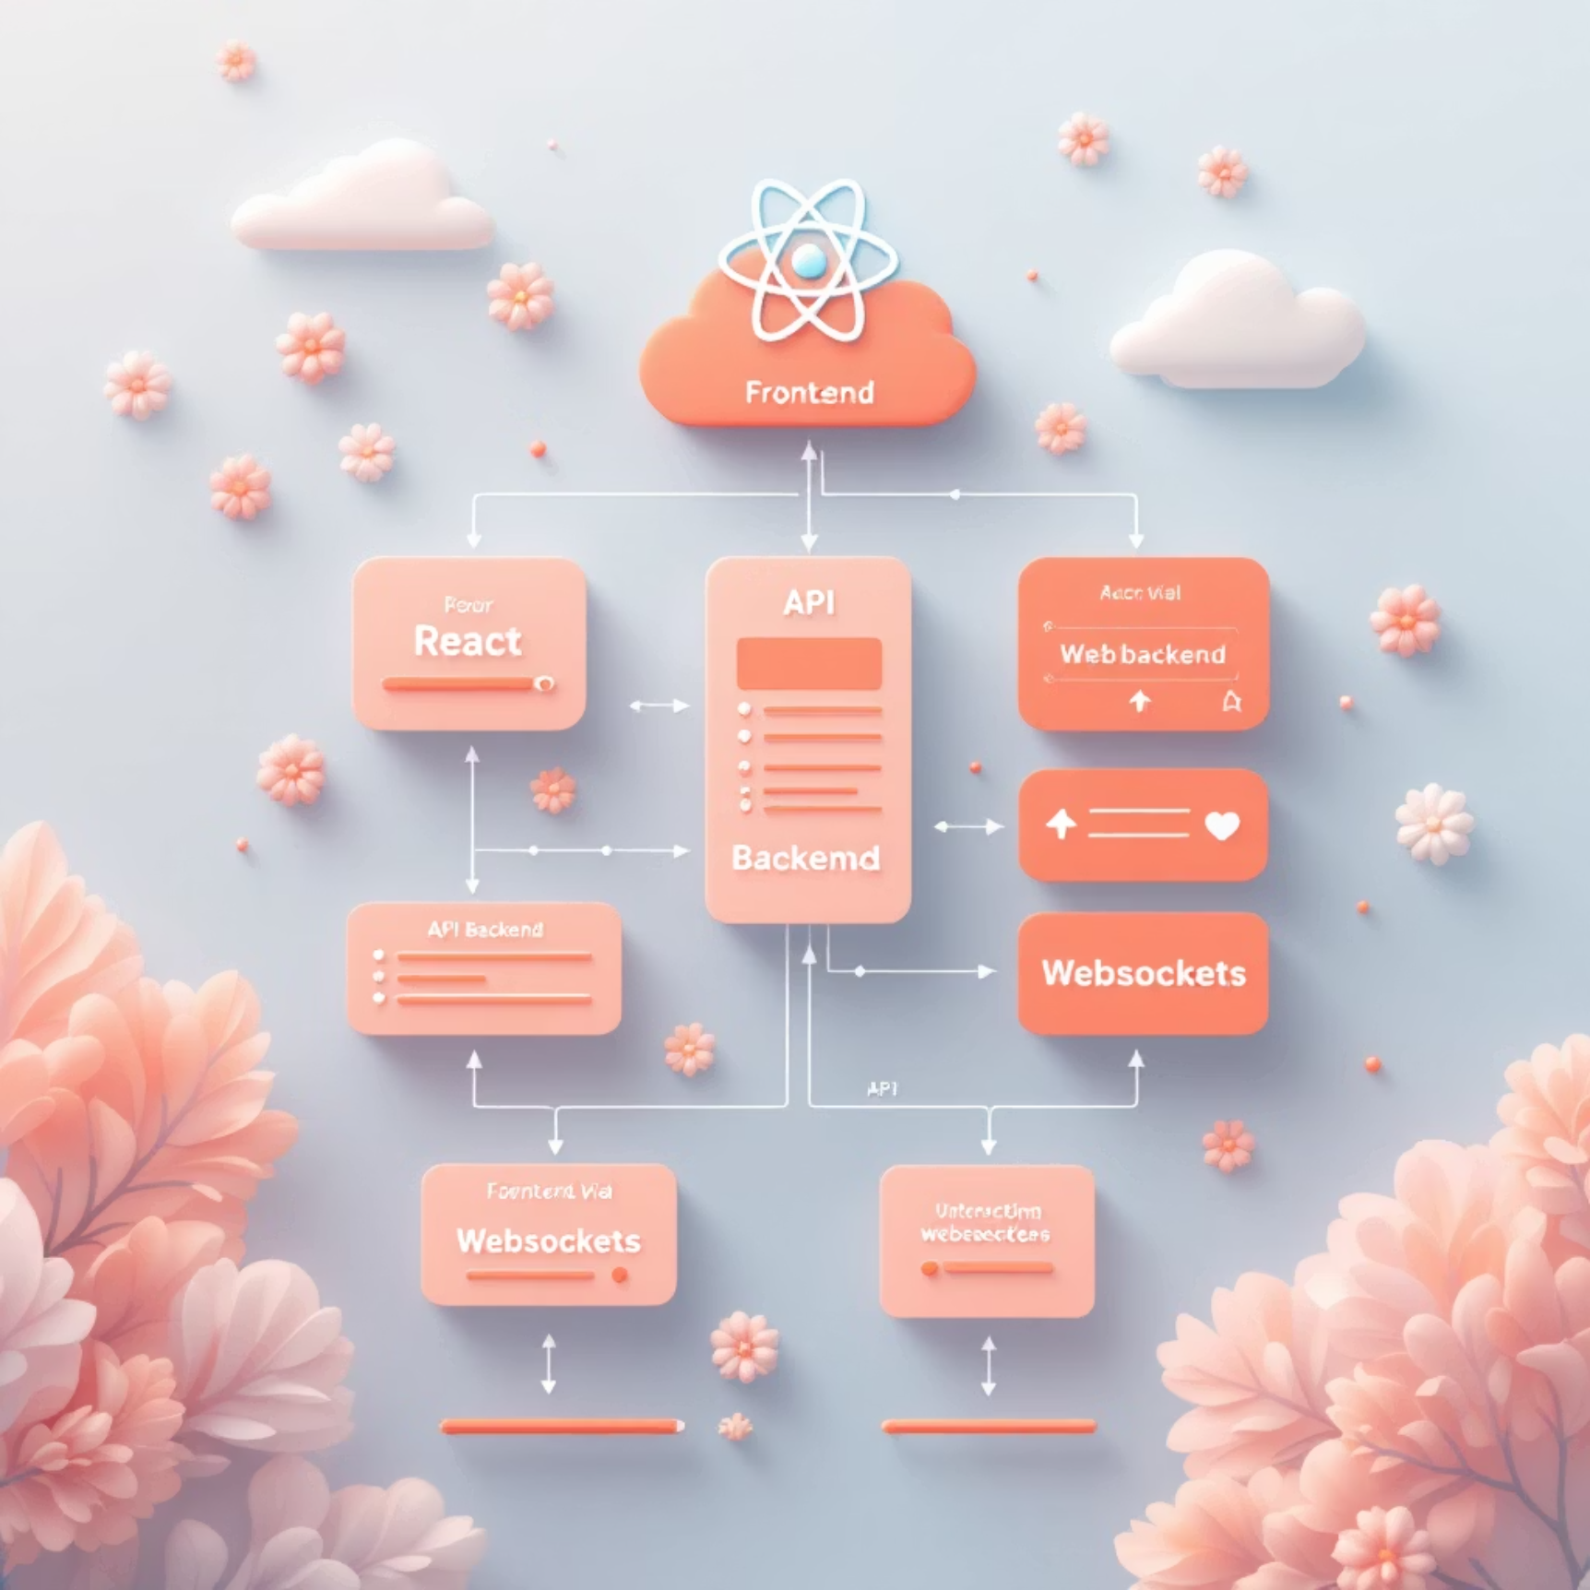




System Architecture
Frontend
React + Tailwind CSS + shadcn/ui component library for a responsive and accessible user experience
Authentication
Modal-based login/signup with secure session management and role-based access control
Backend
REST API / GraphQL-ready architecture built with FastAPI or Flask for optimal performance
Real-time Features
WebSockets or long polling for progress tracking and live updates during recruitment processes
Data Export
Client-side Excel/CSV export via xlsx library for recruitment analytics and reporting
The architecture prioritizes scalability, security, and real-time performance to handle recruitment data processing at enterprise scale.

