Slide 1
Customer & Subscription Analysis using SQL
Name: Pramod Gavade
Date: 1st May 2025
Tools Used: MySQL
Tables: Customers, Subscriptions, Churn, Transactions

Slide 2
Table of Contents
1. Project Objective
2. Database Schema
3. Dataset Overview
4. Business Questions
5. Data Cleaning & Transformation
6. Analysis & Insights
7. Key Queries
8. Conclusion & Future Scope
9. References

Slide 3
Project Objective
Analyze customer data for insights on:
Customer growth & activity
Subscription trends
Transaction history
Revenue distribution
Churn patterns
Perform data cleaning & transformation for better accuracy.

Slide 4
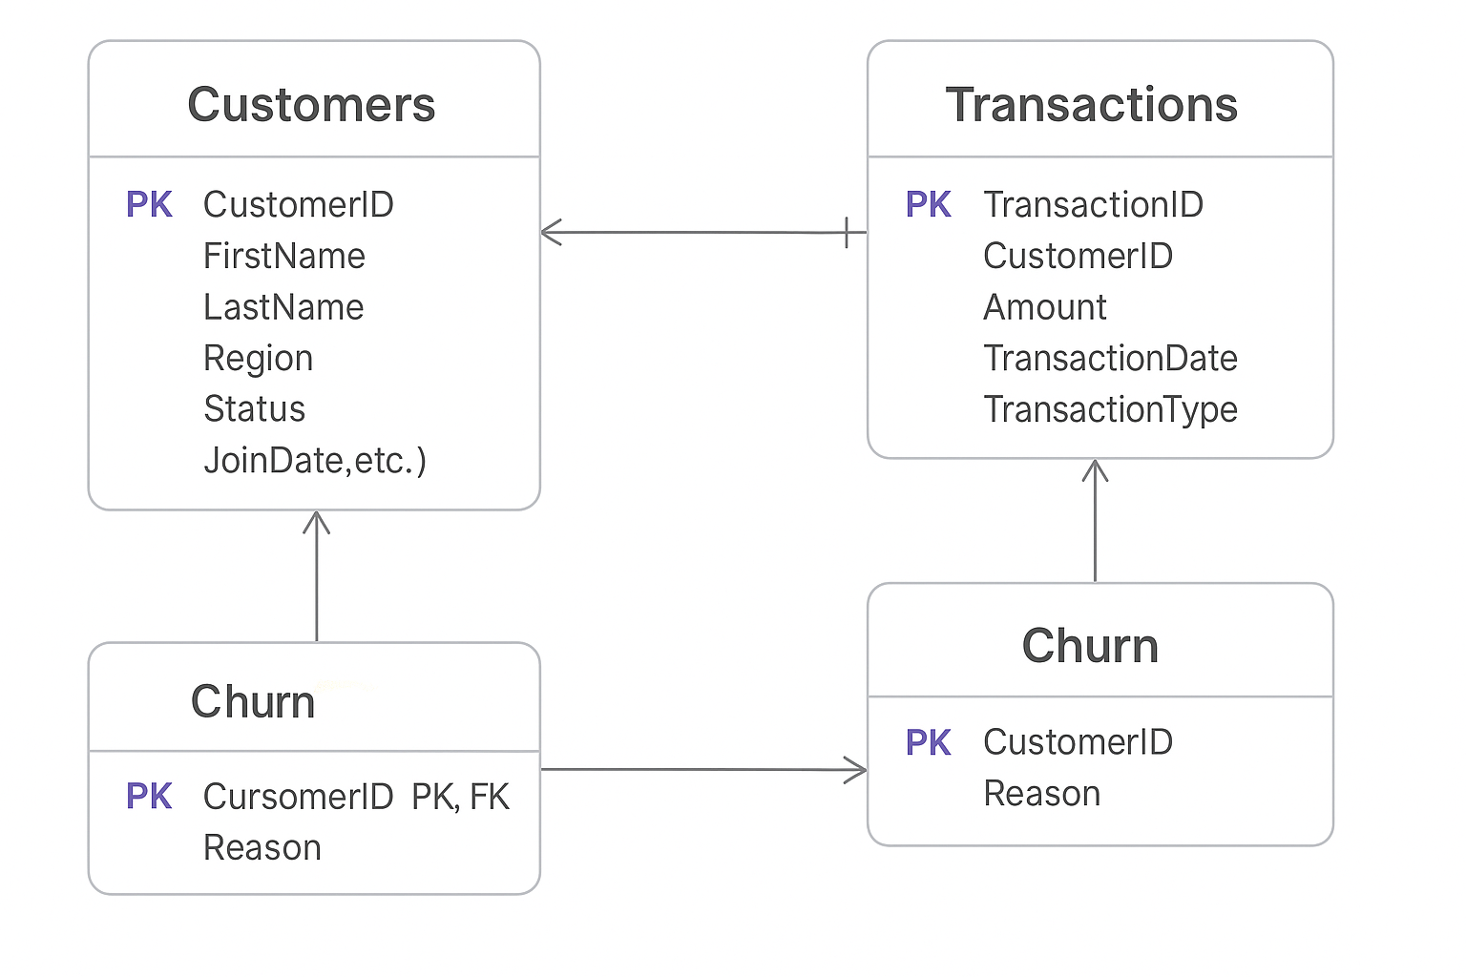
Database Schema
ER Diagram:
Customers (CustomerID, FirstName, LastName, Region, Status, JoinDate, etc.)
Subscriptions (SubscriptionID, CustomerID, PlanType, StartDate, EndDate)
Transactions (TransactionID, CustomerID, Amount, TransactionDate, TransactionType)
Churn (CustomerID, Reason)

Slide 5
Dataset Overview
Total Customers: SELECT COUNT(*) FROM customers;
Total Subscriptions: SELECT COUNT(*) FROM subscriptions;
Total Transactions: SELECT COUNT(*) FROM transactions;
Total Churned Customers: SELECT COUNT(*) FROM churn;
(Optional: include sample data using SELECT * queries.)

Slide 6
Business Questions
How many active customers are there?
What is the churn rate for annual subscriptions?
What are the most popular subscription plans?
How much revenue is generated per region?
Which customers have the highest spending?

Slide 7
Data Cleaning & Transformation
Data Type Modifications:
Converted JoinDate, StartDate, and EndDate to proper DATE formats.
Example:
ALTER TABLE transactions
MODIFY TransactionDate DATE;
Handling Null Values:
Set invalid or missing dates to NULL.
Example:
UPDATE customers
SET JoinDate = NULL
WHERE JoinDate IS NULL;

Slide 8
Customer Analysis
Active customers by region:
SELECT region, COUNT(*) AS customer_count
FROM customers WHERE status = 'active'
GROUP BY region;
New customers in 2022:
SELECT COUNT(*) FROM customers
WHERE YEAR(JoinDate) = 2022;

Slide 9
Subscription Analysis
Plan distribution:
SELECT PlanType, COUNT(*) AS plan_type_count
FROM subscriptions
GROUP BY PlanType;
Customers with multiple subscriptions:
SELECT CustomerID, COUNT(SubscriptionID) AS subscription_count
FROM subscriptions
GROUP BY CustomerID
HAVING COUNT(SubscriptionID) > 1;

Slide 10
Transaction Analysis
Average transaction amount:
SELECT AVG(amount)
FROM transactions;
Revenue by region:
SELECT c.Region, SUM(t.amount) AS Total_Revenue
FROM customers AS c
JOIN transactions AS t ON c.CustomerID = t.CustomerID
GROUP BY c.Region;

Slide 11
Churn Analysis
Churn reasons distribution:
SELECT reason, COUNT(*) AS churn_count
FROM churn
GROUP BY reason;
Churned annual plan customers:
SELECT cu.CustomerID, cu.FirstName, cu.LastName, COUNT(c.CustomerID) AS Churned_Count
FROM customers cu
JOIN subscriptions s ON cu.CustomerID = s.CustomerID
JOIN churn c ON c.CustomerID = cu.CustomerID
WHERE s.PlanType = 'annual'
GROUP BY cu.CustomerID;

Slide 12
Key Findings
Customer Growth: Identified increase in 2022.
Subscription Trends: Annual plans most popular.
Revenue Distribution: Highest in North America.
Churn Patterns: Price was the top reason.

Slide 13
Conclusion
Insights on behavior, preferences, and revenue.
Valuable for strategic decision-making.
Limitations: Missing values, transaction inaccuracies.

Slide 14
Future Scope
Automate data cleaning processes.
Use ML models for churn prediction.
Optimize SQL query performance.

Slide 15
References & Tools
Tools Used: MySQL
Project Repository: [GitHub Link]
Professional Profile: [LinkedIn Link]

Slide 16
Q&A / Thank You
Email: [pramodgavade14@yahoo.com]
LinkedIn: [https://www.linkedin.com/in/pramodgavade14]
GitHub: [https://github.com/pramodgavade14]

