Slide 1
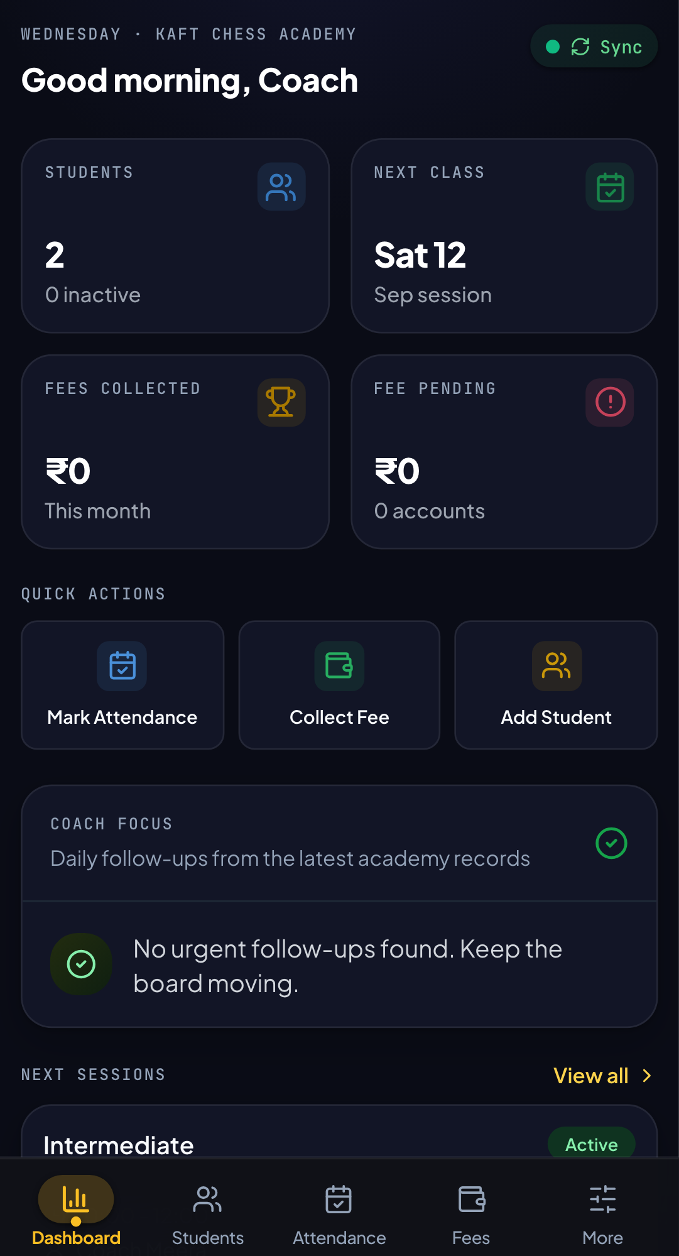
KAFT CHESS
ACADEMY
MOBILE APP
WALKTHROUGH
Screens, workflows, and features explained through the people who use them.
18 MOBILE SCREENS | 24 SLIDES | 1 ACADEMY WORKSPACE
Prepared 09 September 2026
KAFT CHESS ACADEMY | MOBILE WORKSPACE
Notes:
Use the screenshot slides as a visual tour. Screens were captured in the mobile test environment using fixture data, not private production records.

Slide 2
HOW IT FITS TOGETHER
The academy operating loop
The app connects the recurring work of running a chess academy into one mobile routine.
Run the day
Grow the players
Run the academy
Dashboard -> Students -> Attendance -> Fees
The daily operating loop keeps people, classes, and collections visible.
Curriculum -> Resources -> Progress -> Timeline
Teaching activity and learner evidence stay connected.
Tournaments -> Reports -> Operations -> Admin settings
Events, decisions, and configuration have a clear home.
Keep families informed
Parent portal
A focused experience for the people who need student context without the full admin surface.
KAFT CHESS ACADEMY | MOBILE WORKSPACE
Notes:
Use the screenshot slides as a visual tour. Screens were captured in the mobile test environment using fixture data, not private production records.

Slide 3
RECOMMENDED WALKTHROUGH
A simple demo story
Show the product in the order the academy experiences it, not in the order the menu happens to list it.
01 Start with today
02 Follow one learner
03 Show the academy
Open the dashboard and answer: what needs attention now?
Open a student, mark attendance, review fees, and inspect progress.
Move through timetable, tournaments, resources, and curriculum.
04 Close the loop
Finish with reports, settings, operations, and the parent portal.
KAFT CHESS ACADEMY | MOBILE WORKSPACE
Notes:
Use the screenshot slides as a visual tour. Screens were captured in the mobile test environment using fixture data, not private production records.

Slide 4
INTEGRATIONS
Connected academy ecosystem
The app is the mobile control layer. Existing services remain useful, but the coach gets one coherent workflow.
Google OAuth
WhatsApp
Secure coach sign-in
and identity context
Parent contact, group
invites, share-ready updates
KAFT MOBILE APP
One workspace for people, classes, payments, events, and progress
Google Sheets
Google Drive
Live roster, attendance,
fees, settings, events
Resources, PDFs, uploads,
and shared documents
CONNECTED BY LIVE STUDENT CONTEXT
No duplicate admin surface. The app gives each service a useful place in the academy day.
KAFT CHESS ACADEMY | MOBILE WORKSPACE
Notes:
Use the screenshot slides as a visual tour. Screens were captured in the mobile test environment using fixture data, not private production records.

Slide 5
SMART DATA FLOW
From student record to online insight
A strong example of the app doing more than storing fields: it turns IDs into useful coaching context.
01
Student roster
02
Chess.com + Lichess
03
Online stats
04
Academy action
The app fetches the live student record and its saved online IDs.
Platform usernames remain linked to the correct student.
Ratings and monthly or weekly activity can be fetched for review.
Use the insight in tournaments, progress, reports, and WhatsApp updates.
COOL FEATURE | Online identities are not isolated text fields. They become searchable, fetchable, matchable, and shareable academy data.
KAFT CHESS ACADEMY | MOBILE WORKSPACE
Notes:
Use the screenshot slides as a visual tour. Screens were captured in the mobile test environment using fixture data, not private production records.

Slide 6
DAILY CONTROL ROOM
SCREEN 01 / 18
Dashboard
The first screen gives the coach a compact read on what needs attention today.
01
At-a-glance metrics
Attendance, fees, and academy activity in one place.
02
Fast actions
Jump directly into the workflows that happen every day.
03
Decision context
Use the dashboard as the morning starting point.
OPERATIONAL VALUE
Less time hunting for information.
KAFT CHESS ACADEMY | MOBILE WORKSPACE
Notes:
Use the screenshot slides as a visual tour. Screens were captured in the mobile test environment using fixture data, not private production records.

Slide 7
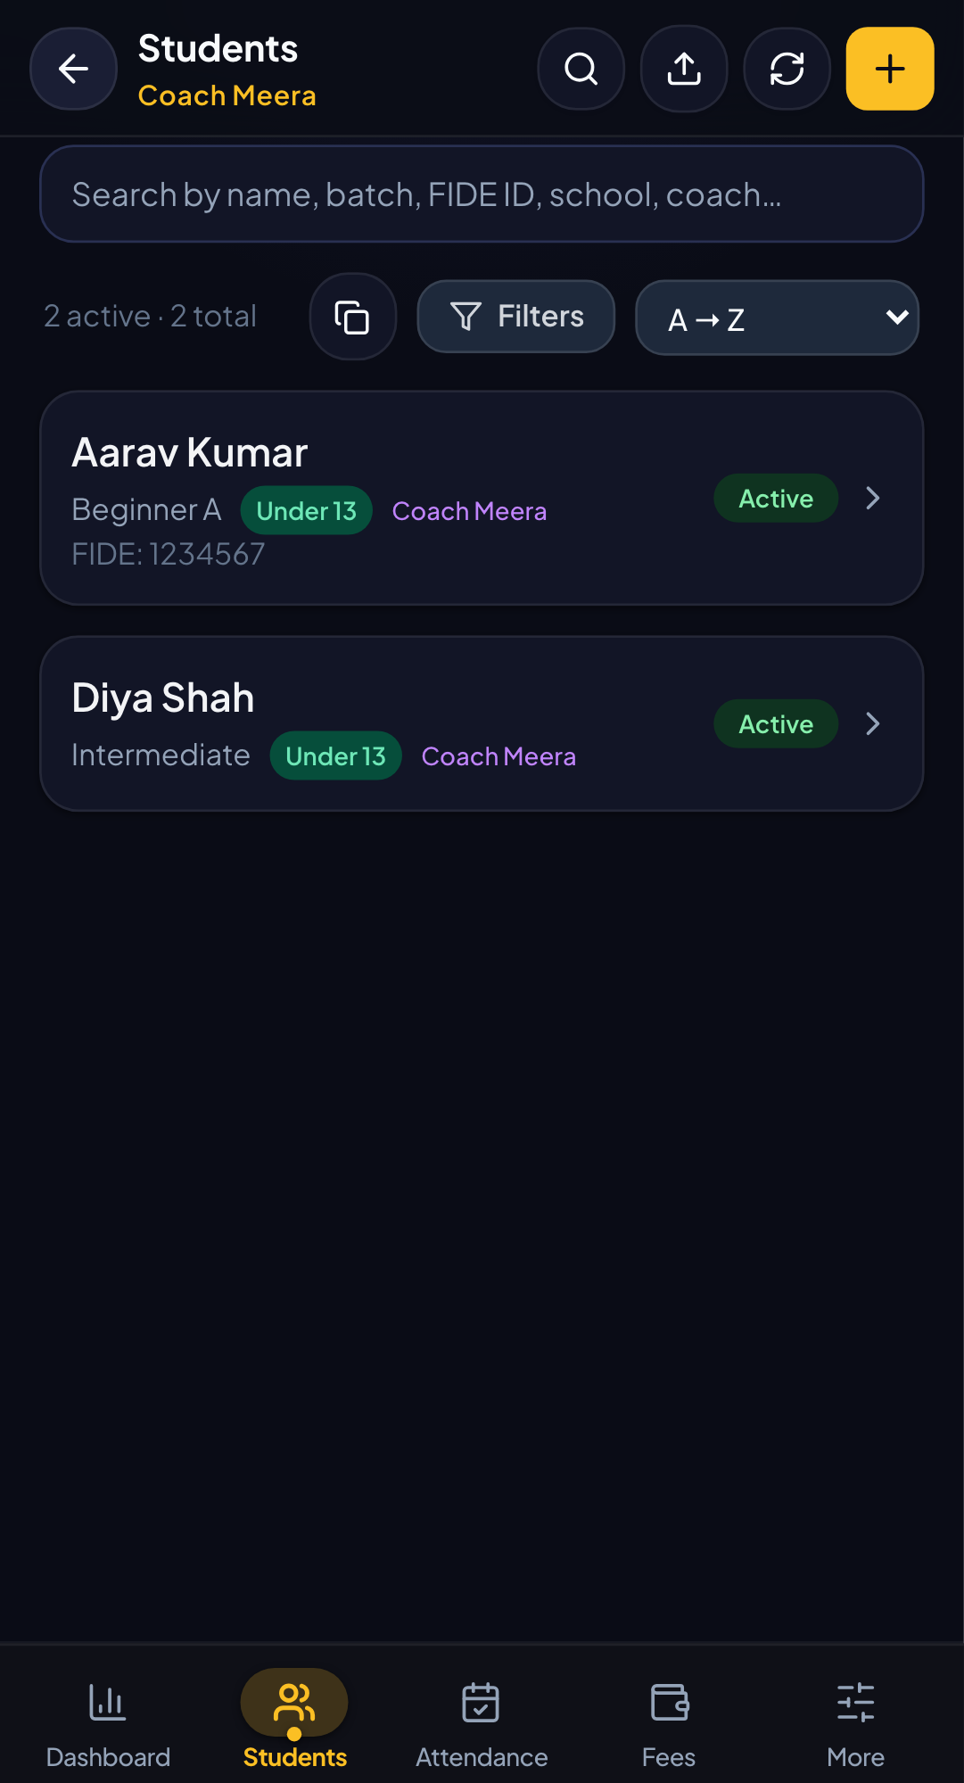
STUDENT RECORDS
SCREEN 02 / 18
Students
The roster is the operational backbone: profiles, filters, IDs, schools, batches, and coaches.
01
Build a complete profile
Capture family details, academic information, ratings, and online IDs.
02
Find the right student
Search and filter by batch, coach, school, status, or age category.
03
Keep data current
Edit, archive, or review a student without leaving the mobile workflow.
OPERATIONAL VALUE
Every learner has one dependable record.
KAFT CHESS ACADEMY | MOBILE WORKSPACE
Notes:
Use the screenshot slides as a visual tour. Screens were captured in the mobile test environment using fixture data, not private production records.

Slide 8
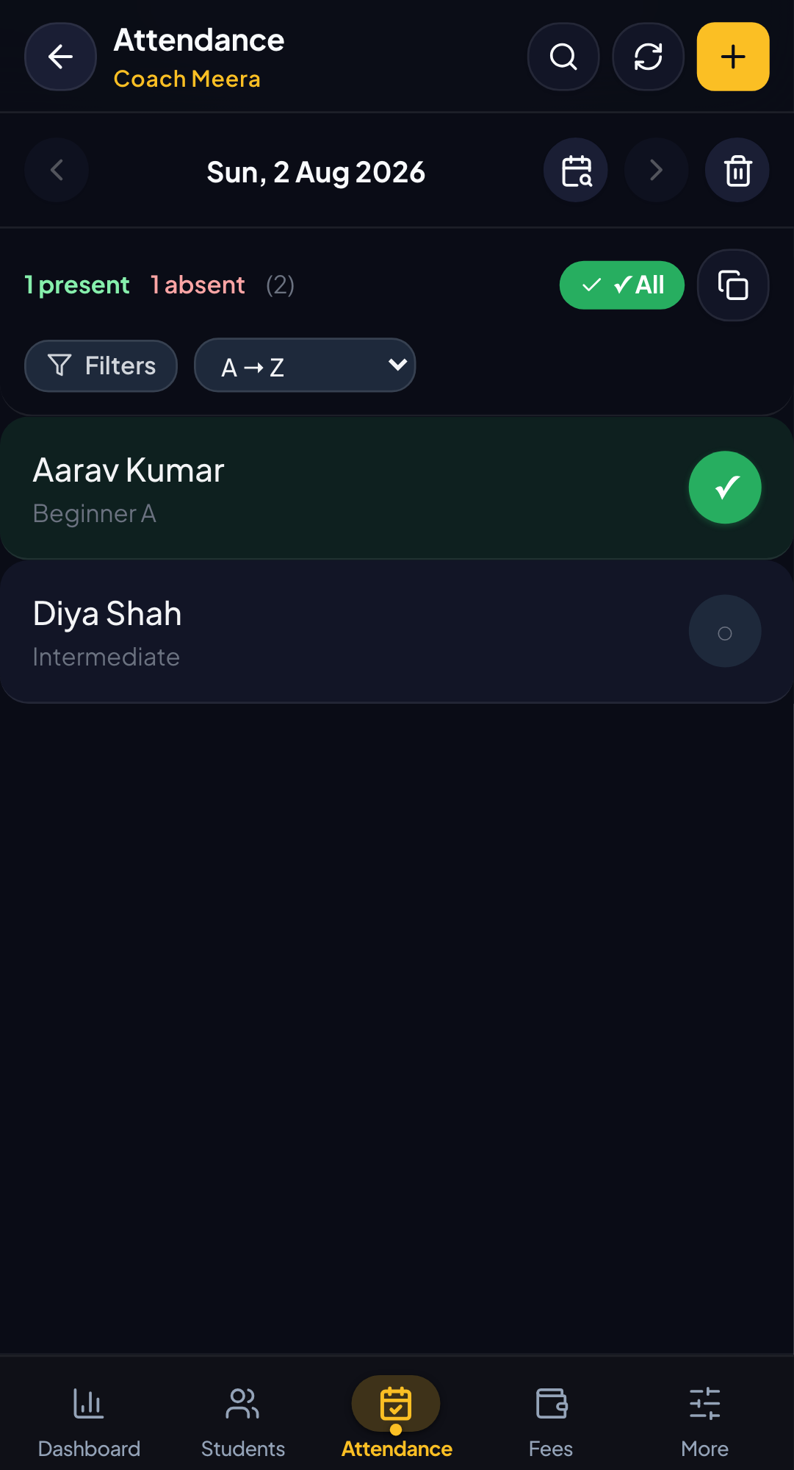
CLASS OPERATIONS
SCREEN 03 / 18
Attendance
Mark class participation against the exact date and keep the academy roster honest.
01
Select the class date
Move across dates without losing the active roster.
02
Mark quickly
Use touch-friendly controls for the whole batch.
03
Review the pattern
Attendance becomes useful when it is consistently captured.
OPERATIONAL VALUE
A reliable attendance habit creates useful progress data.
KAFT CHESS ACADEMY | MOBILE WORKSPACE
Notes:
Use the screenshot slides as a visual tour. Screens were captured in the mobile test environment using fixture data, not private production records.

Slide 9
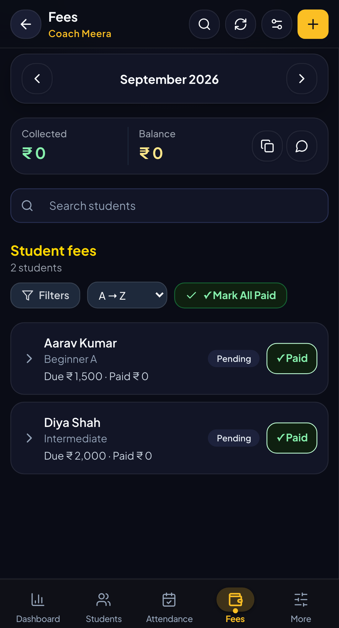
FINANCE
SCREEN 04 / 18
Fees
Track what is due, what was collected, and what still needs follow-up.
01
Record payments
Support paid, partial, and pending states.
02
Use payment context
UPI QR support helps the coach complete collection on mobile.
03
Reconcile confidently
Balances and monthly summaries expose what needs attention.
OPERATIONAL VALUE
Finance becomes a visible routine, not a spreadsheet chase.
KAFT CHESS ACADEMY | MOBILE WORKSPACE
Notes:
Use the screenshot slides as a visual tour. Screens were captured in the mobile test environment using fixture data, not private production records.

Slide 10
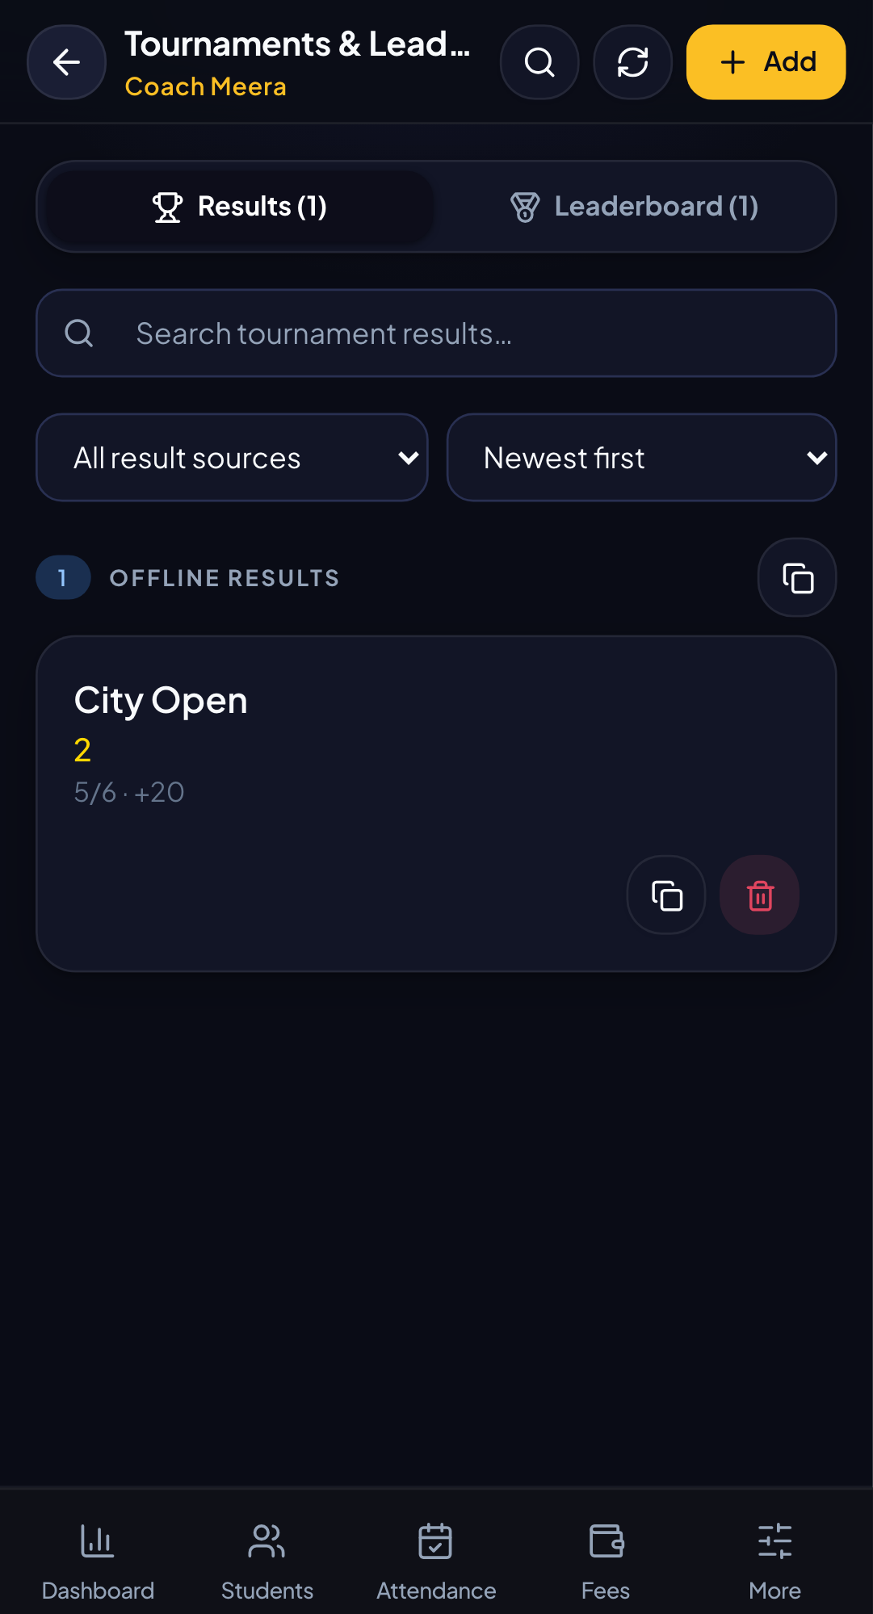
COMPETITION
SCREEN 05 / 18
Tournaments
Bring registrations, results, achievements, and rankings into the academy workflow.
01
Manage participation
Register students and track playing status.
02
Record outcomes
Capture results and connect them to student history.
03
Celebrate progress
Leaderboards and achievements make improvement visible.
OPERATIONAL VALUE
Competition data becomes part of the student story.
KAFT CHESS ACADEMY | MOBILE WORKSPACE
Notes:
Use the screenshot slides as a visual tour. Screens were captured in the mobile test environment using fixture data, not private production records.

Slide 11
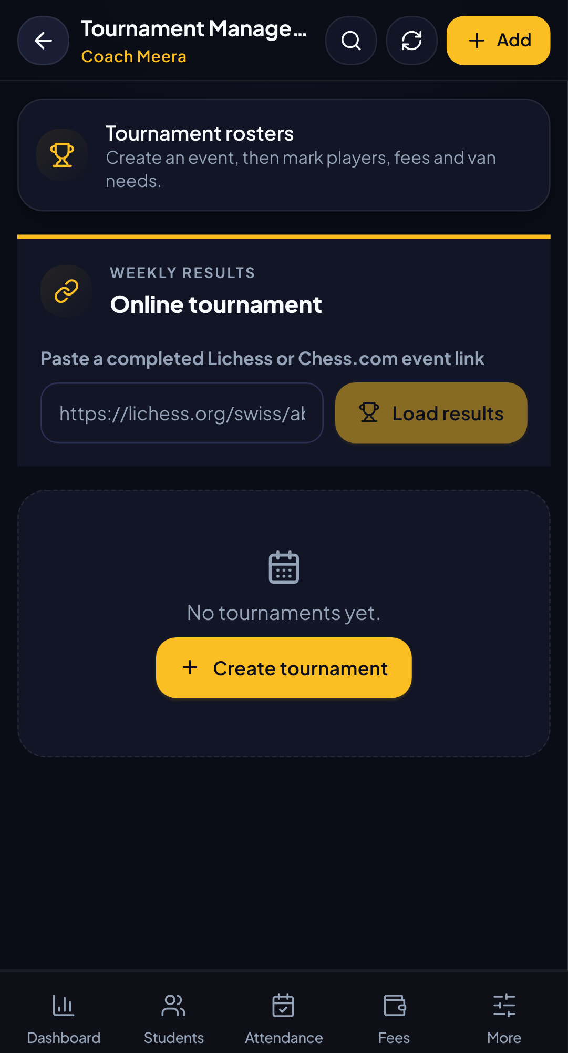
PLANNING
SCREEN 06 / 18
Upcoming tournaments
Keep external events visible before they become last-minute messages.
01
Event essentials
Dates, venues, entry fees, eligibility, and links.
02
Deadline awareness
Registration deadlines are visible to the team.
03
One shared view
Coaches can plan student participation from the same screen.
OPERATIONAL VALUE
The academy can plan ahead with fewer surprises.
KAFT CHESS ACADEMY | MOBILE WORKSPACE
Notes:
Use the screenshot slides as a visual tour. Screens were captured in the mobile test environment using fixture data, not private production records.

Slide 12
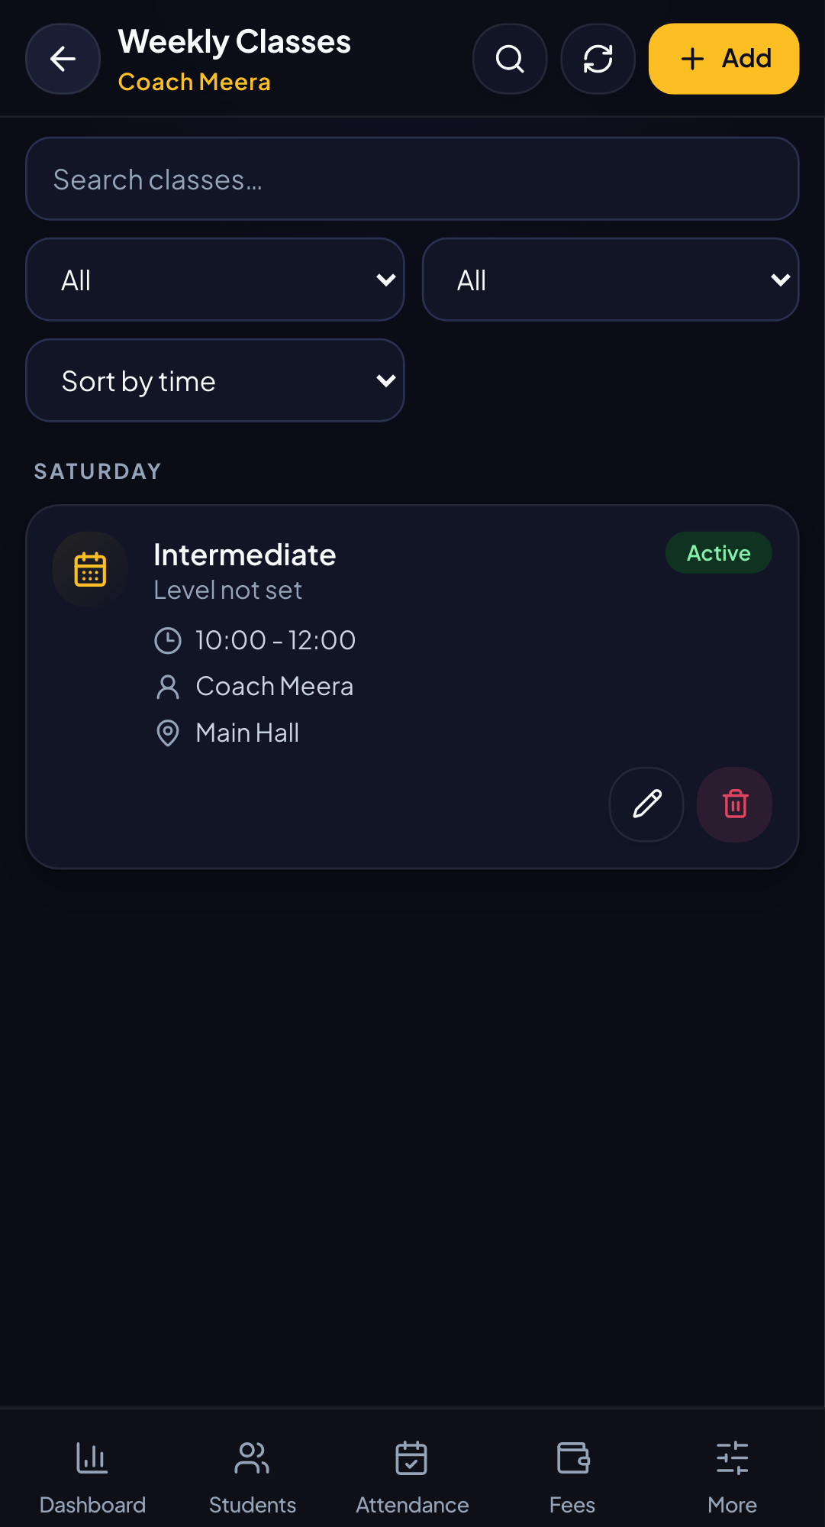
SCHEDULING
SCREEN 07 / 18
Timetable
A weekly view of batches, coaches, times, and locations.
01
Know the week
See what class is happening and when.
02
Coordinate people
Connect each batch to its coach and location.
03
Support parents
Use the same schedule context when answering questions.
OPERATIONAL VALUE
A shared timetable reduces coordination friction.
KAFT CHESS ACADEMY | MOBILE WORKSPACE
Notes:
Use the screenshot slides as a visual tour. Screens were captured in the mobile test environment using fixture data, not private production records.

Slide 13
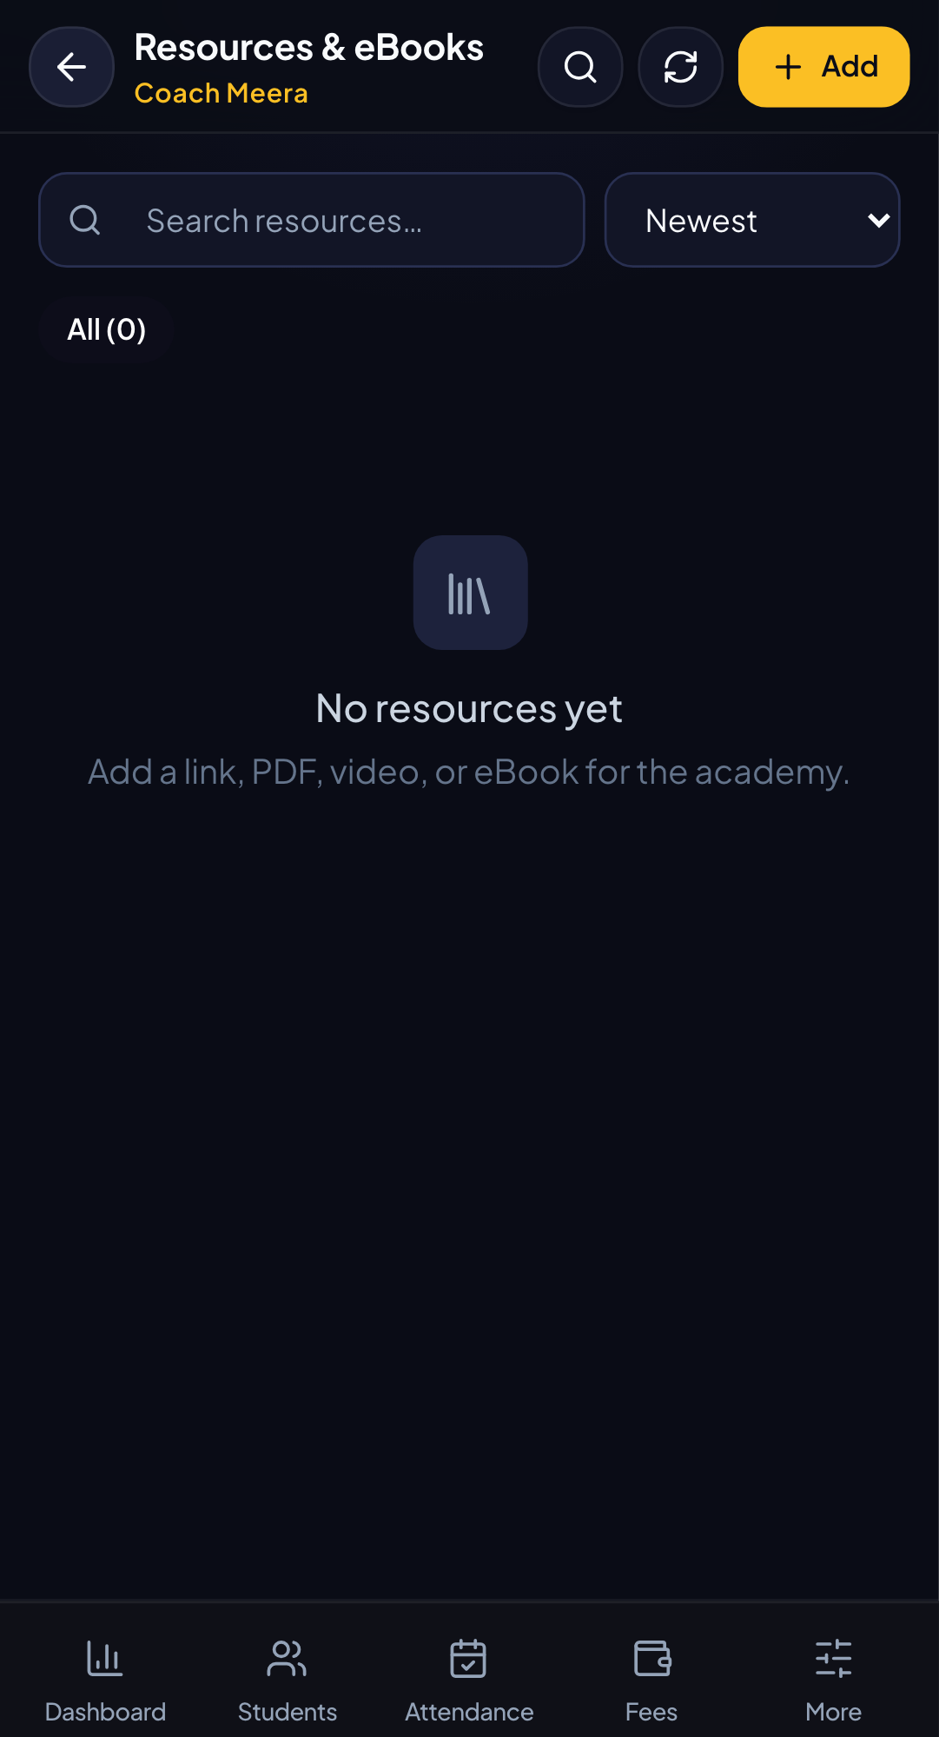
ACADEMY LIBRARY
SCREEN 08 / 18
Resources
Give the coaching team a single place to find supporting material.
01
Open useful material
Links and documents are available from the app.
02
Add context
Descriptions and levels make resources easier to choose.
03
Keep knowledge reusable
Good coaching material does not disappear in chat threads.
OPERATIONAL VALUE
The academy builds a reusable teaching library.
KAFT CHESS ACADEMY | MOBILE WORKSPACE
Notes:
Use the screenshot slides as a visual tour. Screens were captured in the mobile test environment using fixture data, not private production records.

Slide 14
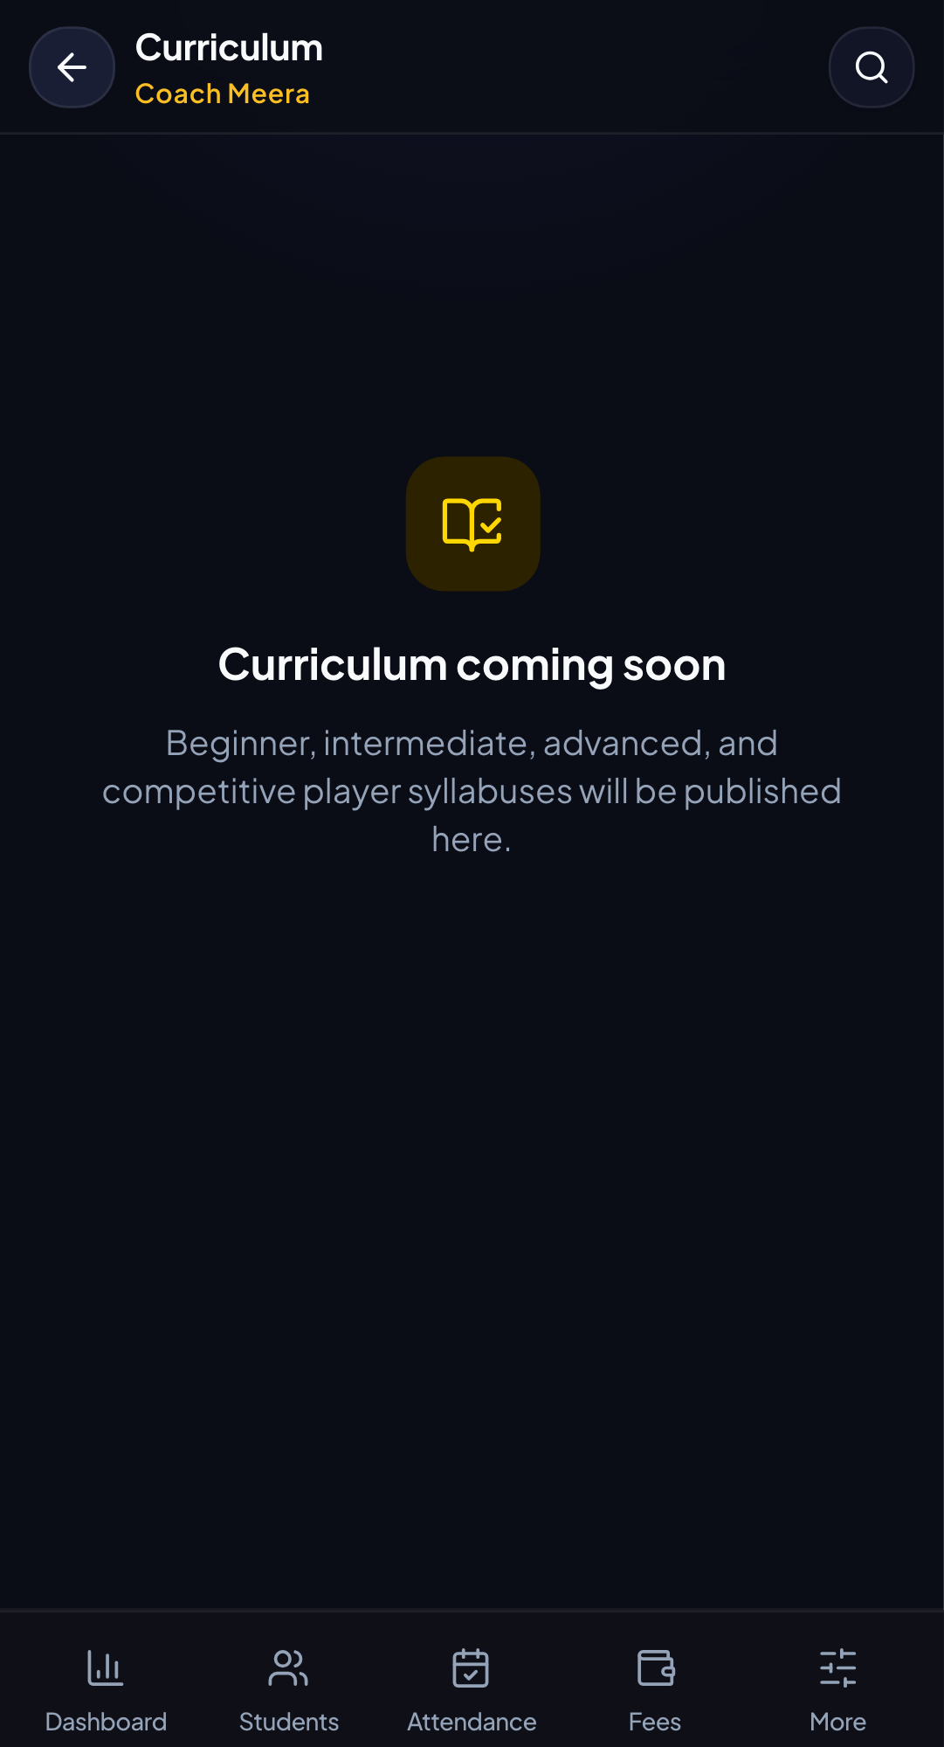
LEARNING PLAN
SCREEN 09 / 18
Curriculum
Turn coaching intent into a progression that can be revisited.
01
Progressive topics
Move from foundational skills toward stronger play.
02
Level awareness
Match content to the learner level.
03
Coach alignment
Give the team a shared teaching reference.
OPERATIONAL VALUE
Lessons become part of a consistent academy method.
KAFT CHESS ACADEMY | MOBILE WORKSPACE
Notes:
Use the screenshot slides as a visual tour. Screens were captured in the mobile test environment using fixture data, not private production records.

Slide 15
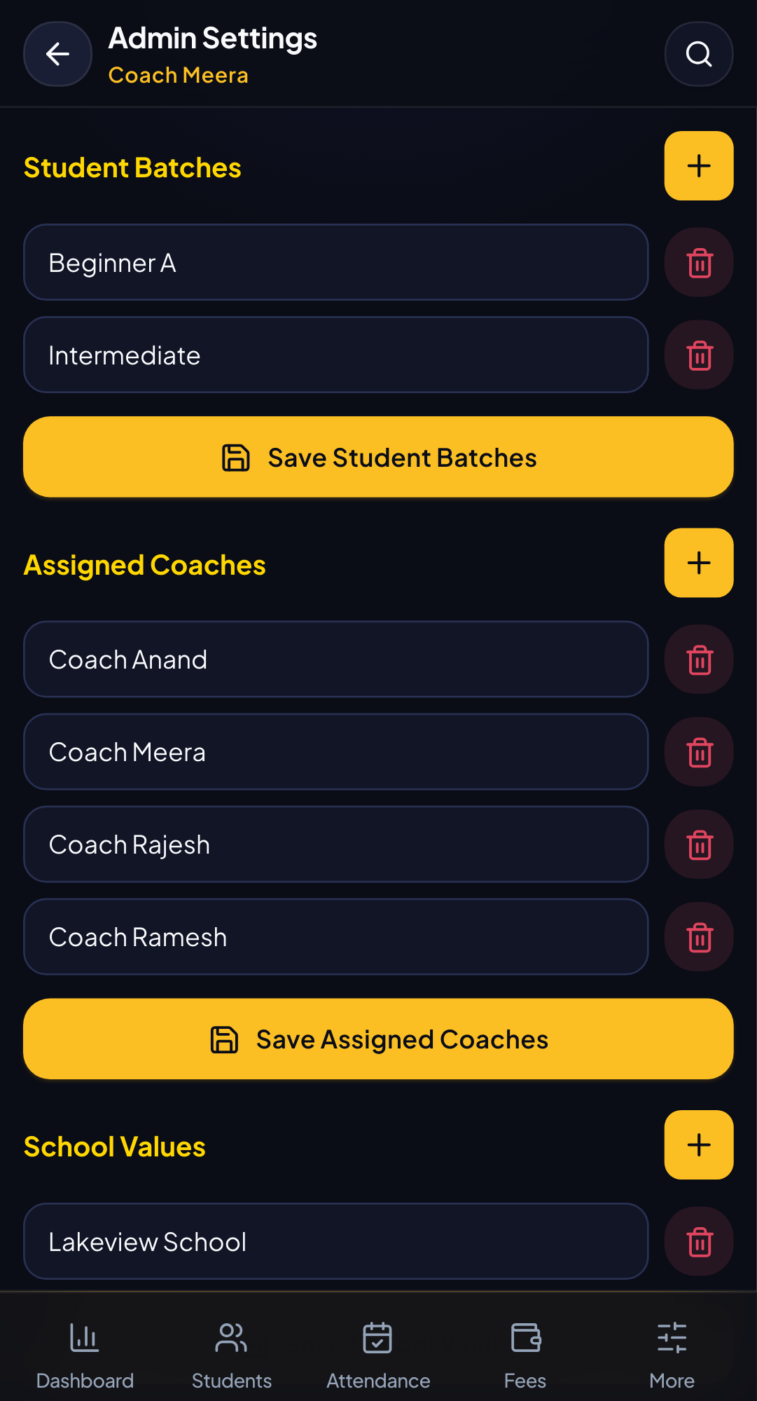
CONFIGURATION
SCREEN 10 / 18
Admin settings
Configure the lists that power the student workflow and synchronize changes to existing records.
01
Manage vocabulary
Batches, coaches, and school values stay controlled.
02
Apply changes safely
Renamed schools and assignments update existing students.
03
Reduce repetition
Configure once, reuse across the app.
OPERATIONAL VALUE
The system stays consistent as the academy grows.
KAFT CHESS ACADEMY | MOBILE WORKSPACE
Notes:
Use the screenshot slides as a visual tour. Screens were captured in the mobile test environment using fixture data, not private production records.

Slide 16
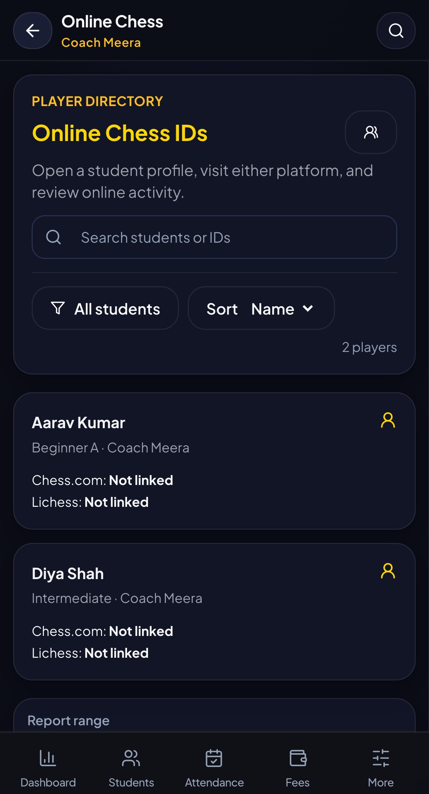
ONLINE PLAY
SCREEN 11 / 18
Online chess
Keep platform identities connected to the student roster.
01
Track IDs
Chess.com and Lichess usernames live with the student profile.
02
Search by context
Use school, batch, and other filters to find players.
03
Respect real usernames
Special characters and platform naming conventions are supported.
OPERATIONAL VALUE
Online activity becomes easier to include in coaching.
KAFT CHESS ACADEMY | MOBILE WORKSPACE
Notes:
Use the screenshot slides as a visual tour. Screens were captured in the mobile test environment using fixture data, not private production records.

Slide 17
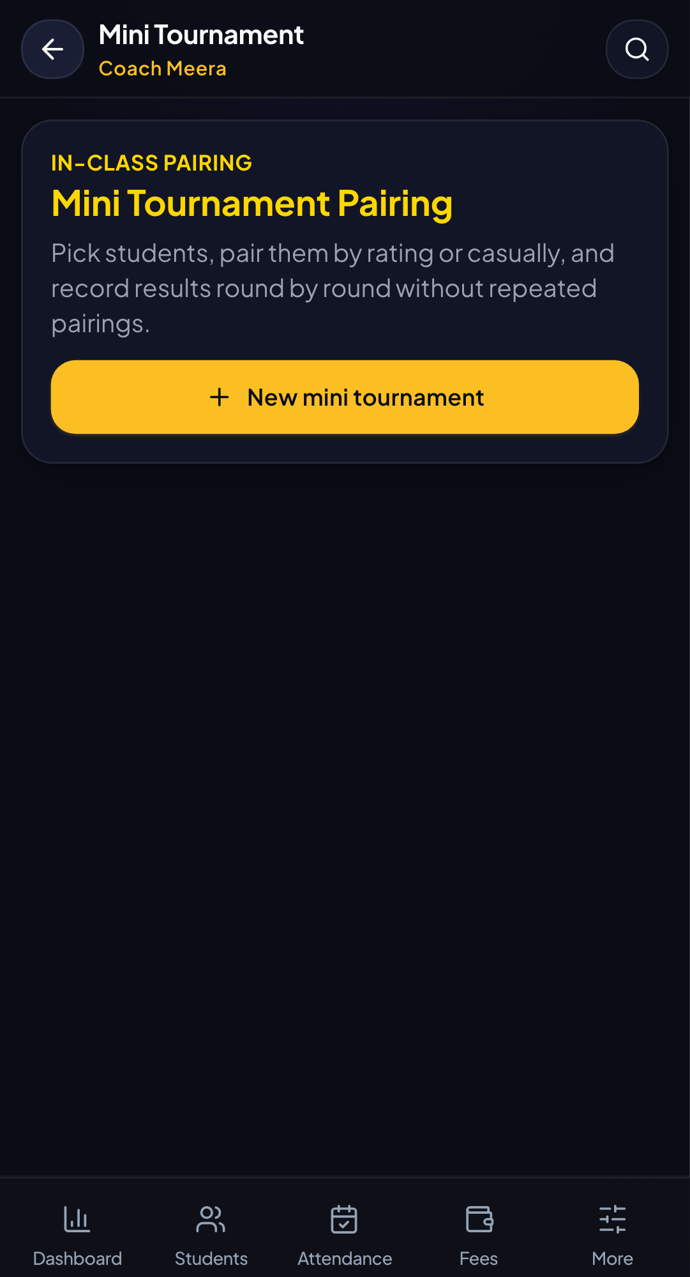
LIVE TOURNAMENT TOOL
SCREEN 12 / 18
Pairing
Run a small tournament session without leaving the academy app.
01
Create a session
Set up a compact event for the current group.
02
Pair rounds
Generate the next round from the active results.
03
Record the result
Keep the session history for later reference.
OPERATIONAL VALUE
A live event can run from one focused mobile screen.
KAFT CHESS ACADEMY | MOBILE WORKSPACE
Notes:
Use the screenshot slides as a visual tour. Screens were captured in the mobile test environment using fixture data, not private production records.

Slide 18
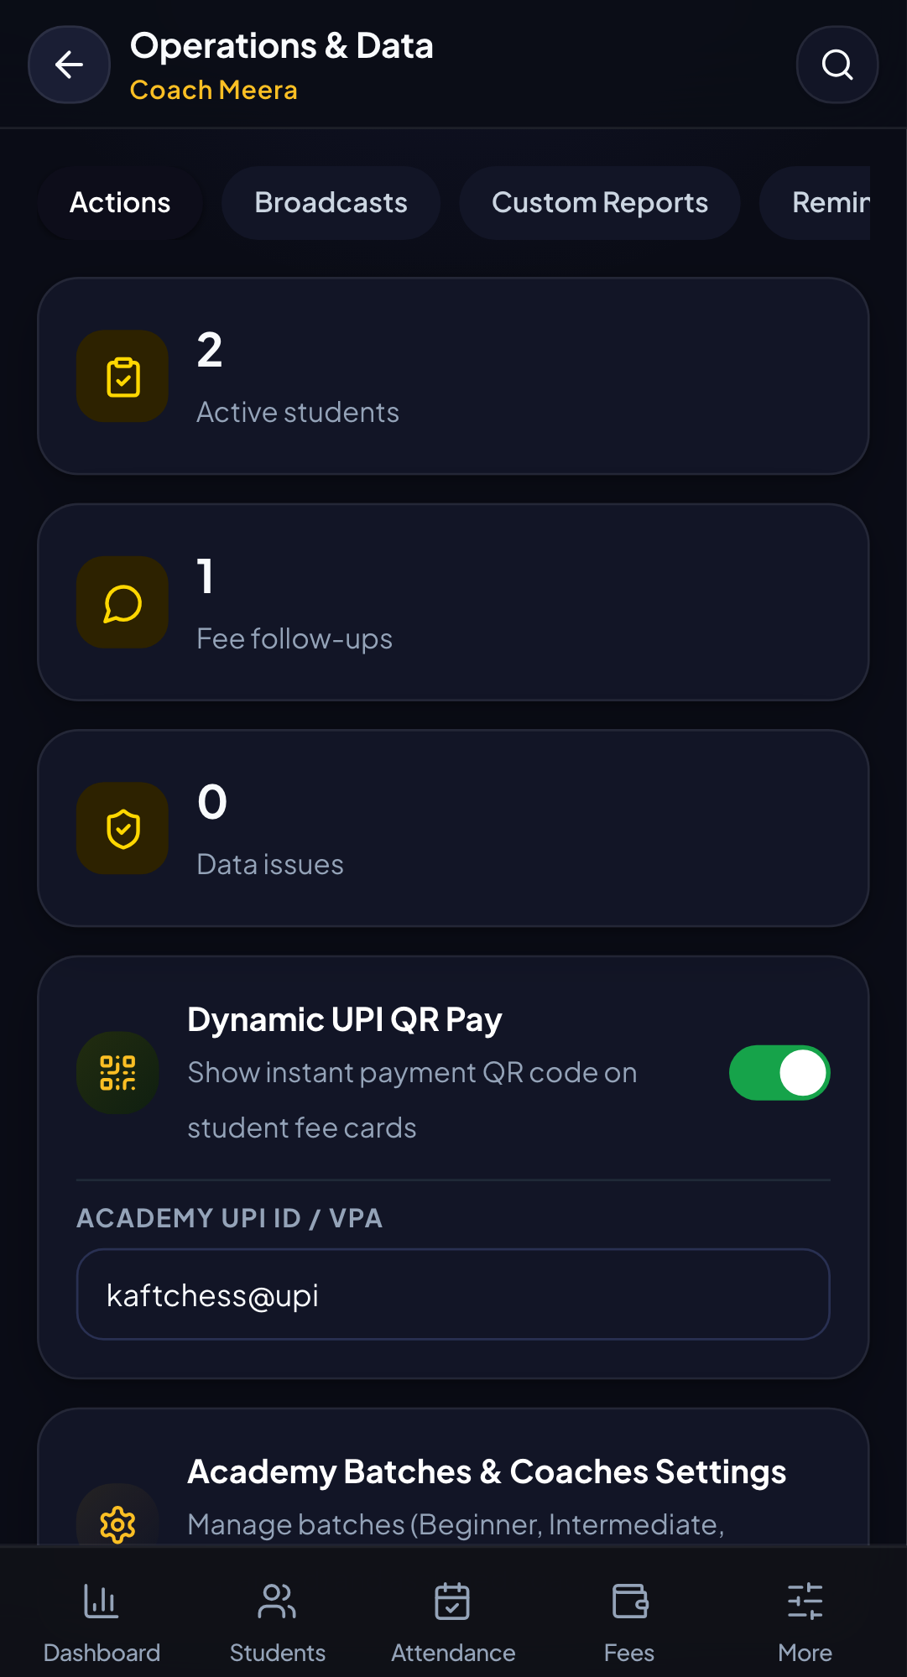
ACADEMY CONTROLS
SCREEN 13 / 18
Operations center
A control surface for operational switches and recurring tasks.
01
Control features
Turn optional workflows on or off.
02
Protect consistency
Keep operational behavior visible to the team.
03
Act quickly
Use a focused page for admin actions.
OPERATIONAL VALUE
Less hidden configuration, more operational clarity.
KAFT CHESS ACADEMY | MOBILE WORKSPACE
Notes:
Use the screenshot slides as a visual tour. Screens were captured in the mobile test environment using fixture data, not private production records.

Slide 19
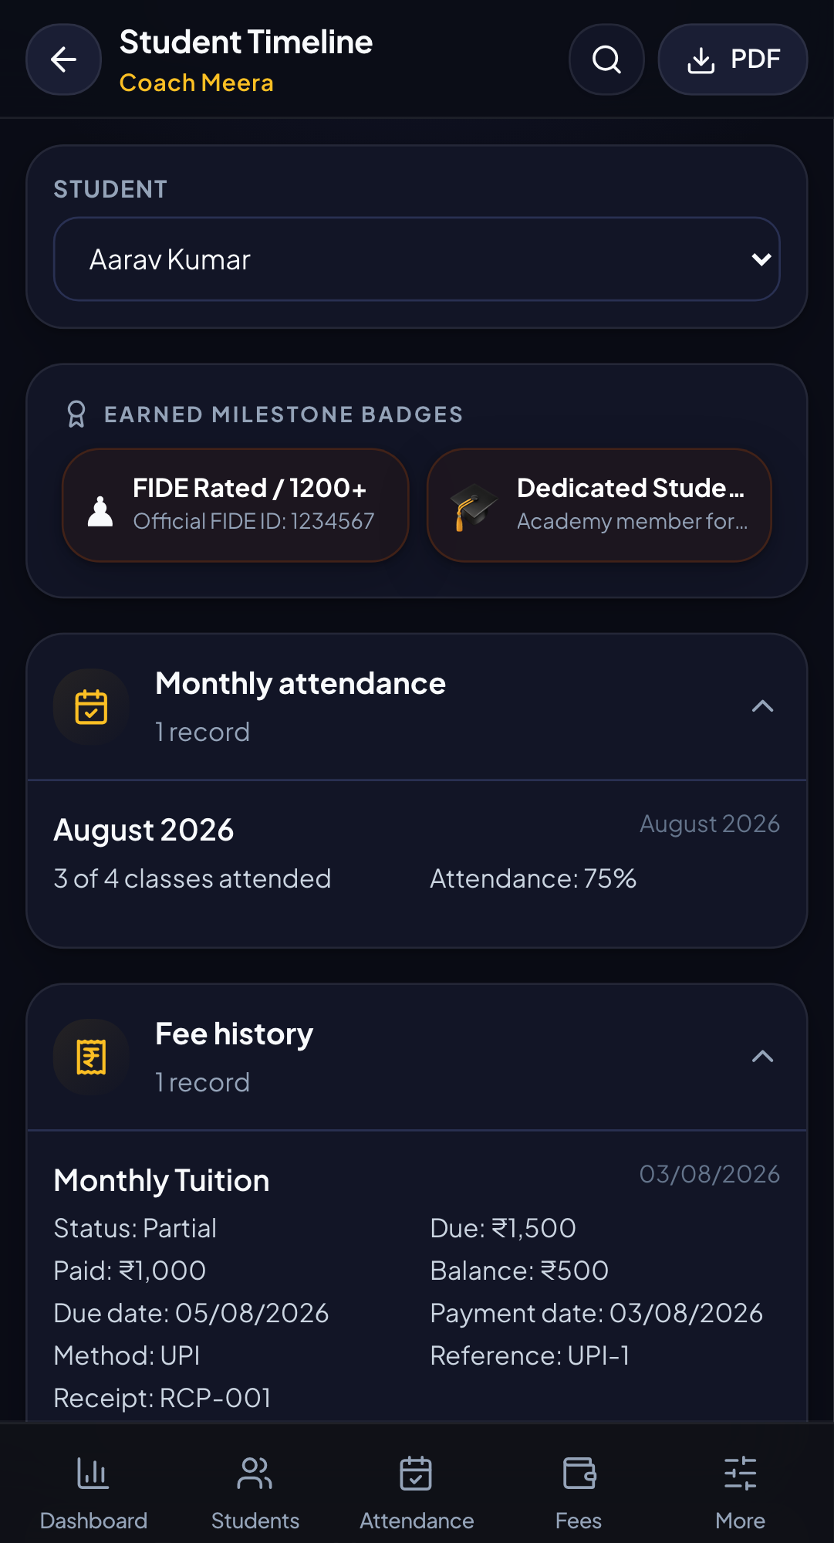
STUDENT INSIGHT
SCREEN 14 / 18
Student timeline
See the learner journey as a connected sequence of activity.
01
Read the story
Attendance, progress, and events sit in chronological context.
02
Start from a student
Open a timeline for the learner you are discussing.
03
Coach with evidence
Use history to guide the next conversation.
OPERATIONAL VALUE
A profile becomes a story, not just a row.
KAFT CHESS ACADEMY | MOBILE WORKSPACE
Notes:
Use the screenshot slides as a visual tour. Screens were captured in the mobile test environment using fixture data, not private production records.

Slide 20
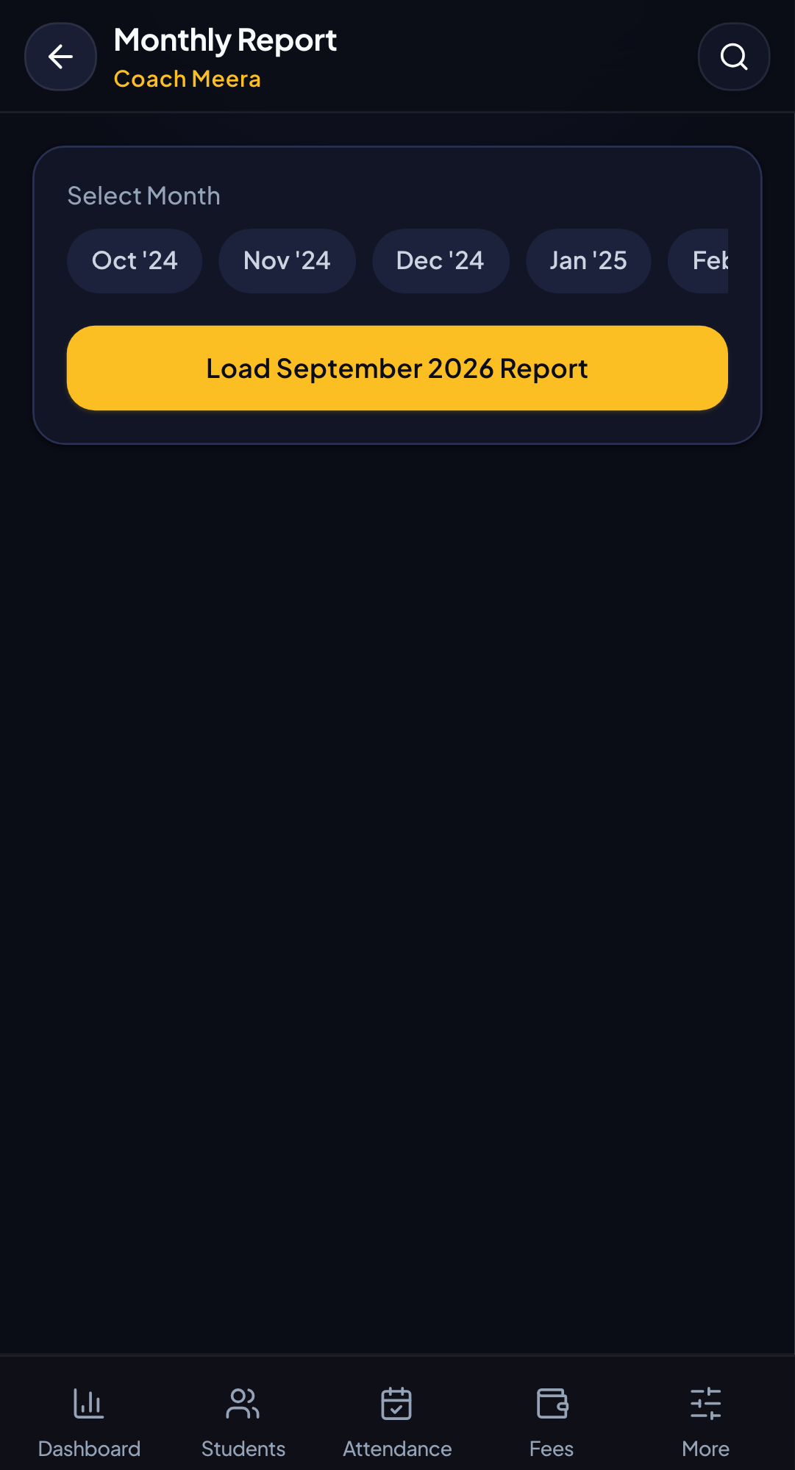
REPORTING
SCREEN 15 / 18
Monthly report
Turn the month into a shareable summary for review and communication.
01
Summarize performance
Bring together useful monthly signals.
02
Export when needed
Create a report that can leave the app.
03
Create a rhythm
Monthly review supports steady academy improvement.
OPERATIONAL VALUE
Reporting becomes a recurring management habit.
KAFT CHESS ACADEMY | MOBILE WORKSPACE
Notes:
Use the screenshot slides as a visual tour. Screens were captured in the mobile test environment using fixture data, not private production records.

Slide 21
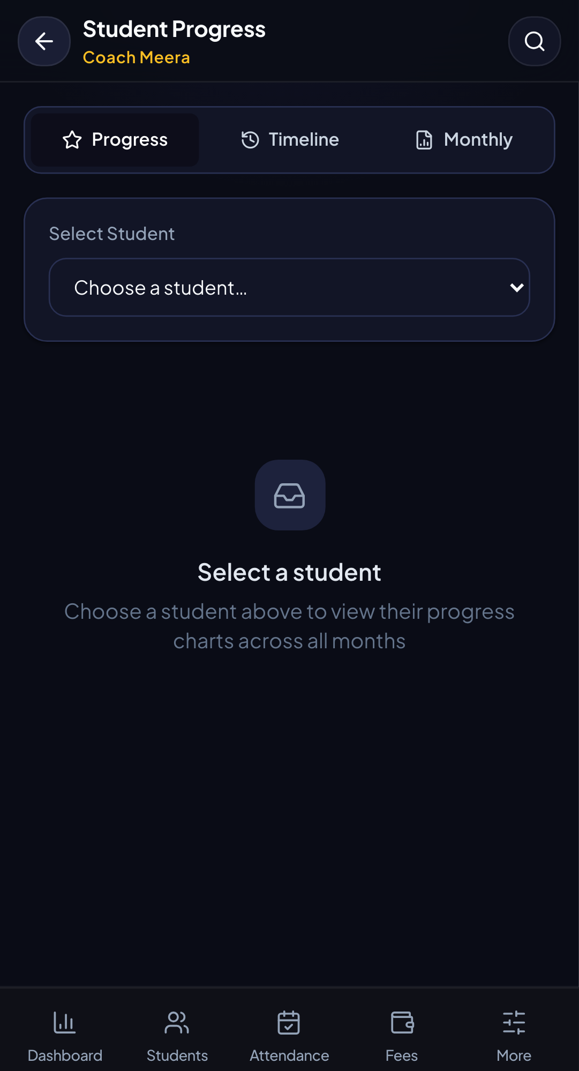
PERFORMANCE
SCREEN 16 / 18
Student progress
Combine attendance, skills, ratings, and insights around one learner.
01
Choose the learner
Navigate from the roster into focused progress.
02
Compare signals
Read performance with context instead of one isolated number.
03
Take action
Use the view to decide what to coach next.
OPERATIONAL VALUE
Better coaching starts with better context.
KAFT CHESS ACADEMY | MOBILE WORKSPACE
Notes:
Use the screenshot slides as a visual tour. Screens were captured in the mobile test environment using fixture data, not private production records.

Slide 22
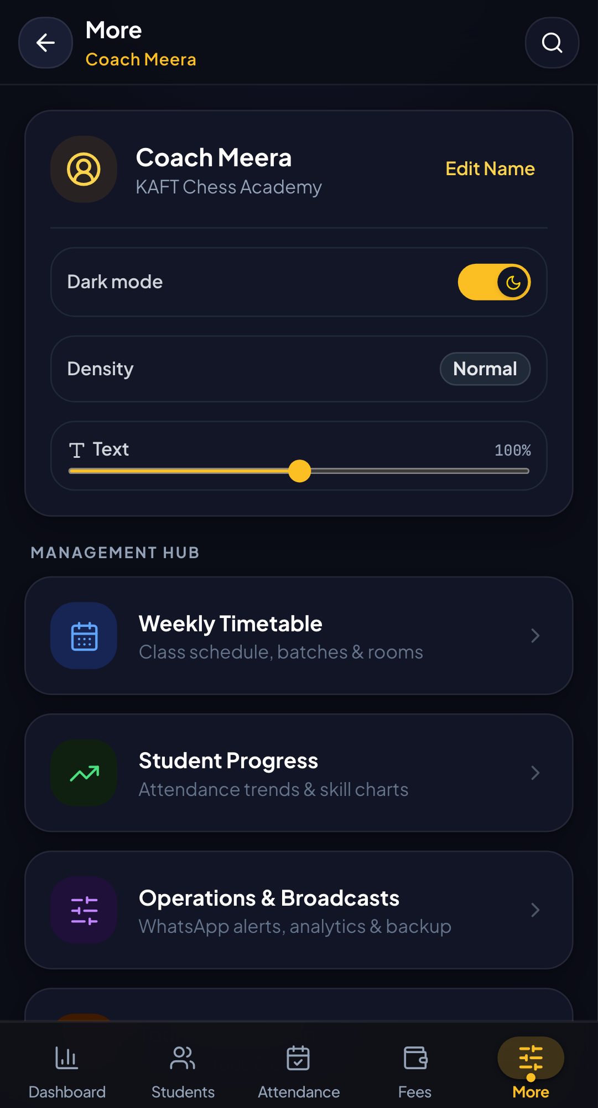
NAVIGATION HUB
SCREEN 17 / 18
More
A mobile-friendly home for secondary screens and utilities.
01
Keep primary navigation clean
Frequent actions stay easy to reach.
02
Discover the rest
Less frequent tools still have a clear home.
03
Stay touch-friendly
The mobile menu keeps the product approachable.
OPERATIONAL VALUE
A large product stays navigable on a small screen.
KAFT CHESS ACADEMY | MOBILE WORKSPACE
Notes:
Use the screenshot slides as a visual tour. Screens were captured in the mobile test environment using fixture data, not private production records.

Slide 23
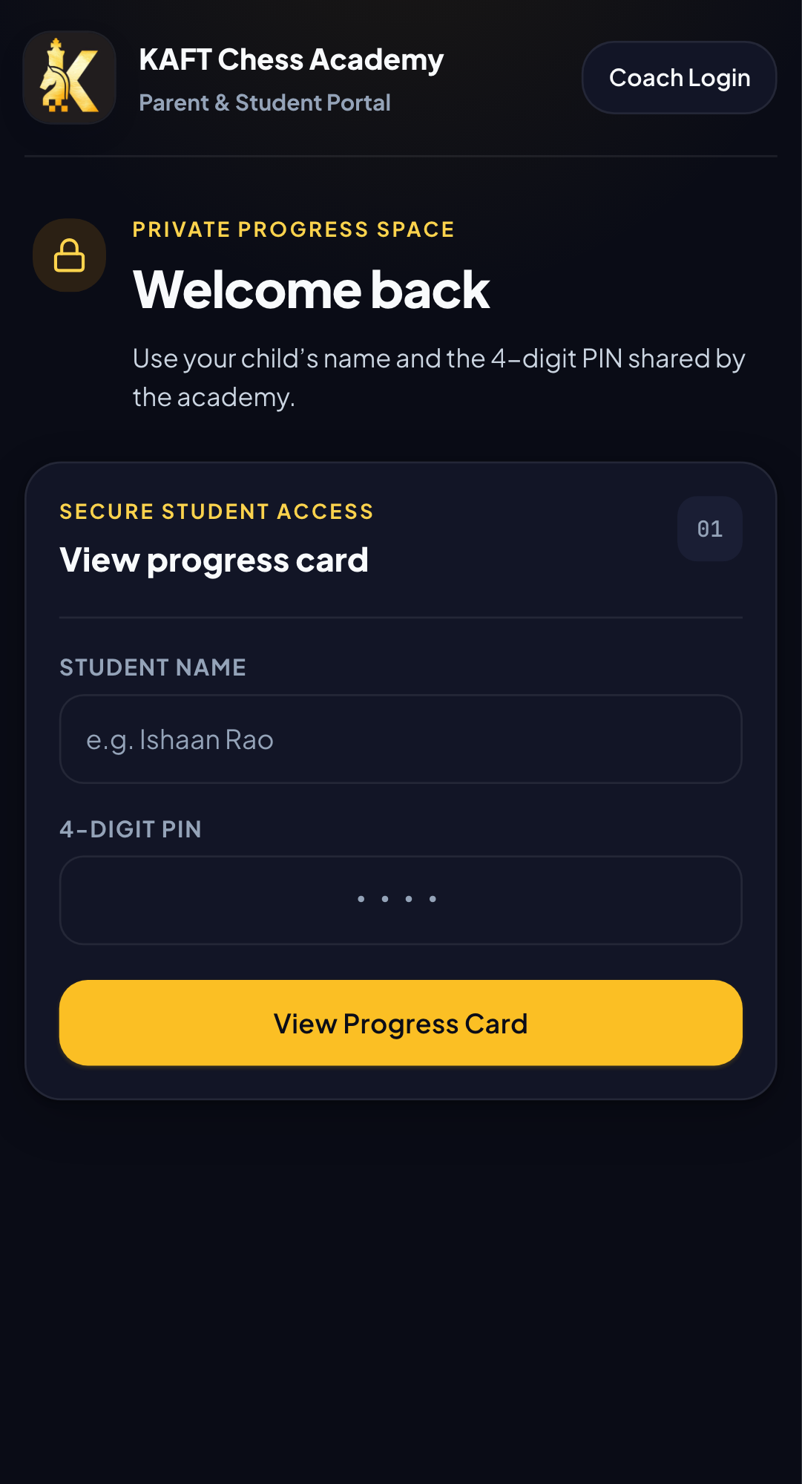
PARENT EXPERIENCE
SCREEN 18 / 18
Parent portal
A focused view for families who need clarity without the full admin surface.
01
See student context
Parents get the information relevant to their learner.
02
Make progress visible
Share useful updates in a simpler format.
03
Reduce back-and-forth
The portal supports more informed conversations.
OPERATIONAL VALUE
Families stay connected without learning the whole system.
KAFT CHESS ACADEMY | MOBILE WORKSPACE
Notes:
Use the screenshot slides as a visual tour. Screens were captured in the mobile test environment using fixture data, not private production records.

Slide 24
WHAT POWERS THE SCREENS
The data layer behind the experience
The app keeps the interface friendly while preserving the academy data in tools the team already understands.
Google Sheets
Google Drive
Mobile PWA
Students, attendance, fees, settings, tournaments, timetable, and reports use structured sheet tabs as the operational source.
Resources and uploaded documents can be connected to Drive for shared access and retrieval.
Responsive layouts, installable behavior, and touch-sized controls support the coach on the move.
Connected decisions
The value is not one isolated screen. It is the connection between roster, classes, payments, events, and progress.
KAFT CHESS ACADEMY | MOBILE WORKSPACE
Notes:
Use the screenshot slides as a visual tour. Screens were captured in the mobile test environment using fixture data, not private production records.

