Slide 1
MACHINE LEARNING
CROSS VALIDATION

Slide 2
CROSS VALIDATION
It is a technique used to protect against overfitting in a predictive model, particularly in a case where the amount of data may be limited. In cross-validation, you make a fixed number of folds (or positions) of the data run the analysis on each fold, and then average the overall error estimate.

Slide 3
Steps Of Cross-Validation
Divide data set at random into training and test sets.
Fit model on training set.
Test model on test set.
Compute and save fit statistic using test data (step 3).
Repeat 1 - 4 several times, then average results of all step 4.

Slide 4
Methods of cross validation
Validation
Leave p-out cross-validation.
Leave-one-out cross-validation.
Hold out cross-validation.
K-fold cross-validation.
Repeated random subsampling validation.
Satisfied k-fold cross-validation.
Time series cross-validation.

Slide 5
Explanation about methods of cross-validation
Validation: In this method, we perform training on the 50% of the
given data set and rest 50% is used for the testing purpose. The
major drawback of this method is that we perform training on the 50%
of the dataset, it may possible that the remaining 50% of the data
contains some important information which we are leaving while
training our model i.e higher bias.

Slide 6
2) LOOCV(Leave One Out Cross Validation)
In this method, we perform training on the whole data-set but leaves only one data-point of the available data-set and then iterates for each data point. It has some Advantages as well as Disadvantages also.
An advantage of using this method is that we make use of all data points and hence it is low bias.
Another drawback is it takes a lot of execution time as it iterates over the number of data points(n) times.

Slide 7
3) Leave p-Out Cross Validation
Leave p-out cross-validation (LPOCV) is an exhaustive cross-validation technique, that involves using p-observation as validation data, and remaining data is used to train the model. This is repeated in all ways to cut the original sample on a validation set of p observations and a training set.

Slide 8
4)Hold-out Cross Validation
The holdout technique is an exhaustive cross-validation method, that randomly splits the dataset into train and test data depending on data analysis. In the case of holdout cross-validation, the dataset is randomly split into training and validation data. Generally, the split of training data is more than test data.

Slide 9
5) K-Fold Cross-Validation
In this method, we split the data-set into k number of subsets (known as folds) then we perform training on the all the subsets but leave one subset for the evaluation of the trained model. In this method, we iterate k times with a different subset reserved for testing purpose each time.

Slide 10
Repeated Random Sub-sampling Validation
Repeated random subsampling validation also referred to as Monte Carlo cross-validation splits the dataset randomly into training and validation. Unlikely k-fold cross-validation split of the dataset into not in groups or folds but splits in this case in random.

Slide 11
Satisfied K-Fold Cross Validation
Stratified K-Folds cross-validator. Provides train/test indices to split data in train/test sets. This cross-validation object is a variation of K-Fold that returns stratified folds. The folds are made by preserving the percentage of samples for each class.

Slide 12
Time Series Cross-Validation
The method that can be used for cross-validating the time-series model is cross-validation on a rolling basis. Start with a small subset of data for training purpose, forecast for the later data points and then checking the accuracy for the forecasted data points.

Slide 13
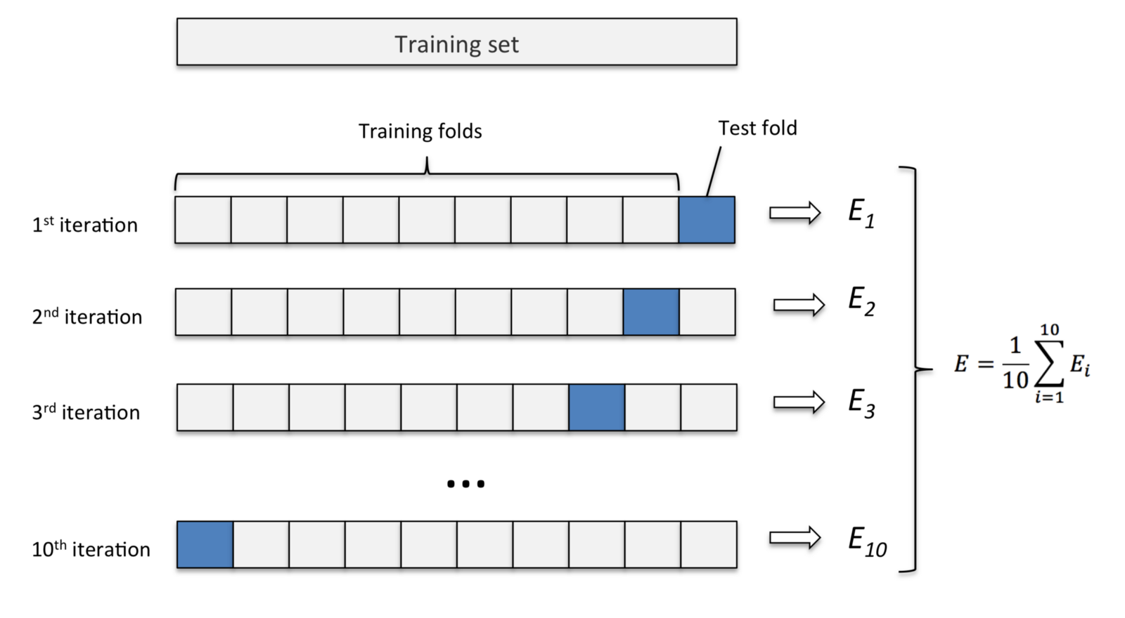

Slide 14
Advantages of Cross-Validation
More accurate estimate of out-of-sample accuracy.
More “efficient” use of data as every observation is used for both training and
testing.
This runs k time faster than leave One Out Cross-Validation because K-Fold cross-
validation repeats the train/test split k-times.
Reserve some portion of sample data-set.
Using the rest data-set train the model.
Test the model using the reserve portion of the data-set.
Disadvantage of Cross-Validation
The training algorithm has to be rerun from scratch k times, which means it takes k times as much computation to make an evaluation. A variant of this method is to randomly divide the data into a test and training set k different times.

Slide 15
Why do we prepare using k-Fold cross validation over other methods.
K-fold cross validation is one way to improve the holdout method. This method guarantees that the score of our model does not depend on the way we picked the train and test set. The data set is divided into k number of subsets and the holdout method is repeated k number of times.

