Slide 1
MACHINE LEARNING Support Vector machine
Submitted by : Pramod P Kulkarni
Nov 25th (BDS) Batch

Slide 2
Support Vector Machine (SVM)
Support Vector Machine (SVM) is a supervised machine learning algorithm capable of performing classification, regression and even outlier detection. The linear SVM classifier works by drawing a straight line between two classes.

Slide 3
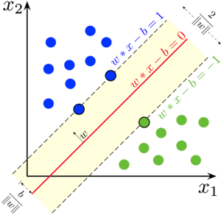
SVM Algorithm
Maximum
Margin
+ve hyperplane
Maximum
Margin
Hyperplane
-ve hyperplane
Support Vectors

Slide 4
Advantages of Support Vector Machine
Effective in high dimensional cases.
Still effective in cases where number of dimensions is greater than the number of samples.
Its memory efficient as it uses a subset of training points in the decision function called support vectors.
Different kernel functions can be specified for the decision functions and its possible to specify custom kernels.

Slide 5
Types of SVM
Linear support vector machine(LSVM)
LSVM is used for linearly separable data, which means if a dataset can be classified into two classes by using a single straight
line, then such data is termed as linearly separable data, and
classifier is used called as LSVM classifier.
Maximum
Margin
+ve hyperplane
Maximum
Margin
Hyperplane
-ve hyperplane
Support Vectors

Slide 6
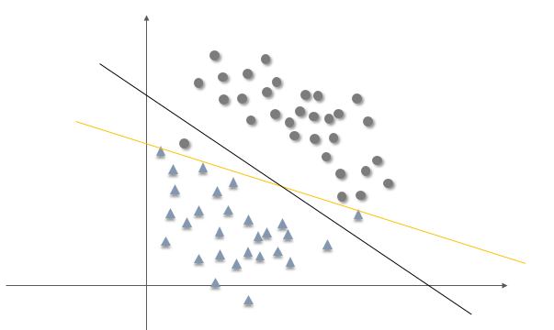
Non-Linear SVM (NLSVM)
Non-Linear SVM is used for non-linearly separated data, which means if a dataset cannot be classified by using a straight line, then such data is termed as non-linear data and classifier used is called as non-linear SVM classifier.

Slide 7
Hyperplane :
There can be multiple lines/decision boundaries to segregate the classes in n-dimensional space, but we need to find out the best decision boundary that helps to classify the data points. This best boundary is known as the hyperplane of SVM.
The dimensions of the hyperplane depend on the features present in the dataset, which means if there are 2 features then hyperplane will be straight line. And if there are 3 features then hyperplane will be 2D plane.
Decision boundary that helps to classify the data points.
We always create a hyperplane that has a maximum margin, which means the maximum distance between the data points.
The hyperplane with maximum margin is called optimal hyperplane.

Slide 8
Support Vector :
The data points or vectors that are the closest to the
hyperplane and which affect the position of the hyperplane are termed as support Vector. Since these vectors support the hyperplane, hence called as support vector.
Margin:
The distance between the support vectors and the
hyperplane is called as margin and the goal of SVM is to
maximize this margin.

Slide 9
Kernel Trick and Function :
A kernel transform a low dimensional input data space into a higher
dimensional space .
It converts non-linear separable problems to linear separable problems by adding more dimension to it . Thus the kernel trick helps us to build a more accurate classifier, hence it is useful in non-linear separation problems.
In the context of SVMs, there are 4 popular kernels namely linear Kernel , Polynomial kernel, Radial Bias function Kernel (RBF) and Sigmoid Kernel.
Kernel function will convert 1D NLSVM into 2D or 3D into
3D NLSVM then fits hyperplane and converts into LSVM.

Slide 10
Pros and Cons of SVM
Pros :
It works really well with a clear margin of separation. It is effective in HD spaces.
Cons :
It doesn’t perform well when we have large data set because the required training time is higher.

Slide 11
Application of SVM
Face Detection : SVM classified parts of the image as a face and
non face and create a square boundary around the face.
Text and Hypertext categorization : They use training data to classify
documents into different categories. It categorizes on the basis of the score generated and then compares with the threshold value.
It uses training data to classify documents into different categories
such as news articles, e-mails, and web pages.
It is used in text and hypertext categorization.
Examples:
Classification of news articles into ‘Business’ and ‘Movies’
Classification of web pages into personal home pages and others

