Slide 1

Tableau
Introduction to tableau

Slide 2
BI Tools
BI Tools are intelligent enough to convert raw data into meaningful
Information. We will use Tableau as BI Tool to convert raw data into
Meaningful information.
Data visualization is a pictorial representation of the data.
Why these visualization tools are in demand because it is human
Phenomenon that our process more on visual than text.

Slide 3
Tableau
Tableau is a data visualization tool or business intelligence tool which analysis and
shows data in the form of a chart or report. It is very easy to use, because it does not
Require any programming skill.
Tableau is a powerful data visualization tool. Tableau helps us to analyze the raw data
in (pictorial form) or in the form of the visual manner; it may be a graph, report, etc.
Data analysis is very fast with Tableau, and the visualizations created are in the form of worksheets and dashboards.

Slide 4
Several options of the start page of tableau desktop
The start page consists of 3 panes : Connect, Open, Discover
Connect : It is used to connect to data and open saved data sources
under to a file, we can connect to the data stored on Microsoft Excel files,
text files, Access files, Tableau extract files, and statistical files.
Under to a server, we can connect to the data stored in databases like
Microsoft SQL Server or Oracle.
2) Open: Open recent workbooks, pin workbooks to the start page, and
explore sample workbooks.
Explore sample workbooks: Open and explore sample workbooks.
3)Discover: In the discover section, we get short tutorial provided by tableau
community. Important blogs or also some important work done by all
contributor in tableau gcommunity .

Slide 5
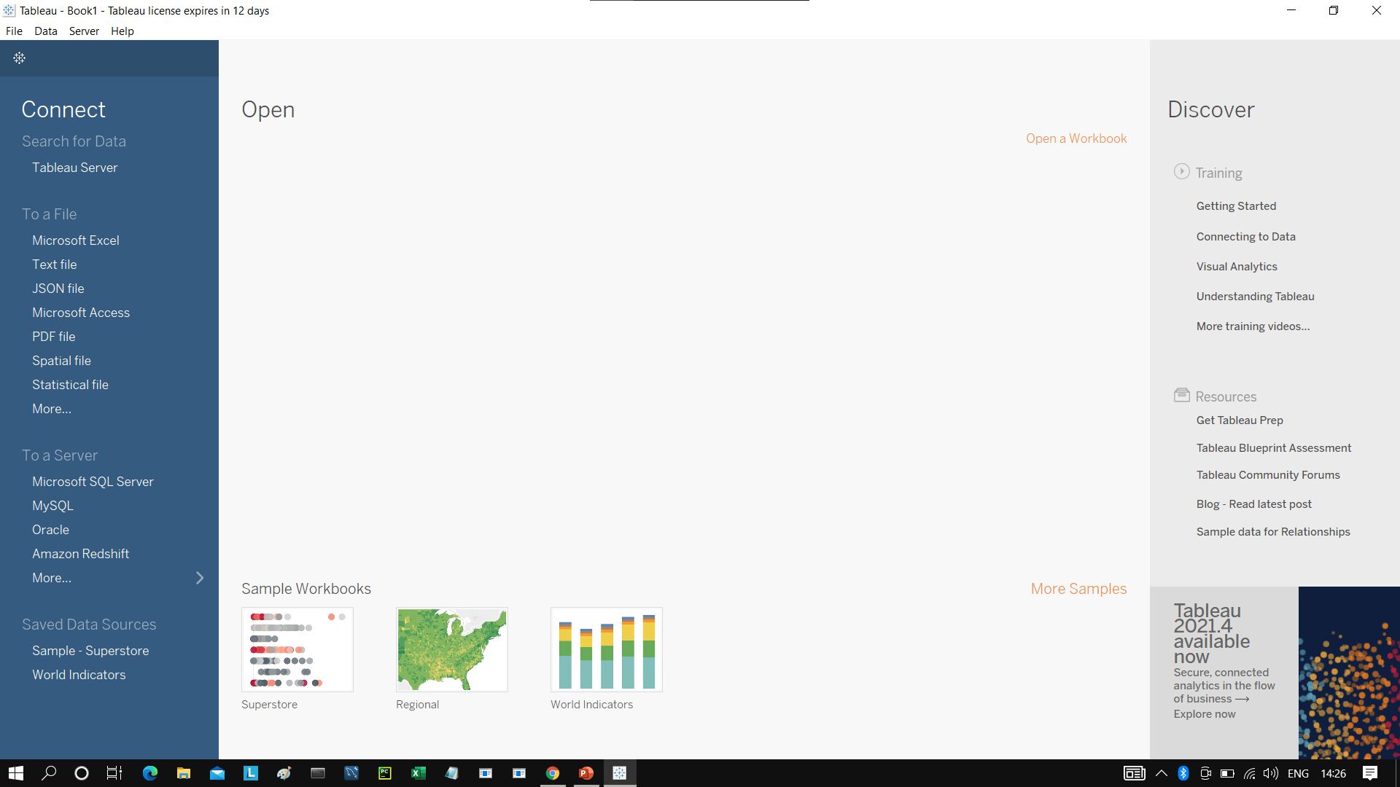
Toggle

Slide 6
The steps of process flow of BI Project.
Business Understanding
Data Understanding
Data Preparation
Modeling
Evaluation
Deployment

Slide 7
Business Understanding : This where the Business problem is defined,
Understanding the business problem is key in coming up with a good model
Because it makes you understand the Business objective.
Data Understanding :A correct solution to the problem involves a correct
Understanding of the problem.
Data Preparation : Data Preparation is the process of cleaning and
transforming raw data prior to processing and analysis.
Modeling : It is the process of creating a data model for the data to be
stored in a database.
Evaluation : It includes identification of research aim, presence of a
research question, type of methodology, data collection processes,
sample information, data analysis techniques and study outcomes.
Deployment : It means sharing our reports to the concern stake holders
or the business owner.

Slide 8
Important part.. Every component of this BI project revolve around one thing
and that is data.
This data understanding starts at business understanding and ends at
deployment.
This is the golden rule if initiating any BI Project in your company or in any organization.

