Slide 1
Tableau
01_Scenarios

Slide 2
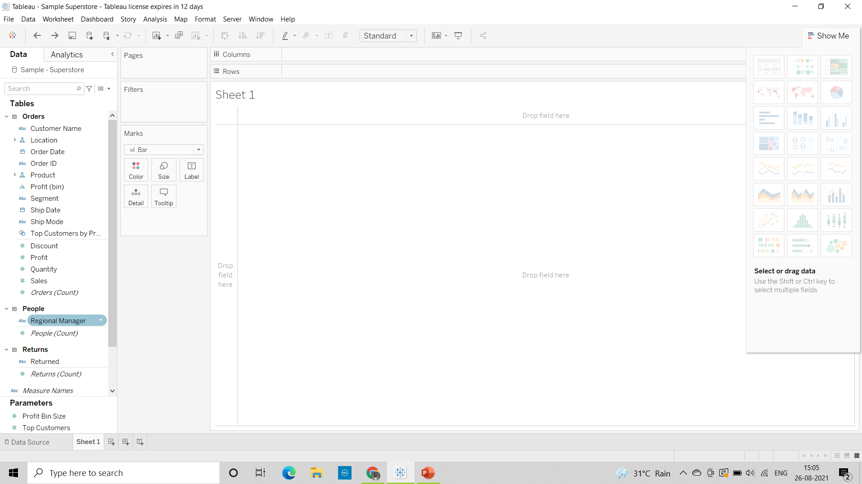
Superstore dataset This is the workspace of tableau to perform various actions and to get meaningful insights from graphs. On the left side we have different dimension and measures columns. On right side we have there is a show me option which represents different graphs.

Slide 3
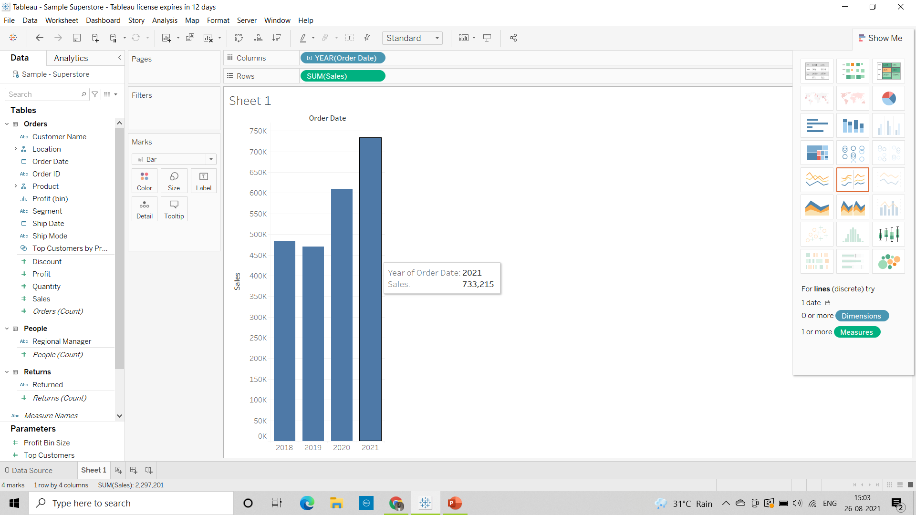
Scenarios:
1) Find the sales for every year and find the highest sales and lowest show the view in bar graph.
The sales for year 2018 - 484,247
2019 - 470,533
2020 - 609,206
2021 - 733,215
The highest sales are 733,215 for
2021
which is represented in bar graph

Slide 4

2) Add label to your view.

Slide 5
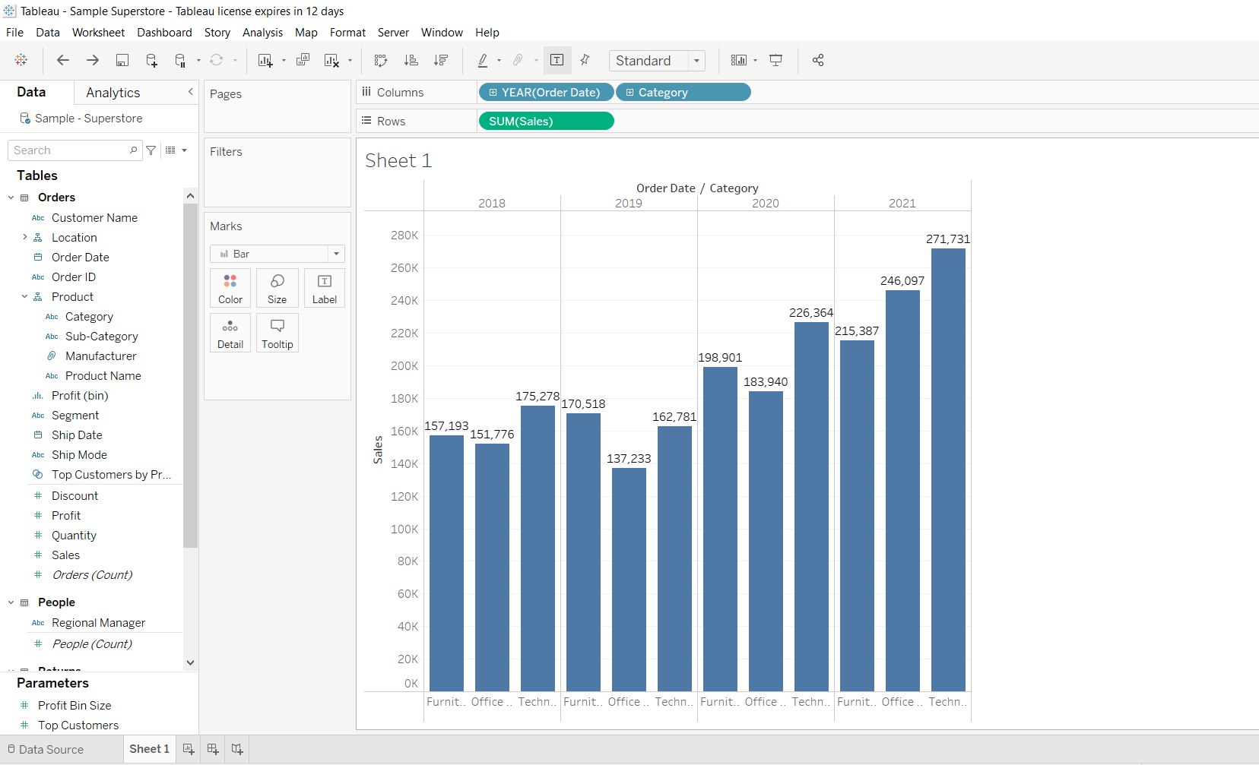
3)Find the category wise sales for every year.
In this data
we have 3
categories that
are Furniture,
Office Supplies,
Technology

Slide 6
4) Which category has the highest sale in the year 2020 and 2021 ?
Technology has highest sales in the year 2020 and 2021
5. Based on the analysis of the year 2020 & 2021. give some suggestions to improve Sales in the year 2022.
We can see there is a growth in Furniture Category from 2020 to 2021 we can expect the same in the further year 2022
There is a huge increment in Office Supplies from 2020 to 2021 which is a good sign we can say it will increase in the 2022 as well
Same for technology category also we can expect the higher sales in 2022
we can focus mainly on Office Supplies and technology categories because they are increasing every year to increase the sales in 2022

Slide 7
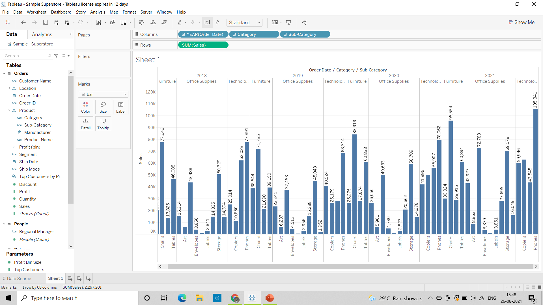
6) Display subcategory and find some insights from the view about max and min sales under every category.

Slide 8
In the year 2018
for furniture category: min sales are 13,826 for furnishings sub category
max sales are 77,242 for chairs sub category
for Office Supplies Category: min sales are 661 for Fasteners subcategory
max sales are 50,329 for storage subcategory
for Technology Category: min sales are 10,850 for copiers sub category
max sales are 77,391 for phones sub category
In the year 2019
for furniture category: min sales are 21,090 for furnishings sub category
max sales are 71,735 for chairs sub category
for Office Supplies Category: min sales are 545 for Fasteners subcategory
max sales are 45,048 for storage sub category
for Technology Category: min sales are 26,179 for copiers sub category
max sales are 68,314 for phones sub category
In the year 2020
for furniture category: min sales are 26,275 for BookCases subcategory
max sales are 83,919 for chairs sub category
for Office Supplies Category: min sales are 960 for Fasteners
subcategory
max sales are 58,789 for storage sub category
for Technology Category: min sales are 41,896 for Accessories
sub category
max sales are 78,962 for phones sub category
In the year 2021
for furniture category: min sales are 28,915 for Furnishings
sub category
max sales are 95,554 for chairs sub category
for Office Supplies Category: min sales are 858 for Fasteners
sub category
max sales are 72,788 for Binders sub category
for Technology Category: min sales are 43,545 for Machines
sub category
max sales are 105,341 for phones sub category

Slide 9
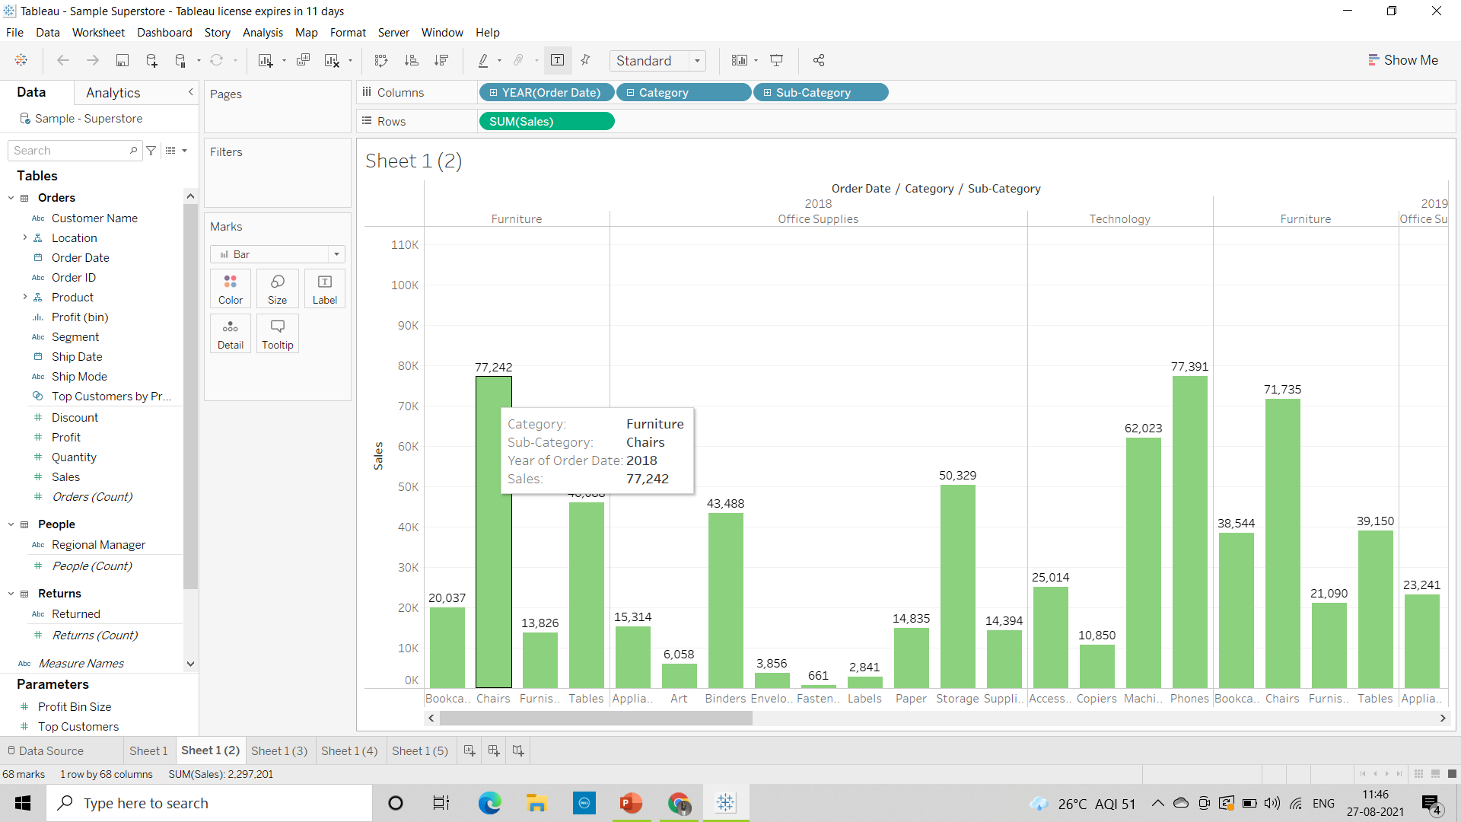
7)Check the Tooltip. Tooltip gives the complete information about that particular bar

Slide 10
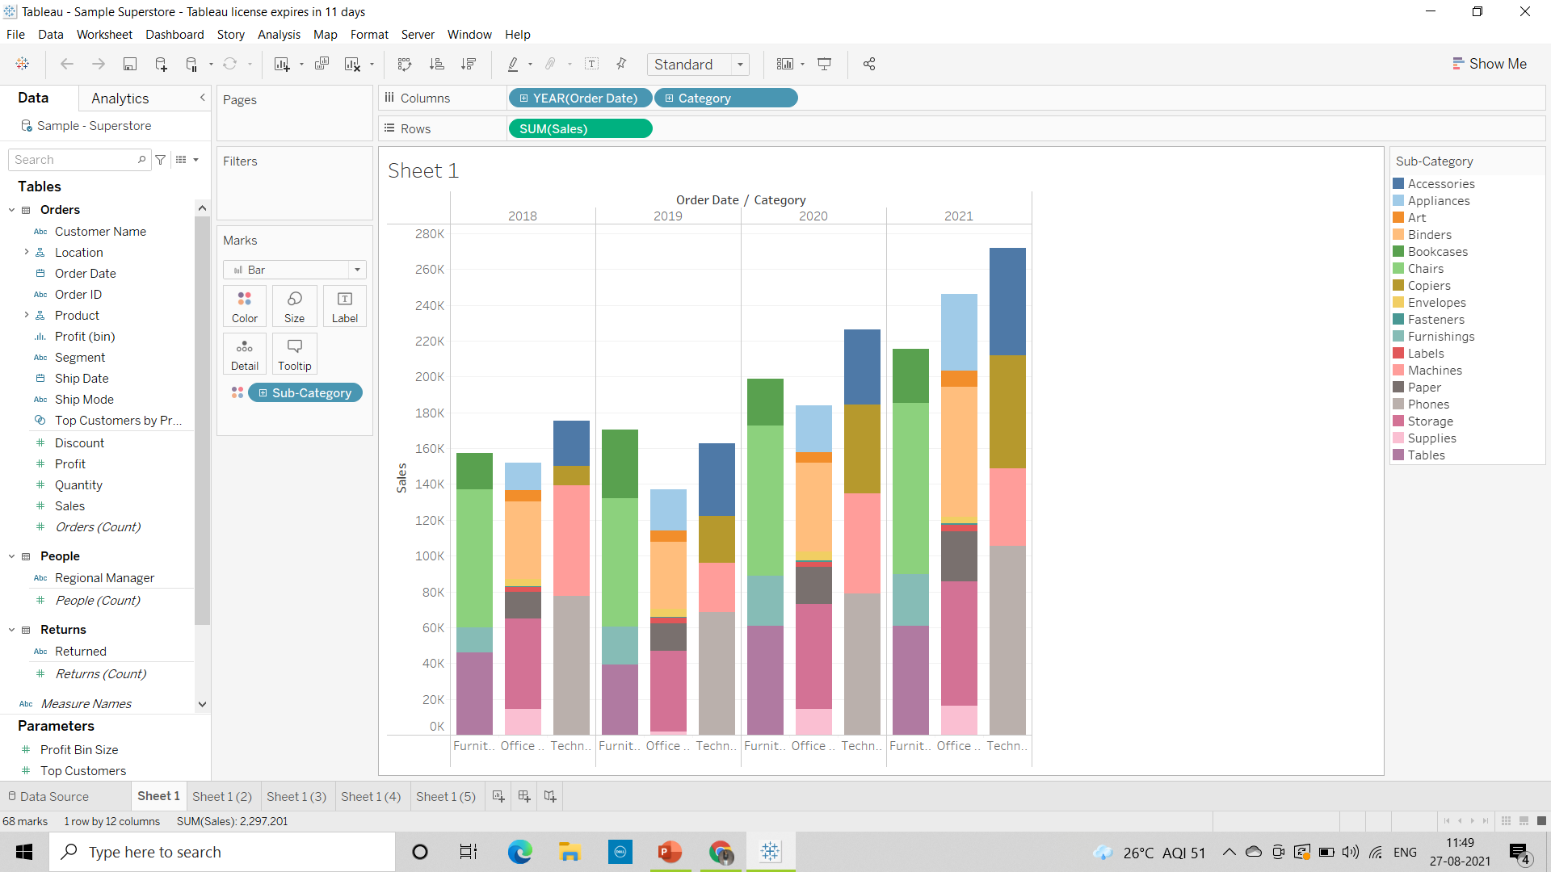
8. In your bar graph, present subcategory under each bar of category using color card

