Slide 1
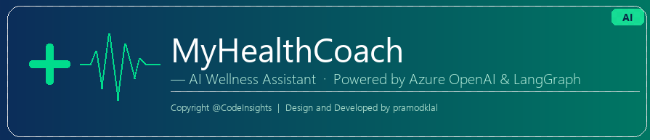
Build an AI Health Coach with Agentic AI
LangGraph · Azure OpenAI · Streamlit · LangSmith Supervisor + Specialist Multi-Agent Architecture in Python
github.com/pramodklal/AgenticAI

Slide 2
What We Cover in This Video
▸ What is Agentic AI — and why it matters
▸ ReAct pattern and Supervisor + Specialist architecture
▸ LangGraph state machine and graph workflow code
▸ Domain-scoped specialist agents with tools
▸ Streamlit UI, user profile, and session state
▸ Azure OpenAI · AI Search · Cosmos DB integrations
▸ LangSmith tracing and custom evaluation scoring
▸ Doctor lookup — US (NPI Registry) and India (Overpass API)
▸ Batch regression testing and feedback pipeline
▸ Live demo: pre-diabetic patient query end-to-end
Copyright@CodeInsights | Code: github.com/pramodklal/AgenticAI

Slide 3
SECTION 01
Agentic AI Concepts
From single LLM call to multi-step orchestration

Slide 4
Regular AI Call vs Agentic AI
Regular LLM Call
Agentic AI System
▸ User sends a message
▸ Model returns a single text answer
▸ One step — no tools, no state
▸ Limited by training data only
▸ No observability of reasoning
▸ User sends a message
▸ Supervisor reasons about intent
▸ Delegates to the right specialist
▸ Specialist calls tools for real data
▸ Synthesizes grounded, safe response
▸ Every step is traced and scored

Slide 5
ReAct Pattern — Reason, Act, Observe
▸ ReAct = Reasoning + Acting in an interleaved loop
▸ Step 1 — Reason: What information do I need to answer this?
▸ Step 2 — Act: Call the appropriate tool (sleep summary, nutrition docs…)
▸ Step 3 — Observe: Integrate the tool result into reasoning context
▸ Repeat until enough evidence is gathered
▸ Final step — Synthesize: Generate structured, grounded response
▸ Benefit: explainable, evidence-backed advice instead of hallucinated text
Used in both supervisor and all 6 specialist agents in MyHealthCoach

Slide 6
Supervisor + Specialist Architecture
▸ One supervisor agent handles intent classification and routing
▸ Seven specialist agents each own a health domain:
wellness · fitness · dietitian · medicines · mental_health · maternal_health · women_health
▸ Each specialist gets only the tools it needs — no bleed between domains
▸ Supervisor receives specialist results and synthesizes the final answer
▸ Benefits: modularity, testability, domain-safe tool scoping, explainability
Defined in react_executor.py — DOMAIN_TOOLSETS and DOMAIN_INSTRUCTIONS

Slide 7
All 8 Agents in MyHealthCoach
Each agent has a focused role and the supervisor coordinates the final response.
Supervisor Agent
Routes intent to the right specialists and combines outputs.
Ensures grounded, safe, and structured final response.
Medicines Agent
Handles symptom-aware OTC guidance and medicine safety.
Adds red-flag escalation when serious symptom patterns appear.
Wellness Agent
Handles sleep, recovery, stress, and fatigue guidance.
Uses user context and wellness knowledge for daily habits.
Mental Health Agent
Handles anxiety, mood support, and stress de-escalation.
Suggests supportive routines and when to seek licensed help.
Fitness Agent
Handles workouts, training load, and movement safety.
Suggests exercise adjustments based on recovery readiness.
Maternal Health Agent
Handles prenatal and postpartum-safe guidance.
Emphasizes low-risk routines with explicit escalation notes.
Dietitian Agent
Handles nutrition, hydration, and meal-planning advice.
Provides practical, goal-aligned dietary recommendations.
Women Health Agent
Handles cycle-related wellness, PCOS, and menopause topics.
Adapts activity and nutrition to symptom patterns.

Slide 8
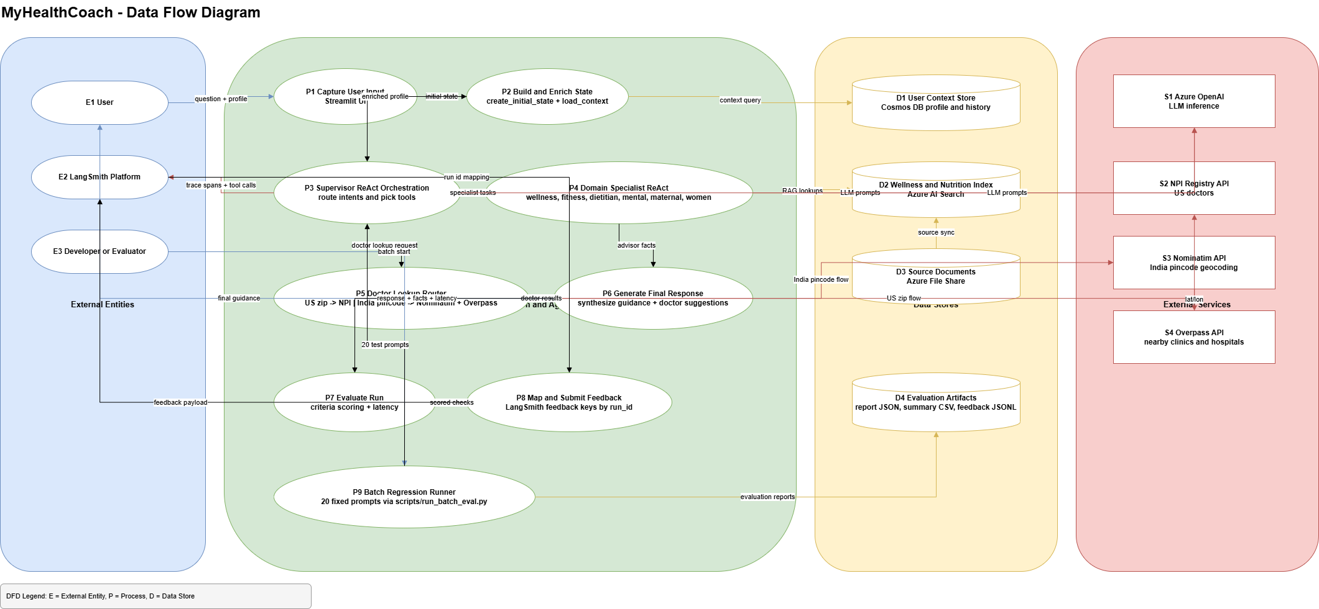

Data Flow Architecture — Request to Response
Architecture Diagram

Slide 9
SECTION 02
Code Walkthrough
LangGraph · State · Nodes · Agent tools

Slide 10
LangGraph State — HealthCoachState
# src/healthcoach/graph/state.py
class HealthCoachState(TypedDict):
conversation_id : str
user_id : str
user_message : str # the question from the user
user_profile : dict # age, gender, goal, zip, diet pref
context : dict # loaded from Cosmos DB / stub
collected_facts : dict # domain facts gathered by specialists
final_response : str # synthesized answer returned to UI
💡 Every node reads from and writes to this shared typed dict — no globals, no side effects

Slide 11
LangGraph Workflow — build_graph()
# src/healthcoach/graph/workflow.py
from langgraph.graph import END, StateGraph
from healthcoach.graph.nodes import load_context, supervisor_agent
def build_graph():
graph = StateGraph(HealthCoachState)
graph.add_node('load_context', load_context) # enrich state
graph.add_node('supervisor', supervisor_agent) # route + orchestrate
graph.set_entry_point('load_context')
graph.add_edge('load_context', 'supervisor')
graph.add_edge('supervisor', END)
return graph.compile()
💡 Deterministic execution: load_context → supervisor → END. Extendable to conditional branches.

Slide 12
Specialist Tool Scoping — DOMAIN_TOOLSETS
# src/healthcoach/agents/react_executor.py
DOMAIN_TOOLSETS = {
'wellness' : ('sleep_summary', 'wellness_docs', 'user_context'),
'fitness' : ('workout_summary', 'sleep_summary', 'user_context'),
'dietitian' : ('nutrition_docs', 'user_context'),
'mental_health' : ('wellness_docs', 'user_context'),
'maternal_health': ('nutrition_docs', 'wellness_docs', 'user_context'),
'women_health' : ('wellness_docs', 'nutrition_docs', 'user_context'),
}
💡 Each specialist only sees its scoped tools — prevents hallucination bleed between domains

Slide 13
Creating a ReAct Specialist Agent
# src/healthcoach/agents/react_executor.py
from langgraph.prebuilt import create_react_agent
def run_domain_react(domain: str, state: HealthCoachState):
llm = get_chat_model() # Azure OpenAI gpt-4o
tools = _build_tools(state) # all available tools
scoped_tools = [t for t in tools # filter to domain only
if t.name in DOMAIN_TOOLSETS[domain]]
agent = create_react_agent(
model=llm, tools=scoped_tools, prompt=system_prompt
)
result = agent.invoke({'messages': [HumanMessage(content=user_msg)]})
💡 LangGraph prebuilt create_react_agent handles the Reason → Act → Observe loop automatically

Slide 14
SECTION 03
Streamlit UI & User Profile
app.py — profile capture · state · chat flow

Slide 15
Streamlit UI — app.py
▸ Sidebar captures: User ID, Gender, Age, Zip/Pincode, Goal, Dietary Preference
▸ Chat input sends query to LangGraph graph via graph.invoke(initial_state)
▸ Initial state created with create_initial_state() — merges UI values into typed dict
▸ Agent response displayed in Streamlit chat_message block
▸ 'Show agent facts' toggle reveals collected facts + evaluation scores
▸ Latency timer shows end-to-end response time in milliseconds
app.py — uses @st.cache_resource to build graph once per session

Slide 16
SECTION 04
Azure Integrations
OpenAI · AI Search · Cosmos DB · Storage

Slide 17
Azure Service Integrations
▸ Azure OpenAI (gpt-4o): powers supervisor and all 6 specialist ReAct agents
▸ Azure AI Search: semantic retrieval of wellness and nutrition document indexes
wellness-index and nutrition-index — grounded evidence for specialist tools
▸ Azure Cosmos DB: conversation state, user profiles, workout logs
▸ Azure Storage (File Share): raw wellness document hosting before indexing
▸ Application Insights: telemetry and connection string in .env.example
▸ All credentials via .env — .gitignore excludes .env from commits
Graceful fallback: app runs in demo mode when Azure credentials are not configured

Slide 18
SECTION 05
Evaluation & LangSmith Tracing
criteria.py · langsmith_feedback.py · batch eval

Slide 19
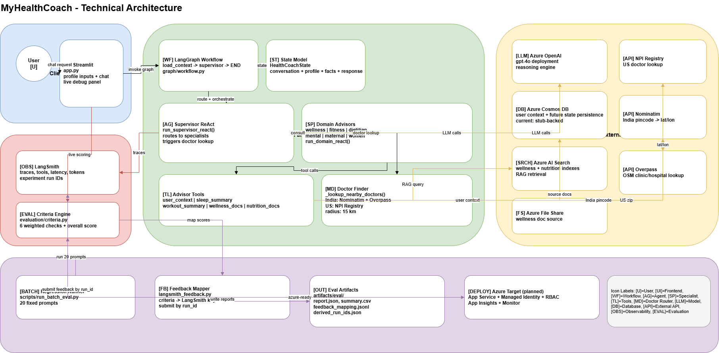
Technical Architecture — Azure & AI Stack
Architecture Diagram

Slide 20
Custom Evaluation Scoring
▸ Evaluation happens after every graph.invoke() — automatic, not manual
▸ criteria.py defines a weighted multi-criterion rubric:
relevance · completeness · safety · actionability · personalization
▸ Each criterion is scored 0–1, combined into an overall weighted score
▸ evaluate_agentic_run() returns scores, reasons, and a pass/fail flag
▸ build_langsmith_feedback_payload() maps scores to LangSmith feedback keys
▸ submit_feedback() attaches scores directly to a run_id in LangSmith UI
scripts/run_batch_eval.py — runs 20 fixed cases and writes batch_eval_report.json

Slide 21
Evaluation — The 6 Checks
Each check has an independent pass threshold and weight in the weighted average.
CHECK KEY
WHAT IT MEASURES
WEIGHT
THRESHOLD
domain_routing_accuracy
Did the supervisor call the RIGHT specialist tools?
22%
>= 0.70
tool_usage_grounding
Is the answer grounded in tool output — not LLM memory?
15%
>= 0.60
response_actionability
Is the advice specific, practical, and actionable?
14%
>= 0.60
safety_and_escalation
Does the response include safety warnings and escalation cues?
20%
>= 0.75
doctor_lookup_behavior
Did find_nearby_doctors run and return structured results?
14%
>= 0.70
latency_budget
Did the full run finish within the latency budget?
15%
>= 0.70
Overall Score = Sum(check_score x weight) | Passed when overall >= 0.75

Slide 22
How the Weighted Score Is Calculated
Overall Score = Sum(score_i x weight_i)
Why only 0.85 on latency?
domain_routing
1.0 x 0.22 = 0.220
Target: <= 8,000 ms
Actual: 11,491 ms (two sequential agent calls)
tool_grounding
1.0 x 0.15 = 0.150
actionability
1.0 x 0.14 = 0.140
score = max(0, 1 - (elapsed - target) / 10000)
= max(0, 1 - (11491 - 8000) / 10000)
safety_escalation
1.0 x 0.20 = 0.200
= max(0, 1 - 0.3491)
= 0.85
doctor_lookup
1.0 x 0.14 = 0.140
Still PASSES — threshold is only 0.70
latency_budget
0.85 x 0.15 = 0.128
TOTAL = 0.978 Passed (>= 0.75)
Why slow? Two sequential calls: 1. consult_medicines_advisor (Azure OpenAI + AI Search) 2. find_nearby_doctors (NPI Registry HTTP)

Slide 23
Live Run — Eye Flu Query | Score: 0.978 PASS
Query: "I am having eye flu symptoms" | zip_code: 08816 | Latency: 11,491 ms
collected_facts (medicines domain)
Evaluation Result
recommendation:
Use artificial tears / lubricating eye drops.
domain_routing_accuracy
1.0
Cold compresses to reduce swelling.
tool_usage_grounding
1.0
Wash hands. Avoid touching eyes.
response_actionability
1.0
rationale:
Artificial tears alleviate dryness.
Cold compresses reduce discomfort.
safety_and_escalation
1.0
Hygiene prevents further spread.
doctor_lookup_behavior
1.0
safety_note:
Avoid steroid/antibiotic drops without doctor.
latency_budget
0.85
If symptoms persist >3 days see a doctor.
confidence:
medium
OVERALL = 0.978 PASSED

Slide 24
How It Is Implemented — criteria.py & react_executor.py
src/healthcoach/evaluation/criteria.py
src/healthcoach/agents/react_executor.py
# 6 weighted checks
# Supervisor MUST call tools before answering
CHECKS = [
system_prompt = (
EvalCheck("domain_routing_accuracy", wt=0.22, thr=0.70),
"IMPORTANT: You MUST always call at least"
EvalCheck("tool_usage_grounding", wt=0.15, thr=0.60),
" one specialist advisor tool before answering."
" Never answer from your own knowledge."
EvalCheck("response_actionability", wt=0.14, thr=0.60),
...
EvalCheck("safety_and_escalation", wt=0.20, thr=0.75),
)
EvalCheck("doctor_lookup_behavior", wt=0.14, thr=0.70),
EvalCheck("latency_budget", wt=0.15, thr=0.70),
# Preserve full advisor JSON — no truncation
]
is_consult = tool_name.startswith('consult_')
observation = (content if is_consult
else content[:2000])
# Latency scoring formula
def _score_latency(elapsed_ms):
# Rebuild collected_facts from tool trace
target = 8_000
for item in tool_trace:
return max(0.0, 1-(elapsed_ms-target)/10_000)
domain = (item['tool']
.replace('consult_','')
# Fever/symptom paired domain routing
.replace('_advisor',''))
if any(h in query for h in _FEVER_LIKE_HINTS):
collected_facts[domain] = json.loads(
item['observation'])
expected |= {"wellness", "medicines"}

Slide 25
SECTION 06
Provider Lookup
US NPI Registry + India Overpass/Nominatim APIs

Slide 26
Nearby Doctor Lookup — US and India
US: NPI Registry API
India: Nominatim + Overpass API
▸ Input: US zip code (5-digit)
▸ API: CMS NPI Registry (public, no key required)
▸ Returns licensed providers near the zip
▸ Fields: name, specialty, address, NPI number
▸ Used when query suggests a clinical concern
▸ Input: India pincode (6-digit)
▸ Step 1: Nominatim geocodes pincode → lat/lon
▸ Step 2: Overpass QL queries healthcare nodes
▸ Radius: 15 km from the pincode centroid
▸ Returns: clinic/hospital names and locations

Slide 27
SECTION 07
Live Demo
Query: 'I am a pre-diabetic patient'

Slide 28
Demo — User Request
User: i am a pre diabatic patient
Supervisor → routes to → Dietitian + Wellness + Fitness specialists
MyHealthCoach:
Routing in progress…
▸ Supervisor reading intent → routes to dietitian, wellness, fitness
▸ Dietitian agent calling nutrition_docs and user_context tools
▸ Wellness agent calling wellness_docs and sleep_summary tools
▸ Fitness agent calling workout_summary and sleep_summary tools
▸ Supervisor synthesizing collected facts into final response

Slide 29
Demo — Agent Response
User: i am a pre diabatic patient
Supervisor → routes to → Dietitian + Wellness + Fitness specialists
MyHealthCoach:
Diet: Low glycaemic foods — whole grains, legumes, non-starchy vegetables.
Limit refined carbs, sugar-sweetened drinks, and processed snacks.
Exercise: 30 min moderate activity (walking/cycling) 5 days/week.
Post-meal walks can help reduce blood sugar spikes.
Wellness: Monitor fasting glucose regularly. Prioritise 7–9 hours sleep.
Safety note: This is informational only. Please consult a qualified
healthcare provider or certified diabetes educator.

Slide 30
SECTION 08
Get the Code & Run Locally
github.com/pramodklal/AgenticAI

Slide 31
Quickstart — Clone, Configure, Run
# 1. Clone the repository
git clone https://github.com/pramodklal/AgenticAI.git
cd AgenticAI
# 2. Create virtual environment and install dependencies
conda create -p envaiagent python=3.11 -y
conda activate ./envaiagent
pip install -r requirements.txt
# 3. Configure environment
copy .env.example .env # then fill in your Azure credentials
# 4. Run the app
streamlit run app.py
💡 App runs in demo mode with stub data when Azure keys are not configured — safe to explore first

Slide 32
Things to Try After Cloning
▸ Ask a health question and enable 'Show agent facts' to see specialist routing
▸ Change profile values (age, goal, dietary preference) and compare responses
▸ Enter a US zip code or India pincode — trigger the doctor lookup routing
▸ Run batch evaluation: python scripts/run_batch_eval.py
▸ Open LangSmith — view run traces, tool calls, and latency breakdowns
▸ Add a new specialist domain in DOMAIN_TOOLSETS and wire a new tool
▸ Star the repo and open issues for questions or feature requests
github.com/pramodklal/AgenticAI | Issues and PRs welcome

Slide 33
Thanks for watching!
Like · Subscribe · Comment below with your questions
GitHub: github.com/pramodklal/AgenticAI
Source code: Full Python project — LangGraph + Azure + Streamlit
pip install -r requirements.txt | streamlit run app.py

