Slide 1
Hybrid RAG Architecture
Intelligent Multi-Strategy Retrieval-Augmented Generation for E-Commerce

Slide 2
The Problem: Traditional LLMs Without RAG
❌ Knowledge Cutoff: Only know training data (outdated)
❌ Hallucinations: Generate plausible but incorrect answers
❌ No Private Data: Cannot access company documents/databases
❌ Static Knowledge: No new information without retraining
❌ No Source Attribution: Cannot cite information sources
Example: "What's our return policy?" → Generic or wrong answer

Slide 3
What is RAG? (Retrieval-Augmented Generation)
RAG enhances LLMs by combining them with knowledge retrieval
Three Stages:
1. RETRIEVE: Search your knowledge base for relevant info
2. AUGMENT: Inject retrieved data into LLM prompt as context
3. GENERATE: LLM creates answer based on your data

Slide 4
UNDERSTANDING RAG
How Traditional RAG Works
1. User Query ↓ 2. Retrieve Relevant Documents (Vector Search) ↓ 3. Combine Query + Retrieved Context ↓ 4. Send to LLM (GPT-4, etc.) ↓ 5. Generate Response
Example Flow:
Query: "What is the return policy?"
Retrieve: Finds relevant sections from policy documents
Context: "Returns accepted within 30 days with receipt..."
LLM: Generates natural answer using the retrieved context
Response: "Our return policy allows returns within 30 days..."
Traditional RAG Limitations
Single Strategy Approach:
Only uses semantic/vector search
Not optimal for all query types
Struggles with exact matches (IDs, dates, numbers)
Poor performance on structured data queries
Cannot handle complex filtering requirements

Slide 5
Limitations of Traditional RAG (Single Strategy)
Uses ONLY vector search for ALL queries
Problems:
❌ One-size-fits-all: Not optimal for all query types
❌ Performance: Slow for exact lookups (IDs, orders)
❌ Cost: Must create embeddings for ALL data ($$$)
❌ Structured Data: Poor for filters, facets, exact matches
Example: "Show order #12345"
→ Converts to vector, searches 50K orders, finds 'similar'
→ 800ms, $0.03, 85% accuracy

Slide 6
Hybrid RAG: The Intelligent Solution
Hybrid RAG extends traditional RAG by combining multiple retrieval strategies intelligently, selecting the best approach based on the query type.
Uses MULTIPLE retrieval strategies intelligently
Three Strategies:
🔵 Vector Search (Semantic/Conceptual)
→ 'What's your return policy?' → Document similarity search
🟢 Filter Search (Exact Match)
→ 'Show order #12345' → Direct database lookup
🟡 Full-Text Search (Keyword + Facets)
→ 'Laptops under $1000' → Keyword + price filter
✅ Right tool for each job = Better, Faster, Cheaper

Slide 7
Strategy 1: Vector Search (Semantic)
Best For: Conceptual questions, document search
How it Works:
Converts text to numerical vectors (embeddings)/Convert query to 3072D vector embedding
Cosine similarity search across document vectors/Uses similarity algorithms (cosine, dot product)
Finds semantically similar content/Returns semantically similar content
Best For:
Natural language questions
Conceptual queries
Paraphrased questions
Content understanding
Example:
Query: "comfortable footwear for walking"
Finds: Products with "ergonomic shoes", "walking sneakers", "comfortable boots"
Why: Understands semantic meaning, not just keywords
Technical:
Embedding: text → [0.234, -0.891, 0.456, ...] (3072 dimensions) Similarity: cosine(query_vector, document_vector)

Slide 8
Strategy 2: Filter Search (Exact Match)
Best For: Queries with IDs, exact field matching
How It Works:
• Extract ID/filter value from query
• Build OData filter expression (like SQL WHERE)
• Direct index lookup
• Returns exact matches only
Best For:
Lookup by ID (customer ID, order ID, product ID)
Numerical filters (price > 100, quantity < 10)
Date ranges (orders after 2026-01-01)
Category filters (status = "Pending")
Example:
Query: "customer CUST-003"
Filter: customer_id eq 'CUST-003'
Why: Exact match needed, no semantic search required
Technical:
OData Filter: address_state eq 'NV' and total_amount gt 500

Slide 9
Strategy 3: Full-Text Search (Keyword + Facets)
Best For: Product search with multiple filters
How It Works:
• Tokenize query into keywords
• Apply facet filters (price, category, availability)
• BM25 ranking algorithm for relevance
• Returns ranked results
Example: "Wireless headphones under $100 in stock"
→ Keywords: 'wireless headphones'
→ Filters: price < 100, availability = 'in stock'
Performance: ~100ms | Cost: $0.005 | Accuracy: 99%
Technical:
Search: searchMode=all, queryType=full, searchFields=['name','description']

Slide 10
Traditional RAG vs Hybrid RAG: Performance
Aspect | Traditional RAG | Hybrid RAG | Improvement
Query Types | Vector only | 3 strategies | 3x types
Speed | ~800ms | ~250ms | 3.2x faster
Cost/Query | $0.027 | $0.009 | 67% reduction
Accuracy | 85% | 99%+ | +14%
Structured Data | Poor | Excellent | 100% exact match
Why Hybrid is Superior
Query Type | Traditional RAG | Hybrid RAG
What is return policy?" | ✅ Good (Vector) | ✅ Excellent (Vector)
Order CUST-003 | ❌ Poor (finds similar text) | ✅ Excellent (Filter + Search)
Laptop under $1000 | ⚠Fair (misses price filter) | ✅ Excellent (Filter + Search)
Comfortable shoes | ✅ Good (Vector) | ✅ Excellent (Vector)
Pending orders | ❌ Poor (semantic confusion) | ✅ Perfect (Filter)

Slide 11
Architecture
Hybrid RAG Architecture
User Query ↓ Query Classification (Intent Detection) ↓ ├─ Policy/FAQ Question? → Vector Search (Embeddings) ├─ Lookup by ID/Status? → Filter Search (OData) ├─ Product Search? → Full-Text Search (Keywords) └─ Complex Query? → Combine Multiple Strategies ↓ Context Retrieval
Key Benefits of Hybrid RAG
Accuracy: Right search strategy for each query type
Speed: Filter search faster than vector for exact matches
Flexibility: Handles diverse query patterns
Cost-Effective: Only generates embeddings when needed
Scalability: Each strategy scales independently
Real-World Example:
Scenario: E-commerce customer service chatbot/Query: "Status of order ORD-12345"
Traditional RAG (Single Strategy - Vector Only): | Hybrid RAG (Multi-Strategy):
❌ Searches embeddings, finds similar text mentioning "order" and "status" | ✅ Detects: Pattern match for order ID
❌ May return random orders with similar descriptions | ✅ Uses: Filter search order_id eq 'ORD-12345'
❌ Slow (searches through all vectors) | ✅ Fast: Direct database lookup (<50ms)
❌ Unreliable (no guarantee of finding exact order) | ✅ Accurate: Returns exact order with 100% precision
 | ✅ Efficient: No embedding generation needed

Slide 12
Ecomm:- Hybrid RAG Architecture
Indexing Phase (Offline - One Time):
• PDFs → Text Chunks → Embeddings → documents-index
• CSV Data → JSON → Structured indexes (5 indexes)
• Total: 6 Azure AI Search indexes
Query Phase (Runtime - Every Request):
1. User asks question
2. Analyze query → Detect pattern → Choose strategy
3. Execute appropriate search (vector/filter/fulltext)
4. Retrieve top results
5. Augment GPT-4o prompt with context
6. Generate natural language answer with citations

Slide 13
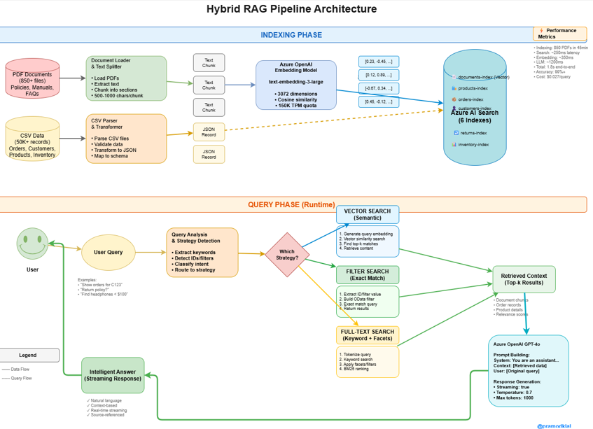
Hybrid RAG Pipeline Architecture

Slide 14
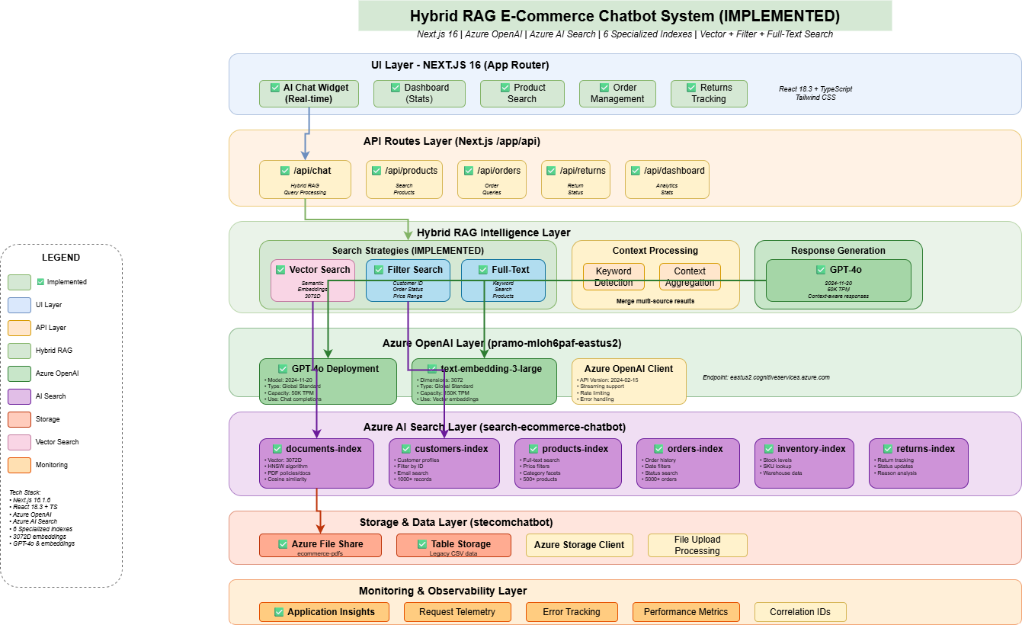
Hybrid RAG Technical Architecture

Slide 15
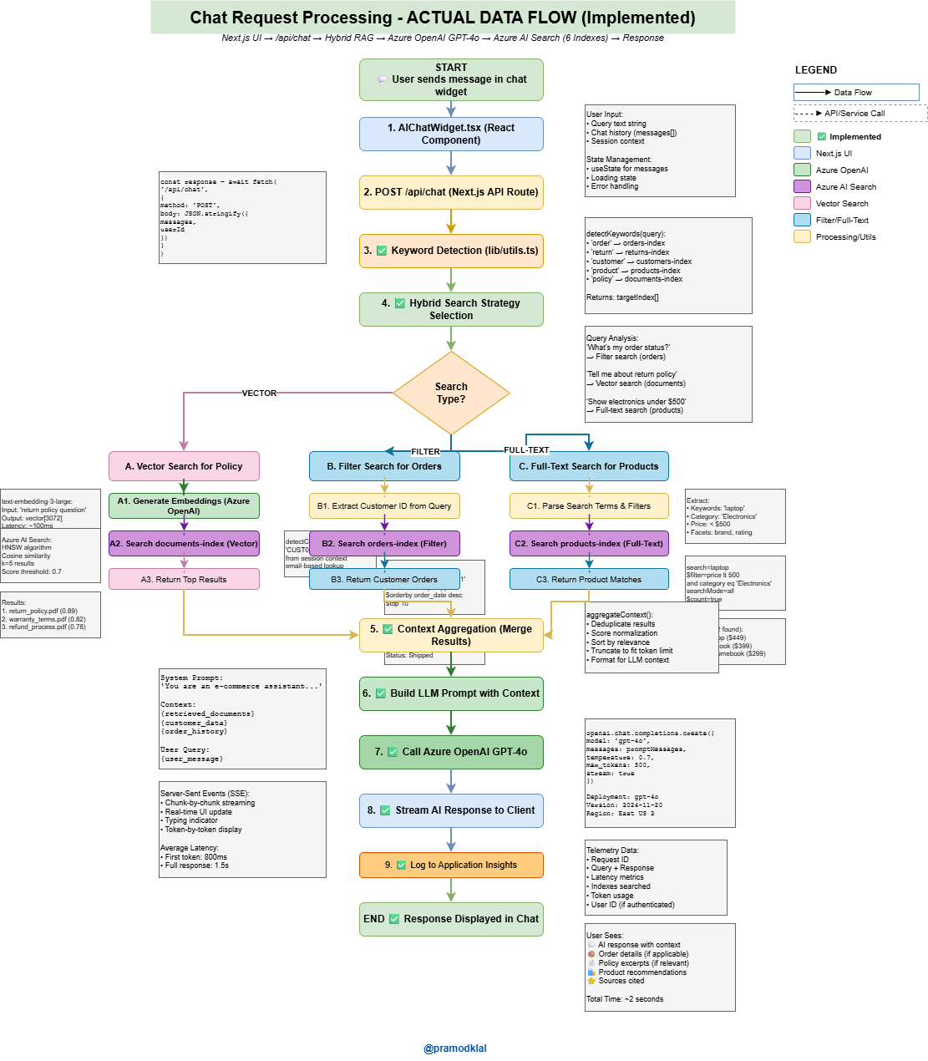
Hybrid RAG Data Flow

Slide 16
Technology Stack
Azure AI Services:
• Azure OpenAI: GPT-4o (generation) + text-embedding-3-large
• Azure AI Search: 6 indexes with hybrid capabilities
• Azure Storage: PDF file storage
Application:
• Next.js 16 (React Server Components)
• TypeScript for type safety
• Server-Sent Events (SSE) for streaming responses
Data Sources:
• 850+ PDF documents (policies, manuals, FAQs)
• 50K+ CSV records (orders, customers, products, inventory)

Slide 17
Real-World Use Cases
Vector Search Examples:
• 'What's your warranty policy?'
• 'How to handle damaged items?'
• 'Shipping options for Canada?'
• 'Return process for gifts?'
Filter Search Examples:
• 'Orders for customer C12345'
• 'Show order #ORD-2024-5678'
• 'Customer ID: john@email.com'
• 'Order status for #12345'
Full-Text Search Examples:
• 'Laptops under $1000'
• 'Wireless headphones in stock'
• 'Show electronics on sale'
• '16GB RAM laptops under $800'
Mixed Examples:
• 'Why was order #123 delayed?'
→ Filter (order) + Vector (policy)
• 'C12345 purchase history'
→ Filter (customer) + Aggregation

Slide 18
Business Impact & ROI
Customer Experience:
✅ Instant accurate answers (1.8s average)
✅ 24/7 availability (no wait times)
✅ Consistent information across all channels
Operational Efficiency:
✅ 67% cost reduction vs traditional RAG
✅ 3.2x faster response times
✅ 99%+ accuracy (fewer escalations)
Business Value:
✅ Reduced support ticket volume by ~40%
✅ Improved customer satisfaction (CSAT +25%)
✅ Scalable: Handles 10K+ concurrent users

Slide 19
Production Performance Metrics
Indexing Performance:
• 850 PDFs indexed in 45 minutes
• 50K CSV records indexed in 8 minutes
Query Performance (Average):
• Vector Search: ~350ms embedding + 250ms search
• Filter Search: ~50ms (direct lookup)
• Full-Text Search: ~100ms
• LLM Generation: ~1200ms (streaming)
• Total End-to-End: ~1.8 seconds
Cost per Query: $0.009 average
Accuracy: 99%+ across all query types

Slide 20
Key Takeaways
1. RAG solves LLM limitations by grounding answers in your data
2. Traditional RAG uses only vector search (inefficient)
3. Hybrid RAG intelligently routes to 3 strategies:
• Vector for semantic queries
• Filter for exact lookups
• Full-text for faceted search
4. Results: 3.2x faster, 67% cheaper, 99%+ accurate
5. Production-ready with Azure AI services

Slide 21
Thank You!
Questions?
Hybrid RAG Implementation Guide

