Slide 1
Application Engineering and Development INFO 5100 A case study in Order Booking

Slide 2
Learning Objectives
how to go from a problem to code
Understand the difference between important and critical data
What is business intelligence
How local knowledge become global
Aggregating small pieces of data to big ideas for running a business
How a well-designed object model is the brain for running a business
How to use data to motivate people do certain things right

Slide 3
Xerox
Xerox sales model is for their sales people to go visit with
Institutional clients
Xerox was facing tough competition from Japanese companies
Xerox’s sales teams were very slow and inflexible. Negotiations
Required that they go back to higher manager for approval of
deals. Decisions were made counter to Xerox’s interests.
This left their sales people frustrated.

Slide 4
Xerox new sales strategy
Build an app to empower the sales teams to make pricing
decisions in the field based on the customer circumstances.
Xerox came up with range pricing
Each product will have 3 prices: high, low, and target
The sales person is supposed to hit the target on
each item on the deal but allowed to vary on some items as long
as the total is greater than the sum of the target.
But there is a problem, a big one

Slide 6
Screen representation of user tasks

Slide 7
Login Screen represents Login Task
Xerox Sales Console
User Login
User:
action
Password:
Role:
login >>

Slide 8
User Screens (contd.)
Xerox Sales Console
John smith
Activity: Manage Customers
Customer name
Serve customer >>
Review sales order history >>
Review sales commission >>
logout

Slide 9
User Screens (contd.)
Xerox Sales Console
John smith
Customer Information summary
Person Contact Information
Activity: Serve Customer
View customer history
Book customer order >>
Check order status >>
Browse product catalog >>

Slide 10
Xerox Sales Console
John smith
Customer Information summary
Person Contact Information
Activity: Book Customer Order
My commission
Supplier
Product Id
Product Name
Floor Price
Ceiling Price
Target Price
Add
>>
>>
Order Items
Product Id
Product Name
Actual Price
Cancel Order >>
Submit Order >>

Slide 11
Xerox Sales Console
Sales person’s name: John smith
Customer Information summary
Person Contact Information
Activity: Browse Product Catalog
Product Description
Find >>
Printing Catalog
Product Id
Product Name
Target Price
Description
View Detail >>
View Detail >>
Done >>

Slide 12
Xerox Sales Console
Sales person’s name: John smith
Customer Information summary
Person Contact Information
Activity: Check Order Status
Time frame
Begin time
End time
Find >>
Order List
Order Id
Date started
Date completed
Status
Action
View
View
Done >>

Slide 13
Sales Process Use Case
1. Manage Customers
1.a Review sales order history
1.b Review sales commission
:
1.c Serve customer
1.c.a Browse product catalog
1.c.b Check order status
1.c.c Book customer order
1.c.c.a Submit customer order
1.c.c.b Cancel customer order
1.c.c.c Save customer order

Slide 14
Sales Process Use Case
1. Manage Customers
Sales Person
1.a Review sales order history
1.b Review sales commission
:
Customer name
1.c Serve customer
Product Catalog
1.c.a Browse product catalog
1.c.b Check order status
Customer
1.c.c Book customer order
1.c.c.a Submit customer order
1.c.c.b Cancel customer order
1.c.c.c Save customer order

Slide 15
Navigation Sequence
Manage Customers
1.a Review sales order history
1.b Review sales commission
1.c Serve customer
1.c.a Browse product catalog
1.c.b Check order status
1.c.c Book customer order
1.c.c.a Submit customer order
1.c.c.b Cancel customer order
1.c.c.c Save customer order

Slide 16
Implicit in the use case above is the fact that there is an authentication step that
must be completed before the user is allowed to use the system
0. Login/validate the user
0.1 Ask the security service if user has the right to use the system
0.2 If user is valid then continue with next step
1. Manage Customers
1.a Review sales order history
1.b Review sales commission
:

Slide 17
Attributes:
Availability
Description
Name
Product ID
Floor, Ceiling, and target
Attributes:
Actual price per item
quantity
Order Item
Product

Slide 18
Attributes:
Availability
Description
Name
Product ID
Floor, Ceiling, and target
Attributes:
Status
Issue date
Completion date
Shipping date
Attributes:
Actual price per item
quantity
Order
Order Item
Product

Slide 19
Attributes:
Availability
Description
Name
Product ID
Attributes:
Paid price per item
quantity
Product
Catalog
Order Item
Product
Attributes:
Status
Issue date
Completion date
Shipping date
Attributes:
Name
Address
orders
Customer
Directory
Order
Person

Slide 20
The complete business hierarchy
Business
product catalog
Customer directory
Product
Catalog
Customer
Directory
customers
Person
orders
Order
products
order items
Product
Order Item

Slide 21
Sales Model Sales person mediates the sale

Slide 22
Business
product catalog
Customer directory
Product
Catalog
Customer
Directory
Employee
Directory
customers
Person
Sales person
orders
Order
products
order items
Product
Order Item

Slide 23
product catalog
Supplier
Directory
Business
Employee directory
Customer directory
Customer
Directory
Employee
Directory
Supplier
customers
Master Order List
Customer Profile
product catalog
Product
Catalog
orders
Order
Sales person
Sales Profile
products
order items
Product
Order Item
Person

Slide 24
How to create an order?
MasterOrderList class creates orders and keep them in an arraylist
MasterOrderList mol = business.getMasterOrderList();
Order order = mol.newOrder();
Business
Order
Master Order List

Slide 25
How to create an order item
Scenario: The user wants to select a product and add it to the order:
OrderItem oi = order.newOrderItem();
oi.setProduct(selectedproduct);
oi.setQuantity(q);
Or
OrderItem oi = order.newOrderItem(selectedproduct);

Slide 26
How to list the order items
ArrayList items = order.getOrderItems();
For (Item I : items)
{
:
i.getProduct() or i.getItemPrice() or i.getQuantity()
:
}

Slide 27
How to list all orders
MasterOrderList mol = business.getMasterOrderList();
For (Order selectedoder : mol.listoforders)
{
<show selectedorder info detail here>
:
}

Slide 28
How to calculate total order?
Define an operation called getOrderItemTotal() on the Order Item
Define the getOrderTotal() operation on the class Order
Order Item
Order

Slide 29
How to calculate order item total?
Order Item
Define the following operations on Order Item
getItemQuantity()
getPaidPrice()
Then
getOrderItem():
return getItemQuantity()*getPaidPrice()

Slide 30
How to calculate order total?
On the Order define
getOrderTotal():
Sum = 0
For each orderitem in the list of orderitems associated with the Order do the following step until done
Sum = sum + orderitem.getOrderItemTotal();
Return sum;
Order

Slide 31
How to calculate total revenue by customer?
On the Customer class define
getTotalRevenues()
Sum = 0
For each order in the list of orders associated with the orderlist do the following step until done
Sum = sum + order.getOrderTotal();
Return sum;
Customer

Slide 33
Coding Steps
product catalog
Supplier
Directory
Business
Employee directory
Customer directory
Customer
Directory
Employee
Directory
Supplier
5
customers
Product Report
Master Order List
Customer Profile
product catalog
Product
Catalog
4
3
products
orders
Product
Summary
Sales person
Employee Profile
Order
1
products
order items
2
Product
Order Item
Person

Slide 34
Coding Steps
product catalog
Supplier
Directory
Business
Employee directory
Customer directory
Customer
Directory
Employee
Directory
Supplier
5
customers
Product Report
Master Order List
Customer Profile
product catalog
Product
Catalog
4
3
products
orders
Product
Summary
Sales person
Employee Profile
Order
1
products
order items
2
Product
Order Item
Person

Slide 35
Product Performance
Product Catalog
Product Report
Many items selected for the product
Product Summary
Product
Order Item

Slide 36
Customer Performance
Customer Directory
Customer Report
Customer Summary
Customer
Order

Slide 37
Range Pricing: Product
What matters is the price for the total package:
Some products in the sales order are sold at lower price
and others are at higher price.
Target Price
Product
Floor Price
Ceiling Price
Actual Price

Slide 38
Key business intelligence decisions
Product
Ceiling Price
Most Actual Prices
Are above target
Target Price
Adjust target higher
Floor Price

Slide 39
Key business intelligence decisions
Product
Ceiling Price
Target Price
Most Actual Prices
Are below target
Floor Price
Adjust target lower

Slide 40
Key business intelligence decisions
Product
Ceiling Price
Target Price
Actual Price
Floor Price
The top 10 profitable customers [can you sell them more]
The top 10 profitable products [get rid of unprofitable products]
The top 3 sales persons [Reward best sales people]
And most challenging: Are we underpricing our products?
Can we charge more

Slide 41
Range Pricing: Product
Target Price
Floor Price
Product
Ceiling Price
Which Product
Who is the customer
Actual Price
Who is the salesperson

Slide 42
Product performs well with positive impact in different direction
Which Product
Actual Price higher than Target
the customer
+
salesperson
+
+
Supplier
Sales organization
All customers

Slide 43
Product performs with negative impact in different direction
Which Product
Actual Price lower
than Target
the customer
--
salesperson
--
--
Supplier
Sales organization
All customers

Slide 44
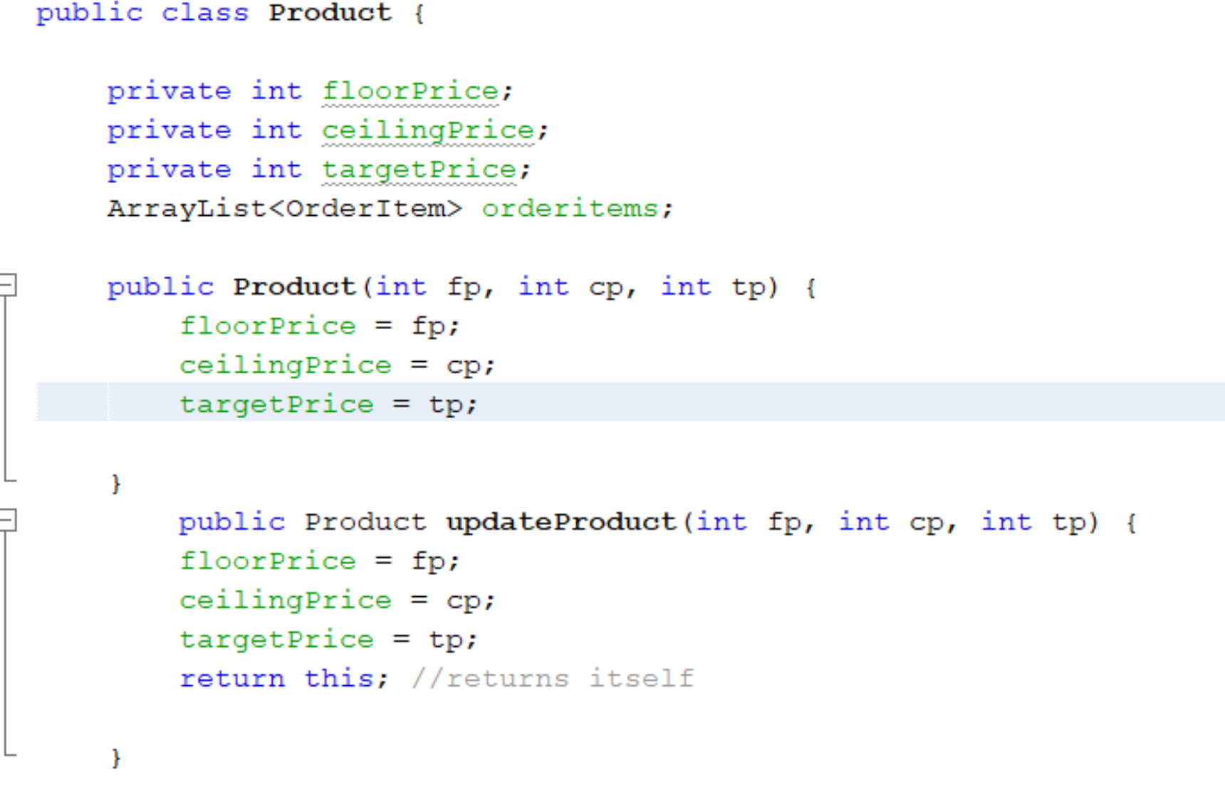
Attributes:
Target
Floor
Ceiling
Availability
Description
Name
Product ID
Product
Catalog
Product

Slide 45
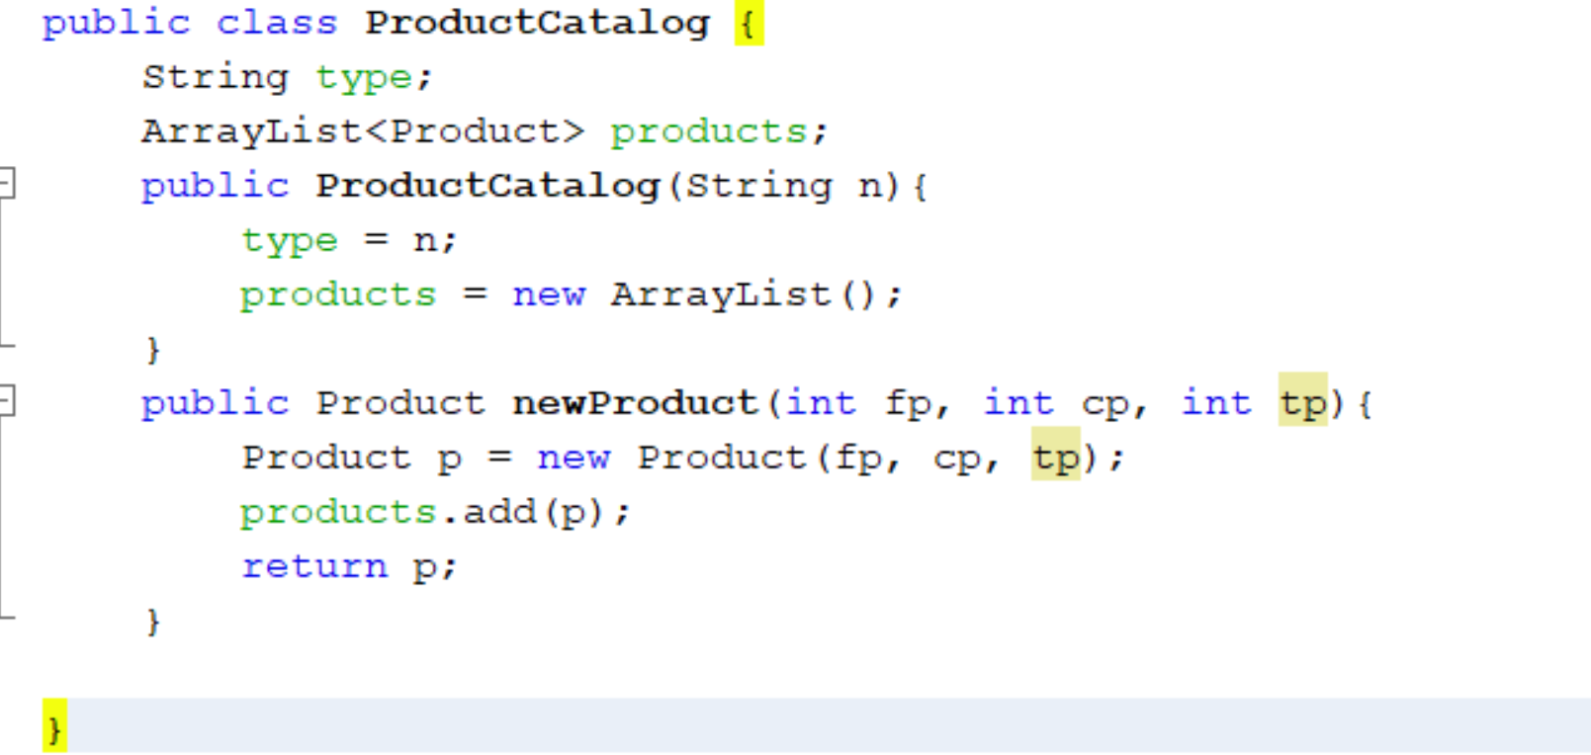
Attributes:
Target
Floor
Ceiling
Availability
Description
Name
Product ID
Product
Catalog
Product

Slide 46
Most basic building block
Attributes:
Paid price per item
quantity
Attributes:
Target
Floor
Ceiling
Order Item
Product
public class OrderItem {
Product selectedproduct;
int ActualPrice;
int quantity;
public OrderItem(Product p, int q){
selectedproduct = p;
quantity = q;
}
}
public class Product {
private int floorPrice;
private int ceilingPrice;
private int targetPrice;
ArrayList<OrderItem> orderitems;
public Product(int fp, int cp, int tp) {
floorPrice = fp;
ceilingPrice = cp;
targetPrice = tp;
}

Slide 47
Linking demand to supply
Attributes:
Paid price per item
quantity
Attributes:
Target
Floor
Ceiling
Order Item
Product
public class OrderItem {
Product selectedproduct;
int ActualPrice;
int quantity;
public OrderItem(Product p, int q){
selectedproduct = p;
quantity = q;
}
}
public class Product {
private int floorPrice;
private int ceilingPrice;
private int targetPrice;
ArrayList<OrderItem> orderitems;
public Product(int fp, int cp, int tp) {
floorPrice = fp;
ceilingPrice = cp;
targetPrice = tp;
}

Slide 48
the most basic intelligence we can have so far
Attributes:
Paid price per item
quantity
Attributes:
Target
Floor
Ceiling
Order Item
Product
Customer agreed to an actual price
Agreed to price is
High (positive) – seller has more negotiating power
Lower (negative), customer has more negotiating power
Target (neutral) meeting item objective – equal power

Slide 49
Range Pricing: Solution Package
P1
P2
P3
Total Price
Seller wins if
Total target Price is lower than ActualPrice(P1) + ActualPrice(P2) + ActualPrice(P3) is less than the sum of the targets
Customer wins if
Total target Price is greater than ActualPrice(P1) + ActualPrice(P2) + ActualPrice(P3)

Slide 50
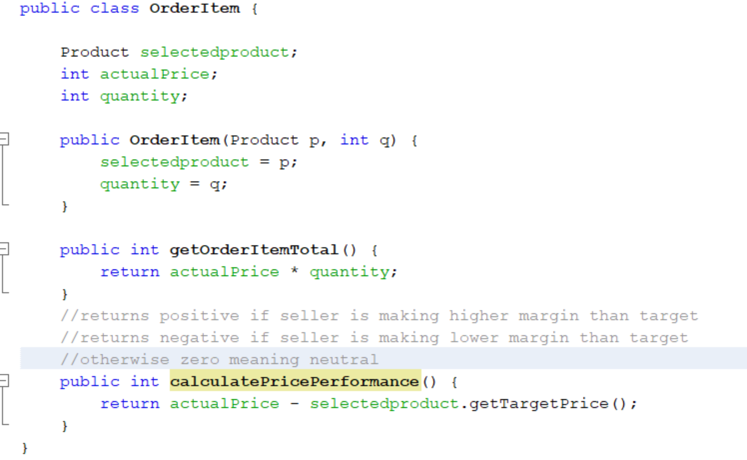

Slide 51
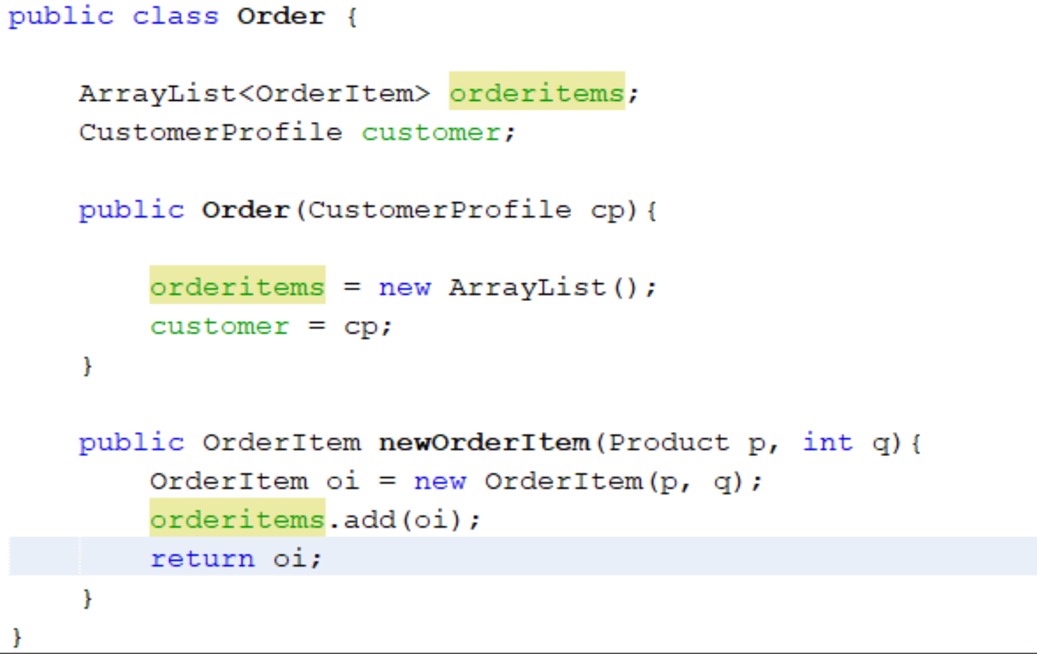
Attributes:
Status
Issue date
Completion date
Shipping date
Attributes:
Paid price per item
quantity
Attributes:
Availability
Description
Name
Product ID
Order
Order Item
Product

Slide 52
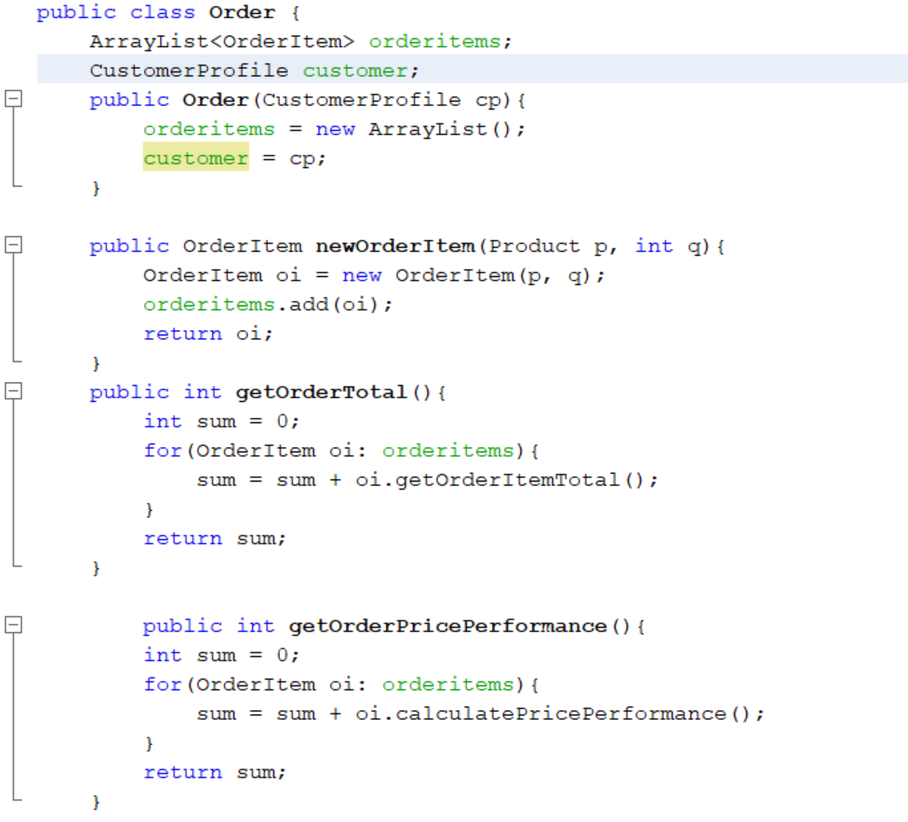
Oder expanded
Order
Order Item
Product
Order price intelligence
d
d
Item price intelligence

Slide 53

Next Steps
product catalog
Supplier
Directory
Business
Employee directory
Customer directory
Customer
Directory
Employee
Directory
Supplier
5
customers
Master Order List
Customer Profile
product catalog
Product
Catalog
4
3
orders
Order
Sales person
Employee Profile
1
products
order items
2
Product
Order Item
Person

Slide 54
M
Managing the business
Product Report
Top Customers
Sales Person Report

Slide 55
Managing the business
Top Customers
Top Products
Top Sales Performers

Slide 56
Product Intelligence
Number of sales above target;
Number of sales below target;
Product price performance; //total profit above target
Actual sales volume;
Rank;

Slide 57
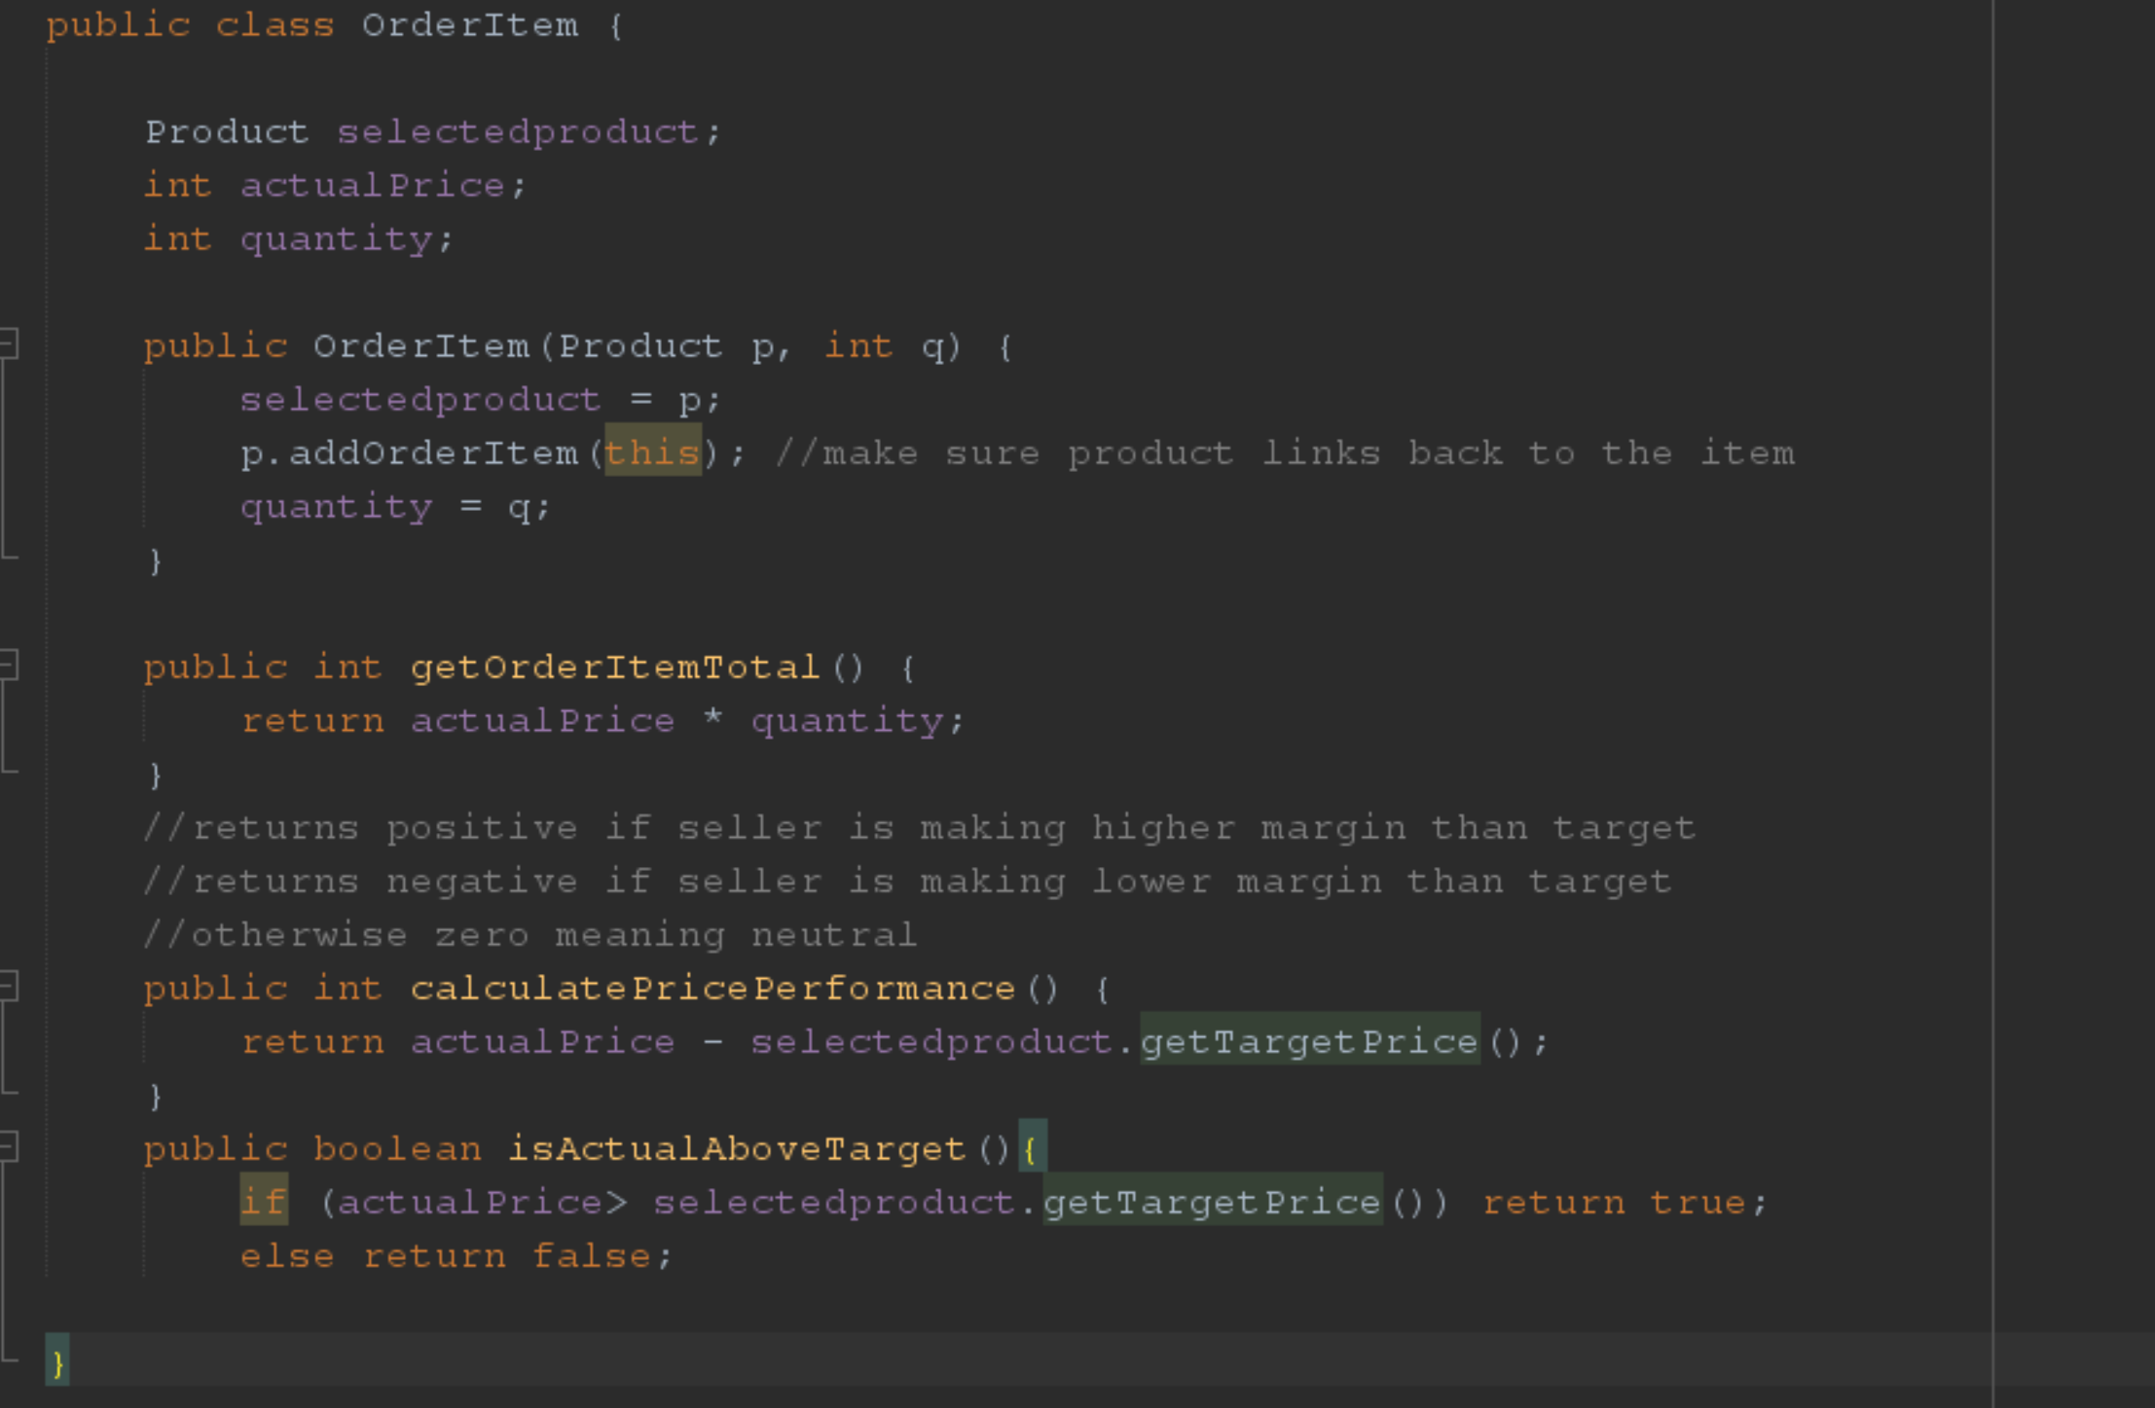

Slide 58
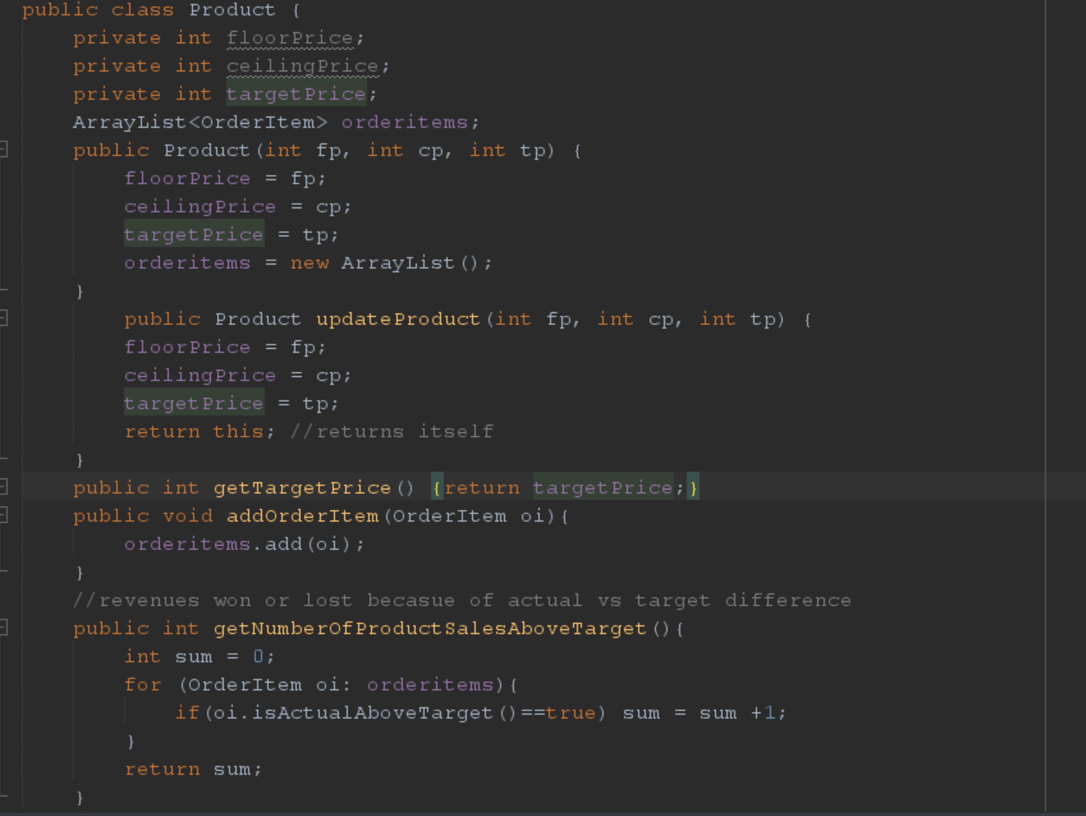

Slide 59
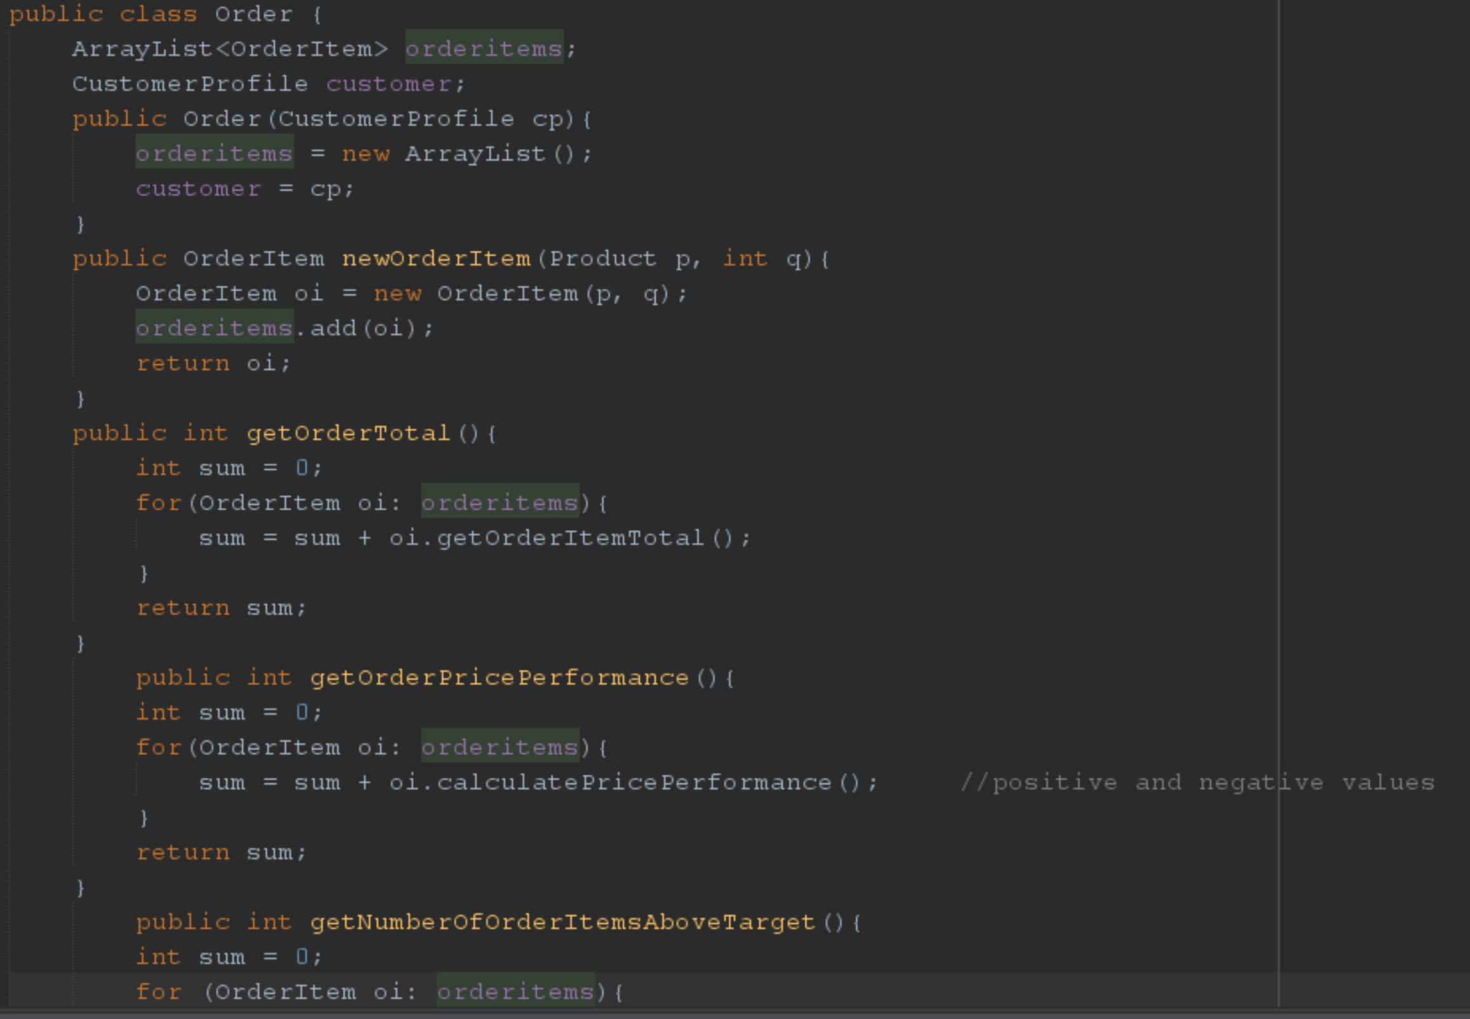

Slide 60
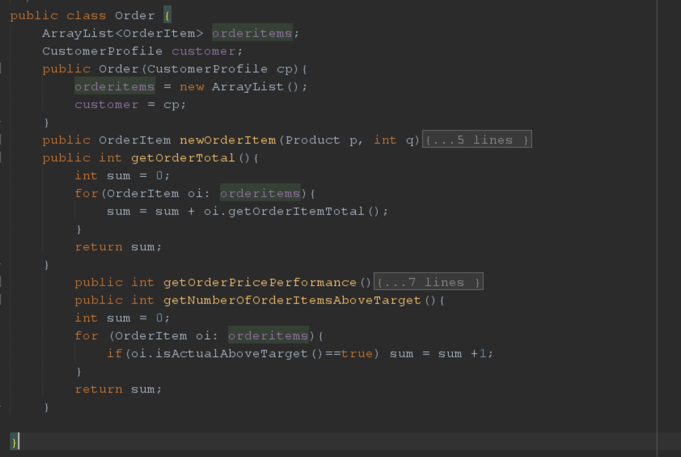

Slide 61
Sales Model Self-serve model where customer prepares own order

