Slide 1

INFORMATION SYSTEM
UNIT 00 : COURSE INTRODUCTION
© 2018, PRAMOD PARAJULI

Slide 2
Disclaimer
These slides are part of teaching materials for Information System (IS). These slides do not cover all aspect of learning IS, nor are these be taken as primary source of information. As the core textbooks and reference books for learning the subject has already been specified and provided to the students, students are encouraged to learn from the original sources.
Contents in these slides are copyrighted to the instructor and authors of original texts where applicable.

Slide 3
Why information systems are important?

Slide 4
Information system as driver of automation, decision-making and collaboration.

Slide 5


Slide 6

http://www.forbes.com/sites/techonomy/2011/11/30/now-every-company-is-a-software-company/

Slide 7
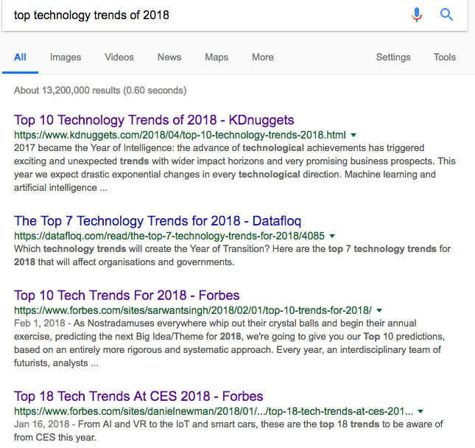
Trends

Slide 8
User experience
Functionality
Reliability
Secure
Ease of use, intuitive
Notes:
Software is not just a product, it’s an experience.

Slide 9
What matters?
IT doesn’t matter.
Nicolas Carr
Harvard Business Review, May 2003
Notes:
Not the software, not the functions, not the business processes, the end-user experience.

Slide 10
IQ CHECK!
Cathedral and the Bazar
ISO/IEC 9126
Design patterns
MVC
CMM and CMMI,
Full stack developer

Slide 11
IQ CHECK!
Production stack
Multi-tenant application
Agile manifesto and SCRUM
CI/CD
UX
Lean software development
MVP

Slide 12

What bad software can do?

Slide 13
Syllabus
Running case (Modern Systems Analysis and Design, 8th Edition)

Slide 14
EVALUATION SCHEME
Criteria Marks
Attendance: 10
Case presentation: 10
Classroom participation: 5
Mid-term examination: 35_
Total 60

