Slide 1
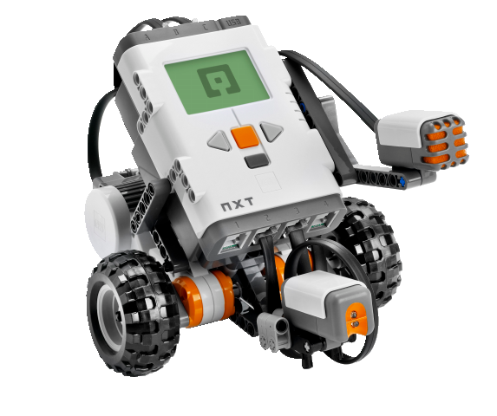
OBJECT-ORIENTED SOFTWARE ENGINEERING
UNIT 01 : INTRODUCTION
© 2019, PRAMOD PARAJULI

Slide 2
Disclaimer
These slides are part of teaching materials for Object Oriented Software Engineering (OOSE). These slides do not cover all aspect of learning OOSE, nor are these be taken as primary source of information. As the core textbooks and reference books for learning the subject has already been specified and provided to the students, students are encouraged to learn from the original sources.
Contents in these slides are copyrighted to the instructor and authors of original texts where applicable.

Slide 3
Organizations and workflows
System’s view
Data-driven view
Functional view
Event-based view
State machine view
Notes:
How can the Social Robotics example be viewed as?

Slide 4
Software AS A PRODUCT
Programs
Associated documents
  System documentation
  Manuals and websites
  User documentation/guide
  Advertisements
Configuration data
Additional services – trainings

Slide 5
Software types
Generally, two types
Generic
  Developers get full control
Bespoke (customised)
  Users get full control
  (Classroom discussion)
System software
Application software
Mobile software/app
Web applications
Production line software
Embedded software
AI software
Ubiquitous computing
Wearable computing
OpenSource software
Legacy software
...

Slide 6
Software characteristics
Software is developed, but not manufactured.
Software doesn’t wear out.
Most software are custom built.
Flexibility vs. complexity
Software qualities
  Portability
  Maintainability
  Modular
  Intuitive (ease of use)
  Reusability
  Stable
  Dependable

Slide 7
SOFTWARE EVOLUTION
THE EARLY YEARS
1950s
Batch oriented
Limited distribution
Custom Software
THE SECOND ERA
1960s – 1970S
Multi-user
Real-time
Database
Product Software
THE THIRD ERA
1980s – 1990S
Distributed systems
Embedded intelligence
Low cost h/w
Consumer impact
THE FOURTH ERA
2000s –
Powerful desktops
OO Technologies
Expert Systems
Parallel computing
Data-centred

Slide 8
CURRENT TREND
Agile manifesto & lean development
Cloud computing
Cognitive computing
Software as a Service
AI as a Service!
Wearable computing
Data analytics
Millions of lines of code
Natural interactions
Collaborative development
Web apps
UX first!

Slide 9
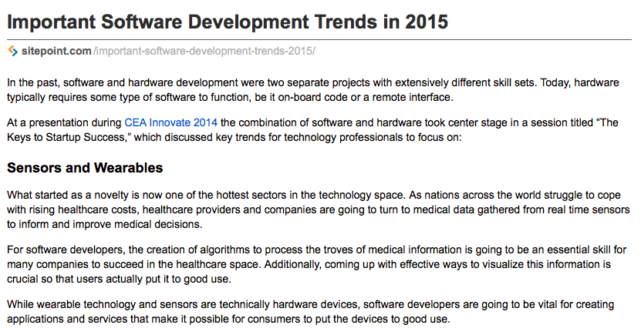
CURRENT TREND

Slide 10
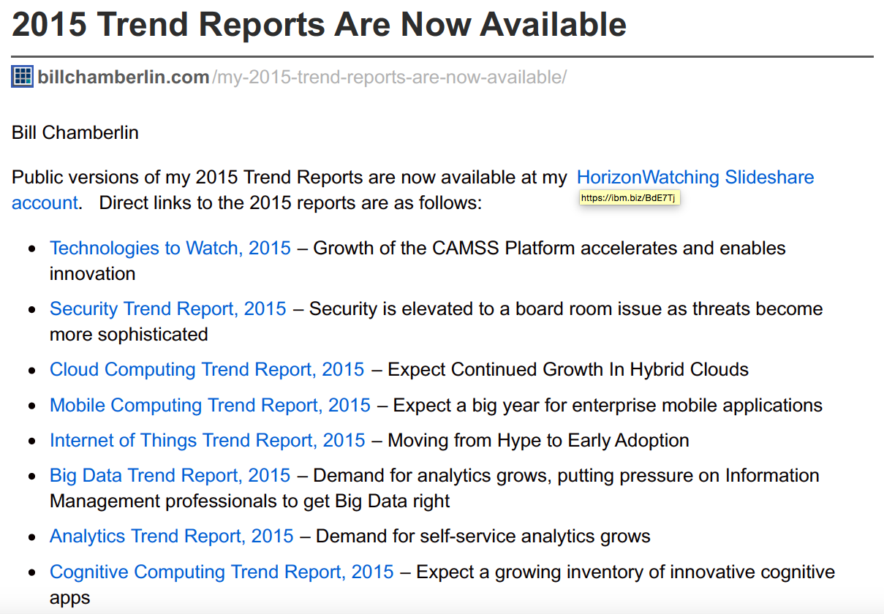
CURRENT TREND

Slide 11
Software engineering
❃ What is software engineering?

Slide 12
Software dev. Life cycle
Conceptualisation
...
Decommissioning

Slide 13
Software dev. Life cycle
Specification
Development
Integration and testing
Deployment

Slide 14
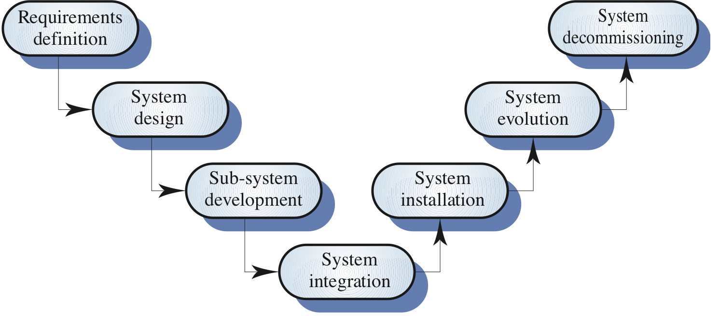
A generic Software process model

Slide 15
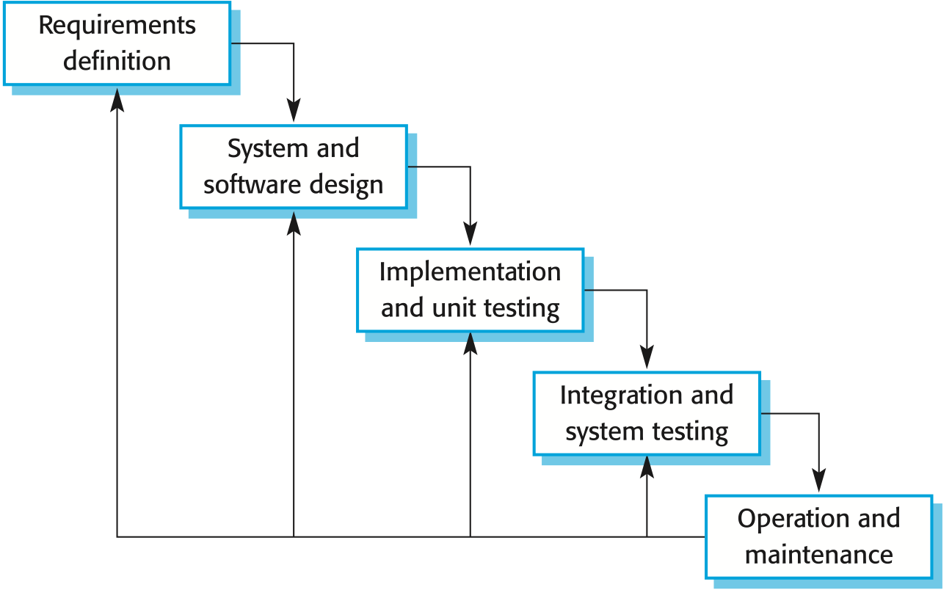
Waterfall model
Notes:
The main drawback of the waterfall model is the difficulty of accommodating change after the process is underway. One phase has to be complete before moving onto the next phase.
Inflexible partitioning of the project into distinct stages makes it difficult to respond to changing customer requirements.
Therefore, this model is only appropriate when the requirements are well-understood and changes will be fairly limited during the design process.

Slide 16
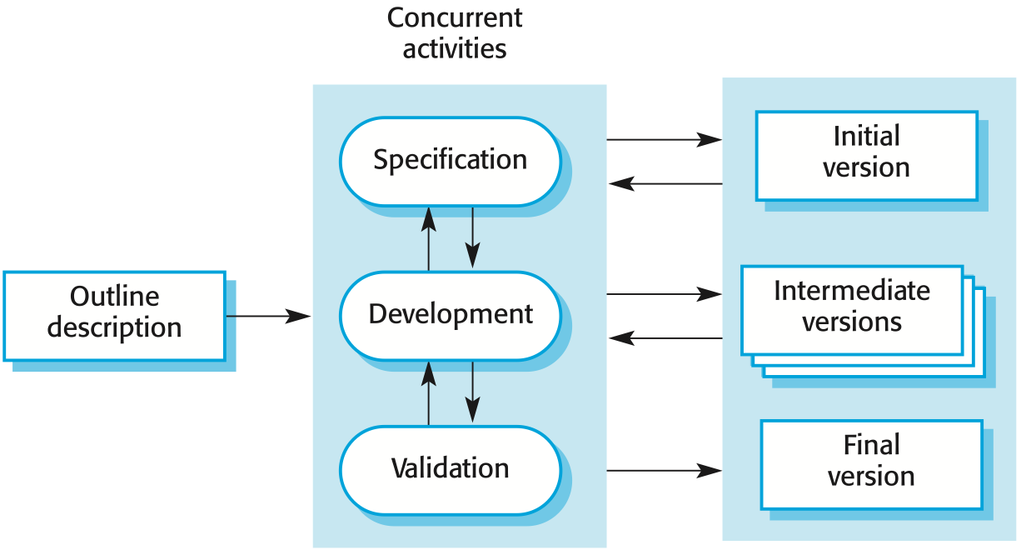
EVOLUTIONARY MODEL
Notes:
Expose initial development to customer them refine through many versions.
Exploratory development - Objective is to work with customers and to evolve a final system from an initial outline specification. Should start with well-understood requirements and add new features as proposed by the customer.
Throw-away prototyping - Objective is to understand the system requirements. Should start with poorly understood requirements to clarify what is really needed.
Problems
Lack of process visibility;
Systems are often poorly structured;
Special skills (e.g. in languages for rapid prototyping) may be required.
Applicability
For small or medium-size interactive systems;
For parts of large systems (e.g. the user interface);
For short-lifetime systems.

Slide 17
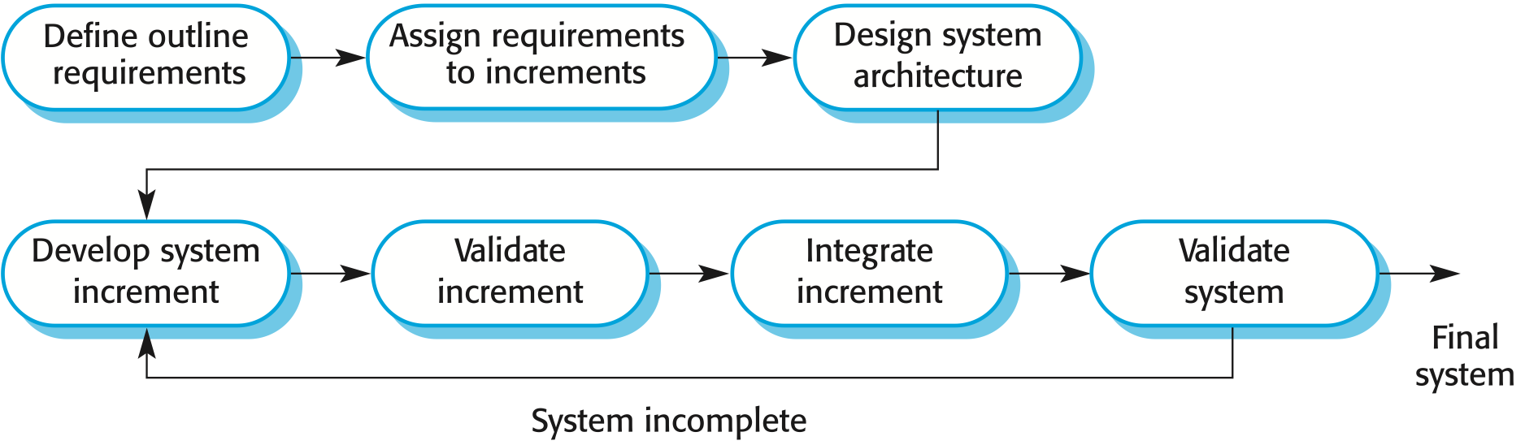
Incremental MODEL
Notes:
First increment – core product, addresses basic requirements
Focuses on ‘operational product’ after each increment unlike prototyping
Used for all ‘agile’ process

Slide 18
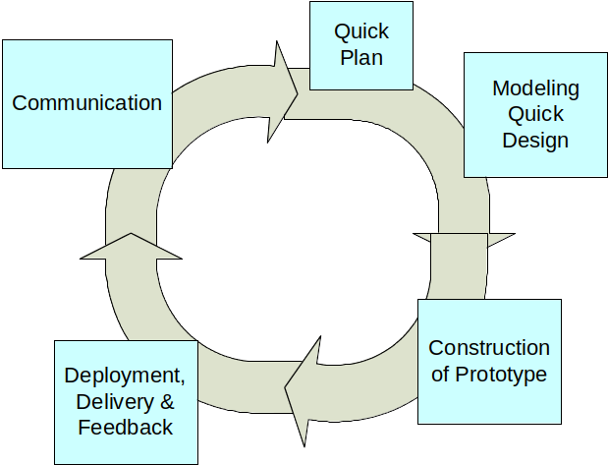
PROTOTYPING MODEL

Slide 19
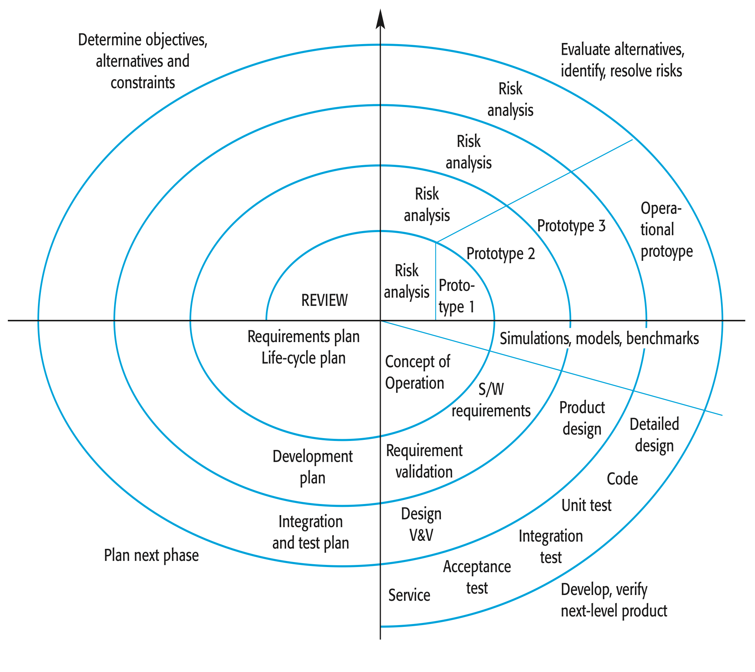
SPIRAL MODEL
Notes:
Customer communication
Planning (estimation, scheduling, risk analysis)
Modeling (analysis, design)
Construction (code, test)
Deployment (delivery, feedback)
(Ref. http://www.sei.cmu.edu/cbs/spiral2000/ )

Slide 20
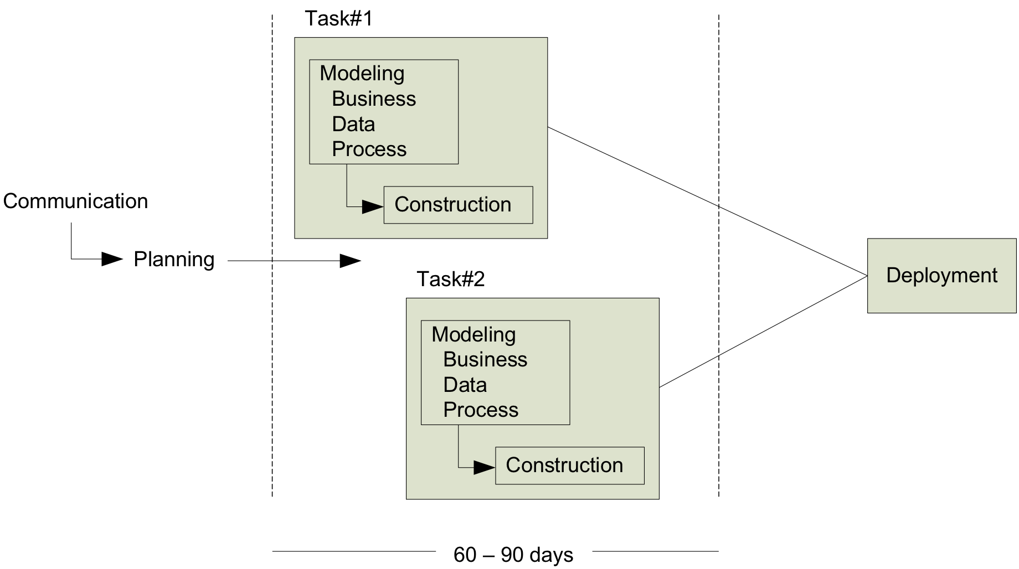
RAD MODEL
Notes:
Incremental S/W process emphasizing on short development cycle

Slide 21
Complex Systems
❃ Why would a system be complex?
w/examples
Notes:
Think of nature, computer, human etc. as complex system.

Slide 22
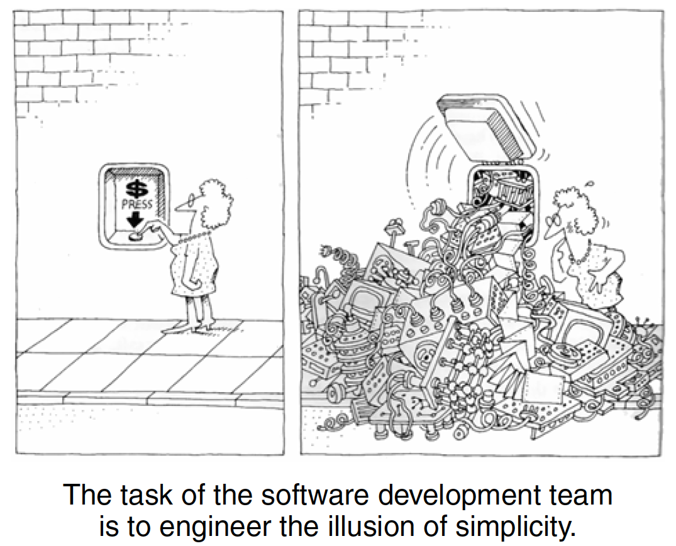
Software complexity
Need to deliver – flexibility, solid performance
End-users have different views
Problem domain is complex
Difficulty of managing the
development process
Difficulty in modeling behavior of discrete systems

Slide 23
5 attributes of complex system
Hierarchic structure – follow hierarchic structure of some kind
Relative primitives – relative measures on primitive operations
Separation of concerns – decomposable and non-decomposable components
Common patterns – repetitive patterns in the structure
Stable intermediate forms – complex system when evolves from stable simple system

Slide 24
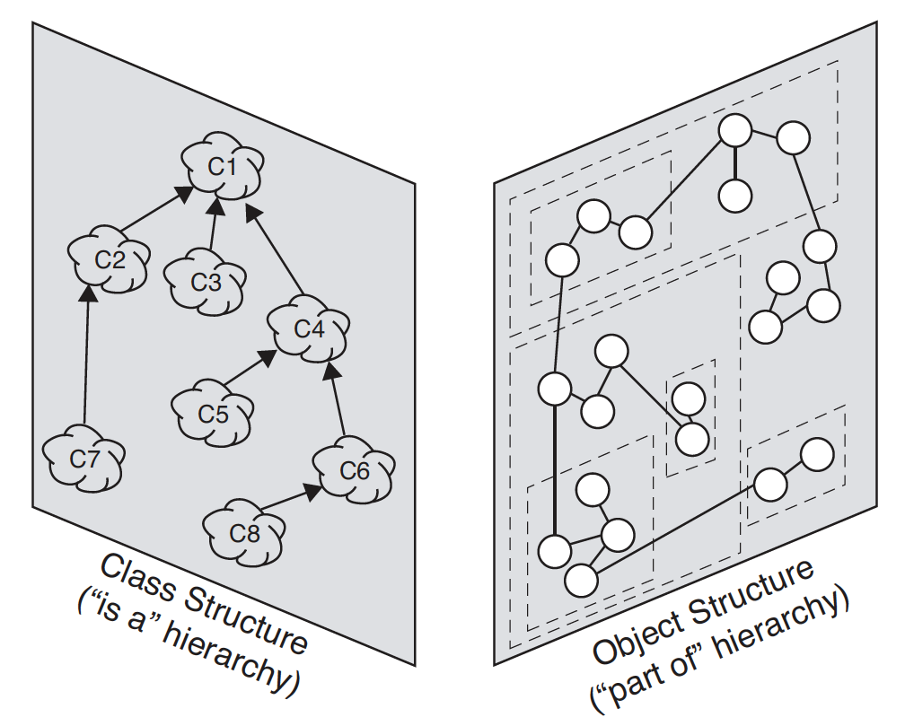
Organised and disorganised complexity
Finding abstractions help organise complexity
Canonical form of complexity – hierarchical: part of, is a
Humans are limited in understanding complexity in detail

Slide 25
Managing chaos
Decomposition – decompose system into manageable chunks (algorithmic decomposition, object-oriented decomposition)
Abstraction – generalized common components
Hierarchy – follow hierarchical structure

Slide 26
Designing complex systems
Engineering is a science as well as an art
Design - Stroustrup suggests, “the purpose of design is to create a clean and relatively simple internal structure, sometimes also called an architecture. . . . A design is the end product of the design process”
Model building – multiple models
Software design – using notation, process, and tools

Slide 27
Models of ‘oose’
Object oriented analysis and design
Unified Modeling Language
Rational Unified Process
Open Unified Process

Slide 28
Useful links
Software Engineering Institute: sei.cmu.edu
Object Management Group: omg.org
Rational Unified Process: ibm.com
Open Unified Process: epf.eclipse.org/wikis/openup/
Roger S. Presman: rspa.com/spi/

Slide 29
End of Unit 01 : Introduction

