Slide 1
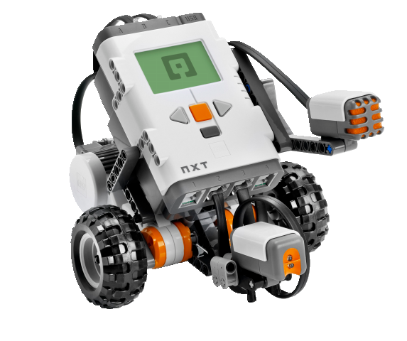
OBJECT-ORIENTED SOFTWARE ENGINEERING
UNIT 02 : PROJECT MANAGEMENT, PLANNING AND RISK ANALYSIS
© 2019, PRAMOD PARAJULI

Slide 2
Disclaimer
These slides are part of teaching materials for Object Oriented Software Engineering (OOSE). These slides do not cover all aspect of learning OOSE, nor are these be taken as primary source of information. As the core textbooks and reference books for learning the subject has already been specified and provided to the students, students are encouraged to learn from the original sources.
Contents in these slides are copyrighted to the instructor and authors of original texts where applicable.

Slide 3
COCOMO
UNIT 02: PROJECT MANAGEMENT

Slide 4
Software Cost Estimation Methods
Cost estimation: prediction of both the person-effort and elapsed time of a project
Methods:
  Algorithmic
  Expert judgment
  Estimation by analogy
  Parkinsonian
Best approach is a combination of methods
  compare and iterate estimates, reconcile differences
COCOMO - the “COnstructive COst MOdel”
  COCOMO II is the update to Dr. Barry Boehm’s COCOMO 1981
COCOMO is the most widely used, thoroughly documented and calibrated cost model
  Price-to-win
  Top-down
  Bottom-up

Slide 5
INTRODUCTION
proposed by Barrey W. Boehm in 1981.
Empirical software estimation model in the world.
Predicts the effort and duration of a project based on :
inputs relating to the size of the resulting systems and
number of "cost drives" that affect productivity.

Slide 6
The Development Mode
1. Organic mode :
  Relatively simple ,
  small projects with a small team are handled .
  good application experience to less rigid requirements.
2. Semidetached mode:
  For intermediate software projects(little complex compared to organic mode projects in terms of size).
  have a mix of rigid and less than rigid requirements.
3.Embedded mode:
  Project to be developed within a tight set of hardware and software operational constraints.
  Example of complex project: Air traffic control system

Slide 7
The coefficients of A_{a}, b_{b}, c_{c}, d_{d} for the three modes are:
 | A_{a} | b_{b} | c_{c} | d_{d}
Organic | 2.4 | 1.05 | 2.5 | 0.38
Semi-Detached | 3.0 | 1.12 | 2.5 | 0.35
Embedded | 3.6 | 1.20 | 2.5 | 0.32

Slide 8
COCOMO: Some Assumptions
Primary cost driver is the number of Delivered Source Instructions (DSI) / Delivered Line Of Code developed by the project
COCOMO estimates assume that the project will enjoy good management by both the developer and the customer
Assumes the requirements specification is not substantially changed after the plans and requirements phase.

Slide 9
Forms of COCOMO Models
COCOMO is defined in terms of three different models:
  Basic model,
  Intermediate model, and
  Detailed model.
Basic Model:
  a function of program size expressed in terms of lines of Code (LOC).
  good for quick, early, rough order of magnitude estimates of software costs .

Slide 10
1.Basic COCOMO
a function of program size expressed in terms of lines of Code (LOC).
good for quick, early, rough order of magnitude estimates of software costs
It does not account for differences in
  hardware constraints,
  personnel quality and experience,
    use of modern tools and techniques, and
    other project attributes

Slide 11
1.Basic COCOMO
The basic COCOMO model takes the following form:
E=a_{b} (KLOC^{)bb} persons-months
D=c_{b} (E^{)db} months
where,
E - Stands for the effort applied in terms of person months
D - Development time in chronological months
KLOC - Kilo lines of code of the project.
From E & D we can compute the no. of people required to accomplish the project as
N=E/D

Slide 12
1.Basic COCOMO
Merits
good for quick, early, rough order of magnitude estimates of software project.
Limitations
Limited Accuracy: does not consider certain factors (hardware constraints, personal quality and experiences, modern techniques and tools ) for cost estimation of software.
The estimates within a factor of 1.3 only 29% of the time and within the factor of 2 only 60% of time.

Slide 13
1.Basic COCOMO
Example: Consider your team is developing a software project using semi-detached mode with 30,000 lines of code . We will obtain estimation for this project as follows:
(1)Effort estimation
(2) Duration estimation
(3)Person estimation

Slide 14
1.Basic COCOMO
Example: Consider your team is developing a software project using semi-detached mode with 30,000 lines of code . We will obtain estimation for this project as follows:
(1)Effort estimation
E= a (KLOC)^{b} person-months
E=3.0(30)^{1.12} = 135.36 (136)
(2) Duration estimation
D=c (E)^{d} months
D=2.5 (136) ^{0.35} = 13.95 (14)
(3)Person estimation
N=E/D persons
N =136/14 = 9.7 (10)

Slide 15
2. Intermediate COCOMO
Computes effort as a function of program size and a lot of cost drivers that includes subjective assessment of
  product attributes,
  hardware attributes,
  personal attributes and
  project attributes

Slide 16
 | Cost Driver | COCOMO_II Post Architecture | COCOMO_II Early Design | REVIC | COCOMO_87 | COCOMO_81 & COCOMO_85
Personnel Factors
ACAP | Analyst Capability | Yes |  | Yes | Yes | Yes
APEX AEXP | Applications Experience | Yes |  | Yes | Yes | Yes
PCAP | Programmer Capability | Yes |  | Yes | Yes | Yes
LEXP | Programming Language Experience |  |  | Yes | Yes | Yes
VEXP | Virtual Machine Experience |  |  | Yes | Yes | Yes
PERS | Personnel Capability |  | Yes
PREX | Personnel Experience |  | Yes
PCON | Personnel Continuity | Yes
PLEX PEXP | Platform Experience | Yes
LTEX | Language and Tool Experience | Yes
Product Factors
RELY | Required Software Reliability | Yes |  | Yes | Yes | Yes
DATA | Database Size | Yes |  | Yes | Yes | Yes
CPLX | Software Product Complexity | Yes |  | Yes | Yes | Yes
RUSE | Required Reusability | Yes | Yes | Yes | Yes
DOCU | Documentation Match to Life-Cycle Needs | Yes
RCPX | Product Reliability and Complexity |  | Yes

Slide 17
 | Cost Driver | COCOMO_II Post Architecture | COCOMO_II Early Design | REVIC | COCOMO_87 | COCOMO_81 & COCOMO_85
Platform Factors
TIME | Execution Time Constraint | Yes |  | Yes | Yes | Yes
STOR | Main Storage Constraint | Yes |  | Yes | Yes | Yes
TURN | Computer Turnaround Time |  |  | Yes | Yes | Yes
VIRT | Virtual Machine Volatility |  |  | Yes |  | Yes
VMVH | Virtual Machine Volatility: Host |  |  |  | Yes
VMVT | Virtual Machine Volatility: Target |  |  |  | Yes
PVOL | Platform Volatility | Yes
PDIF | Platform Difficulty |  | Yes
PLAT | Platform |  |  | Yes
Project Factors
TOOL | Use of Software Tools | Yes |  | Yes | Yes | Yes
MODP | Modern Programming Practices |  |  | Yes | Yes | Yes
SCED | Required Development Schedule | Yes | Yes | Yes | Yes | Yes
SECU | Classified Security Application |  |  | Yes | Yes
SITE | Multisite Development | Yes
FCIL | Facilities |  | Yes
RVOL | Requirements Volatility |  |  | Yes

Slide 18
2. Intermediate COCOMO
Based on the rating effort multipliers is determined. The product of all effort Multipliers result in “effort adjustment factor” (EAF). The intermediate COCOMO takes the form.
E = a_{i} (KLOC)^{bi} × EAF where
E - Effort applied in terms of person-months
KLOC - Kilo lines of code for the project
EAF - It is the effort adjustment factor
The duration and person estimate is same as in basic COCOMO model i.e;
D = c_{b} (E)^{db} months i.e; use values of c_{b} and d_{b} coefficients.
N=E/D persons

Slide 19
The values of a_{i} and b_{i} for various class of software projects are:
2. Intermediate COCOMO
Software Projects | A_{i} | B_{i}
Organic | 3.2 | 1.05
Semi-detached | 3.0 | 1.12
Embedded | 2.8 | 1.20

Slide 20
2. Intermediate COCOMO
Merits:
This model can be applied to almost entire software product for easy and rough cost estimation during early stage.
It can also be applied at the software product component level for obtaining more accurate cost estimation.
Limitations:
The effort multipliers are not dependent on phases.
A product with many components is difficult to estimate.

Slide 21
2. Intermediate COCOMO
Example: Consider your team is developing a project having 30,000 lines of code which in an embedded software with critical area hence reliability is high .
The estimation can be
E = a (KLOC)^{bi} × EAF
As reliability is high
EAF=1.15 (product attribute)
a_{i} =
b_{i} =
E =
D = c_{b} (E)^{db}
=
N = E/D

Slide 22
2. Intermediate COCOMO
Example: Consider your team is developing a project having 30,000 lines of code which in an embedded software with critical area hence reliability is high .
The estimation can be
E = a (KLOC)^{bi} × EAF
As reliability is high
EAF=1.15 (product attribute)
a_{i} =2.8
b_{i} =1.20 for embedded software
E = 2.8 (30)^{1.20} × 1.15
= 191 person month
D = c_{b} (E)^{db}
= 2.5(191) ^{0.32}
= 13 months approximately
N = E/D
= 191/13
N = 15 persons approx.

Slide 23
3. Detailed COCOMO Model
Detailed COCOMO incorporates all characteristics of the intermediate version with an assessment of the cost driver’s impact on each phase of the development process.
This helps in determining the man power allocation for each phase of the project.

Slide 24
3. Detailed COCOMO Model
Phase-Sensitive Effort Multipliers:
  Some phases( Design, programming, integration/test)are more affected than others by factors defined by the cost drivers.
Three –Level Product Hierarchy:
  Modules,
  Sub-System, and
  System Levels
The rating of the cost drivers are done at appropriate level. i.e. the level at which it is most suspicious to variation.

Slide 25
3. Detailed COCOMO Model
Phases
  Plans and requirements
  System Design
  Detailed Design
  Module code and test
  Integrate and test
Cost of each subsystem is estimated separately. This reduces the margin of error.

Slide 26
3. Detailed COCOMO Model
Multiply all 15 Cost Drivers to get Effort Adjustment Factor(EAF)
E(Effort) = a_{b}(KLOC)^{bb} × EAF(in Person-Month)
D(Development Time) = c_{b}(E)^{db} (in month)
E_{p} (Total Effort) = µ_{p} × E (in Person-Month)
D_{p} (Total Development Time) = τ_{p} × D (in month)

Slide 27
3. Detailed COCOMO Model
Consider you are developing a full screen editor as a project. The major components identified and their sizes are
  Screen Edit – 4K
  Command Lang Interpreter – 2K
  File Input and Output – 1K
  Cursor movement – 2K
  Screen Movement – 3K.
Assume the Required software reliability is high, product complexity is high, analyst capability is high & programming language experience is low. Use COCOMO model to estimate cost and time for different phases.

Slide 28
3. Detailed COCOMO Model
Size of modules : 4 + 2 + 1 + 2 + 3 = 13 KLOC [Organic]
EAF = 1.15 * 1.15 * 0.86 * 1.07 = 1.2169
Cost Drivers | Very Low | Low | Nominal | High | Very High | Extra High
RELY | 0.75 | 0.88 | 1.00 | 1.15 | 1.40 | --
CPLX | 0.70 | 0.85 | 1.00 | 1.15 | 1.30 | 1.65
ACAP | 1.46 | 1.19 | 1.00 | 0.86 | 0.71
LEXP | 1.14 | 1.07 | 1.00 | 0.95 | -- | --

Slide 29
3. Detailed COCOMO Model
Initial Effort (E) = a_{b}(KLOC)^{bb} × EAF = 3.2 (12)^{1.05} × 1.2169
= 52.9 person-months
Initial Development Time (D) = c_{b}(E)^{d}b =2.5*(52.9)^{0.38} = 11.29 months
Phase value of µ_{p} and τ_{p}
 | Plan & Req | System Design | Detail Design | Module code & test | Integration & Test
Organic Small µ_{p} | 0.06 | 0.16 | 0.26 | 0.42 | 0.16
Organic Small τ_{p} | 0.10 | 0.19 | 0.24 | 0.39 | 0.18

Slide 30
3. Detailed COCOMO Model
Phase wise effort & development time distribution
 | E | D | Ep (in person-months) | Dp (in months)
Plan & Requirement | 52.9 | 11.29 | 0.06*52.9 = 3.17 | 0.10*11.29=1.12
System Design
Detail Design
Module code & test
Integration & test
Reference: COCOMO-I, Classroom Presentation, Jagat Man Mulguthi, NCIT, Spring 2018

Slide 31
COCOMO-II
UNIT 02: PROJECT MANAGEMENT
Reference: Cost Estimation with COCOMO II, Barry Boehm, University of Southern California

Slide 32
COCOMO Black Box Model
product size estimate
development, maintenance
cost and schedule estimates
product, process,
platform, and personnel
attributes
reuse, maintenance,
and increment parameters
COCOMO II
cost, schedule distribution by
phase, activity, increment
organizational
project data
recalibration to
organizational data

Slide 33
COCOMO Effort Formulation
# of cost drivers
Effort (person-months) = A (Size)^{E} Π Σm_{i}
i=1
Where:
  A is a constant derived from historical project data
  (currently A = 2.94 in COCOMOII.2000)
  Size is in KSLOC (thousand source lines of code),
  or converted from function points or object points
  Σ is an exponent for the diseconomy of scale dependent on five additive scale drivers according to
  b = .91 + .01×ΣSF_{i},
  where SF_{i} is a weighting factor for i^{th} scale driver
  ΣM_{i} is the effort multiplier for the i^{th} cost driver. The geometric product results in an overall effort adjustment factor to the nominal effort.
Automated translation effects are not included

Slide 34
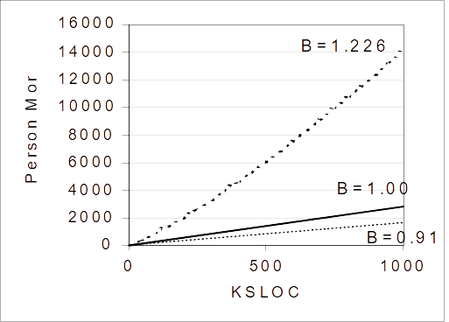
Diseconomy of Scale
Nonlinear relationship when exponent > 1

Slide 35
COCOMO Schedule Formulation
Where:
  Schedule is the calendar time in months from the requirements baseline to acceptance
  C is a constant derived from historical project data
  (currently C = 3.67 in COCOMOII.2000)
  Effort is the estimated person-months excluding the SCED effort multiplier
  E is the exponent in the effort equation
  SCED% is the compression / expansion percentage in the SCED cost driver
This is the COCOMOII.2000 calibration
Formula can vary to reflect process models for reusable and COTS software, and the effects of application composition capabilities.
Schedule (months) = C (Effort)^{(.33+0.2(E-1.01))} x SCED% / 100

Slide 36
RUP/ICSM Phase Distributions
Phase
Effort %
Schedule %
Inception
6
12.5
Elaboration
24
37.5
Construction
76
62.5
Transition
12
12.5
COCOMO Total
100
100
Project Total
118
125

Slide 37
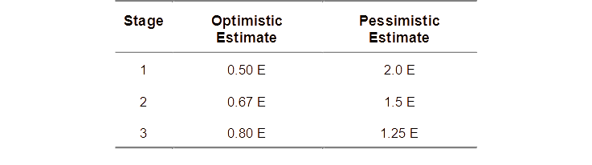
COCOMO II Output Ranges
COCOMO II provides one standard deviation optimistic and pessimistic estimates.
Reflect sources of input uncertainties per funnel chart.
Apply to effort or schedule for all of the stage models.
Represent 80% confidence limits: below optimistic or pessimistic estimates 10% of the time.

Slide 38
Reused and Modified Software
Effort for adapted software (reused or modified) is not the same as for new software.
Approach: convert adapted software into equivalent size of new software.

Slide 39
Nonlinear Reuse Effects
The reuse cost function does not go through the origin due to a cost of about 5% for assessing, selecting, and assimilating the reusable component.
Small modifications generate disproportionately large costs primarily due the cost of understanding the software to be modified, and the relative cost of interface checking.

Slide 40
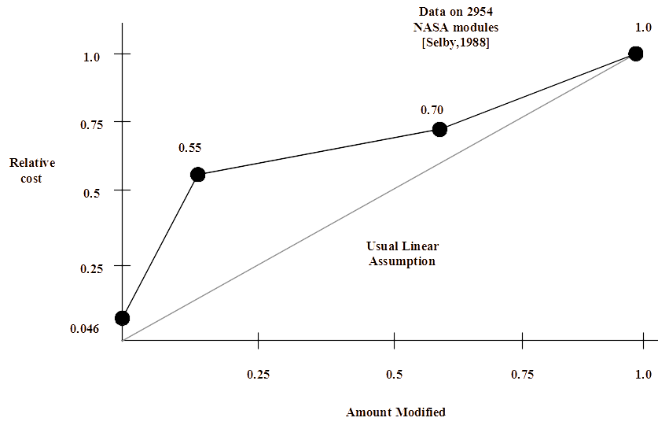
Nonlinear Reuse Effects

Slide 41
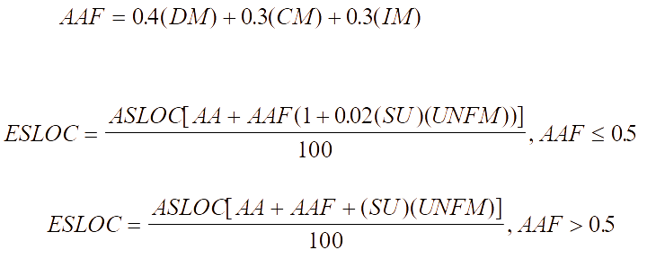
COCOMO Reuse Model
A nonlinear estimation model to convert adapted (reused or modified) software into equivalent size of new software:

Slide 42
COCOMO Reuse Model cont’d
ASLOC - Adapted Source Lines of Code
ESLOC - Equivalent Source Lines of Code
AAF - Adaptation Adjustment Factor
DM - Percent Design Modified. The percentage of the adapted software's design which is modified in order to adapt it to the new objectives and environment.
CM - Percent Code Modified. The percentage of the adapted software's code which is modified in order to adapt it to the new objectives and environment.
IM - Percent of Integration Required for Modified Software. The percentage of effort required to integrate the adapted software into an overall product and to test the resulting product as compared to the normal amount of integration and test effort for software of comparable size.
AA - Assessment and Assimilation effort needed to determine whether a fully-reused software module is appropriate to the application, and to integrate its description into the overall product description. See table.
SU - Software Understanding. Effort increment as a percentage. Only used when code is modified (zero when DM=0 and CM=0). See table.
UNFM - Unfamiliarity. The programmer's relative unfamiliarity with the software which is applied multiplicatively to the software understanding effort increment (0-1).

Slide 43
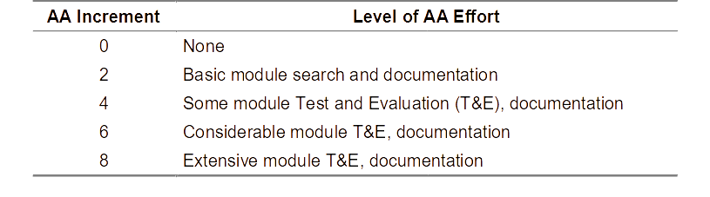
Assessment and Assimilation Increment (AA)

Slide 44
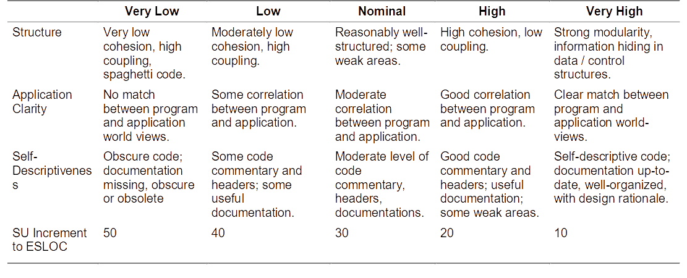
Software Understanding Increment (SU)
Take the subjective average of the three categories.
Do not use SU if the component is being used unmodified (DM=0 and CM =0).

Slide 45
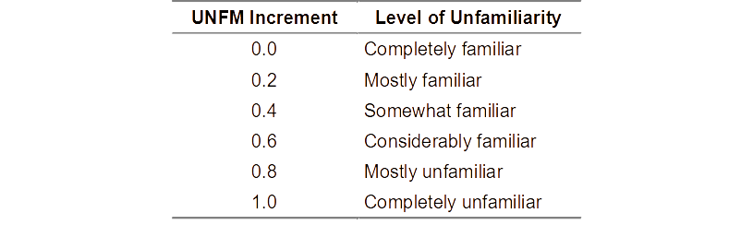
Programmer Unfamiliarity (UNFM)
Only applies to modified software

Slide 46
Cost Factors
Significant factors of development cost:
  scale drivers are sources of exponential effort variation
  cost drivers are sources of linear effort variation
    product, platform, personnel and project attributes
    effort multipliers associated with cost driver ratings
  Defined to be as objective as possible
Each factor is rated between very low and very high per rating guidelines
  relevant effort multipliers adjust the cost up or down
Notes:
May be difficult to quantify, but better than ignoring important project factors (e.g. b asic vs. intermediate accuracies)

Slide 47
Scale Factors
Precedentedness (PREC)
  Degree to which system is new and past experience applies
Development Flexibility (FLEX)
  Need to conform with specified requirements
Architecture/Risk Resolution (RESL)
  Degree of design thoroughness and risk elimination
Team Cohesion (TEAM)
  Need to synchronize stakeholders and minimize conflict
Process Maturity (PMAT)
  SEI CMM process maturity rating

Slide 48
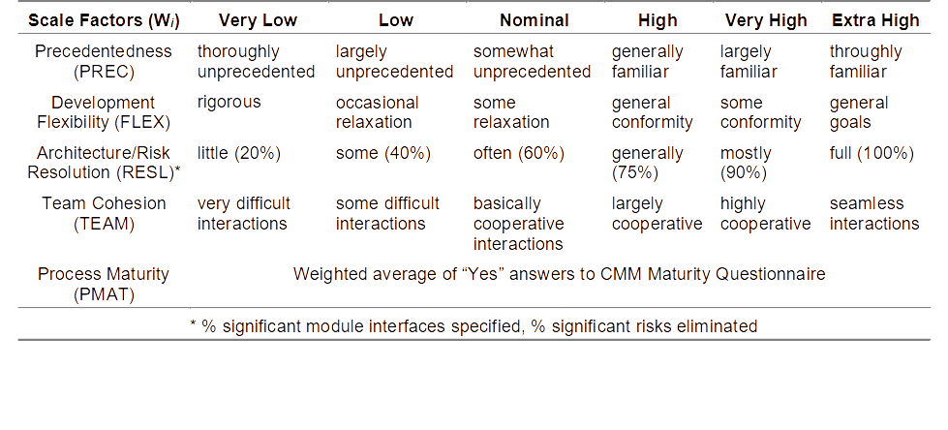
Scale Factor Rating

Slide 49
Cost Drivers
Personnel factors
  Analyst capability (ACAP)
  Program capability (PCAP)
  Applications experience (APEX)
  Platform experience (PLEX)
  Language and tool experience (LTEX)
  Personnel continuity (PCON)
Project Factors
  Software tools (TOOL)
  Multisite development (SITE)
  Required schedule (SCED)
Product Factors
  Reliability (RELY)
  Data (DATA)
  Complexity (CPLX)
  Reusability (RUSE)
  Documentation (DOCU)
Platform Factors
  Time constraint (TIME)
  Storage constraint (STOR)
  Platform volatility (PVOL)

Slide 50
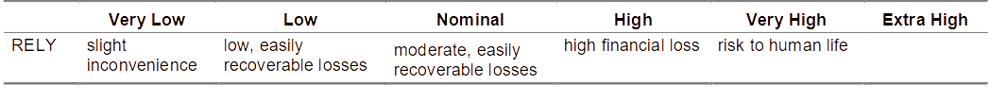
Product Factors
Required Software Reliability (RELY)
  Measures the extent to which the software must perform its intended function over a period of time.
  Ask: what is the effect of a software failure

Slide 51
Example Effort Multiplier Values for RELY
1.39
Low, Easily Recoverable Losses
1.15
Very Low
Low
Nominal
High
Very High
1.0
Slight Inconvenience
Moderate, Easily Recoverable Losses
High Financial Loss
Risk to Human Life
0.88
0.75

Slide 52
Example Effort Multiplier Values for RELY
E.g. a highly reliable system costs 39% more than a nominally reliable system 1.39/1.0=1.39)
or a highly reliable system costs 85% more than a very low reliability system (1.39/.75=1.85)

Slide 53
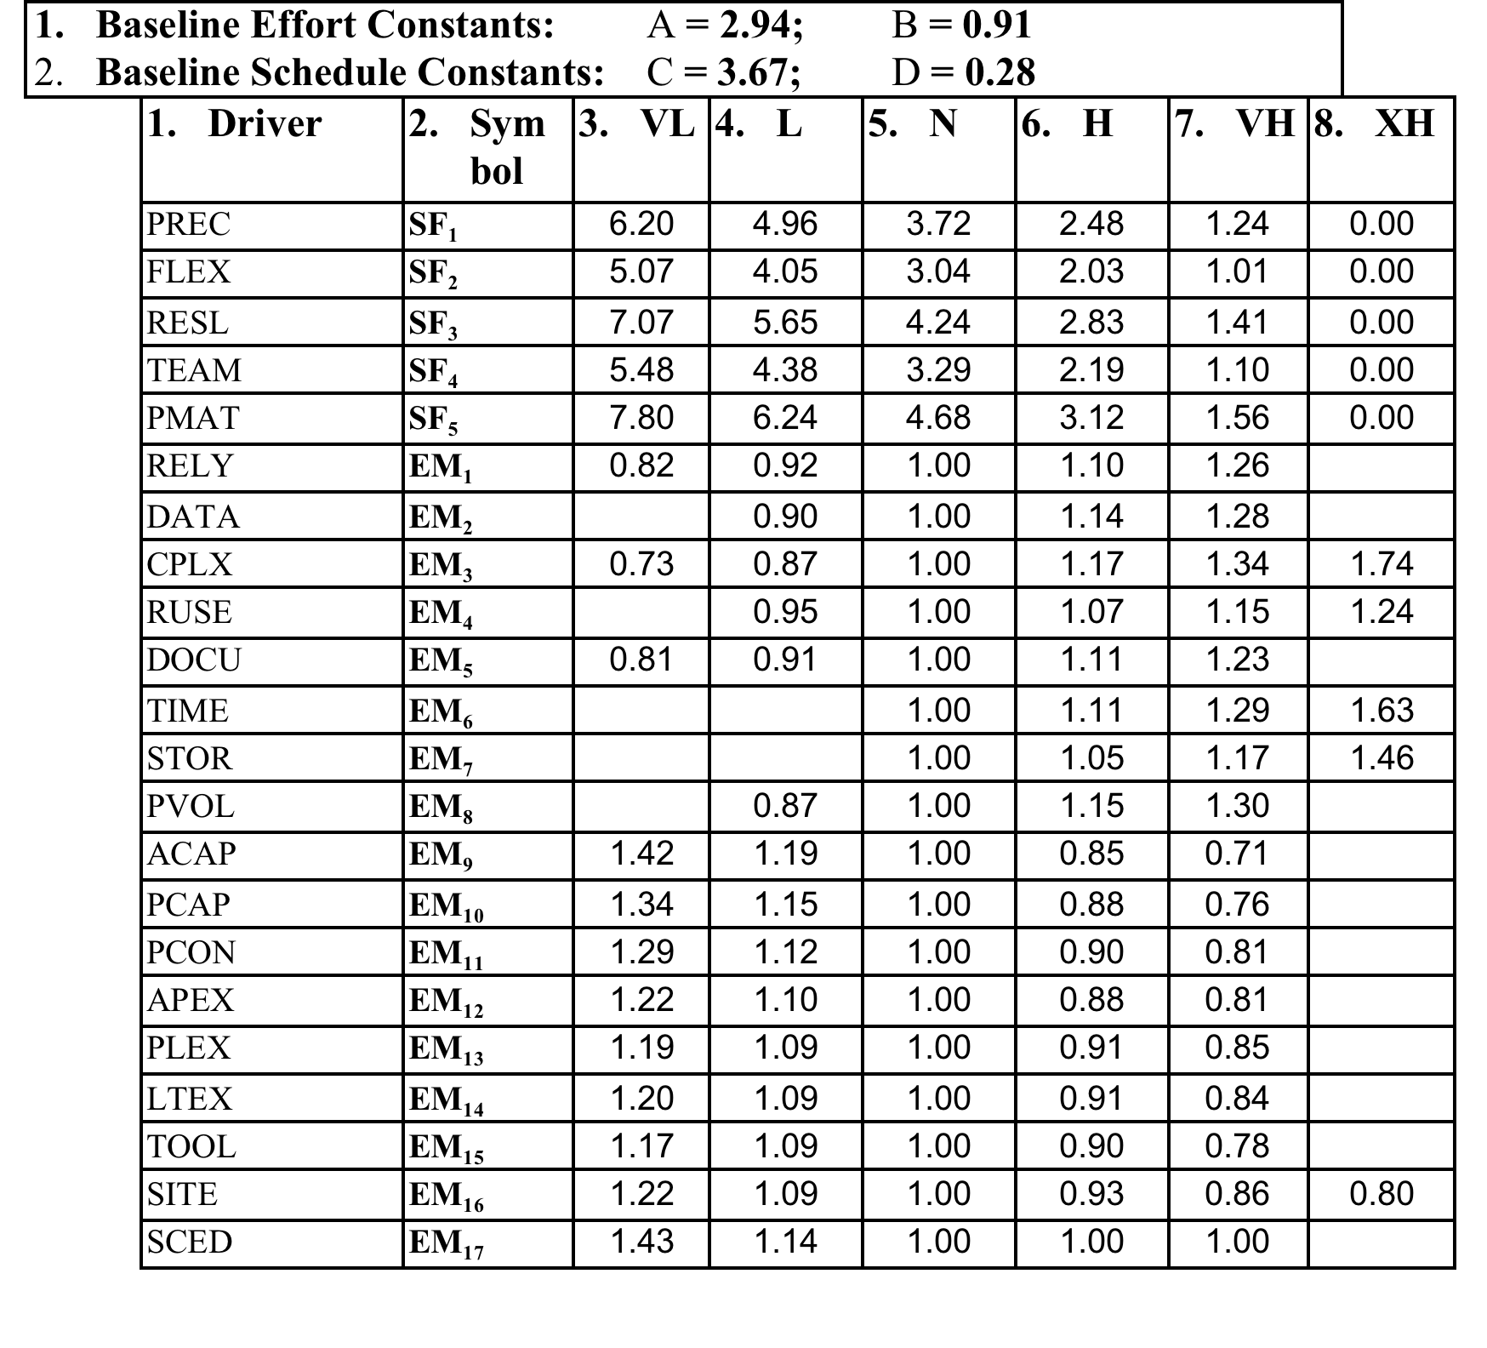
Table 2.50 COCOMO II Scale Factors & Multipliers

Slide 54
Example Table-Based Estimation
Effort (person-months) = 2.94 (Size)^{E} Π Σm_{i}
E is an exponent for the diseconomy of scale dependent on five additive scale drivers according to b = .91 + .01 × Σ SF_{i},
where SF_{i} is a weighting factor for i^{th} scale driver
Example estimate: Size=30 KSLOC; RELY, CPLX = High; TOOL= High; All other scale factors and cost drivers = Nominal
E = 0.91 + .01 (3.72+3.04+4.24+3.29+4.68) = 0.91 + .1897 = 1.0997 ~ 1.1
Σm_{i} = (1.10) × (1.17) × (0.90) = 1.1583
Size = 30 KSLOC
Effort = 2.94 × 30 ^{1.1 ×} 1.1583 = 143.55 person-months

Slide 55
End of Unit 02 : Project Management, Planning and Risk Analysis

