Slide 1
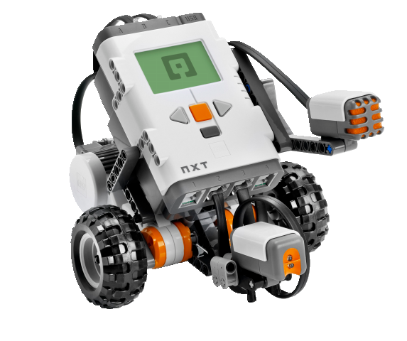
OBJECT-ORIENTED SOFTWARE ENGINEERING
UNIT 02 : PROJECT MANAGEMENT, PLANNING AND RISK ANALYSIS
© 2019, PRAMOD PARAJULI

Slide 2
Disclaimer
These slides are part of teaching materials for Object Oriented Software Engineering (OOSE). These slides do not cover all aspect of learning OOSE, nor are these be taken as primary source of information. As the core textbooks and reference books for learning the subject has already been specified and provided to the students, students are encouraged to learn from the original sources.
Contents in these slides are copyrighted to the instructor and authors of original texts where applicable.

Slide 3


Slide 4
Project management spectrum,
4 Ps
UNIT 02: PROJECT MANAGEMENT
Reference: Pressman, R., Software Engineering – A Practitioner’s Approach, 5th Ed., Chapter 3

Slide 5
People
The players
  Senior managers
  Project managers
  Practitioners
  Customers
  End users
Team leaders
  Motivate people
  Build and organise team
  Bring ideas/innovations
Software team
  n individuals assigned to m different tasks
  n individuals assigned to m different tasks (m < n)
  n individuals organised into t teams, each team assigned to one or more tasks
  Modes:
  democratic decentralised (DD), controlled decentralised (CD), and controlled centralised (CC)

Slide 6
People
7 factors to consider while planning the structure of software engineering teams:
The difficulty of the problem to be solved.
The size of the resultant program(s) in lines of code or function points
The time that the team will stay together (team lifetime).
The degree to which the problem can be modularized.
The required quality and reliability of the system to be built.
The rigidity of the delivery date.
The degree of sociability (communication) required for the project.

Slide 7
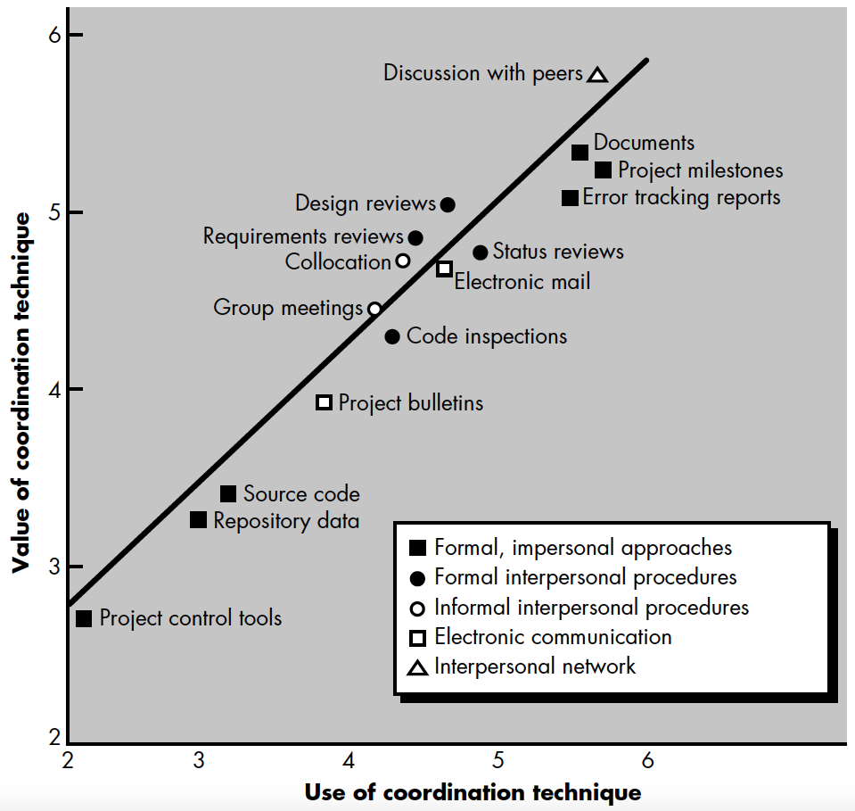
Coordination and communication issues
Formal, impersonal approaches
Formal, interpersonal procedures
Informal, interpersonal procedures
Electronic communication
Interpersonal networking

Slide 8
The product
Software scope
Context
Information objectives
Function and performance
Problem decomposition
How do we divide the problem into small manageable chunks?

Slide 9
The PROCESS
the linear sequential model
the prototyping model
the RAD model
the incremental model
the spiral model
the WINWIN spiral model
the component-based development model
the concurrent development model
the formal methods model
the fourth generation techniques model

Slide 10
The PROCESS
Product characteristics
Customer requirements
Project environment
Process ?

Slide 11
Melding the product and the process
Customer communication
Planning
Risk analysis
Customer evaluation
Construction and release
Engineering

Slide 12
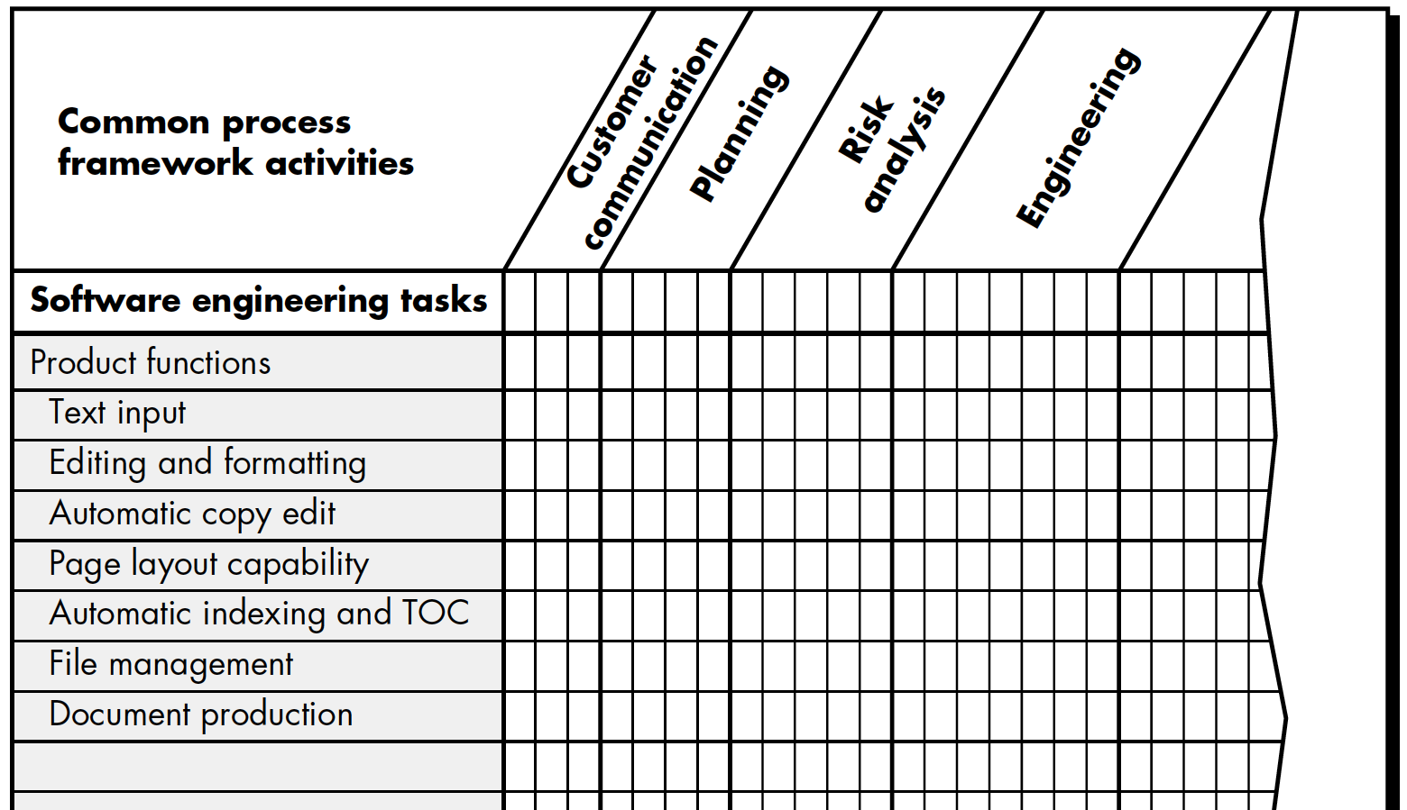
Melding the product and the process
(AN EXAMPLE)

Slide 13
PROCESS DECOMPOSITION
Review customer request
Plan and schedule a formal, facilitated meeting with the customer
Conduct research to specify the proposed solution and existing approaches
Prepare a ‘working document’ and an agenda for the formal meeting
Conduct the meeting
Jointly develop mini-specs that reflect data, function, and behavioral features of the software
Review each mini-spec for correctness, consistency and lack of ambiguity
Assemble the mini-specs into a scoping document
Review the scoping document with all concerned
Modify the scoping document as required

Slide 14
The project
Challenges
Software people don’t understand their customer’s needs.
The product scope is poorly defined.
Changes are managed poorly.
The chosen technology changes.
Business needs change [or are ill-defined].
Deadlines are unrealistic.
Users are resistant.
Sponsorship is lost [or was never properly obtained].
The project team lacks people with appropriate skills.
Managers [and practitioners] avoid best practices and lessons learned

Slide 15
Approaches
Pareto Principal: 80-20
Start on the right foot – with proper autonomy, team, resources, ...
Maintain the momentum – encourage, retain, interact, ...
Track progress – quantify activities, check milestones, ...
Make smart decisions – reuse, risk transfer, buy, follow standards, ...
Conduct a post-mortem analysis – experiential learning, analyze project using metrics, get feedback, ...

Slide 16
The W⁵hh principle
Analyse following questions
Why is the system being developed? – customer validation
What will be done, by when? – scheduling, milestones, ...
Who is responsible for a function? – roles, assignments, ...
Where are they organizationally located? – stakeholders’ responsibilities
How will the job be done technically and managerially?
How much of each resource is needed?

Slide 17
Critical practices
Every project must go through various critical practices.
Formal risk management
Empirical cost and schedule estimation
Metric-based project management
Earned value tracking
Defect tracking against quality targets
People-aware program management

Slide 18
Feasibility study
UNIT 02: PROJECT MANAGEMENT
References: Various

Slide 19
Feasibility study
Deciding whether or not the proposed system is worthwhile – both for customer and the developer
A short focused study that checks
  If the system contributes to organisational objectives
  If the system can be engineered using current technology and within budget
  If the system can be integrated with other systems that are used

Slide 20
Feasibility study
Questions to be asked
What if the system wasn’t implemented?
What are current process problems?
How will the proposed system help?
What will be the integration problems?
Is new technology needed? What skills?
What facilities must be supported by the proposed system?

Slide 21
Feasibility study
Types
Economic – is the project cost reasonable?
Technical – are the technologies required to build the product available?
Operational – is our schedule inline with customer’s schedule? do we have sufficient expertise?

Slide 22
Resources
Human – roles of teams, industry experts, customer etc. is important
Reusable software – libraries, SDKs, tool-chains, software components, tools etc.
Software development environment – physical environment as well as organisation, workflow, cultural context, etc.

Slide 23
Project metrics
UNIT 02: PROJECT MANAGEMENT
Reference: Pressman, R., Software Engineering – A Practitioner’s Approach, 5th Ed., Chapter 4

Slide 24
Measures and metrics
Software process and project metrics are quantitative measures that enable software engineers to gain insight into the efficiency of the software process and the projects conducted using the process framework.
In software project management, we are primarily concerned with productivity and quality metrics.
The four reasons for measuring software processes, products, and resources ;
  to characterize,
  to evaluate,
  to predict, and
  to improve.

Slide 25
Process metrics
Private process metrics (e.g. defect rates by individual or module) are known only to the individual or team concerned.
Public process metrics enable organizations to make strategic changes to improve the software process.
Metrics should not be used to evaluate the performance of individuals.
Statistical software process improvement helps and organization to discover where they are strong and where are week.

Slide 26
Project metrics
Software project metrics
are used by the software team to adapt project workflow and technical activities.
Project metrics
are used to avoid development schedule delays, to mitigate potential risks, and to assess product quality on an on-going basis.
Every project should measure its inputs (resources), outputs (deliverables), and results (effectiveness of deliverables).

Slide 27
Software measurement
Direct measures of software engineering process include cost and effort.
Direct measures of the product include
lines of code (LOC), execution speed, memory size, defects per reporting time period.
Indirect measures examine the quality of the software product itself
(e.g. functionality, complexity, efficiency, reliability, maintainability).

Slide 28
Size-oriented metrics
Derived by normalizing (dividing) any direct measure (e.g. defects or human effort) associated with the product or project by LOC.
Size oriented metrics are widely used but their validity and applicability is widely debated.

Slide 29
function-oriented metrics
Function points - computed from direct measures of the information domain of a business software application and assessment of its complexity.
Once computed function points are used like LOC to normalize measures for software productivity, quality, and other attributes.
Feature points and 3D function points - provide a means of extending the function point concept to allow its use with real-time and other engineering applications.
The relationship of LOC and function points depends on the language used to implement the software.

Slide 30
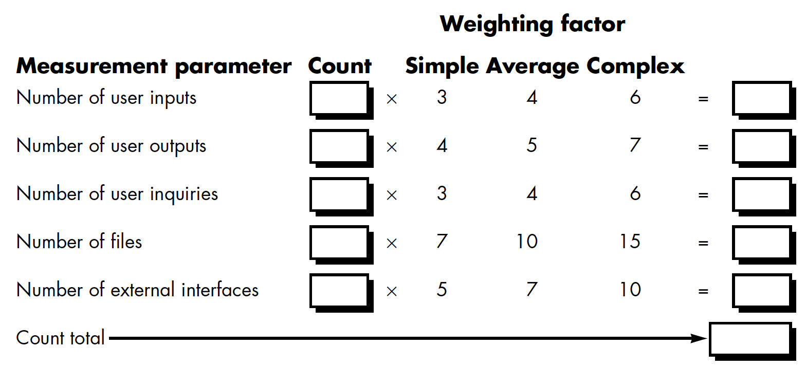
function-oriented metrics

Slide 31
function-oriented metrics
Every Fi relates to;
Does the system require reliable backup and recovery?
Are data communications required?
Are there distributed processing functions?
Is performance critical?
Will the system run in an existing, heavily utilized operational environment?
Does the system require on-line data entry?
Does the on-line data entry require the input transaction to be built over multiple screens or operations?
Are the master files updated on-line?
Are the inputs, outputs, files, or inquiries complex?
Is the internal processing complex?
Is the code designed to be reusable?
Are conversion and installation included in the design?
Is the system designed for multiple installations in different organizations?
Is the application designed to facilitate change and ease of use by the user?

Slide 32
Extended fp and 3d
Refer to Pressman, R., Software Engineering – A practitioner’s Approach
Chapter 4

Slide 33
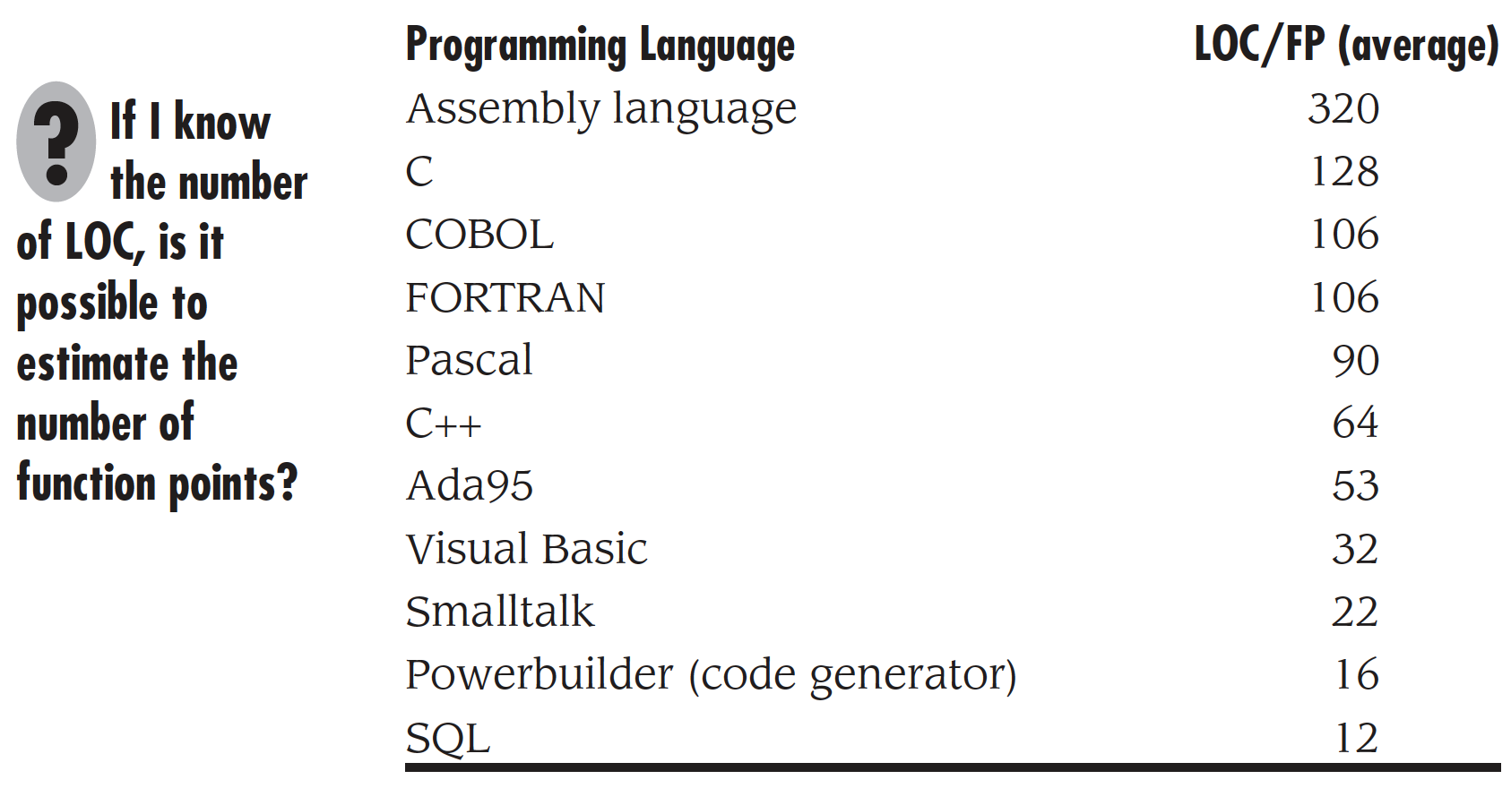
Metrics interoperability

Slide 34
Software Quality Metrics
Factors assessing software quality come from three distinct points of view (product operation, product revision, product modification).
Software quality factors requiring measures include correctness (defects per KLOC), maintainability (mean time to change), integrity (threat and security), and usability (easy to learn, easy to use, productivity increase, user attitude).
Defect removal efficiency (DRE) is a measure of the filtering ability of the quality assurance and control activities as they are applied through out the process framework.

Slide 35
Software Quality Metrics
Equations of Integrity and DRE
Refer to Pressman, R., Software Engineering – A practitioner’s Approach
Chapter 4

Slide 36
OBJECT ORIENTED METRICS
  No. of scenario
  No. of key classes
  No. of support classes
  No. of subsystems

Slide 37
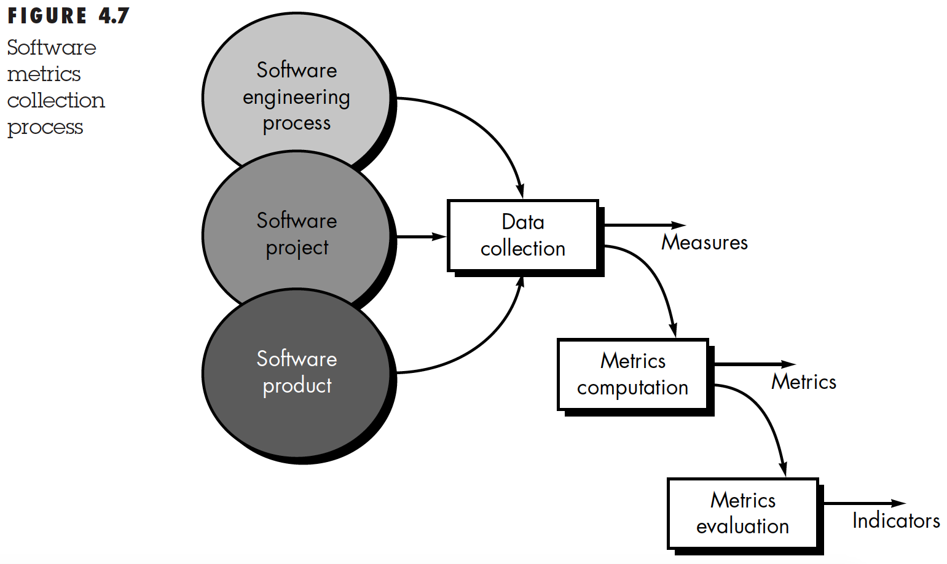
Making use of measurements
Notes:
Measures: software size, time, cost etc.
Metrics: Units of measurements such as LOC, Function points, Man months, ...
Indicators: Make decisions possible

Slide 38
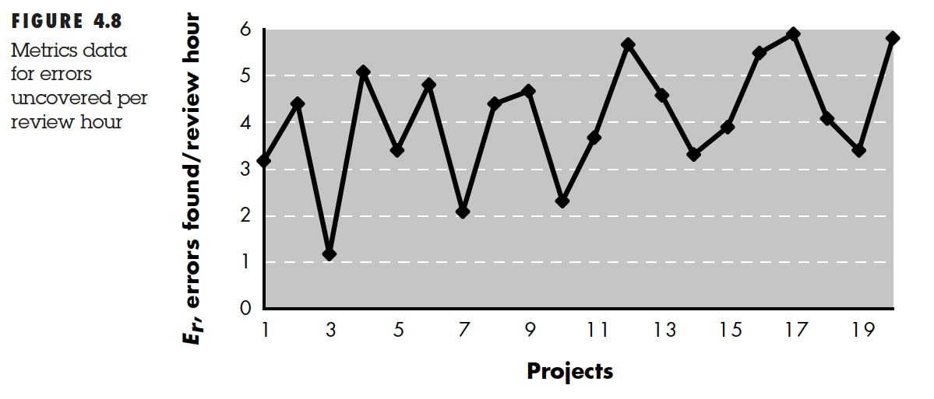
Making use of measurements

Slide 39
Integrating Metrics with Software Process
Many software developers do not collect measures.
Without measurement it is impossible to determine whether a process is improving or not.
Baseline metrics data should be collected from a large, representative sampling of past software projects.
Getting this historic project data is very difficult, if the previous developers did not collect data in an on-going manner.

Slide 40
Statistical Process Control
It is important to determine whether the metrics collected are statistically valid and not the result of noise in the data.
Control charts provide a means for determining whether changes in the metrics data are meaningful or not.
Zone rules identify conditions that indicate out of control processes (expressed as distance from mean in standard deviation units).

Slide 41
Metrics for Small Organizations
Most software organizations have fewer than 20 software engineers.
Best advice is to choose simple metrics that provide value to the organization and don’t require a lot of effort to collect.
Even small groups can expect a significant return on the investment required to collect metrics, if this activity leads to process improvement.

Slide 42
Establishing a Software Metrics Program
Identify business goal
Identify what you want to know
Identify sub-goals
Identify sub-goal entities and attributes
Formalize measurement goals
Identify quantifiable questions and indicators related to sub-goals
Identify data elements needed to be collected to construct the indicators
Define measures to be used and create operational definitions for them
Identify actions needed to implement the measures
Prepare a plan to implement the measures

Slide 43
ROLE OF COMMUNICATION IN PROJECT
MESSENGER GAME

Slide 44
Messenger game
Observer: look at the original design, describe to messenger
verbally
Messenger: listen to the observer, then tell builders
Builder/s: listen to the messenger and build the product
Referee: can nod (yes) or shake (no) their heads. Are allowed to
view original design.
Rule 01: messenger can not see the original nor the final
Rule 02: Referee can not speak, can not move hands.
Rule 03: Maximum time allowed: 30 minutes

Slide 45

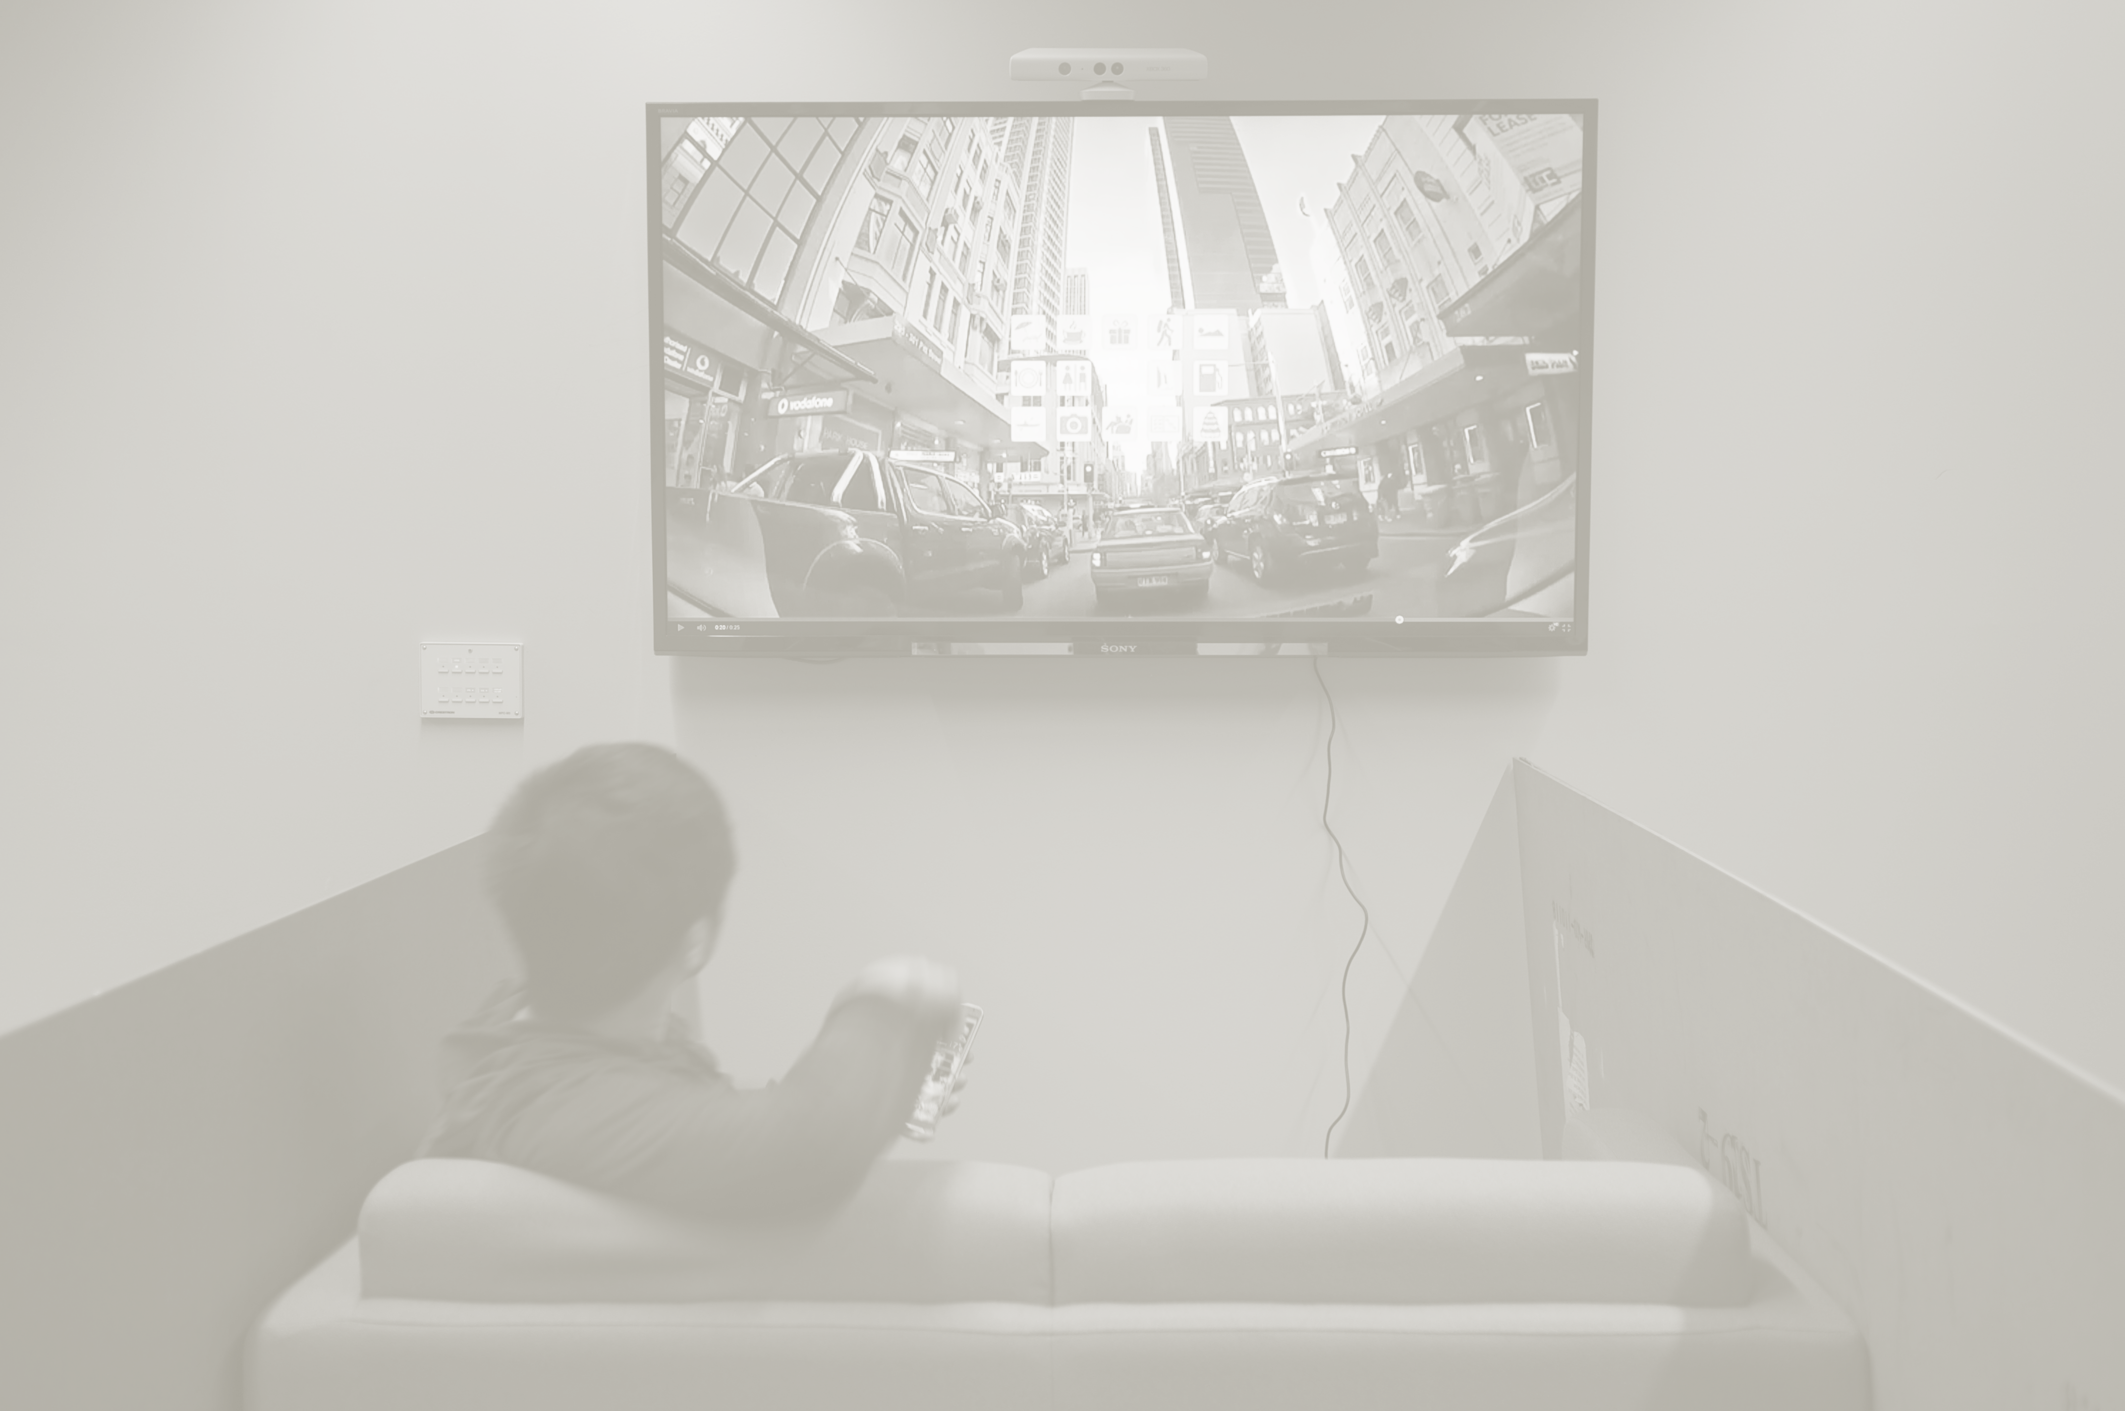
Messenger game LAYOUT
Referee
Observer
Messenger
Builder/s

Slide 46
Messenger game - awards
Best team – will get reward
2 best analysis will also get reward.

Slide 47
Messenger game - reflections
Observer (System analysts, end-users)
Messenger (System analysts, analyst programmers)
Builder/s (Developers, project managers)
Referee (Customer validation, QA)

Slide 48
Assignments and project works
DISCUSSION ON

Slide 49
Software project planning
UNIT 02: PROJECT MANAGEMENT
Reference: Pressman, R., Software Engineering – A Practitioner’s Approach, 5th Ed., Chapter 5

Slide 50


Slide 51
estimating
Project complexity – cohesiveness, inter and intra-modular interactions
Project size – increase in size increases interactions among modules
Degree of structural uncertainty – change in structure of software changes interactions
Risk – quantified uncertainty in estimations of resources, cost and schedule.

Slide 52
PROJECT PLANNING - OBJECTIVE
To provide a framework that enables software manager to make a reasonable estimate of resources, cost, and schedule.
Project outcomes should be bounded by 'best case' and 'worst case' scenarios.
Estimates should be updated as the project progresses.

Slide 53
Software scope
Describes
  the data to be processed and produced,
  control parameters,
  function,
  performance,
  constraints,
  external interfaces, and
  reliability.
Often functions described in the software scope statement are refined to allow for better estimates of cost and schedule.

Slide 54
Software Project Estimation Options
Delay estimation until late in the project.
Base estimates on similar projects already completed.
Use simple decomposition techniques to estimate project cost and effort.
Use empirical models for software cost and effort estimation.
Automated tools may assist with project decomposition and estimation.

Slide 55
Decomposition techniques
Software sizing (fuzzy logic, function point, standard component, change)
Problem-based estimation (using LOC decomposition focuses on software functions, using FP decomposition focuses on information domain characteristics)
Process-based estimation (decomposition based on tasks required to complete the software process framework)

Slide 56
Empirical Estimation Models
Typically derived from regression analysis of historical software project data with estimated person-months as the dependent variable and KLOC or FP as independent variables.
Constructive Cost Model (COCOMO) is an example of a static estimation model.
The Software Equation is an example of a dynamic estimation model.

Slide 57
Make-Buy Decision
It may be more cost effective to acquire a piece of software rather than develop it.
Decision tree analysis provides a systematic way to sort through the make-buy decision.
As a rule outsourcing software development requires more skillful management than does in-house development of the same product.
Decision-trees
Using outsourcing, offshoring, insourcing etc.

Slide 58
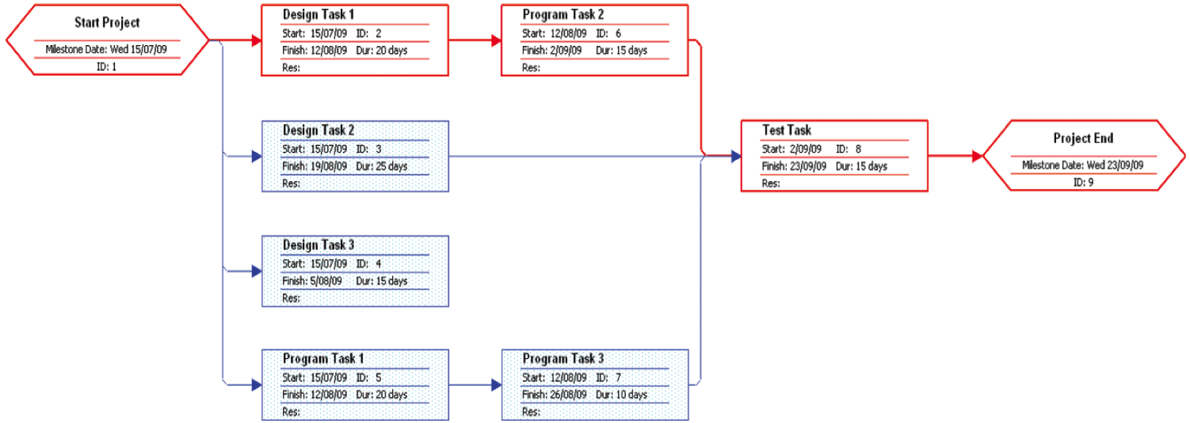
Planning tools
PERT (Performance Evaluation and Review Technique)

Slide 59
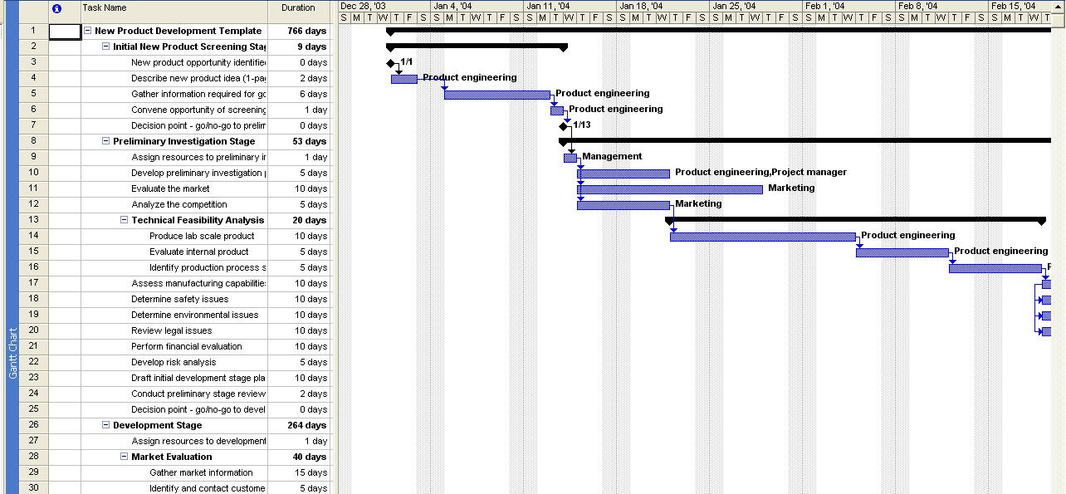
Planning tools
Gantt chart

Slide 60
Risk analysis and management
UNIT 02: PROJECT MANAGEMENT
Reference: Pressman, R., Software Engineering – A Practitioner’s Approach, 5th Ed., Chapter 6

Slide 61
‘If you don’t actively attack the risks, they will actively attack you.’
~ Tom Gilb

Slide 62
Risk management
Risk management is concerned with identifying risks and drawing up plans to minimise their effect on a project.
A risk is a loss of value due to some adverse circumstance that might occur (loss due to uncertainty).
  Project risks affect schedule or resources
  Product risks affect the quality or performance of the software being developed
  Business risks affect the organisation developing or procuring the software

Slide 63
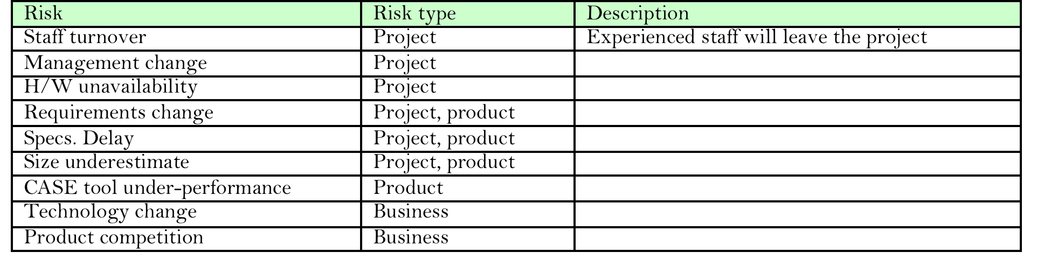
Software Risks
Project risks – project schedule and resources
Product risks – quality or performance of the software product
Business risks – organization

Slide 64
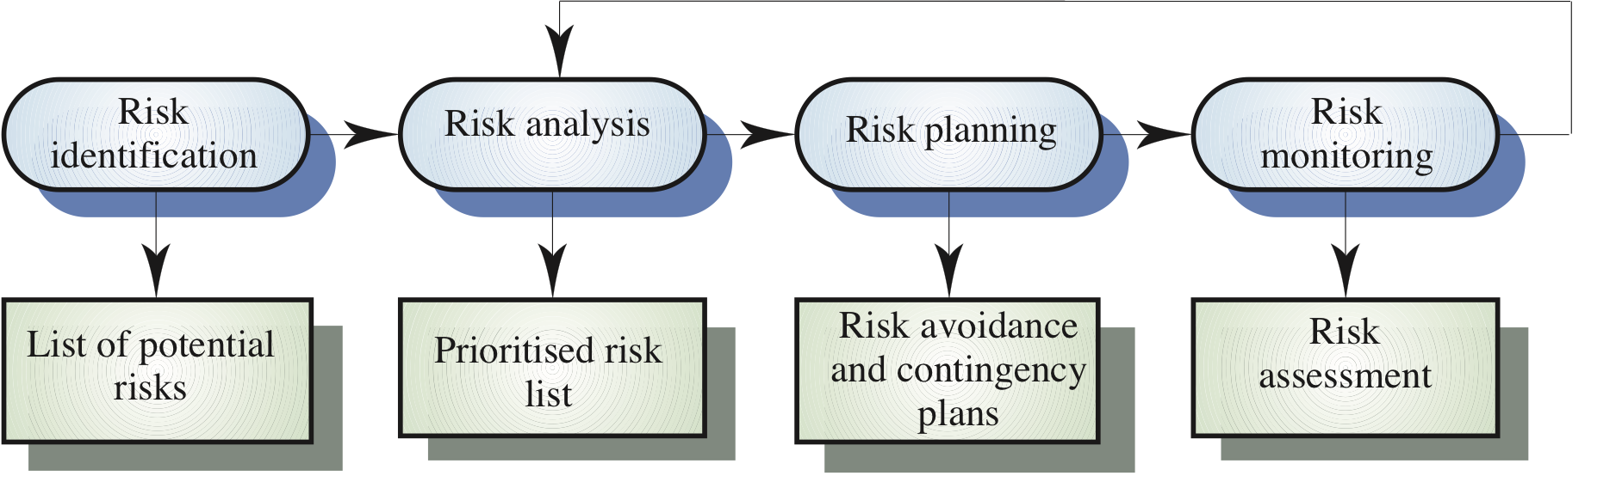
Risk management process

Slide 65
Risk management process
Risk identification
  Identify project, product and business risks
Risk analysis
  Assess the likelihood and consequences of these risks
Risk planning
  Draw up plans to avoid or minimise the effects of the risk
Risk monitoring
  Monitor the risks throughout the project

Slide 66
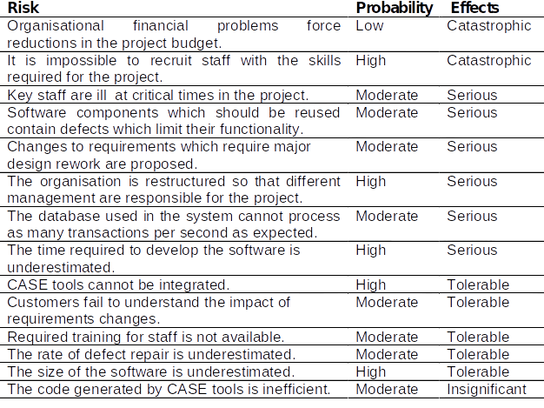
Risk analysis
Assess probability and seriousness of each risk
Probability may be very low, low, moderate, high or very high
Risk effects might be catastrophic, serious, tolerable or insignificant

Slide 67
Risk item checklist
Product size — risks associated with the overall size of the software to be built or modified.
Business impact — risks associated with constraints imposed by management or the marketplace.
Customer characteristics —risks associated with the sophistication of the customer and the developer's ability to communicate with the customer in a timely manner.
Process definition — risks associated with the degree to which the software process has been defined and is followed.
Development environment — risks associated with the availability and quality of the tool.
Technology to be built — risks associated with the complexity of the system to be built
Staff size and experience

Slide 68
Assessing Overall Project Risk
Have top software and customer managers formally committed to support the project?
Are end-users enthusiastically committed to the project and the system/product to be built?
Are requirements fully understood by the software engineering team and their customers?
Have customers been involved fully in the definition of requirements?
Do end-users have realistic expectations?
Is project scope stable?
Does the software engineering team have the right mix of skills?
Are project requirements stable?
Does the project team have experience with the technology to be implemented?
Is the number of people on the project team adequate to do the job?
Do all customer/user constituencies agree on the importance of the project and on the requirements for the system/product to be built?

Slide 69
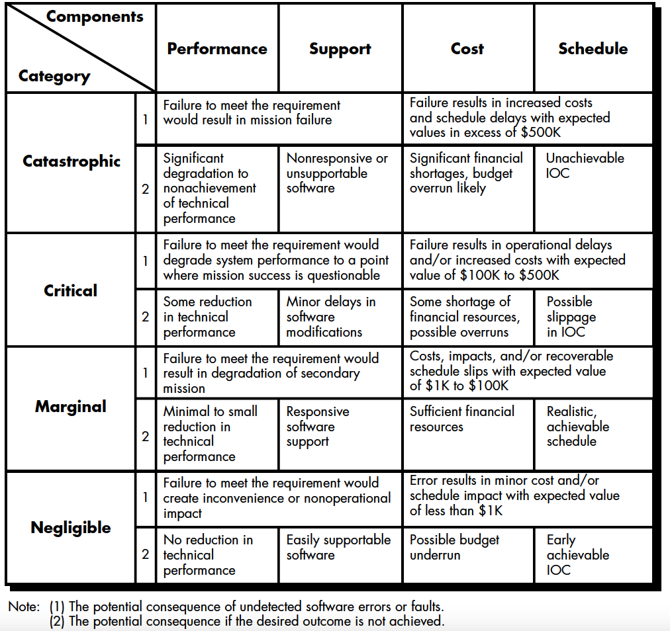
Risk components and drivers

Slide 70
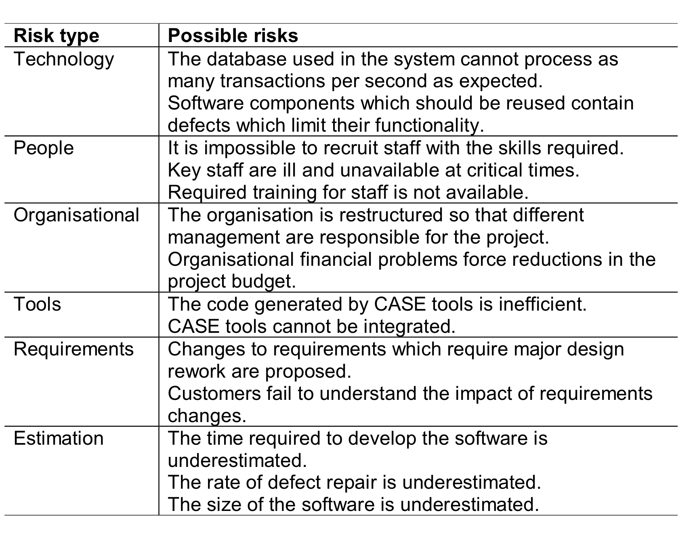
Risk identification

Slide 71
Risk matrix and risk table

Slide 72
Risk impact
Risk exposure (RE) = risk probability * risk impact
A triplet can represent risk [r_{i}, l_{i}, x_{i}]
Risk refinement - Given that <condition> then there is concern that (possibly) <consequence>.
e.g. Certain reusable components were developed by a third party with no knowledge of internal design standards.

Slide 73
Risk planning
Consider each risk and develop a strategy to manage that risk
Reactive vs. proactive approach
Avoidance strategies
  The probability that the risk will arise is reduced
Minimisation strategies
  The impact of the risk on the project or product will be reduced
Contingency plans
  If risk arises, contingency plans are to deal with that risk
Risk appetite, risk mitigation, risk transfer

Slide 74
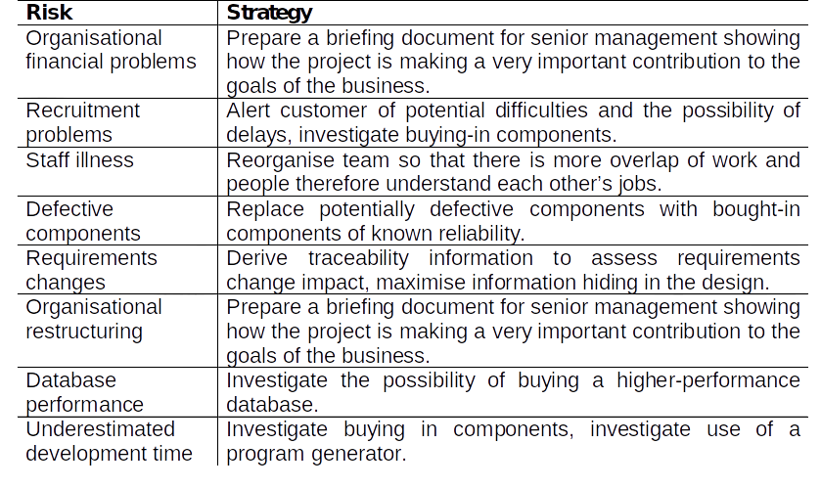
Risk management strategies

Slide 75
Risk mitigation example – employee turn over and possible steps
Meet with current staff to determine causes for turnover (e.g., poor working conditions, low pay, competitive job market).
Mitigate those causes that are under our control before the project starts.
Once the project commences, assume turnover will occur and develop techniques to ensure continuity when people leave.
Organize project teams so that information about each development activity is widely dispersed.
Define documentation standards and establish mechanisms to be sure that documents are developed in a timely manner.
Conduct peer reviews of all work (so that more than one person is "up to speed”).
Assign a backup staff member for every critical technologist.

Slide 76
Risk monitoring
Assess each identified risks regularly to decide whether or not it is becoming less or more probable
Also assess whether the effects of the risk have changed
Each key risk should be discussed at management progress meetings

Slide 77
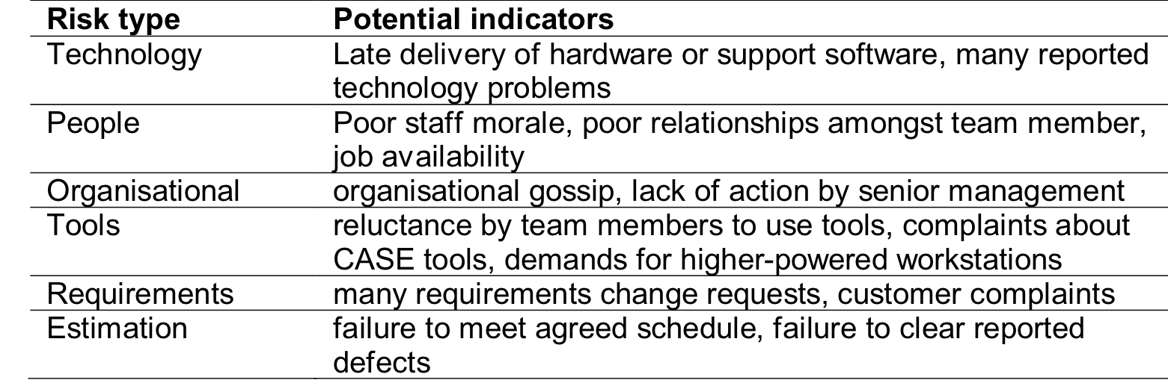
Risk factors

Slide 78
End of Unit 02 : Project Management, Planning and Risk Analysis

