Slide 1
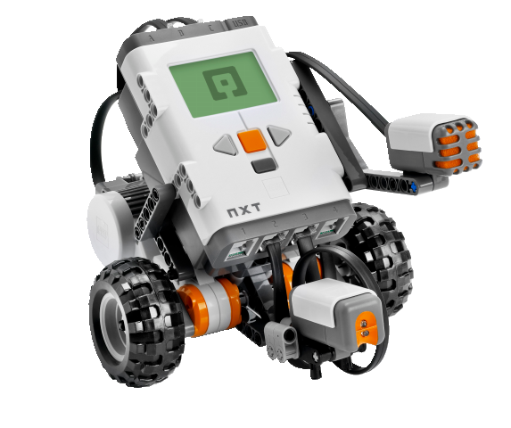
OBJECT-ORIENTED SOFTWARE ENGINEERING
UNIT 03 : Object Orientation Fundamentals
© 2019, PRAMOD PARAJULI

Slide 2
Disclaimer
These slides are part of teaching materials for Object Oriented Software Engineering (OOSE). These slides do not cover all aspect of learning OOSE, nor are these be taken as primary source of information. As the core textbooks and reference books for learning the subject has already been specified and provided to the students, students are encouraged to learn from the original sources.
Contents in these slides are copyrighted to the instructor and authors of original texts where applicable.

Slide 3


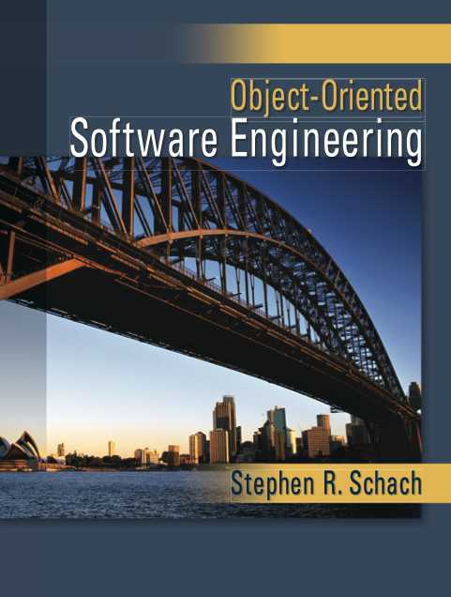


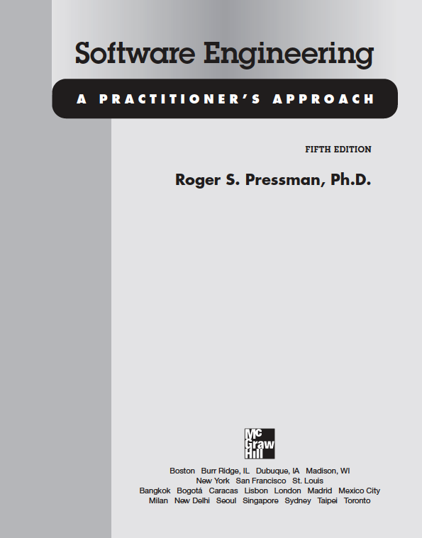

Slide 4
Introduction of OOAD, OO Life Cycle
Unified Modeling Language
Models, use cases
(Rational) Unified process

Slide 5
SOFTWARE ENGINEERING
UNIT 03: Object Orientation Fundamentals

Slide 6
Organizations and workflows
System’s view
Data-driven view
Functional view
Event-based view
State machine view
Notes:
How can the Social Robotics example be viewed as?

Slide 7
Software AS A PRODUCT
Programs
Associated documents
  System documentation
  Manuals and websites
  User documentation/guide
  Advertisements
Configuration data
Additional services – trainings

Slide 8
Software types
Generally, two types
Generic
  Developers get full control
Bespoke (customised)
  Users get full control
  (Classroom discussion)
System software
Application software
Mobile software/app
Web applications
Production line software
Embedded software
AI software
Ubiquitous computing
Wearable computing
OpenSource software
Legacy software
...

Slide 9
Software characteristics
Software is developed, but not manufactured.
Software doesn’t wear out.
Most software are custom built.
Flexibility vs. complexity
Software qualities
  Portability
  Maintainability
  Modular
  Intuitive (ease of use)
  Reusability
  Stable
  Dependable

Slide 10
SOFTWARE EVOLUTION
THE EARLY YEARS
1950s
Batch oriented
Limited distribution
Custom Software
THE SECOND ERA
1960s – 1970S
Multi-user
Real-time
Database
Product Software
THE THIRD ERA
1980s – 1990S
Distributed systems
Embedded intelligence
Low cost h/w
Consumer impact
THE FOURTH ERA
2000s –
Powerful desktops
OO Technologies
Expert Systems
Parallel computing
Data-centred

Slide 11
CURRENT TREND
Lean development
Cloud computing
Cognitive computing
Software as a Service
AI as a Service!
Wearable computing
Quantum computation
Data analytics
Millions of lines of code
Natural interactions
Collaborative development
Web apps
UX first!
Disruptive technologies!

Slide 12
Complex Systems
❃ Why would a system be complex?
Notes:
Think of nature, computer, human etc. as complex system.

Slide 13
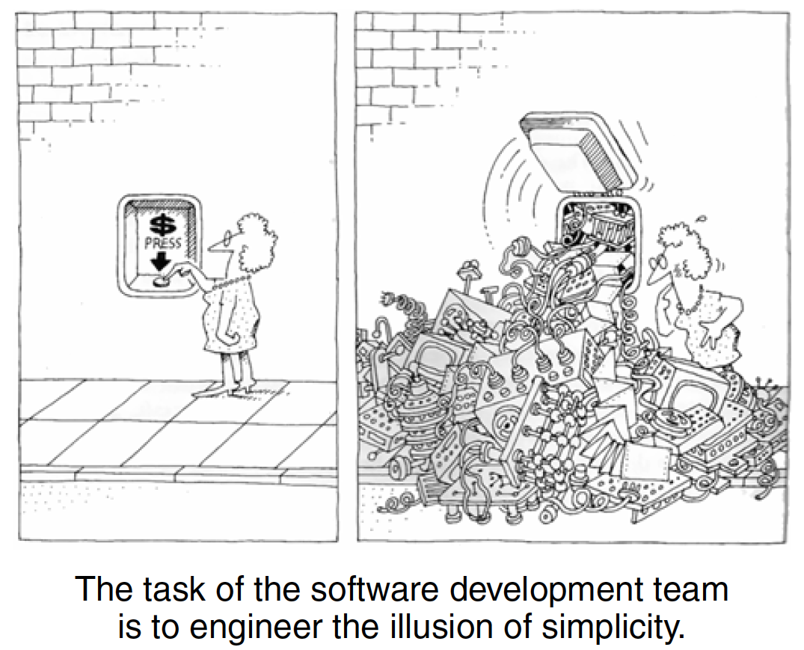
Software complexity
Need to deliver – flexibility, solid performance
End-users have different views
Problem domain is complex
Difficulty of managing the
development process
Difficulty in modeling behavior of discrete systems

Slide 14
5 attributes of complex system
Hierarchic structure – follow hierarchic structure of some kind
Relative primitives – relative measures on primitive operations
Separation of concerns – decomposable and non-decomposable components
Common patterns – repetitive patterns in the structure
Stable intermediate forms – complex system when evolves from stable simple system

Slide 15
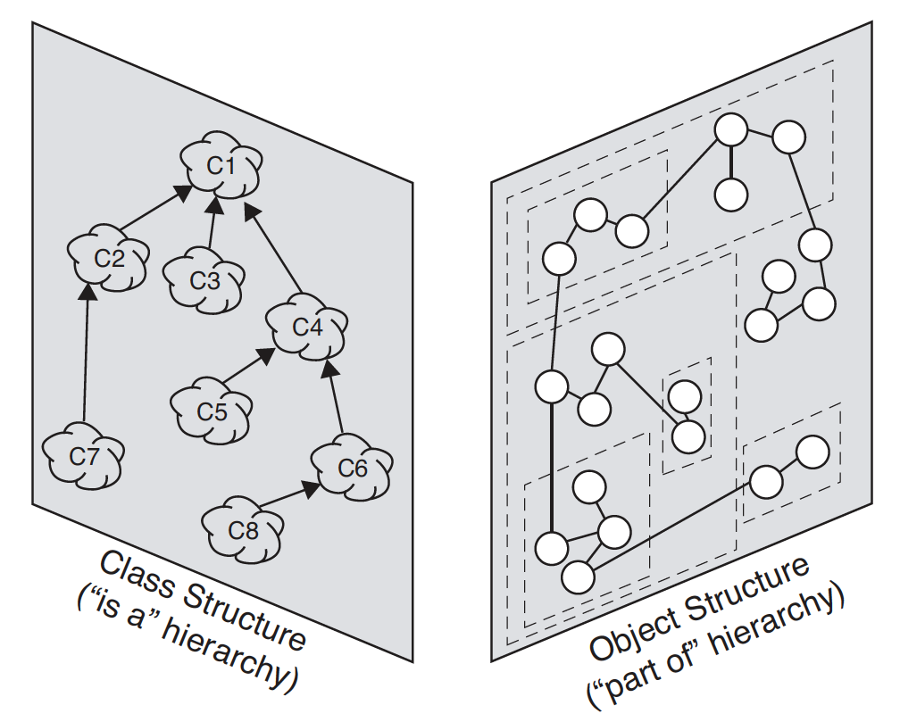
Organised and disorganised complexity
Finding abstractions help organise complexity
Canonical form of complexity – hierarchical: part of, is a
Humans are limited in understanding complexity in detail

Slide 16
Managing chaos
Decomposition – decompose system into manageable chunks (algorithmic decomposition, object-oriented decomposition)
Abstraction – generalized common components
Hierarchy – follow hierarchical structure

Slide 17
Designing complex systems
Engineering is a science as well as an art
Design - Stroustrup suggests, “the purpose of design is to create a clean and relatively simple internal structure, sometimes also called an architecture. . . . A design is the end product of the design process”
Model building – multiple models
Software design – using notation, process, and tools

Slide 18
Models of ‘oose’
Object oriented analysis and design
Unified Modeling Language
Rational Unified Process
Open Unified Process

Slide 19
Useful links
Software Engineering Institute: sei.cmu.edu
Object Management Group: omg.org
Rational Unified Process: ibm.com
Open Unified Process: epf.eclipse.org/wikis/openup/
Roger S. Presman: rspa.com/spi/

Slide 20
Software engineering
❃ What is software engineering?

Slide 21
Software dev. Life cycle
Conceptualisation
...
Decommissioning

Slide 22
Software dev. Life cycle
Specification
Development
Integration and testing
Deployment

Slide 23
Introduction to Object orientation
UNIT 03: Object Orientation Fundamentals and UML
Reference: Philippe Kruchten, The Rational Unified Process – An Introduction, Third Edition, Addison Wesley, 2003

Slide 24
How object-orientation helps model complex systems?
How object-orientation helps reduce software/development risks?
What are software development problems?
What are the best practices of software development ?

Slide 25
Basic consideration
The world consists of;
Objects, and
Events

Slide 26
Functional vs object-oriented
Functional approach
Functions
Modules
Data structures
Shared space (monolithic)
Object oriented approach
Objects – properties (attributes)
Events – methods (capabilities)

Slide 27

Why object oriented approach?

Slide 28
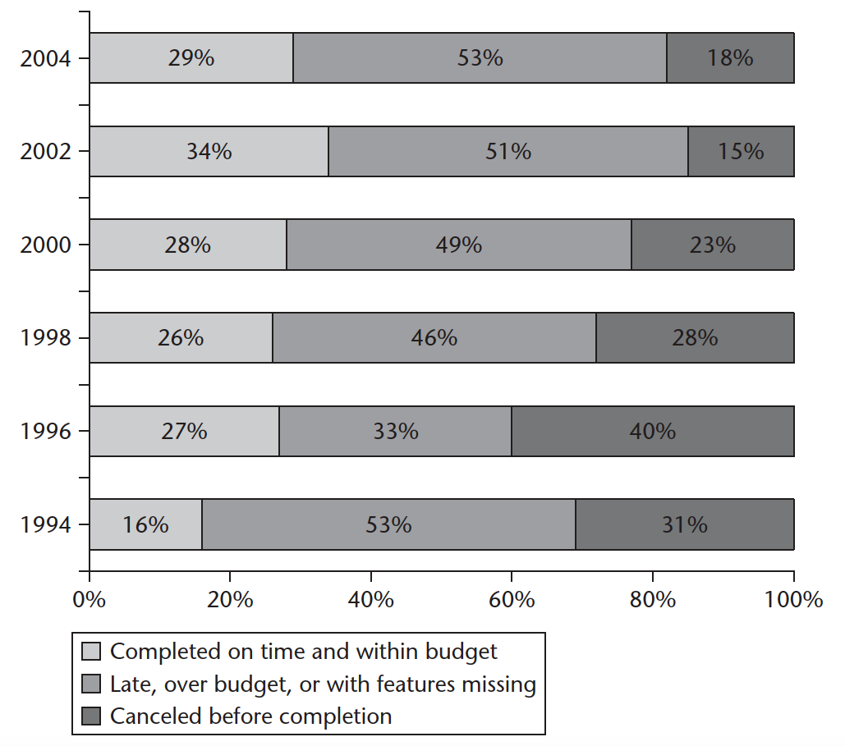
Software projects

Slide 29
Software development problems - symptoms
Inaccurate understanding of end-user needs
Inability to deal with changing requirements
Modules that don't fit together
Software that's hard to maintain or extend
Late discovery of serious project flaws
Poor software quality
Unacceptable software performance
Team members in each other's way, making it impossible to reconstruct who changed what, when, where, and why
An untrustworthy build-and-release process

Slide 30
Software development problems - roots
Ad hoc requirements management
Ambiguous and imprecise communication
Brittle architectures
Overwhelming complexity
Undetected inconsistencies in requirements, designs, and implementations
Insufficient testing
Subjective assessment of project status
Failure to attack risk
Uncontrolled change propagation
Insufficient automation

Slide 31
Software development – best practices
Develop software iteratively.
Manage requirements.
Use component-based architectures
Visually model software.
Continuously verify software quality.
Control changes to software.

Slide 32
1. Develop software iteratively
Serious misunderstandings are made evident early in the lifecycle when it's possible to react to them.
This approach enables and encourages user feedback so as to elicit the system's real requirements.
The development team is forced to focus on those issues that are most critical to the project and are shielded from those issues that distract them from the project's real risks.
Continuous, iterative testing enables an objective assessment of the project's status.

Slide 33
1. Develop software iteratively
Inconsistencies among requirements, designs, and implementations are detected early.
The workload of the team, especially the testing team, is spread more evenly throughout the project's lifecycle.
The team can leverage lessons learned and therefore can continuously improve the process.
Stakeholders in the project can be given concrete evidence of the project's status throughout its lifecycle.

Slide 34
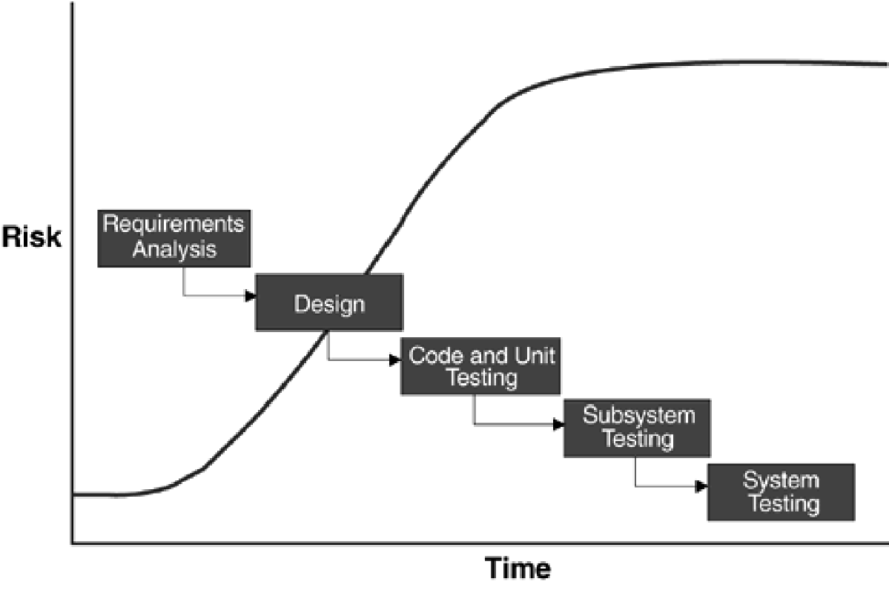
Waterfall model

Slide 35
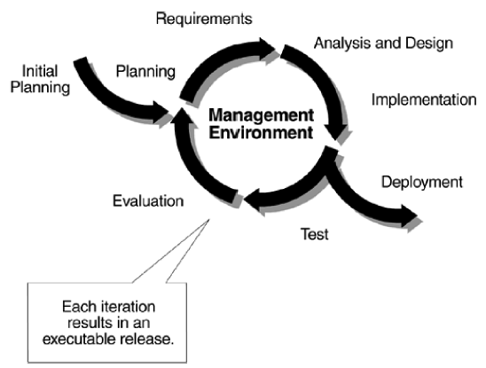
Iterative development

Slide 36
2. Manage requirements
A condition or capability a system must have.
A disciplined approach is built into requirements management.
Communications are based on defined requirements.
Requirements can be prioritized, filtered, and traced.
An objective assessment of functionality and performance is possible.
Inconsistencies are detected more easily.
With suitable tool support, it is possible to provide a repository for a system's requirements, attributes, and traces, with automatic links to external documents.

Slide 37
3. Use component-based architecture
Organisation of building blocks and their interactions.
Helps decision-making for
The organization of a software system
The selection of the structural elements and their interfaces by which the system is composed
Their behavior, as specified by the collaborations among those elements
The composition of these structural and behavioral elements into progressively larger subsystems
The architectural style that guides this organization: these elements and their interfaces, their collaborations, and their composition

Slide 38
3. Use component-based architecture
Benefits
Components facilitate resilient architectures.
Modularity enables a clear separation of concerns among elements of a system that are subject to change.
Reuse is facilitated by leveraging standardized frameworks (such as
COM+, CORBA, and EJB) and commercially available components.
Components provide a natural basis for configuration management.
Visual modeling tools provide automation for component-based development.

Slide 39
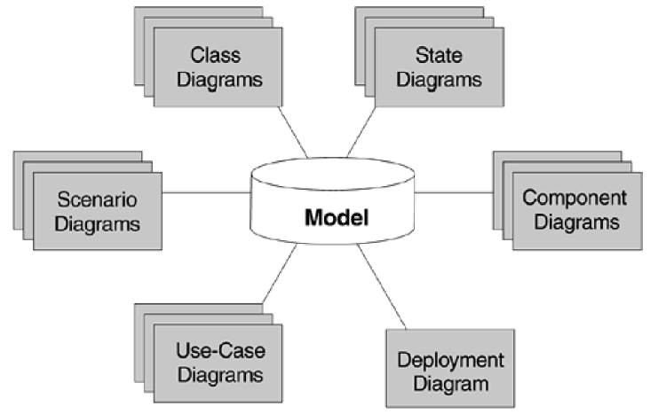
4. Visually model software
Model is a simplified representation. Modeling is a process of building a model with an objective.

Slide 40
4. Visually model software
Benefits
Use cases and scenarios unambiguously specify behavior.
Models unambiguously capture software design.
Non-modular and inflexible architectures are exposed.
Details can be hidden when necessary.
Unambiguous designs reveal their inconsistencies more readily.
Application quality starts with good design.
Visual modeling tools provide support for UML modeling.

Slide 41
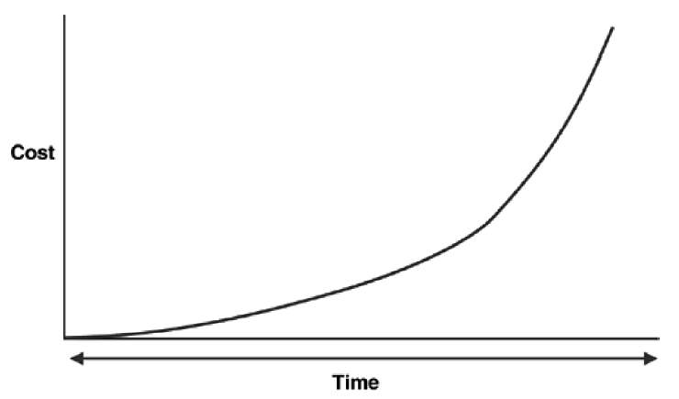
5. Continuously verify software quality
Cost of fixing problem

Slide 42
5. Continuously verify software quality
Benefits
Project status assessment is made objective, not subjective, because test results, not paper documents, are evaluated.
This objective assessment exposes inconsistencies in requirements, designs, and implementations.
Testing and verification are focused on areas of highest risk, thereby increasing the quality and effectiveness of those areas.
Defects are identified early, radically reducing the cost of fixing them.
Automated testing tools provide testing for functionality, reliability, and performance.

Slide 43
6. Control changes to software
Multiple stakeholders might result into chaos.
Dividing the software team into different teams, delegating tasks, and proper coordination is required.

Slide 44
6. Control changes to software
Benefits
The workflow of requirements changes is defined and repeatable.
Change requests facilitate clear communications.
Isolated workspaces reduce interference among team members working in parallel.
Change rate statistics provide good measurements for objectively assessing project status.
Workspaces contain all artifacts, which facilitates consistency.
Change propagation is assessable and controlled.
Changes can be maintained in a robust, customizable system.

Slide 45
Object oriented development cycle
UNIT 03: Object Orientation Fundamentals and UML
Reference: Brown et al., Object-oriented Analysis 2nd. Ed., Wiley, 2001

Slide 46
Object oriented development cycle
Phase | Activity | Models produced | Components
Analysis | OOA | Requirements model | Project scope, feasibility study, context diagram, class diagram (entity classes, interface classes, control classes), behavior diagrams (statechart diagrams, collaborations and CRC cards), sequence diagrams, activity diagrams
Design | OOD | Design versions of the OO models
Construction | OOP | Actual system
Testing | OO Testing | Working system
Maintenance | All of the above | All of the above

Slide 47
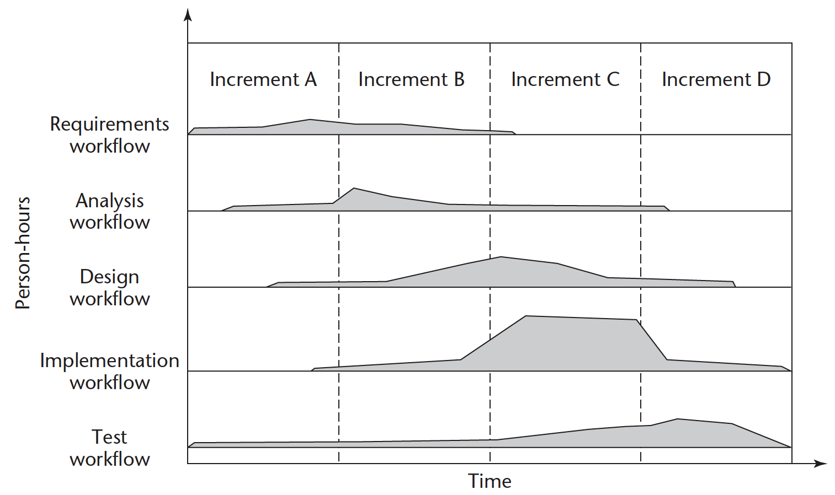
EXAMPLE – UNIFIED PROCESS

Slide 48
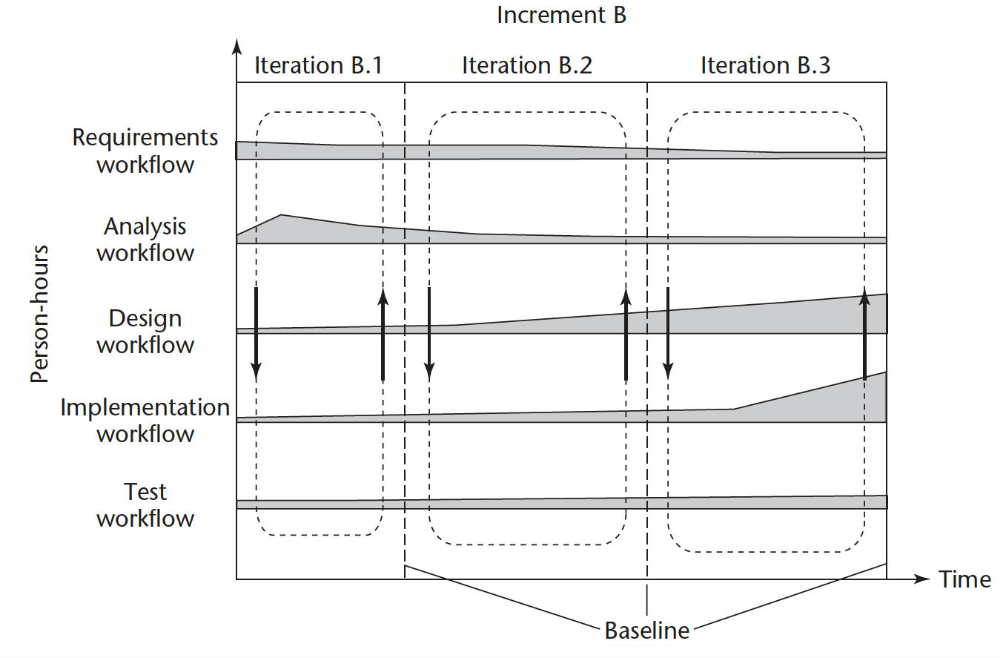
EXAMPLE

Slide 49
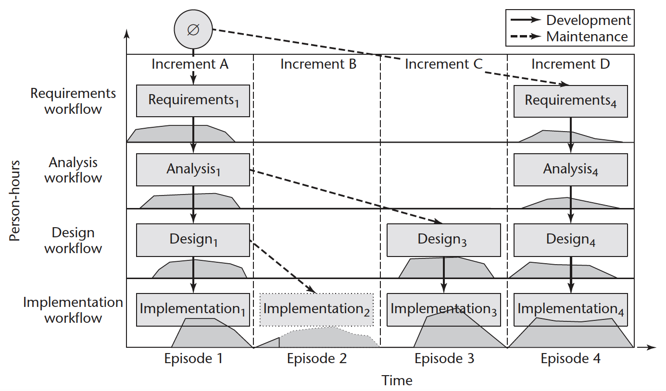
EXAMPLE

Slide 50
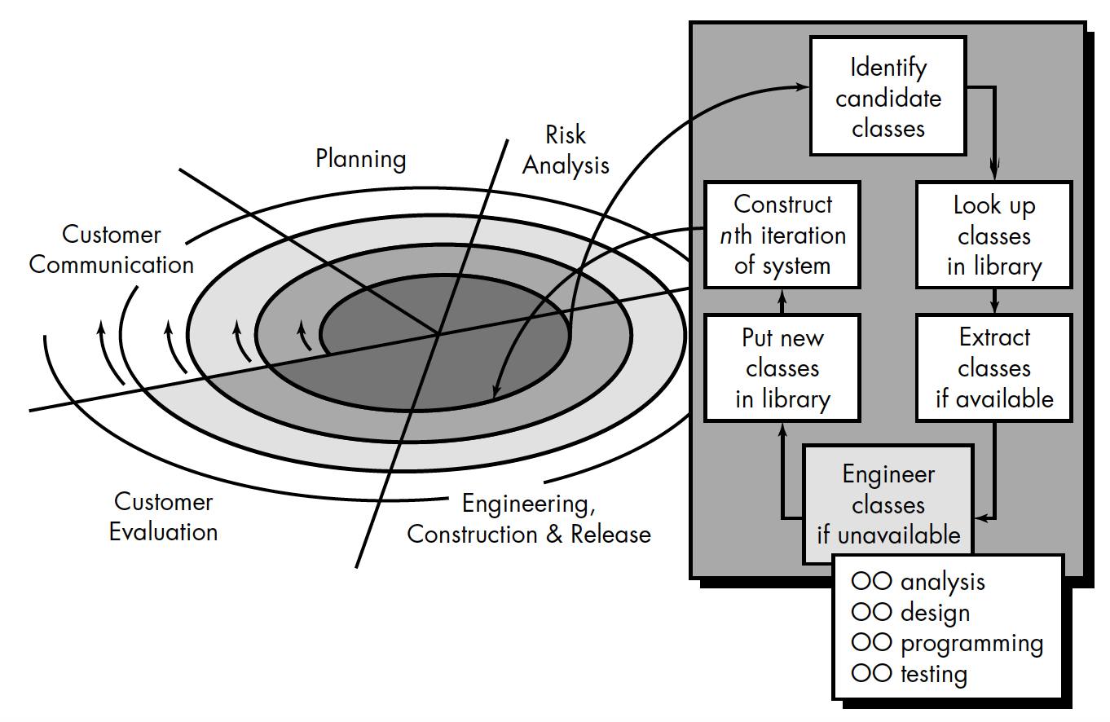
According to pressman

Slide 51
The object model
UNIT 03: Object Orientation Fundamentals and UML
References:
Booch et al., The Unified Modeling Language User Guide, Pearson. and
Booch et al., Object-Oriented Analysis and Design with Applications, 3rd ed., Addison-Wesley., Chapter 2 and 3.

Slide 52
Models:
simplification of reality

Slide 53
models
Are developed so that we can better understand the system we are developing.
  Help us visualise a system as it is or as we want it to be
  Permit us to specify the structure or behavior of the system
  Give us a template that guides us structuring a system
  Document decisions we made

Slide 54
models
Different levels
Conceptual level
Logical level
Physical level

Slide 55
modeling
Principles of modeling
  The choice of what models to create has a profound influence on the how a problem is attacked and how a solution is shaped.
  Every model may be expressed at different level of precision.
  The best models are connected to reality.
  No single model is sufficient. Every nontrivial system is best approached through a small set of nearly independent models.

Slide 56
Object-oriented modeling
Object-oriented perspective
Basic building block of a software system is the object or class.
Object is a thing.
Class is a set of common objects.
Every object has;
  Identity (name)
  State (properties/data associated)
  Behavior (methods)

Slide 57
The object model
Generations of programming languages allowed the shift from programming-in-the-small to programming-in-the-large
  Object-oriented languages (Smalltalk, C++, Ada83, Eiffel)
  Emergence of framework (Visual Basic, Java, Python, J2EE, .NET, Visual C#, Visual Basic .NET)

Slide 58
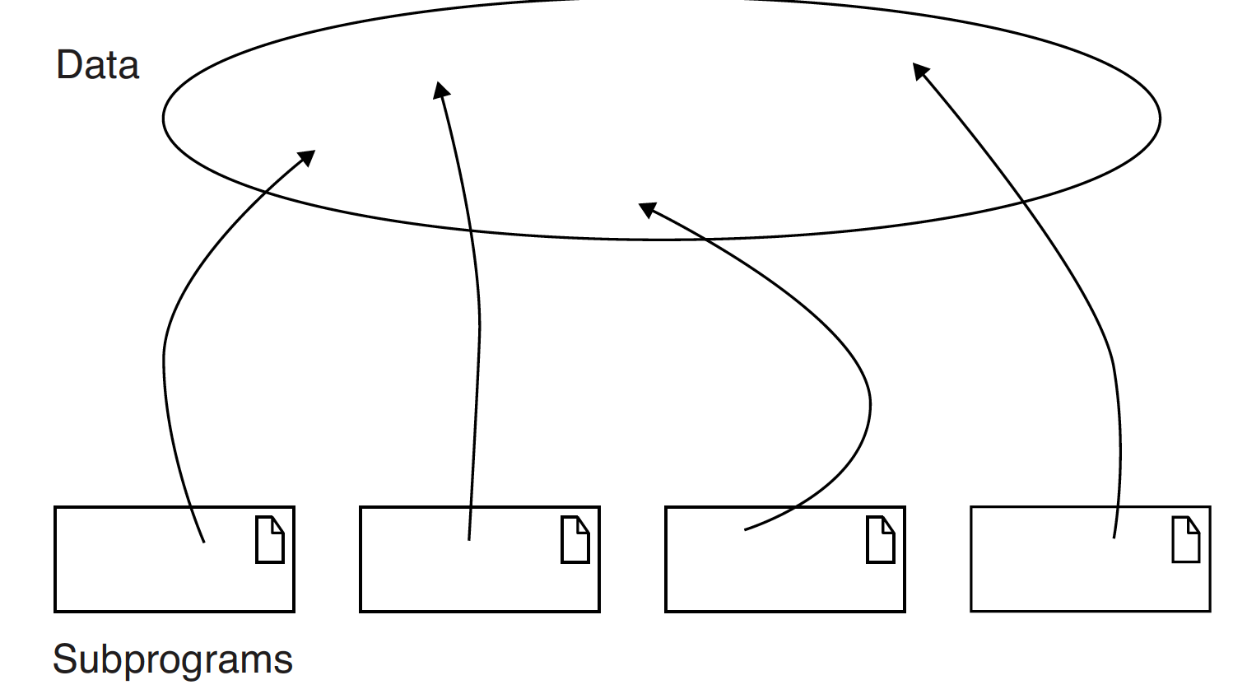
The object model
Topology of languages

Slide 59
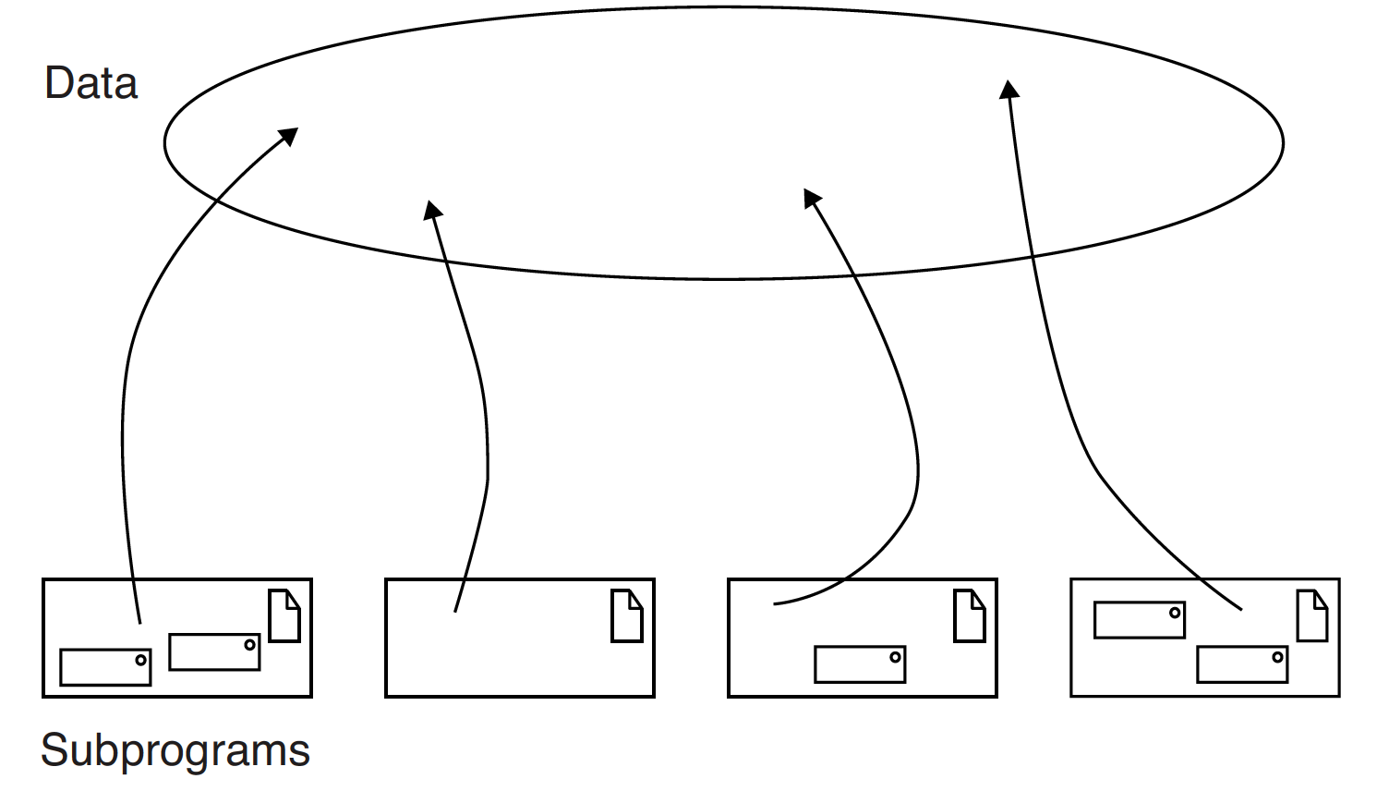
The object model
Topology of languages

Slide 60
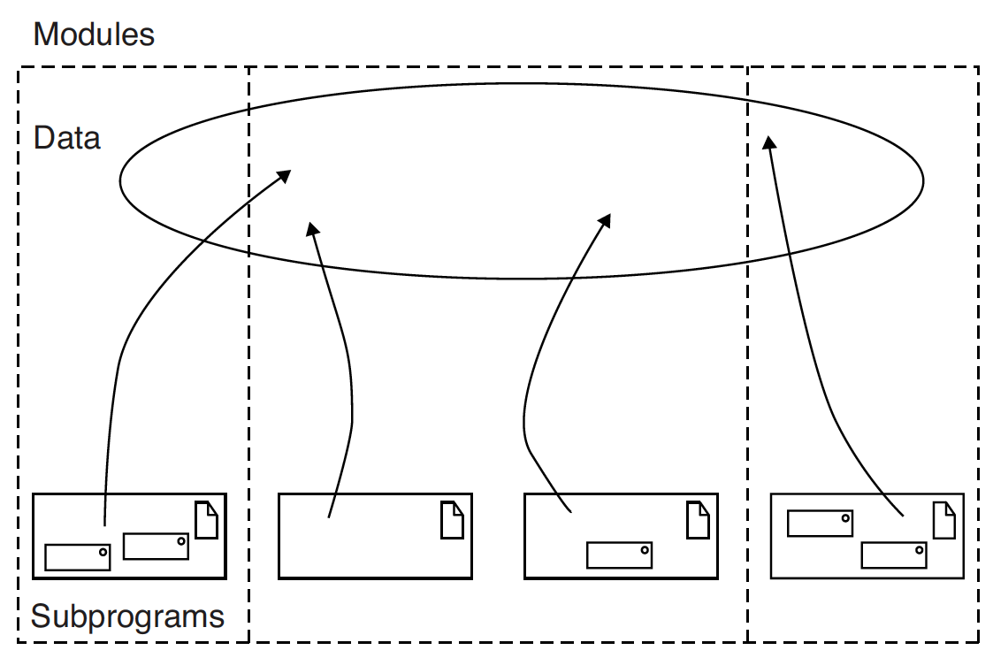
The object model
Topology of languages

Slide 61
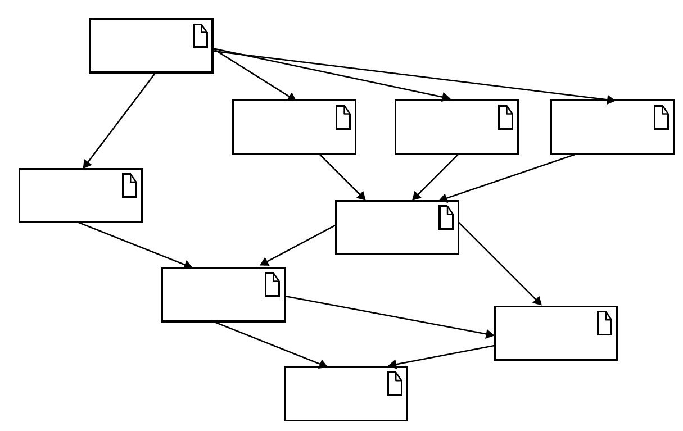
The object model
Object-oriented languages

Slide 62
The object model
Foundations
Object model is influenced by many factors, not just object-oriented programming. e.g. design of user interfaces, databases, and computer architectures.
An object – maintains integrity and there exist invariant properties that characterize an object and its behavior.
Objects cooperate with other!

Slide 63
The object model
Object-oriented programming (OOP)
A method of implementation in which programs are organised as cooperative collections of objects.
Three features;
  OOP uses objects, not algorithms, as its fundamental building blocks (‘has a’);
  Each object is an instance of some class; and
  Classes may be related to one another via inheritance (‘is a’). (no inheritance → abstract data types, e.g. stack)

Slide 64
The object model
Object-oriented programming (OOP)
A language is object-oriented if and only if it satisfies the following requirements :
It supports objects that are data abstractions with an interface of named operations and a hidden local state.
Objects have an associated type [class ].
Types [classes ] may inherit attributes from supertypes [superclasses ].

Slide 65
The object model
Object-oriented design (OOD)
A design method encompassing the process of object-oriented decomposition and a notation for depicting both logical and physical as well as static and dynamic models of the system under design.
Design
Notation

Slide 66
The object model
Object-oriented analysis (OOA)
A method of analysis that examines requirements from the perspective of the classes and objects found in the vocabulary of the problem domain.
OOA → OOD → OOP

Slide 67
The object model
Elements of object model
Abstraction – essential characteristics
Encapsulation – compartmentalizing the elements of an abstraction that constitute its structure and behavior
Modularity – system decomposed into cohesive and loosely coupled modules
Hierarchy – inheritance, multiple inheritance, avoid redundancy

Slide 68
The object model
Elements of object model
Typing – precise characterisation of structural or behavioral properties (enforcement of the class of an object), static typing, dynamic typing (polymorphism)
Concurrency – active object can be distinguished from one that is not active
Persistence – state and class of an object is consistent across time or space

Slide 69
The object model
Benefits
Expressive – real world objects and their interactions are better expressed using OM
Helps in complex system modeling
OM encourages reuse
Modular design allows resilient change

Slide 70
Classes and objects
Real-world consists of objects
An object
  A tangible and/or visible thing
  Something that may be comprehended intellectually
  Something toward which thought or action is directed

Slide 71
objects
An object
  Has state – static properties and current properties (dynamic)
  Has well-define behavior – how object acts and reacts in terms of its state changes and message passing (operations: modifier, selector, iterator, constructor, destructor; roles and responsibilities)
  Has a unique identity – every object should be distinguishable from other objects

Slide 72
objects
Relationship among objects
Two types
  Links – physical/conceptual connection between two objects (peer-to-peer or client/supplier)
  Aggregation – whole/part hierarchy

Slide 73
objects
Relationship among objects
Links – show message passing
While passing message, an object may play one of three roles;
  Controller
  Server
  Proxy (both controller and server, represents a real-world object in the domain of the application)

Slide 74
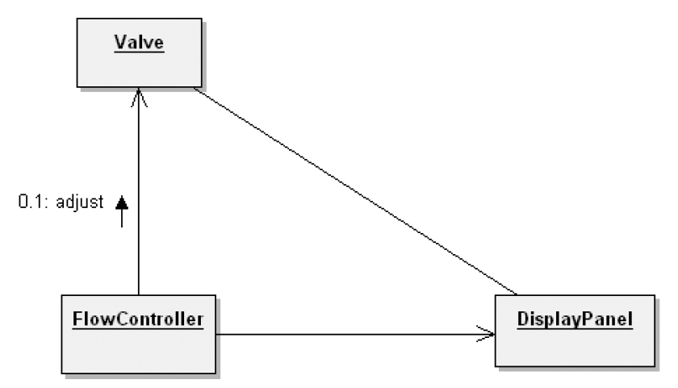
objects
Relationship among objects
Links – show message passing
Notes:
Fig. OOAD #001

Slide 75
objects
Relationship among objects
Links
  Visibility - for an object to receive messages, it must be visible to others.
  Synchronisation – objects may be active in sequence, guarded (mutual exclusion), or concurrent

Slide 76
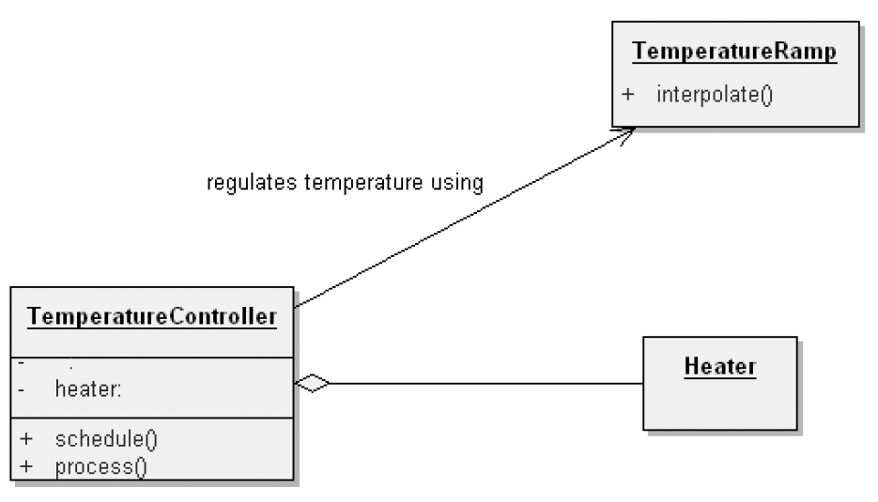
objects
Relationship among objects
Aggregation – whole/part hierarchy
Notes:
Fig. OOAD #002

Slide 77
Classes
Classes provide framework for objects
An object is an instance of a class.
A class represents a set of objects that share common structure and a common behavior.

Slide 78
Classes
Interface of a class
  Public – components of a class accessible to all clients)
  Protected – accessible to itself and its subclasses
  Private – accessible to itself
  Package – accessible by classes in the same package

Slide 79
Classes
Relationship among classes
  Association
    Semantic dependencies – e.g. a weather station has multiple sensors.
    Multiplicity – one-to-one, one-to-many, many-to-many
  Inheritance – a class may inherit a super-class
    Single inheritance
    Polymorphism
    Multiple inheritance

Slide 80
Classes
Relationship among classes
  Aggregation - whole and part relationship (has a), enforces physical containment
  Dependencies – when one element is dependent on other, e.g. one module dependent on other.

Slide 81
Interplay of classes and objects
Identify the classes that form the vocabulary of the problem domain.
Invent the structures whereby sets of objects work together to provide the behaviors that satisfy the requirements of the problem.

Slide 82
Building quality classes and objects
Measuring quality of abstraction –
  Coupling,
  Cohesion,
  Sufficiency,
  Completeness,
  Primitiveness
Choosing operations
  Functional semantics – focusing on reusability, complexity, applicability and implementation performance
  Time and space semantics

Slide 83
Building quality classes and objects
Choosing relationships
  Law of demeter – the methods of a class should not depend on structure of other classes, except its immediate super class.
  Visibility
Implementation
  Proper representation
  Proper packaging

Slide 84
classification
UNIT 03: Object Orientation Fundamentals and UML
References:
Booch et al., Object-Oriented Analysis and Design with Applications, 3rd ed., Addison-Wesley., Chapter 4.

Slide 85
Proper classification
Classification helps generalisation, specialisation, aggregation hierarchies among classes.
Objects, classes, hierarchies, associations etc. need to properly identified.
Help maintain proper level of cohesion and coupling.
Challenges – there is no perfect classification, intelligent classification requires tremendous amount of creative insight

Slide 86
Identifying classes and objects
Three approaches to classification;
Classical cetegorisation - All the entities that have a given property or collection of properties in common form a category. Such properties are necessary and sufficient to define the category. e.g. employee
Conceptual clustering – classes are generated by formulating conceptual descriptions then classifying the entities according to the descriptions. e.g. love songs
Prototype theory – class represented by prototypical object e.g. game

Slide 87
Identifying classes and objects
We will revisit identification of classes and objects in Unit 4. Refer to
Object-oriented analysis (Chapter 4.2, p. 131)
Key Abstractions and mechanisms (Chapter 4.3, p. 138)

Slide 88
UNIFIED PROCESS
UNIT 03: Object Orientation Fundamentals and UML
References:
Schach, S. R., 2008, Object-oriented software engineering, McGrawHill (Chapter – 3)
Bruegge B., and Dutoit A. H. 2010, Object-oriented Software Engineering using UML, Patterns and Java, 3rd ed., Prentice Hall (Chapter 15)

Slide 89
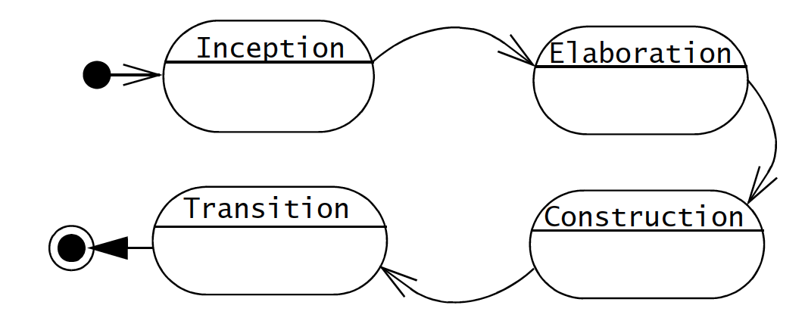
Unified software development process
Development time – divided into cycles
Cycles – birth, childhood, adulthood, retirement etc.
Each cycle end with release of the system
Each cycle can be in one of four phases

Slide 90
Unified software development process
Each phase might contain a number of iterations
Each iteration
  Use use-cases
  Mitigate risks in the iteration
  Acts as a project
Activities, also known as workflows, in each cycle are performed in parallel

Slide 91
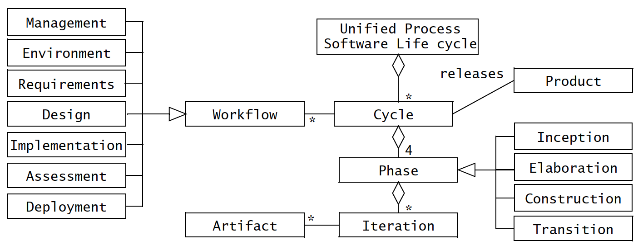
Unified process - workflows

Slide 92
Unified process - workflows
Engineering workflows
  Requirements – analysis of application domain and creation of specifications
  Design – design of the software – creation of solution
  Implementation - code
  Test – test cases, benchmarking

Slide 93
Unified process - workflows
Supporting workflows
  Management – project planning
  Environment – development environment, automation of the software process
  Assessment – verification and validation (reviews, walkthroughs and inspections)
  Deployment – configuration, transition of the software system to the end user

Slide 94
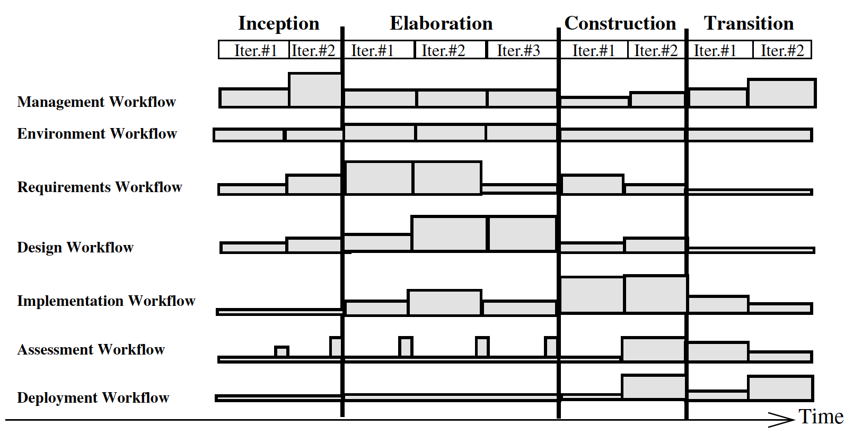
Unified process - workflows

Slide 95
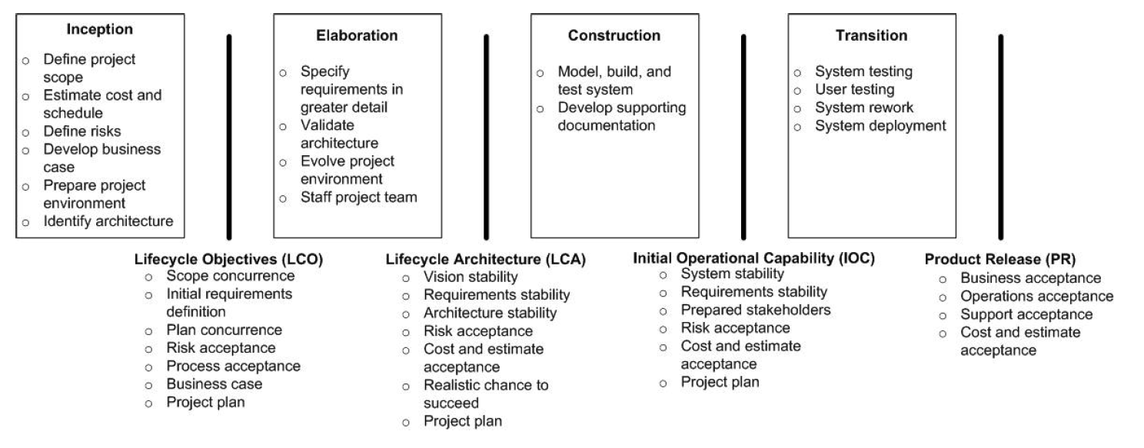
IBM RATIONAL UNIFIED PROCESS

Slide 96
❃ Read Chapter 3 from book Object-oriented software engineering by Stephen R. Schach.

Slide 97
End of Unit 03 : Object Orientation Fundamentals

