Slide 1

OBJECT-ORIENTED SOFTWARE ENGINEERING
UNIT 03 : Unified Modeling Language
© 2019, PRAMOD PARAJULI

Slide 2
Disclaimer
These slides are part of teaching materials for Object Oriented Software Engineering (OOSE). These slides do not cover all aspect of learning OOSE, nor are these be taken as primary source of information. As the core textbooks and reference books for learning the subject has already been specified and provided to the students, students are encouraged to learn from the original sources.
Contents in these slides are copyrighted to the instructor and authors of original texts where applicable.

Slide 3
UNIFIED modeling LANGUAGE
Is a standard to model systems
Is not a process! Optimally should be used in a process that is use case driven, architecture-centric, iterative, and incremental.
Helps to
  visualise a system throughout different phases of development.
  specify requirements
  design software components
  document (requirements, architecture, design, source code, project plans, tests, prototypes, release)

Slide 4
Building blocks of uml
UML has 3 types of building blocks
Things – abstraction of ‘first class citizens’
Relationships – among things
Diagrams – group interesting collections of things

Slide 5
THINGS
Things in UML
Structural things
Behavioral things
Grouping things
Annotational things

Slide 6
THINGS
Structural things
Structural components, the noun part of models
Class – set of objects e.g. Sensor
Interface – externally visible behavior of an element that specify a service of a class or component
Collaboration
Use case
Active classes, components, and nodes

Slide 7
THINGS
Structural things
Class – set of objects e.g. Sensor
Sensor
-name -value -time_stamp
+powerUp() +calibrate() +readSensor() +setInterval()

Slide 8
THINGS
Structural things
Interface – externally visible behavior of an element that specify a service of a class or component
Interface defines only the specifications not the implementations!
IReadSensorData

Slide 9
THINGS
Structural things
Collaboration – specify structure and behavior of collaboration between entities
We visualise such collaborations in use-case diagrams and activity diagrams.
Init Sensor

Slide 10
THINGS
Structural things
Use case – specify description of set of sequence of actions
Used to structure the behavioral things
Realised by a collaboration
Request data

Slide 11
THINGS
Structural things
Active class – a class that its objects represent elements whose behavior is concurrent with other elements.
EventManager
+start() +stop() +flush()

Slide 12
THINGS
Structural things
Component – physical and replaceable part that represents the packaging of logical elements such as classes, interfaces and collaborations.
COM+, Java Beans etc.
sensordata.java

Slide 13
THINGS
Structural things
Node – exists at runtime and represents a computational resource
Contains a set of components
WebServer

Slide 14
THINGS
Structural things
Structural components, the noun part of models
Class – set of objects e.g. Sensor
Interface – externally visible behavior of an element that specify a service of a class or component
Collaboration
Use case
Active classes, components, and nodes

Slide 15
THINGS
Behavioral things
Represent dynamic components in UML models, the verb part of UML models
Two types;
  Interaction
  State machine

Slide 16
THINGS
Behavioral things
Interaction – messages passed between/among components
display

Slide 17
THINGS
Behavioral things
State machine – specifies the sequence of states an object or an interaction goes through during its lifetime in response to events
Waiting

Slide 18
THINGS
Grouping things
Packages – organise elements into groups
Conversion rules

Slide 19
THINGS
Annotational things
Notes – explanatory parts of UML model
regex for formatting

Slide 20
Relationships
Relationships in UML
Dependency
Association
Generalisation
Realisation

Slide 21
Relationships
Relationships in UML
Dependency – shows semantic relationship between two things in which a change to one thing (independent) may affect the semantics of the other (dependent)

Slide 22
Relationships
Relationships in UML
Association – shows links among objects along with labels and multiplicity
0..1 *
weather station sensor

Slide 23
Relationships
Relationships in UML
Generalisation – shows generalisation/specialisation relationships in which objects of specialised element (the child) are substitutable for objects of generalised element (the parent)

Slide 24
Relationships
Relationships in UML
Realisation – semantic relationship between classifiers.
Used between interfaces and classes or components that realise them, and between use cases and the collaborations that realise them.

Slide 25
UML notations (diagrams)
UNIT 03: Object Orientation Fundamentals and UML
References:
Booch et al., The Unified Modeling Language User Guide, Pearson. and
Booch et al., Object-Oriented Analysis and Design with Applications, 3rd ed., Addison-Wesley., Chapter 5.

Slide 26
diagrams
Diagrams in UML
Graphical representation of a set of elements
Different combination of elements serve different purpose
Package diagram
Component diagrams
Deployment diagrams
Use case diagrams
Activity diagrams
Class diagrams
Sequence diagrams
Interaction overview diagrams
Composite structure diagrams
State machine diagrams
Timing diagrams
Object diagrams
Communication diagrams

Slide 27
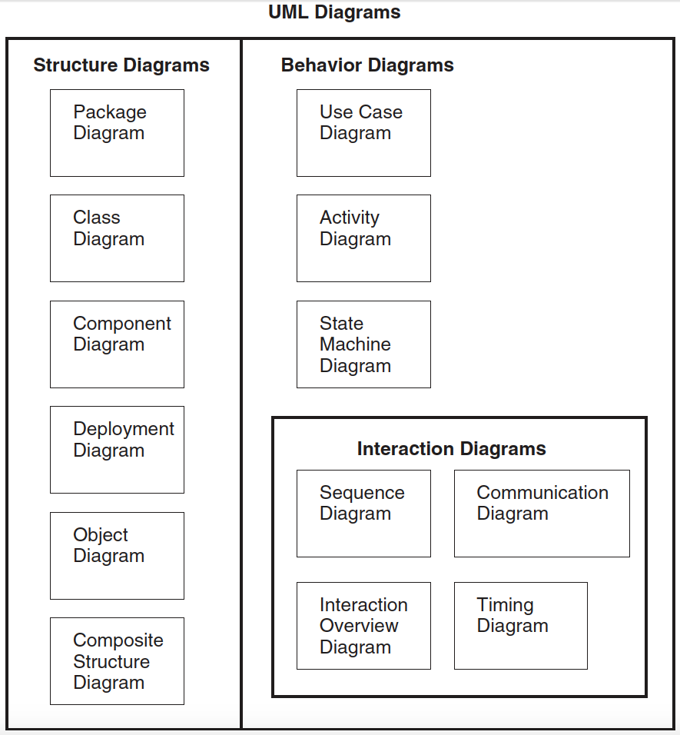

Slide 28
 |  | Process segments
 |  | Requirements | Analysis | Design | Development | Deployment
UML diagrams | Use case diagram | Sponsor objectives | Conceptual model
 | Class diagram |  | Conceptual level classes | Specification level classes | Implementation level classes
 | Object diagram |  | Identify objects | Identify objects
 | State diagram |  | Object behavior
 | Sequence diagram |  | Object interaction
 | Collaboration diagram |  | Object interaction
 | Activity diagram | User operation(s) |  | System operations
 | Component diagram |  |  | Visualise components
 | Package diagram | System requirements
 | Deployment diagrams | System elements | System integration | System integration

Slide 29
Structure diagrams
Package diagram
Class diagram
Component diagram
Deployment diagram
Object diagram
Composite structure diagram

Slide 30
Behavior diagrams
Use-case diagrams
Activity diagram
State machine diagram
Interaction diagrams
  Sequence diagram
  Communication diagram
  Interaction overview diagram
  Timing diagram

Slide 31
Example on the book for diagrams:
Hydroponics Gardening System

Slide 32
Package diagrams
It is essential to organise OOAD artifacts;
Provide clarity and understanding of complex system development
Supports concurrent model used by multiple users
Supports version control
Provides abstraction at multiple levels – from systems to classes in a component
Provides encapsulation and containment; supports modularity.
(fig. 5-2, 5-3)

Slide 33
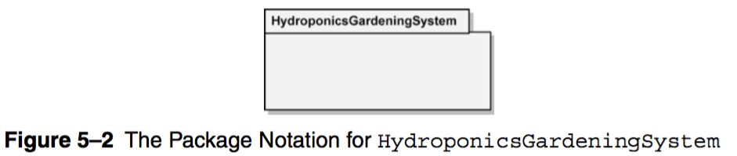
Package diagrams

Slide 34
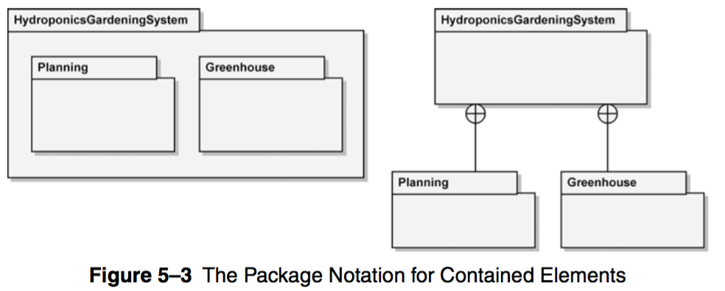
Package diagrams

Slide 35
Package diagrams
Visibility of elements
Public ( + ) – can be thought as package interface
Private ( - )
(fig. 5-4)
Dependency relationship
Elements of package depends on elements of the same or other packages
Tail of the arrow – dependent (client)
Arrowhead – supporter (supplier)
Type of dependency – defined within guillemets ( « » )
e.g. «import»
(fig. 5-5)

Slide 36
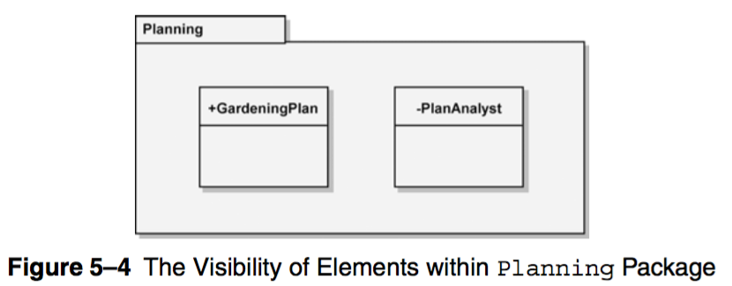
Package diagrams

Slide 37
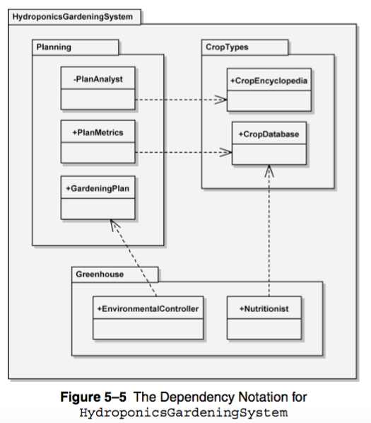
Package diagrams

Slide 38
Package diagrams
Multiple dependencies between packages are aggregated to the level of containing package.
(fig. 5-6)
Package diagrams can also be used to show different model elements such as classes, (fig. 5-7)
Can also be used on UML diagrams that are not structure diagrams
e.g. use cases
Usage
package_name::element_name

Slide 39
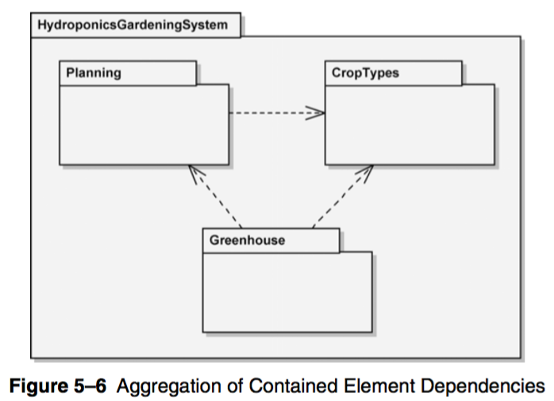
Package diagrams

Slide 40
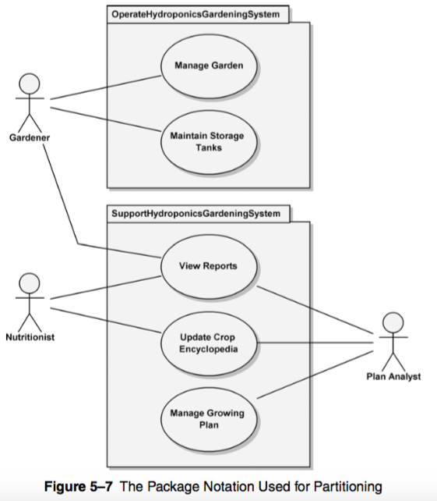
Package diagrams

Slide 41
Package diagrams
Advanced concepts
Import – import public package
Access – within the package
(fig. 5-8)

Slide 42
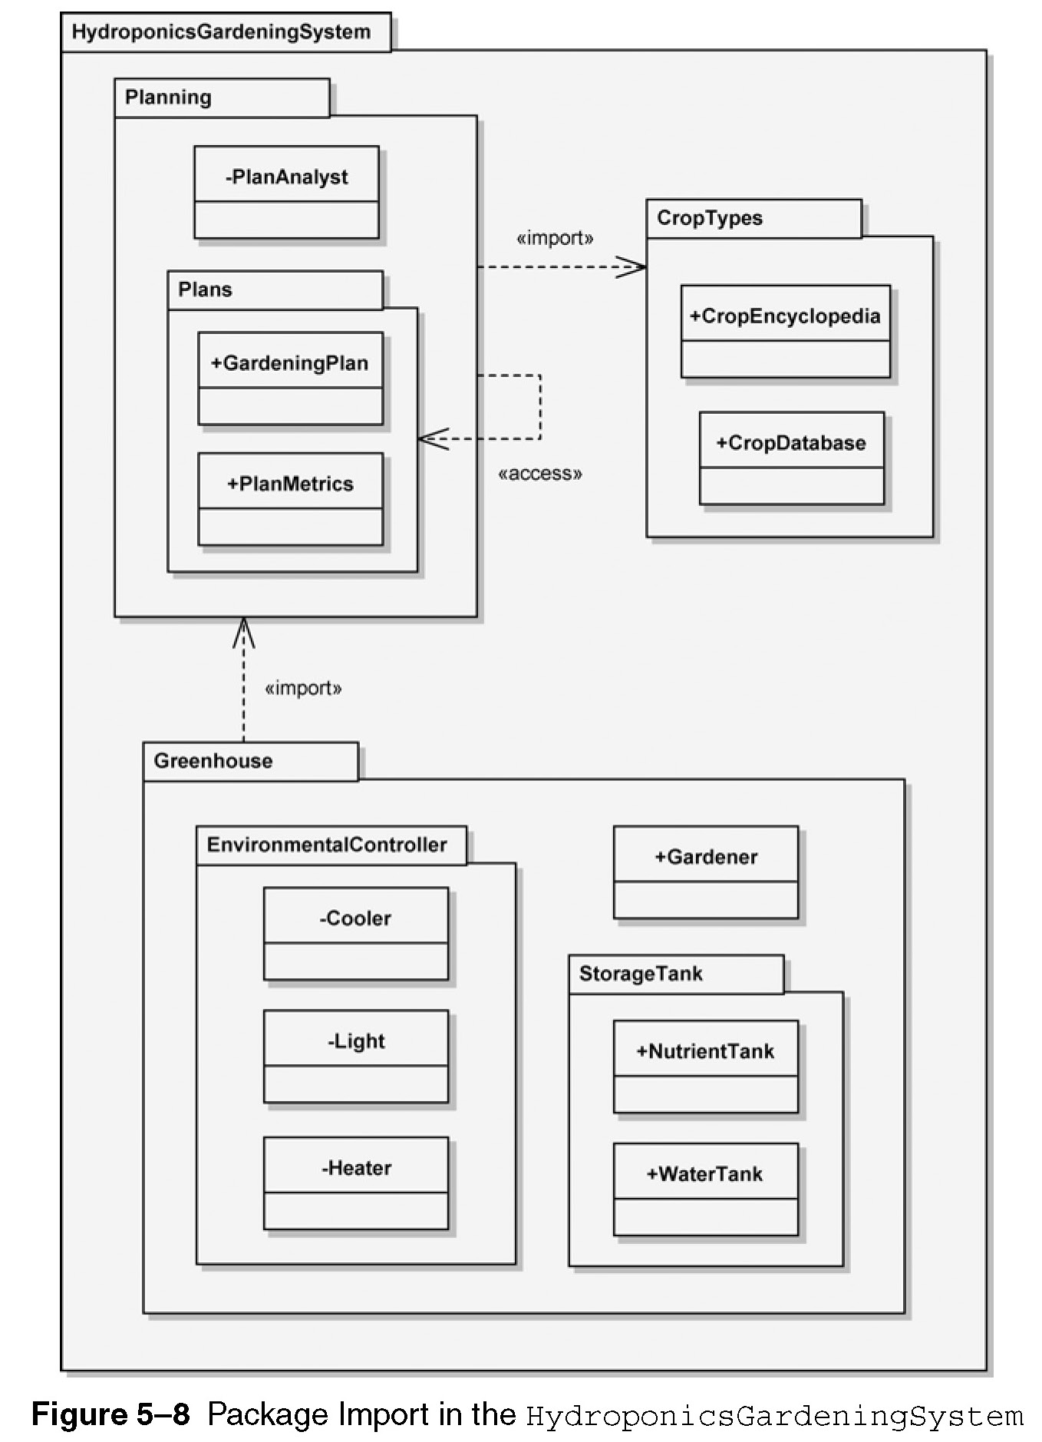

Slide 43
Component diagrams
Components
  reusable piece of software,
  provides meaningful aggregation of functionality
  collaborate with other through well-defined interfaces

Slide 44
Component diagrams
Components
  ports – have public visibility unless otherwise noted, kept on the boundary
  components may have hidden ports (kept totally inside the boundary), used for testing
  Named as
  port_name:Port_Type
  Use of ball and socket, (fig. 5-9)

Slide 45
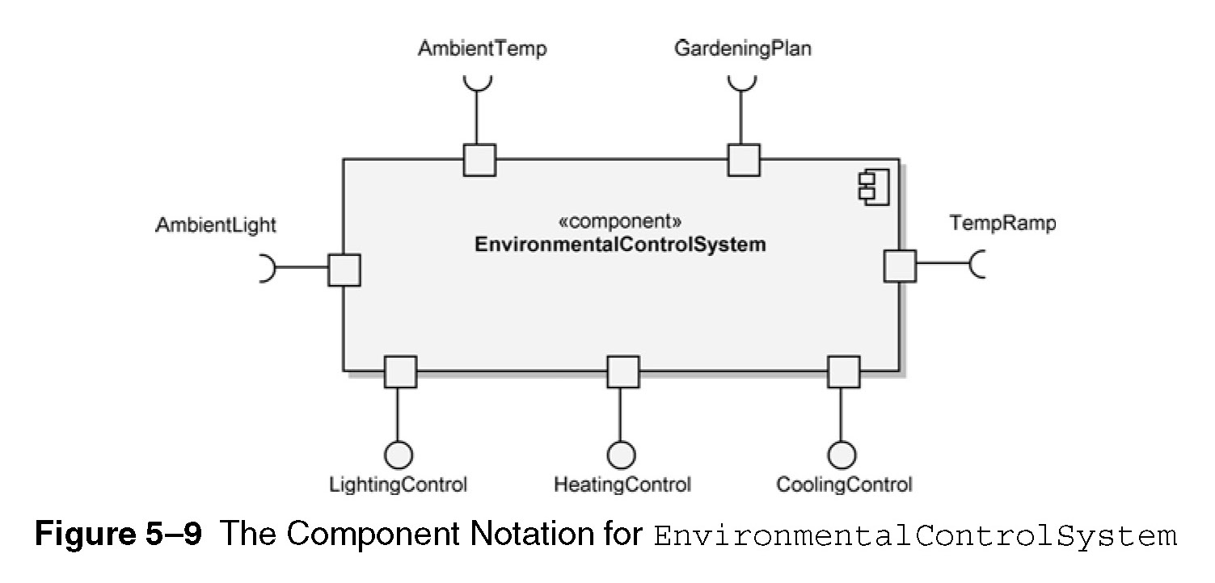

Slide 46
Component diagrams
Components – interfaces
  Interfaces can be grouped, (fig. 5-10)
  An example of component diagram, (fig. 5-11)
  Interface specification, (fig. 5-12)
  Alternate notation for the interface, (fig. 5-13)
  Realization of dependencies, (fig. 5-14)
  Containment of realization, (fig. 5-15)

Slide 47
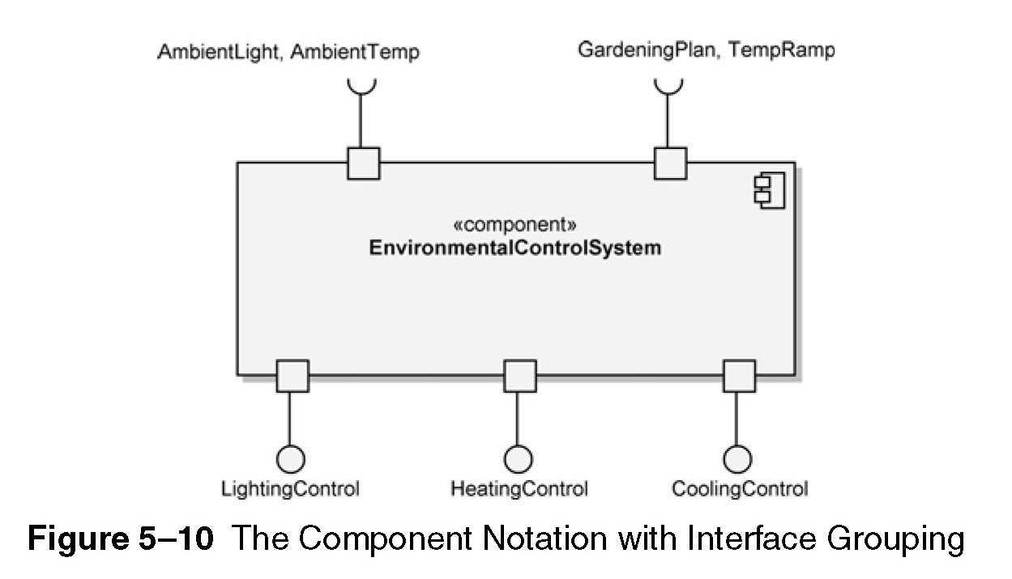

Slide 48
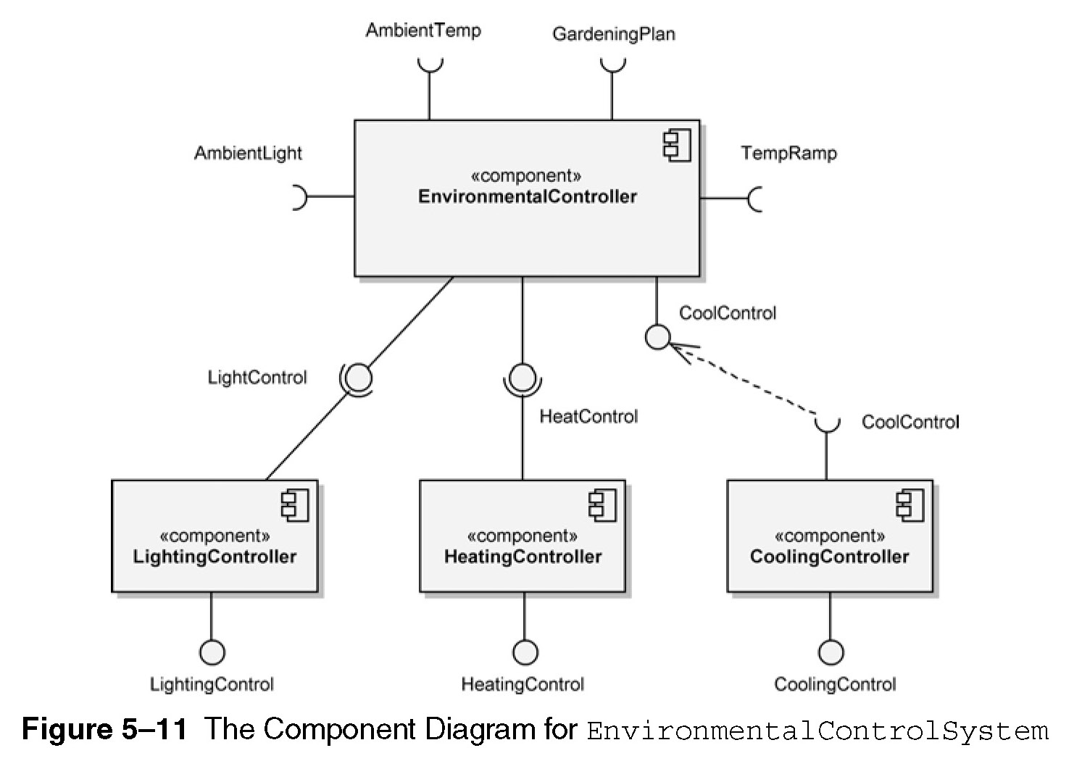

Slide 49
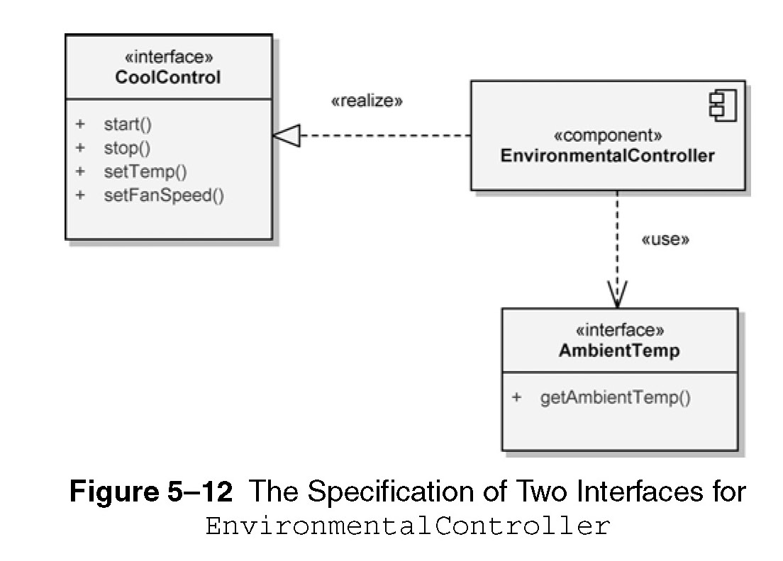

Slide 50
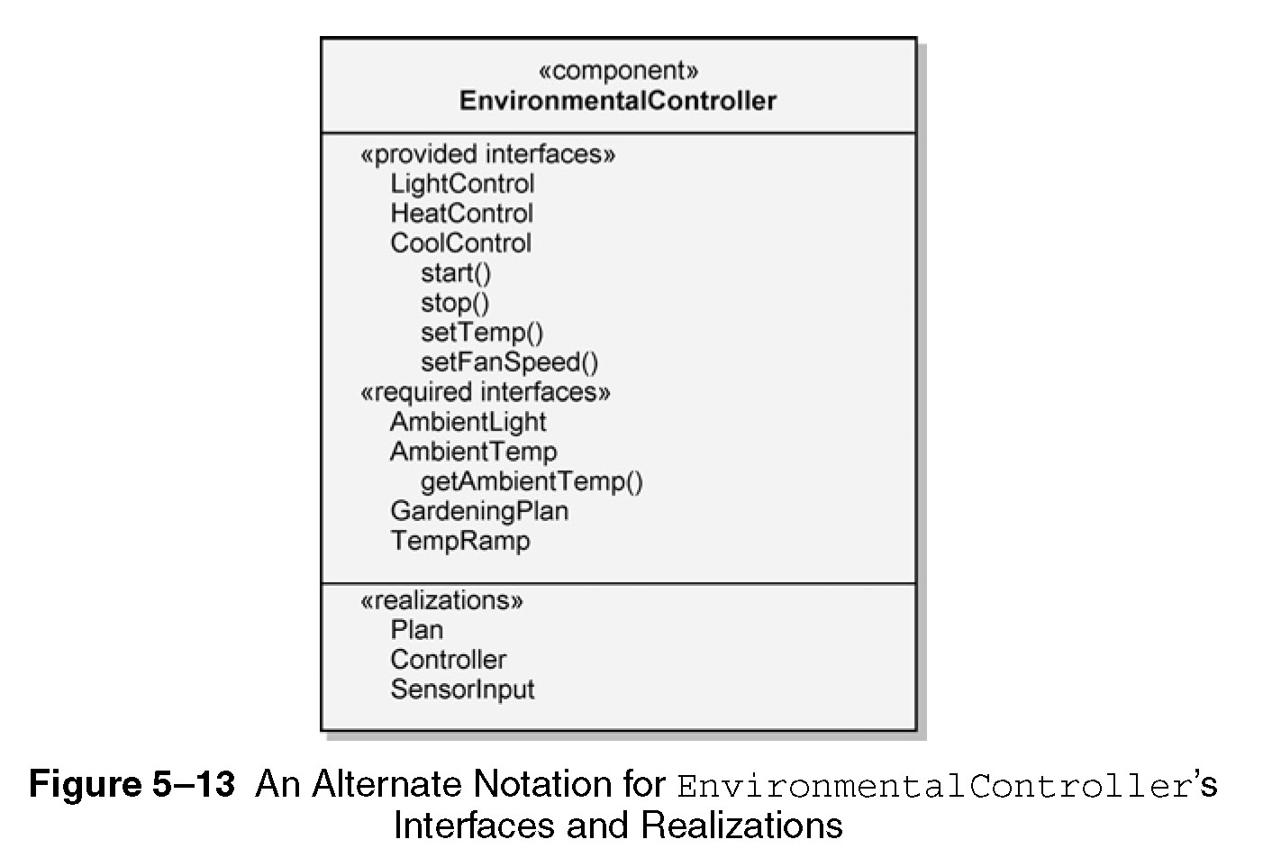

Slide 51
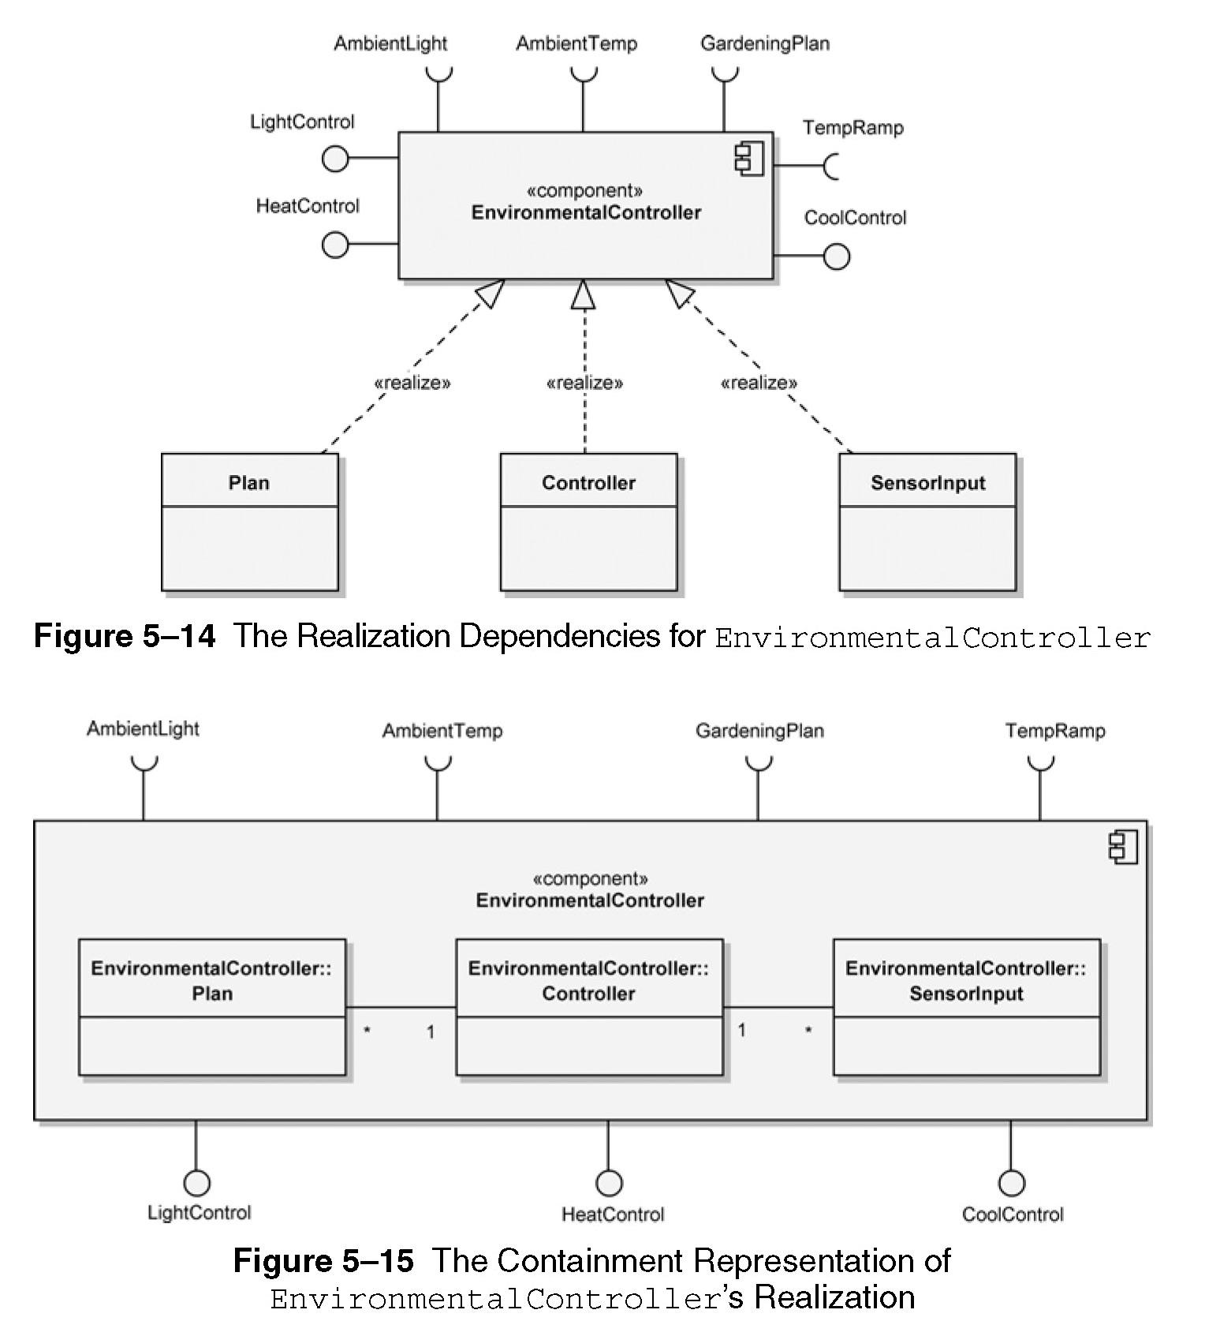

Slide 52
Component diagrams
Components – internal structure
  A component may contain subsystems
  These subsystems have their own interfaces
  (fig. 5-16)

Slide 53
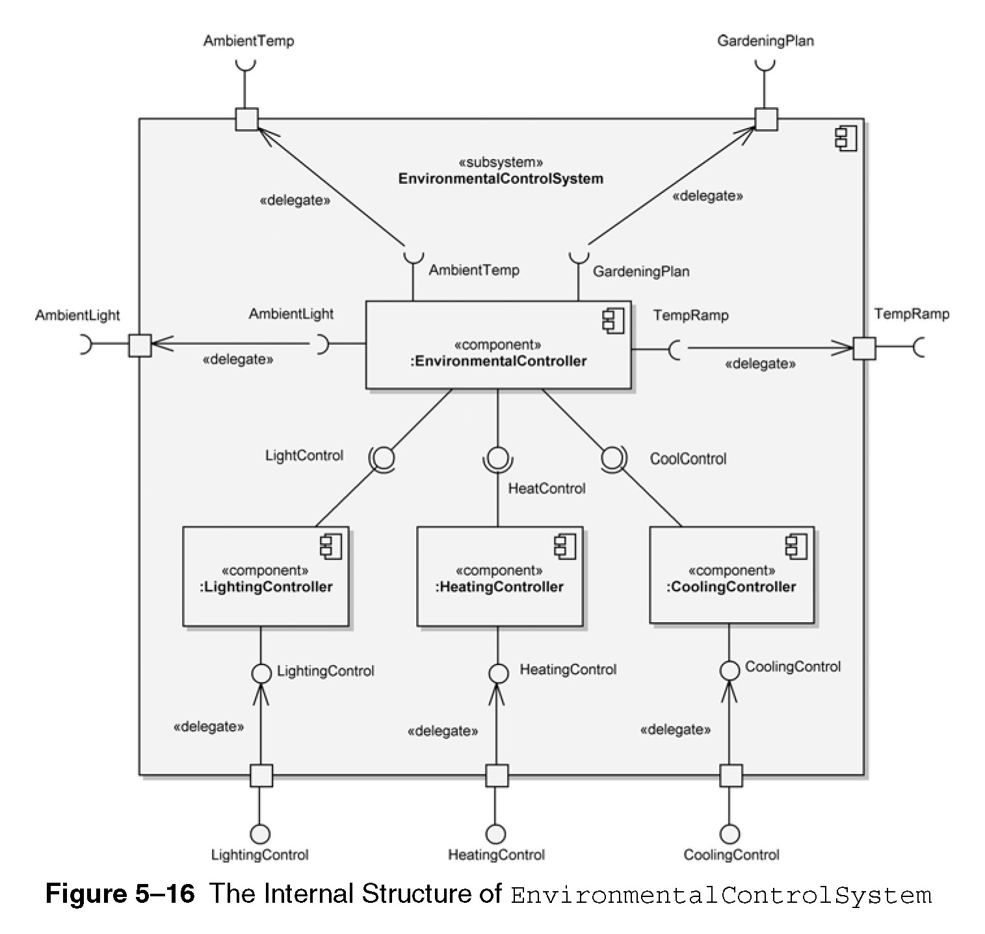

Slide 54
Deployment diagrams
Shows allocation of artifacts to nodes in the physical design of a system
3 essential elements
  Artifacts
  Nodes
  Their connections

Slide 55
Deployment diagrams
The artifact notation – using <<manifest>>, (fig. 5-17)
The node notation – represents computational resource
Two types of nodes;
  Devices
  Execution environment
Nodes can have multiplicity, (fig. 5-18)
Example of a deployment diagram, (fig. 5-19)

Slide 56
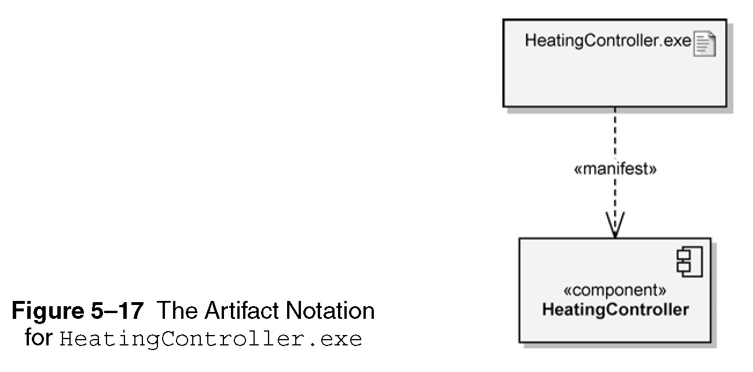

Slide 57
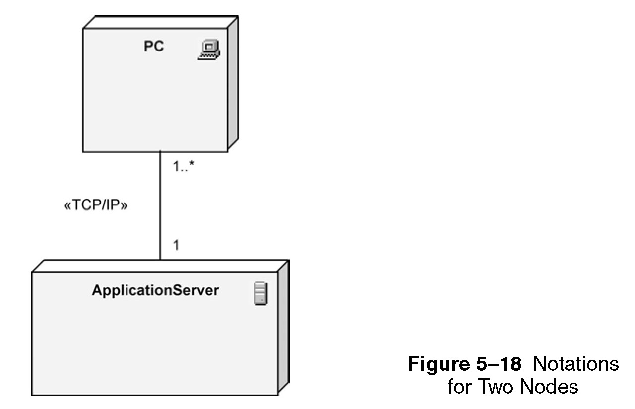

Slide 58
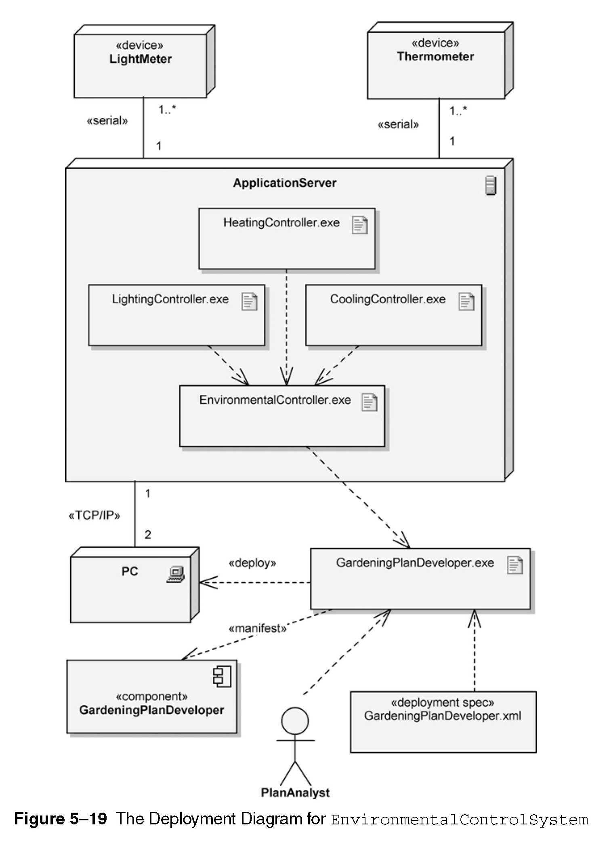

Slide 59
USE-CASE diagrams
Specify business needs
Includes roles as actors (fig. 5-20)
Shows who needs what
Use cases – a function
Use case diagram (exists in environment, may have system boundary) (fig. 5-22)

Slide 60
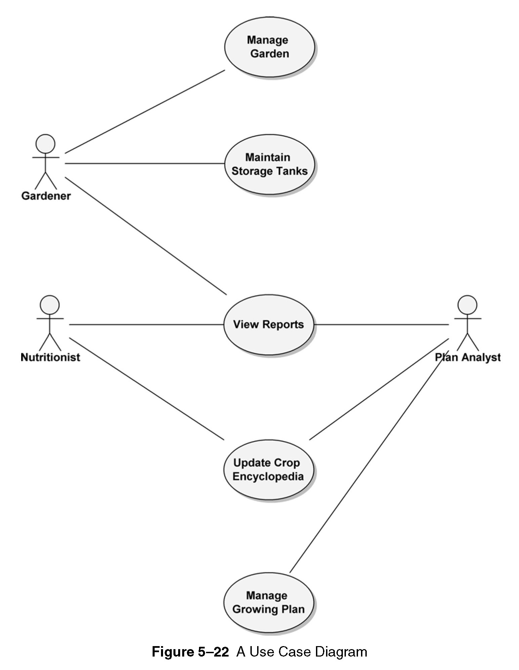
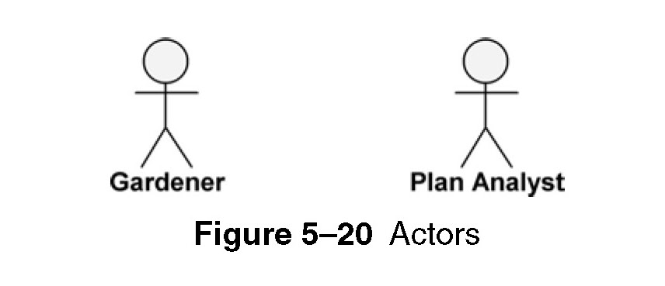
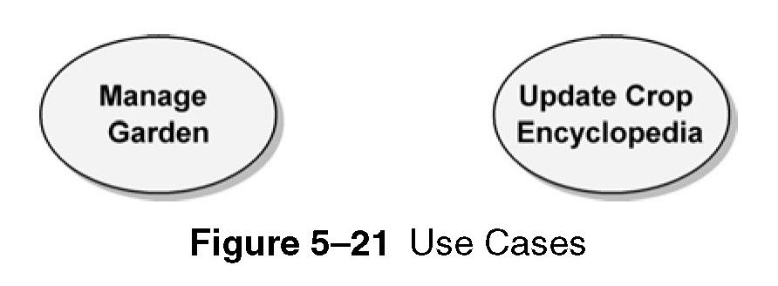

Slide 61
USE-CASE diagrams
Use cases are detailed using use case specification, example on p.179
Use case diagram may include «include» and «extend» relationships among the use cases,
(fig. 5-25)
When to use «include» and «extend»? (table 5-1, p. 184)
Advanced concept: generalization (fig. 5-26)

Slide 62
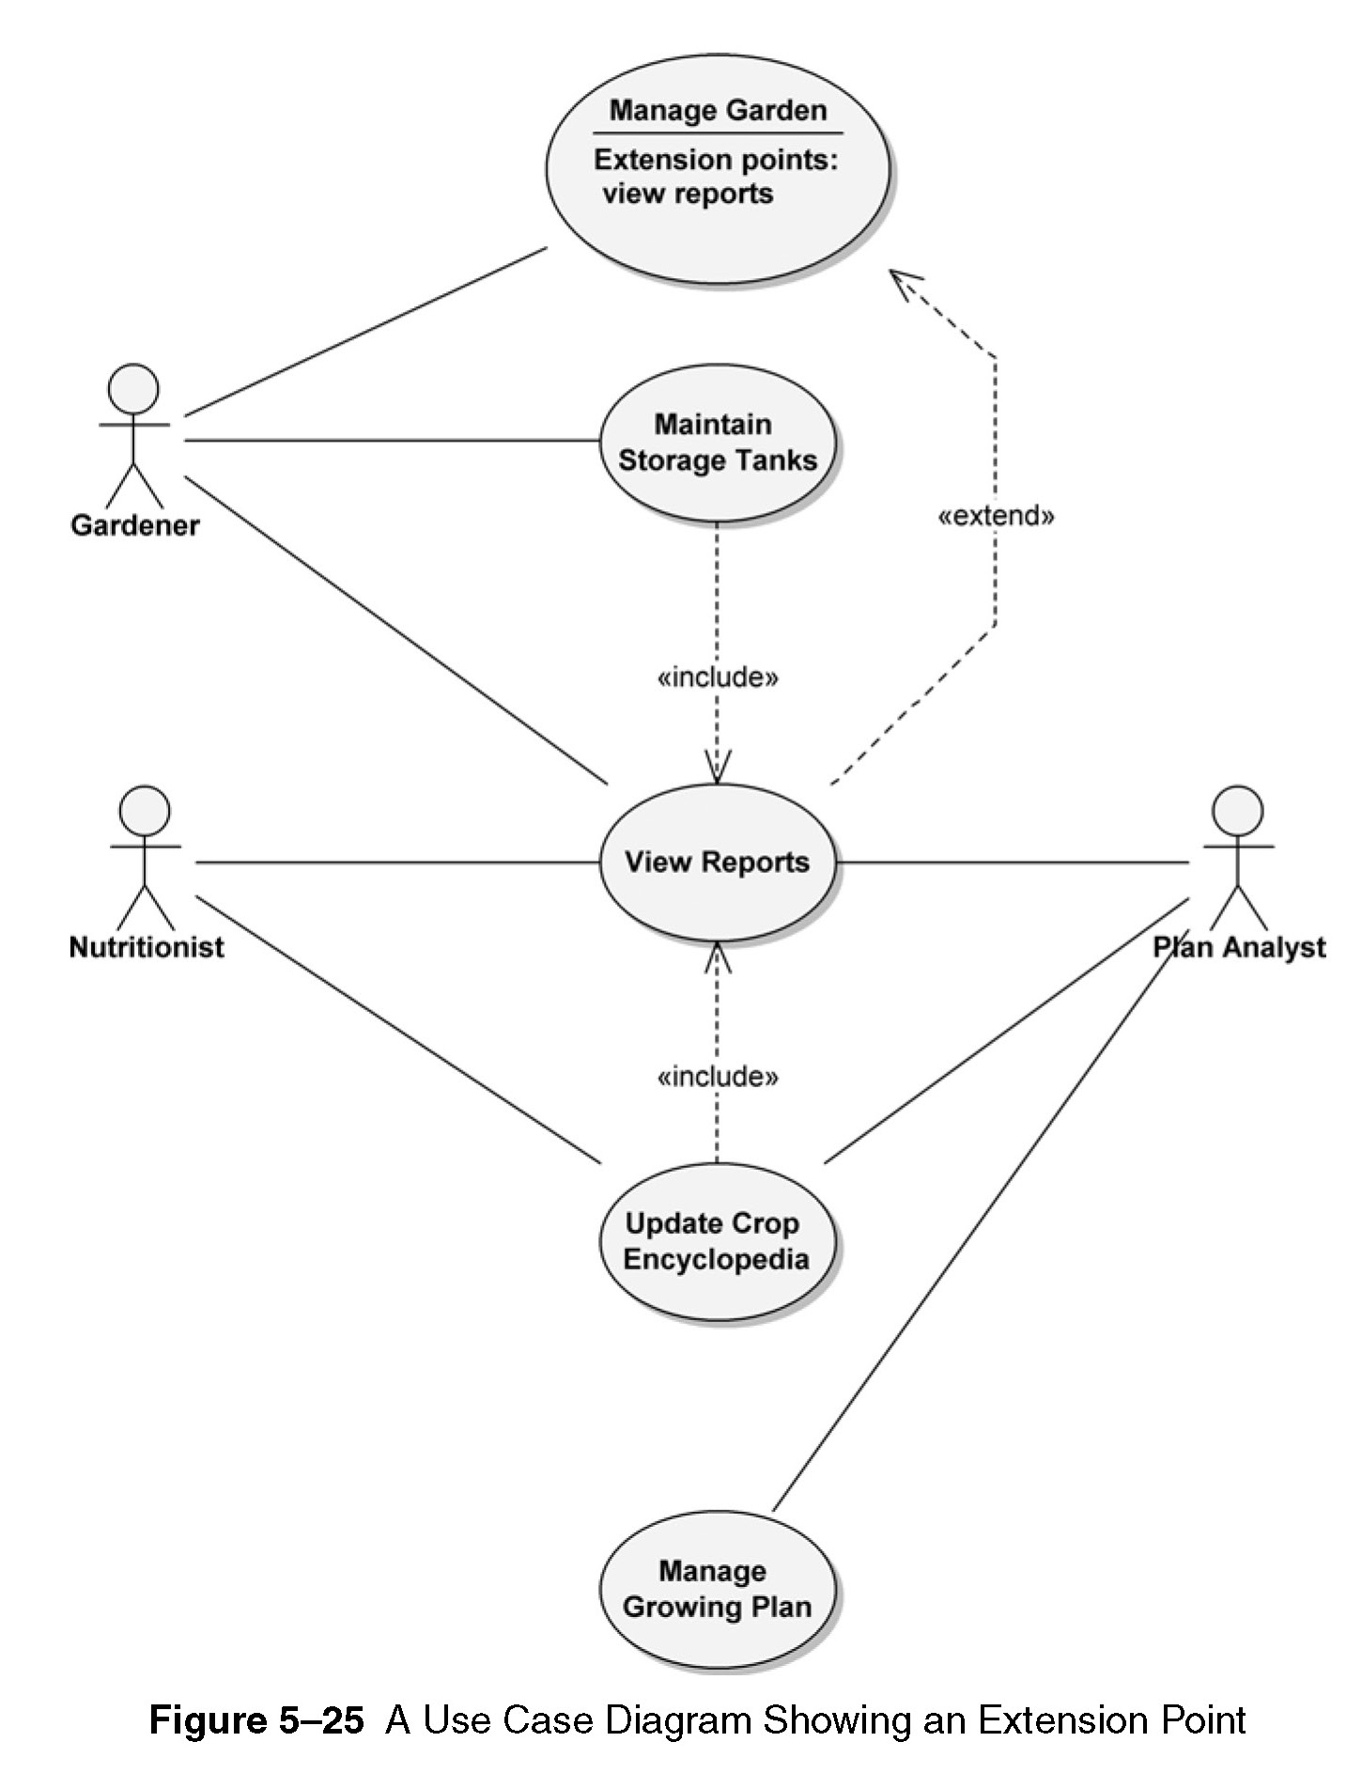

Slide 63
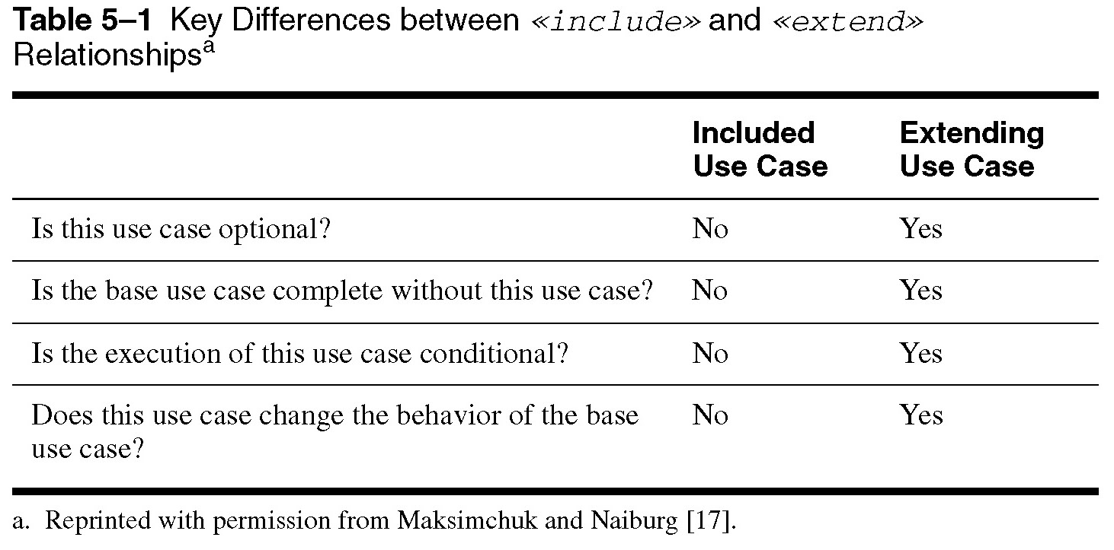

Slide 64
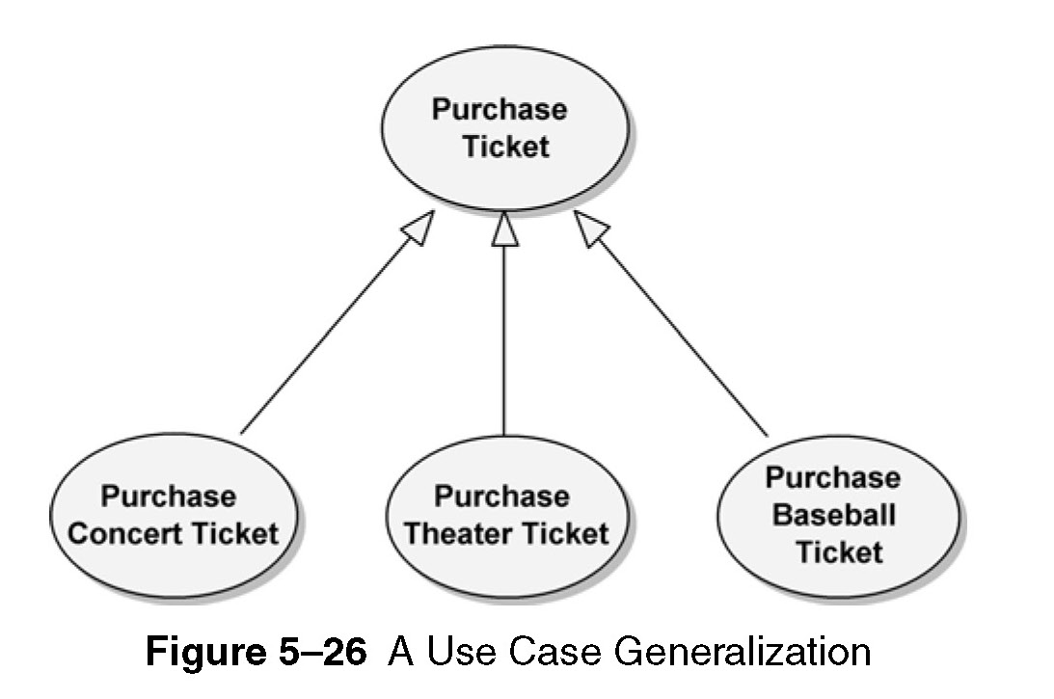

Slide 65
Activity diagrams
Representing flow of process graphically, has very high semantics
Elements: action nodes, control nodes, and object nodes.
Control notes – 3 types:
  initial and final (activity final and flow final), (fig. 5-28)
  decision and merge (fig. 5-29, fig. 5-30), and
  fork and join (fig. 5-31)
Activity diagram with objects (fig. 5-32)

Slide 66
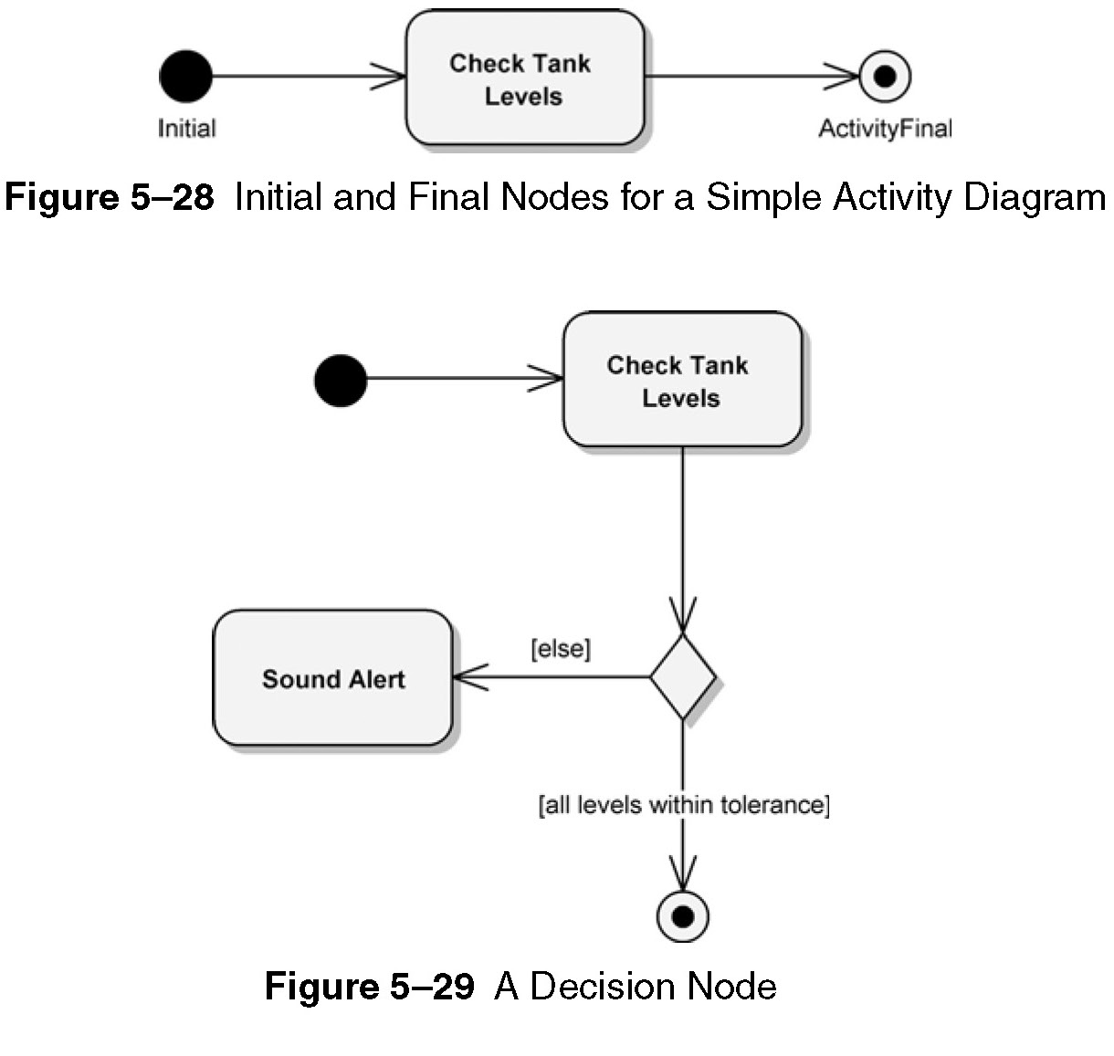

Slide 67
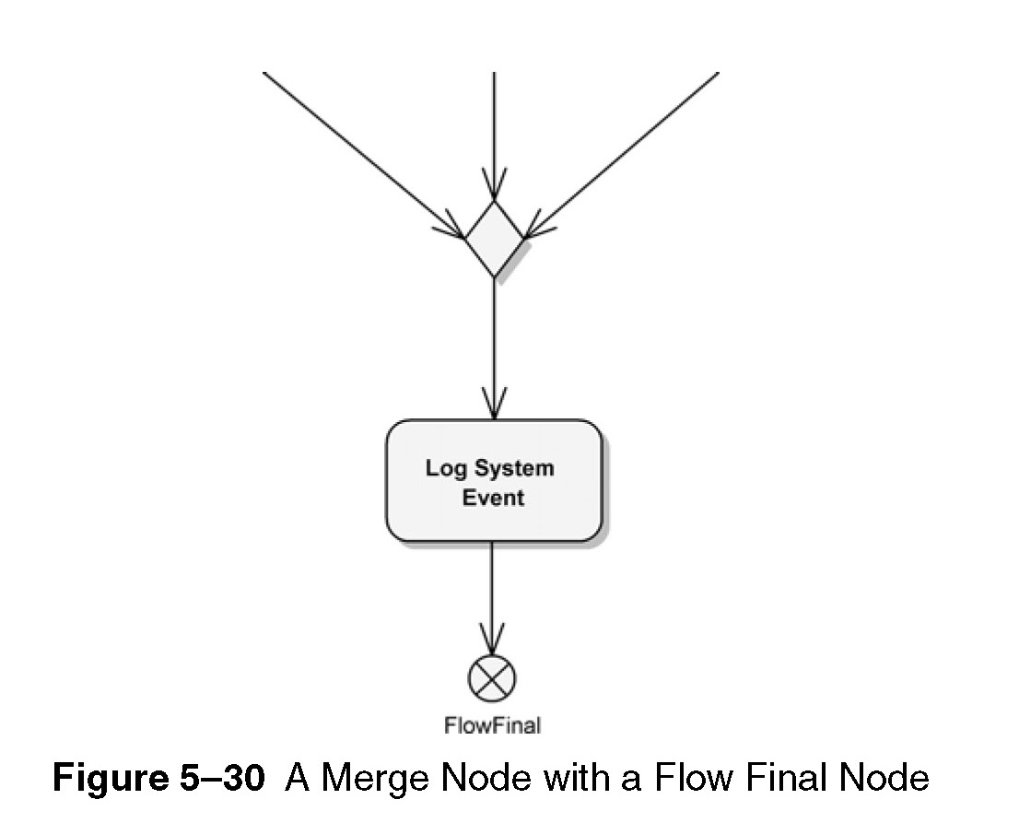

Slide 68
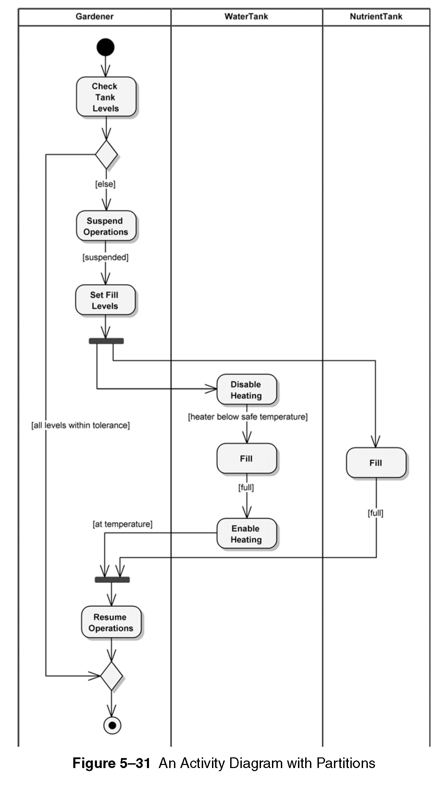

Slide 69
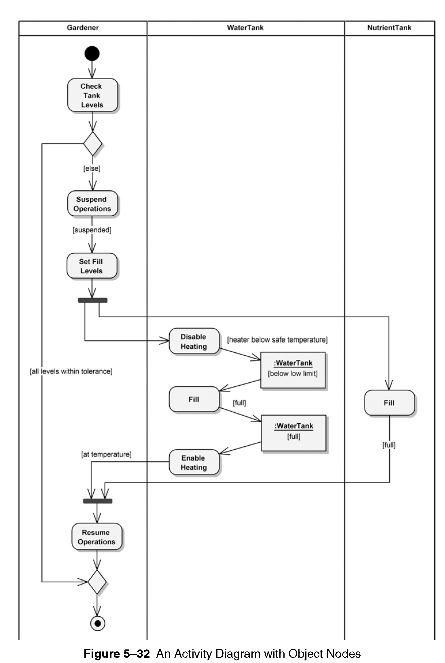

Slide 70
Class diagrams
Class notations (fig. 5-33)
Set of attributes, methods
Detailed attribute and operation specification
Abstract class – has no instances (italicize the name) (fig. 5-34) – FoodItem
Subclass (Tomato) inherits the abstract class
Content (has-a relationship)
Class relationship may contain multiplicity

Slide 71
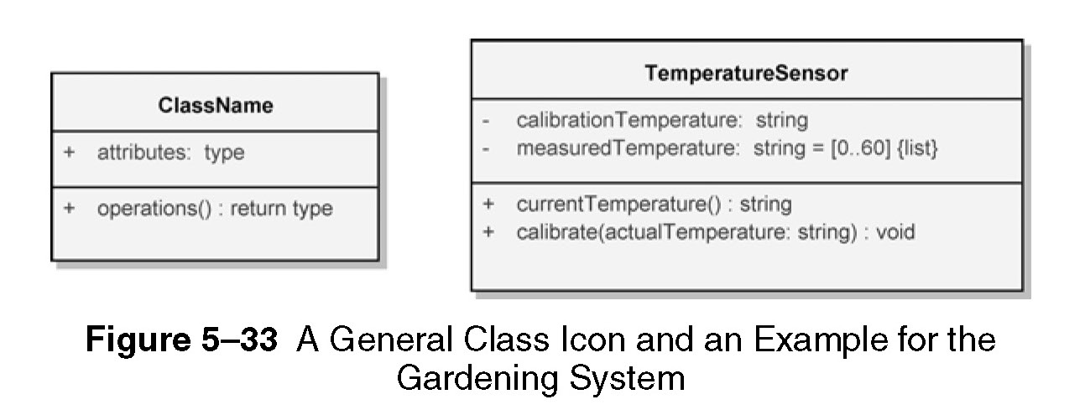
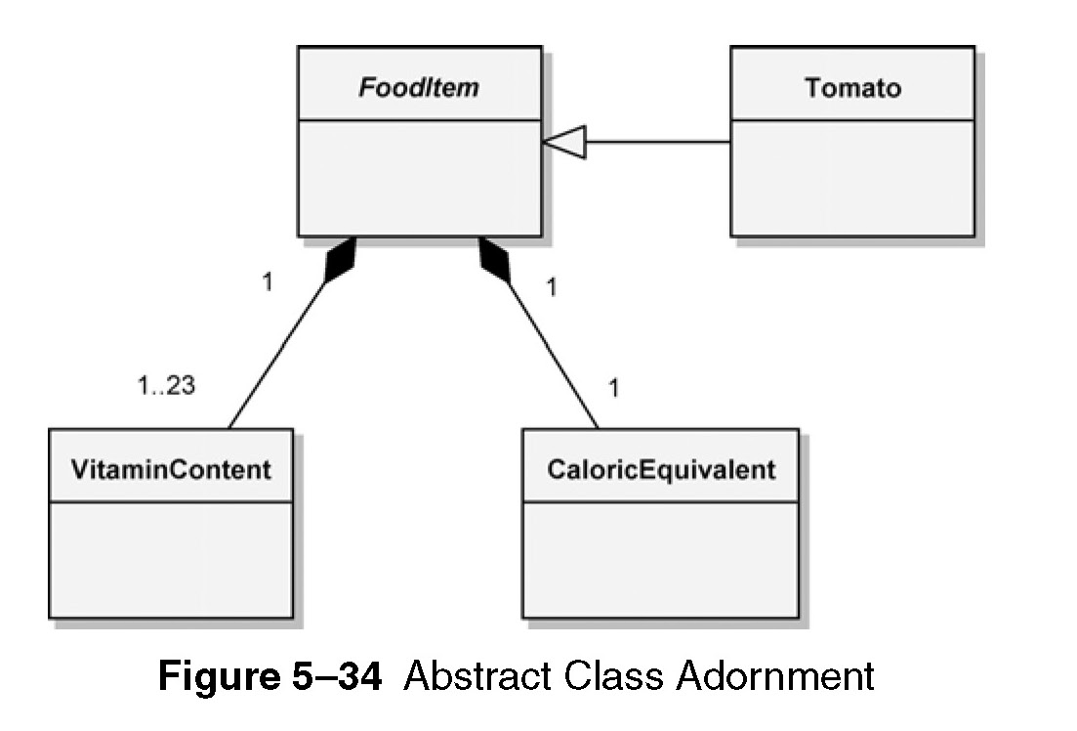

Slide 72
Class diagrams
Class relationships (fig. 5-35)
  Association
  Generalisation
  Aggregation
  Composition
Classes can be used to represent physical containment (fig. 5-36)

Slide 73
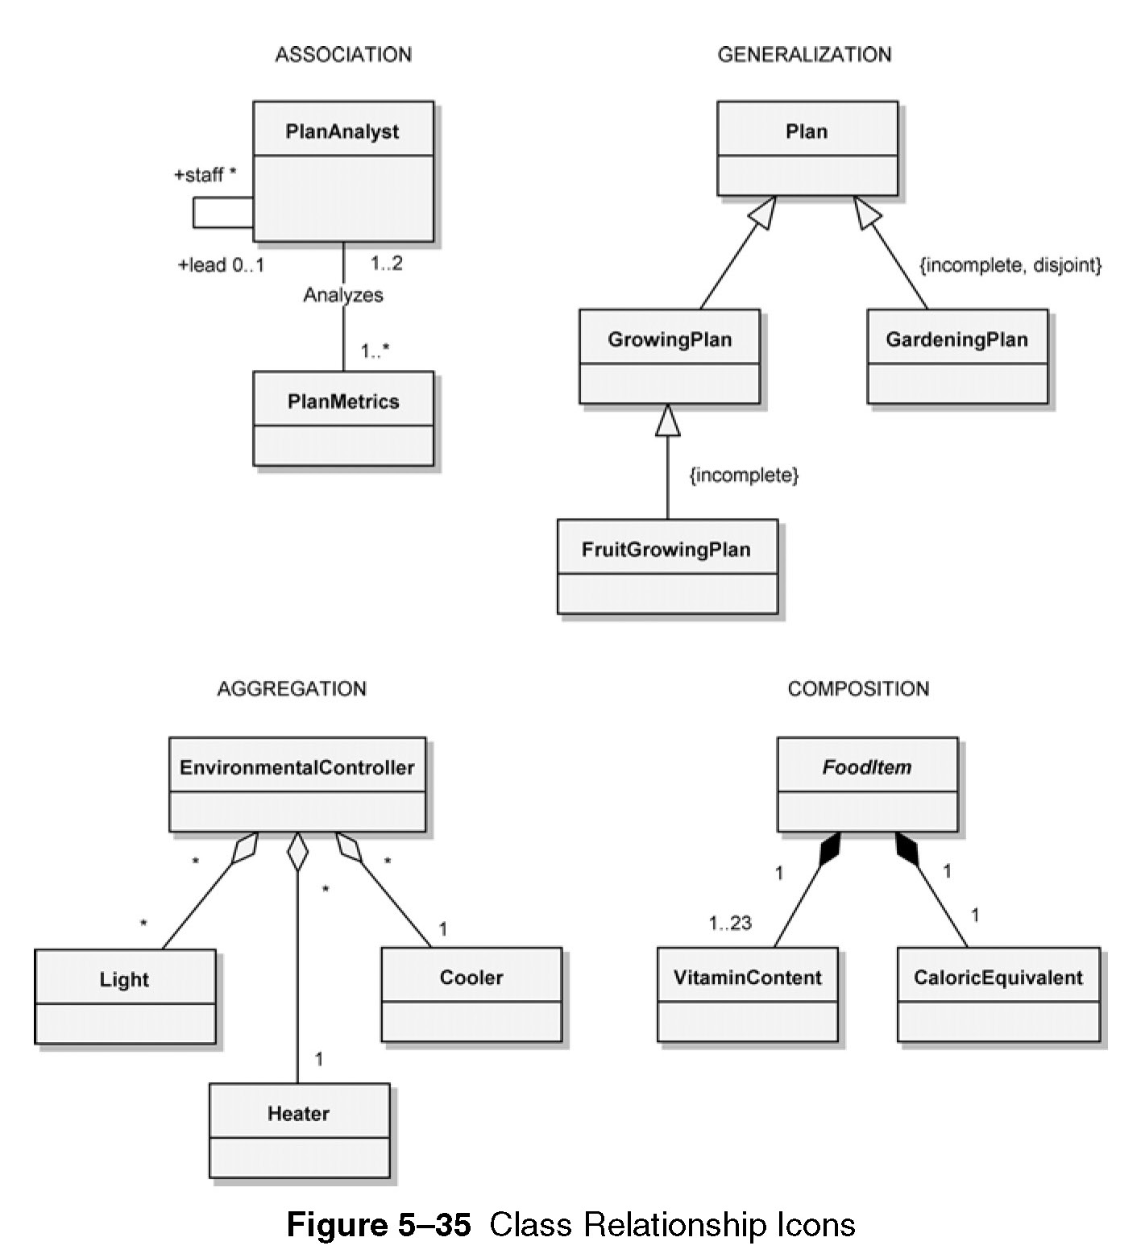

Slide 74
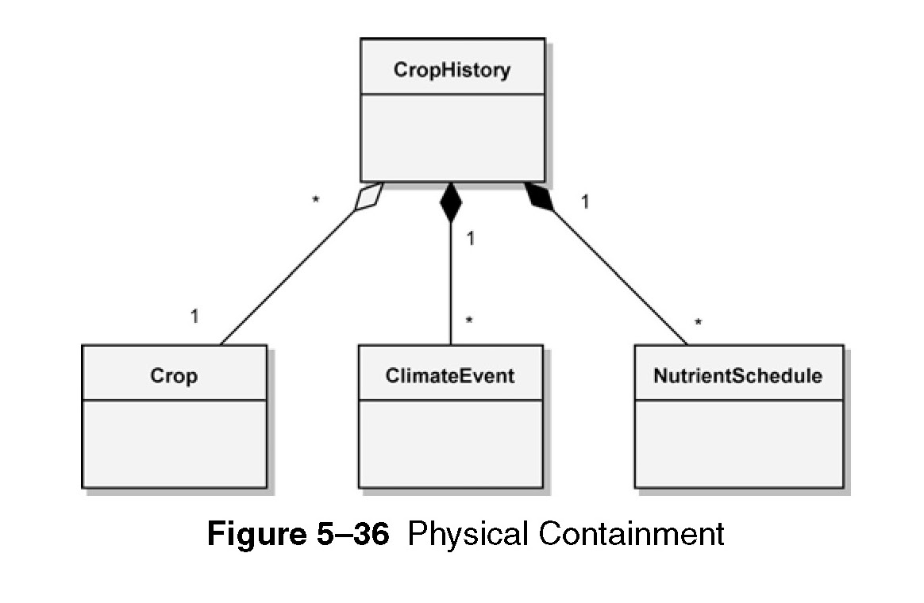

Slide 75
Class diagrams
Advanced concepts
Template classes (fig. 5-37)
Visibility of elements (fig. 3-38)
  Public ( + )
  Protected ( # )
  Private ( - )
  Package ( ~ )
Association end names and qualifiers (roles played by classes), (fig. 5-39)

Slide 76
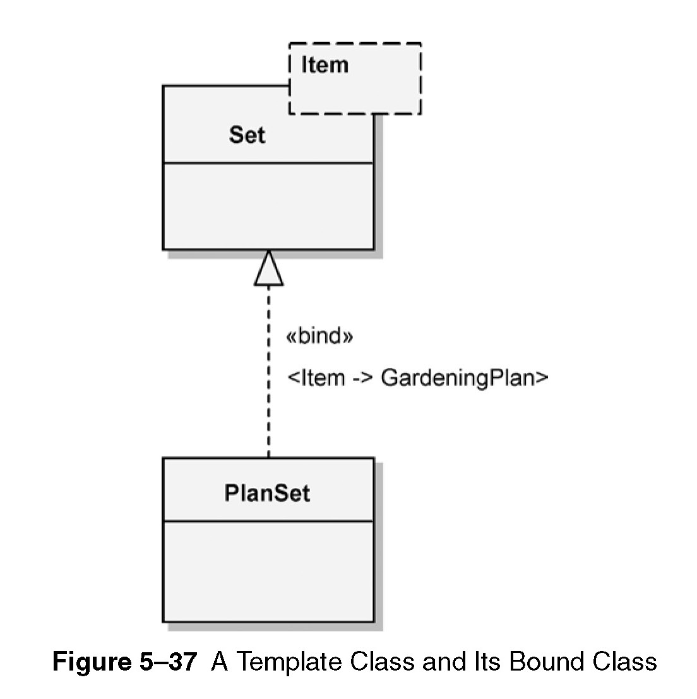
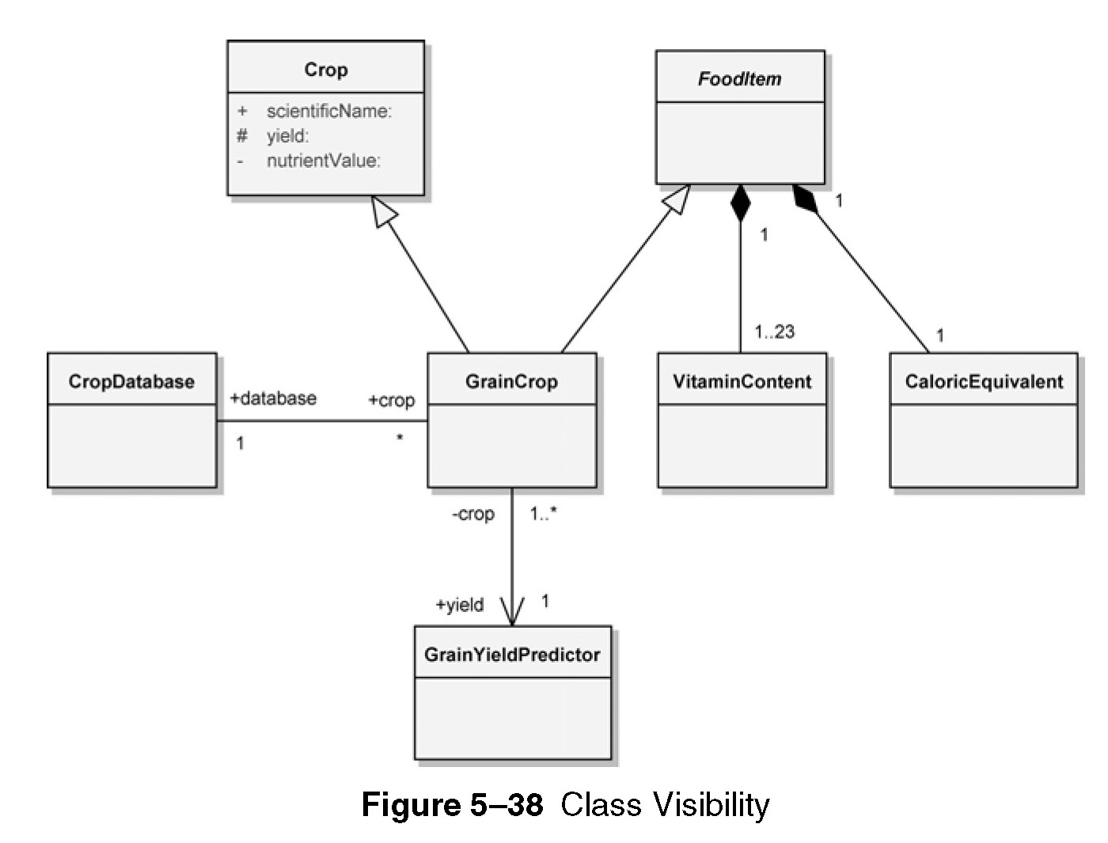

Slide 77
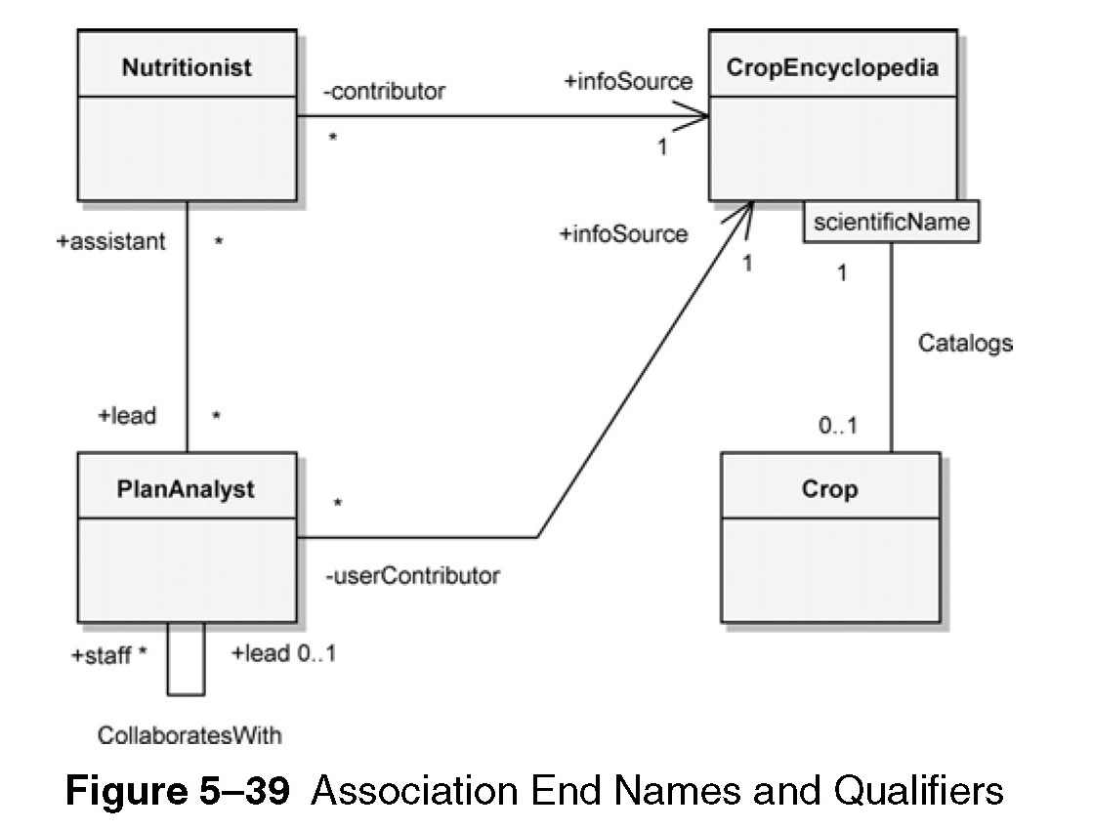

Slide 78
Class diagrams
Advanced concepts
Constraints – can be specifies for classes and their relationships, (fig. 5-40)
Association classes and notes, (fig. 5-41)

Slide 79
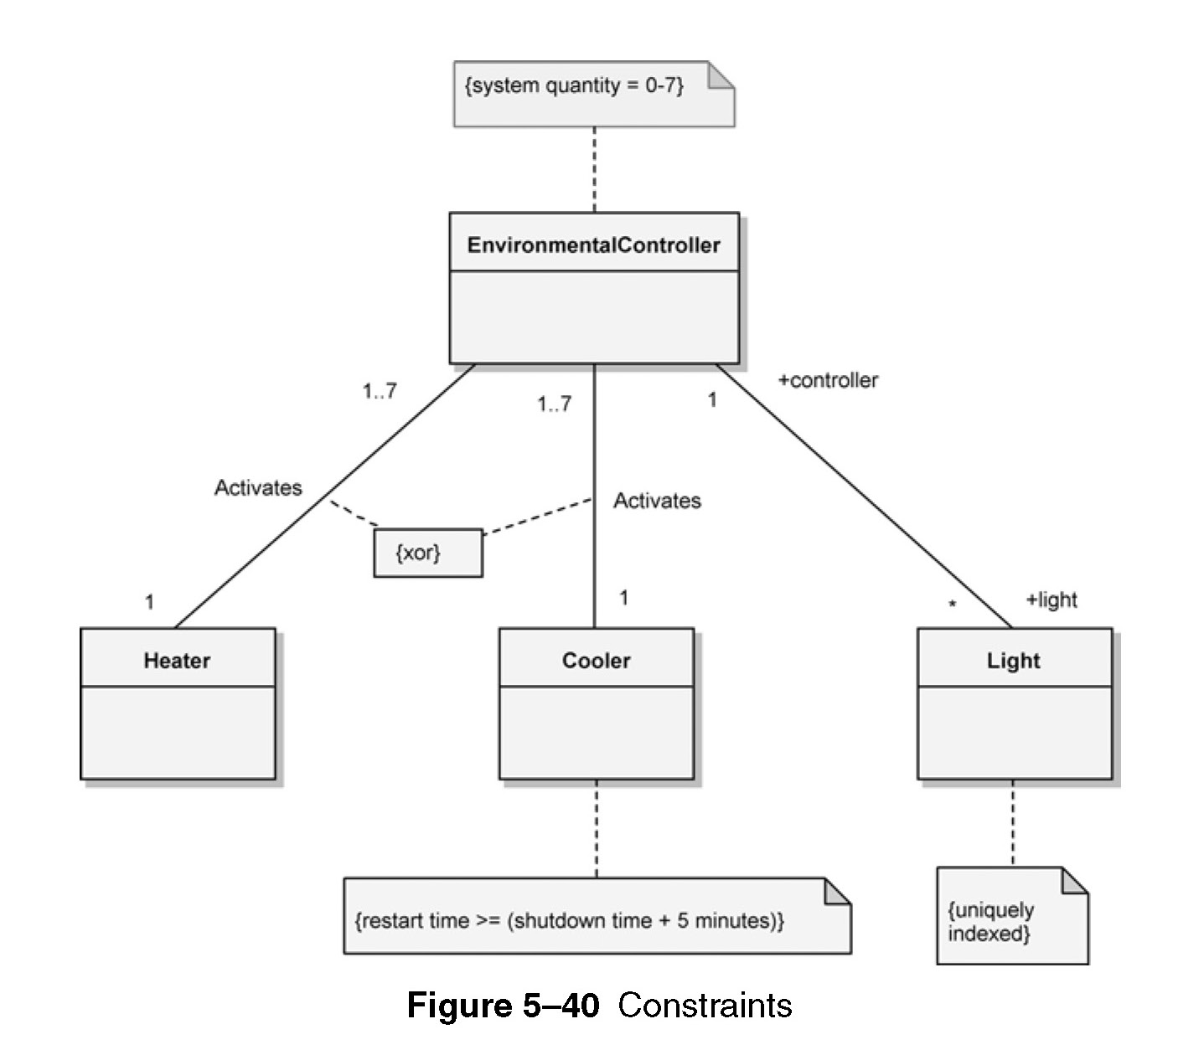

Slide 80
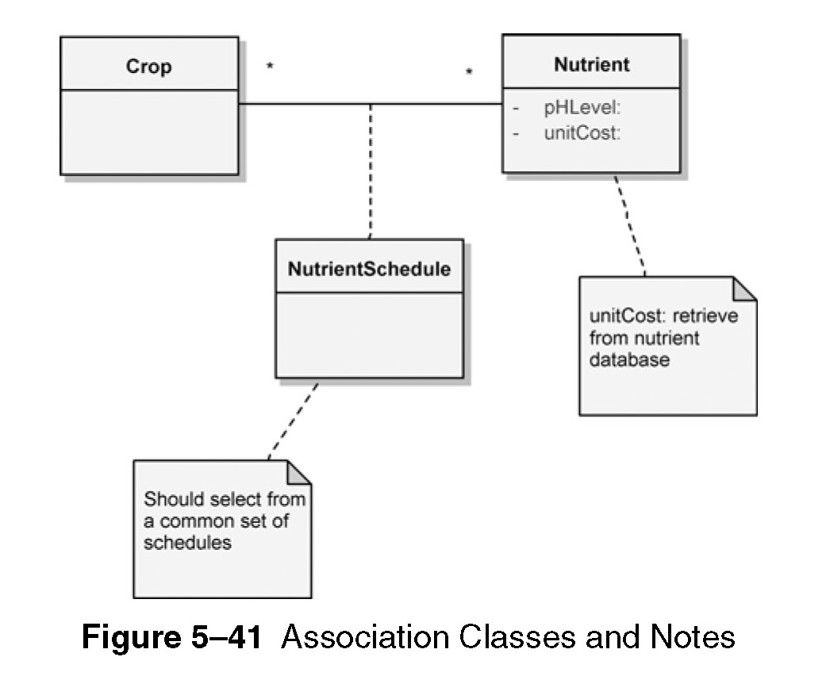

Slide 81
Sequence diagrams
Used to trace the execution of a scenario in the same context as a communication diagram (included together).
Objects and interactions – lifelines and messages (events/invocation of operations), (fig. 5-42)
Different notations can be used for types of messages (fig. 5-43)
Destruction events

Slide 82
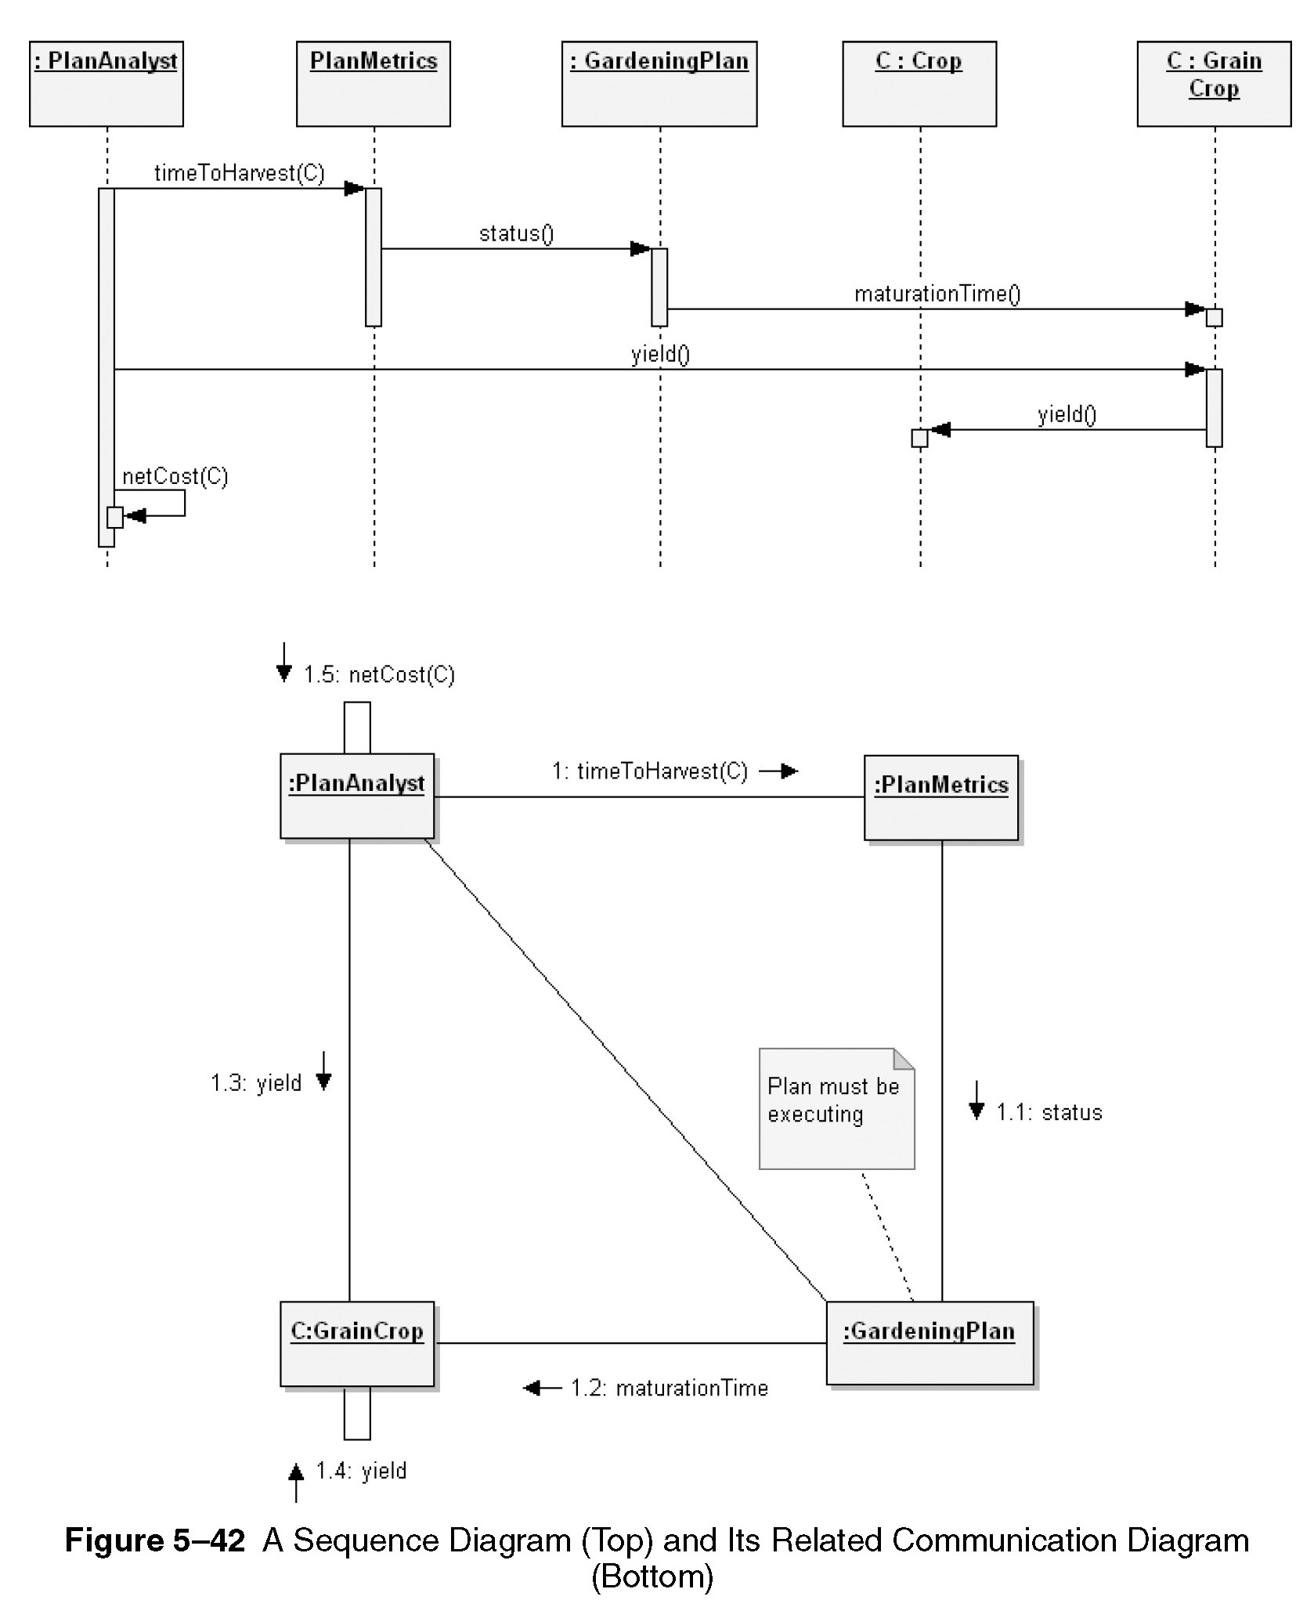

Slide 83
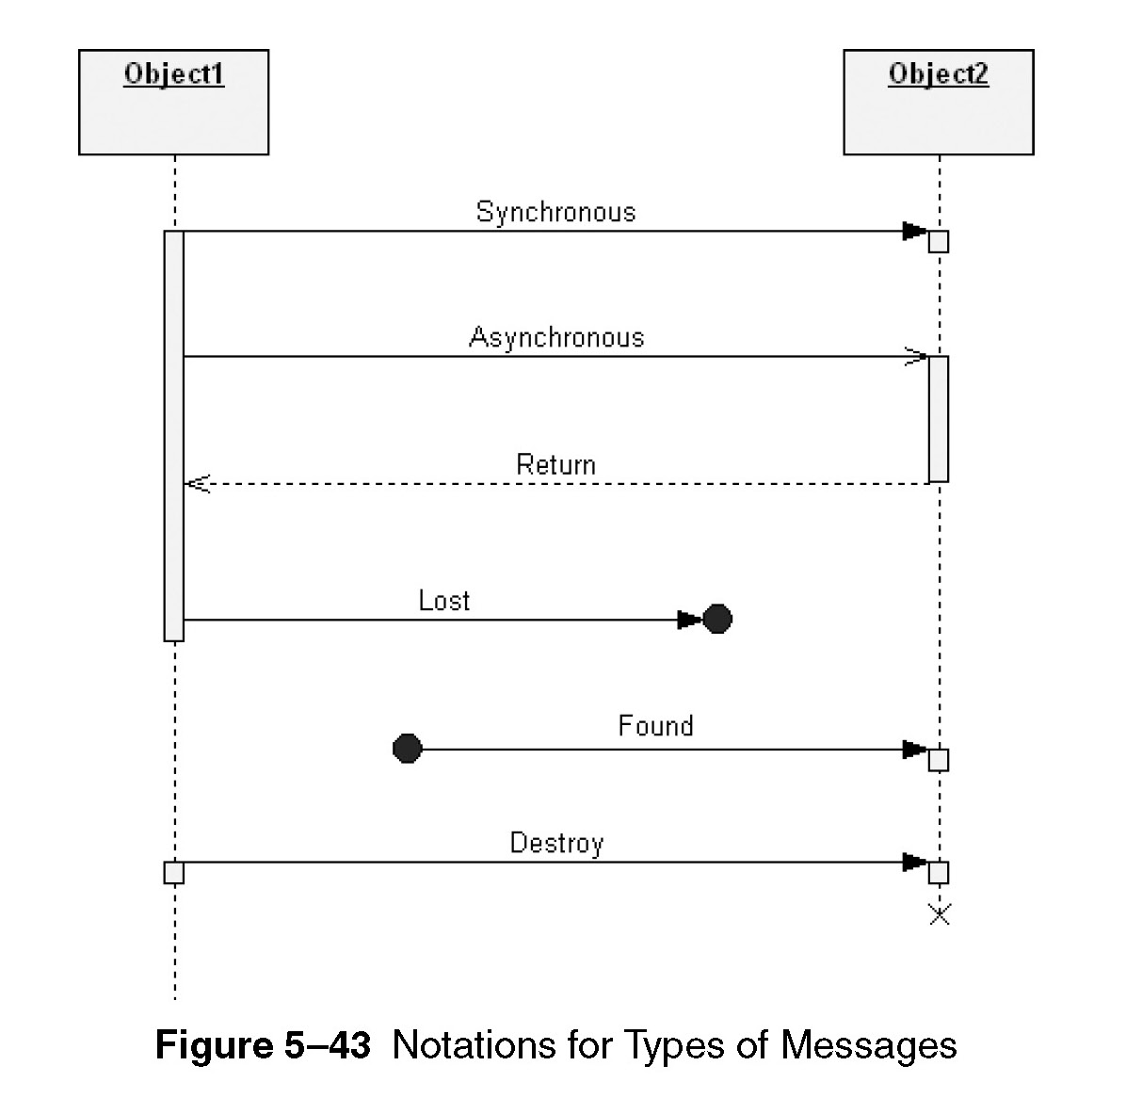

Slide 84
Sequence diagrams
Advanced concepts
Execution specification – detailed message sequence (fig. 5-44)
Can use scripts to provide details (fig. 5-45)
Interaction use – reuse interaction defined somewhere else (fig. 5-46)
Control constructs – define flow control (fig. 5-47, fig. 5-48)

Slide 85
Interaction overview diagrams
Combination of activity diagram and interaction diagram.
Provide overview of the flow control between interaction diagram elements.
Any interaction diagram can be used. But in most cases, sequence diagram is used.
Flow of control elements (fig. 5-49), for parallel paths, a fork node is used.

Slide 86
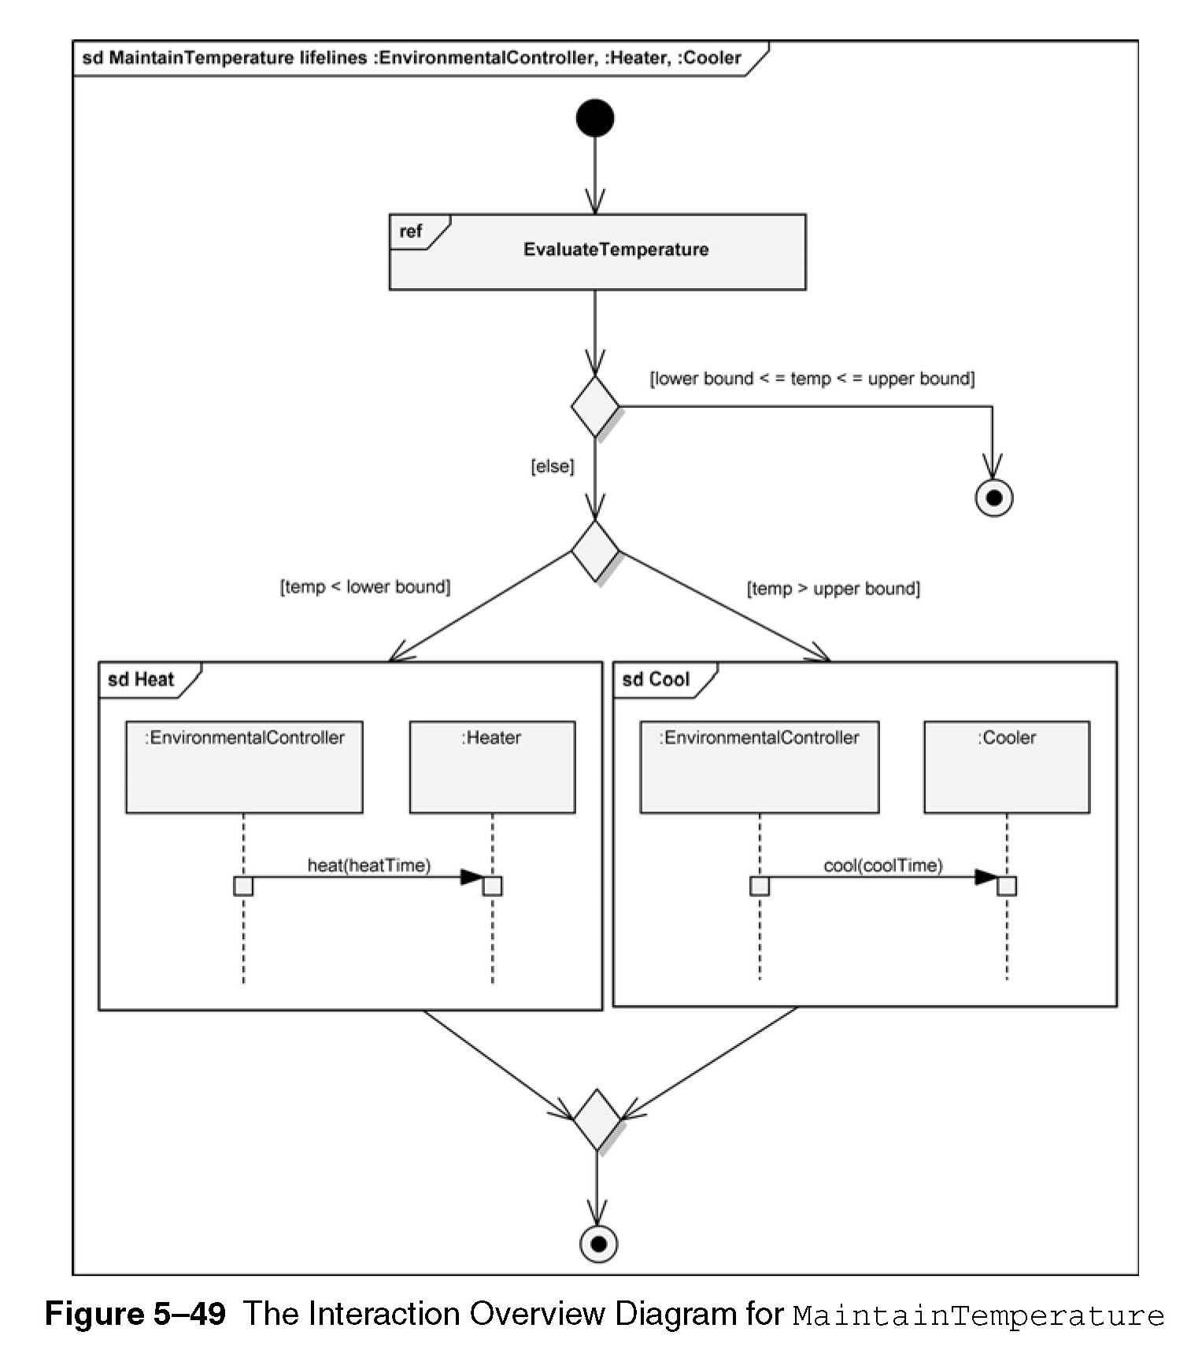

Slide 87
Composite structure diagrams
Explains structured classifier with the definition of its internal structure.
The internal structure contains parts and their relationships.
They can be nested.
Useful for decomposition of models.
Essential elements - parts, ports, interfaces, connectors
Example: (fig. 5-50)

Slide 88
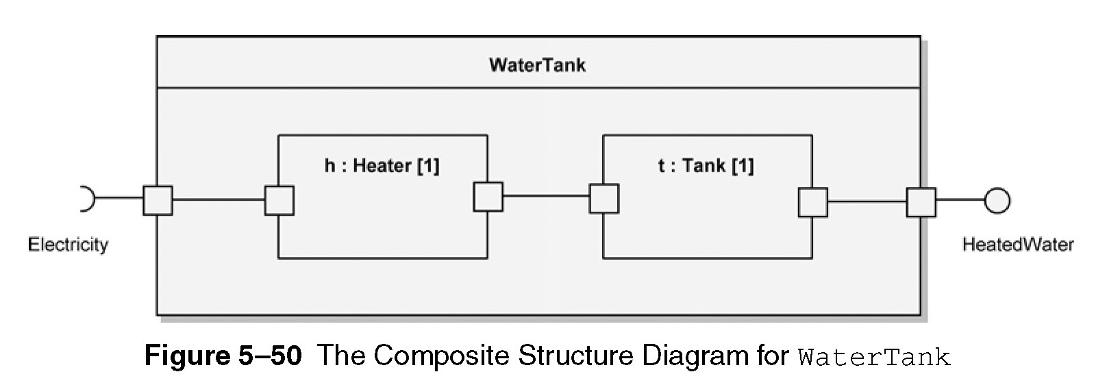

Slide 89
State machine diagrams
Useful to model time-critical systems
Shows behavior progression through a series of states, triggered by events.
Typically used to describe the behavior of individual objects.
Applicable to only those classes that exhibit event-ordered behavior.
Useful to analyse and design dynamic behavior.

Slide 90
State machine diagrams
Initial, final, and simple states, (fig. 5-52)
Transition and events – movement between states, (fig. 5-53)
A transition without any annotation is called complete transition.
States can have additional states, (fig. 5-54)

Slide 91
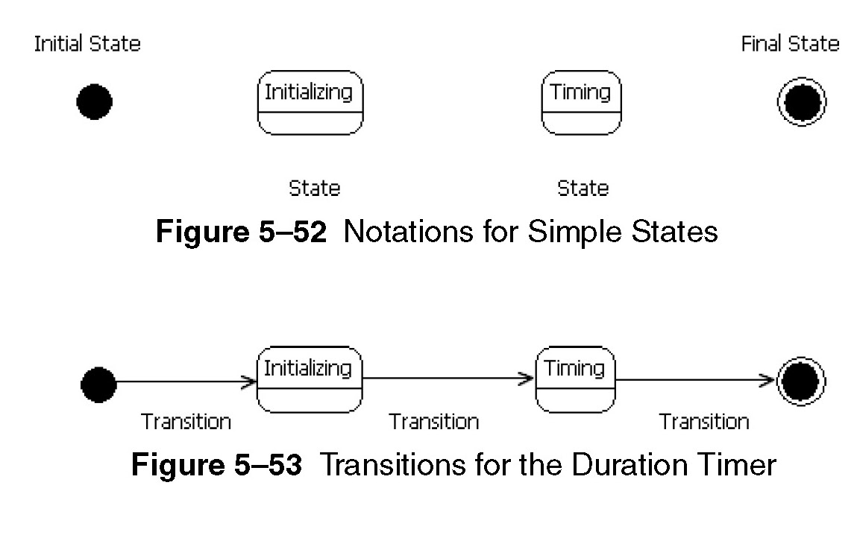

Slide 92
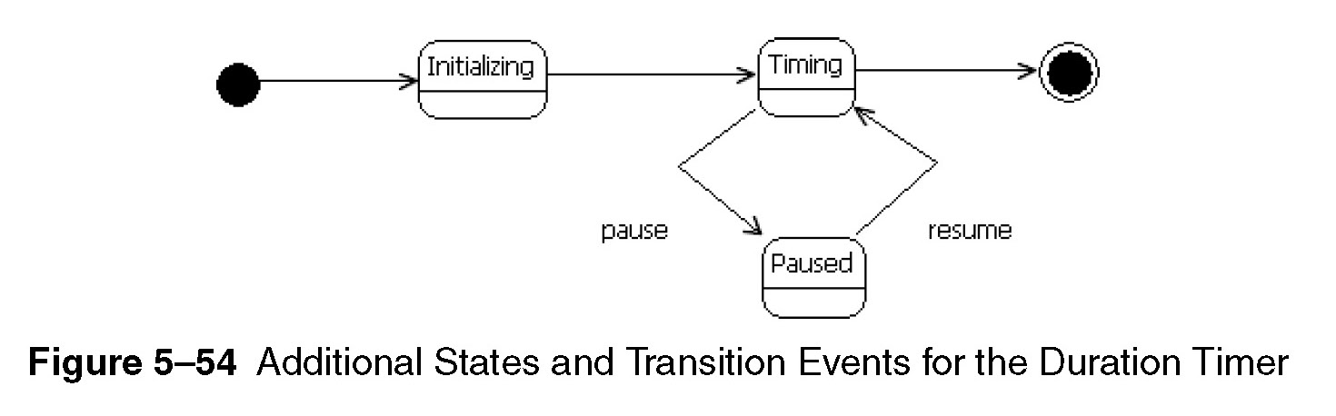

Slide 93
State machine diagrams
Advanced concepts
State activities – entry, do and exit, (fig. 5-55)
Controlling transitions use;
  If-then conditions
  Effects of states (fig. 5-56)
Composite and nested states, (fig. 5-57, 5-58)
Concurrency and control, (fig. 5-59 – 67)
Sub-machine state, (fig. 5-68)

Slide 94
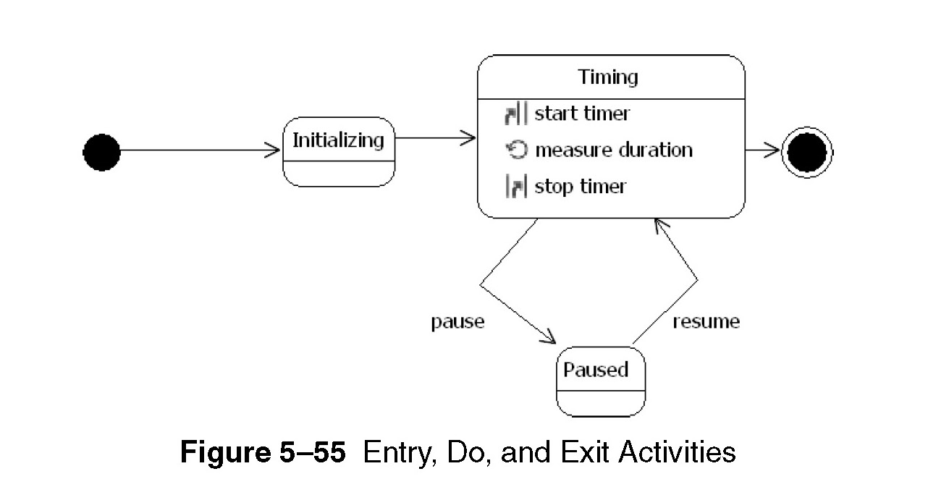
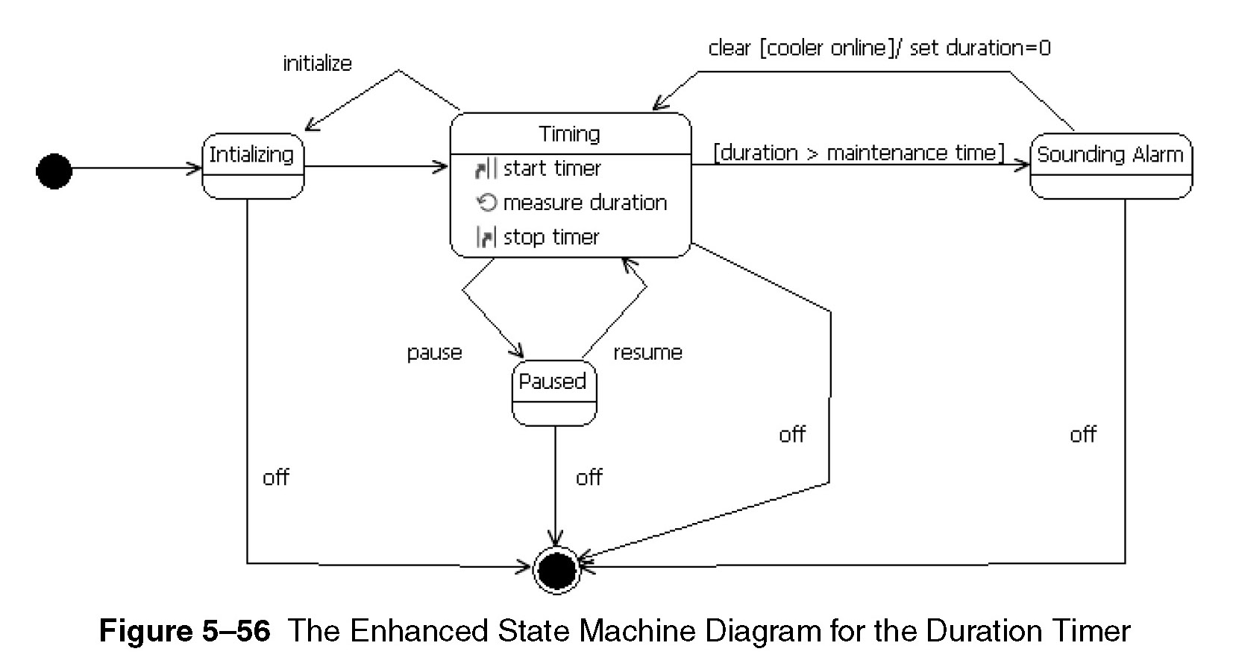

Slide 95
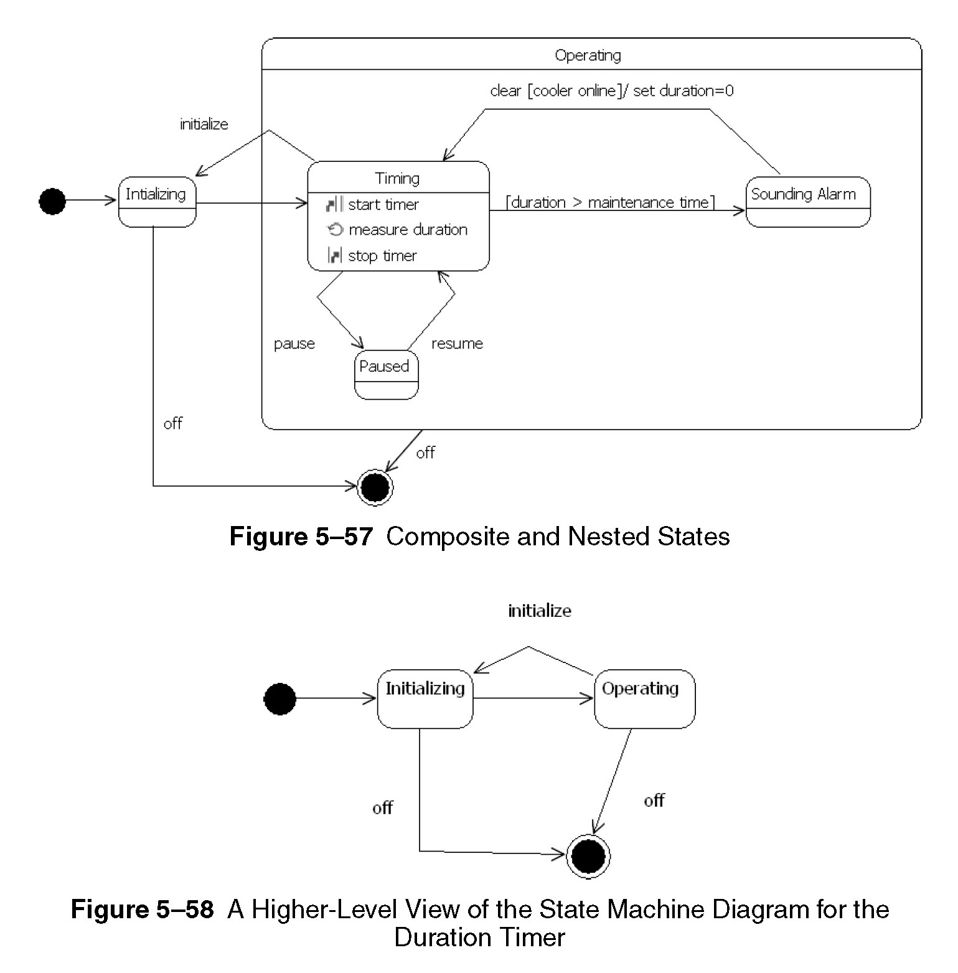

Slide 96
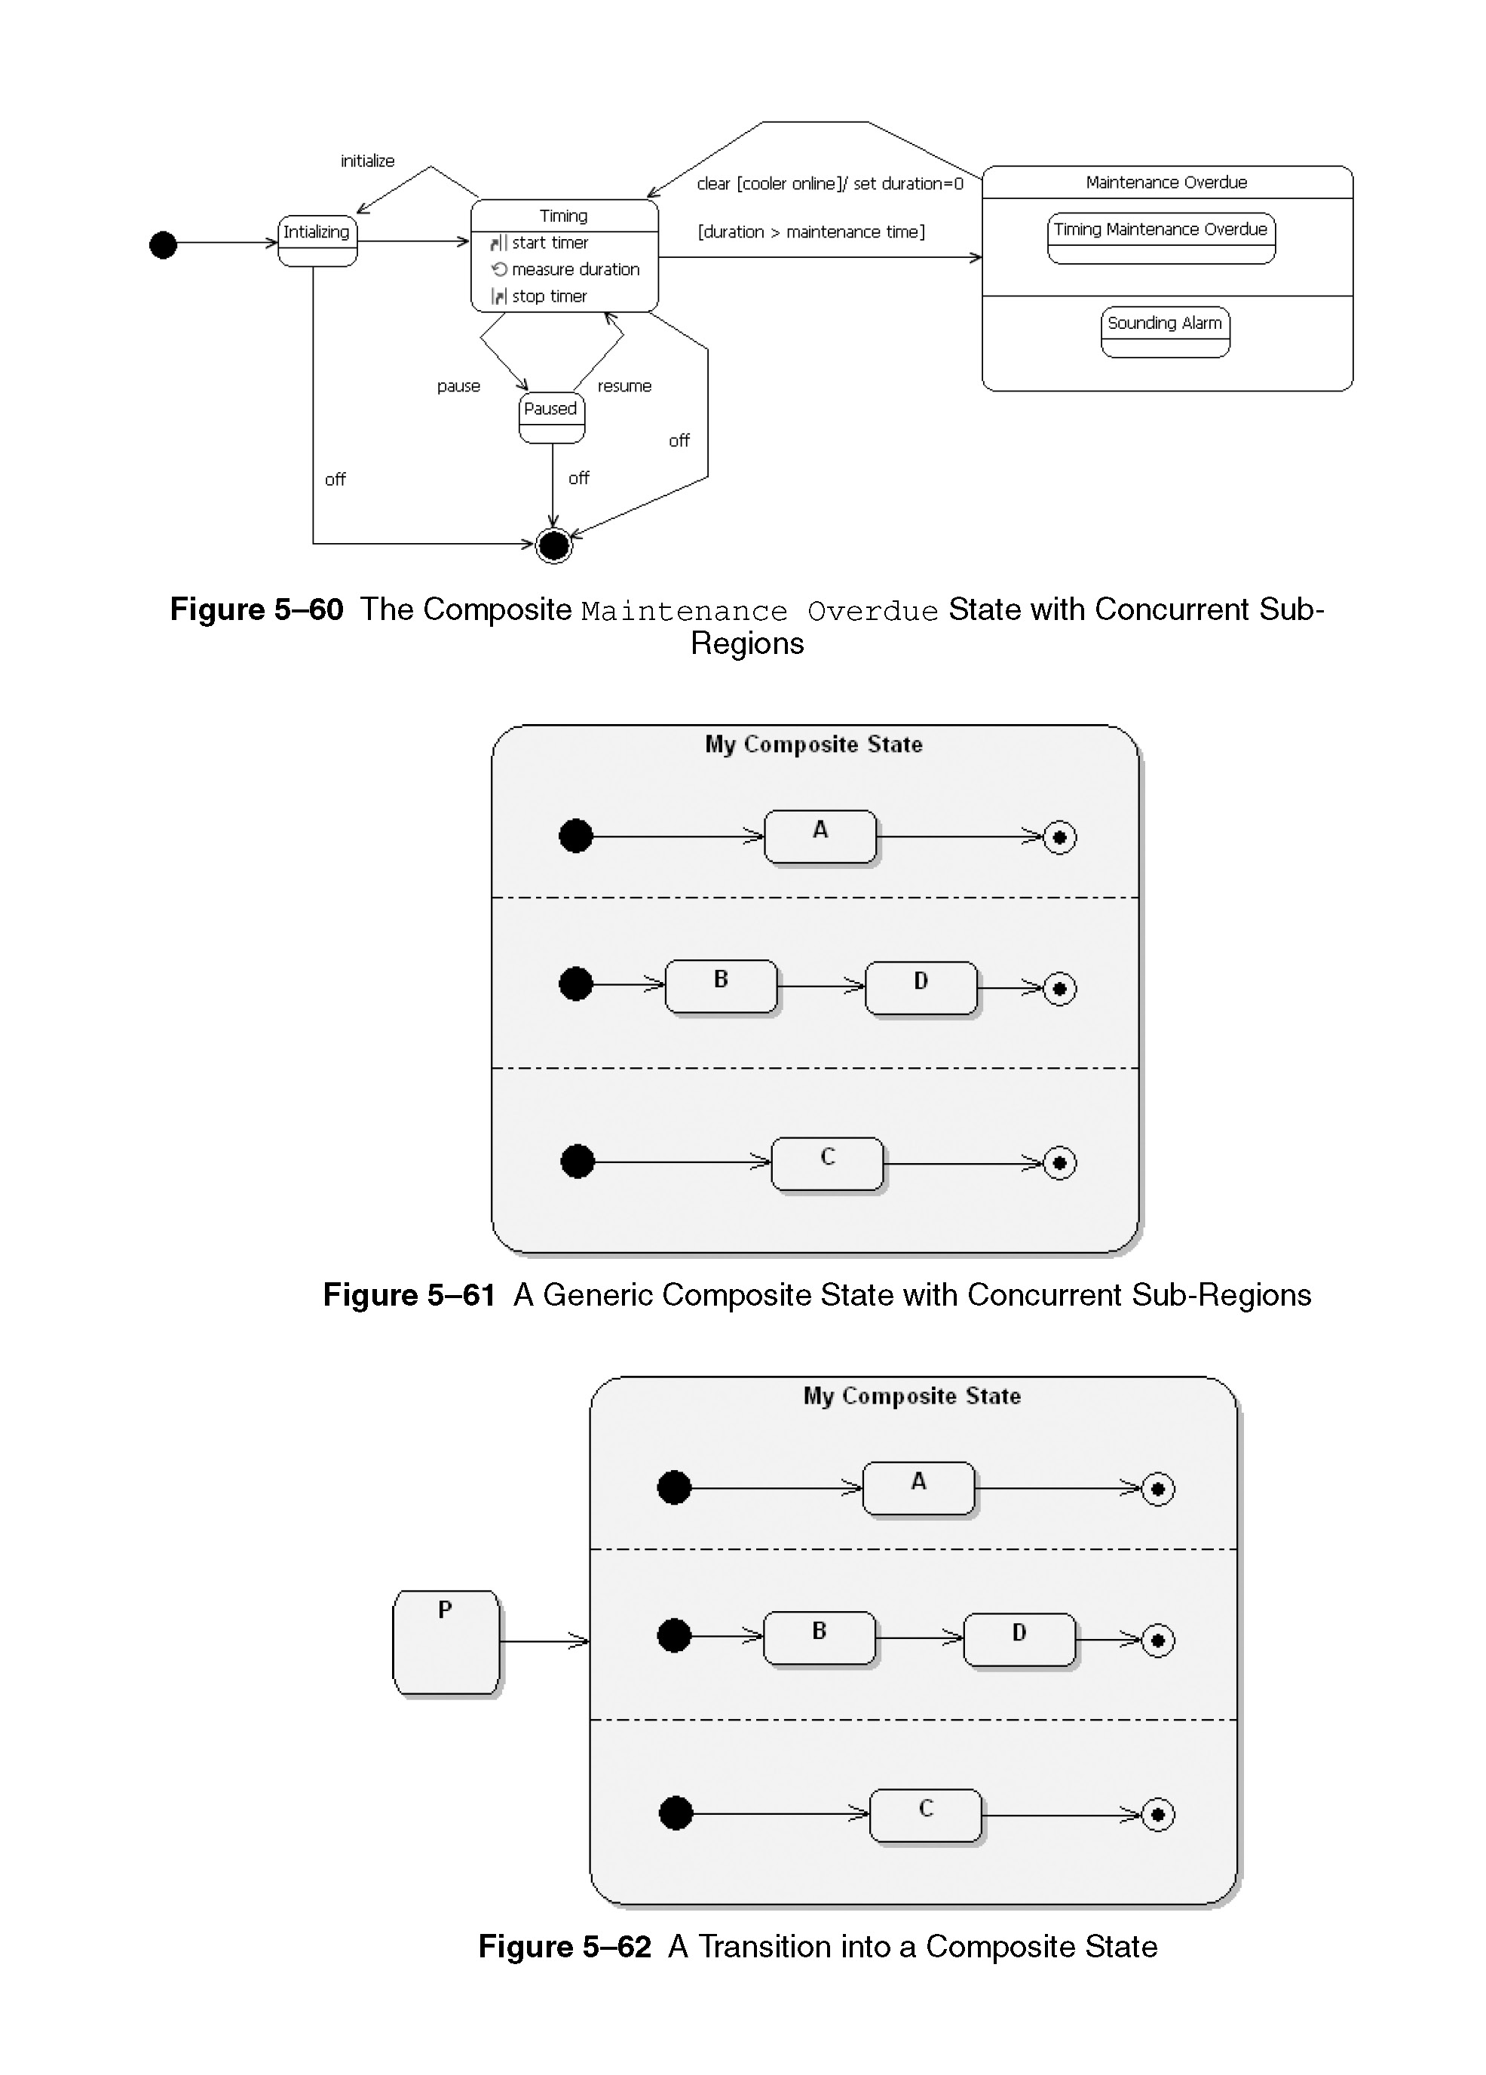
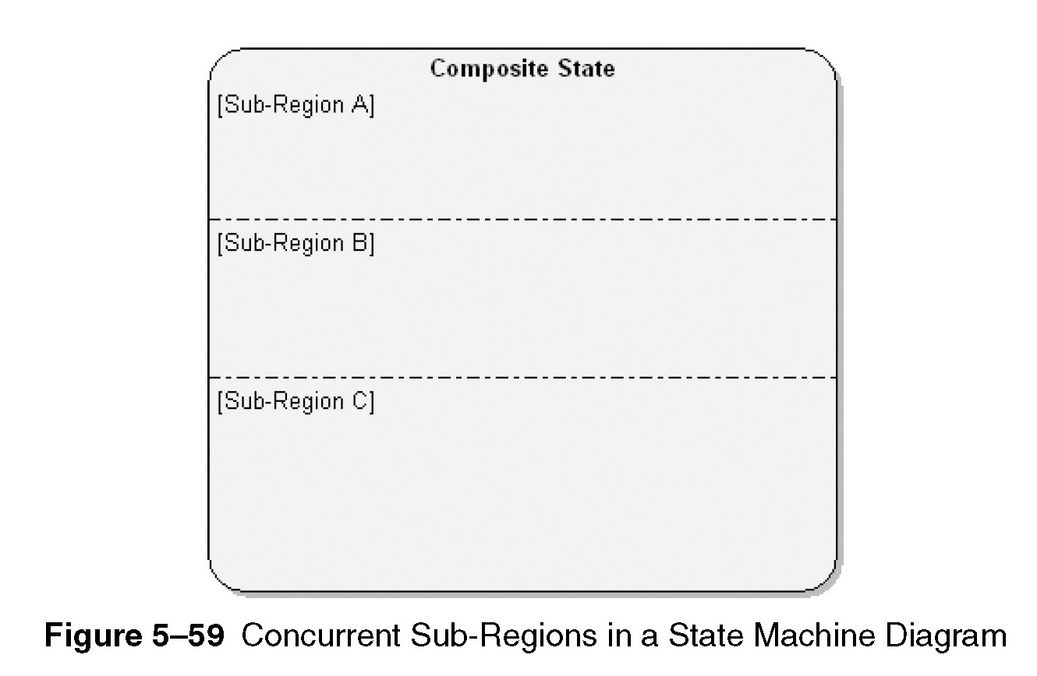

Slide 97
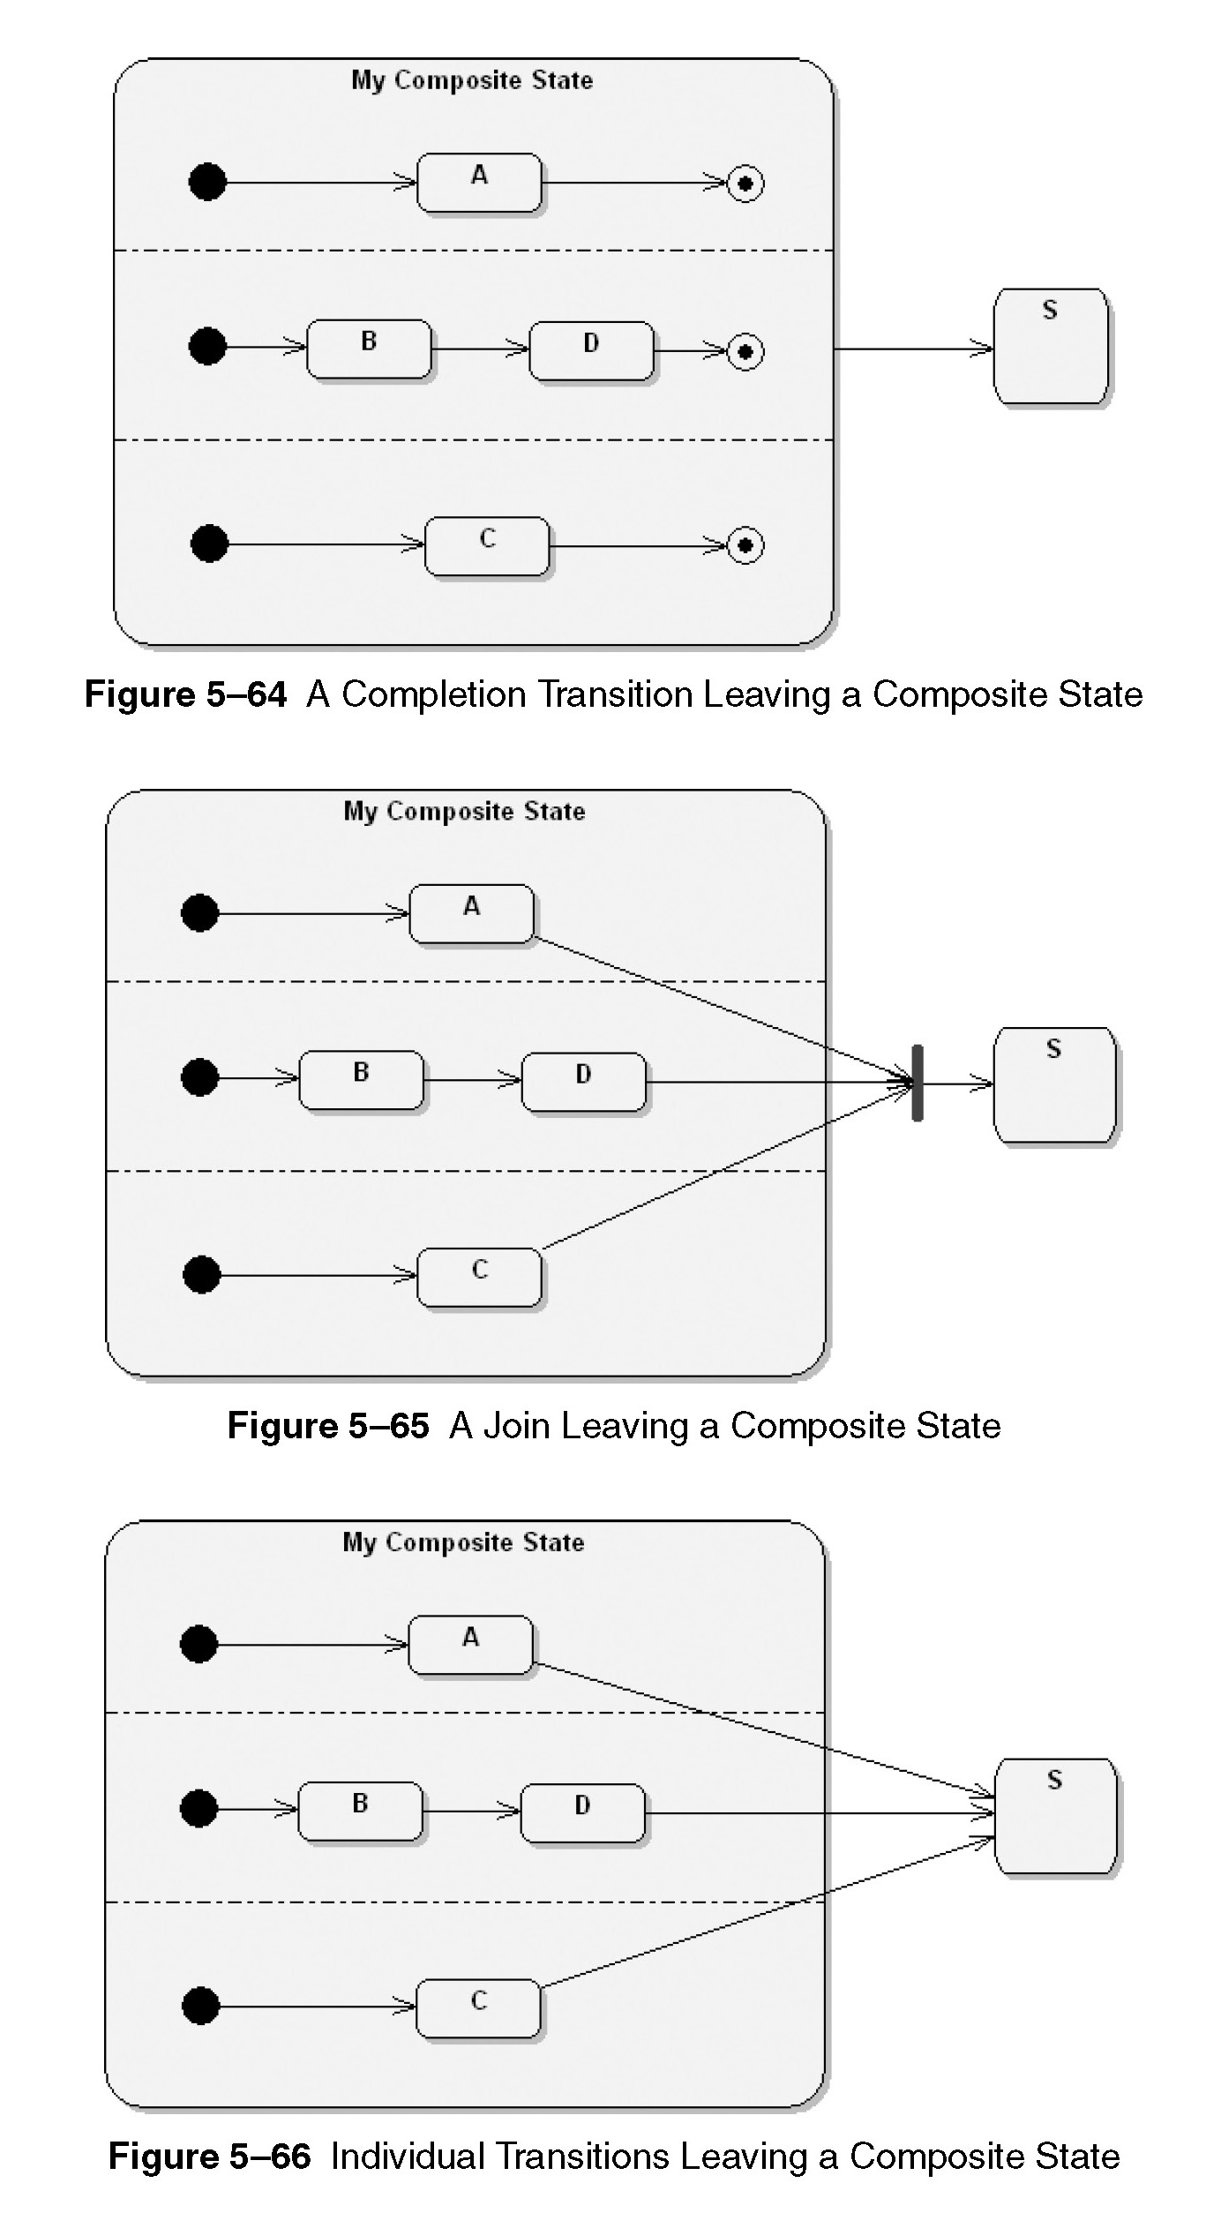
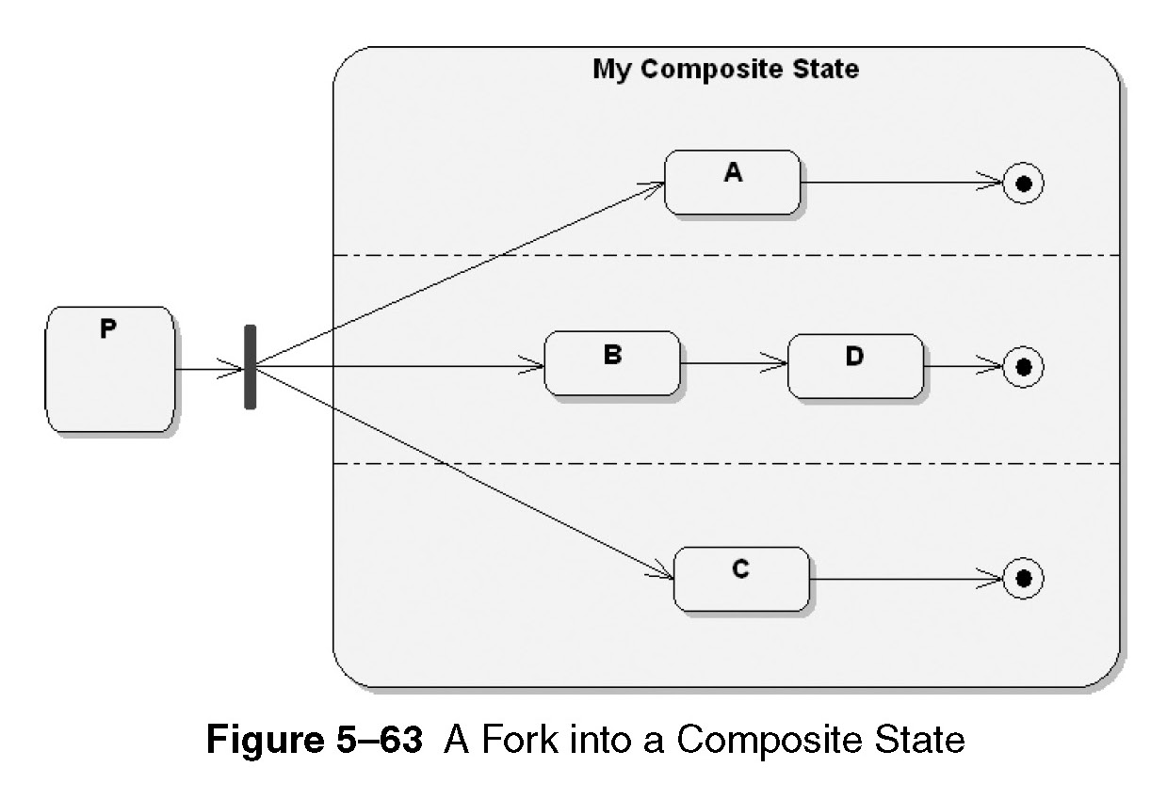

Slide 98


Slide 99
Timing diagrams
Model timing requirements of given system
Reuse elements that appear in other UML diagrams.
(fig. 5-69, 5-70)
Events and constrains can be defined, (fig. 5-71, 5-72)

Slide 100


Slide 101


Slide 102
Timing diagrams
Advanced concepts
Alternate representations, (fig. 5-73)
Events vs. messages, (fig. 5-74)

Slide 103



Slide 104
Object diagrams
Model objects and their relationships in logical design of a system
Represents a snapshot in time of events over a certain configuration of objects.
During analysis, used to indicate semantics of primary and secondary scenarios
During design, used to illustrate the semantics of mechanisms in the logical design of a system

Slide 105
Object diagrams
Two elements
Objects, (fig. 5-75)
Relationships, (fig. 5-76)
May use end names and qualifiers

Slide 106



Slide 107
Communication diagrams
A type of interaction diagram that shows how objects are linked and what messages they pass
Contain;
  Objects
  Links
  Messages
Sequence is expressed (fig. 5-77)

Slide 108


Slide 109
Communication diagrams
Synchronisation is supported, (fig. 5-79)
Iterations and conditions, (fig. 5-80)

Slide 110


Slide 111


Slide 112
End of Unit 03 : UML

