Slide 1
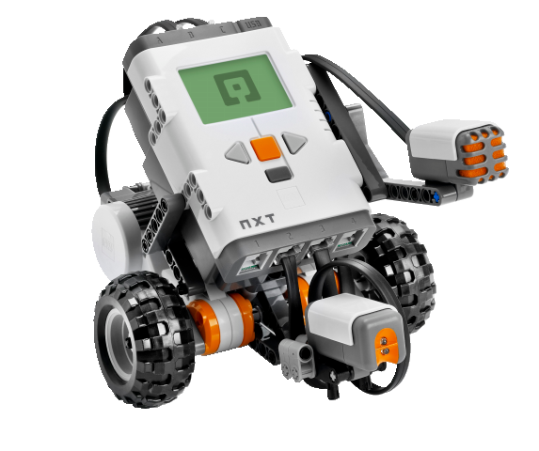
OBJECT-ORIENTED SOFTWARE ENGINEERING
UNIT 04 : Object Oriented Analysis
© 2019, PRAMOD PARAJULI

Slide 2
Disclaimer
These slides are part of teaching materials for Object Oriented Software Engineering (OOSE). These slides do not cover all aspect of learning OOSE, nor are these be taken as primary source of information. As the core textbooks and reference books for learning the subject has already been specified and provided to the students, students are encouraged to learn from the original sources.
Contents in these slides are copyrighted to the instructor and authors of original texts where applicable.

Slide 3

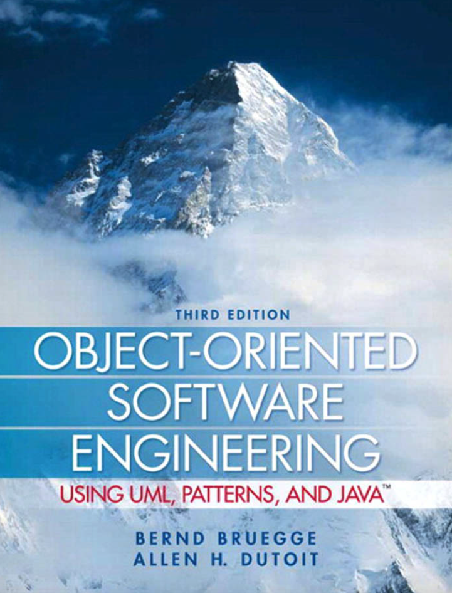
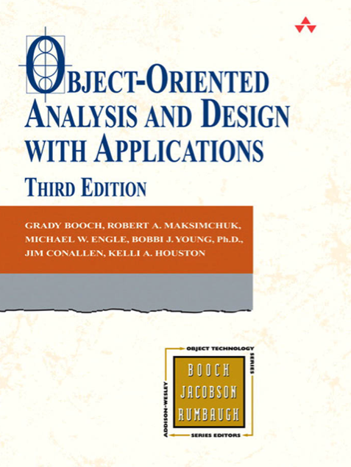


Slide 4
Requirements elicitation
UNIT 04: Object-oriented Analysis
References:
Bruegge B., and Dutoit A. H. 2010, Object-oriented Software Engineering using UML, Patterns and Java, 3rd ed., Prentice Hall (Chapter 4)
Pressman, R. S., 2001, Software Engineering - A Practitioner's Approach, Fifth Ed., McGrawHill (Chapter 21)

Slide 5
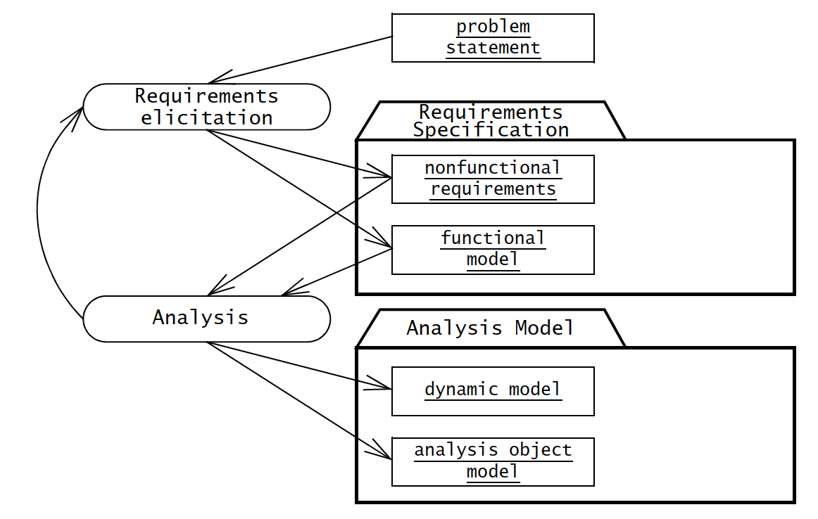
Requirements elicitation

Slide 6
Requirements elicitation activities
Identify actors
Identify scenarios
Identify use cases
Refine use cases
Identifying relationships among use cases
Identifying nonfunctional requirements
Source of information
Client-supplied documents
Manuals
Technical documentation of legacy systems
End-user discussions

Slide 7
Two methods for eliciting information
Joint Application Design – focuses on building consensus among developers, users, and clients by jointly developing requirements specification
Traceability – focuses on recording, structuring, linking, grouping, and maintaining dependencies among requirements and between requirements.

Slide 8
Requirements elicitation concepts
Functional requirements
Nonfunctional requirements
Completeness, consistency, clarity and correctness
Realism, verifiability, traceability
Greenfield engineering, reengineering and interface engineering

Slide 9
Nonfunctional requirements
Broad variety of requirements that are not related to functional behavior of the system
FURPS+ model suggests following categories of nonfunctional requirements
  Usability
  Reliability
  Performance
  Supportability

Slide 10
Nonfunctional requirements
Other categories in FURPS+
Implementation requirements (tools, programming languages, hardware platforms)
Interface requirements (constrains of interfaces imposed by external systems, legacy systems, end user, data interchange formats etc.)
Operations requirements (administration, configuration, management of system in operational setting)
Package requirements (delivery of packages, installation media etc.)
Legal requirements (accessibility, encryption and security, no-read-up no-write-down etc.)

Slide 11
Completeness, consistency, clarity and correctness – review the language, sentences, phrases etc.
Realism, verifiability, and traceability – use numbers, specific scenarios
Greenfield engineering – build system from scratch
Reengineering – reverse engineer existing system, redesign and re implement
Interface engineering – redesign the user interface of an existing system

Slide 12
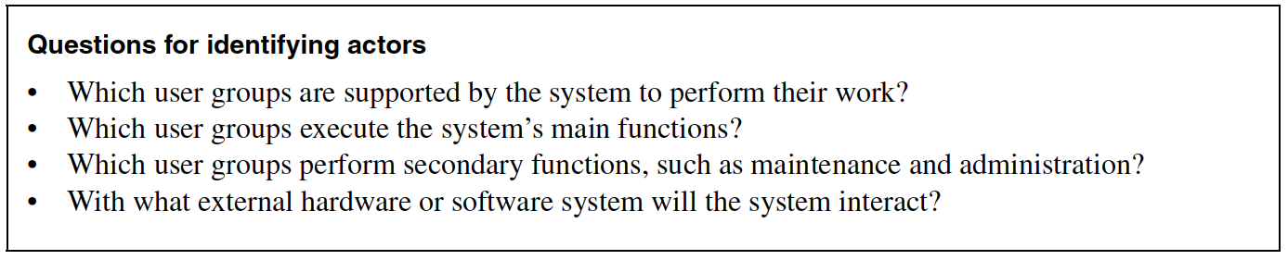
Identifying actors
Nouns that initiate/trigger events

Slide 13
Identifying scenarios
Concrete, focused, informal description of a single feature of the system from viewpoint of a single actor

Slide 14
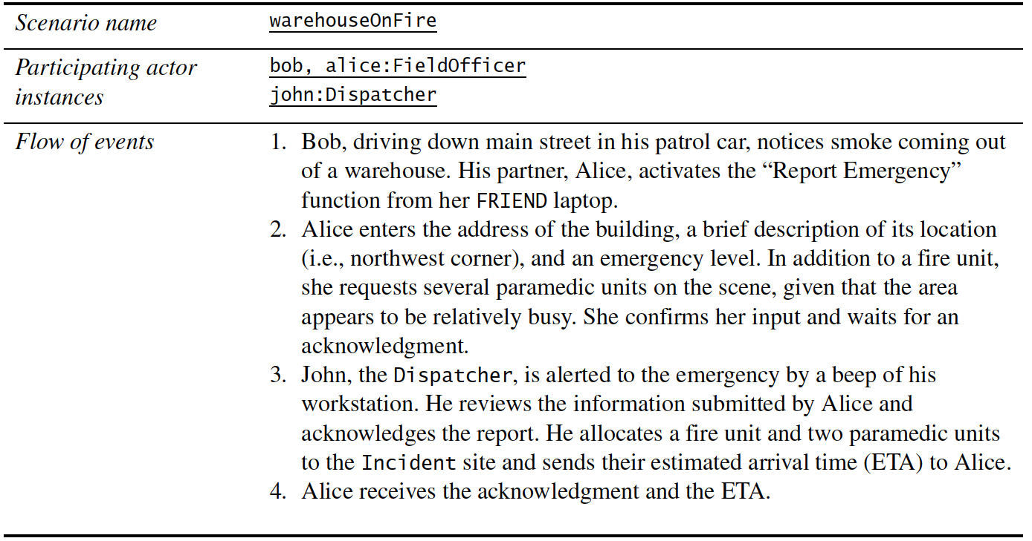
Identifying scenarios

Slide 15
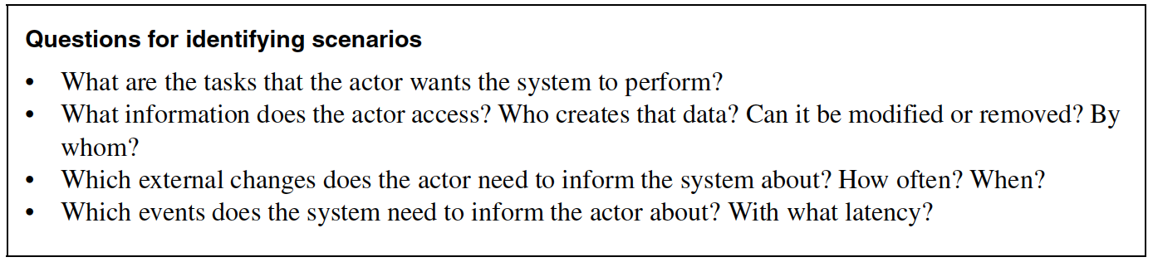
Identifying scenarios

Slide 16
Identifying use cases
Use cases represent all possible scenarios for given piece of functionality
A use case is initiated by an actor
A use case may interact with other actors
Name of a use case – should be a verb phrase

Slide 17
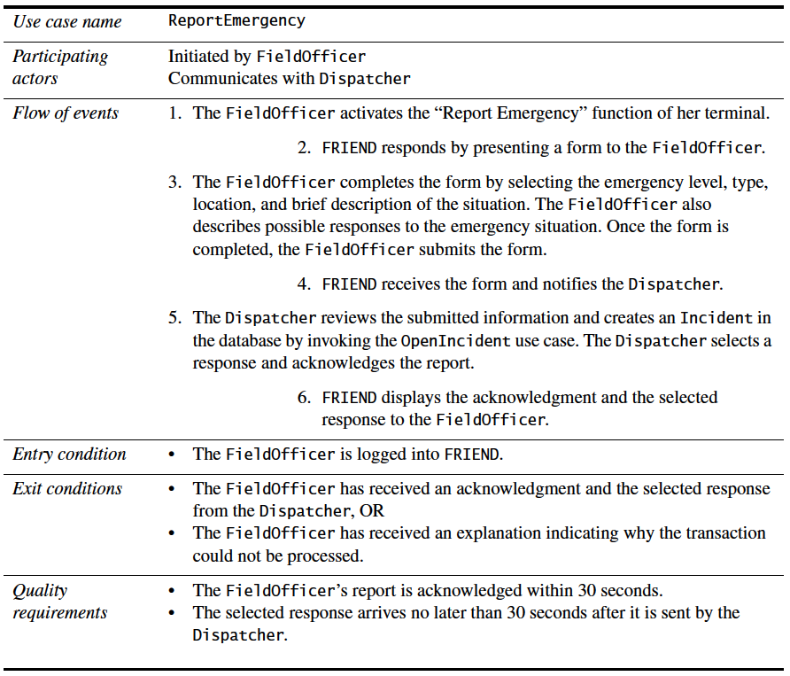
Another example

Slide 18
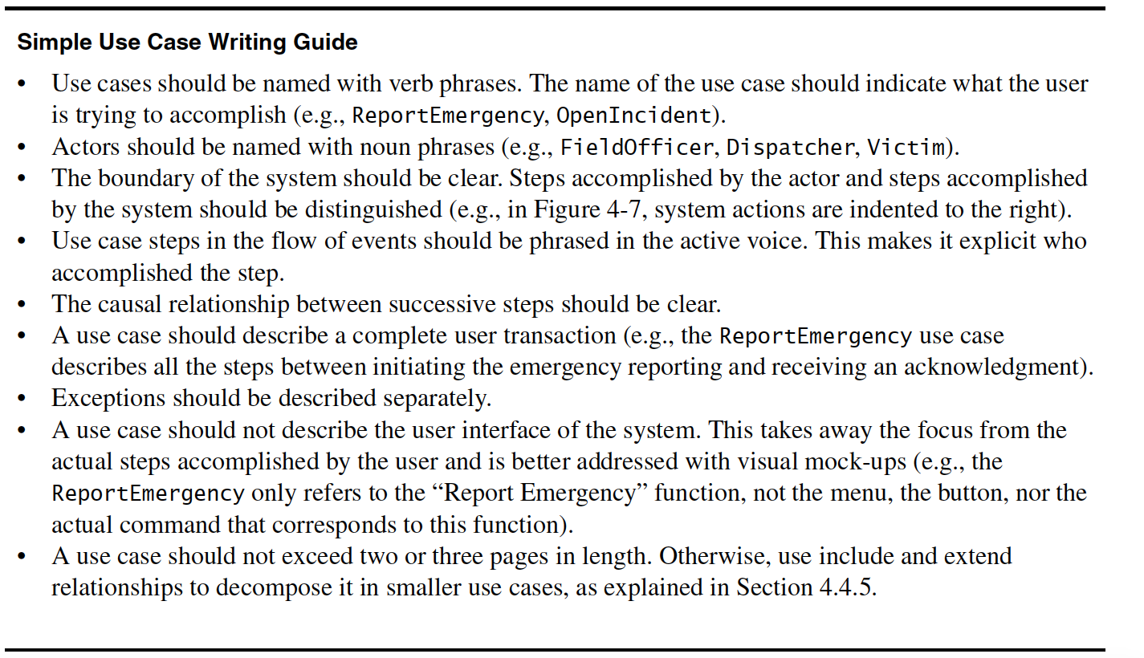

Slide 19
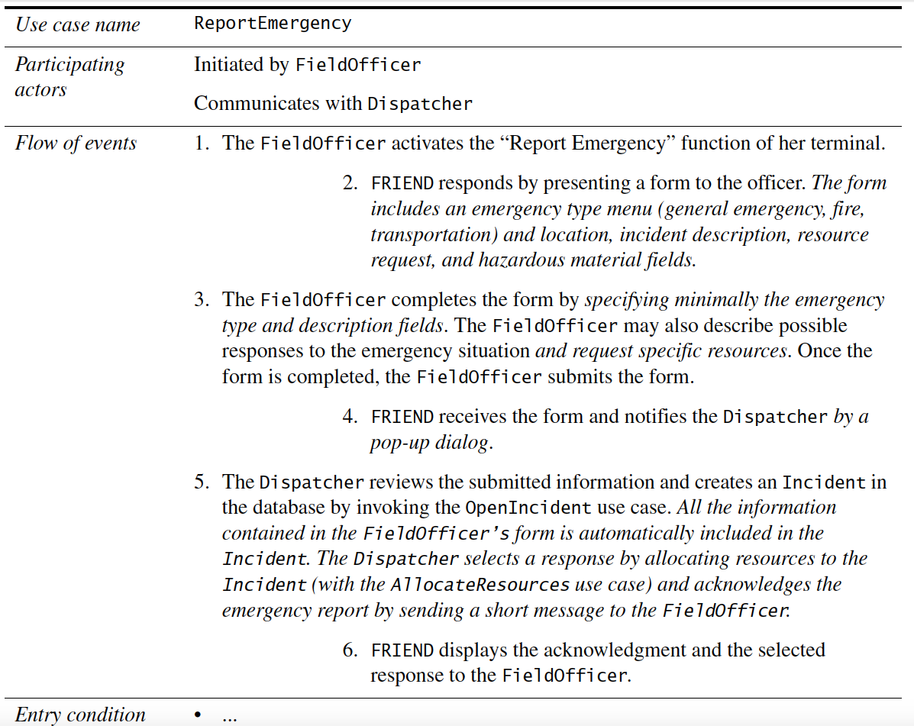
Refining use cases

Slide 20
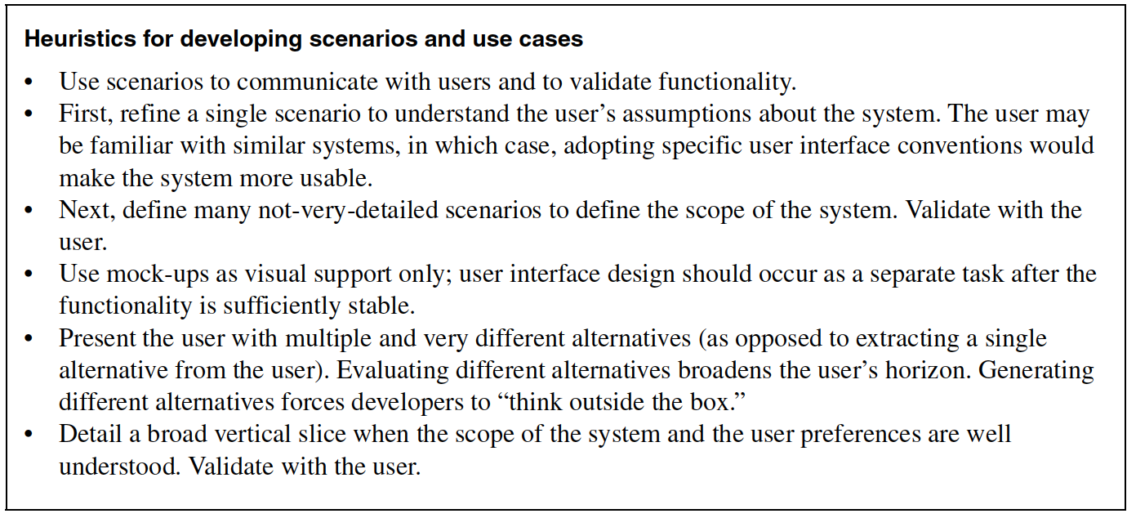

Slide 21
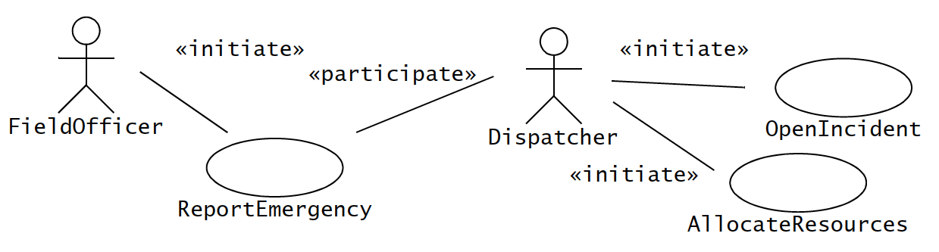
Identifying relationships between actors and use cases
Communication relationships between actors and use cases
Actor who initiates the use case should be distinguished from other actors

Slide 22
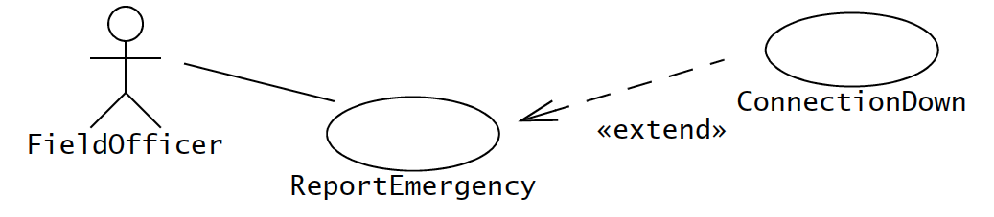
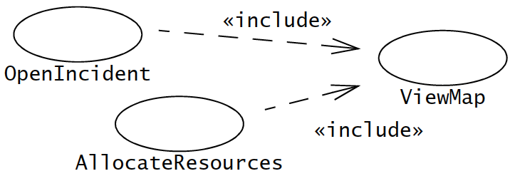

Slide 23
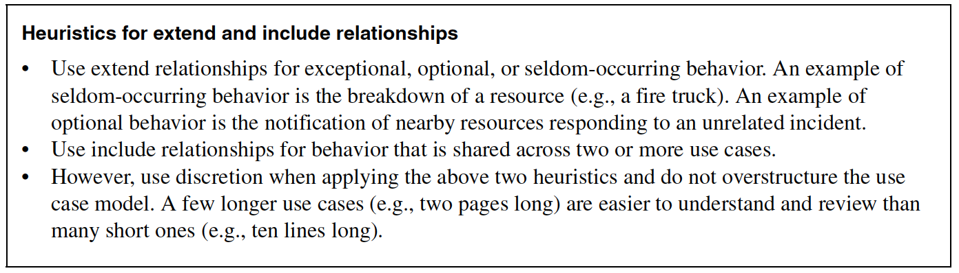

Slide 24
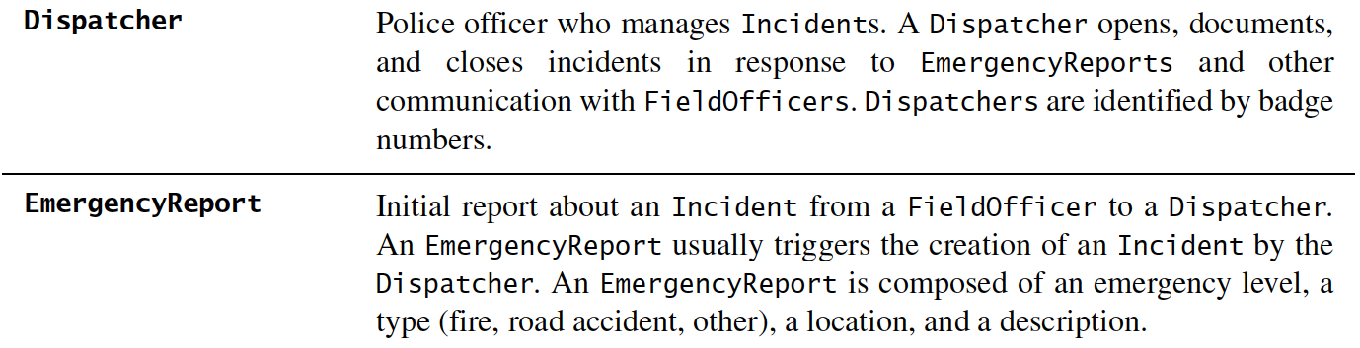
Identifying INITIAL ANALYSIS OBJECTS
Identify participating objects for each use case.
Give proper name and description, build a glossary

Slide 25
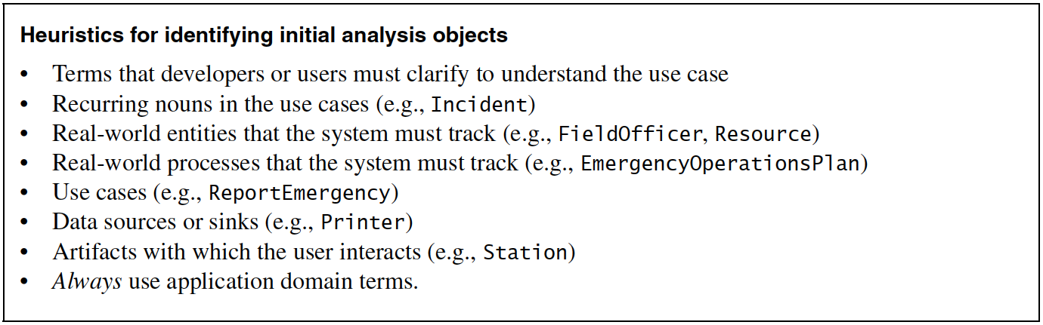
Identifying INITIAL ANALYSIS OBJECTS

Slide 26
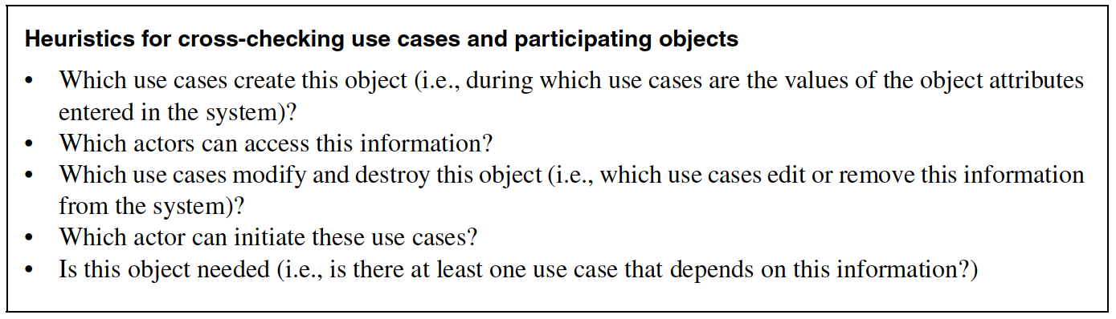
Identifying INITIAL ANALYSIS OBJECTS

Slide 27
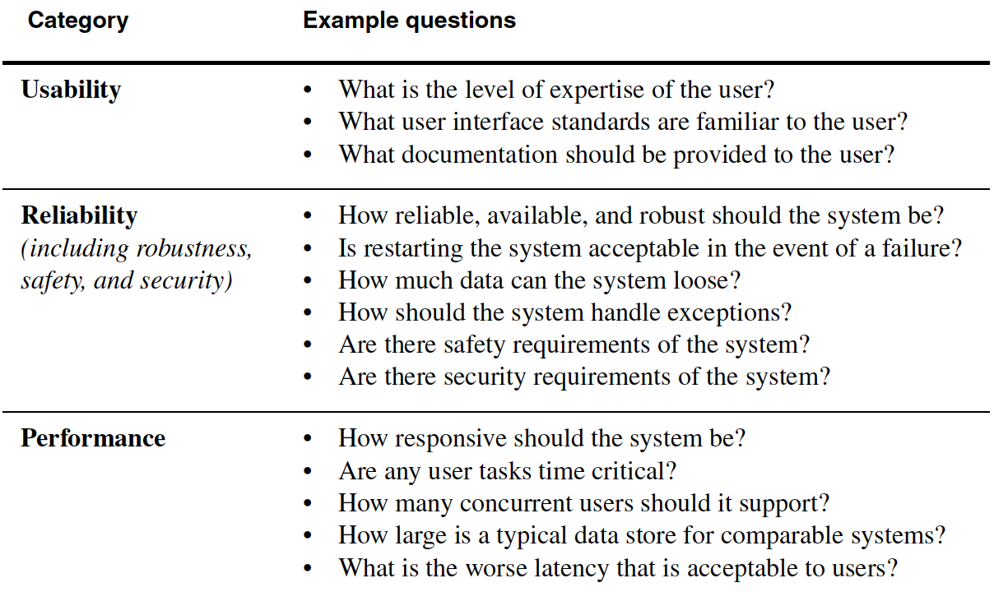
Identifying nonfunctional requirements

Slide 28
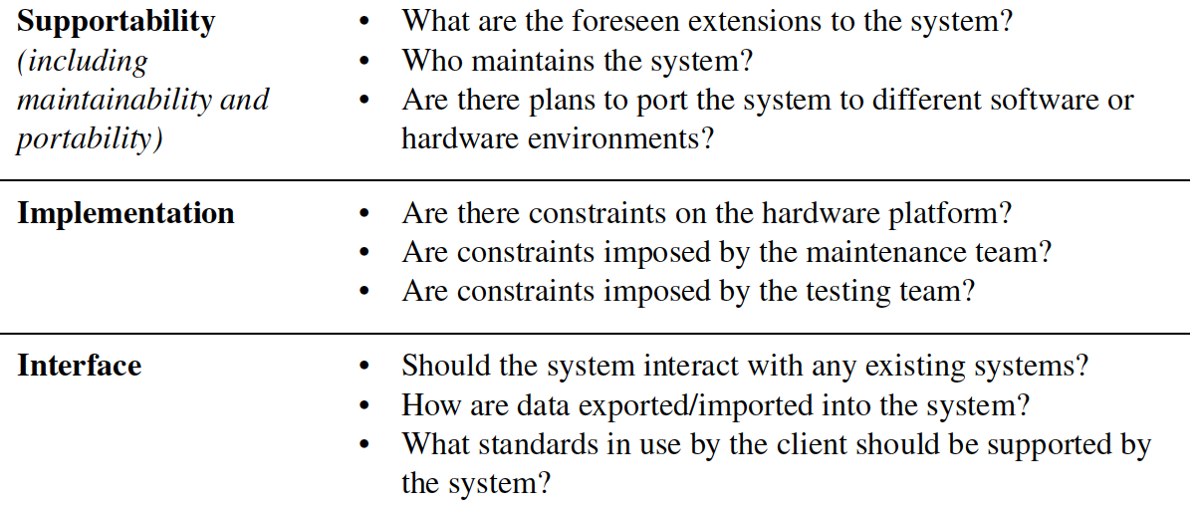
Identifying nonfunctional requirements

Slide 29
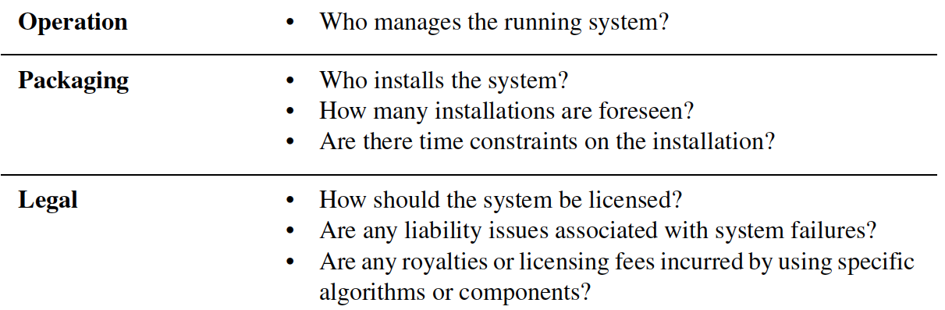
Identifying nonfunctional requirements

Slide 30
Managing Requirements elicitation
UNIT 04: Object-oriented Analysis
References:
Bruegge B., and Dutoit A. H. 2010, Object-oriented Software Engineering using UML, Patterns and Java, 3rd ed., Prentice Hall (Chapter 4)
Pressman, R. S., 2001, Software Engineering - A Practitioner's Approach, Fifth Ed., McGrawHill (Chapter 21)

Slide 31
Managing requirements elicitation
Negotiating specifications with clients (joint application design)
Focuses on building consensus among developers, users, and clients by jointly developing requirements specification

Slide 32
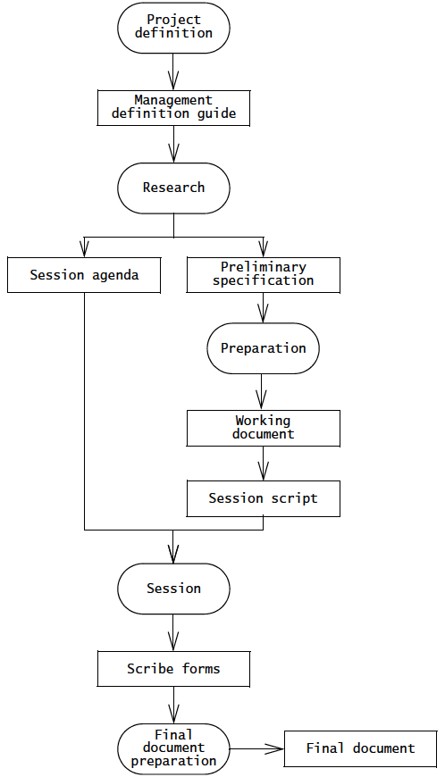

Slide 33
Managing traceability
Tracing where requirements came from (who originated it, which client need does it address) to which aspect of the system and the project it affects
Helps show the system is complete
Focuses on - recording, structuring, linking, grouping, and maintaining dependencies among requirements and between requirements.

Slide 34
Documenting requirements elicitation
Introduction
1.1 Purpose of the system
1.2 Scope of the system
1.3 Objectives and success
criteria of the project
1.4 Definitions, acronyms, and
abbreviations
1.5 References
1.6 Overview
Current system
Proposed system
3.1 Overview
3.2 Functional requirements
3.3 Nonfunctional requirements
3.3.1 Usability
3.3.2 Reliability
3.3.3 Performance
3.3.4 Supportability
3.3.5 Implementation
3.3.6 Interface
3.3.7 Packaging
3.3.8 Legal

Slide 35
Documenting requirements elicitation
3.4 System models
3.4.1 Actors
3.4.2 Scenarios
3.4.3 Use case model
3.4.4 Object model
3.4.5 Dynamic model
3.4.6 User interface—navigational paths and screen mock-ups
4. Glossary

Slide 36
❃ Read ‘4.6 ARENA Case Study’ from
Bruegge B., and Dutoit A. H. 2010, Object-oriented Software Engineering using UML, Patterns and Java, 3rd ed., Prentice Hall (Chapter 4)

Slide 37
Requirements analysis
UNIT 04: Object-oriented Analysis
References:
Bruegge B., and Dutoit A. H. 2010, Object-oriented Software Engineering using UML, Patterns and Java, 3rd ed., Prentice Hall (Chapter 5)
Pressman, R. S., 2001, Software Engineering - A Practitioner's Approach, Fifth Ed., McGrawHill (Chapter 21)

Slide 38
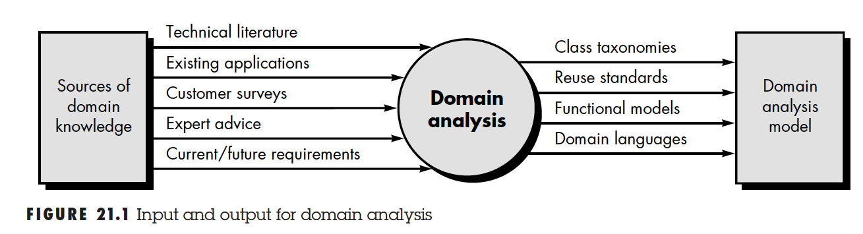
Domain analysis

Slide 39
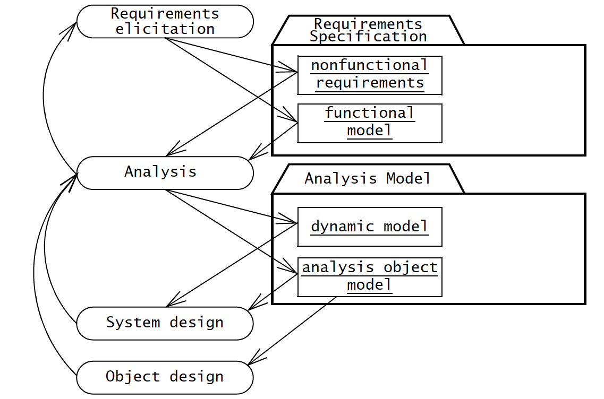
Requirements elicitation and analysis

Slide 40
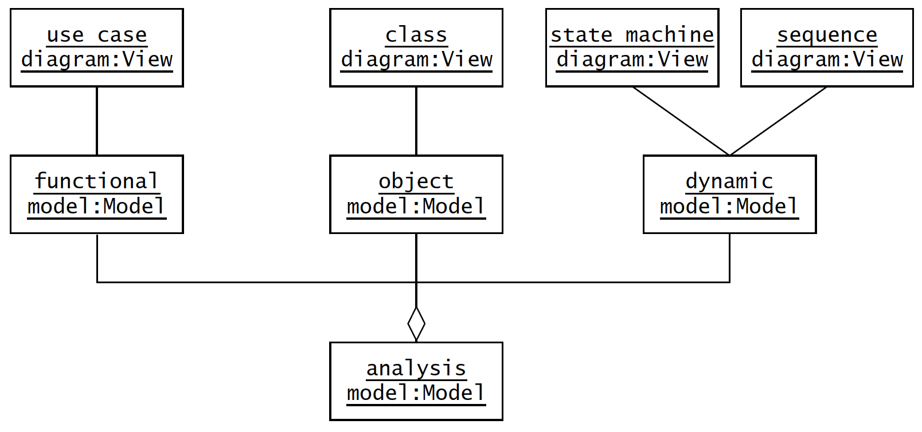
Analysis model

Slide 41
Analysis concepts
Analysis object models and dynamic models
  Object model – system, properties and relationships (class diagram)
  Dynamic model – behavior of system (sequence diagram, state machine)

Slide 42
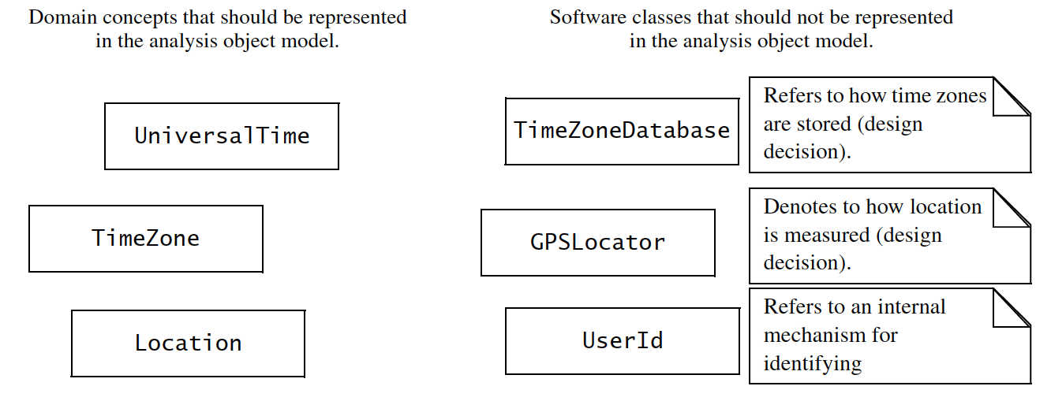
Analysis concepts
Classes

Slide 43
Analysis concepts
Entity, boundary, and control objects
  Entity – objects
  Boundary – interactions between actors and system
  Control – realising use cases

Slide 44
Analysis concepts
Generalisation and specialisation
  Generalisation – identify abstract concepts from lover-level ones
  Specialisation – identify more specific concepts from high-level one

Slide 45
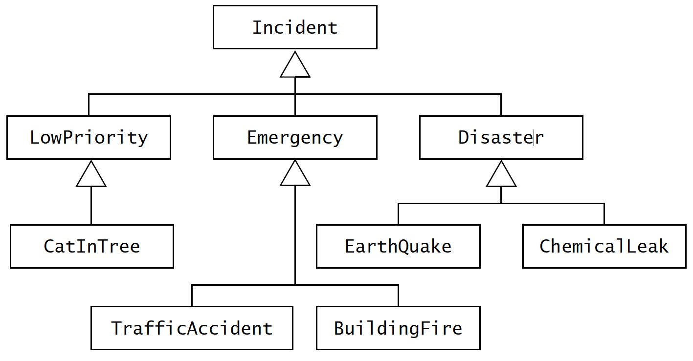
Analysis concepts
Generalisation and specialisation

Slide 46
Analysis activities
Identifying Entity Objects
Identifying Boundary Objects
Identifying Control Objects
Mapping Use Cases to Objects with Sequence Diagrams
Modeling Interactions among Objects with CRC Cards
Identifying Associations
Identifying Aggregates
Identifying Attributes
Modeling State-Dependent Behavior of Individual Objects
Modeling Inheritance Relationships
Reviewing the Analysis Model

Slide 47
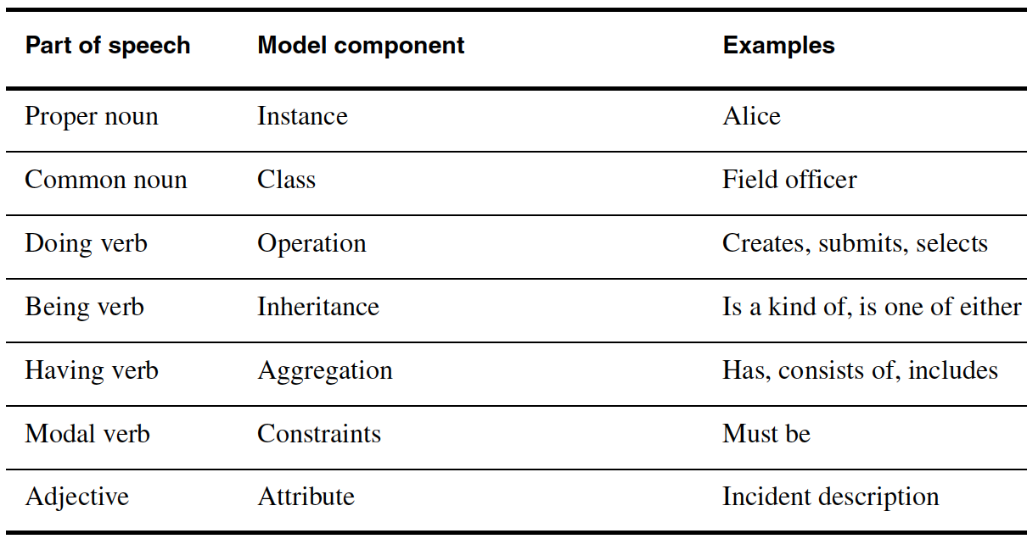
1. Identifying entity objects

Slide 48
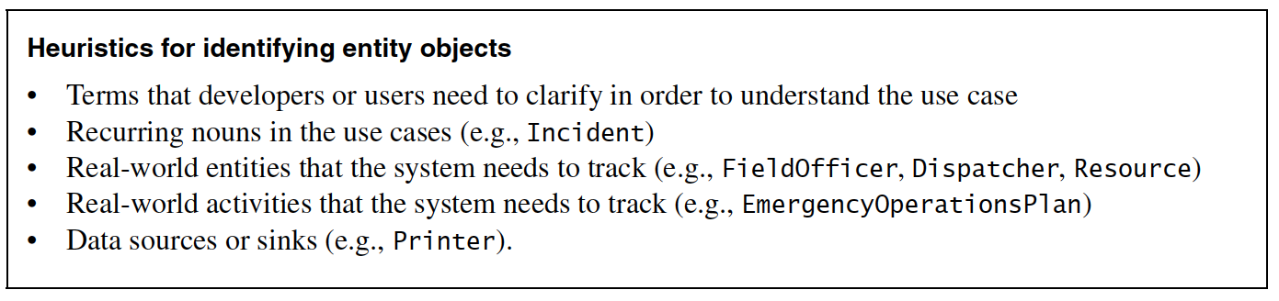
Identifying entity objects

Slide 49
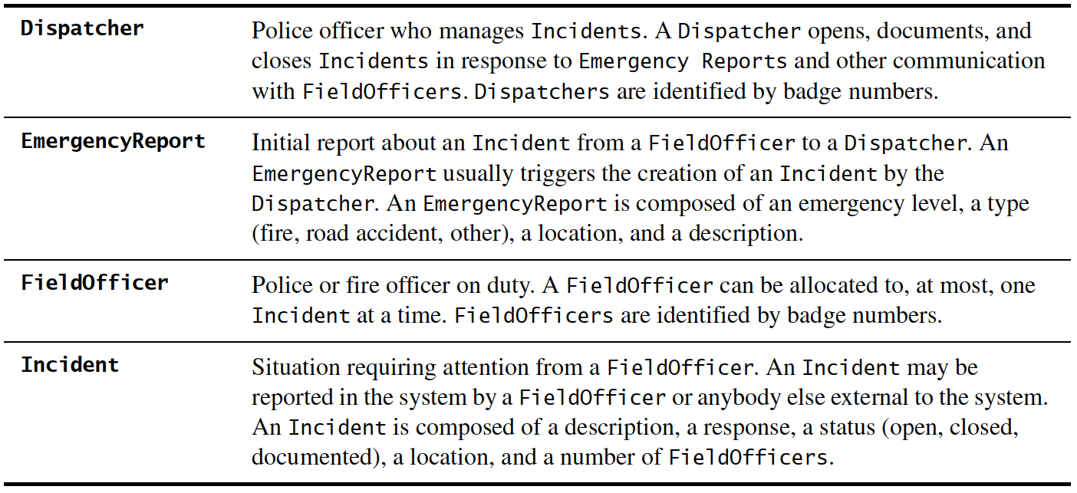
ReportEmergency use case

Slide 50
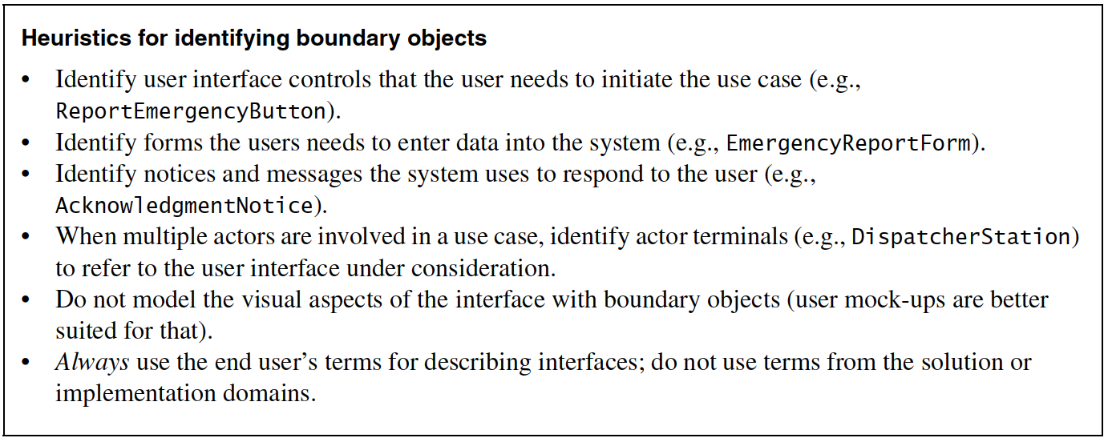
2. Identifying boundary objects

Slide 51
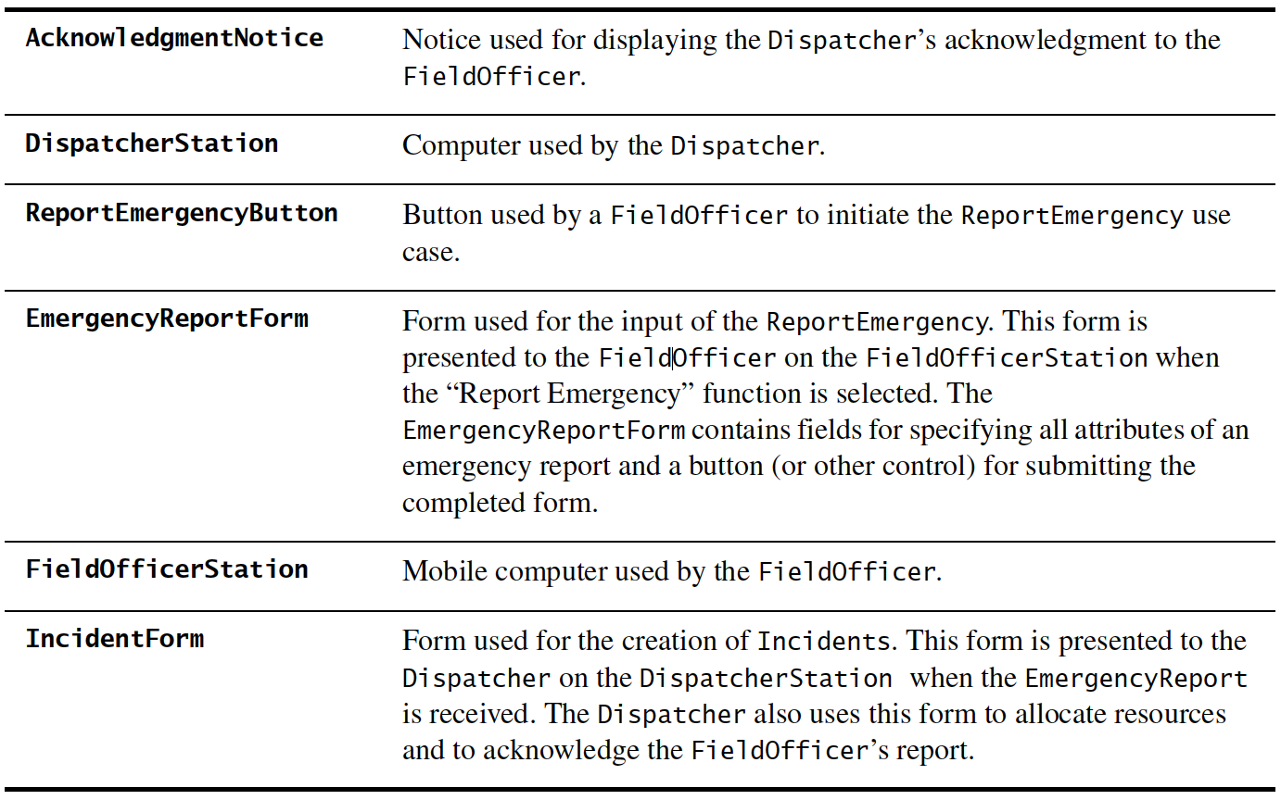
ReportEmergency boundary objects

Slide 52
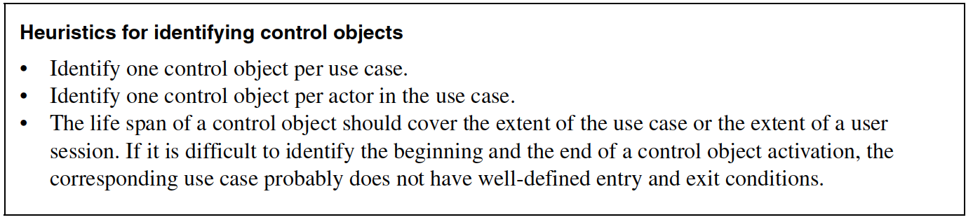
3. Identifying control objects

Slide 53
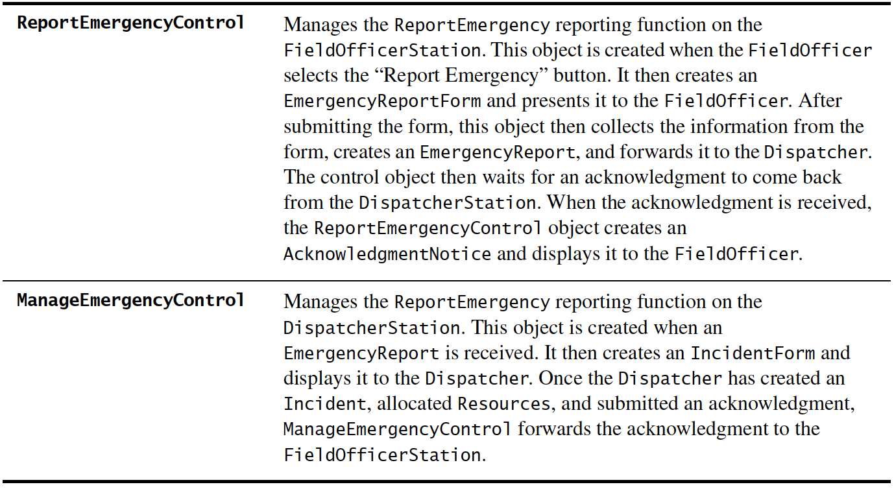
Identifying control objects

Slide 54
USE CASES
Define functional and operational requirements of the system by defining a scenario of usage.
Provide a clear and unambiguous description of how the end-user and system interact with one another.
Provide a basis for validation testing.

Slide 55
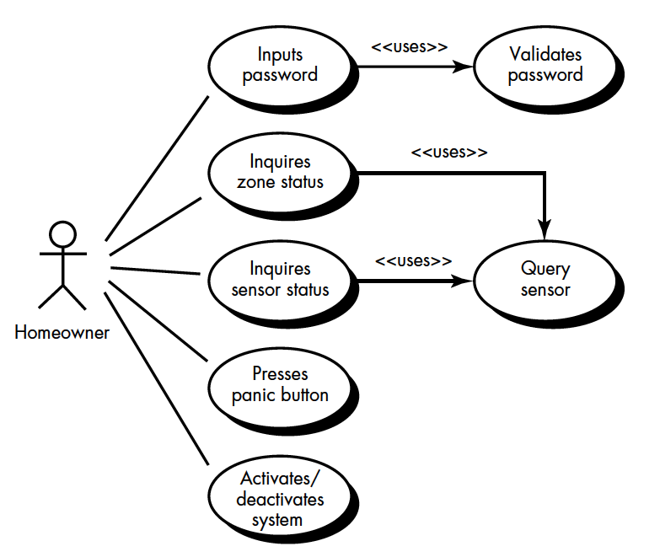
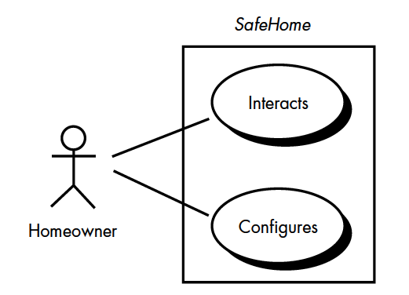
USE CASES

Slide 56
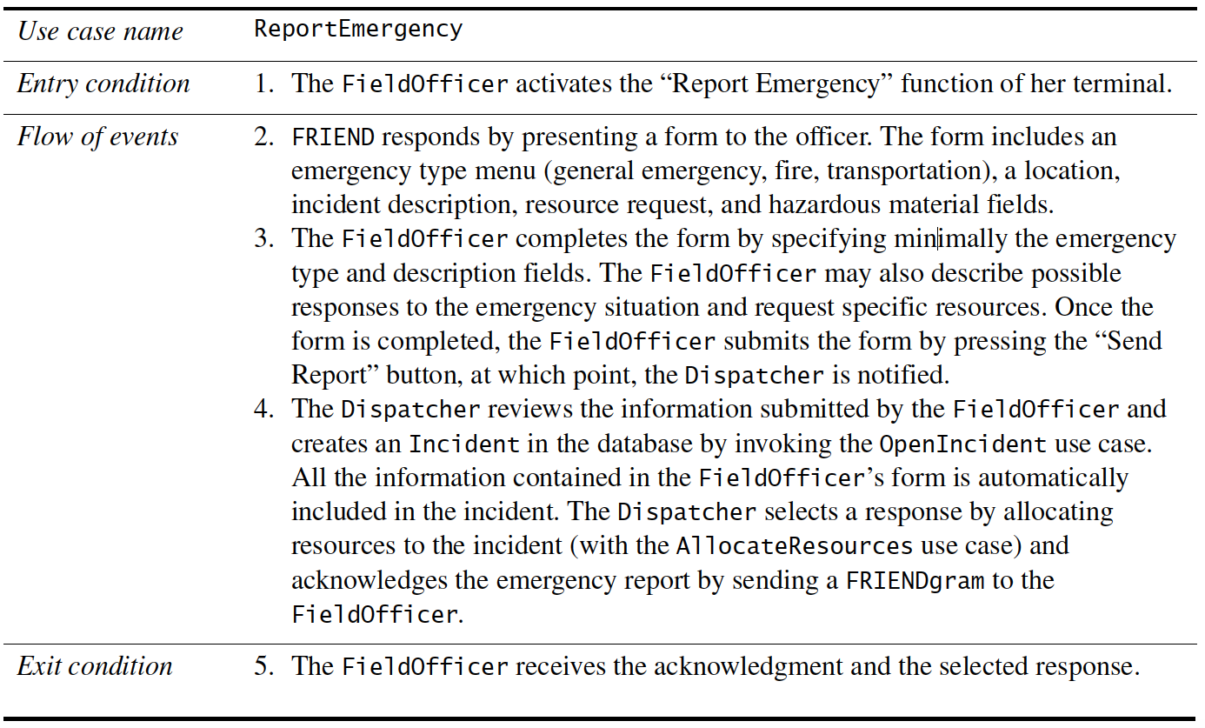
USE CASES

Slide 57
4. Mapping USE CASES to objects with sequence diagrams
Shows how the behavior of a use case is distributed among its participating objects
Columns of objects
Left most column – actor that initiates the use case
Horizontal arrows – messages
Time proceeds vertically

Slide 58
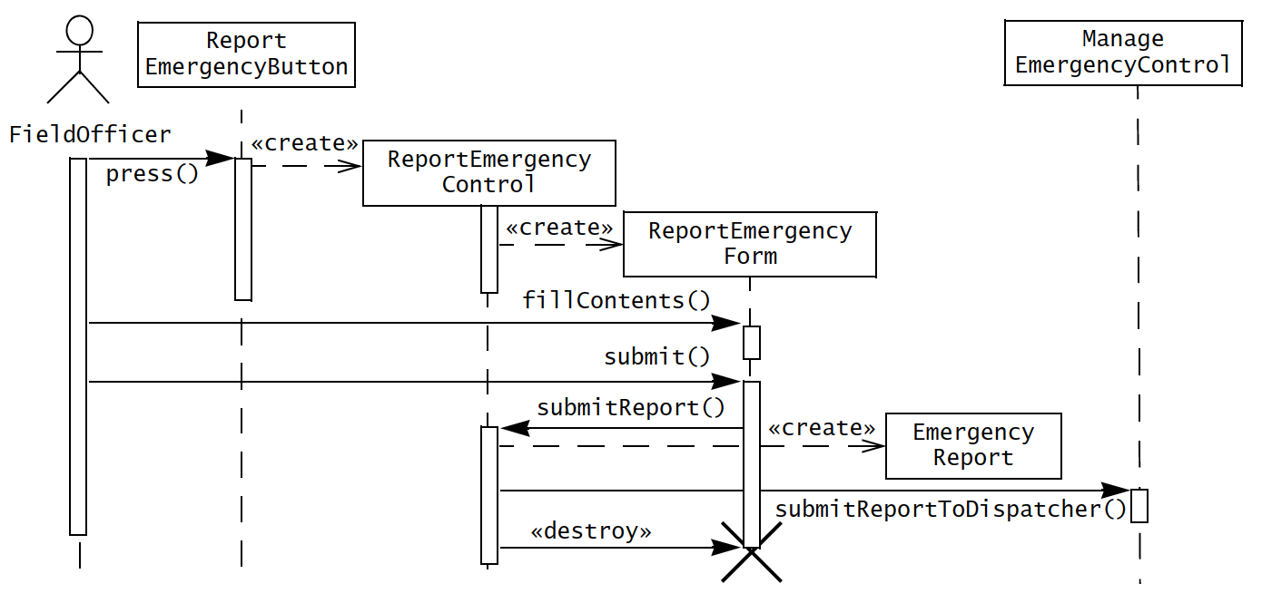
sequence diagram for report emergency

Slide 59
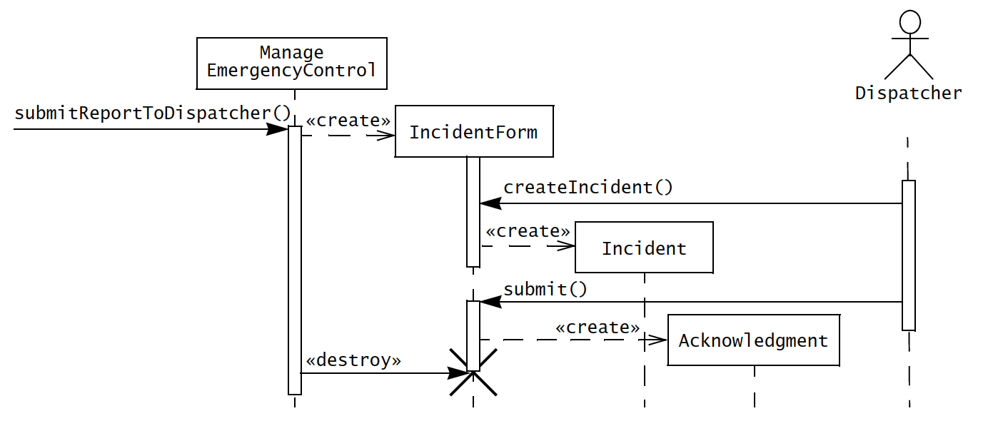
sequence diagram for report emergency

Slide 60
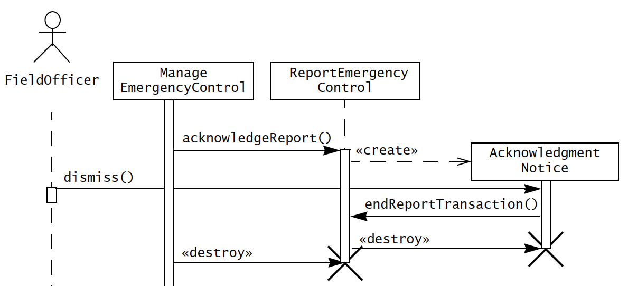
sequence diagram for report emergency

Slide 61
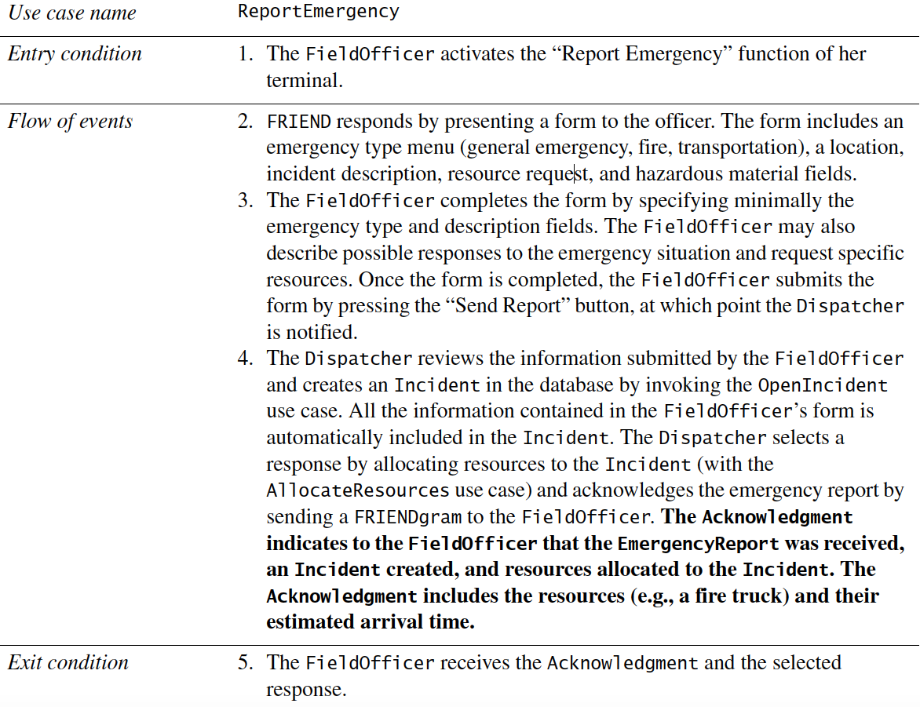

Slide 62
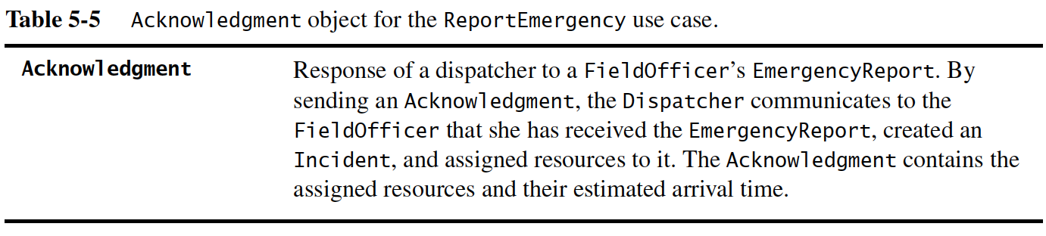

Slide 63
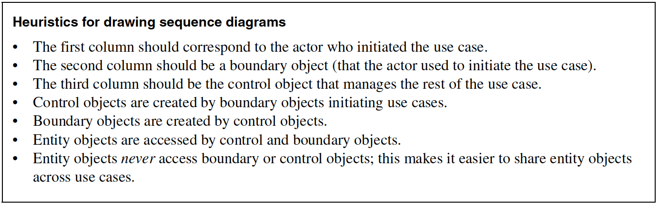
Mapping USE CASES to objects with sequence diagrams

Slide 64
5. Mapping interactions among objects with crc cards
Class-responsibility-collaborator modeling
Classes – have characteristics: retained information, needed services, multiple attributes, common attributes, common operations, essential requirements
Class types:
    device class (e.g. sensor)
    property class (e.g. rating)
    interaction class (e.g. purchase, license, acquisition)

Slide 65
Mapping interactions among objects with crc cards
Responsibilities (attributes and operations)
Attributes – stable features
Operations – processing narrative
Five guidelines
    System intelligence should be evenly distributed
    Each responsibility should be stated as generally as possible
    Information and behavior related to it should reside within the same class
    Information about one thing should be localised with single class, not distributed across multiple classes.
    Responsibilities should be shared among related classes, when appropriate.

Slide 66
Mapping interactions among objects with crc cards
Collaborations fulfill their responsibilities in one of two ways;
  A class can use its own operations to manipulate its own attributes
  A class can collaborate with other classes

Slide 67
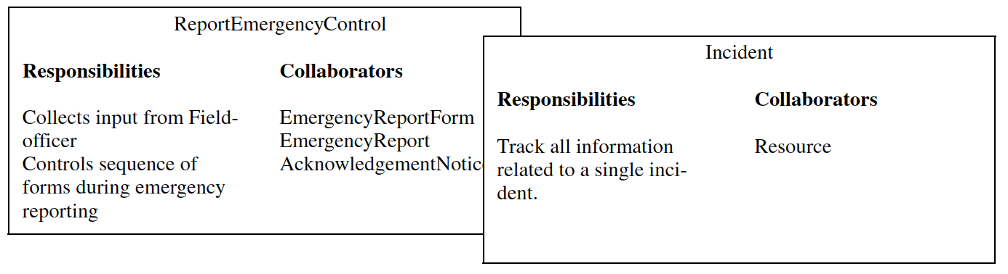
crc cards

Slide 68
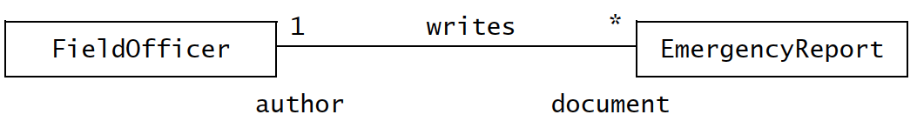
6. Identifying associations
An association shows relation between two or more classes.
Have several properties;
  Name
  Role
  Multiplicity

Slide 69
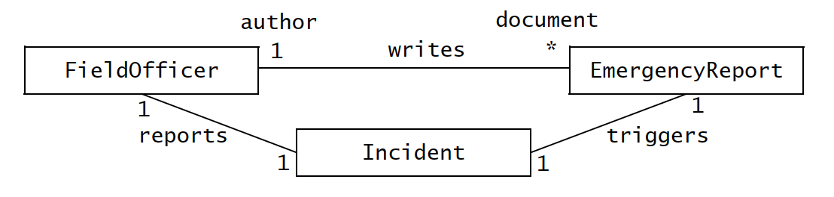
Eliminating redundant association
Redundant associations should be removed.
e.g.

Slide 70
7. Identifying aggregates
Aggregation – denotes whole-part relationship
The diamond part – represents whole
Two types of aggregation
  Composition aggregation
  Shared aggregation

Slide 71
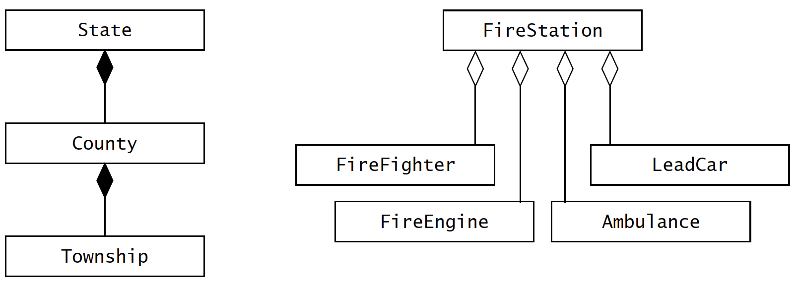
Two types of aggregates

Slide 72
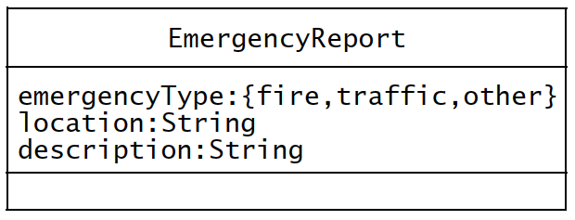
8. Identifying attributes
Attributes – properties of individual objects, least stable part
Properties are different to attributes!
First identify as many associations as possible before identifying attributes
Attributes have;
  Name
  Brief description
  Type

Slide 73
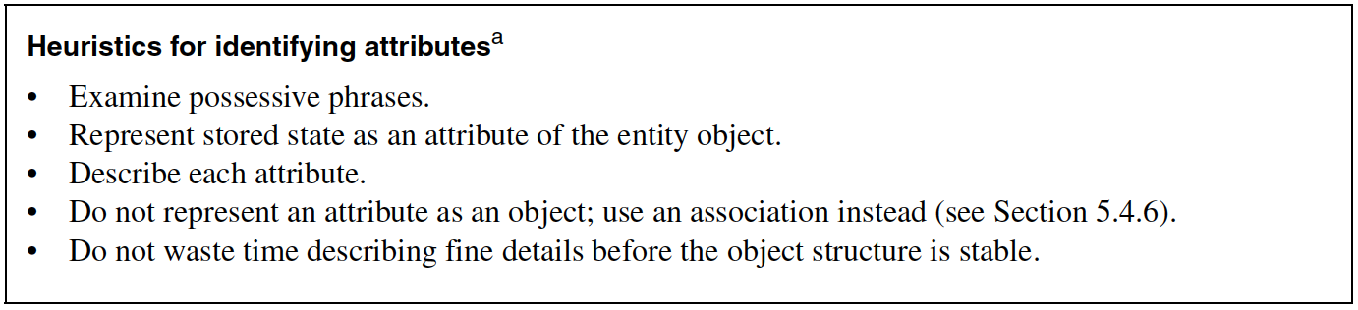
8. Identifying attributes

Slide 74
9. Modeling state-dependent behavior of individual objects
Sequence diagrams - distribute behavior across objects
Sequence diagrams - represent the behavior of the system from the perspective of a single use case.
State machine diagrams - represent behavior from the perspective of a single object
By modeling state change upon certain event, enables a developer to detail use cases.

Slide 75
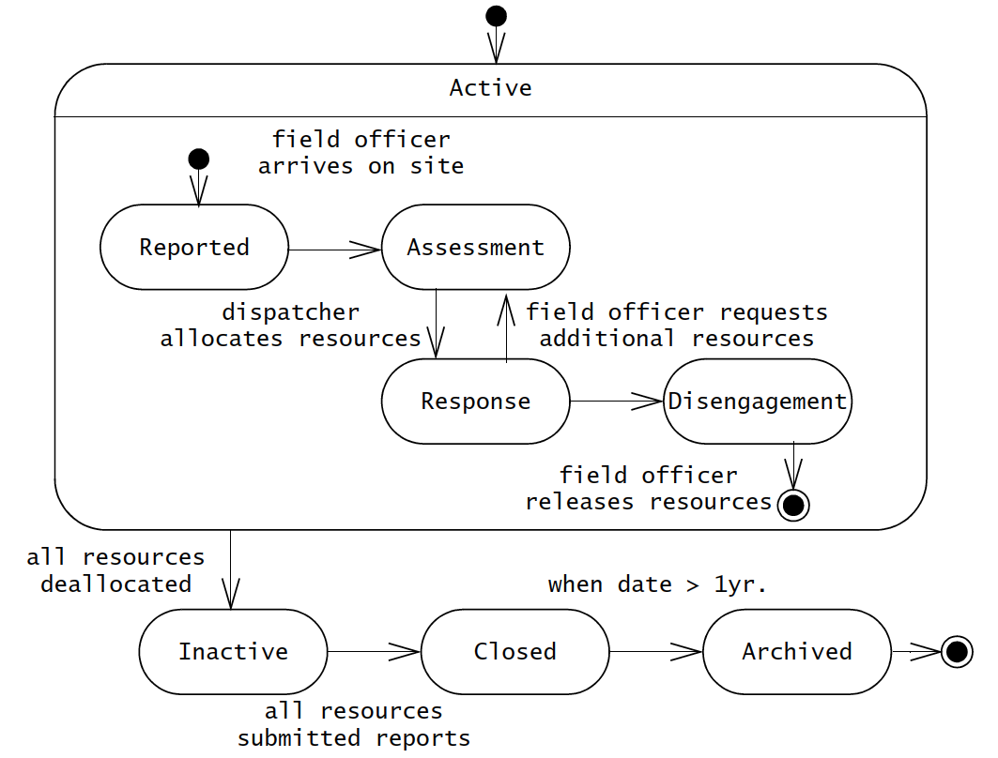
9. Modeling state-dependent behavior of individual objects

Slide 76

10. Modeling inheritance relationships between objects

Slide 77
11. Reviewing the analysis model
Analysis model is build incrementally and iteratively.
When number of changes become minimal in iterations, then the model is stable.
Need to look for a model that is
  Correct
  Complete
  Consistent
  Realistic

Slide 78
A correct model?
Is the glossary of entity objects understandable by the user?
Do abstract classes correspond to user-level concepts?
Are all descriptions in accordance with the users’ definitions?
Do all entity and boundary objects have meaningful noun phrases as names?
Do all use cases and control objects have meaningful verb phrases as names?
Are all error cases described and handled?

Slide 79
A complete model?
For each object: Is it needed by any use case? In which use case is it created? modified? destroyed? Can it be accessed from a boundary object?
For each attribute: When is it set? What is its type? Should it be a qualifier?
For each association: When is it traversed? Why was the specific multiplicity chosen?
Can associations with one-to-many and many-to-many multiplicities be qualified?
For each control object: Does it have the necessary associations to access the objects participating in its corresponding use case?

Slide 80
A consistent model?
Are there multiple classes or use cases with the same name?
Do entities (e.g., use cases, classes, attributes) with similar names denote similar concepts?
Are there objects with similar attributes and associations that are not in the same generalization hierarchy?

Slide 81
A realistic model?
Are there any novel features in the system? Were any studies or prototypes built to ensure their feasibility?
Can the performance and reliability requirements be met? Were these requirements verified by any prototypes running on the selected hardware?

Slide 82

Analysis
activities

Slide 83
Managing analysis process
Document analysis – using object models and dynamic models
Requirements analysis document
1. Introduction
2. Current system
3. Proposed system
3.1. Overview
3.2. Functional requirements
3.3. Nonfunctional requirements
3.4. System models
3.4.1. Scenarios
3.4.2. Use case model
3.4.3. Object model
3.4.3.1 Data dictionary
3.4.3.2 Class diagrams
3.4.4. Dynamic models
3.4.5. User interface—navigational paths and screen mock-ups
4. Glossary

Slide 84
Assigning responsibilities
End-user - functions, workflows, data
Client – integration role, scope of system
Analyst – application domain expert, models current system and future system, detailed use cases
Architect – integrates use cases and object models
Document editor – documentation
Configuration manager – maintains revisions, decompositions
Reviewer – validates correctness, completeness, consistency, and clariy

Slide 85

Revision
process

Slide 86
Self study
5.5.3. Analysis communication
5.5.4. Iterating over analysis model
5.5.5. Client sign-off
5.6. ARENA Case Study

Slide 87
End of Unit 04 : Object-oriented Analysis

