Slide 1

OBJECT-ORIENTED SOFTWARE ENGINEERING
UNIT 05 : Object Oriented Design
© 2019, PRAMOD PARAJULI

Slide 2
Disclaimer
These slides are part of teaching materials for Object Oriented Software Engineering (OOSE). These slides do not cover all aspect of learning OOSE, nor are these be taken as primary source of information. As the core textbooks and reference books for learning the subject has already been specified and provided to the students, students are encouraged to learn from the original sources.
Contents in these slides are copyrighted to the instructor and authors of original texts where applicable.

Slide 3
Decomposing the system
UNIT 05: Object-oriented Design
References:
Bruegge B., and Dutoit A. H. 2010, Object-oriented Software Engineering using UML, Patterns and Java, 3rd ed., Prentice Hall (Chapter 6)
Pressman, R. S., 2001, Software Engineering - A Practitioner's Approach, Fifth Ed., McGrawHill (Chapter 22)

Slide 4
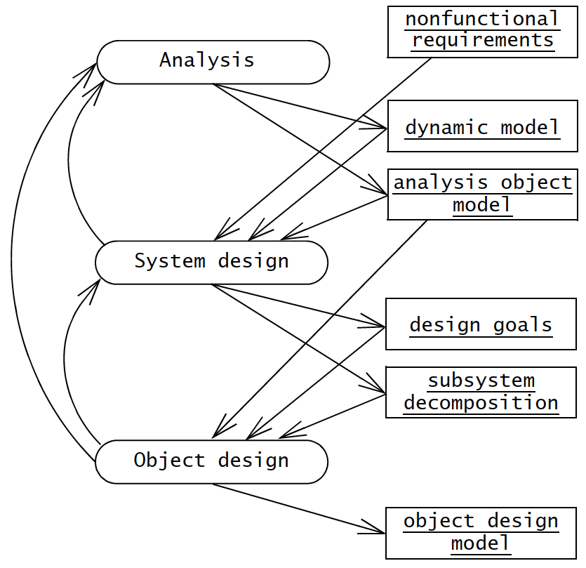
System design activities

Slide 5
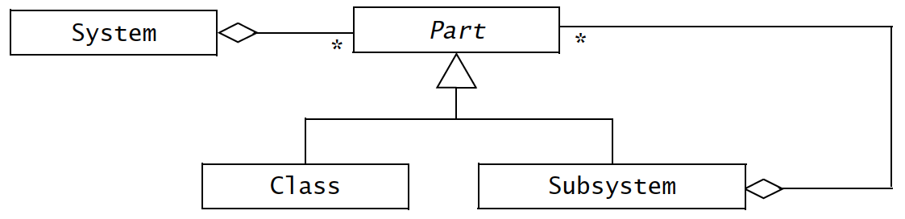
Subsystems and classes
Decompose system into independent systems
Abstract away one class from rest of the subsystems
Recursively apply this technique

Slide 6
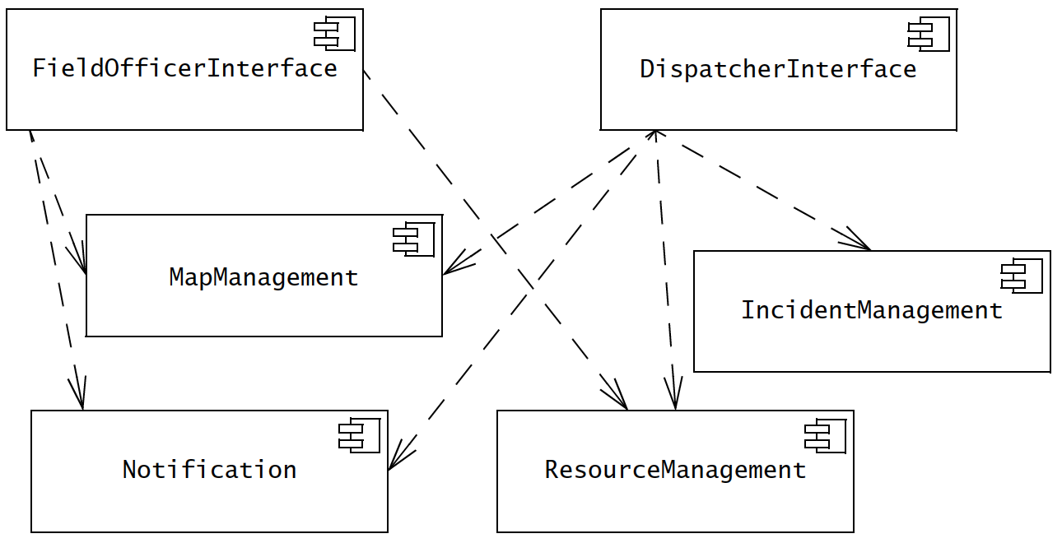
Components and dependencies
Use component diagrams to represent different subsystems and dashed arrow to indicate dependencies

Slide 7
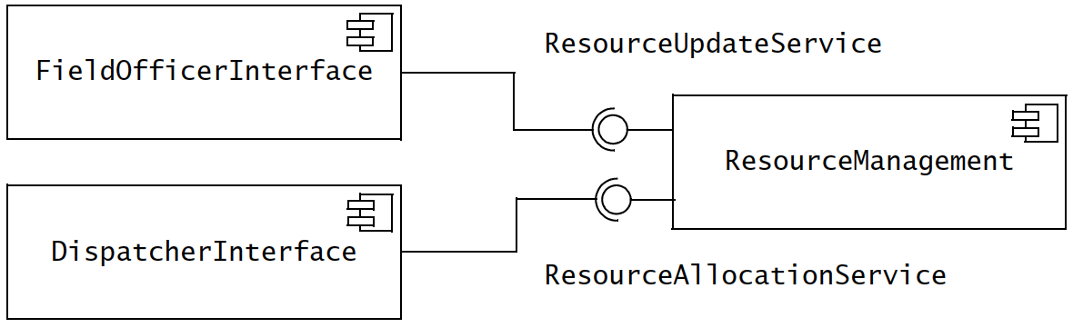
Services and components
Components provide different services through interfaces

Slide 8
Cohesion and coupling
Cohesion – number of dependencies between components within a subsystem
Coupling – number of dependencies between two subsystems

Slide 9
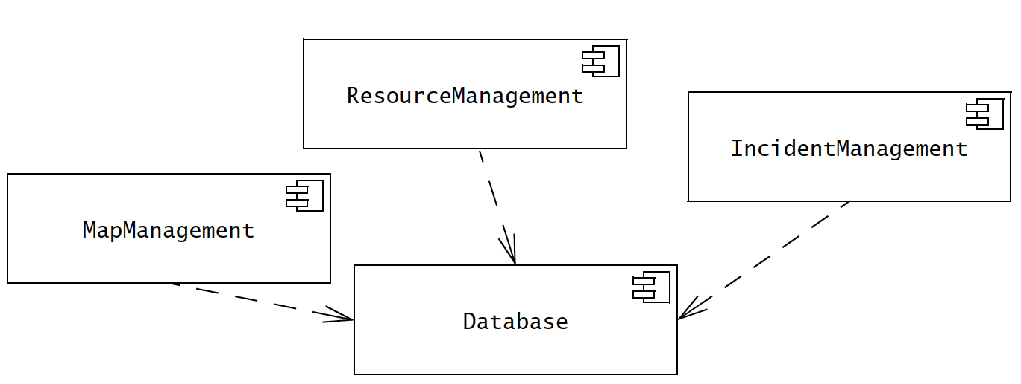
Cohesion and coupling
One of the design rule is to minimise coupling and enhance cohesiveness

Slide 10
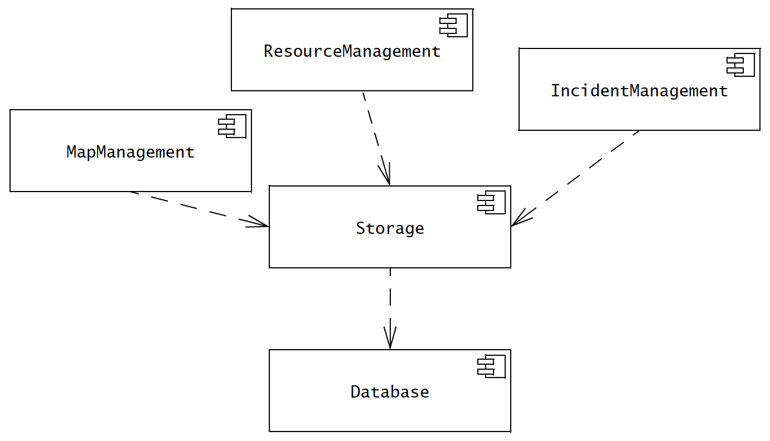
Cohesion and coupling

Slide 11
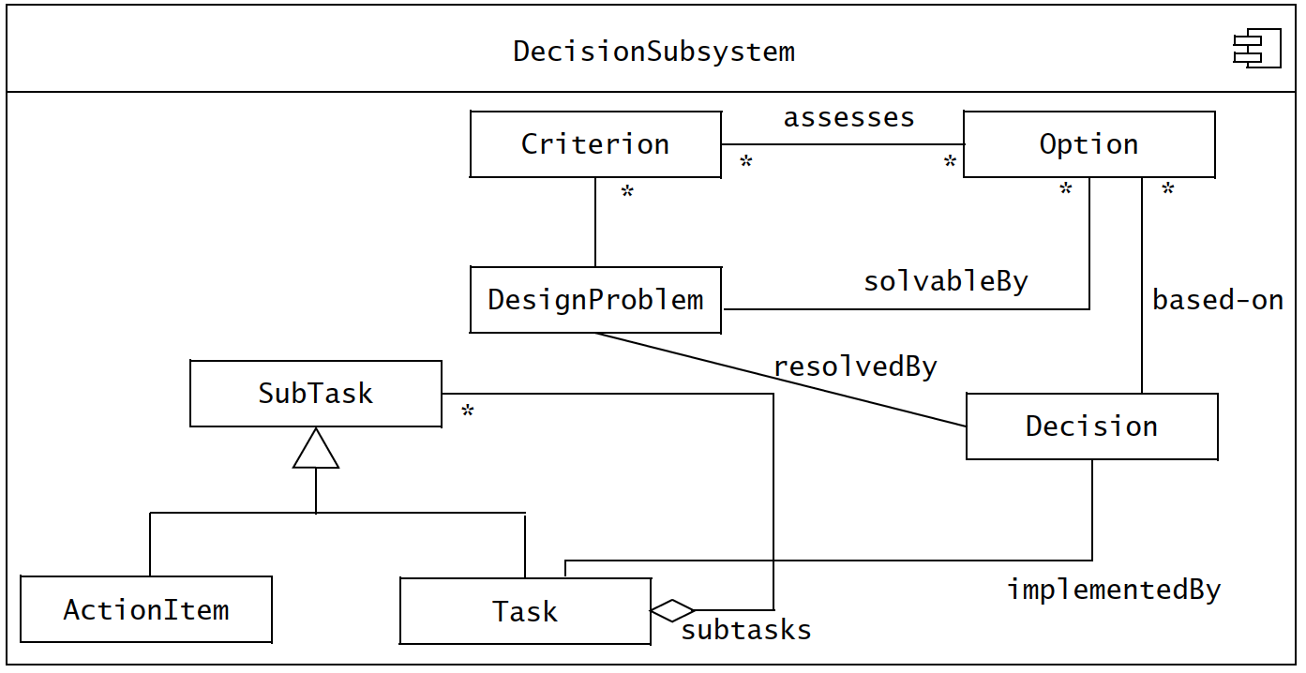
Cohesion and coupling

Slide 12
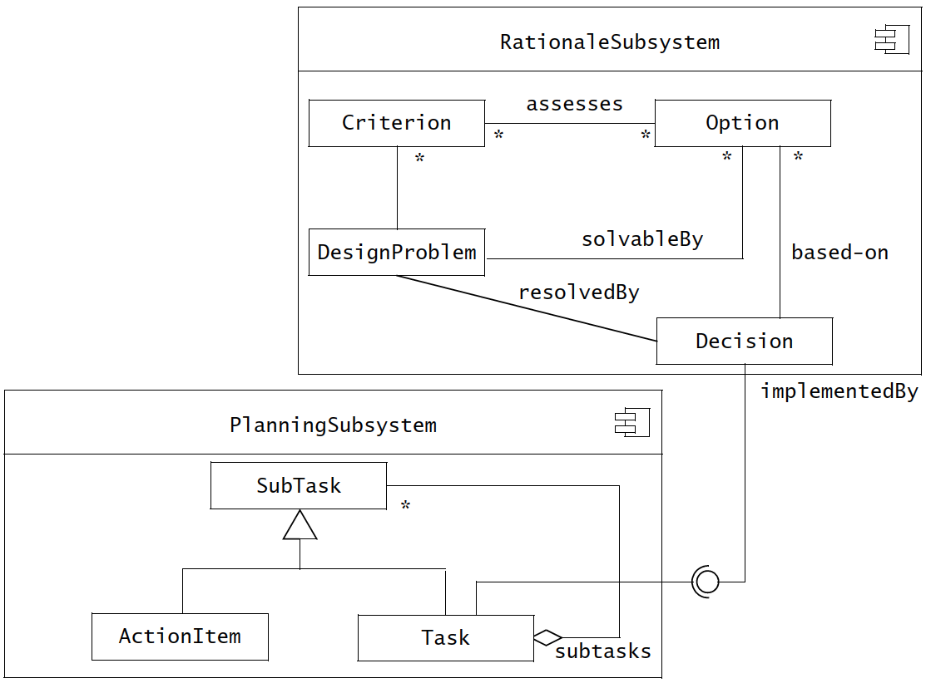
Cohesion and coupling

Slide 13
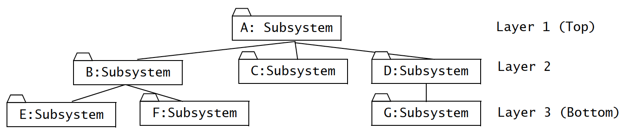
Layers and partitions
Hierarchical decomposition of a system results into an ordered set of layers.

Slide 14
Architectural styles
Subsystems can be organised in different ways.
An architectural style provides a systematic method to decompose a system. It includes;
  System decomposition,
  global control flow,
  handling boundary conditions, and
  intersubsystem communications

Slide 15
Architectural styles
Repository
Model-view-controller
Client-server
Peer-to-peer
Four-tier
Pipe and filter

Slide 16
Repository architectural style
Subsystems access and modify a single data structure called the central repository.
Subsystems are relatively independent, interact through the repository.
Repository may trigger events to control flow
Used for – database management systems, centralised global control flow, constantly changing complex data processing tasks etc.

Slide 17
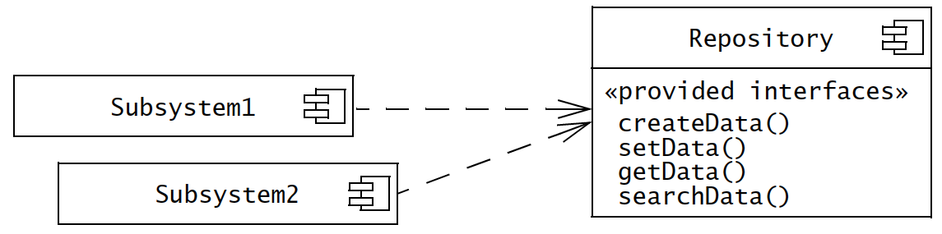
Repository architectural style

Slide 18
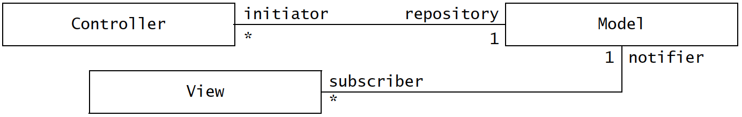
Model-view-controller
Three subsystems
  Model – contains domain knowledge, computation models etc.
  View – represent output to the user
  Controller – manage sequence of interactions with the user
Useful where input/output representation changes are required

Slide 19
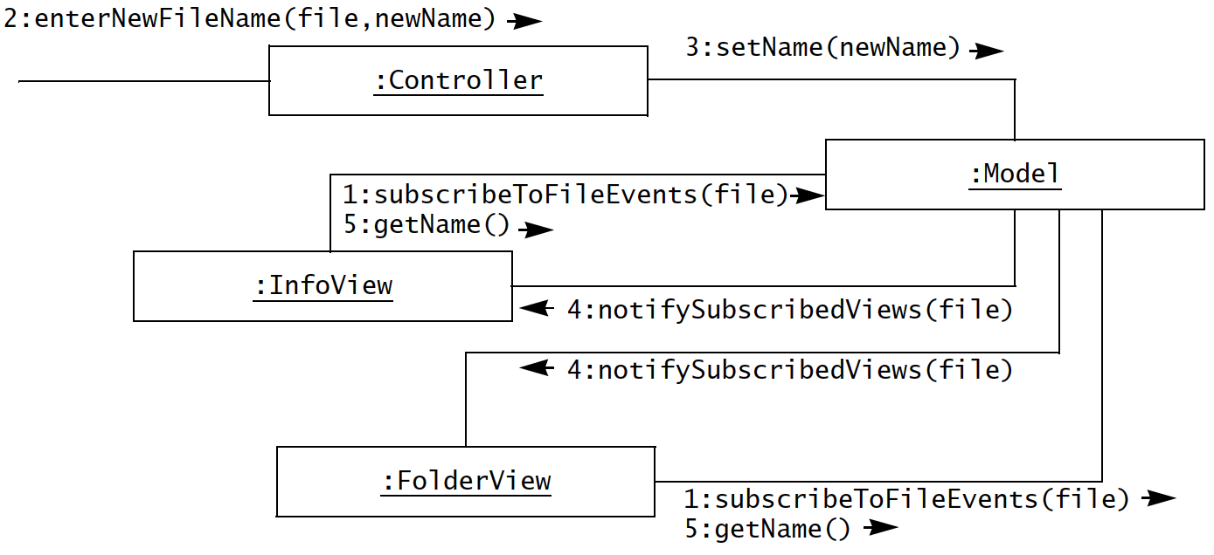
Model-view-controller

Slide 20
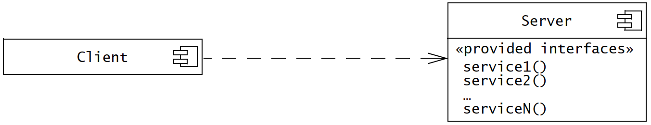
Client-server
Server – provides services to instances of other subsystems called clients
Clients – request for service via RPC or object broker such as CORBA, Java RMI, HTTP etc.

Slide 21
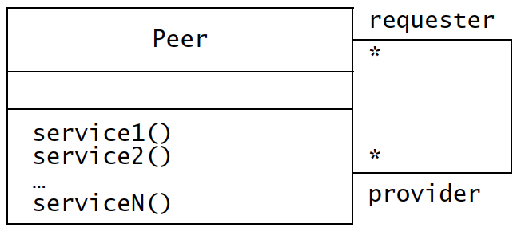
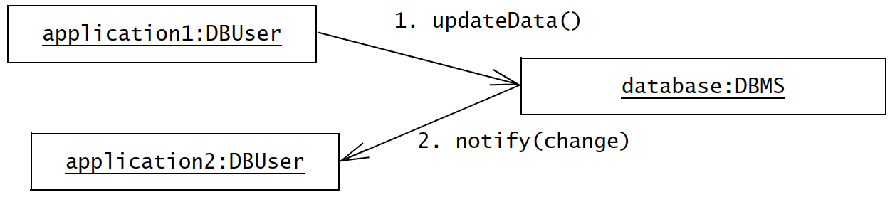
Peer-to-peer

Slide 22
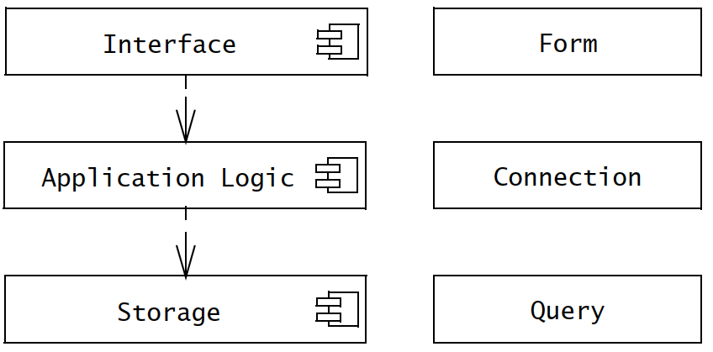
Three-tier
Interface layer – includes all boundary objects that deal with the user
Application logic layer – includes all control and entity objects
Storage layer – realises
storage, retrieval,a and
query of persistent objects

Slide 23
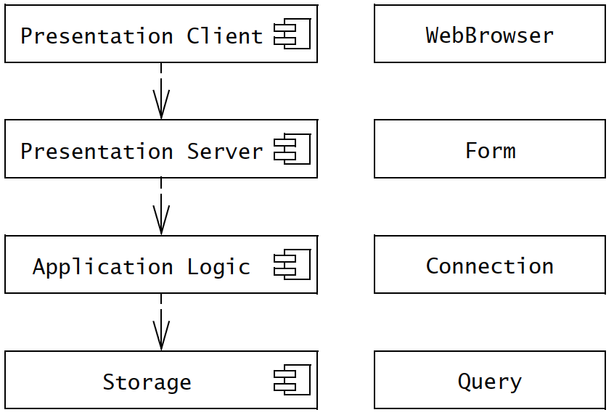
four-tier

Slide 24
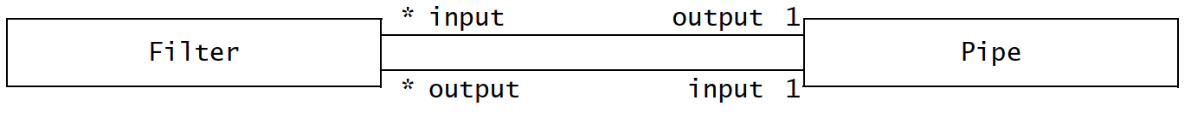
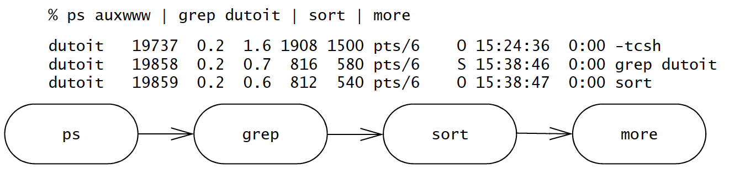
Pipe-filter
Filters – subsystems, can run concurrently
Pipes – associations between them, provide synchronisation

Slide 25
System design activities
From objects to subsystems
Review analysis model
Identify design goals – e.g. reliability, fault tolerant, security, modifiability, etc.
Define various criteria such as - performance, dependability, cost, maintenance, and end user criteria
❃ Read the details of these criteria from Bruegge & Dutoit, pp.
249-252.

Slide 26
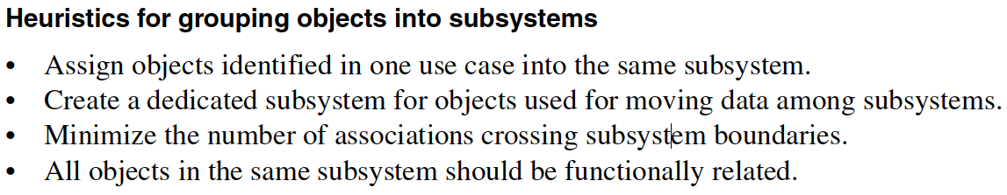
Identifying subsystems
Start with initial set of subsystems decomposed according to functional requirements.
Keep functionality related objects together

Slide 27
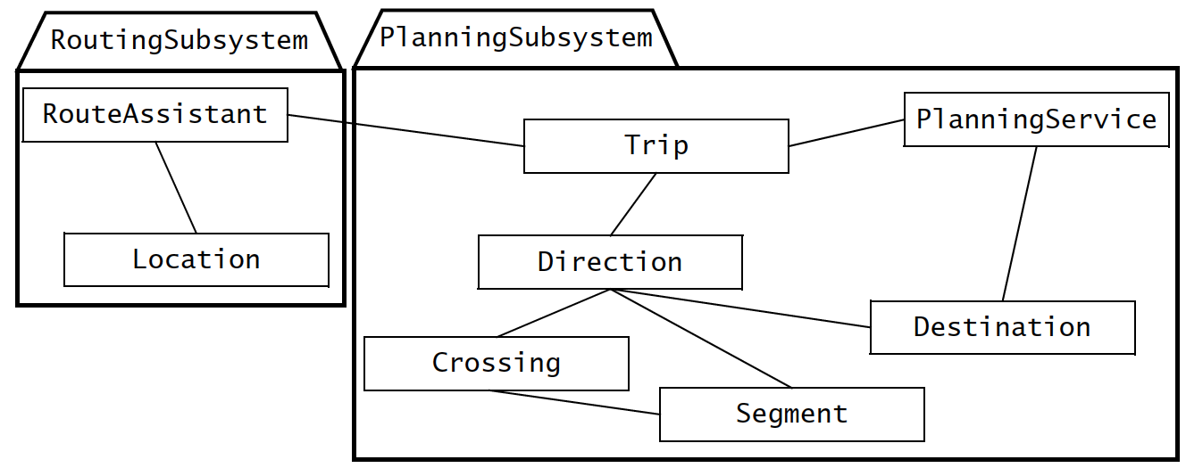
Using façade design pattern
Allows further reduce dependencies between classes by encapsulating a subsystem with a simple, unified interface

Slide 28
System design activities
UNIT 05: Object-oriented Design
References:
Bruegge B., and Dutoit A. H. 2010, Object-oriented Software Engineering using UML, Patterns and Java, 3rd ed., Prentice Hall (Chapter 7)
Pressman, R. S., 2001, Software Engineering - A Practitioner's Approach, Fifth Ed., McGrawHill (Chapter 22)

Slide 29
concerns
Selection of off-the shelf and legacy components
Mapping of subsystem to hardware
Design of a persistent data management infrastructure
Specification of an access control policy
Design of the global control flow
Handling of boundary conditions

Slide 30
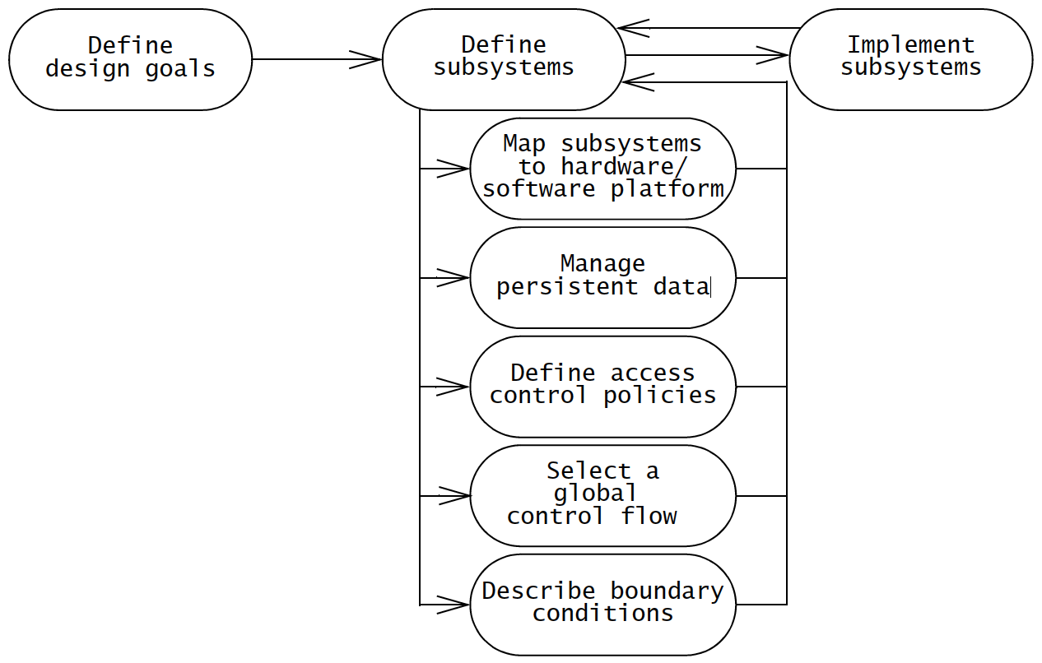
System design activities

Slide 31
Self study
Since we’ve already covered various design modeling and diagramming techniques, read following sections from Bruegge & Dutoit on your own.
7.3 Concepts: UML Deployment Diagrams
7.6 ARENA Case study

Slide 32
Addressing Design Goals
Design goals - reliability, fault tolerance, security, modifiability etc.
Selecting a hardware config. and a platform – use deployment diagrams
Allocating objects and subsystems to nodes – revise the deployment diagrams using component diagrams
Identifying and storing persistent data – refine the component diagrams for data storage

Slide 33
Addressing Design Goals
Identifying persistent objects – determine which object is persistent to the users e.g. Sensor
Selecting a storage management strategy – flat fles, relational databases, object-oriented databases. Ref. to table 7-7.
Providing access control – detail authentication and authorisation, global access table (actor, class, operation), use access control lists (actor, operation), capability associates (class, operation) paired with an actor

Slide 34
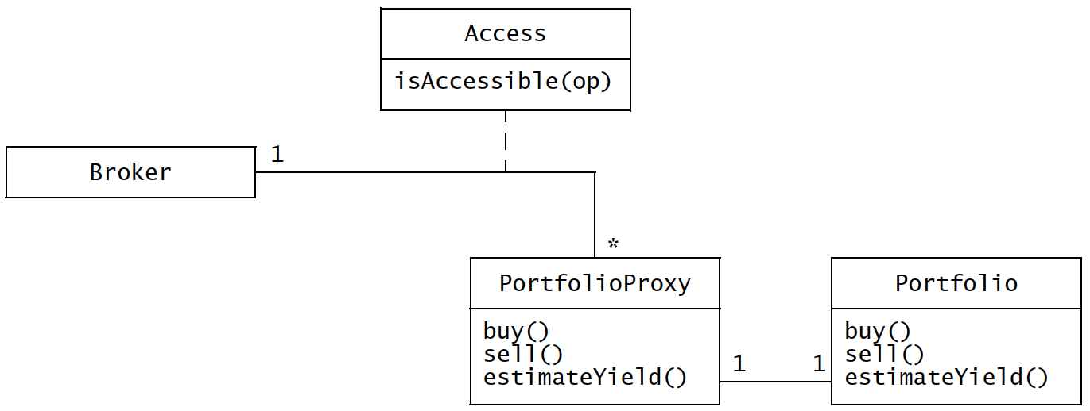
Addressing Design Goals

Slide 35
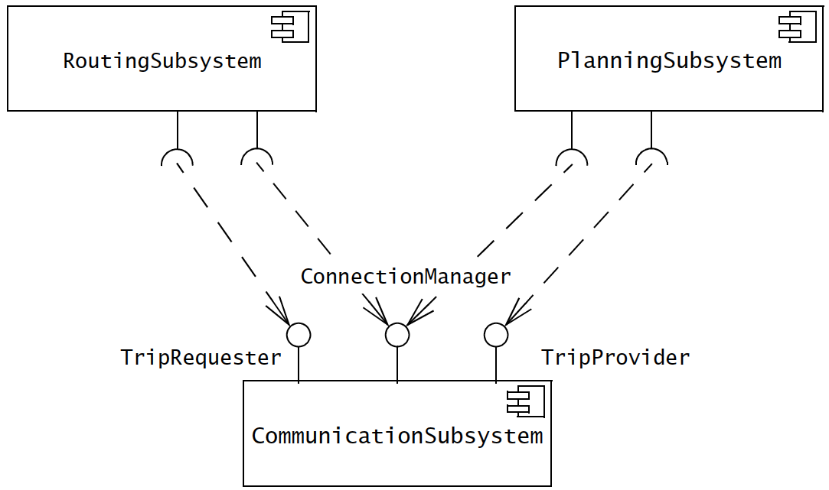
Addressing Design Goals
Designing the global control flow
  Procedure-driven control flow
  Event-driven control flow
  Threads
Identifying services

Slide 36
Addressing Design Goals
Identifying boundary conditions
  Initial configuration
  Start-up and shutdown
  Exception handling (hardware failure, changes in the operating environment, software fault etc.)

Slide 37
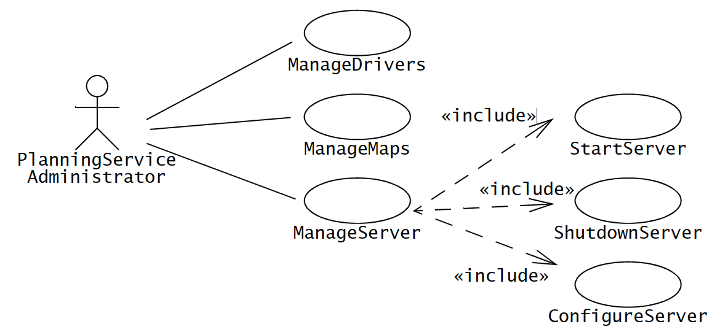
Addressing Design Goals
Identifying boundary conditions

Slide 38
Reviewing system design
Correctness
Can every subsystem be traced back to a use case or a nonfunctional requirement?
Can every use case be mapped to a set of subsystems?
Can every design goal be traced back to a nonfunctional requirement?
Is every nonfunctional requirement addressed in the system design model?
Does each actor have an access policy?
Is every access policy consistent with the nonfunctional security requirement?

Slide 39
Reviewing system design
Completeness
Have the boundary conditions been handled?
Was there a walkthrough of the use cases to identify missing functionality in the system design?
Have all use cases been examined and assigned a control object?
Have all aspects of system design (i.e., hardware allocation, persistent storage, access control, legacy code, boundary conditions) been addressed?
Do all subsystems have definitions?

Slide 40
Reviewing system design
Consistency
Are conflicting design goals prioritized?
Does any design goal violate a nonfunctional requirement?
Are there multiple subsystems or classes with the same name?
Are collections of objects exchanged among subsystems in a consistent manner?

Slide 41
Reviewing system design
Reality
Are any new technologies or components included in the system? Was the appropriateness or robustness of these technologies or components evaluated? How?
Have performance and reliability requirements been reviewed in the context of subsystem decomposition?
Have concurrency issues (e.g., contention, deadlocks) been addressed?

Slide 42
Reviewing system design
Readability
Are subsystem names understandable?
Do entities (e.g., subsystems, classes) with similar names denote similar concepts?
Are all entities described at the same level of detail?

Slide 43
Managing system design
Assigning responsibilities
The architect – ensures consistency in design decisions and interface styles
Architecture liaisons – representatives from different subsystem teams, design subsystem services
The document editor, configuration manager, and reviewer

Slide 44
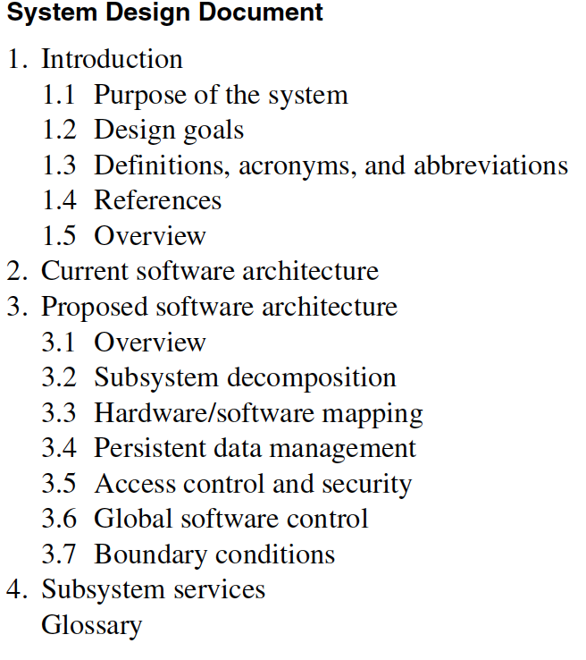
Managing system design

Slide 45
Managing system design
Challenges in design
Size – no. of issues, objects, components etc.
Change – change in specification of interfaces, components
Level of abstraction – detail of the interfaces
Reluctance to confront problems – human behavior, non reproducibility
Conflicting goals and criteria – different design goals

Slide 46
Managing system design
Best practices
Identify and prioritise the design goals for system and make them explicit
Make the current version of the system decomposition available to all concerns
Maintain an up-to-date glossary
Confront design problems
Iterate over

Slide 47
❃ Read ‘7.6 ARENA Case Study’ from
Bruegge B., and Dutoit A. H. 2010, Object-oriented Software Engineering using UML, Patterns and Java, 3rd ed., Prentice Hall (Chapter 7)

Slide 48
Reusing patterns
UNIT 05: Object-oriented Design
References:
Bruegge B., and Dutoit A. H. 2010, Object-oriented Software Engineering using UML, Patterns and Java, 3rd ed., Prentice Hall (Chapter 8)
Pressman, R. S., 2001, Software Engineering - A Practitioner's Approach, Fifth Ed., McGrawHill (Chapter 22)

Slide 49
Object design
Includes four groups of activities
Reuse – off-the-shelf or legacy subsystems, classes
Interface/service specification – identifying subsystem services
Restructuring of object model – for code reuse, high cohesiveness, lower coupling
Optimisation of object model – meet performance requirements

Slide 50
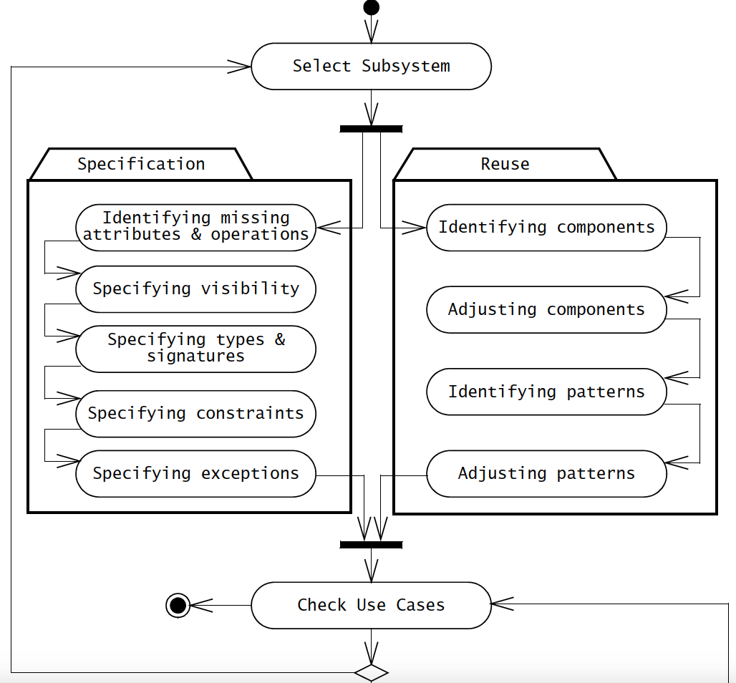

Slide 51
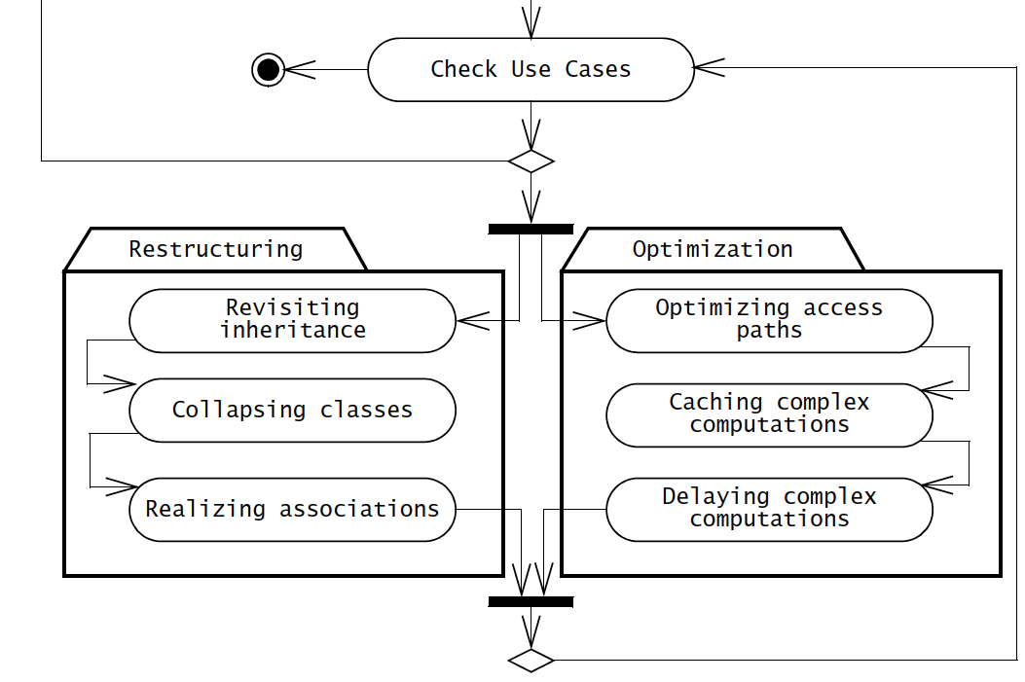

Slide 52
reuse
Reuse existing objects/classes
Inheritance – decouples classes using superclasses. Strong coupling along the inheritance hierarchy.

Slide 53
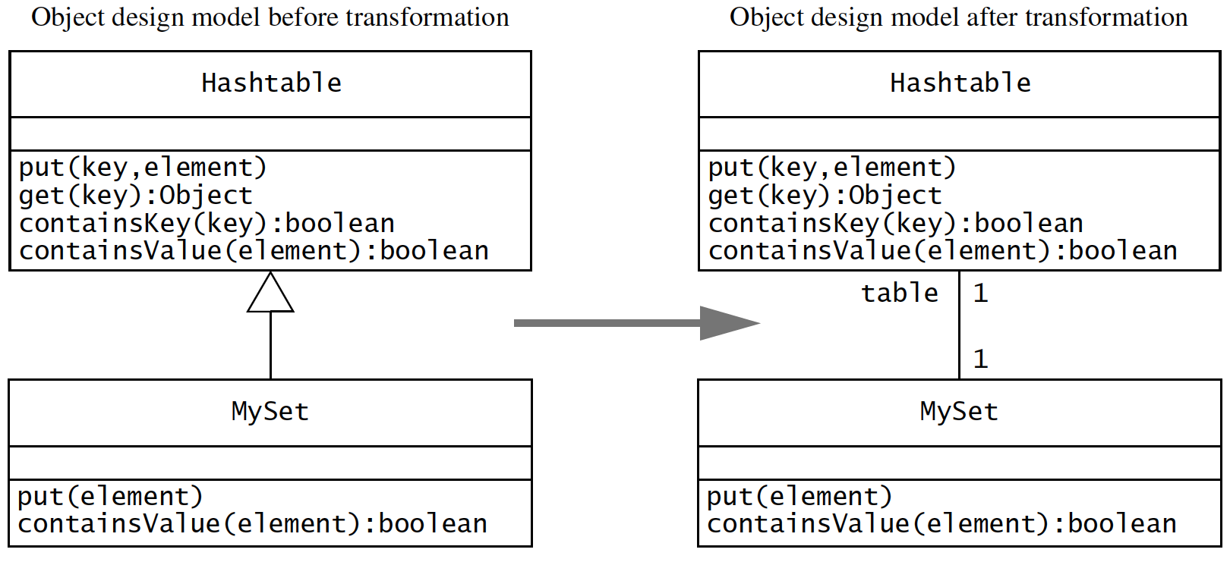
reuse

Slide 54
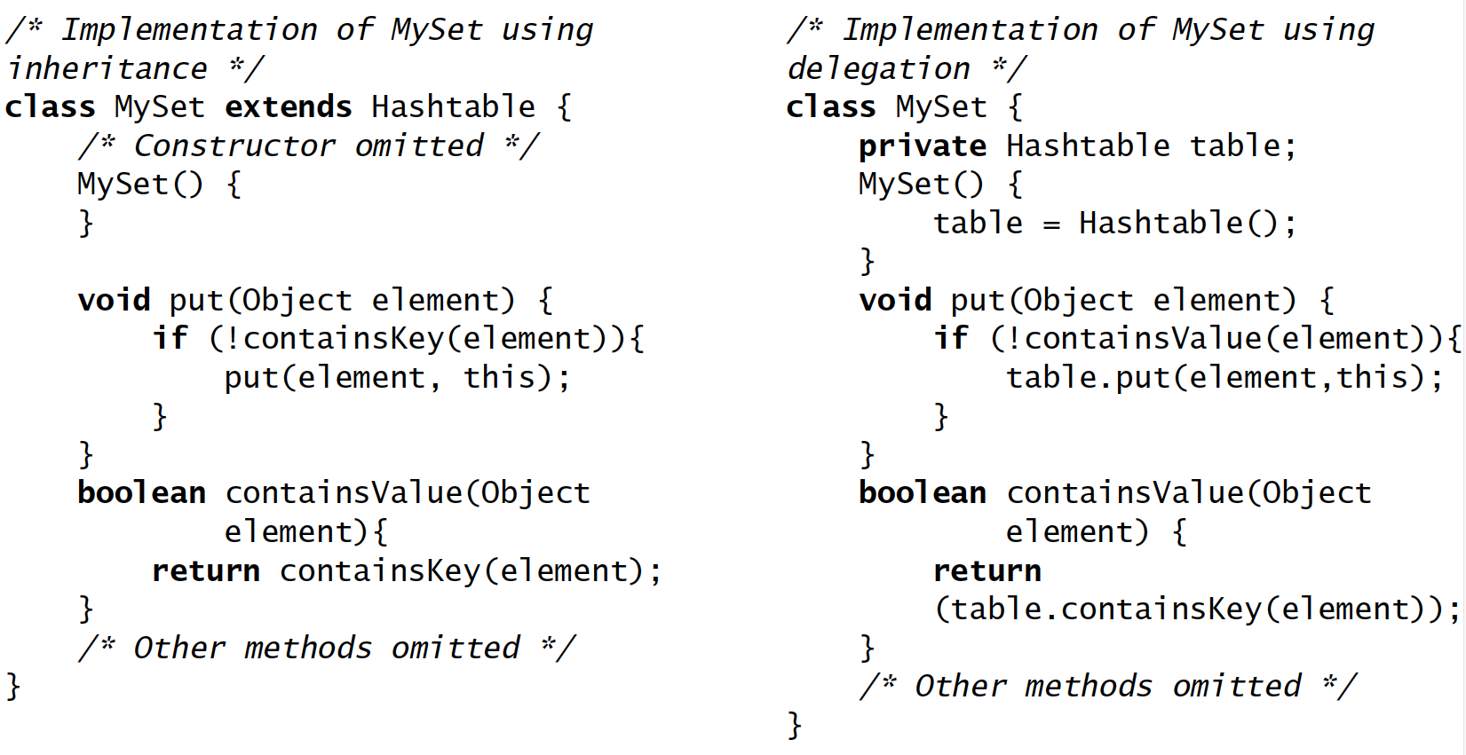
reuse

Slide 55
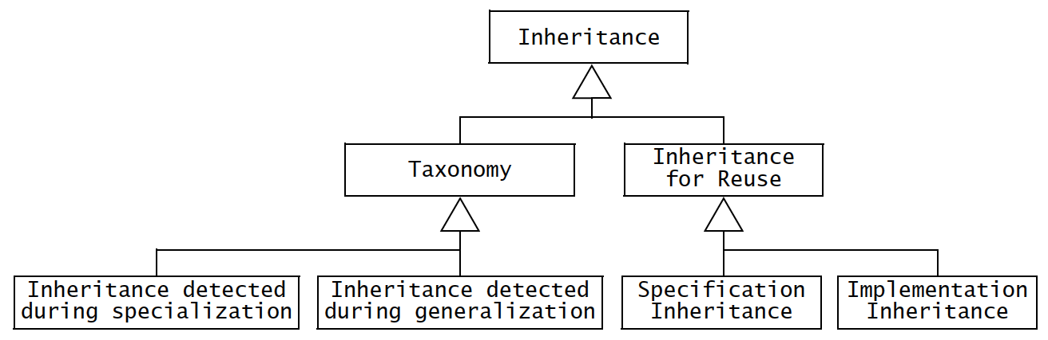
reuse

Slide 56
reuse
Delegation – an alternative to inheritance that should be used when reuse is desired.
A class delegates another one if it implements an operation by sending message to another class.
Extensibility – extend the functionality (e.g. containsValue can extend function of containsKey())
Subtyping – MySet does not inherit from Hashtable

Slide 57
The liskov substitution principle
If an object of type S can be substituted in all the places where an object of type T is expected, then S is a subtype of T.
Interpretation
In object design, the Liskov Substitution Principle means that if all classes are subtypes of their superclasses, all inheritance relationships are specification inheritance relationships. In other words, a method written in terms of a superclass T must be able to use instances of any subclass of T without knowing whether the instances are of a subclass. Consequently, new subclasses of T can be added without modifying the methods of T, hence leading to an extensible system. An inheritance relationship that complies with the Liskov Substitution Principle is called strict inheritance.

Slide 58
Design patterns
Design patterns – template solutions for a range of recurring problems. Contain;
Name – unique identifier
Problem description – situation where the pattern is used
Solution – set of collaborating classes and interfaces
Consequences – trade-offs, alternatives

Slide 59
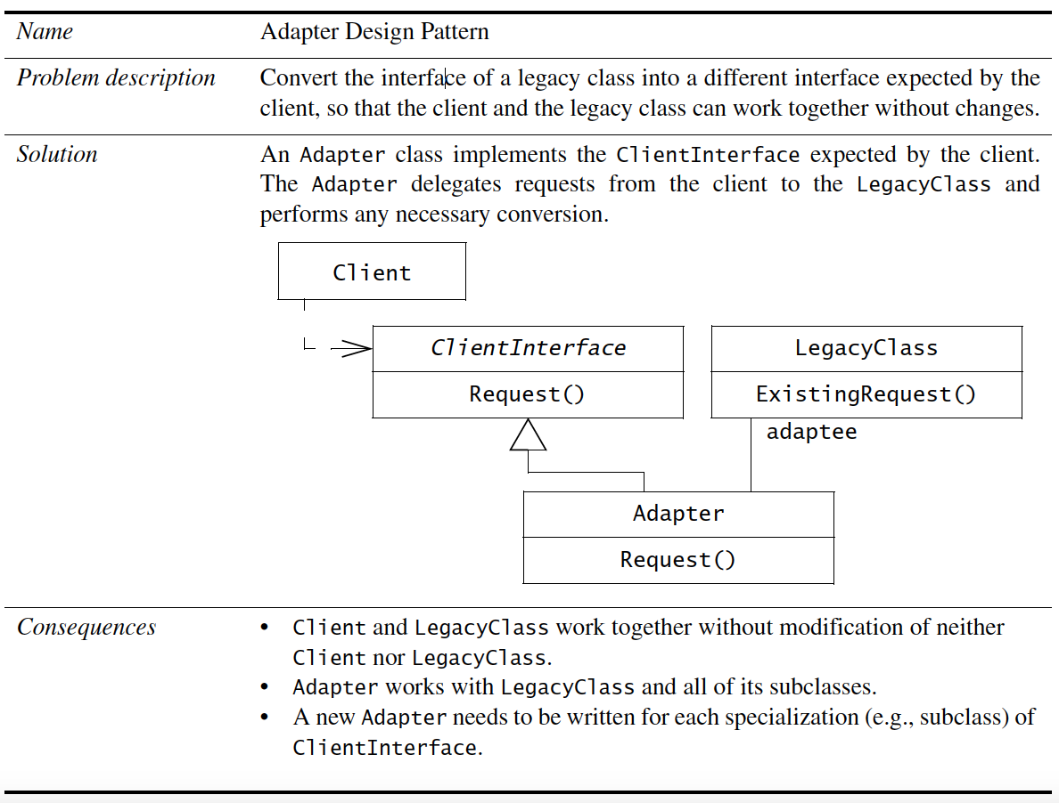
Design patterns

Slide 60
Design patterns
Example – in previous example, Adapter pattern, the participating classes are;
Client class – accesses the pattern
Pattern interface – realised by abstract class or an interface
Implementor class – provides lower-level behavior
Extender class – provides a different implementation or extended behavior of the pattern

Slide 61
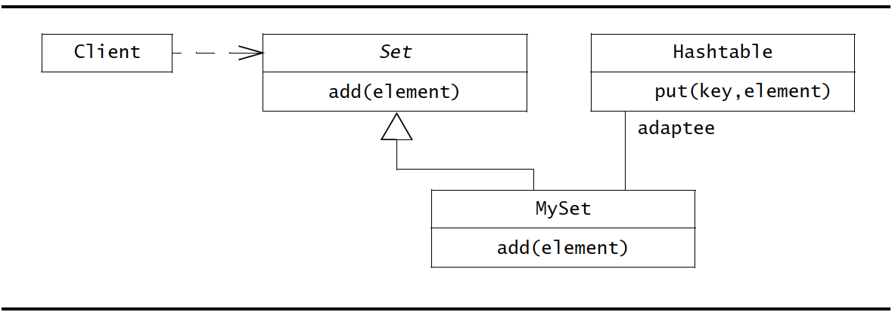
Design patterns

Slide 62
Reuse activities
Selecting design patterns and components;
To adapt to changes, design patterns help by reducing amount of time and effort.

Slide 63
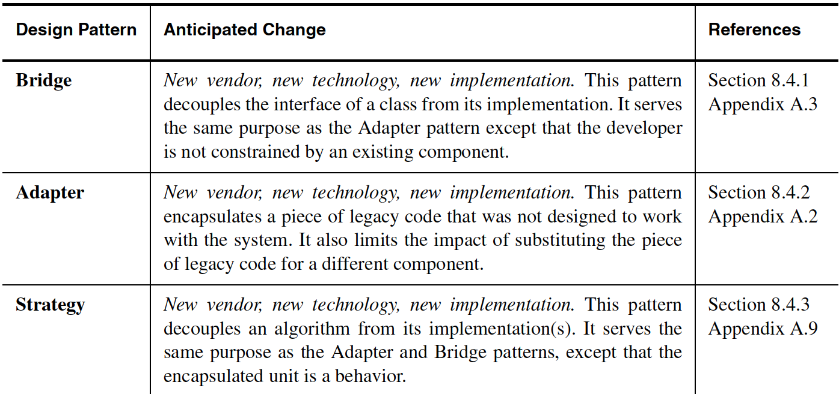
Selecting patterns

Slide 64
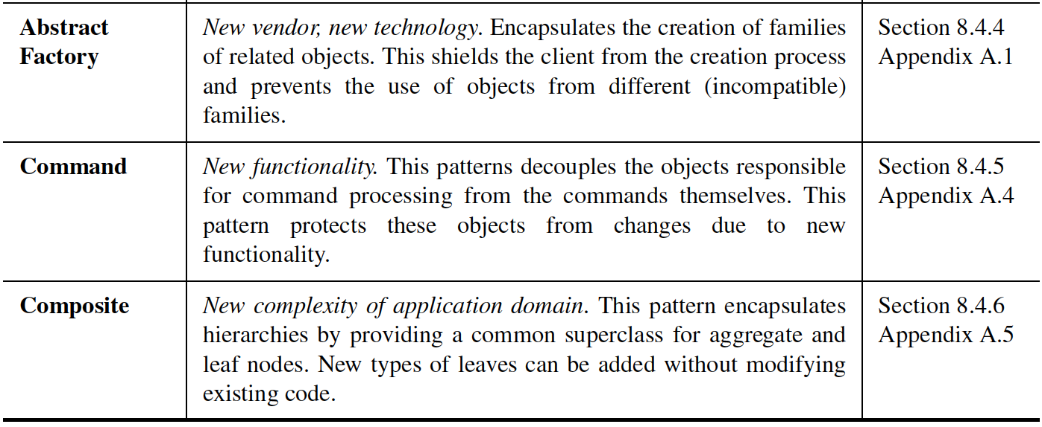
Selecting patterns

Slide 65
❃ Read from
Bruegge B., and Dutoit A. H. 2010, Object-oriented Software Engineering using UML, Patterns and Java, 3rd ed., Prentice Hall (Chapter 8)
8.4.1 Encapsulating data stores with the bridge pattern
8.4.2 Encapsulating legacy components with the adapter pattern
8.4.3 Encapsulating context with the strategy pattern
8.4.4 Encapsulating platforms with the abstract factory pattern
8.4.5 Encapsulating Control Flow with the Command Pattern
8.4.6 Encapsulating Hierarchies with the Composite Design Pattern
8.4.7 Heuristics for Selecting Design Patterns

Slide 66
Identifying and adjusting application frameworks
Application frameworks – reusable partial application that can be specialised to produce custom applications.
Different than class libraries, frameworks are trageted to particular technologies such as data processing, cellular communications, user interfaces, real-time components etc.

Slide 67
Framework classification according to their position in the software dev. process
Infrastructure frameworks – operating systems, debuggers, communication protocols, user interfaces etc.
Middleware frameworks – used to integrate existing distributed applications and components. E.g. Microsoft’s MFC, DCOM, Java RMI, WebSphere, WebLogic, Corba, transactional databases etc.
Enterprise application frameworks – application specific, e.g. JavaEE

Slide 68
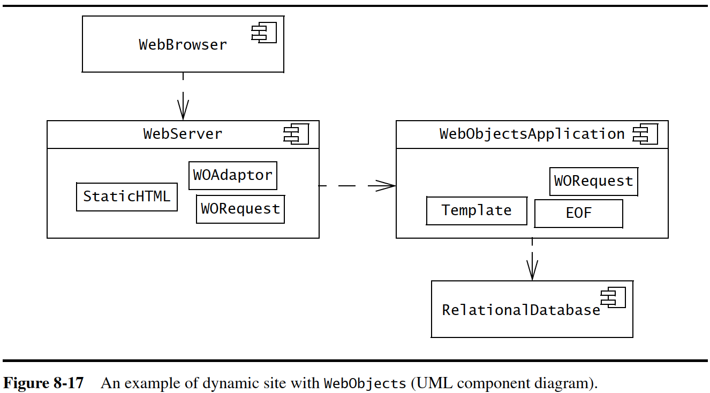
Framework example: WebObject

Slide 69
Managing reuse
Advantages
Lower development effort
Lower risk
Widespread use of standard terms
Increased reliability
Challenges
Not invented here (NIH) syndrome
Process support
Training

Slide 70
Documenting reuse
Reference to system using the solution
Example of use
Alternative solutions considered
Encountered trade-offs

Slide 71
Reuse roles
Component expert
Pattern expert
Technical writer
Configuration manager

Slide 72
❃ Read ‘8.6 ARENA Case Study’ from
Bruegge B., and Dutoit A. H. 2010, Object-oriented Software Engineering using UML, Patterns and Java, 3rd ed., Prentice Hall (Chapter 8)

Slide 73
Specifying interfaces
UNIT 05: Object-oriented Design
References:
Bruegge B., and Dutoit A. H. 2010, Object-oriented Software Engineering using UML, Patterns and Java, 3rd ed., Prentice Hall (Chapter 9)
Pressman, R. S., 2001, Software Engineering - A Practitioner's Approach, Fifth Ed., McGrawHill (Chapter 22)

Slide 74
All previous models
Analysis object model – entity, boundary and control objects visible to the user
Subsystem decomposition – cohesive partitions
Hardware/software mapping – classes, APIs etc.
Boundary use cases – user’s point of view
Design patterns – partial object design models

Slide 75
Interface specification
Identify missing attributes and operations – examine each subsystem service and each analysis object. Identify missing operations and attributes that are needed to realise the subsystem service.
Specify visibility and signatures – define visibility, no. of parameters etc.
Specify contracts – services provided by each object, conditions that must be met to invoke the services, return values

Slide 76
Interface specification concepts
Class Implementor, Class Extender, and Class User
Types, Signatures, and Visibility
Contracts: Invariants, Preconditions, and Postconditions
Object Constraint Language
OCL Collections: Sets, Bags, and Sequences
OCL Qualifiers: forAll and exists

Slide 77
❃ Read from
Bruegge B., and Dutoit A. H. 2010, Object-oriented Software Engineering using UML, Patterns and Java, 3rd ed., Prentice Hall (Chapter 8)
9.3.1 Class implementor, class extender, and class user
9.3.2 Types, signatures and visibility
9.3.3 Contracts: invariants, preconditions, and postconditions
9.3.4 Object constraint language
9.3.5 OCL collections: sets, bags, and sequences
9.3.6 OCL qualifiers: forALL and exists

Slide 78
Managing object design
Three approaches to document object design
Self-contained ODD generated from model
OOD as extension of the RAD
OOD embedded into source code

Slide 79
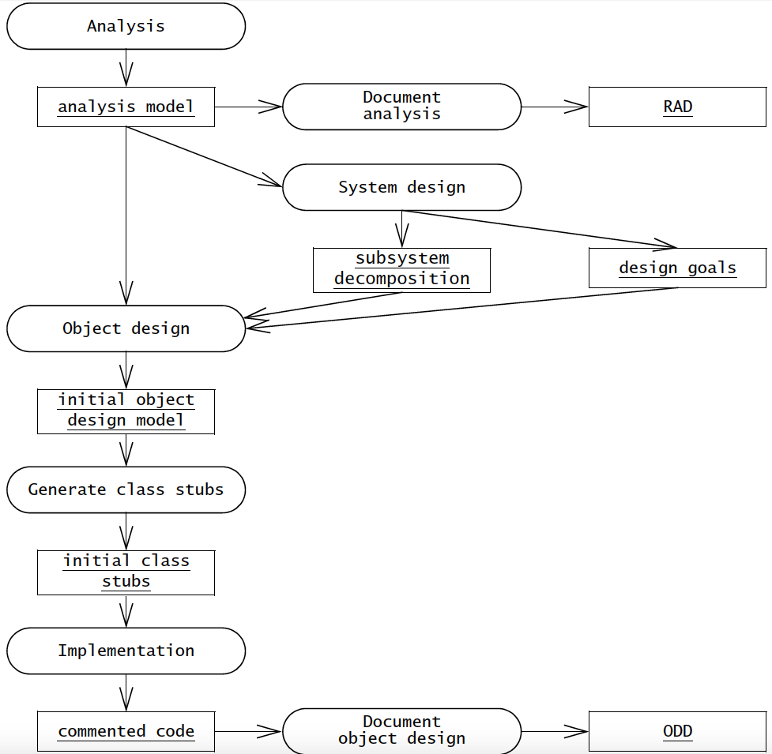
Embedded odd

Slide 80
OBJECT DESIGN DOCUMENT
Introduction
  Object design trade-offs
  Interface documentation guidelines
  Definitions, acronyms, and abbreviations
  References
Packages
Class interfaces
Glossary

Slide 81
roles
The core architect
The architecture liaisons
The object designers
The configuration manager
Technical writers

Slide 82
Contracts during requirements analysis
Communication among stakeholders
Level of detail and rate of change
Level of detail and elicitation effort
Testing requirements

Slide 83
❃ Read ‘9.6 ARENA Case Study’ from
Bruegge B., and Dutoit A. H. 2010, Object-oriented Software Engineering using UML, Patterns and Java, 3rd ed., Prentice Hall (Chapter 9)

Slide 84
End of Unit 05 : Object-oriented Design

