Slide 1

OBJECT-ORIENTED SOFTWARE ENGINEERING
UNIT 06 : Object Oriented Implementation
© 2018, PRAMOD PARAJULI

Slide 2
Disclaimer
These slides are part of teaching materials for Object Oriented Software Engineering (OOSE). These slides do not cover all aspect of learning OOSE, nor are these be taken as primary source of information. As the core textbooks and reference books for learning the subject has already been specified and provided to the students, students are encouraged to learn from the original sources.
Contents in these slides are copyrighted to the instructor and authors of original texts where applicable.

Slide 3
Reference:
Bruegge B., and Dutoit A. H. 2010, Object-oriented Software Engineering using UML, Patterns and Java, 3rd ed., Prentice Hall (Chapter 10)

Slide 4
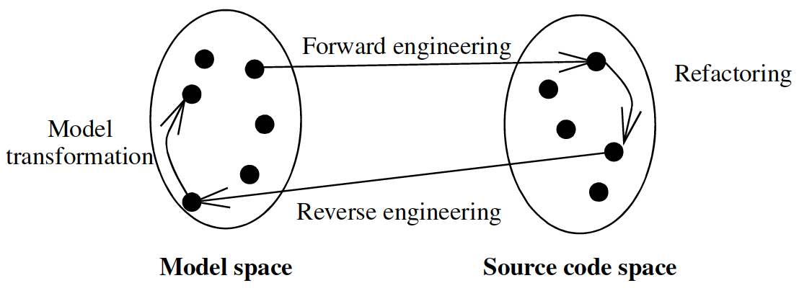
Mapping concepts
Model transformations
Refactorings
Forward engineering
Reverse engineering

Slide 5
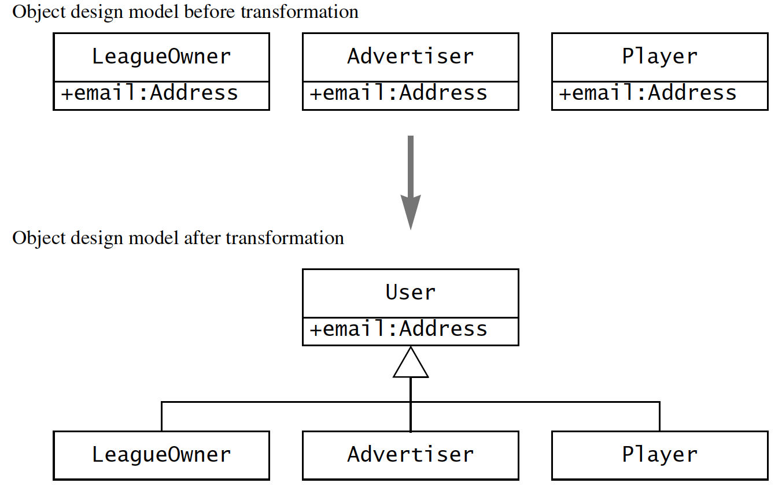
Model transformation
Applied to object model and results in another object model.

Slide 6
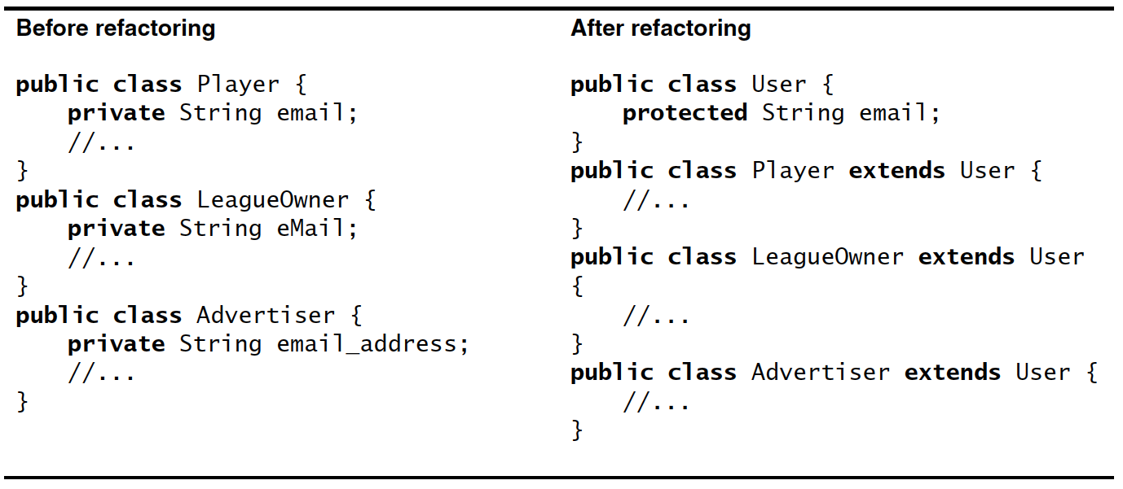
refactoring
To improve source code readability or modifiability without changing its behavior.

Slide 7
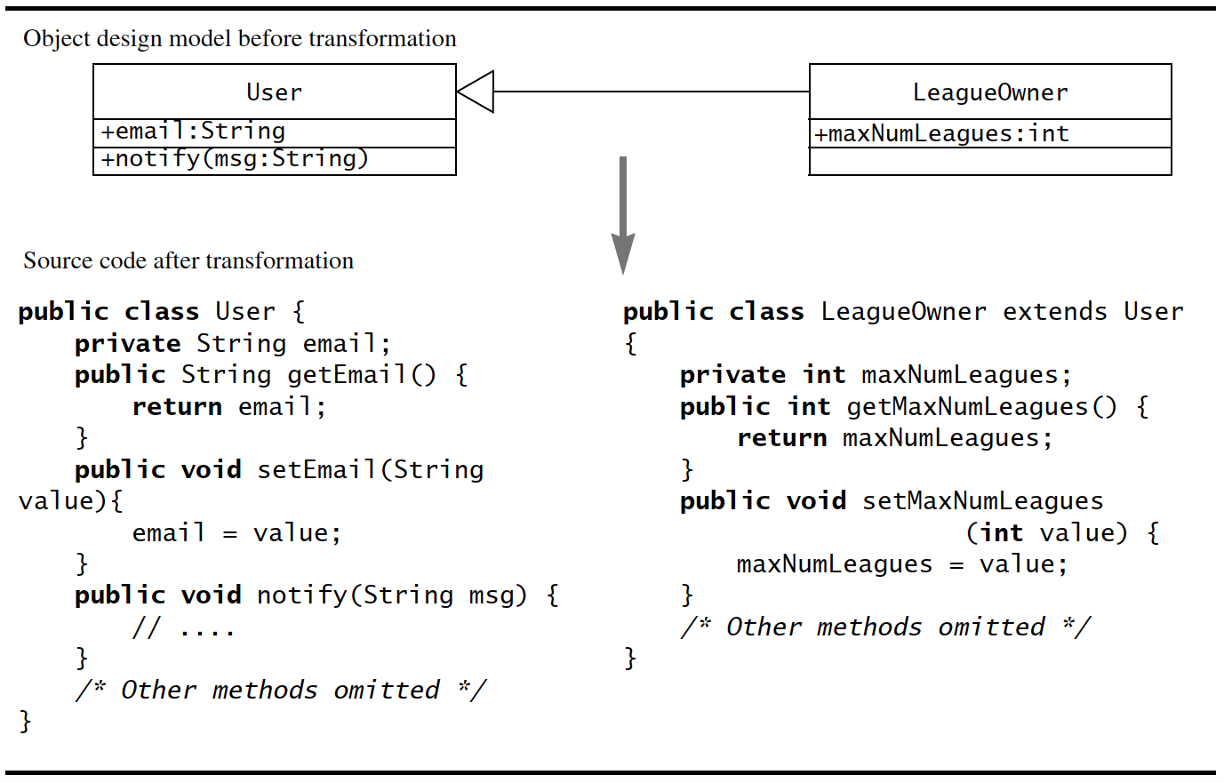
Forward engineering

Slide 8
Reverse engineering
Mapping source code elements back to a set of model elements.
CASE tools help build an approximate model.
Approximate – because forward engineering may lose information e.g. associations are turned into collections of references.

Slide 9
Transformation principles
Each transformation must address a single criteria.
Each transformation must be local.
Each transformation must be applied in isolation to other changes.
Each transformation must be followed by a validation step.

Slide 10
transformations
Transform models
Optimising the object design models i.e. class models
Mapping associations to collections
Mapping operations contracts to exceptions
Mapping the class model to a persistent storage schema

Slide 11
Optimising the object design model
Optimising access paths
Repeated association traversals – frequent operations between two objects through other objects must be simplified by creating an association.
“Many” associations – decrease search time by reducing the “many” to “one”
Misplaced attributes – reduce excessive modeling, calling vs. hosting classes

Slide 12
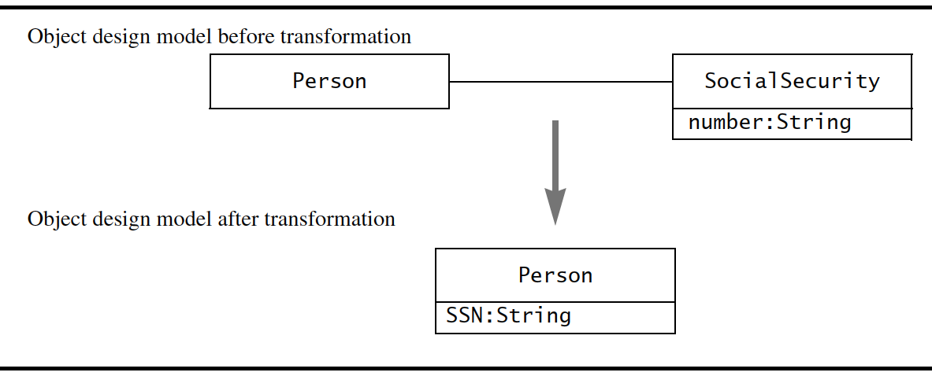
Optimising the object design model
Collapsing objects

Slide 13
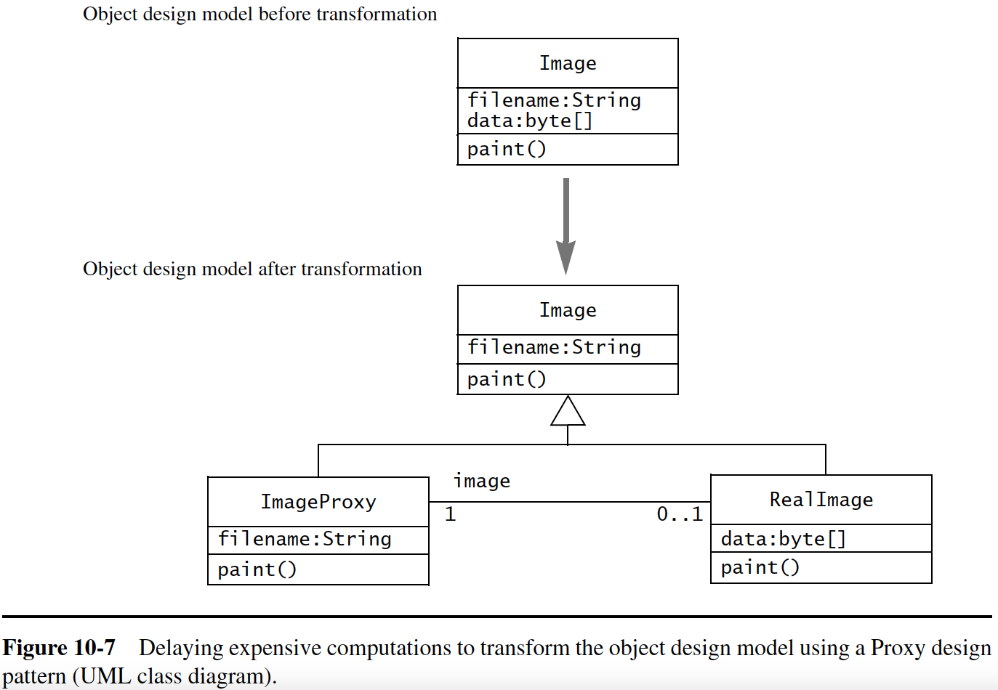
Optimising the object design model
Delaying
expensive
computations

Slide 14
Optimising the object design model
Caching the result of expensive computations
If some values are repeatedly access after computation, its better to keep them in cache.

Slide 15
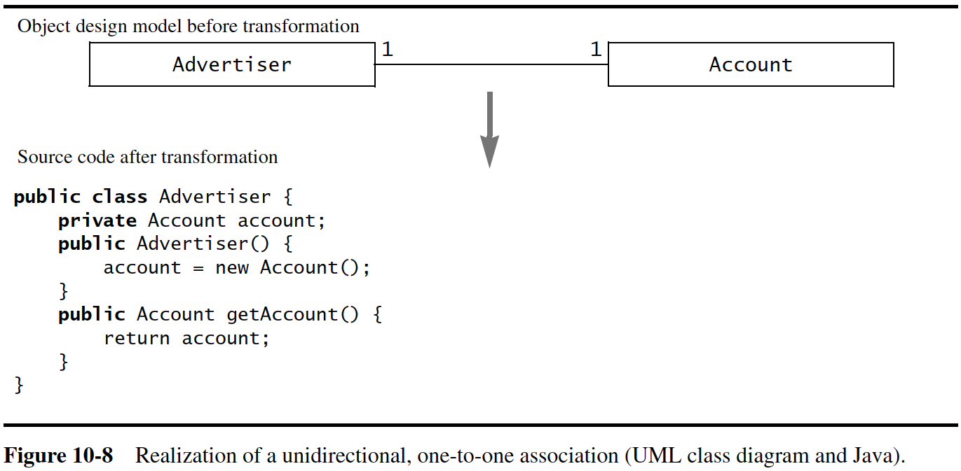
Mapping associations to collections

Slide 16
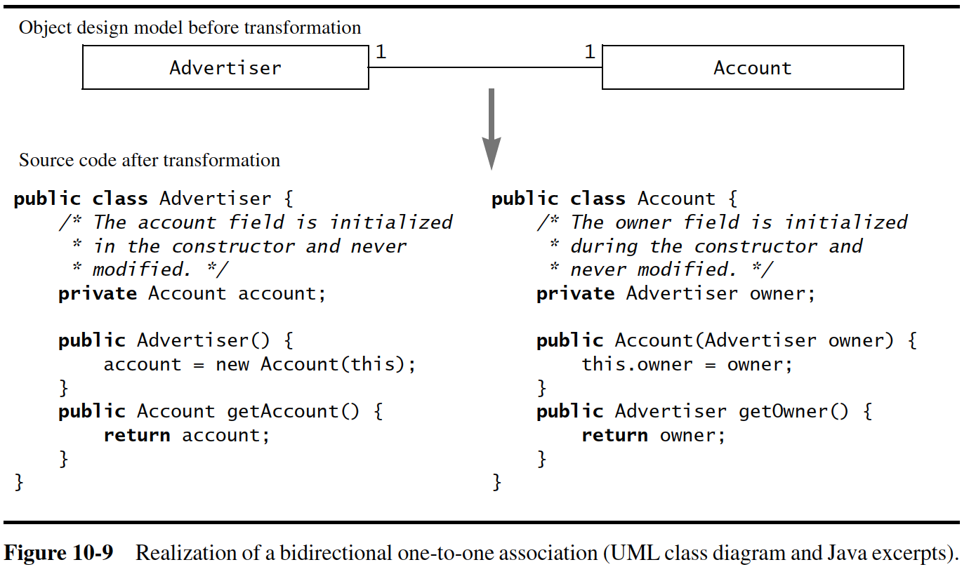
Mapping associations to collections

Slide 17
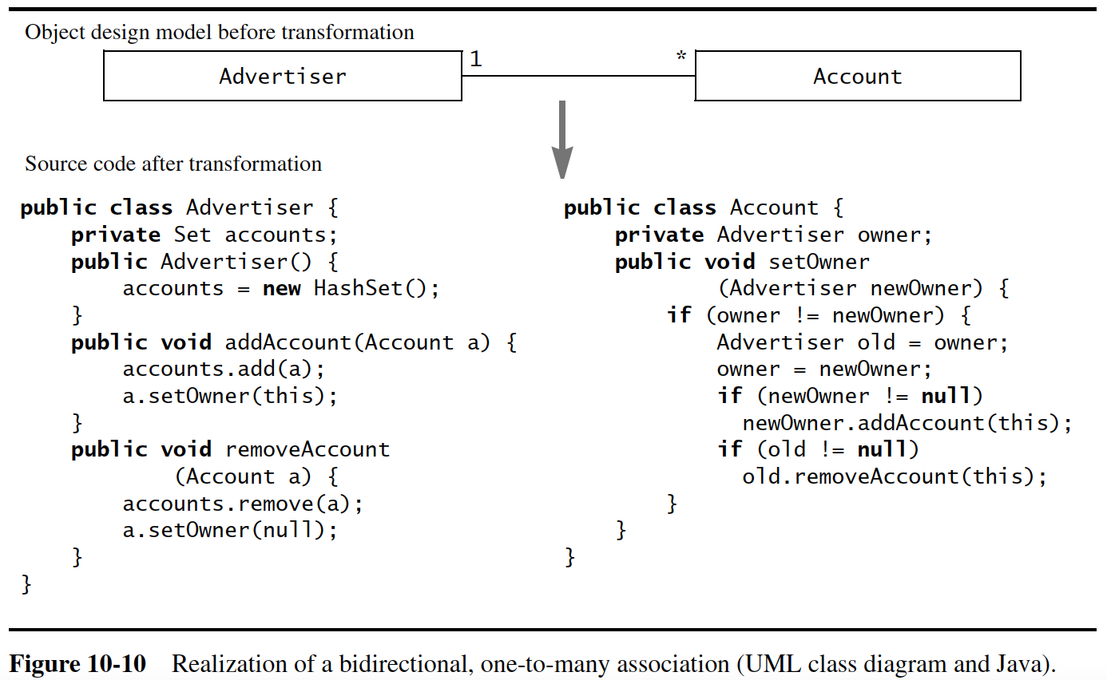
Mapping associations to collections

Slide 18
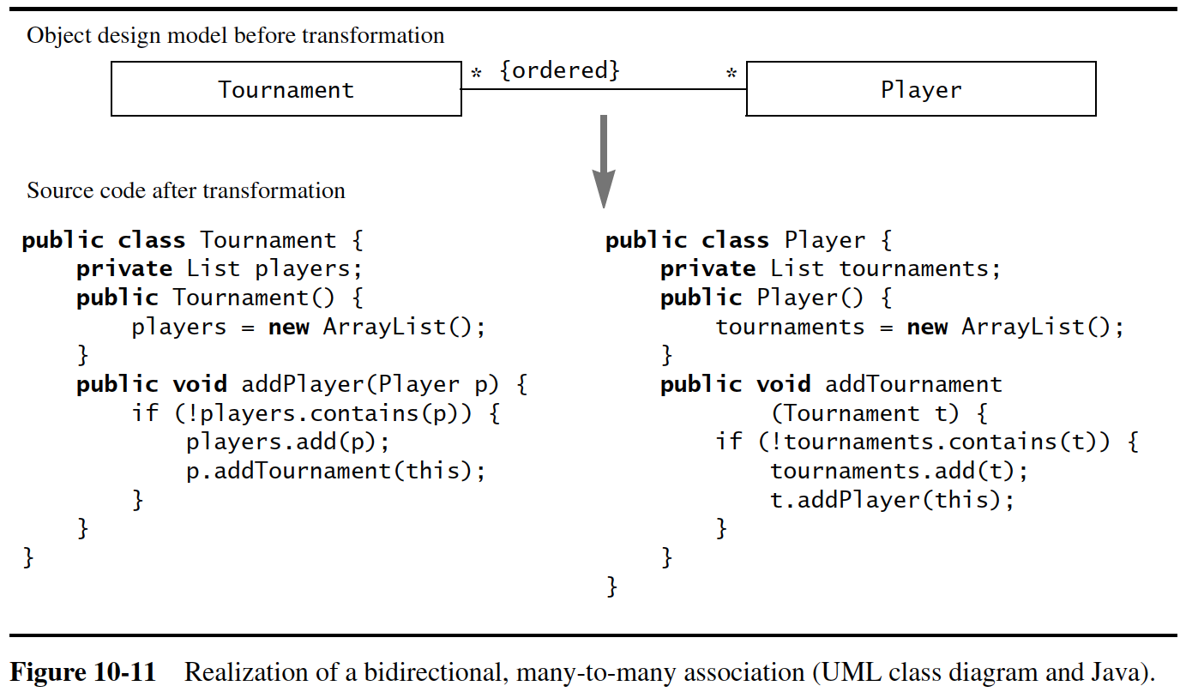
Mapping associations to collections

Slide 19
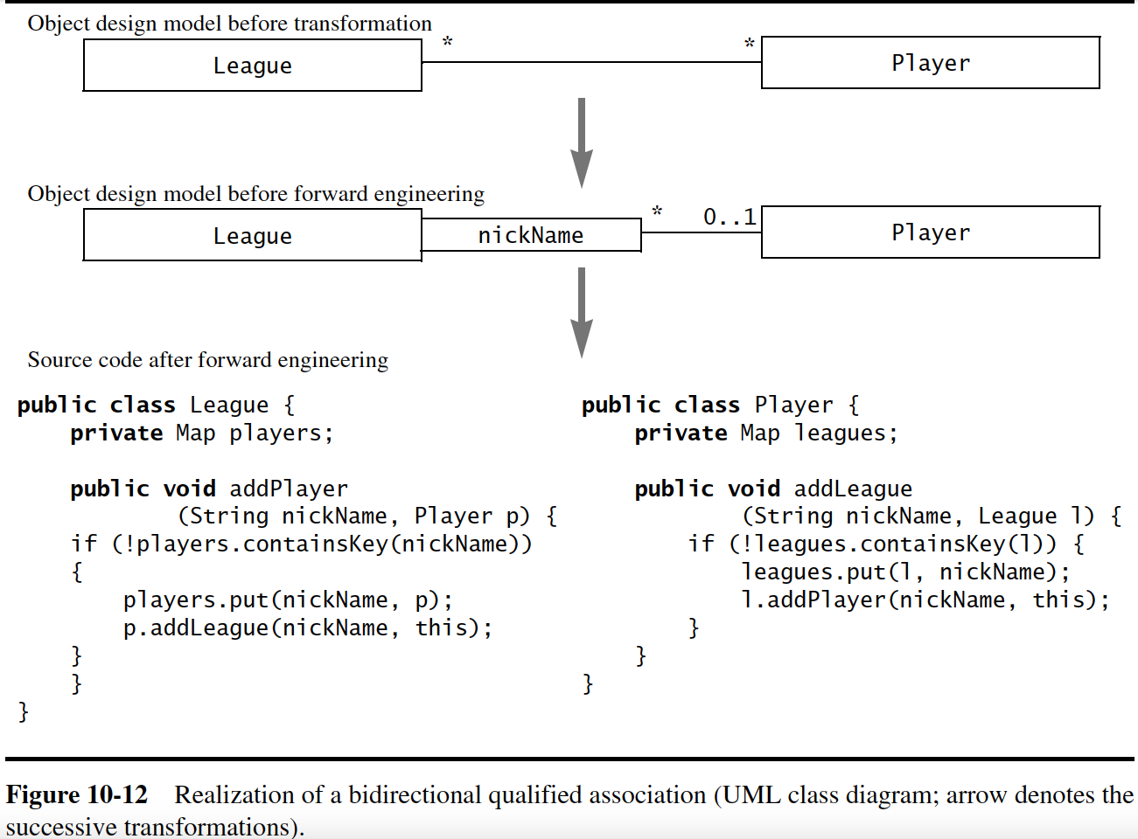
Qualified associations

Slide 20
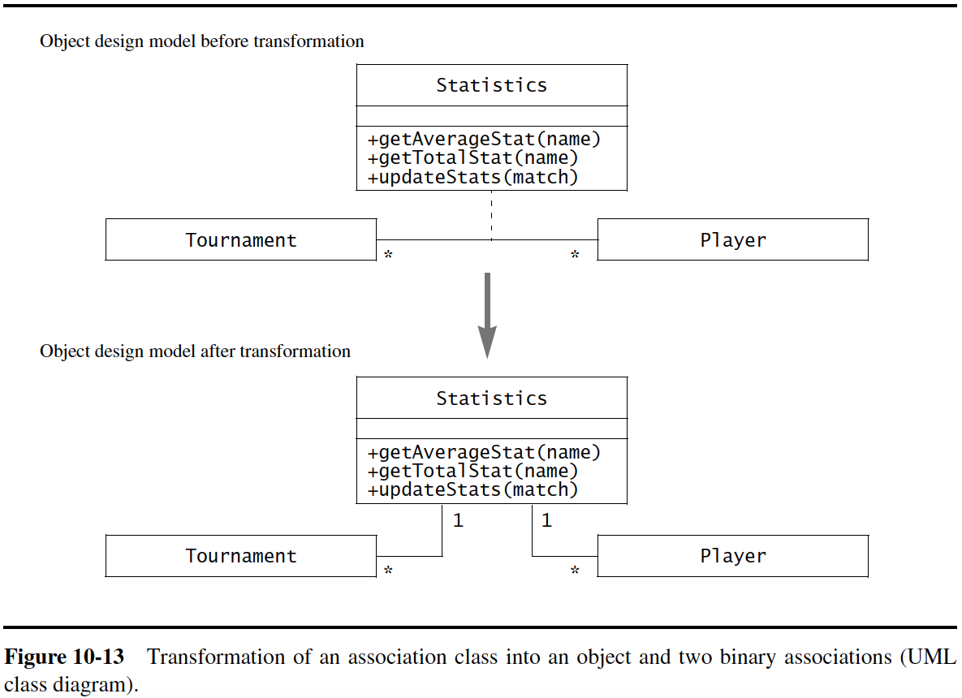
Association classes

Slide 21
Mapping contracts to exceptions
Contracts help in;
Checking preconditions
Checking postconditions
Checking invariants
Dealing with inheritance

Slide 22
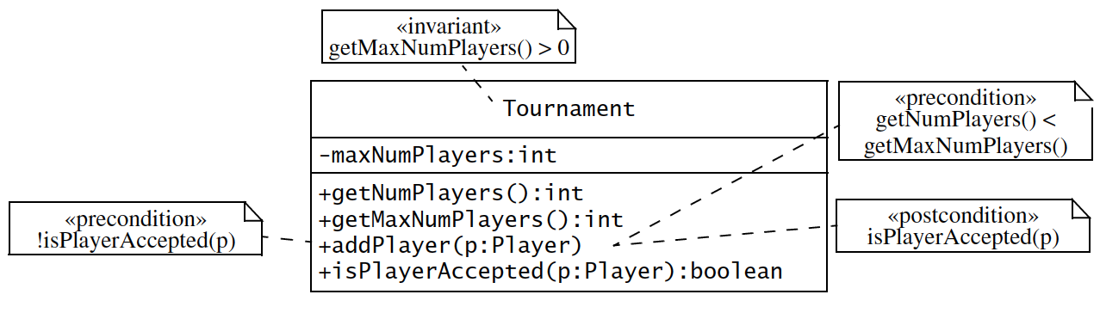
Mapping contracts to exceptions
Example

Slide 23
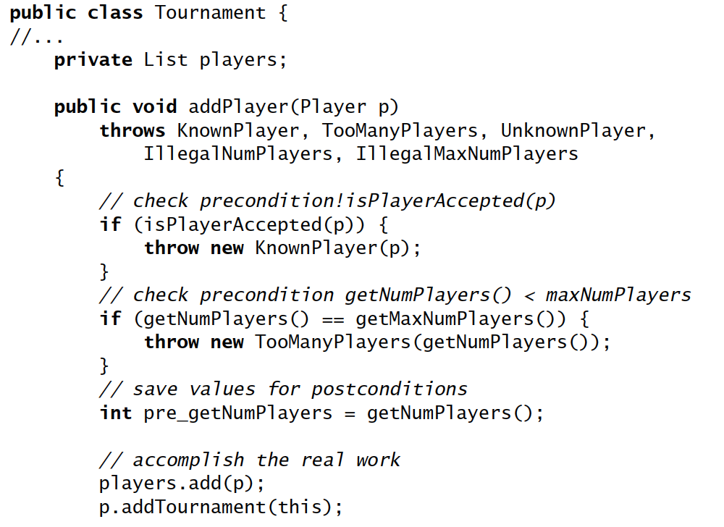

Slide 24
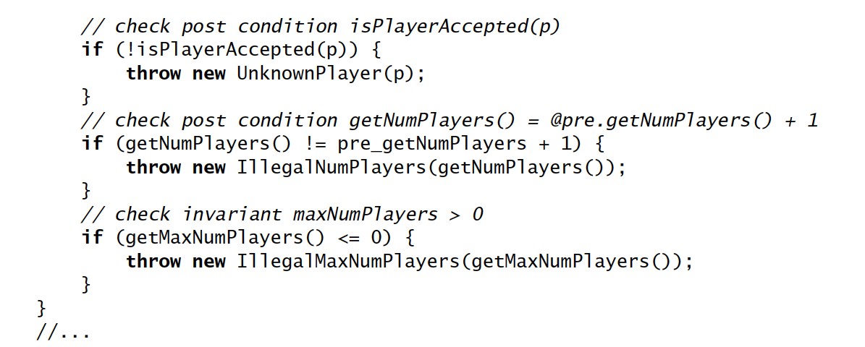

Slide 25
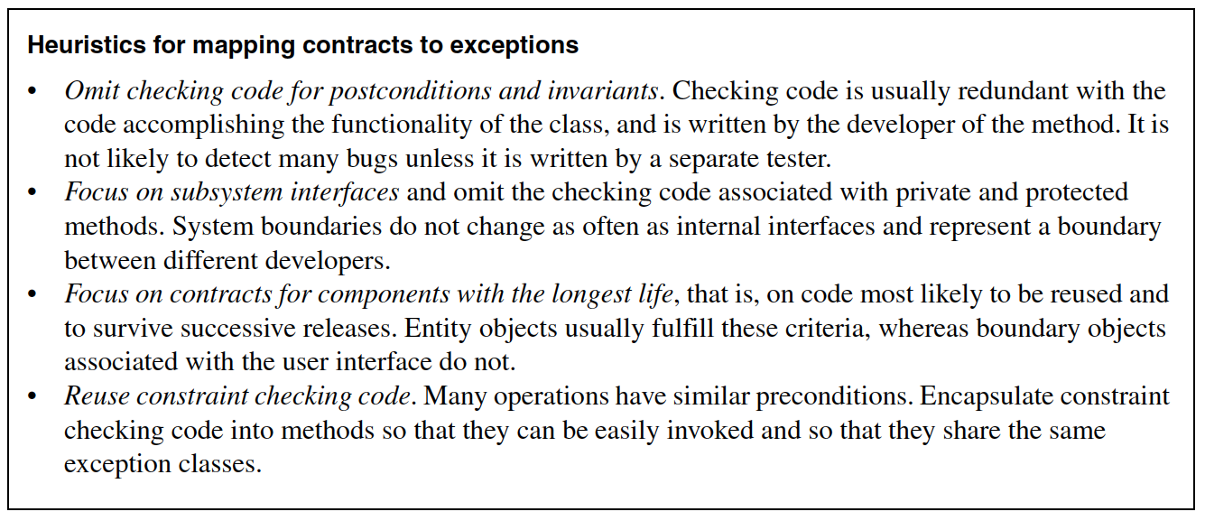
Mapping contracts to exceptions

Slide 26
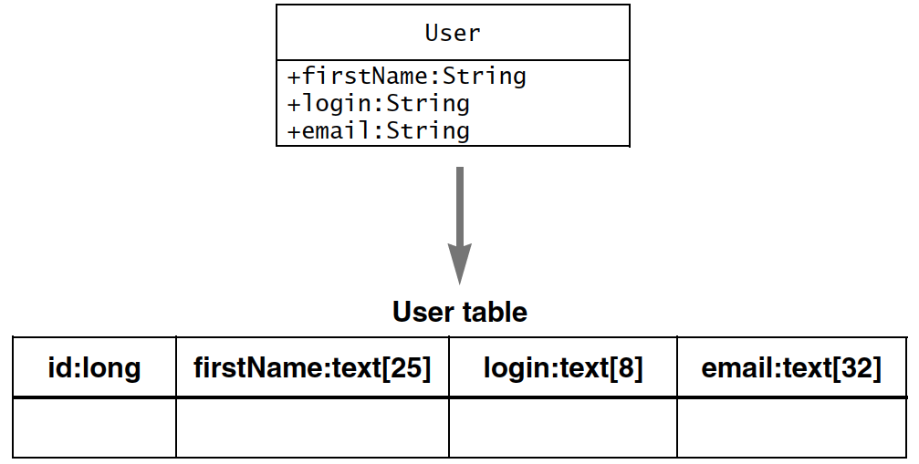
Mapping object models to persistent storage schema
Mapping classes and attributes

Slide 27
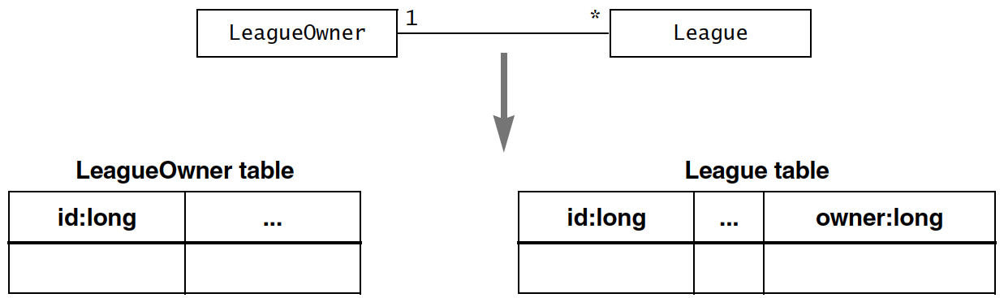
Mapping object models to persistent storage schema
Mapping associations

Slide 28
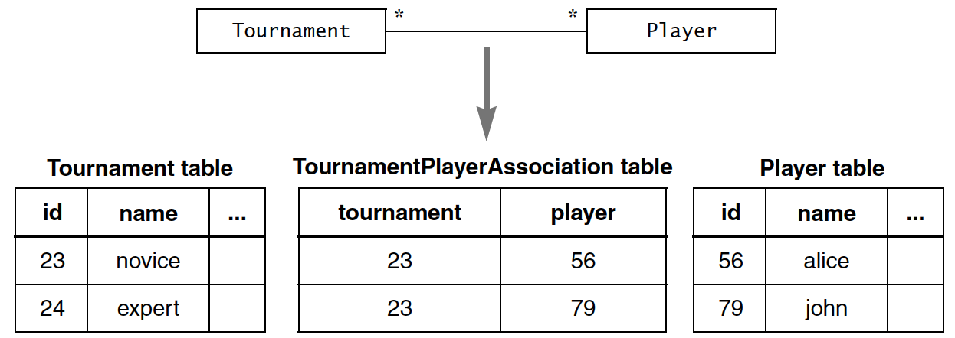
Mapping object models to persistent storage schema
Mapping associations

Slide 29
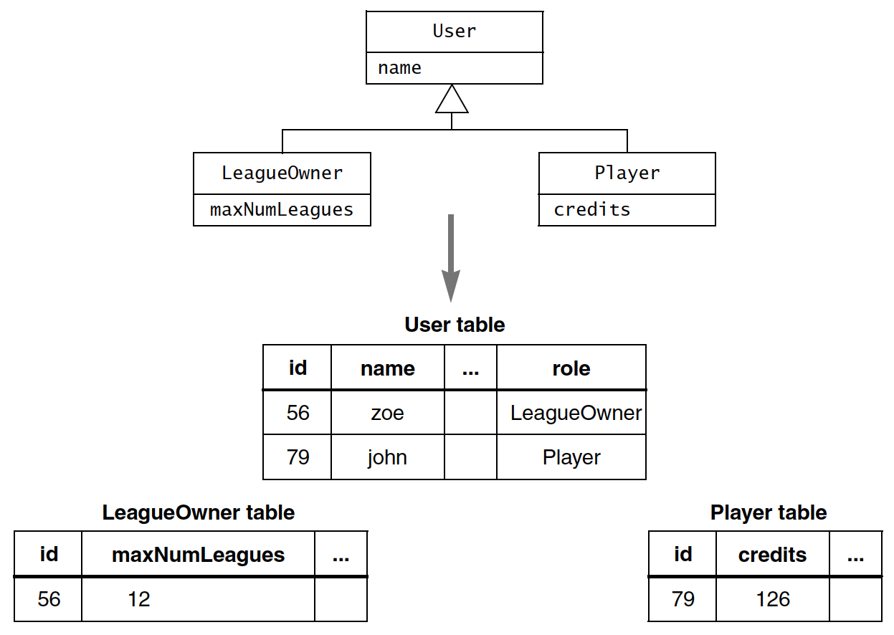
Mapping object models to persistent storage schema
Mapping inheritance
relationships
(vertical)

Slide 30
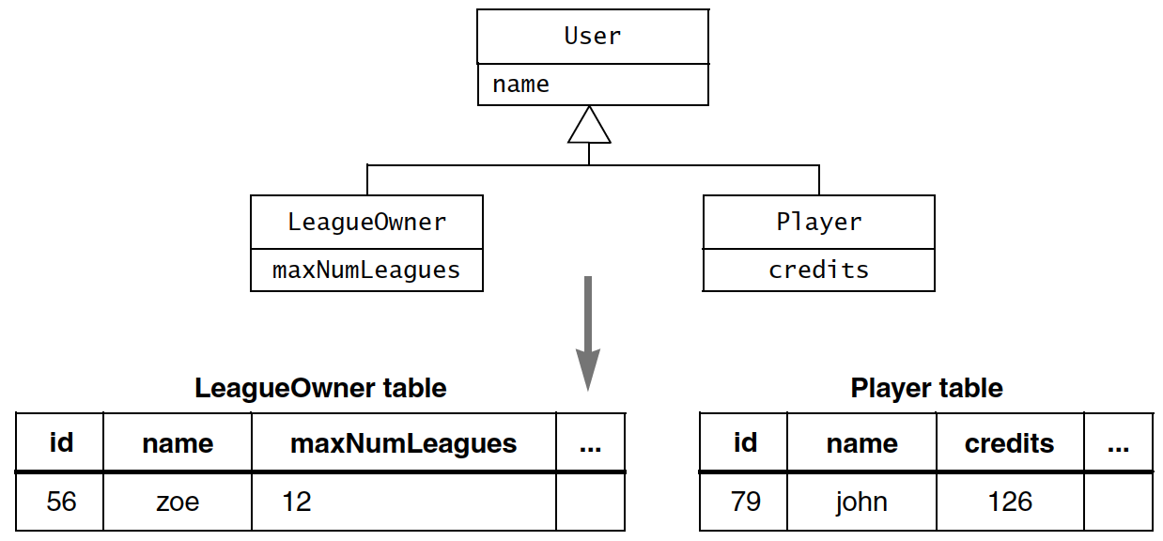
Mapping object models to persistent storage schema
Mapping inheritance
relationships
(horizontal)

Slide 31
Managing implementation
Documenting transformations
For given transformation, use same tool
Keep the contracts in the source code, not in the object design model
Use the same names for the same objects
Make transformations explicit
Assigning responsibilities
The core architect
The architecture liaison
The developer

Slide 32
❃ Read ‘10.6 ARENA Case Study’ from
Bruegge B., and Dutoit A. H. 2010, Object-oriented Software Engineering using UML, Patterns and Java, 3rd ed., Prentice Hall (Chapter 10)

Slide 33
End of Unit 06 : Object-oriented Implementation

