Slide 1
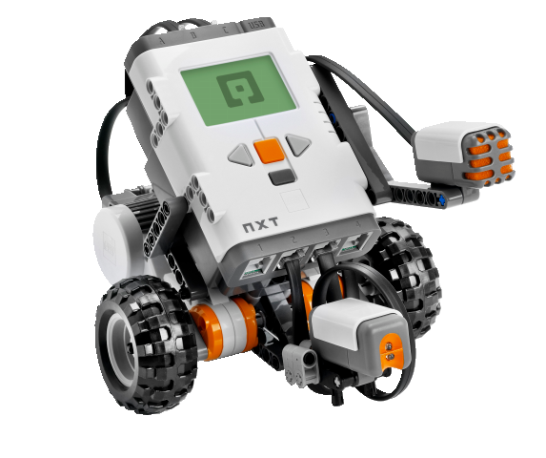
OBJECT-ORIENTED SOFTWARE ENGINEERING
UNIT 07 : Software Testing Techniques
© 2018, PRAMOD PARAJULI

Slide 2
Disclaimer
These slides are part of teaching materials for Object Oriented Software Engineering (OOSE). These slides do not cover all aspect of learning OOSE, nor are these be taken as primary source of information. As the core textbooks and reference books for learning the subject has already been specified and provided to the students, students are encouraged to learn from the original sources.
Contents in these slides are copyrighted to the instructor and authors of original texts where applicable.

Slide 3
Software testing
Process of executing a program with the intent of finding an error
Good test case has high probability of finding an as-yet undiscovered error
A successful test is one that uncovers an as-yet undiscovered error

Slide 4
TESTING PRINCIPLE
All test should be traceable to customer requirements
Test should be planned long before testing begins
Pareto principle applies to S/W testing
Testing should begin ‘in the small’ and progress towards testing ‘in large’
Exhaustive testing is not possible

Slide 5

TESTING TYPES
Unit/component/defect testing
Mutation testing
Integration testing
System testing
Alpha testing
Beta testing
Acceptance testing

Slide 6
TESTING priorities
Only exhaustive testing can show a program is free from defects. However, exhaustive testing is impossible
Tests should exercise a system's capabilities rather than its components
Testing old capabilities is more important than testing new capabilities
Testing typical situations is more important than boundary value cases

Slide 7
TEST DATA AND TEST CASES
Test data Inputs which have been devised to test the system
Test cases Inputs to test the system and the predicted outputs from these inputs if the system operates according to its specification

Slide 8
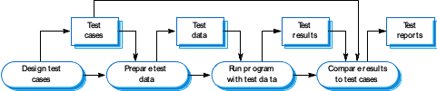
DEFECT (UNIT) TESTING PROCESS

Slide 9
Black-box testing
An approach to testing where the program is considered as a ‘black-box’
The program test cases are based on the system specification
Test planning can begin early in the software process
Equivalence class partitioning
Boundary value analysis

Slide 10
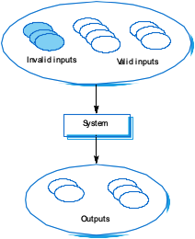
Equivalence class partitioning
Input data and output results often fall into different classes where all members of a class are related
Each of these classes is an equivalence partition where the program behaves in an equivalent way for each class member
Test cases should be chosen from each partition

Slide 11
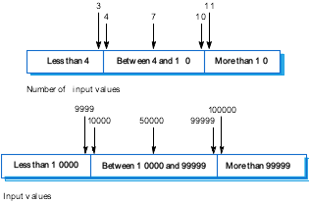
Equivalence class partitioning
Partition system inputs and outputs into ‘equivalence sets’
If input is a 5-digit integer
between 10,000 and 99,999,
equivalence partitions are
<10,000, 10,000-99, 999 and
> 10, 000
Choose test cases at the boundary of these sets
00000, 09999, 10000, 99999, 10001

Slide 12
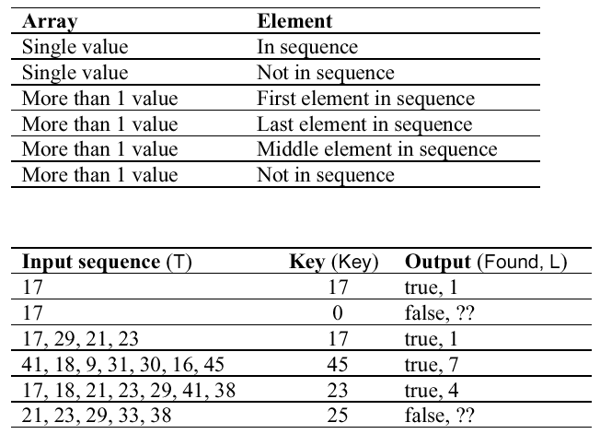
EXAMPLE: SEARCH ROUTINE

Slide 13
STRUCTURAL TESTING
Sometime called white-box testing (glass-box testing)
Derivation of test cases according to program structure. Knowledge of the program is used to identify additional test cases
Objective is to exercise all program statements (not all path combinations)
statement coverage
branch coverage
condition coverage
path coverage

Slide 14
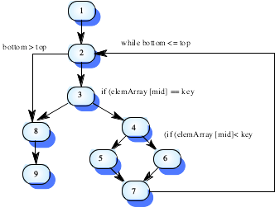
PATH TESTING
The objective of path testing is to ensure that the set of test cases is such that each path through the program is executed at least once

Slide 15
INTEGRATION TESTING
Tests complete systems or subsystems composed of integrated components
Integration testing should be black-box testing with tests derived from the specification
Main difficulty is localising errors
Incremental integration testing reduces this problem

Slide 16
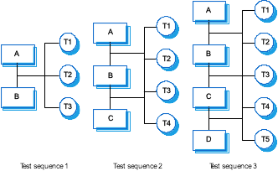
INTEGRATION TESTING

Slide 17
APPROACHES TO INTEGRATION TESTING
Big-bang integration testing
Top-down testing
Start with high-level system and integrate from the top-down replacing individual components by stubs where appropriate
Bottom-up testing
Integrate individual components in levels until the complete system is created
In practice, most integration involves a combination of these strategies

Slide 18
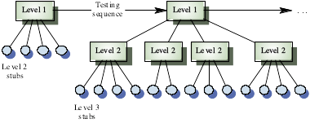
TOP-DOWN APPROACH

Slide 19
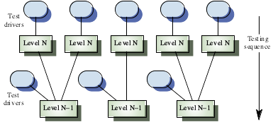
BOTTOM-UP APPROACH

Slide 20
TESTING APPROACHES
Architectural validation
Top-down integration testing is better at discovering errors in the system architecture
System demonstration
Top-down integration testing allows a limited demonstration at an early stage in the development
Test implementation
Often easier with bottom-up integration testing
Test observation
Problems with both approaches. Extra code may be required to observe tests

Slide 21
SYSTEM TESTING
Alpha testing – test carried by test team within the organization
Beta testing – testing performed by a selected group of friendly customers
Acceptance testing – performed by customer to determine whether or not to accept the delivery of the system
Stress testing – test systems beyond its maximum design load

Slide 22
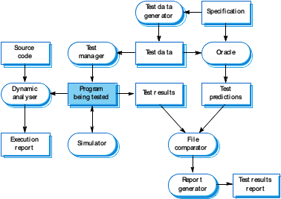
TESTING WORKBENCHES

Slide 23
OBJECT-ORIENTED TESTING
The components to be tested are object classes that are instantiated as objects
Larger grain than individual functions so approaches to white-box testing have to be extended
No obvious ‘top’ to the system for top-down integration and testing

Slide 24
OOT LEVELS
Testing operations associated with objects
Testing object classes
Testing clusters of cooperating objects
Testing the complete OO system

Slide 25
OBJECT CLASS TESTING
Complete test coverage of a class involves
Testing all operations associated with an object
Setting and interrogating all object attributes
Exercising the object in all possible states
Inheritance makes it more difficult to design object class tests as the information to be tested is not localised

Slide 26
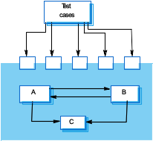
INTERFACE TESTING
Takes place when modules or sub-systems are integrated to create larger systems
Objectives are to detect faults due to interface errors or invalid assumptions about interfaces
Particularly important for object-oriented development as objects are defined by their interface

Slide 27
INTERFACE TYPES
Parameter interfaces
Data passed from one procedure to another
Shared memory interfaces
Block of memory is shared between procedures
Procedural interfaces
Sub-system encapsulates a set of procedures to be called by other sub-systems
Message passing interfaces
Sub-systems request services from other sub-systems

Slide 28
INTERFACE ERRORS
Interface misuse
A calling component calls another component and makes an error in its use of its interface e.g. parameters in the wrong order
Interface misunderstanding
A calling component embeds assumptions about the behaviour of the called component which are incorrect
Timing errors
The called and the calling component operate at different speeds and out-of-date information is accessed

Slide 29
INTERFACE TESTING GUIDELINES
Design tests so that parameters to a called procedure are at the extreme ends of their ranges
Always test pointer parameters with null pointers
Design tests which cause the component to fail
Use stress testing in message passing systems
In shared memory systems, vary the order in which components are activated

Slide 30
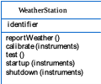
WEATHER STATION INTERFACE
Use a state model to identify state transitions for testing
Examples of testing sequences
Shutdown -> Waiting -> Shutdown
Waiting -> Calibrating -> Testing -> Transmitting -> Waiting
Waiting -> Collecting -> Waiting -> Summarising -> Transmitting -> Waiting

Slide 31
OBJECT INTEGRATION
Levels of integration are less distinct in object-oriented systems
Cluster testing is concerned with integrating and testing clusters of cooperating objects
Identify clusters using knowledge of the operation of objects and the system features that are implemented by these clusters

Slide 32
APPROACHES TO CLUSTER TESTING
Use-case or scenario testing
Testing is based on a user interactions with the system
Has the advantage that it tests system features as experienced by users
Thread testing
Tests the systems response to events as processing threads through the system
Object interaction testing
Tests sequences of object interactions that stop when an object operation does not call on services from another object

Slide 33
SCENARIO-BASED TESTING
Identify scenarios from use-cases and supplement these with interaction diagrams that show the objects involved in the scenario
Consider the scenario in the weather station system where a report is generated

Slide 34
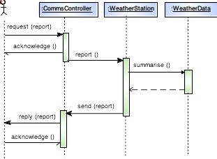
SCENARIO-BASED TESTING - EXAMPLE

Slide 35
SCENARIO-BASED TESTING - EXAMPLE
Thread of methods executed
CommsController:request -> WeatherStation:report -> WeatherData:summarise
Inputs and outputs
Input of report request with associated acknowledge and a final output of a report
Can be tested by creating raw data and ensuring that it is summarised properly
Use the same raw data to test the WeatherData object

Slide 36
End of Unit 07 : Software Testing Techniques

