Slide 1
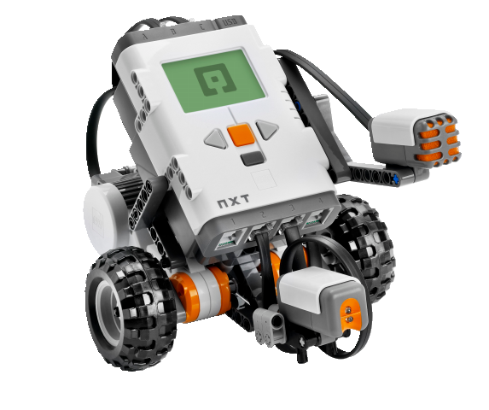
OBJECT-ORIENTED SOFTWARE ENGINEERING
UNIT 08 : Software Quality Assurance
© 2018, PRAMOD PARAJULI

Slide 2
Disclaimer
These slides are part of teaching materials for Object Oriented Software Engineering (OOSE). These slides do not cover all aspect of learning OOSE, nor are these be taken as primary source of information. As the core textbooks and reference books for learning the subject has already been specified and provided to the students, students are encouraged to learn from the original sources.
Contents in these slides are copyrighted to the instructor and authors of original texts where applicable.

Slide 3
Quality Concepts
Reference: Chapter 14, Software Engineering: A Practitioner’s Approach, Roger S. Pressman, 7th Edition

Slide 4
Software Quality
In 2005, ComputerWorld [Hil05] lamented that
  “bad software plagues nearly every organization that uses computers, causing lost work hours during computer downtime, lost or corrupted data, missed sales opportunities, high IT support and maintenance costs, and low customer satisfaction.
A year later, InfoWorld [Fos06] wrote about the
  “the sorry state of software quality” reporting that the quality problem had not gotten any better.
Today, software quality remains an issue, but who is to blame?
  Customers blame developers, arguing that sloppy practices lead to low-quality software.
  Developers blame customers (and other stakeholders), arguing that irrational delivery dates and a continuing stream of changes force them to deliver software before it has been fully validated.

Slide 5
Quality
For software, two kinds of quality may be encountered:
  Quality of design encompasses requirements, specifications, and the design of the system.
  Quality of conformance is an issue focused primarily on implementation.
  User satisfaction = compliant product + good quality + delivery within budget and schedule

Slide 6
Quality—A Pragmatic View
The transcendental view argues (like Persig) that quality is something that you immediately recognize, but cannot explicitly define.
The user view sees quality in terms of an end-user’s specific goals. If a product meets those goals, it exhibits quality.
The manufacturer’s view defines quality in terms of the original specification of the product. If the product conforms to the spec, it exhibits quality.
The product view suggests that quality can be tied to inherent characteristics (e.g., functions and features) of a product.
Finally, the value-based view measures quality based on how much a customer is willing to pay for a product. In reality, quality encompasses all of these views and more.

Slide 7
Software Quality
Software quality can be defined as:
  An effective software process applied in a manner that creates a useful product that provides measurable value for those who produce it and those who use it.
This definition has been adapted from [Bes04] and replaces a more manufacturing-oriented view presented in earlier editions of this book.

Slide 8
Effective Software Process
An effective software process establishes the infrastructure that supports any effort at building a high quality software product.
The management aspects of process create the checks and balances that help avoid project chaos—a key contributor to poor quality.
Software engineering practices allow the developer to analyze the problem and design a solid solution—both critical to building high quality software.
Finally, umbrella activities such as change management and technical reviews have as much to do with quality as any other part of software engineering practice.

Slide 9
Useful Product
A useful product delivers the content, functions, and features that the end-user desires
But as important, it delivers these assets in a reliable, error free way.
A useful product always satisfies those requirements that have been explicitly stated by stakeholders.
In addition, it satisfies a set of implicit requirements (e.g., ease of use) that are expected of all high quality software.

Slide 10
Quality Dimensions
  Performance Quality. Does the software deliver all content, functions, and features that are specified as part of the requirements model in a way that provides value to the end-user?
  Feature quality. Does the software provide features that surprise and delight first-time end-users?
  Reliability. Does the software deliver all features and capability without failure? Is it available when it is needed? Does it deliver functionality that is error free?
  Conformance. Does the software conform to local and external software standards that are relevant to the application? Does it conform to de facto design and coding conventions? For example, does the user interface conform to accepted design rules for menu selection or data input?

Slide 11
Quality Dimensions
  Durability. Can the software be maintained (changed) or corrected (debugged) without the inadvertent generation of unintended side effects? Will changes cause the error rate or reliability to degrade with time?
  Serviceability. Can the software be maintained (changed) or corrected (debugged) in an acceptably short time period. Can support staff acquire all information they need to make changes or correct defects?
  Aesthetics. Most of us would agree that an aesthetic entity has a certain elegance, a unique flow, and an obvious “presence” that are hard to quantify but evident nonetheless.
  Perception. In some situations, you have a set of prejudices that will influence your perception of quality.

Slide 12
The Software Quality Dilemma
If you produce a software system that has terrible quality, you lose because no one will want to buy it.
If on the other hand you spend infinite time, extremely large effort, and huge sums of money to build the absolutely perfect piece of software, then it's going to take so long to complete and it will be so expensive to produce that you'll be out of business anyway.
Either you missed the market window, or you simply exhausted all your resources.

Slide 13
“Good Enough” Software
Good enough software delivers high quality functions and features that end-users desire, but at the same time it delivers other more obscure or specialized functions and features that contain known bugs.
Arguments against “good enough.”
  It is true that “good enough” may work in some application domains and for a few major software companies. After all, if a company has a large marketing budget and can convince enough people to buy version 1.0, it has succeeded in locking them in.
  If you work for a small company be wary of this philosophy. If you deliver a “good enough” (buggy) product, you risk permanent damage to your company’s reputation.
  You may never get a chance to deliver version 2.0 because bad buzz may cause your sales to plummet and your company to fold.
  If you work in certain application domains (e.g., real time embedded software, application software that is integrated with hardware can be negligent and open your company to expensive litigation.

Slide 14
Cost of Quality
Prevention costs include
  quality planning
  formal technical reviews
  test equipment
  Training
Internal failure costs include
  rework
  repair
  failure mode analysis
External failure costs are
  complaint resolution
  product return and replacement
  help line support
  warranty work

Slide 15
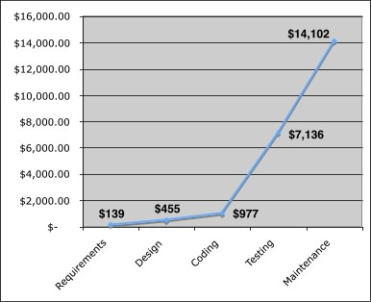
Cost
The relative costs to find and repair an error or defect increase dramatically as we go from prevention to detection to internal failure to external failure costs.

Slide 16
Quality and Risk
“People bet their jobs, their comforts, their safety, their entertainment, their decisions, and their very lives on computer software. It better be right.” SEPA, Chapter 1
Example:
  Throughout the month of November, 2000 at a hospital in Panama, 28 patients received massive overdoses of gamma rays during treatment for a variety of cancers. In the months that followed, five of these patients died from radiation poisoning and 15 others developed serious complications. What caused this tragedy? A software package, developed by a U.S. company, was modified by hospital technicians to compute modified doses of radiation for each patient.

Slide 17
Negligence and Liability
The story is all too common. A governmental or corporate entity hires a major software developer or consulting company to analyze requirements and then design and construct a software-based “system” to support some major activity.
  The system might support a major corporate function (e.g., pension management) or some governmental function (e.g., healthcare administration or homeland security).
Work begins with the best of intentions on both sides, but by the time the system is delivered, things have gone bad.
The system is late, fails to deliver desired features and functions, is error-prone, and does not meet with customer approval.
Litigation ensues.

Slide 18
Quality and Security
Gary McGraw comments [Wil05]:
“Software security relates entirely and completely to quality. You must think about security, reliability, availability, dependability—at the beginning, in the design, architecture, test, and coding phases, all through the software life cycle [process]. Even people aware of the software security problem have focused on late life-cycle stuff. The earlier you find the software problem, the better. And there are two kinds of software problems. One is bugs, which are implementation problems. The other is software flaws—architectural problems in the design. People pay too much attention to bugs and not enough on flaws.”

Slide 19
Achieving Software Quality
Critical success factors:
  Software Engineering Methods
  Project Management Techniques
  Quality Control
  Quality Assurance

Slide 20
Software Quality Assurance
Reference: Chapter 16, Software Engineering: A Practitioner’s Approach, Roger S. Pressman, 7th Edition

Slide 21
Elements of SQA
Standards
Reviews and Audits
Testing
Error/defect collection and analysis
Change management
Education
Vendor management
Security management
Safety
Risk management

Slide 22
Role of the SQA Group-I
Prepares an SQA plan for a project.
  The plan identifies
    evaluations to be performed
    audits and reviews to be performed
    standards that are applicable to the project
    procedures for error reporting and tracking
    documents to be produced by the SQA group
    amount of feedback provided to the software project team
Participates in the development of the project’s software process description.
  The SQA group reviews the process description for compliance with organizational policy, internal software standards, externally imposed standards (e.g., ISO-9001), and other parts of the software project plan.

Slide 23
Role of the SQA Group-II
Reviews software engineering activities to verify compliance with the defined software process.
  identifies, documents, and tracks deviations from the process and verifies that corrections have been made.
Audits designated software work products to verify compliance with those defined as part of the software process.
  reviews selected work products; identifies, documents, and tracks deviations; verifies that corrections have been made
  periodically reports the results of its work to the project manager.
Ensures that deviations in software work and work products are documented and handled according to a documented procedure.
Records any noncompliance and reports to senior management.
  Noncompliance items are tracked until they are resolved.

Slide 24
SQA Goals
Requirements quality. The correctness, completeness, and consistency of the requirements model will have a strong influence on the quality of all work products that follow.
Design quality. Every element of the design model should be assessed by the software team to ensure that it exhibits high quality and that the design itself conforms to requirements.
Code quality. Source code and related work products (e.g., other descriptive information) must conform to local coding standards and exhibit characteristics that will facilitate maintainability.
Quality control effectiveness. A software team should apply limited resources in a way that has the highest likelihood of achieving a high quality result.

Slide 25
Statistical SQA
Information about software errors and defects is collected and categorized.
An attempt is made to trace each error and defect to its underlying cause (e.g., non-conformance to specifications, design error, violation of standards, poor communication with the customer).
Using the Pareto principle (80 percent of the defects can be traced to 20 percent of all possible causes), isolate the 20 percent (the vital few).
Once the vital few causes have been identified, move to correct the problems that have caused the errors and defects.

Slide 26
Six-Sigma for Software Engineering
The term “six sigma” is derived from six standard deviations—3.4 instances (defects) per million occurrences—implying an extremely high quality standard.
The Six Sigma methodology defines three core steps:
  Define customer requirements and deliverables and project goals via well-defined methods of customer communication
  Measure the existing process and its output to determine current quality performance (collect defect metrics)
  Analyze defect metrics and determine the vital few causes.
  Improve the process by eliminating the root causes of defects.
  Control the process to ensure that future work does not reintroduce the causes of defects.

Slide 27
Software Reliability
A simple measure of reliability is mean-time-between-failure (MTBF), where
MTBF = MTTF + MTTR
The acronyms MTTF and MTTR are mean-time-to-failure and mean-time-to-repair, respectively.
Software availability is the probability that a program is operating according to requirements at a given point in time and is defined as
Availability = [MTTF/(MTTF + MTTR)] x 100%

Slide 28
Software Safety
Software safety is a software quality assurance activity that focuses on the identification and assessment of potential hazards that may affect software negatively and cause an entire system to fail.
If hazards can be identified early in the software process, software design features can be specified that will either eliminate or control potential hazards.

Slide 29
ISO 9001:2000 Standard
ISO 9001:2000 is the quality assurance standard that applies to software engineering.
The standard contains 20 requirements that must be present for an effective quality assurance system.
The requirements delineated by ISO 9001:2000 address topics such as
  management responsibility, quality system, contract review, design control, document and data control, product identification and traceability, process control, inspection and testing, corrective and preventive action, control of quality records, internal quality audits, training, servicing, and statistical techniques.

Slide 30
Review Techniques
Reference: Chapter 15, Software Engineering: A Practitioner’s Approach, Roger S. Pressman, 7th Edition

Slide 31
What Are Reviews?
a meeting conducted by technical people for technical people
a technical assessment of a work product created during the software engineering process
a software quality assurance mechanism
a training ground

Slide 32
What Reviews Are Not
A project summary or progress assessment
A meeting intended solely to impart information
A mechanism for political or personal reprisal!

Slide 33
What Do We Look For?
Errors and defects
  Error—a quality problem found before the software is released to end users
  Defect—a quality problem found only after the software has been released to end-users
We make this distinction because errors and defects have very different economic, business, psychological, and human impact
However, the temporal distinction made between errors and defects in this book is not mainstream thinking

Slide 34
Defect Amplification
A defect amplification model [IBM81] can be used to illustrate the generation and detection of errors during the design and code generation actions of a software process.
Defects
Detection
Errors from
Previous step
Errors passed through
Percent
Efficiency
Errors passed
To next step
Amplified errors 1:x
Newly generated errors
Development step

Slide 35
Defect Amplification
In the example provided in SEPA, Section 15.2,
  a software process that does NOT include reviews,
    yields 94 errors at the beginning of testing and
    Releases 12 latent defects to the field
  a software process that does include reviews,
    yields 24 errors at the beginning of testing and
    releases 3 latent defects to the field
  A cost analysis indicates that the process with NO reviews costs approximately 3 times more than the process with reviews, taking the cost of correcting the latent defects into account

Slide 36
Metrics
The total review effort and the total number of errors discovered are defined as:
    E_{review} = E_{p} + E_{a} + E_{r}
    Err_{tot} = Err_{minor} + Err_{major}
Defect density represents the errors found per unit of work product reviewed.
    Defect density = Err_{tot} / WPS
where …

Slide 37
Metrics
Preparation effort, E_{p}—the effort (in person-hours) required to review a work product prior to the actual review meeting
Assessment effort, E_{a}— the effort (in person-hours) that is expending during the actual review
Rework effort, E_{r}— the effort (in person-hours) that is dedicated to the correction of those errors uncovered during the review
Work product size, WPS—a measure of the size of the work product that has been reviewed (e.g., the number of UML models, or the number of document pages, or the number of lines of code)
Minor errors found, Err_{minor}—the number of errors found that can be categorized as minor (requiring less than some pre-specified effort to correct)
Major errors found, Err_{major}— the number of errors found that can be categorized as major (requiring more than some pre-specified effort to correct)

Slide 38
An Example—I
If past history indicates that
  the average defect density for a requirements model is 0.6 errors per page, and a new requirement model is 32 pages long,
  a rough estimate suggests that your software team will find about 19 or 20 errors during the review of the document.
  If you find only 6 errors, you’ve done an extremely good job in developing the requirements model or your review approach was not thorough enough.

Slide 39
An Example—II
The effort required to correct a minor model error (immediately after the review) was found to require 4 person-hours.
The effort required for a major requirement error was found to be 18 person-hours.
Examining the review data collected, you find that minor errors occur about 6 times more frequently than major errors. Therefore, you can estimate that the average effort to find and correct a requirements error during review is about 6 person-hours.
Requirements related errors uncovered during testing require an average of 45 person-hours to find and correct. Using the averages noted, we get:
Effort saved per error = E_{testing} – E_{reviews}
45 – 6 = 30 person-hours/error
Since 22 errors were found during the review of the requirements model, a saving of about 660 person-hours of testing effort would be achieved. And that’s just for requirements-related errors.

Slide 40
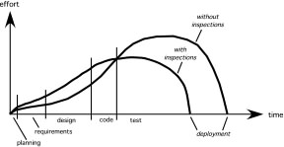
Overall
Effort expended with and without reviews
with reviews

Slide 41
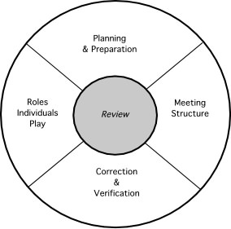
Reference Model

Slide 42
Informal Reviews
Informal reviews include:
  a simple desk check of a software engineering work product with a colleague
  a casual meeting (involving more than 2 people) for the purpose of reviewing a work product, or
  the review-oriented aspects of pair programming
pair programming encourages continuous review as a work product (design or code) is created.
  The benefit is immediate discovery of errors and better work product quality as a consequence.

Slide 43
Formal Technical Reviews
The objectives of an FTR are:
  to uncover errors in function, logic, or implementation for any representation of the software
  to verify that the software under review meets its requirements
  to ensure that the software has been represented according to predefined standards
  to achieve software that is developed in a uniform manner
  to make projects more manageable
The FTR is actually a class of reviews that includes walkthroughs and inspections.

Slide 44
The Review Meeting
Between three and five people (typically) should be involved in the review.
Advance preparation should occur but should require no more than two hours of work for each person.
The duration of the review meeting should be less than two hours.
Focus is on a work product (e.g., a portion of a requirements model, a detailed component design, source code for a component)

Slide 45
The Players
review
leader
standards bearer (SQA)
producer
maintenance
oracle
recorder
reviewer
user rep

Slide 46
The Players
Producer—the individual who has developed the work product
  informs the project leader that the work product is complete and that a review is required
Review leader—evaluates the product for readiness, generates copies of product materials, and distributes them to two or three reviewers for advance preparation.
Reviewer(s)—expected to spend between one and two hours reviewing the product, making notes, and otherwise becoming familiar with the work.
Recorder—reviewer who records (in writing) all important issues raised during the review.

Slide 47
Conducting the Review
Review the product, not the producer.
Set an agenda and maintain it.
Limit debate and rebuttal.
Enunciate problem areas, but don't attempt to solve every problem noted.
Take written notes.
Limit the number of participants and insist upon advance preparation.
Develop a checklist for each product that is likely to be reviewed.
Allocate resources and schedule time for FTRs.
Conduct meaningful training for all reviewers.
Review your early reviews.

Slide 48
Review Options Matrix
*
IPR
WT
IN
RRR
trained leader
agenda established
reviewers prepare in advance
producer presents product
“reader” presents product
recorder takes notes
checklists used to find errors
errors categorized as found
issues list created
team must sign-off on result
IPR—informal peer review WT—Walkthrough
IN—Inspection RRR—round robin review
no
maybe
maybe
maybe
no
maybe
no
no
no
no
yes
yes
yes
yes
no
yes
no
no
yes
yes
yes
yes
yes
no
yes
yes
yes
yes
yes
yes
yes
yes
yes
no
no
yes
no
no
yes
maybe
*

Slide 49
Sample-Driven Reviews (SDRs)
SDRs attempt to quantify those work products that are primary targets for full FTRs.
To accomplish this …
Inspect a fraction a_{i} of each software work product, i. Record the number of faults, f_{i} found within a_{i}.
Develop a gross estimate of the number of faults within work product i by multiplying f_{i} by 1/a_{i}.
Sort the work products in descending order according to the gross estimate of the number of faults in each.
Focus available review resources on those work products that have the highest estimated number of faults.

Slide 50
Metrics Derived from Reviews
inspection time per page of documentation
inspection time per KLOC or FP
inspection effort per KLOC or FP
errors uncovered per reviewer hour
errors uncovered per preparation hour
errors uncovered per SE task (e.g., design)
number of minor errors (e.g., typos)
number of major errors (e.g., nonconformance to req.)
number of errors found during preparation

Slide 51
Software Configuration Management
Reference: Chapter 22, Software Engineering: A Practitioner’s Approach, Roger S. Pressman, 7th Edition

Slide 52
The “First Law”
No matter where you are in the system life cycle, the system will change, and the desire to change it will persist throughout the life cycle.
Bersoff, et al, 1980

Slide 53
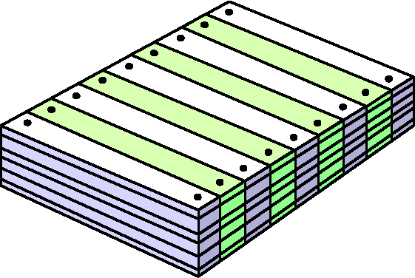
What Are These Changes?
changes in
business requirements
changes in
technical requirements
changes in
user requirements
other
documents
software models
Project
Plan
data
Test
code

Slide 54
The Software Configuration
programs
documents
The pieces
data

Slide 55
Baselines
The IEEE (IEEE Std. No. 610.12-1990) defines a baseline as:
    A specification or product that has been formally reviewed and agreed upon, that thereafter serves as the basis for further development, and that can be changed only through formal change control procedures.
a baseline is a milestone in the development of software that is marked by the delivery of one or more software configuration items and the approval of these SCIs that is obtained through a formal technical review

Slide 56
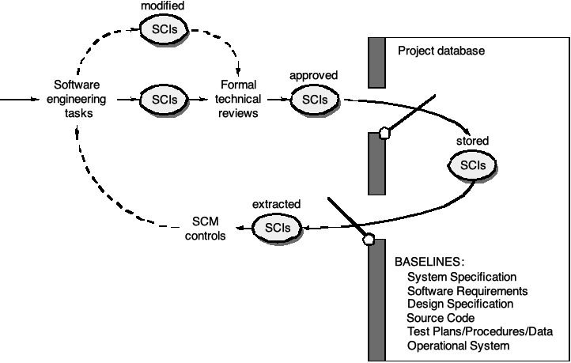
Baselines

Slide 57
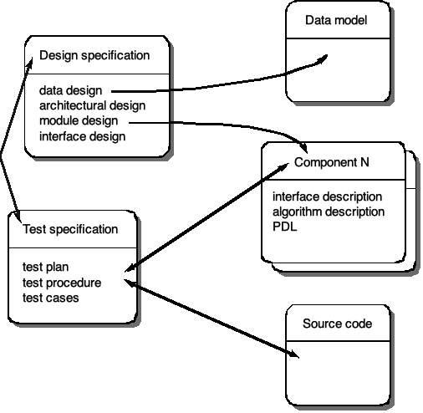
Software Configuration Objects

Slide 58
SCM Repository
The SCM repository is the set of mechanisms and data structures that allow a software team to manage change in an effective manner
The repository performs or precipitates the following functions:
  Data integrity
  Information sharing
  Tool integration
  Data integration
  Methodology enforcement
  Document standardization

Slide 59
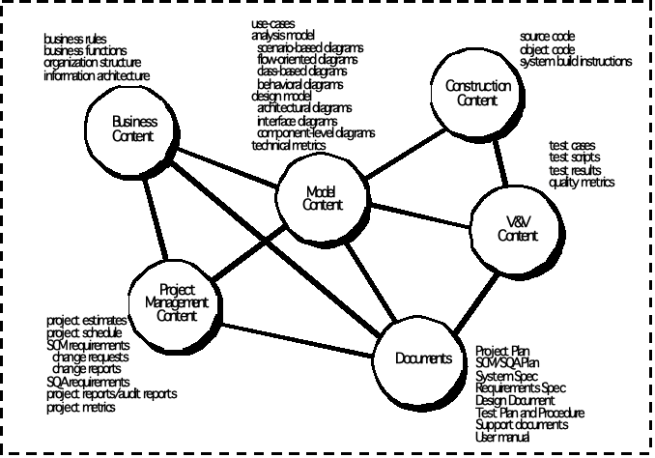
Repository Content

Slide 60
Repository Features
Versioning.
  saves all of these versions to enable effective management of product releases and to permit developers to go back to previous versions
Dependency tracking and change management.
  The repository manages a wide variety of relationships among the data elements stored in it.
Requirements tracing.
  Provides the ability to track all the design and construction components and deliverables that result from a specific requirement specification
Configuration management.
  Keeps track of a series of configurations representing specific project milestones or production releases. Version management provides the needed versions, and link management keeps track of interdependencies.
Audit trails.
  establishes additional information about when, why, and by whom changes are made.

Slide 61
SCM Elements
Component elements—a set of tools coupled within a file management system (e.g., a database) that enables access to and management of each software configuration item.
Process elements—a collection of procedures and tasks that define an effective approach to change management (and related activities) for all constituencies involved in the management, engineering and use of computer software.
Construction elements—a set of tools that automate the construction of software by ensuring that the proper set of validated components (i.e., the correct version) have been assembled.
Human elements—to implement effective SCM, the software team uses a set of tools and process features (encompassing other CM elements)

Slide 62
The SCM Process
Addresses the following questions …
How does a software team identify the discrete elements of a software configuration?
How does an organization manage the many existing versions of a program (and its documentation) in a manner that will enable change to be accommodated efficiently?
How does an organization control changes before and after software is released to a customer?
Who has responsibility for approving and ranking changes?
How can we ensure that changes have been made properly?
What mechanism is used to appraise others of changes that are made?

Slide 63
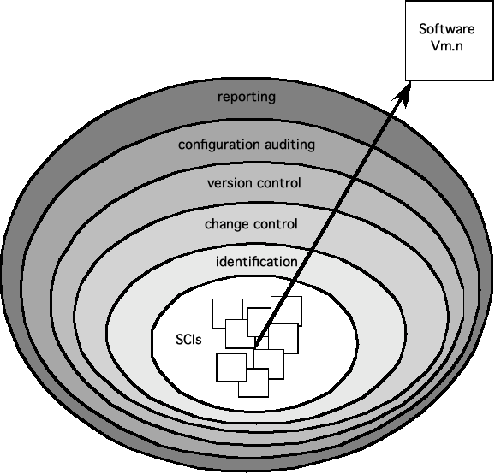
The SCM Process

Slide 64
Version Control
Version control combines procedures and tools to manage different versions of configuration objects that are created during the software process
A version control system implements or is directly integrated with four major capabilities:
  a project database (repository) that stores all relevant configuration objects
  a version management capability that stores all versions of a configuration object (or enables any version to be constructed using differences from past versions);
  a make facility that enables the software engineer to collect all relevant configuration objects and construct a specific version of the software.
  an issues tracking (also called bug tracking) capability that enables the team to record and track the status of all outstanding issues associated with each configuration object.

Slide 65
Change Control
STOP

Slide 66
Change Control Process—I
need for change is recognized
change request from user
developer evaluates
change report is generated
change control authority decides
request is queued for action
change request is denied
user is informed
change control process—II

Slide 67
Change Control Process-II
assign people to SCIs
check-out SCIs
make the change
review/audit the change
establish a “baseline” for testing
change control process—III

Slide 68
Change Control Process-III
perform SQA and testing activities
check-in the changed SCIs
promote SCI for inclusion in next release
rebuild appropriate version
review/audit the change
include all changes in release

Slide 69
Auditing
Change
Requests
SQA
Plan
SCIs
SCM Audit

Slide 70
Status Accounting
Change
Reports
Change
Requests
ECOs
SCIs
Status Accounting
Reporting

Slide 71
SCM for Web Engineering-I
Content.
  A typical WebApp contains a vast array of content—text, graphics, applets, scripts, audio/video files, forms, active page elements, tables, streaming data, and many others.
  The challenge is to organize this sea of content into a rational set of configuration objects (Section 27.1.4) and then establish appropriate configuration control mechanisms for these objects.
People.
  Because a significant percentage of WebApp development continues to be conducted in an ad hoc manner, any person involved in the WebApp can (and often does) create content.

Slide 72
SCM for Web Engineering-II
Scalability.
  As size and complexity grow, small changes can have far-reaching and unintended affects that can be problematic. Therefore, the rigor of configuration control mechanisms should be directly proportional to application scale.
Politics.
  Who ‘owns’ a WebApp?
  Who assumes responsibility for the accuracy of the information on the Web site?
  Who assures that quality control processes have been followed before information is published to the site?
  Who is responsible for making changes?
  Who assumes the cost of change?

Slide 73
Content Management-I
The collection subsystem encompasses all actions required to create and/or acquire content, and the technical functions that are necessary to
  convert content into a form that can be represented by a mark-up language (e.g., HTML, XML
  organize content into packets that can be displayed effectively on the client-side.
The management subsystem implements a repository that encompasses the following elements:
  Content database—the information structure that has been established to store all content objects
  Database capabilities—functions that enable the CMS to search for specific content objects (or categories of objects), store and retrieve objects, and manage the file structure that has been established for the content
  Configuration management functions—the functional elements and associated workflow that support content object identification, version control, change management, change auditing, and reporting.

Slide 74
Content Management-II
The publishing subsystem extracts from the repository, converts it to a form that is amenable to publication, and formats it so that it can be transmitted to client-side browsers. The publishing subsystem accomplishes these tasks using a series of templates.
Each template is a function that builds a publication using one of three different components [BOI02]:
  Static elements—text, graphics, media, and scripts that require no further processing are transmitted directly to the client-side
  Publication services—function calls to specific retrieval and formatting services that personalize content (using predefined rules), perform data conversion, and build appropriate navigation links.
  External services—provide access to external corporate information infrastructure such as enterprise data or “back-room” applications.

Slide 75
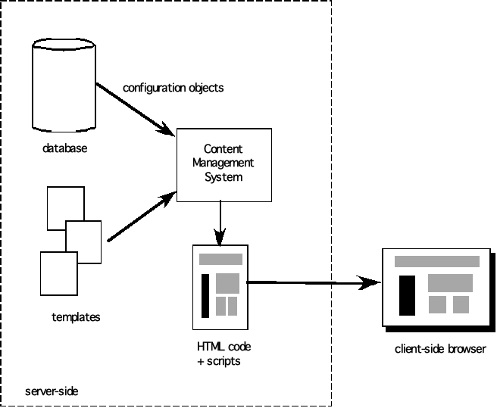
Content Management

Slide 76
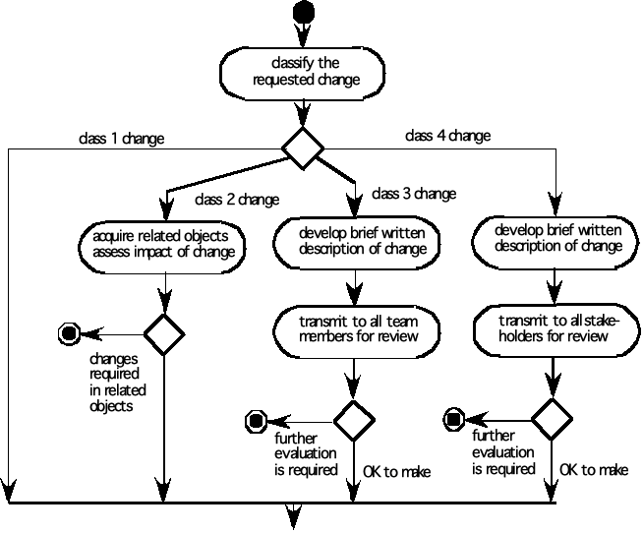
Change Management for WebApps-I

Slide 77
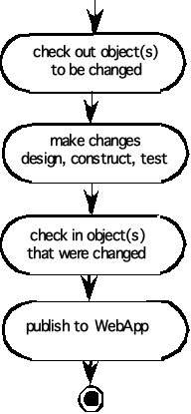
Change Management for WebApps-II

Slide 78
End of Unit 08 : Software Quality Assurance

