Slide 1
Capstone Project
Group members:
Pramod S
Soham Desai

Slide 2
Business Understanding
OBJECTIVE
A leading credit card provider is facing in increase credit loss
The objective is to mitigate credit risk by ‘acquiring the right customers’
STRATEGY
Identify customers that present a credit risk using demographic and credit bureau data
Offer credit cards to only those customers that are deemed as less risky

Slide 3
Problem Solving Methodology
Problem Understanding and Analysis
EDA
Model Selection
Results are satisfactory?
Model Evaluation and Tuning
Implement
Yes
Modify/Change the model
No

Slide 4
Data Understanding
UNDERSTANDING DATA
2 datasets are available – Customer Demographic Data and Credit Bureau Data
71295 customer data is present
The dependent variable is Performance Tag
The common variable of both data set on which it will be merged is Application ID
DATA QUALITY
Duplicate Application ID needs to be removed
Entries that have already been identified as defaulters or don’t have any credit bureau data are also needs to be removed
Post that only unique customer data to be taken for analysis
Outliers has to be addressed
We will calculate IV(Information Value) to find the important variables ,we will reject the variable which has IV less than 0.01.

Slide 5
Exploratory Data Analysis
Univariate Analysis
Median income is 27.19 and median age is 45 years
23.16% of the customers are female
85% of the customers are married
75% are living in rented residence
77% customers never defaulted 90 DPD or worse in last 6 months, 73% customers never defaulted 60 DPD or worse in last 6 months, 70% customers never defaulted 30 DPD or worse in last 6 months
Bivariate Analysis
Demographic data was not able to give very clear inferences as the number of defaulters were higher in large populations such as male customers, married customers, salaried customers etc.
Bureau dataset variables such as DPD data and trades data are better at predicting default behavior

Slide 6
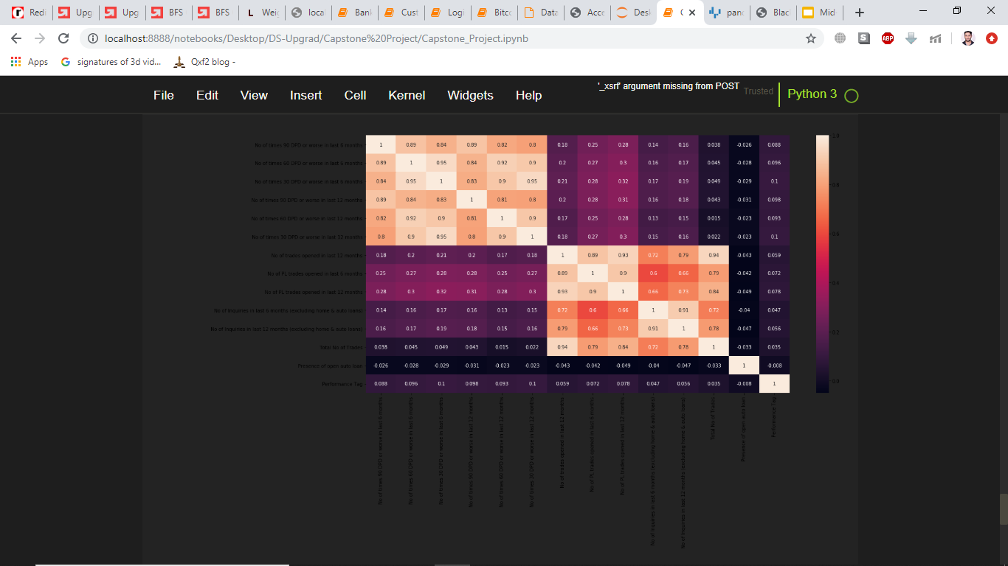
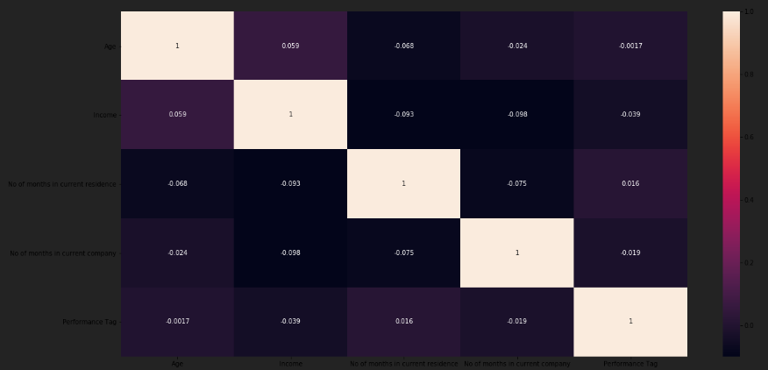
Exploratory Data Analysis
As we can see there is some significant correlation in credit bureau data ,but no correlation in demographic data we will treat these correlated variables while building model.
Correlation matrix for credit bureau data.
Correlation matrix for demographic data.

Slide 7
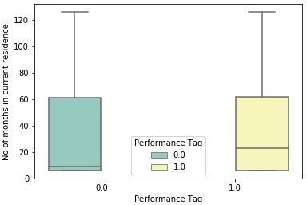
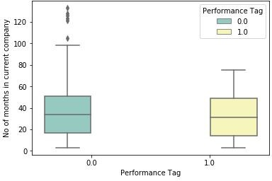
Exploratory Data Analysis
No of months in current residence of non-defaulters are lower than that of defaulters.
The median No of months in current Company of non defaulters is slightly lower than that of defaulters.

Slide 8
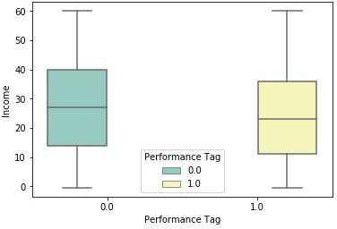
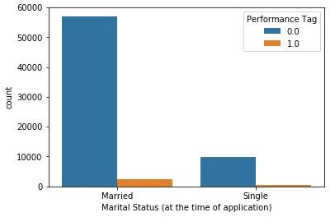
Exploratory Data Analysis
The median values for income of defaulters are lower than that of non-defaulters
There are more married Applicant than single, hence default no of married is also higher

Slide 9
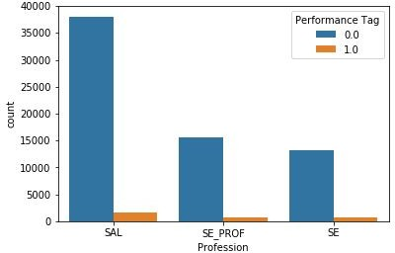
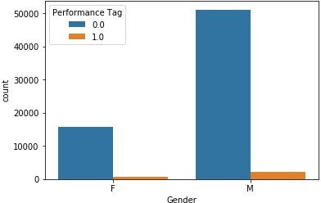
Exploratory Data Analysis
There are more salaried applicants than other professional
There are more Male Applicant than Female, hence default no of married is also higher

Slide 10
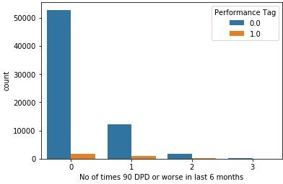
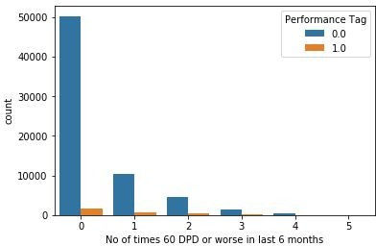
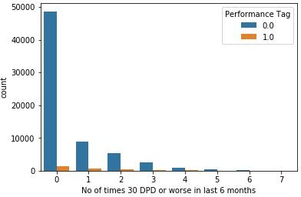
Exploratory Data Analysis
Defaulter increased in number with the 30/60/90 DPD or worse in last 6 months value, hence this is one of the important predictor

Slide 11
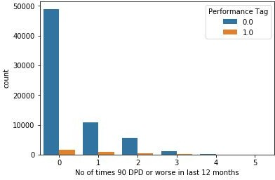
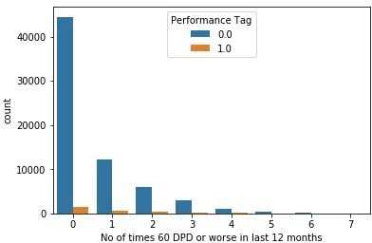
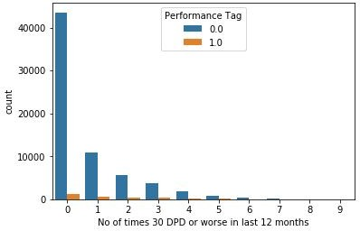
Exploratory Data Analysis
Defaulter increased in number with the 30/60/90 DPD or worse in last 12 months value, hence this is one of the important predictor

Slide 12
Conclusion :EDA
Below 3 demographic predicator seems to be significant
Income
No of month in current residence
No of month in current company
Credit bureau data has many predictor which seems to be significant
No of times 90 DPD or worse in last 6 months
No of times 60 DPD or worse in last 6 months
No of times 30 DPD or worse in last 6 months
No of times 90 DPD or worse in last 12 months
No of times 60 DPD or worse in last 12 months
No of times 30 DPD or worse in last 12 months
There is some significant correlation in credit bureau data ,but no correlation in demographic data

Slide 13
WOE & IV Analysis
WOE and IV values are calculated for each of the attributes using information and python functions
Attributes for which WOE values that were made by default using the python functions and were not monotonically changing across bins, coarser bins were made by decreasing the number of bins until monotonic behavior is observed across bins
For 9 variables with Missing values, the variable values were replaced by their corresponding WOE values
Information Value helps in reducing Dimension
Weight of Evidence shows the effect of each independent variable on the dependent variable
Data Balancing is carried out using SMOTE

Slide 14
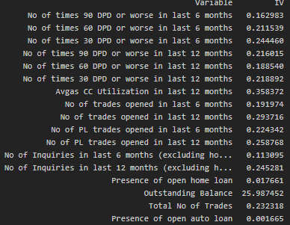
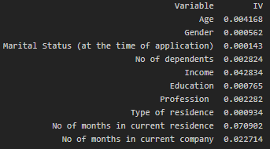
WOE & IV Analysis
From our IV analysis we can see that there are many not so useful predictors in the demographic data set like age, gender , profession , type of residence ,education ,no. of dependents and marital status.
In Credit bureau data we can see that almost all the predictors are strong predictor except or one which is outstanding balance ,which is suspiciously strong predictor.
Information Value or Demographic data
Information Values for Credit Bureau Data

Slide 15
Model Building Approach
OUTLIER TREATMENT
Need to perform the outlier treatment on the dataset before building model
DATA SCALING
Need to scale the all variables except performance tag and app id using either min nax or using standard scalar
DATA SPLIT
1. Data needs to be split in Train and Test in 70 : 30 ratio
2. All models are trained on training datasets and regularization was done by tuning of hyper parameters with cross validation on validation datasets.
3. All the models are tested on test datasets that were kept separate from training and validation datasets.
DATA SAMPLING
The given data is highly imbalanced. We have to sampled data using any available package for balancing the training data sets
MODEL EVALUTION
We will perform Logistic regression with RFE ,Logistic regression with regularization, Decision tree & Random forest to evaluate and finalize the best fitted model based on the confusion matrix parameter

Slide 16
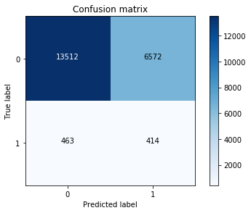
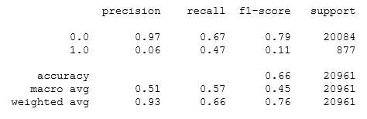
Logistic Regression (Demographic)
Since alone Demographic Dataset is not very much helpful in Predictions, we will build model on combined dataset of Demographic and Creditbureu

Slide 17
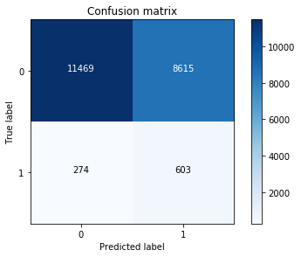
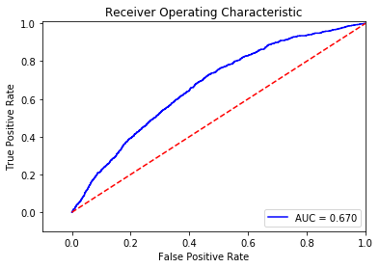
Logistic Regression
precision recall f1-score support
0.0 0.98 0.57 0.72 20084
1.0 0.07 0.69 0.12 877
accuracy 0.58 20961
macro avg 0.52 0.63 0.42 20961
weighted avg 0.94 0.58 0.70 20961
Total Accuracy: 0.5759
Recall metric in the testing dataset: 68%
Precision metric in testing dataset: 97%

Slide 18
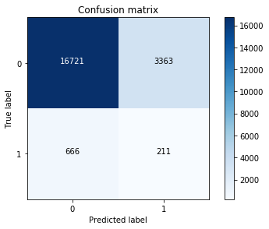
Decision Tree
precision recall f1-score support
0.0 0.96 0.83 0.89 20084
1.0 0.06 0.24 0.09 877
accuracy 0.81 20961
macro avg 0.51 0.54 0.49 20961
weighted avg 0.92 0.81 0.86 20961
Total Accuracy: 0.8077858880778589
Recall metric in the testing dataset: 24.059293044469783%
Precision metric in the testing dataset: 96.16955196411112%

Slide 19
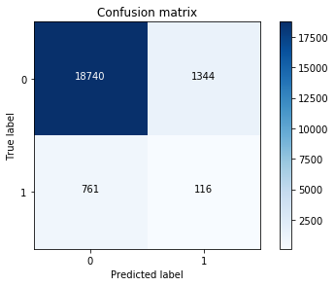
Random Forrest
precision recall f1-score support
0.0 0.96 0.91 0.95 20084
1.0 0.07 0.14 0.10 877
accuracy 0.88 20961
macro avg 0.51 0.53 0.51 20961
weighted avg 0.92 0.88 0.90 20961
Total Accuracy: 0.8995754019369305
Recall metric in the testing dataset: 13.22690992018244%
Precision metric in the testing dataset: 96.09763601866571%

Slide 20
Application Scorecard Approach
The scorecard will be made using the following steps:
Application score card will be made with odds of 10 to 1 being a score of 400. Score increases by 20 points for doubling odds.
Probability of default for all applicants will be calculated
Odds for good will be calculated. Since the probability computed is for rejection (bad customers), Odd(good) = (1-P(bad))/P(bad)
ln(odd(good)) will be calculated
By using the following formula for computing application score card:
400 + slope * (ln(odd(good)) - ln(10)) where slope is 20/(ln(20)-ln(10))
Where, slope=20/(log(20)-log(10))

Slide 21
Application Scorecard Approach
Maximum Credit Score : 388
Optimal Cut -off Credit Score : 330
Minimum Rejected Score : 208
Maximum Rejected Score : 330

Slide 22
Financial Benefit of the Model
Profit Calculation
Average profit of 500 Inr by non – defaulter and Average loss of 10,000 Inr by every defaulter
So Net Profit Without model = 39.71 Lakh
Profit Using our Model = [(TP * profit value)+(TN*Loss Value)]- [(FP * profit value)+(FN*Loss Value)] =164.07 Lakh
Net Financial Gain = 124.36 Lakh
% Financial Gain = 313%
Revenue Loss
No of candidate rejected by model which didn’t default = 28572
Total no of candidate who didn’t default = 66919
% Good Candidate rejected by our model = 42% (Loss of INR 1.42 Cr apx)
Credit Loss Saved
% of candidate approved and defaulted when model not used = 4.12
% of candidate approved and defaulted when model used = 1.28
Credit loss saved = 4.12-1.28 = 2.84 %
Total percentage of defaulter correctly identified = 70 % (Which Saves around INR 2.05 Cr)

Slide 23
Conclusion
Logistic Regression chosen as final Model as it seems to be balance among all we used in model
Accuracy of the Model is around 60 %
Optimal Cut-Off Score = 330
By using this model we can able reduce credit loss of 3 %
Net Financial Gain is 313 %
Assumption on which model is built:
Variables in a models should be stable.
Distribution of the population across various level of variables should remain relatively constant over time.
Percentage of population with high, low and medium score should remain constant if population is stable.

