Slide 1
Capstone Project
Group members:
Pramod S
Soham Desai

Slide 2
Problem solving methodology
Problem Understanding and Analysis
EDA
Model Selection
Results are satisfactory?
Model Evaluation and Tuning
Implement
Yes
Modify/Change the model
No

Slide 3
Problem Understanding
Task is to help CredX identify the right customers using predictive models. Using past data of the bank’s applicants, we need to determine the factors affecting credit risk, create strategies to mitigate the acquisition risk and assess the financial benefit of the project.
We have two types of data demographic and credit bureau, we have to consider both type of data to build model , and we have to build a model using only demographic data ,this is because there are times when credit bureau data will not be available.
Demographic data is obtained from the information provided by the applicants at the time of credit card application. It contains customer-level information on age, gender, income, marital status, etc.
This is taken from the credit bureau and contains variables such as 'number of times 30 DPD or worse in last 3/6/12 months', 'outstanding balance', 'number of trades', etc.

Slide 4
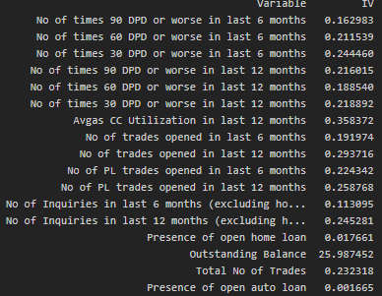
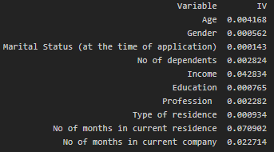
Exploratory Data Analysis:
There are missing values in the ‘performance tag’ which is our target variable ,from EDA we can see that these are the people who applied credit card for the first time and mostly have been rejected , hence we keep these rows separately for testing our model.
We saw that there are missing values in the dataset ,as we are going to calculate woe values we will keep this missing values as a separate category and replace actual values with woe values .
We will calculate IV(Information Value) to find the important variables ,we will reject the variable which has IV less than 0.01.
Information Value or Demographic data
Information Values for Credit Bureau Data

Slide 5
Exploratory Data Analysis
From our IV analysis we can see that there are many not so useful predictors in the demographic data set like age, gender , profession , type of residence ,education ,no. of dependents and marital status.
In Credit bureau data we can see that almost all the predictors are strong predictor except or one which is outstanding balance ,which is suspiciously strong predictor.

