Slide 1


Amazon
Review Analysis
Sonali Sri Yadav Tokala- U01984761
Shivani Kotturi - U01982782
Pramod kumar Reddy Parvath Reddy - U01999241
Raghava Thyagaraj - U01984899

Slide 2
Abstract
This project focuses on developing a machine learning model for entity-level sentiment analysis on Amazon reviews. Using advanced Natural Language Processing (NLP) techniques, the model classifies reviews into positive, negative, neutral, or irrelevant sentiments.
The goal is to gain insights into public opinion about Amazon Alexa products and enhance the accuracy of sentiment classification, even when reviews are informal or brief.
Notes:
Real-Time Feedback:
Twitter provides a real-time platform where users express opinions and reactions instantly.
Sentiment analysis on Twitter enables businesses to receive immediate feedback, allowing for agile decision-making and quick responses to emerging trends or issues.
Global Audience Insights:
Twitter has a diverse global user base, offering insights from various demographics, cultures, and regions.
Analyzing sentiments on Twitter provides a comprehensive understanding of how entities are perceived on a global scale, helping businesses tailor their strategies accordingly.
Brand Reputation Management:
Monitoring sentiments on Twitter is crucial for brand reputation management.
Businesses can proactively address negative sentiments, capitalize on positive feedback, and maintain a favorable online image, contributing to long-term brand success.
Politics: Monitoring public sentiment towards political figures, parties, and policies.

Slide 3

Introduction
Amazon product reviews are a crucial source of customer feedback. This project aims to explore sentiment trends, particularly for Amazon Alexa products.
Key objectives:
Build a high-accuracy sentiment classifier.
Address challenges like informal language, short text length, and mixed sentiments.
Extract insights that can guide business improvements and customer satisfaction.

Slide 4
Problem Statement
This project aims to develop a high-accuracy model for entity-level sentiment analysis on Amazon reviews. The goal is to categorize tweets into positive, negative, neutral, or irrelevant sentiments using advanced NLP techniques.
The challenge is to create a highly accurate model adept at handling the informal language and brevity found in Amazon reviews.
By understanding public sentiments on entities, the project seeks to gain valuable insights into Amazon reviews.
The focus is on developing a robust model capable of discerning whether tweets convey positive, negative, neutral, or irrelevant sentiments, we aim to gain insights into public opinion on various topics discussed on Amazon.
&
Notes:
Introduction to Sentiment Analysis:
Sentiment Analysis, also known as opinion mining, is a natural language processing (NLP) technique that involves determining the sentiment expressed in a piece of text—whether it's positive, negative, or neutral. This field has gained prominence due to the increasing volume of user-generated content on the internet, providing valuable insights into public opinion.
Twitter Sentiment Analysis Project Goal:
The goal of our Twitter Sentiment Analysis project is to leverage NLP techniques to analyze and categorize the sentiments expressed in tweets. By developing a model capable of discerning whether tweets convey positive, negative, neutral, or irrelevant sentiments, we aim to gain insights into public opinion on various topics discussed on Twitter. This project can have implications for brand management, social listening, and understanding the dynamics of online conversations.

Slide 5
Dataset
Content
Sentiment Classes
Diversity
The dataset comprises Amazon reviews, each centering around a distinct entity, such as a brand or topic.
This categorization helps us understand the overall sentiment expressed in the review about the mentioned entity.
The dataset captures a variety of opinions and expressions from Amazon users, providing a diverse set of sentiments that our model will learn to recognize.

Slide 6
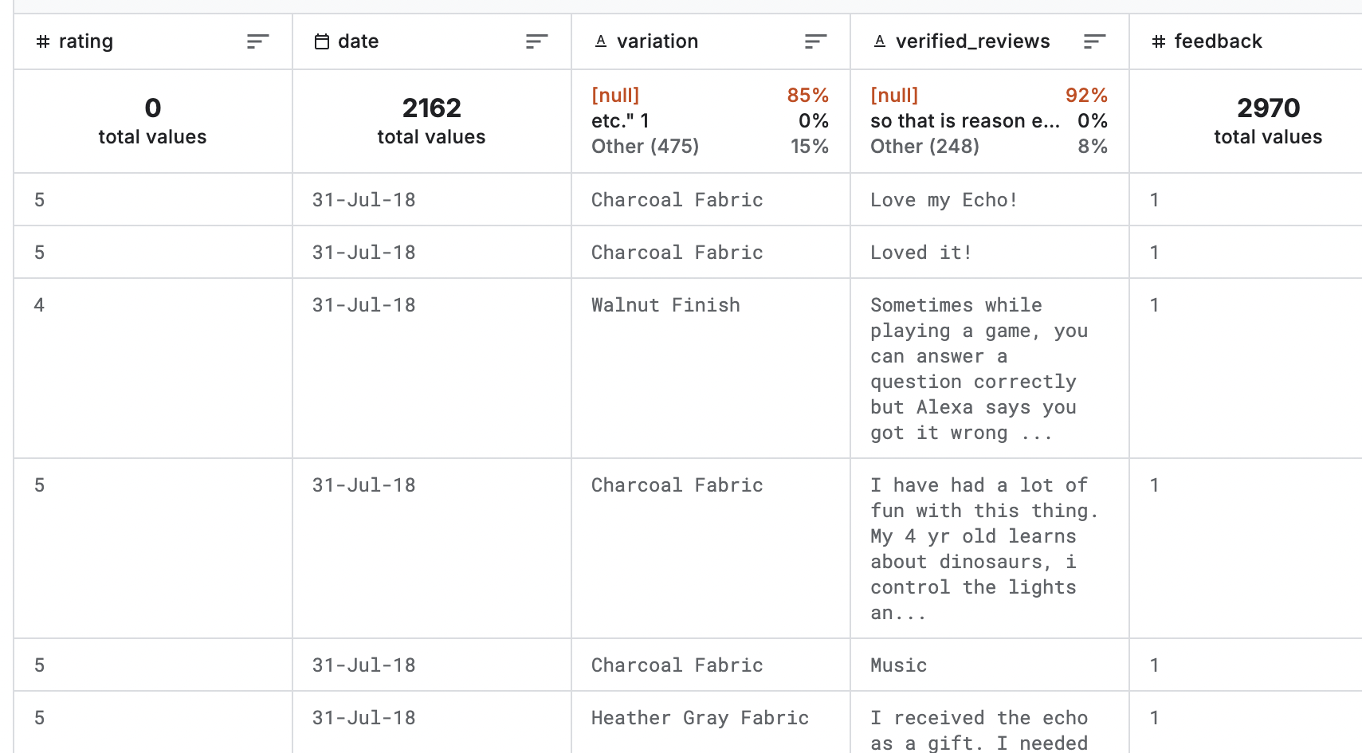
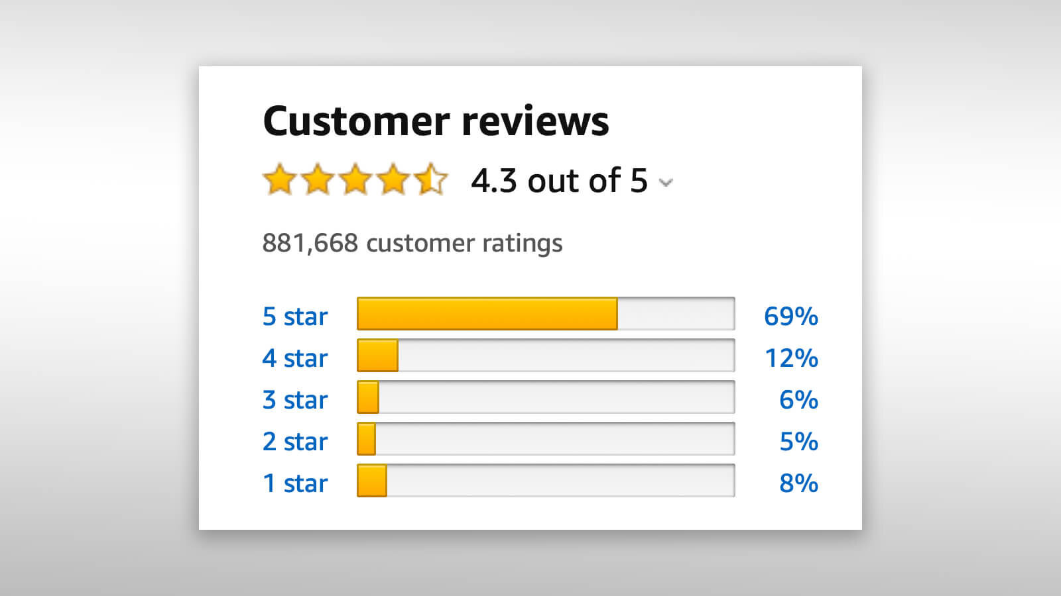
Information about Dataset
Source:Amazon alexa dataset
From Kaggle datasource
This dataset consists of a nearly 3000 Amazon customer reviews (input text), star ratings, date of review, variant and feedback of various amazon Alexa products like Alexa Echo, Echo dots, Alexa Firesticks etc. for learning how to train Machine for sentiment analysis

Slide 7
Why Exploratory Data Analysis ?
01
Understanding the label distribution
Insights into imbalances
02
The pie chart and count plot help you visually understand the distribution of sentiment labels
in your dataset
Analyzing the count of each sentiment label allows you to identify any imbalances in the dataset.
03
Data Quality Assessment
Communication of Results
04
The EDA code provides a quick overview of the quality of your sentiment labels.
Visualization is a powerful tool for communication. The pie chart and count plot make it easier.
05
Decision making for Preprocessing
Modeling Strategy
06
The insights gained from EDA can guide your decisions regarding data preprocessing.
The distribution of sentiment labels influences your modeling strategy
Notes:
Understanding Label Distribution:
The pie chart and count plot help you visually understand the distribution of sentiment labels in your dataset. This is crucial for knowing the prevalence of positive, negative, or neutral sentiments. It informs you about the balance of classes, which is important for building a robust sentiment analysis model.
Insights into Imbalances:
Analyzing the count of each sentiment label allows you to identify any imbalances in the dataset. Imbalanced datasets can pose challenges during model training, and understanding the distribution helps you decide on appropriate strategies for handling this issue.
Data Quality Assessment:
The EDA code provides a quick overview of the quality of your sentiment labels. You can assess whether your dataset is well-represented across different sentiment categories or if there are potential issues such as rare or missing labels.
Communication of Results:
Visualization is a powerful tool for communication. The pie chart and count plot make it easier to convey complex information about the dataset sentiment distribution to both technical and non-technical stakeholders.
Decision-Making for Preprocessing:
The insights gained from EDA can guide your decisions regarding data preprocessing. For example, if there is a significant class imbalance, you may consider techniques like oversampling, undersampling, or using weighted loss functions during model training.
Modeling Strategy:
The distribution of sentiment labels influences your modeling strategy. For instance, if certain sentiments are underrepresented, you might explore transfer learning, fine-tuning pre-trained models, or experimenting with different architectures like LSTM to capture nuanced sentiment patterns.
Initial Findings for Presentation:
The visualizations generated from EDA serve as an excellent starting point for your presentation, allowing you to share initial findings about the sentiment distribution in a clear and concise manner.

Slide 8
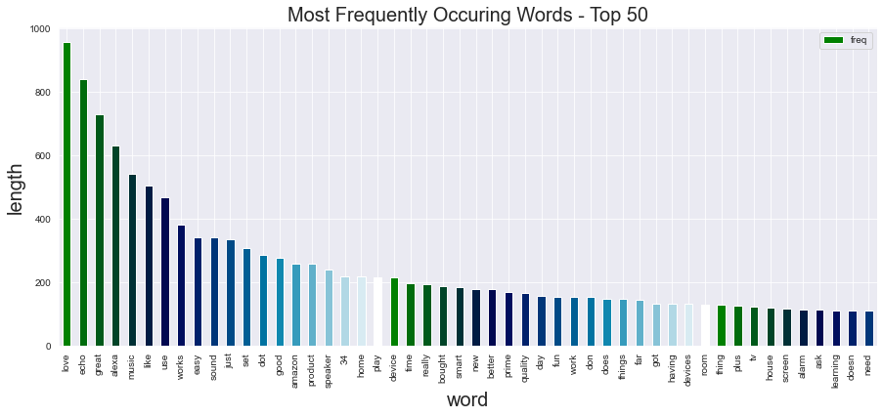

Slide 9
Data Preprocessing
01
02
Text cleaning
Tokenization & Punctuation Removal
The significance of cleaning text to reduce noise and ensure meaningful analysis
Tokenizing text into individual words.
Removing punctuation to further refine the text data
03
04
Stopword Removal
Data Preprocessing
Handling the duplicates
Eliminating common English stopwords to focus on meaningful words.
Identifying and removing duplicate tweets to maintain data integrity.
05
06
Outliers Removal
Review length analysis
Setting a threshold to remove tweets with extremely high word counts.
Creating a new column ('len') to store the word count for each cleaned tweet.
Notes:
Data Preprocessing Techniques:
1. Text Cleaning:
Use of regular expressions to remove HTML tags, numbers, special characters, URLs, mentions, and hashtags from the text data.
The significance of cleaning text to reduce noise and ensure meaningful analysis.
2. Tokenization and Punctuation Removal:
Tokenizing text into individual words.
Removing punctuation to further refine the text data.
3. Stopword Removal:
Eliminating common English stopwords to focus on meaningful words.
Explanation of the rationale behind removing stopwords to enhance the relevance of the text.
4. Lemmatization:
Applying lemmatization to reduce words to their base or root form.
Discussion on how lemmatization contributes to text normalization.
5. Handling Duplicates:
Identifying and removing duplicate tweets to maintain data integrity.
6. Tweet Length Analysis:
Creating a new column ('tweet_len') to store the word count for each cleaned tweet.
Visualizing the distribution of tweet lengths to identify outliers.
7. Outlier Removal:
Setting a threshold (quantile of 0.995) to remove tweets with extremely high word counts.
Displaying a count plot to visualize the distribution of tweet lengths after outlier removal.
8. Visualizing Tweet Labels:
Utilizing pie charts and count plots to visualize the distribution of sentiment labels (positive, negative, neutral, irrelevant).
Insights into the balance or imbalance of sentiment classes.
Key Takeaways:
A clean and well-preprocessed dataset is crucial for the success of sentiment analysis.
Cleaning and normalization steps contribute to meaningful analysis and model performance.
Understanding the distribution of sentiment labels helps in choosing appropriate evaluation metrics.
Visualizations aid in the exploration and understanding of the dataset.

Slide 10
Literature Review
Our work relates strongly to Purington et al. Amazon Echo review analysis. To explore how much they personiﬁed the device, what factors linked with personiﬁcation were, how sociable the interactions were, and how satisfaction was inﬂuenced, they reviewed 851 Amazon Echo reviews collected from Amazon.com during two weeks in December 2016. However, the performance for the casestudy is indeed limited. This is on account of the sample size being small when it is compared to the total number exceeding 60,000 of all the Echo reviews. Three main aspects differentiate our work from theirs: (1) Our sample covers from May 2015 to May 2017's 55,000-review range. (2) We did introduce feature mining [5] and also sentimental mining [6] techniques into the Amazon Echo review analysis. These techniques automate analysis across a large text dataset. (3) Exploring what special role Amazon Echo is playing in comparison with wireless speakers and customary electronic devices is the focus of our study. We also aim, with the integration of case study, featuremining, as well as sentimental mining, to ﬁnd out a more detailed personiﬁcation of the device rather than using name Alexa or personal pronouns so as to refer to the device, also analyze how the personiﬁcation correlates with the emotion expressions that exist in the reviews.

Slide 11
Methodology
01
02
03
04
Importing Libraries
Loading datasets
Exploratory data analysis
Data Preprocessing
Empower your project with the right tools
Fueling intelligence with data
Uncover the story within your data
Refine, reshape and ready your data
05
Split the Data
Strategically segmenting success
08
07
06
Compare between models
Testing the model
Model Training
Because not all models are created equal
Witness the power of predictive analytics
Where models learn the art of remembering

Slide 12
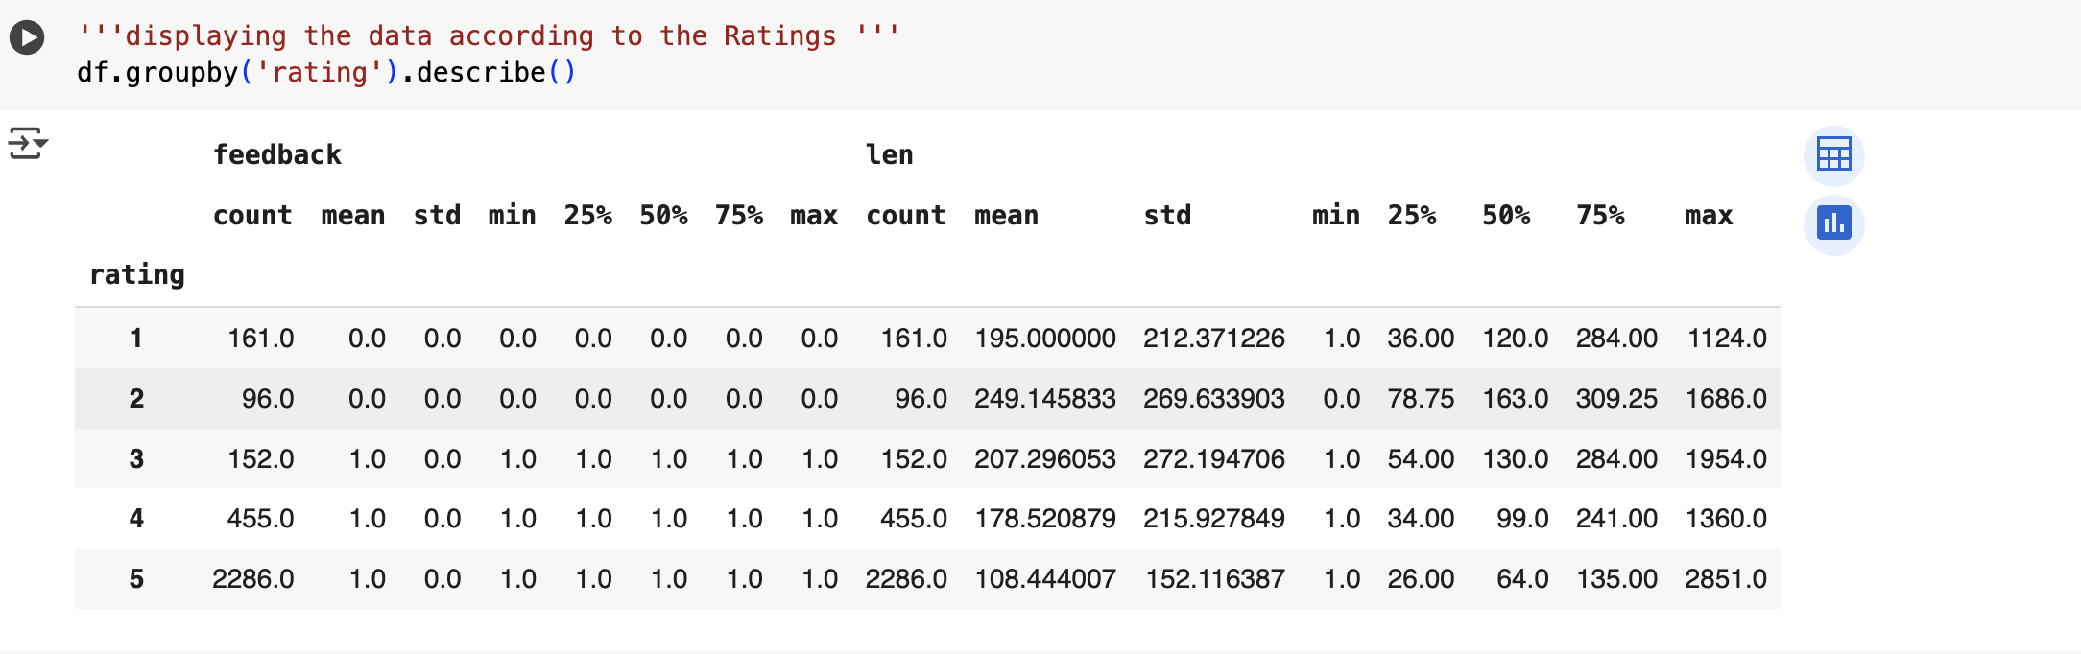
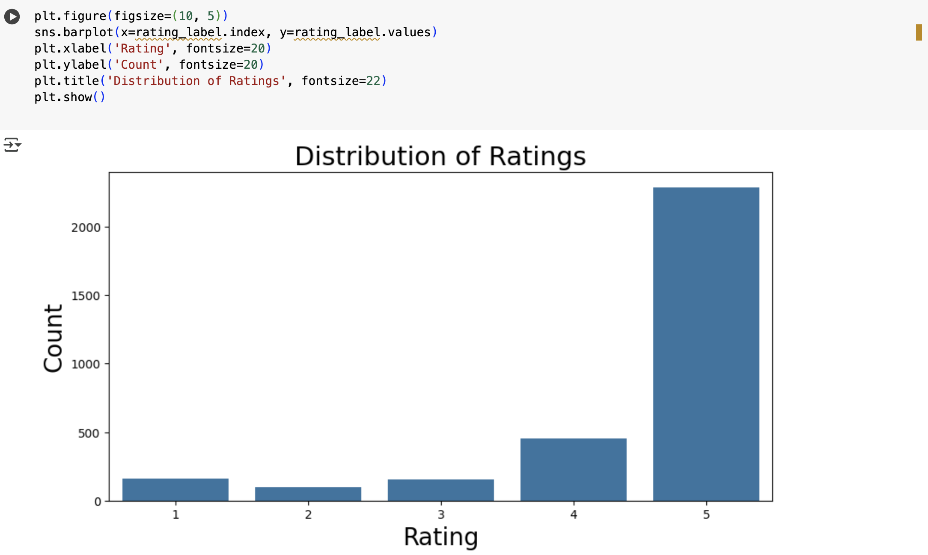
Distribution of Ratings

Slide 13
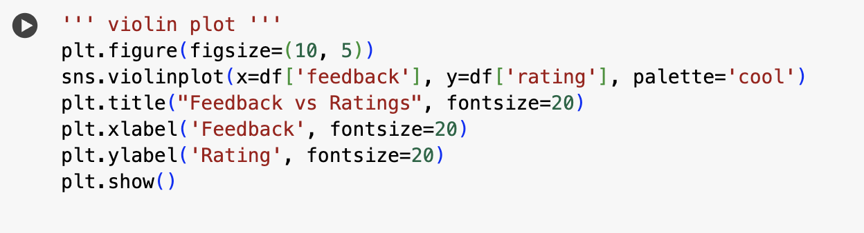
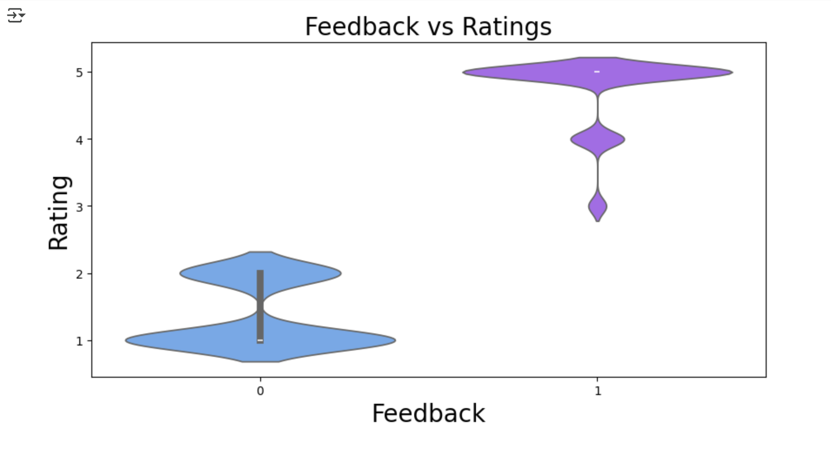
Feedback vs Ratings

Slide 14
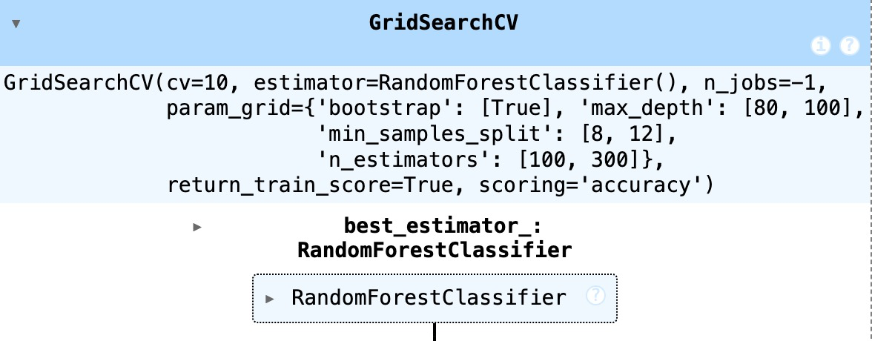
Random Forest Classifier
Random Forest Classifier is a popular machine learning algorithm that builds multiple decision trees and combines their predictions for accurate classification. It uses bagging to train trees on random data subsets and selects random features at each split, making it robust and less prone to overfitting. The code provided creates a Random Forest model, fits it to training data (`X_train`, `y_train`), predicts labels for test data (`X_test`), and visualizes performance with a confusion matrix. It also tunes hyperparameters like `max_depth`, `n_estimators`, and `min_samples_split` using `GridSearchCV` to find the best combination for accuracy. Random Forest shines in tasks like fraud detection or medical diagnosis due to its flexibility and ability to handle complex data. While it’s powerful and easy to use, it can be computationally intensive and less interpretable than single trees. Overall, it’s a reliable choice for many classification problems.

Slide 15
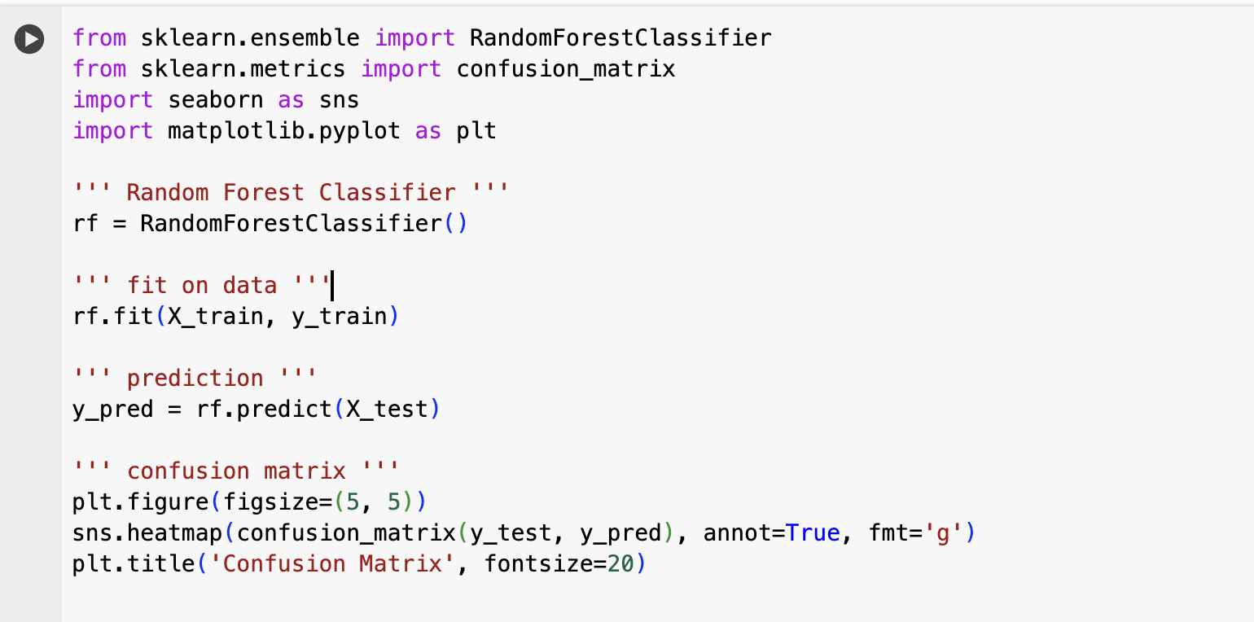
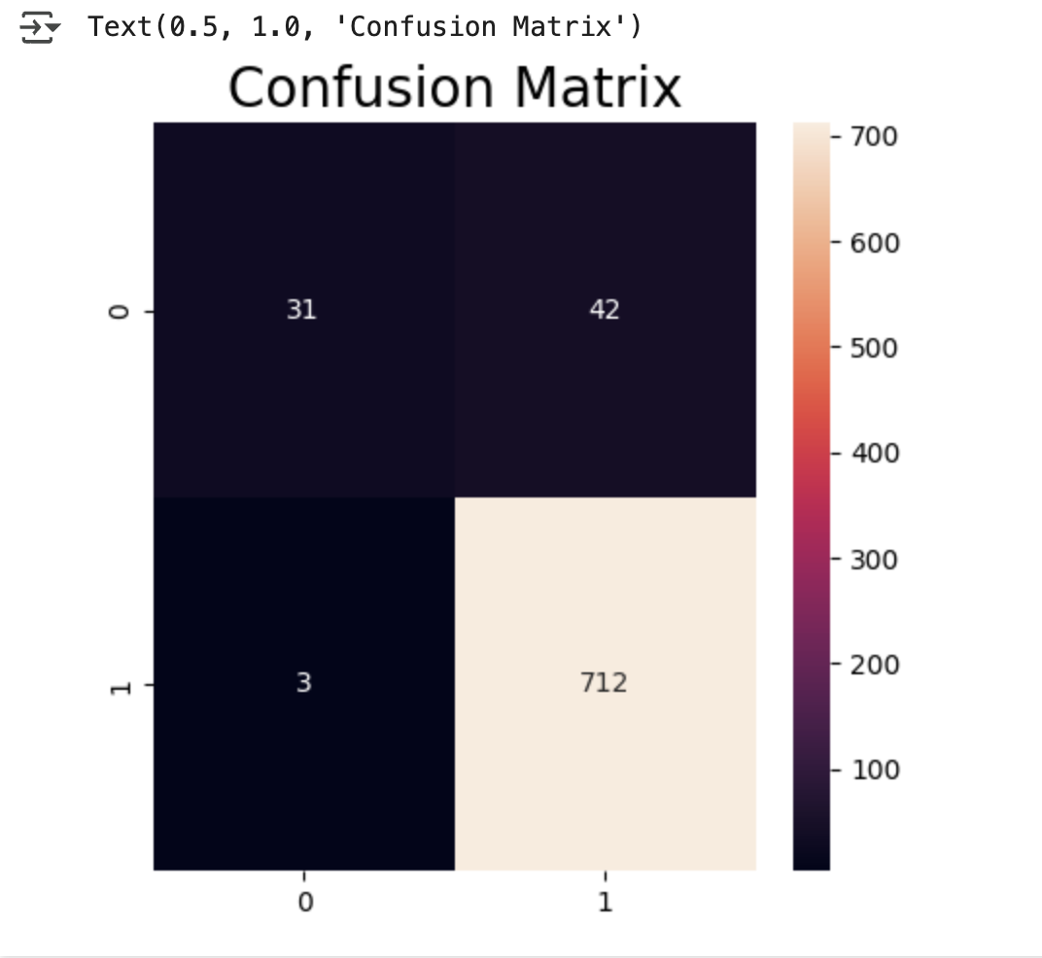
Random Forest Classifier

Slide 16
Results
•Most common Alexa variations identified
•Ratings are skewed toward 4 and 5 stars
•Longer reviews often indicate stronger sentiment
•Short reviews often have extreme sentiment
•Feedback generally matches rating scores

Slide 17
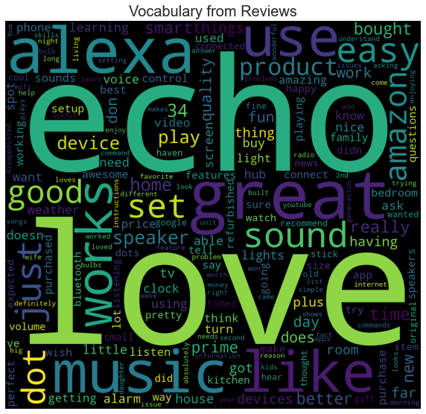
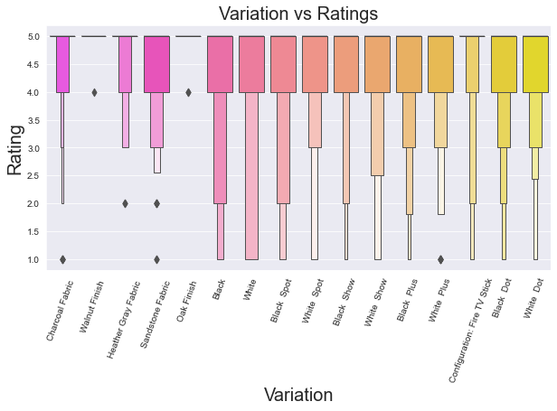

Slide 18
Conclusion.
•Amazon Alexa reviews show an overall positive sentiment
•Product variation influences user perception
•Review length can reflect engagement and sentiment strength
•This project provides a baseline for ML-based sentiment classifiers

Slide 19
References
Purington et al., 2016 – Personification in Amazon Echo Reviews.
Kaggle Dataset – Amazon Alexa Reviews.
Scikit-learn Documentation – Random Forest Classifier.
Relevant research articles (feature mining, sentiment mining).

Slide 20


