Slide 1
Fortifying Security through Hybrid Cryptography
Team Details
Ch. Sree Charan(20EG105307)
P Pramod Reddy(20EG105335)
P Shiva Prasad(20EG105340)
Project Supervisor
Dr. T Shyam Prasad
Asst Professor

Slide 2
Introduction
Cryptography and Information Security: Hybrid of two algorithms ECC and Diffie-Hellman.
A hybrid algorithm that combines Elliptic Curve Cryptography (ECC) and the Diffie-Hellman key exchange can provide a secure way of key generation and exchanging process.
The ECC key exchange provides secrecy and protection against quantum attacks, while Diffie-Hellman offers a well-established method for secure key exchange.

Slide 3
Problem Statement
The collaboration of Diffie-Hellman serves as a reliable key exchange mechanism for RSA, where RSA ensures the security of the messages. Nevertheless, this approach involves extensive key lengths, significantly impacting the system's performance.

Slide 4
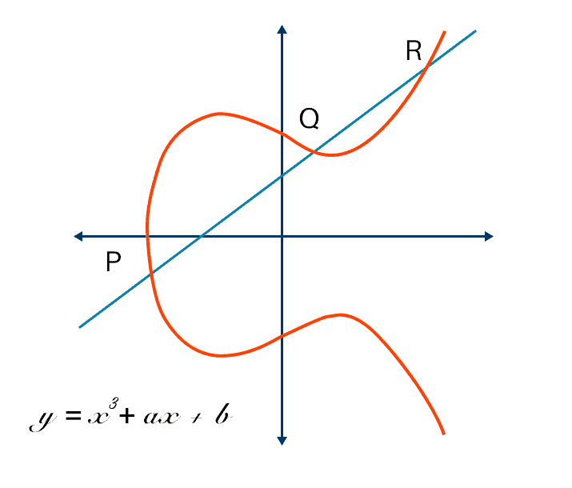
Proposed Method
ECC, an alternative technique to RSA, is a powerful cryptography approach. It generates security between key pairs for public key encryption by using the mathematics of elliptic curves.
It makes use of elliptic curves.
The curves are symmetric to x-axis.
A line is drawn at any random place on the curve , the points where the line touches are taken as public and private values .

Slide 5
Proposed Method Illustration
Start
Generate ECC Key Pair (Alice)
Select ECC Parameters (Curve, Base Point)
Generate ECC Key Pair (Bob)
Alice and Bob exchange public keys
Alice computes Shared Secret Key
Bob computes Shared Secret Key
Shared Secret Key is now established
End

Slide 6
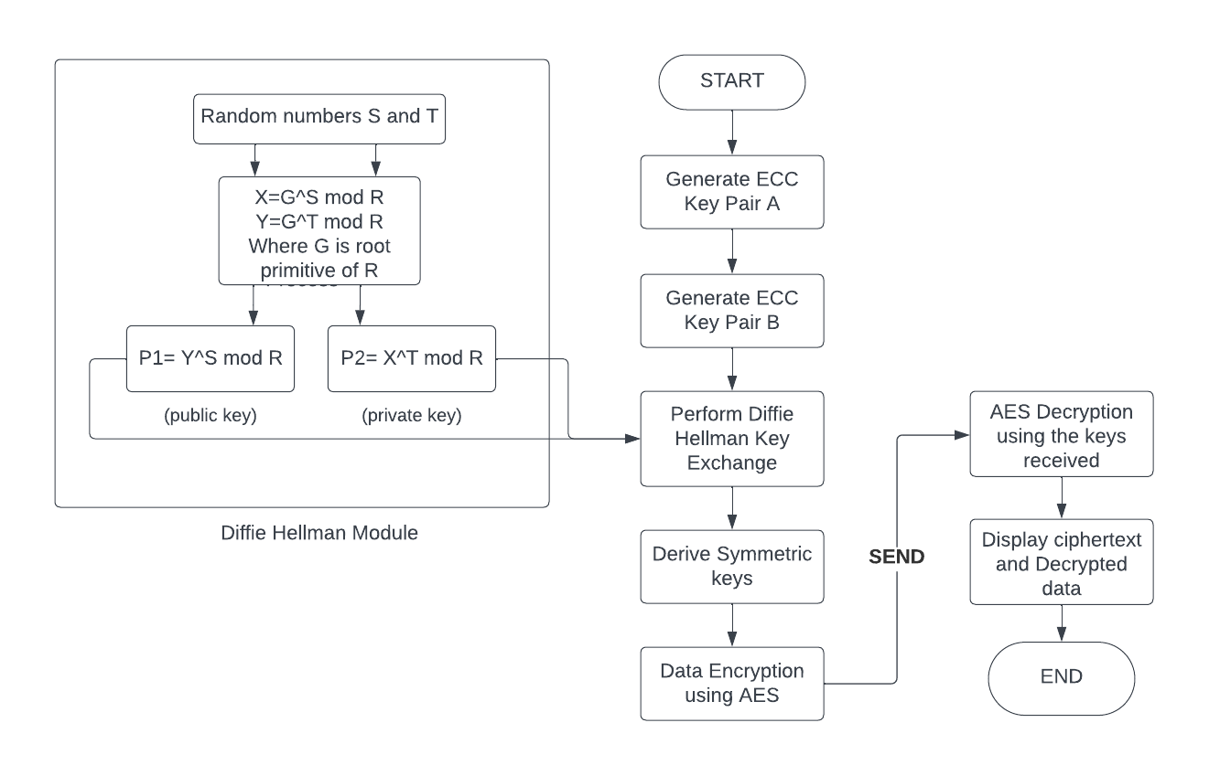
Proposed Method Illustration

Slide 7

Experiment Environment
Google Colab is an open-source, interactive web application that allows you to create and share documents that contain live code, equations, visualizations and narrative texts.
Libraries and Tools used in Google Colab
PyNaCl: This library provides a high-level interface for various cryptographic operations, including hybrid cryptography. It can be a good choice for simpler implementations.
Cryptography: The cryptography library (used in the provided code snippet) is a well-regarded and secure option. It offers a comprehensive set of primitives for various cryptographic tasks, including key generation, key exchange, key derivation, encryption, and decryption.

Slide 8
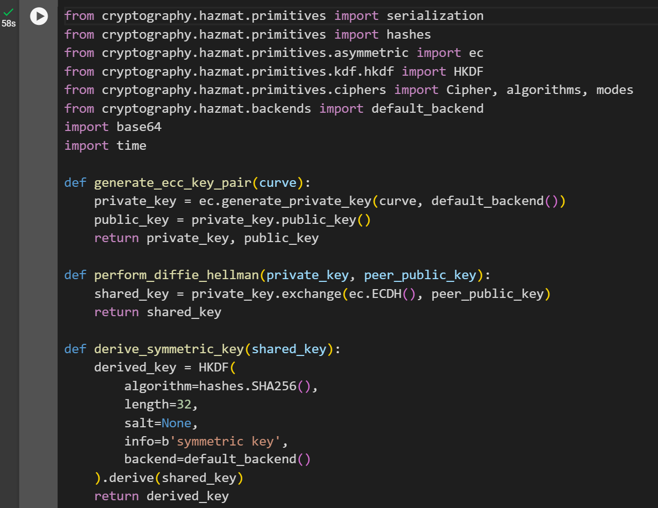
Experiment Screenshots

Slide 9
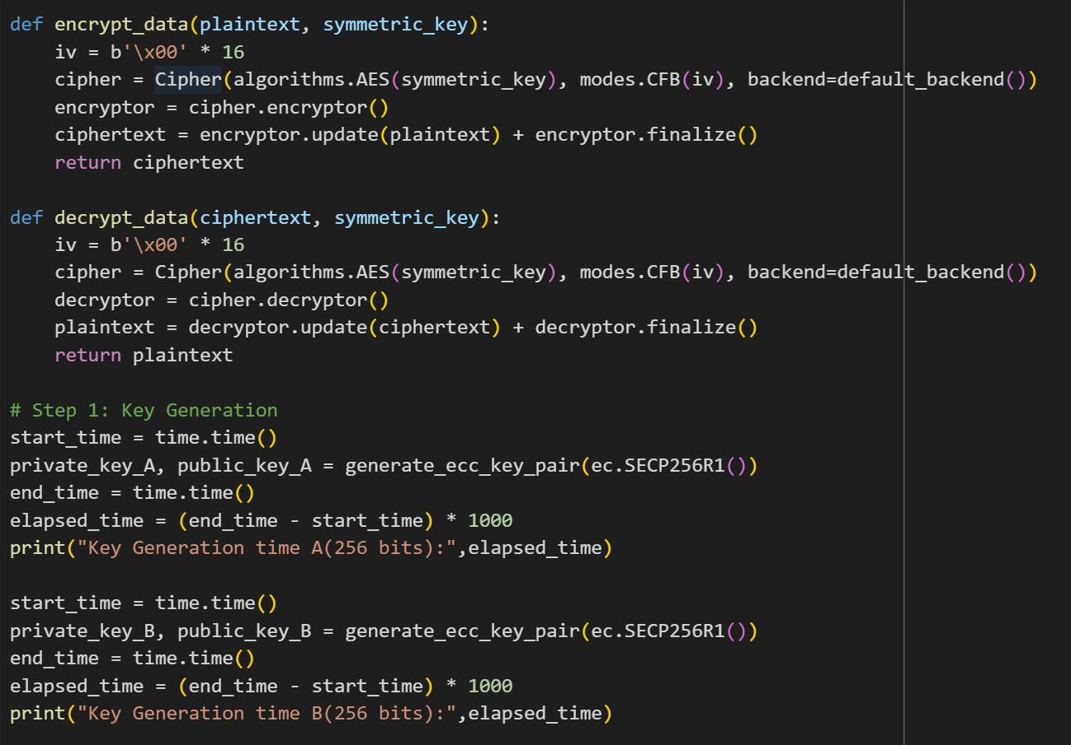
Experiment Screenshots

Slide 10
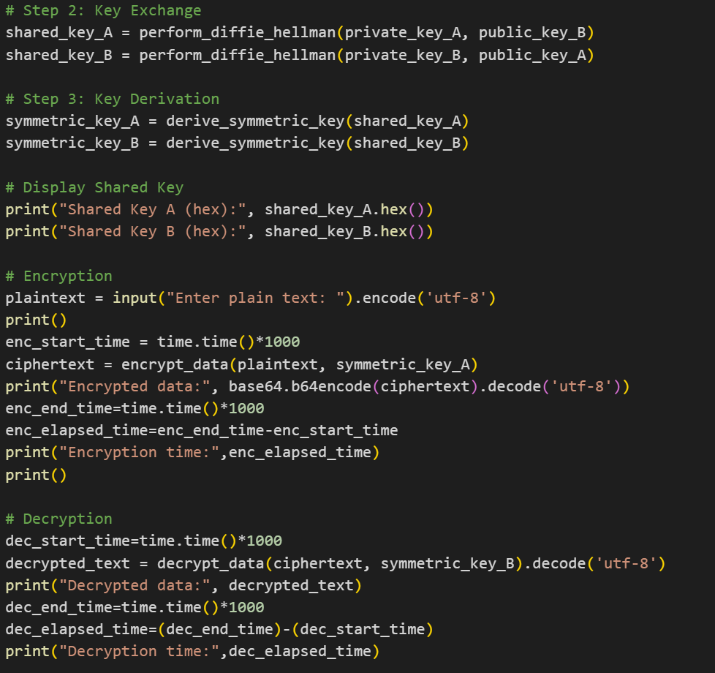
Experiment Screenshots

Slide 11
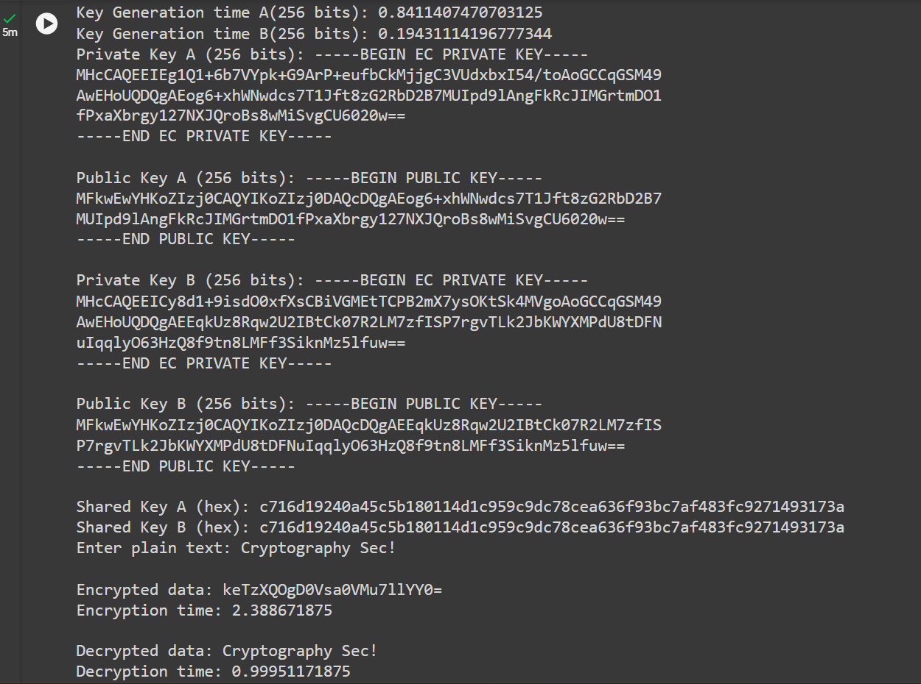
Experiment Results

Slide 12
Finding
Security: ECC provides a high level of security with smaller key sizes compared to traditional algorithms like RSA. This enhances the overall security of the key generation and exchange process. The Diffie-Hellman key exchange ensures that even if an attacker intercepts the public keys exchanged during the key exchange, it is computationally infeasible for them to derive the private keys.
Efficiency: ECC allows for smaller key sizes while maintaining a high level of security. This results in faster key generation and exchange compared to algorithms with larger key sizes. The use of ECC and efficient key exchange algorithms like Diffie-Hellman minimizes computational overhead, making it more efficient for devices with limited resources.
Secure Communication: The derived shared secret can be used for subsequent symmetric encryption, enabling secure communication between parties. The encrypted data can only be decrypted by the intended recipient possessing the appropriate private key.
Ease of Integration: The project provides a clear and structured demonstration of implementing ECC, Diffie-Hellman key exchange. This can be used as a basis for integrating these cryptographic processes into real-world applications.

Slide 13
Justification
The parameters improved by this method are:
Security: This Hybrid algorithm ensures confidentiality and integration better than that of RSA with Diffie Hellman
Speed and Performance: Using this hybrid algorithm, it gives better performance and ensures Performance Optimization and also doesn't require high computational power.
Key Exchange Mechanism: Diffie Hellman is the best key exchange algorithm. ECC with Diffie Hellman makes key exchange mechanism more secure and also faster.
Secure Communication: ECC and Diffie Hellman enables secure communication between parties. The encrypted data can only be decrypted by the intended recipient possessing the appropriate private key.

Slide 14
Thank you

