Slide 1

Coffee Shop Sales Data Analysis
Sonali Sri Yadav Tokala- U01984761
Shivani Kotturi - U01982782
Pramod kumar Reddy Parvath Reddy - U01999241
Raghava Thyagaraj - U01984899

Slide 2
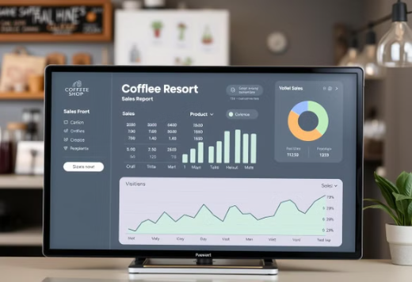
Introduction to the Dataset
Dataset Source: Kaggle - Coffee Shop Sales.
Total Records: 149,116 sales transactions.
Key Columns: Transaction Date/Time, Store, Product, Quantity, Unit Price.
Goal: Analyze sales patterns and customer behavior.

Slide 3

Business Objective
Identify peak sales periods and best-selling products.
Understand customer preferences across store locations.
Analyze sales distribution across categories.
Support data-driven decisions in retail strategy.
Gain insights into sales trends over time.

Slide 4
Abstract
This project conducts Exploratory Data Analysis (EDA) on a Coffee Shop Sales Dataset to uncover insights into sales trends, product performance, and store-level analysis. By examining factors like unit prices, sales distribution, product categories, and time-based patterns, the analysis aims to identify key factors driving sales. The findings provide valuable recommendations for optimizing product offerings, store performance, and marketing strategies to enhance business operations.

Slide 5
Data Preprocessing
Data processing involved several steps to prepare the dataset for analysis:
Loading the Data: Importing the dataset into a suitable environment (e.g., Pandas in Python).
Exploratory Data Analysis (EDA): Conducting initial analyses to understand the structure and distribution of the data.
Data Cleaning
Converted date and time into proper formats
Extracted day, month, year, and weekday for time-based analysis
Created a new total_sales column from quantity × unit price

Slide 6
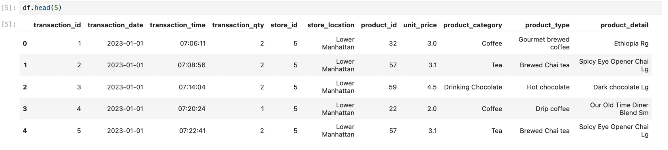
Sample Data

Slide 7
Literature Review
The importance of sales data in understanding customer preferences and product performance.
Prior studies in retail analytics have shown that analyzing time-based patterns can significantly improve sales forecasting and inventory planning.
Product-level and location-based sales analysis has helped businesses identify top-performing items and optimize store operations.
Visualization tools like Seaborn and Matplotlib are widely used to uncover hidden trends and patterns in sales data.

Slide 8
Methodology
Data Preprocessing: Cleaning data, handling missing values, and converting date/time columns.
Feature Engineering: Creating new features like total_sales and extracting time-based attributes (day, month, year).
Univariate Analysis: Analyzing distributions of unit price, total sales, and quantities sold.
Bivariate & Multivariate Analysis: Exploring relationships between variables like product type, category, and location.
Time Series Analysis: Detecting weekly/monthly sales trends to identify seasonality and peak periods.
Visualization: Using Matplotlib and Seaborn to present insights clearly.

Slide 9
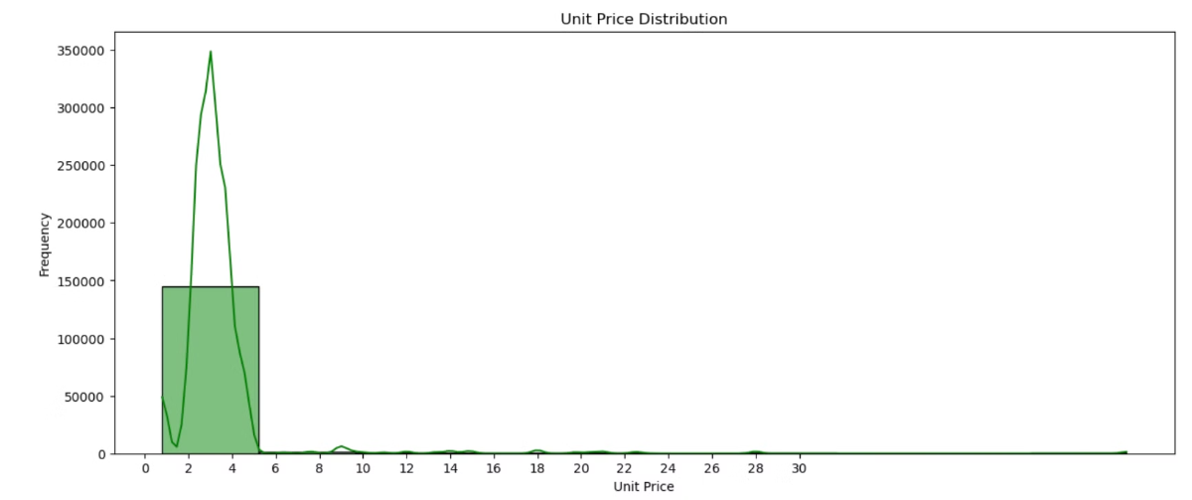
Unit Price - Distribution
Product unit prices mostly between $2 and $5.
Few premium items exceed $10.
Indicates an affordable product range.
Helps understand pricing strategy.

Slide 10
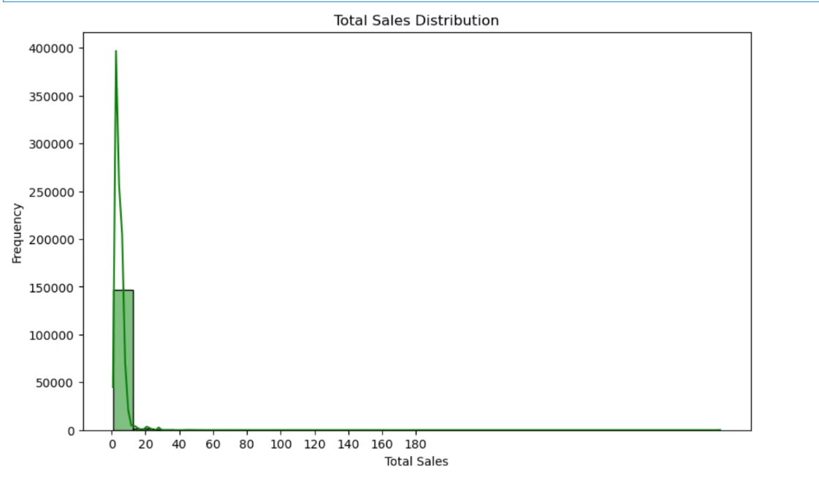
Total Sales - Distribution
Total sales = Quantity x Unit Price.
Most transactions are smaller amounts.
High volume-low value model indicated.
Spikes hint at bulk purchases or combos.

Slide 11
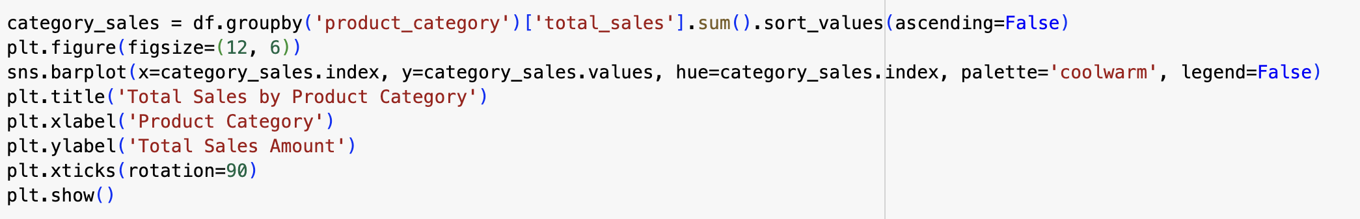
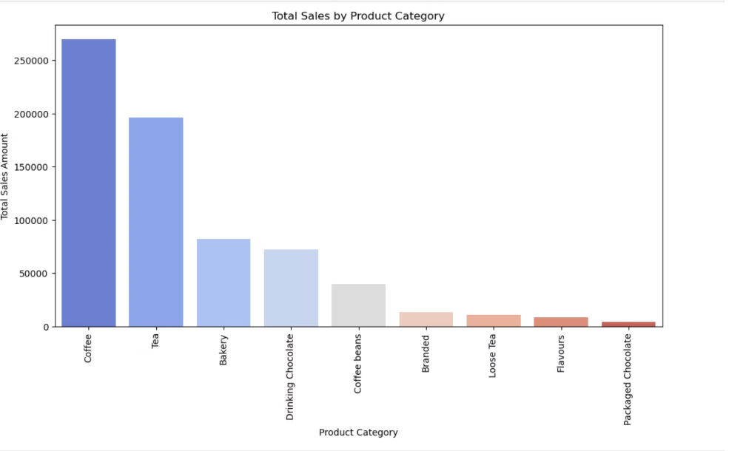
Sales by Product Category
We grouped all transactions by the product_category column.
Sorted categories from highest to lowest sales for visual comparison.
Coffee and Tea sold most frequently.
Drinking Chocolate and Bakery items fewer outliers.
Helps plan inventory and promotions.

Slide 12
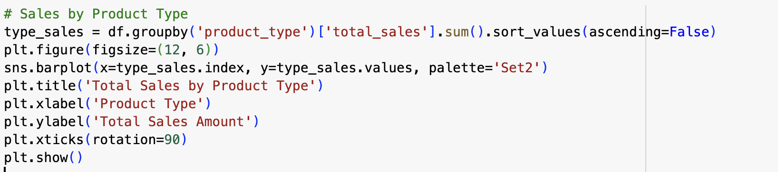
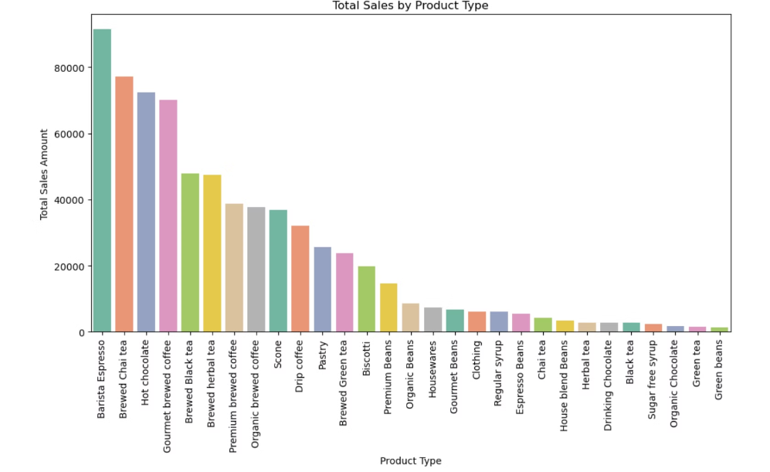
Sales by Product Type
Groups data by specific product types.
Total sales per type are calculated.
Barista Espresso made the most amount.
Products like Green Beans, Green Tea, and Organic Chocolate made the least amount.

Slide 13
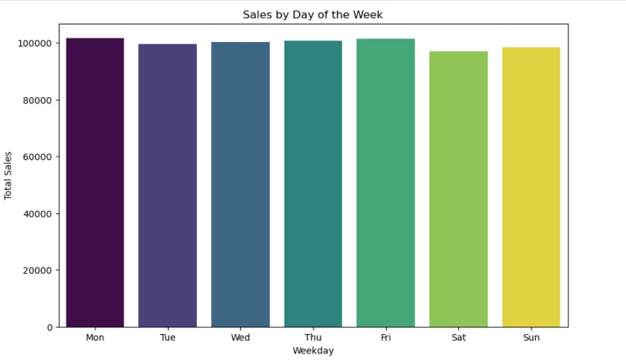
Sales Over Time
1
Morning hours (7 AM - 11 AM) - High Sales
2
Weekdays - Slightly outperform weekends
3
June - Higher revenue, Feb - lowest Revenue
Seasonal and time-based planning essential.

Slide 14
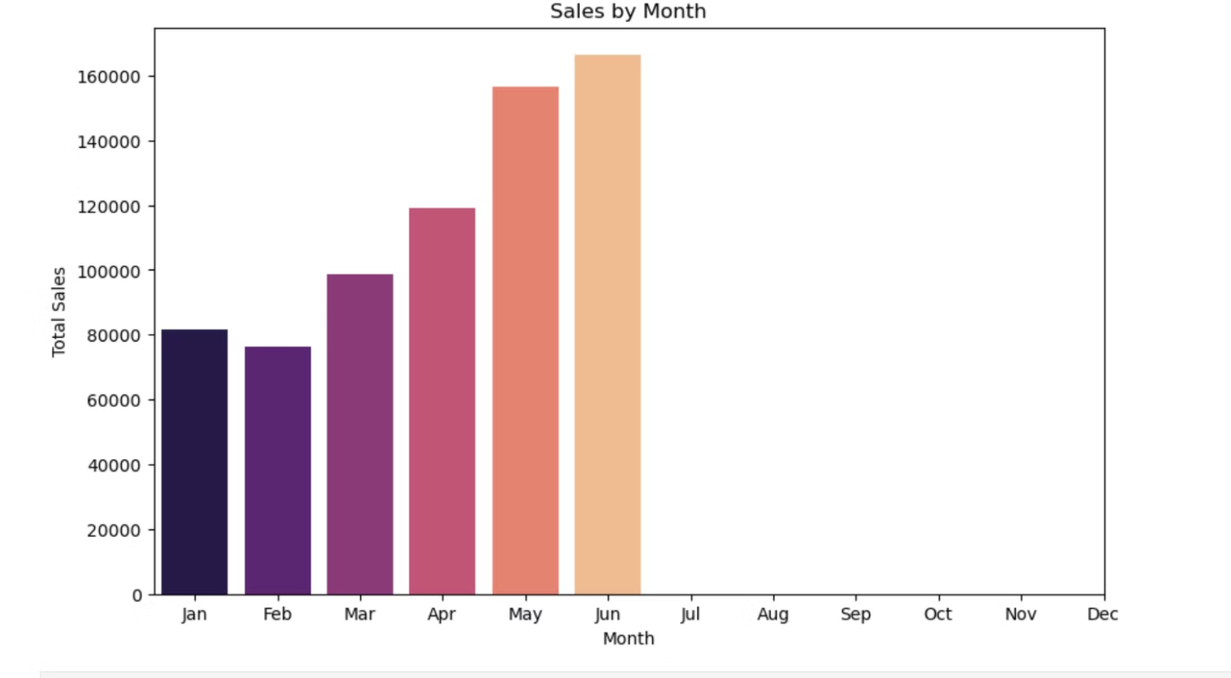

Slide 15
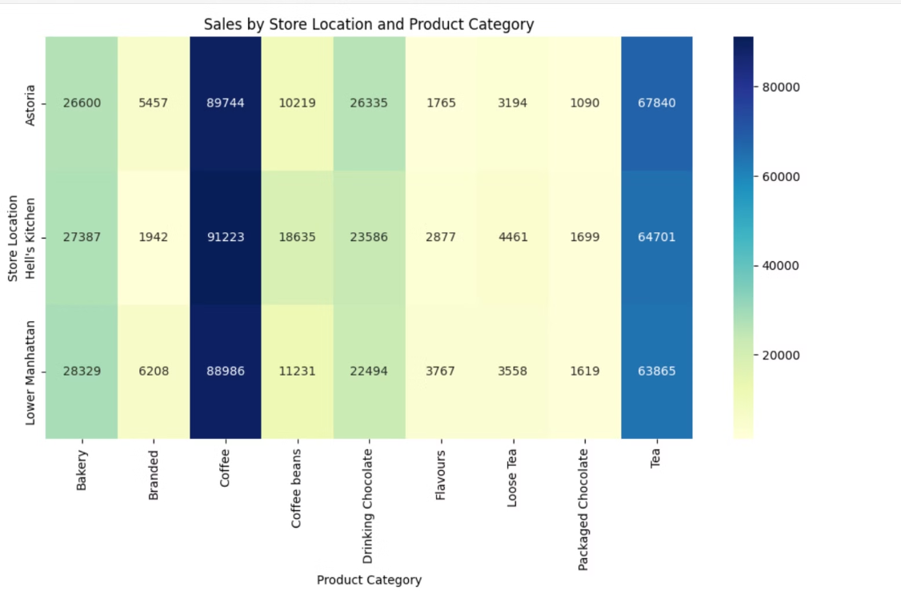
Store Location Performance
Lower Manhattan - Highest Sales
Variations in revenue and category preference by location.
Opportunity for targeted marketing per region.

Slide 16
Key Insights
• Coffee dominates in both quantity and revenue
• Morning time window is the most profitable
• Pricing is consistent, with minor high-end product pricing
• Regional differences in preferences can guide promotions
Conclusions & Takeaways
EDA helped to uncover the customer patterns, popular products, and peak times
Actional insights include personalised campaigns and better inventory planning
This real time dataset is ideal for understanding the real-time business decisions

Slide 17
THANK YOU

