Slide 1
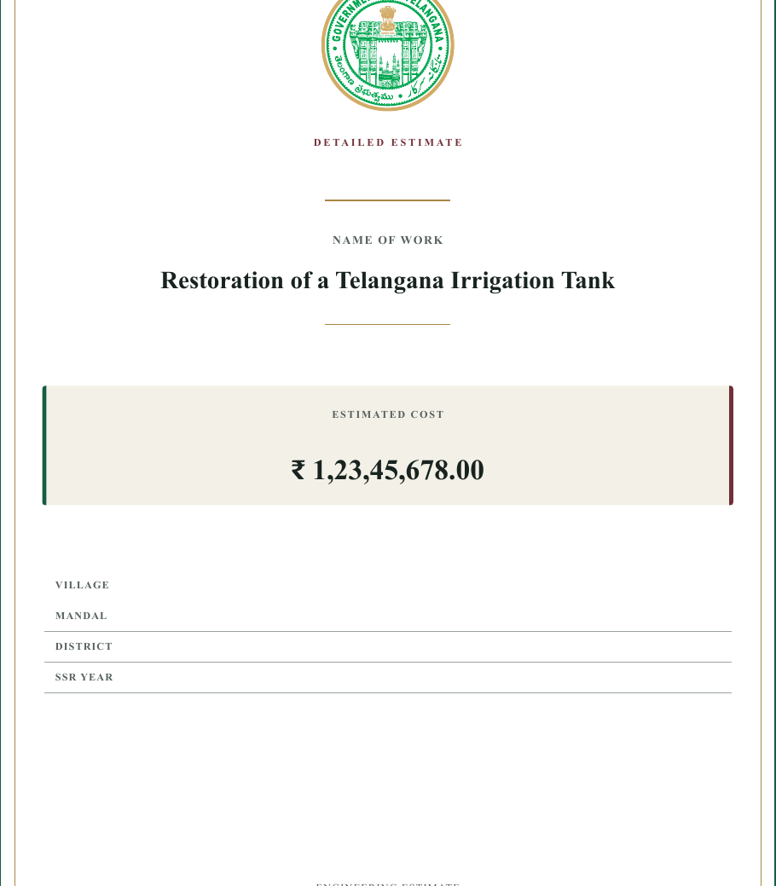
E-ESTIMATE
Construction estimates
that stay connected
A Windows desktop workspace for Telangana SOR/SSR estimate preparation, calculation and print-ready documentation.
Software pitch | September 2026
Notes:
Product pitch prepared from the E-Estimate repository README and product assets.

Slide 2
02
The estimate process spans too many disconnected tasks
Teams need one working record from item selection to the final document.
01
02
03
Estimate inputs
Technical checks
Deliverables
Item quantities, rates and project data must remain traceable.
Lead, rate analysis, seigniorage and bund work add calculation depth.
Stakeholders need consistent, print-ready project documents.
E-Estimate keeps these workflows in a single desktop workspace.
E-ESTIMATE | CONFIDENTIAL PRODUCT PITCH
02
Notes:
Challenge framing is a product-positioning summary, not a quantified market claim.

Slide 3
03
One workspace for the estimate lifecycle
E-Estimate keeps project data, calculations and output preparation close together.
The operating model
Build the estimate once.
Use the same project data
through calculation and print.
A desktop application designed for estimation work, not a collection of loose spreadsheets.
E-ESTIMATE | CONFIDENTIAL PRODUCT PITCH
03
Notes:
Product capability summary based on README.md.

Slide 4
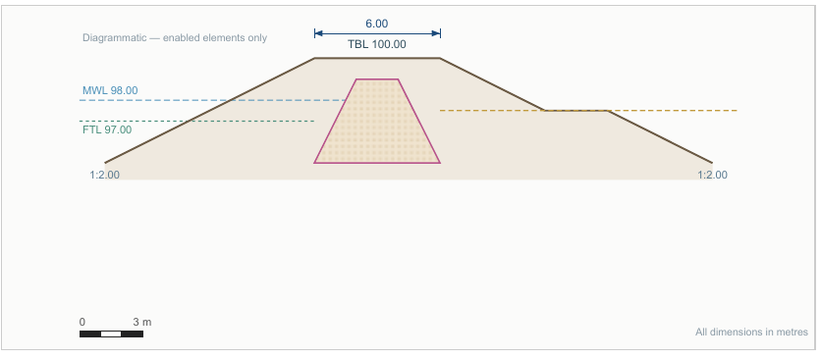
04
Core estimation workflows
Purpose-built modules keep specialist work connected to the project record.
1
SOR / SSR catalogue
Find and reuse schedule items.
2
Rate analysis
Build transparent rate inputs.
3
Lead calculations
Model material movement and leads.
4
Seigniorage
Handle applicable royalty workflows.
5
Bund analysis
Prepare bund data and simulation inputs.
Bund workflow visual from the product repository
E-ESTIMATE | CONFIDENTIAL PRODUCT PITCH
04
Notes:
Module names and visual sourced from E-Estimate repository.

Slide 5
05
From project data to print-ready documents
The same project record supports calculation, review and formal output.
01
02
03
04
Project setup
Calculation
Document preparation
Windows delivery
Capture estimate data in the project workspace.
Apply rate, lead, seigniorage and related workflows.
Assemble the project book and required print content.
Package the desktop app for installation and use.
Project data remains central throughout the workflow.
E-ESTIMATE | CONFIDENTIAL PRODUCT PITCH
05
Notes:
Workflow synthesized from README and repository structure, including Typst print compilation and Tauri packaging.

Slide 6
06
Designed around Telangana SOR/SSR workflows
E-Estimate focuses the product on the rules and documents that estimation teams already use.
TELANGANA
FOCUSED
WORKFLOWS
A domain-specific estimation environment
Built around the estimation process.
The product brings SOR/SSR catalogue work, rate analysis, leads, seigniorage and project output into one application.
E-ESTIMATE | CONFIDENTIAL PRODUCT PITCH
06
Notes:
Regional focus stated in README.md.

Slide 7
07
Desktop delivery for everyday estimation work
E-Estimate ships as a packaged Windows application.
Windows desktop
Print-ready output
Packaged distribution
A native desktop shell built with Tauri 2 and WebView2.
Typst-based document compilation supports formal estimate output.
The project produces a Windows NSIS installer.
The pitch can support a product demo, pilot discussion or stakeholder review.
E-ESTIMATE | CONFIDENTIAL PRODUCT PITCH
07
Notes:
Technical delivery details are sourced from README.md.

Slide 8
E-ESTIMATE
A clearer working record
for every estimate
Next conversation
Select a pilot estimate, walk through the workflow, and define the output needed by your team.
Thank you
E-Estimate | Construction cost estimation software
Notes:
Closing slide.

