Slide 1
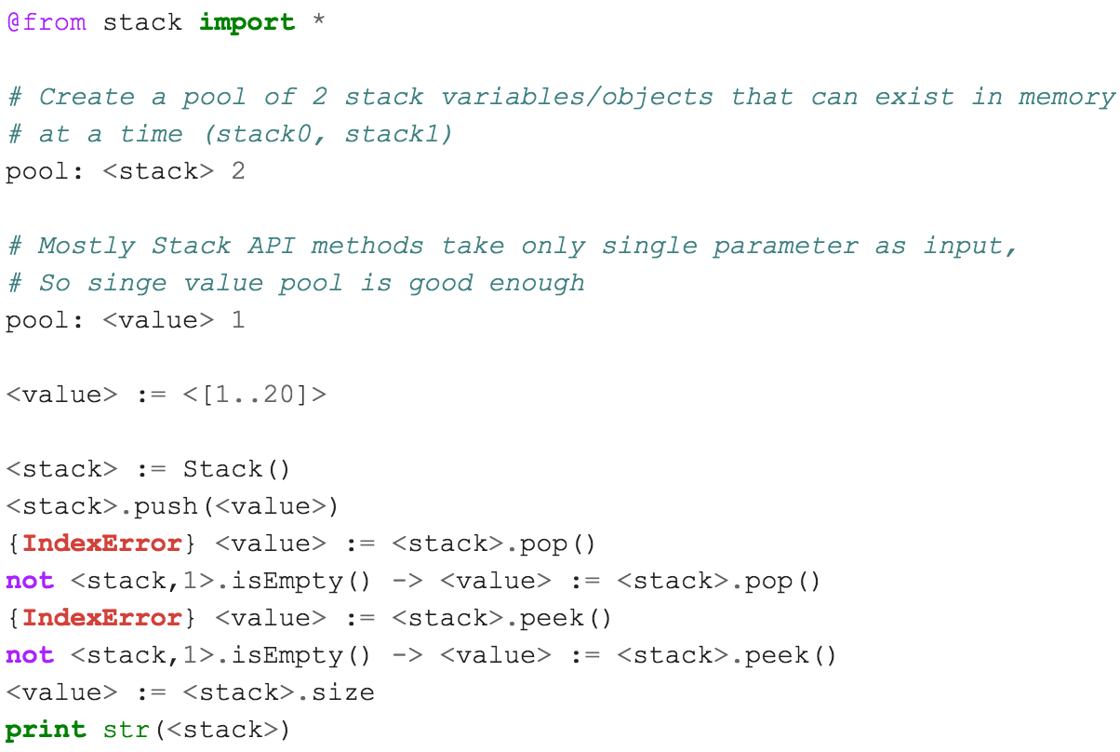
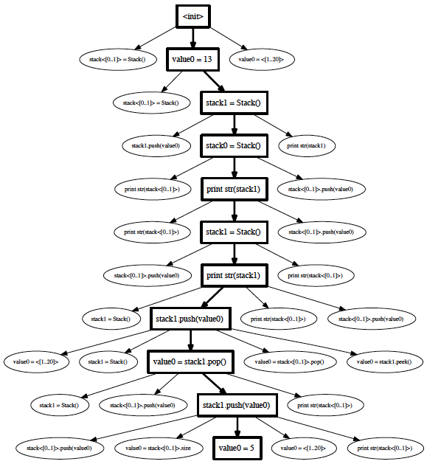
School of Electrical Engineering and Computer Science
TSTL: Template Scripting Testing Language
Pranjal Mittal, MS CS Student; Alex Groce, Associate Professor;
Introduction
Writing a test harness is arduous. The lack of tools for automated testing is an obstacle to adopting effective automated test generation methods, including random testing. TSTL is a domain-specific language for testing, written in Python, & allowing embedded Python code, that makes it easy to produce test harnesses, usable with many different test generation methods and tools.
Problem
Automated testing often requires a user to write a test harness —- essentially a program that defines (or generates) the set of valid tests for the Software Under Test (SUT). Such harnesses are common to random testing, many kinds of model checking, and various machine-learning influenced approaches.
Unfortunately, these harnesses themselves are complex software artifacts and it is all too easy to spend valuable testing time hunting down bugs in the test harness and not the System Under Test. Harness code is often highly repetitive (choosing between a set of available API calls to make, and assigning values to parameters in those calls, for example) and is almost always tightly coupled to one particular test generation method.
Solving the problem: TSTL
TSTL is a language written in Python, embedding Python, intended to make these testing difficulties less onerous and decouple testing technology from the System Under Test. This will enable reuse of advanced testing techniques and tools without rewriting test harnesses.
System Under Test (Declarative): TSTL allows a system under test to be defined in declarative style, with few lines of code in files with a .tstl extension.
TSTL Compiler: Complies this .tstl file and generates a python harness (there is java version too) in the sut.py file. Essentially transforms set of valid tests/properties/input pools defined in <system>.tstl file into a graph to explore by choosing valid actions.
System Under Test (Compiled): The sut.py file is a TSTL-generated Python interface for testing that can be tested by any Python test generator that uses its interface to choose actions, restart tests, and check properties.
Generators are tools for generating tests for any sut.py. Generators distributed with TSTL include a heavily-developed random testing tool, and simple BFS and DFS based explicit-state model checkers.
Head 1 Head 1 Head 1
Velit vendipit, quat iustrud eraeseniat do conummod ea alisci tie vel ea commodo lortis aliquamcommy niat aliquat niam ercillan eu feugue magnisl utpat autat. Bullet. lum exer adipsustrud doloree tuerat lorpera esenibh eu faccum eum iuscili quamcommy nit lorerillut ullam quat lore verostrud ming et, si tie faciliquisse modolortin volore
vel et vel dionsenit adit, consenim zzrillute el euguerostie faci bla conse minim zzriure tio dolore tet, volobor si.
vel et vel dionsenit adit, consenim zzrillute el euguerostie faci bla conse minim zzriure tio dolore tet, volobor si
vel et vel dionsenit adit, consenim zzrillute el euguerostie faci bla conse minim zzriure tio dolore tet, volobor si.
vel et vel dionsenit adit, consenim zzrillute el euguerostie faci bla conse minim zzriure tio dolore tet, volobor si.
vel et vel dionsenit adit, consenim zzrillute el euguerostie faci bla conse minim zzriure tio dolore tet, volobor si.
Example: (stack.tstl) Declarative TSTL script for testing a stack implementation which can be used with a test generator to generate automated tests for stack API. Stack API contains: __init__, __str__, push, pop, peek, etc methods and size property.
Secondary logo if necessary

