Slide 1
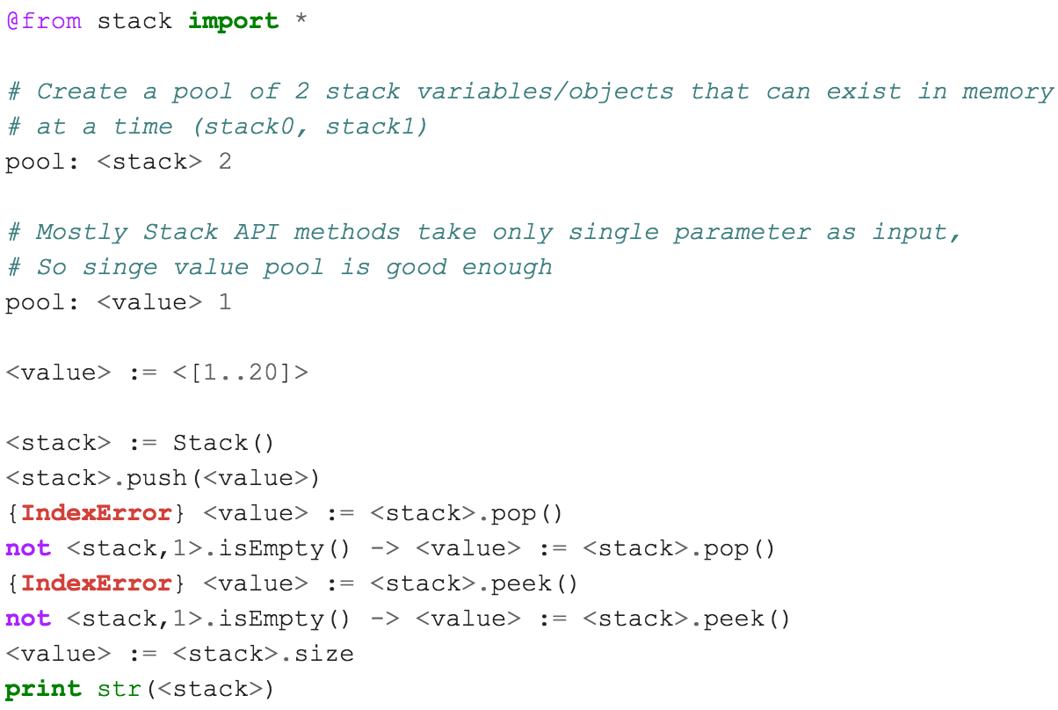
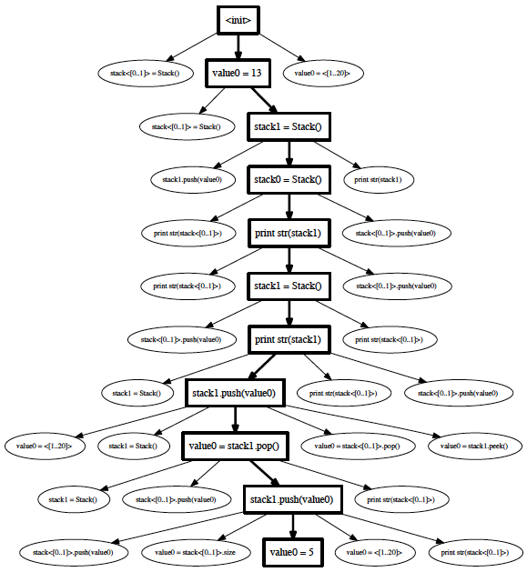
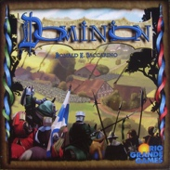
School of Electrical Engineering and Computer Science
TSTL: Template Scripting Testing Language
Pranjal Mittal, MS CS Student, Alex Groce, Associate Professor
Introduction
Writing a test harness is an unpleasant task. The lack of tools for automated testing is an obstacle to the adoption of effective automated test generation methods, including random testing. TSTL is a domain-specific language for testing, written in Python, for Python code, that makes it easy to produce test harnesses, usable with many different test generation methods and tools.
The Problem
Automated testing often requires a user to write a test harness —- essentially a program that defines (or generates) the set of valid tests for the Software Under Test (SUT). Such harnesses are common to random testing, many kinds of model checking, and various machine-learning influenced approaches to testing.
Unfortunately, these harnesses themselves are complex software artifacts and it is all too easy to spend valuable testing time hunting down bugs in the test harness and not the System Under Test. Harness code is often highly repetitive (choosing between a set of available API calls to make, and assigning values to parameters in those calls, for example) and is almost always tightly coupled to one particular test generation method.
Solving the Problem: TSTL
TSTL is a language written in Python, embedding Python, intended to ease harness construction and decouple testing technology from the System Under Test. TSTL enables reuse of advanced testing techniques and tools without rewriting test harnesses.
System Under Test (Declarative): TSTL allows a system under test to be defined in declarative style, with few lines of code, mostly in Python itself
TSTL Compiler: The compiler takes a .tstl files and produces a class that is a standalone interface to the System Under Test, defining its valid tests
System Under Test (Compiled): The sut.py file is a TSTL-generated Python interface for testing that can be tested by any Python test generator that uses the well-defined TSTL interface; sut.py automatically supports common testing activities, such as replaying regression tests, checking code coverage, and collecting logging information
Generators are tools for generating tests for any sut.py. Generators distributed with TSTL include a powerful random testing tool, incorporating state-of-the-art research methods for better testing and automated debugging
Utilities are tools for producing graphs of the behavior of a tested system (see right), standalone test cases that do not depend on TSTL, etc.
Terminology/Features
Test consists of actions that assign values to pools of values
Actions defined by writing Python code
TSTL automatically produces valid test sequences
Integrated with coverage.py to collect/use code coverage
Automatic reduction of test cases
Automatic coverage-based fault localization
Automatic test normalization to help deal with large numbers of similar failing tests
Allows the ideas of QuickCheck/Hypothesis to be applied in a state-based, API-call-centered domain
Opportunities for TSTL industry adoption
Game Testing: Games are often state based systems with several API calls / methods for changing state. TSTL can be very useful for testing such games. TSTL has tested the card game Dominion.
Testing programming libraries: in use for testing numpy, arcpy, biopython, Z3Py, and other critical Python libraries
Grammar-based test generation: TSTL can produce strings from arbitrary grammars, and call the system
Testing any state based system: many software systems in different domains are state based systems
Example: stack.tstl -- declarative TSTL script for testing a stack implementation; can be used with a test generator to generate automated tests for stack API. Stack API contains: __init__, __str__, push, pop, peek, etc. methods and size property.
Links
NASA Formal Methods 2015 Paper http://www.cs.cmu.edu/~agroce/nfm15.pdf
ISSTA 2015 Tool Paper, ACM Digital Library link: http://dl.acm.org/citation.cfm?id=2784769
TSTL for Java (work in progress by flipturnapps): https://github.com/flipturnapps/TSTL-Java
TSTL authors are: Alex Groce, Jervis Pinto, Josie Holmes, Pranjal Mittal, and Pooria Azimi. We thank Ned Batchelder for help with integrating coverage.py, and students in CS362, 562, and 569 at Oregon State University for comments and suggestions.
TSTL Team / Contributors: Alex Groce, Josie Holmes, Pranjal Mittal, Pooria Azimi, Jervis Pinto, Dr. James O’Brien

