Slide 1
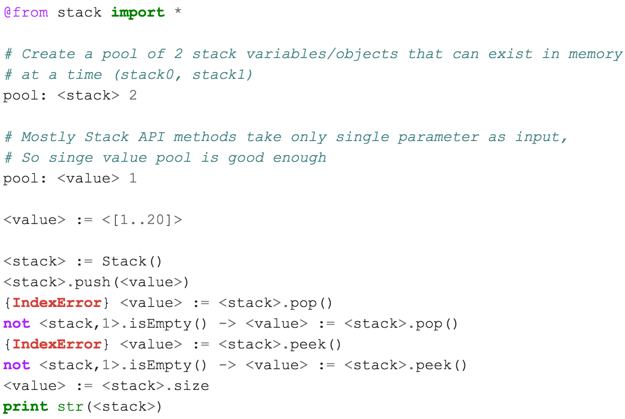
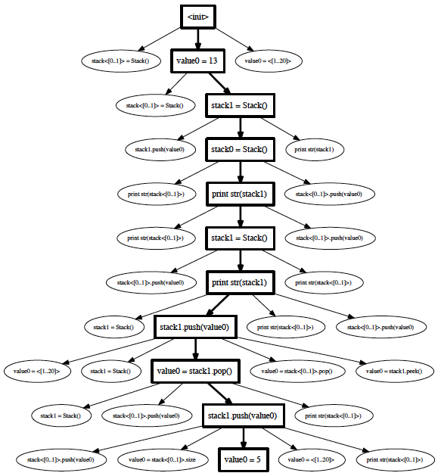
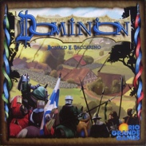
School of Electrical Engineering and Computer Science
TSTL: Template Scripting Testing Language
Pranjal Mittal, MS CS Student; Alex Groce, Associate Professor;
Introduction
Writing a test harness is arduous. The lack of tools for automated testing is an obstacle to adopting effective automated test generation methods, including random testing. TSTL is a domain-specific language for testing, written in Python, & allowing embedded Python code, that makes it easy to produce test harnesses, usable with many different test generation methods and tools.
Problem
Automated testing often requires a user to write a test harness —- essentially a program that defines (or generates) the set of valid tests for the Software Under Test (SUT). Such harnesses are common to random testing, many kinds of model checking, and various machine-learning influenced approaches.
Unfortunately, these harnesses themselves are complex software artifacts and it is all too easy to spend valuable testing time hunting down bugs in the test harness and not the System Under Test. Harness code is often highly repetitive (choosing between a set of available API calls to make, and assigning values to parameters in those calls, for example) and is almost always tightly coupled to one particular test generation method.
Solving the problem: TSTL
TSTL is a language written in Python, embedding Python, intended to make these testing difficulties less onerous and decouple testing technology from the System Under Test. This will enable reuse of advanced testing techniques and tools without rewriting test harnesses.
System Under Test (Declarative): TSTL allows a system under test to be defined in declarative style, with few lines of code in files with a .tstl extension, a.k.a ACT files.
TSTL Compiler: Complies this .tstl file and generates a python harness (there is java version too) in the sut.py file. Essentially transforms set of valid tests/properties/input pools defined in <system>.tstl file into a graph to explore by choosing valid actions.
System Under Test (Compiled): The sut.py file is a TSTL-generated Python interface for testing that can be tested by any Python test generator that uses its interface to choose actions, restart tests, and check properties.
Generators are tools for generating tests for any sut.py. Generators distributed with TSTL include a heavily-developed random testing tool, and simple BFS and DFS based explicit-state model checkers.
Terminology/Features
TSTL Keywords: pool, init, log
Literal Code: Raw/embedded Python code.
Pool Variable: Used to define value pools. A pool variable can take a range of values.
Pool Variable with a REF: Used for differential testing.
Action Line: Any line where an action is performed. Usually the ones with assignment := or ones where a method of the API is called without assignment.
Integrated with coverage.py to show resulting coverage from running a test generator or model checker on the complied SUT
Tool to generate visual graph of possible action sequence(s).
Opportunities for TSTL industry adoption
Game Testing: Games are often state based systems with several API calls / methods within. TSTL can be very useful for testing such games where often a game state is maintained internally. TSTL has been used to test games like dominion.
Testing programming libraries: We tested numpy, arcpy, biopython amongst other libraries.
Compiler Testing: TSTL can be used for testing compiler source code.
Testing any state based system. Several software systems in different domains are state based systems.
Example: (stack.tstl) Declarative TSTL script for testing a stack implementation which can be used with a test generator to generate automated tests for stack API. Stack API contains: __init__, __str__, push, pop, peek, etc methods and size property.
Links
Nasa Formal Methods 2015 http://www.cs.cmu.edu/~agroce/nfm15.pdf
ISSTA 2015, ACM Digital Library link: http://dl.acm.org/citation.cfm?id=2784769
TSTL for Java (work in progress by flipturnapps team): https://github.com/flipturnapps/TSTL-Java
TSTL Team / Contributors: Alex Groce, Josie Holmes, Pranjal Mittal, Pooria Azimi, Jervis Pinto, Dr. James O’Brien

