Slide 1
Client server Architecture used by BigBlueButton and its Scalability, Performance and Security
Group No : SE3030_WE_60
Name | IT Number
Senevirathna D.K.C. | IT20009540
Nadula J.K.D.P. | IT20168568
Mapatuna R.M. | IT20072674
Kulathunga H.M.C.K. | IT20274498

Slide 2

What is BigBluButton
Audio
Web cams
Slide share
Screen share
Whiteboard
Chat Rooms
Polling
Notes
Senevirathna D.K.C
IT20009540

Slide 3




What is BigBluButton
Major Customers
Paradiso Solutions (LMS)
47Deck
Palm Beach Atlantic University
SOFTWARE SOLUTIONS
National University College-Arecibo
Senevirathna D.K.C
IT20009540

Slide 4

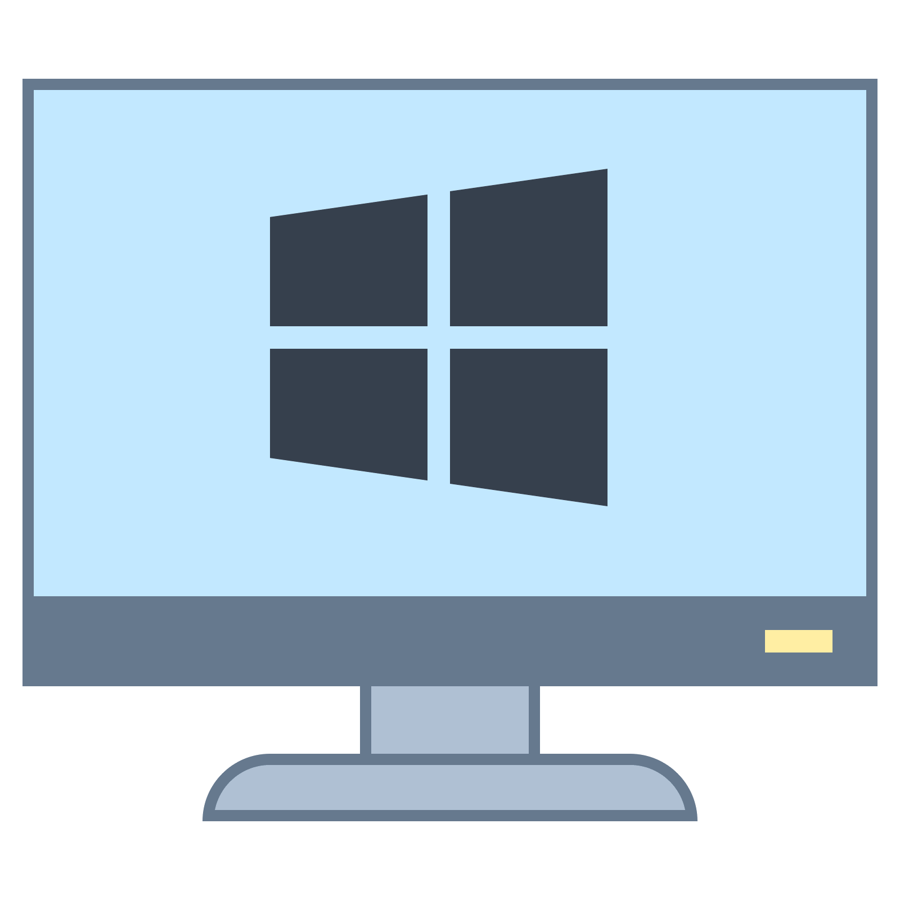


Architecture OF BIGBLUEBUTTON
LAYERS IN BIGBLUEBUTTON
Client
2. Server
3. Database
4. Configuration
Senevirathna D.K.C
IT20009540

Slide 5
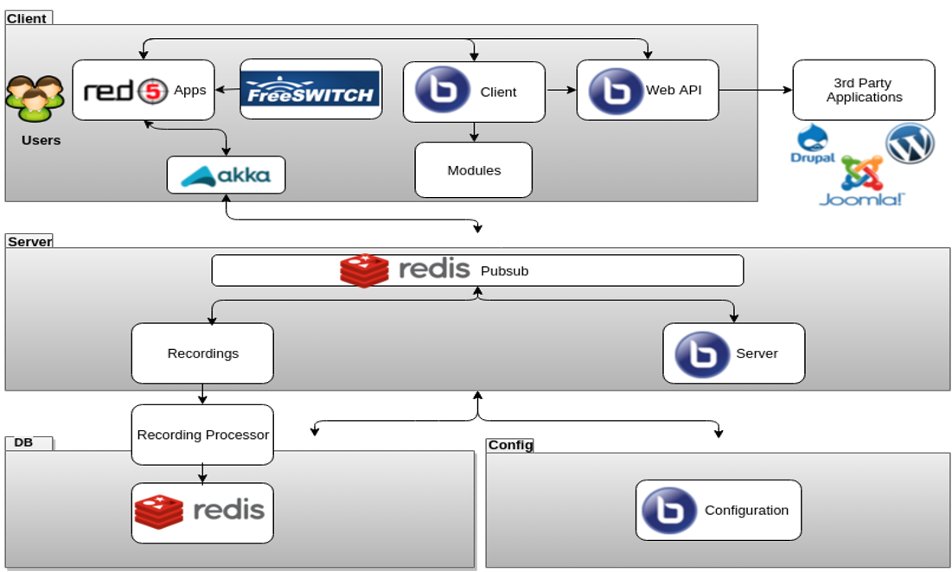
Architecture Diagram OF BIGBLUEBUTTON
Architecture OF BIGBLUEBUTTON
Senevirathna D.K.C
IT20009540

Slide 6


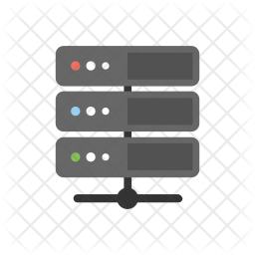


Architecture OF BIGBLUEBUTTON
Client
Red5 Apps
FreeSWITCH
Web API
Modules
Akka Apps
Server
Redis Pubsub
Recording
Senevirathna D.K.C
IT20009540

Slide 7
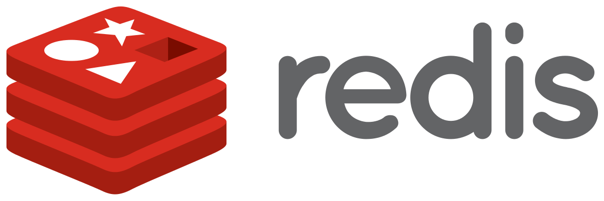
Architecture OF BIGBLUEBUTTON
Database
Saving all the data of a conference session
Configuration
Contains client config file
Contains integrated module settings
Contains login system configurations
IP address and permission configurations
Senevirathna D.K.C
IT20009540

Slide 8
Performance
Improved scaling of webcams and screenshare
Real-time sharing of audio and video
Public and private chat
Interactive multi-user whiteboard
Slide presentations
Screen-sharing
Break-out rooms
IT20072674 Mapatuna R.M.

Slide 9


BigBlueButton vs Jitsi
Features | BigBlueButton | Jitsi
Whiteboard | Yes | No
Documents Upload | Yes | No
Breakout Rooms | Yes | No
Video Options | Yes | Yes
Chat | Yes | Yes
Polling | Yes | No
Multi-User Whiteboard | Yes | No
Shared Notes | Yes | No
Hand Rise | Yes | Yes
Emojis | Yes | Yes
Video Share | Yes | No
Closed Captions | Yes | No
Audio | Yes | Yes
Easy Recordings | Yes | No
IT20072674 Mapatuna R.M.

Slide 10

BigBlueButton vs Zoom
Performance | BigBlueButton | Zoom
Primary purpose | Online meetings | Online classes
Video & Audio | Yes | Yes
Chat | Yes | Yes
Screen share | Yes | Yes
Application share | Yes | No
Share computer sound | Yes | No
Record | Yes | Yes
Whiteboard | Yes | Yes
Annotate shared documents | Yes | Yes
Break-out room | Yes | Yes
Co-host/Moderator | Yes | Yes
File transfer | Yes | No (share link on chat)
Shared notes | No | Yes
Dial-in with phone | Yes | Yes
Analytics | Minimal | Detailed (attendance, chat transcripts, poll answers, hands raised)
Integration with LMS | Completely separate from LMS | Integrates well with LMS such as Moodle, Canvas, Joomla, Schoology, WordPress and many others
Desktop client or browser | Desktop client with frequent updates and onetime audio plug-in | Runs in browser. No need for any additional app.
IT20072674 Mapatuna R.M.

Slide 11

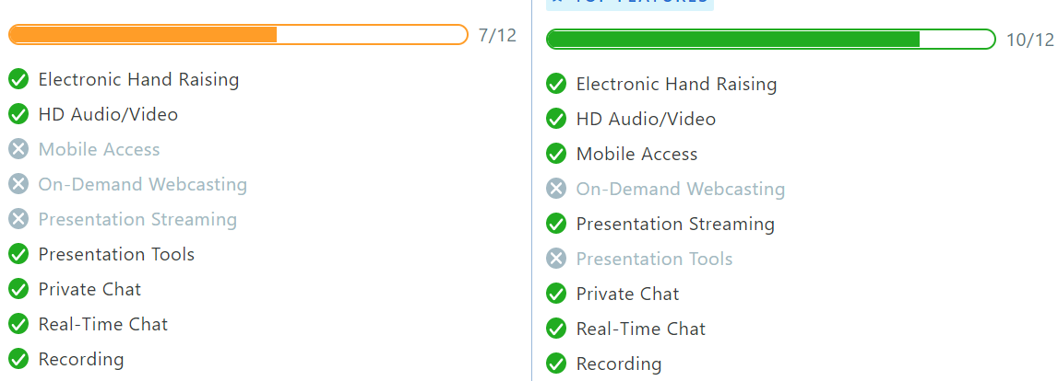
BigBlueButton vs Google meet
IT20072674 Mapatuna R.M.

Slide 12
Updated version Performances
User list and chat list now re-render only visible components
Refactoring of user joining sequence
Support for multiple NodeJS processes for supporting meetings larger than 100 users
Whiteboard performance improvements
Faster queue based processing of launching recordings workers
Configurable pool of recording workers (default 1)
Faster processing of recordings
IT20072674 Mapatuna R.M.

Slide 13
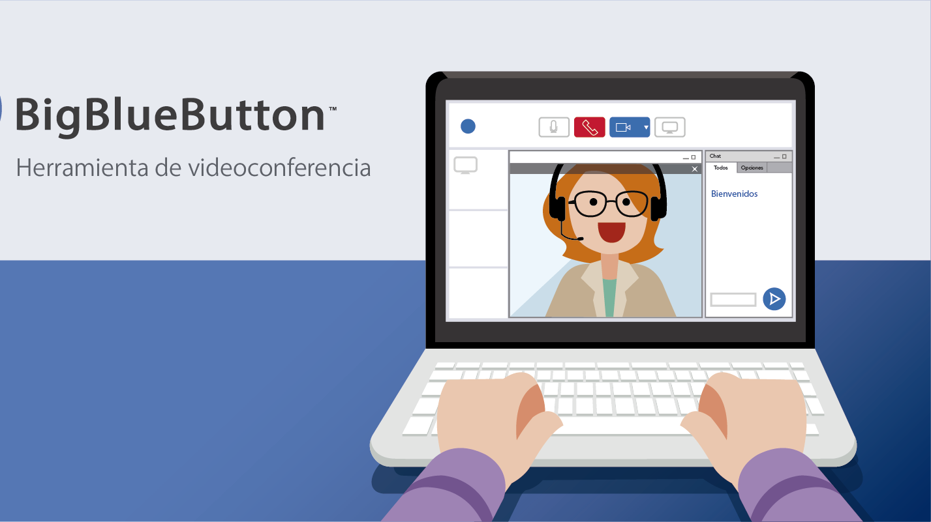
Scalability
Nadula J.K.D.P
IT20168568

Slide 14
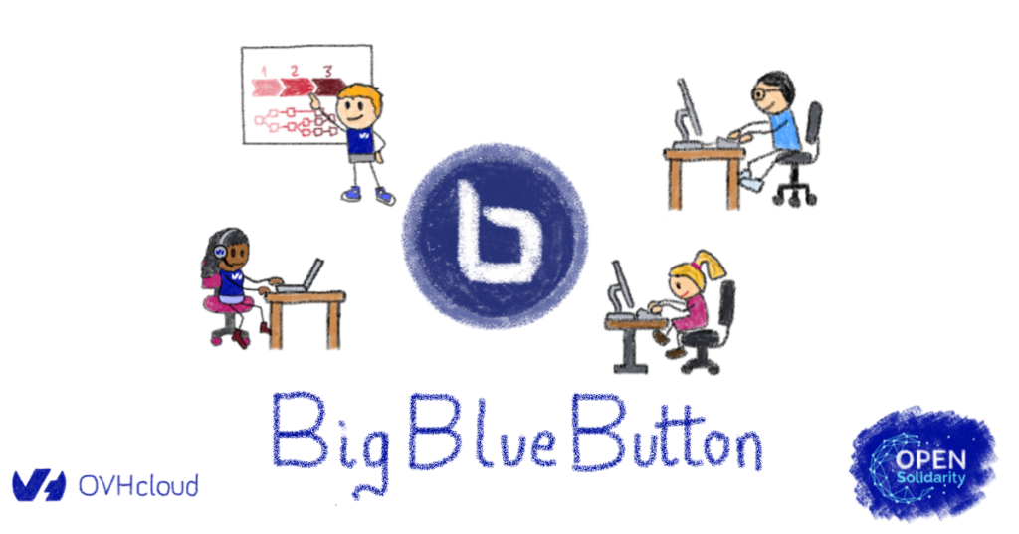
If you already have a learning management software such as Moodle, Canvas or Salaki, you can use appropriate plugins to integrate BigBlueButton.
customize BigBlueButton
Manage recordings: delete recordings older than N days, move recording to a different partition and migrate recordings from a previous version.
Reduce bandwidth from webcams.
Disable webcams or screen sharing to save bandwidth.
Add a phone number to the conference bridge, so that your students can join the class by using a telephone number.
Pass custom parameters to the client. This helps you in, for example, minimizing the presentation area or hiding the chat panel when a student joins a class.
Nadula J.K.D.P
IT20168568

Slide 15

Scalability of HTML5 server component
BigBlueButton 2.2 used a single nodejs process for all client-side communication.
This process would start to bottleneck (the nodejs process, running on a single CPU core, started to use 100% of the core). Because nodejs was running on a single CPU core,
having a 16 or 32 CPU core server for BigBlueButton 2.2 failed to yield much additional scalability.
Nadula J.K.D.P
IT20168568

Slide 16
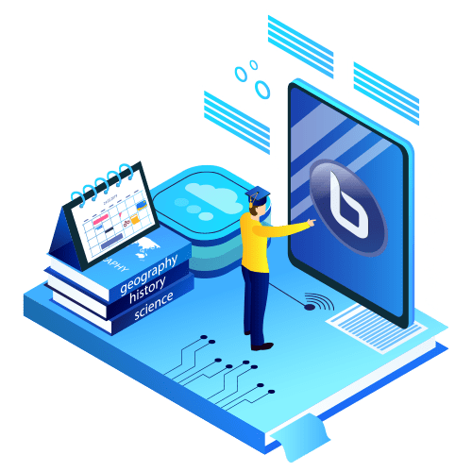
Each node of BigBlueButton can run on the hardware server and are combined horizontally into a cluster of multiple BigBlueButton servers.
While maintaining each users’ privacy, all users have access to any of the servers at any time and are automatically routed to them.
You can scale BigBlueButton horizontally simply by adding a new BigBlueButton server node to your cluster each time your cluster runs out of capacity.
Users in different geographical regions are possible as well.
Recordings are pooled to a single server and can be scaled using a CDN or Amazon Web Services’ S3 service.
Nadula J.K.D.P
IT20168568

Slide 17

is BigBLUEBUTTON Secure?
YES
Kulathunga H.M.C.K
IT20274498

Slide 18


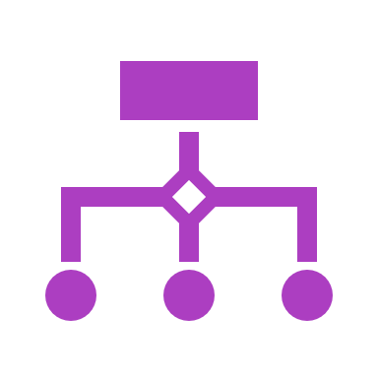
what are protection layers include in bigbluebutton?
BigBlueButton includes HTTPS to secure users' browser and server connections.
BigBlueButton uses checksums to validate API calls.
BigBlueButton uses Datagram Transport Layer Security (see DTLS) to ensure the sending of audio and video data packets over WebRTC over UDP connections.
Kulathunga H.M.C.K
IT20274498

Slide 19





Security mechanisms in BigBlueButton
When the BigBlueButton server is secured with a transport level security (TLS) certificate, all content download from the server to the user’s browser occurs via hypertext transport protocol secure (HTTPS).
When a front-end makes an API request to BigBlueButton, the BigBlueButton server validates the incoming server checksum computed from a shared secret. If the checksum match fails, the request is ignored.
When the BigBlueButton client loads, it makes data connections back to the BigBlueButton server using a web socket connection encrypted HTTPS.
When the BigBlueButton shares the user’s audio, video, or screen, the browser uses the built-in web real-time communication (WebRTC) libraries that transmit real-time protocol packets (RTP) over user datagram protocol (UDP) via Datagram Transport Layer Security.
To provide communications privacy for datagram protocols the media packets are encrypted using the Secure Real-Time Protocol.
Kulathunga H.M.C.K
IT20274498

Slide 20
Security Vulnerabilities in BigBlueButton
An issue was discovered in BigBlueButton through 2.2.29. “A brute-force attack may occur because an unlimited number of codes can be entered for a meeting that is protected by an access code.”(1 year ago)
An issue was discovered in BigBlueButton through 2.2.29. “When at attacker is able to view an account_activations/edit?token= URI, the attacker can create an approved user account associated with an email address that has an arbitrary domain name.”(1 year ago)
“BigBlueButton before 2.2.5 allows remote attackers to obtain sensitive files via Local File Inclusion.”(2 year ago)
Kulathunga H.M.C.K
IT20274498

Slide 21
THANK YOU

