Slide 1
Remote Sensing Image Analysis using Merkel Quad Trees
Akash Rao - 17IT205
Harsh Maru - 17IT215
Pranav P - 17IT229
Shashank KV - 17IT140

Slide 2
Remote Sensing Image Analysis
Remote sensing is the science of obtaining information about about objects or areas from a distance, typically from satellites or aircrafts.
Given the large volume and diversity of the remote sensing data, the images on different aspects are also frequently updated, and it is labour-consuming to figure whether two particular images are the same.
Therefore, we need a lightweight and straightforward methodology which can facilitate timely remote sensing data monitoring and evaluation, especially for a large geographical area.

Slide 3
Data Structure
Merkle Tree
Quadtree
Merkle Quadtree

Slide 4
Merkle Tree
In cryptography and computer science, a Hash tree or Merkle tree is a tree in which every leaf node is labelled with the hash of a data block and every non-leaf node is labelled with the cryptography hash of the labels of its child nodes
Merkel tree is repeatedly created by hashing the pairs of nodes until there is only one hash left(this hash is called the Root Hash, or the Merkle Root)
Merkle root node summarizes all of the data, if the root hashes of two trees are different implies that the data set the two trees are representing are also different

Slide 5
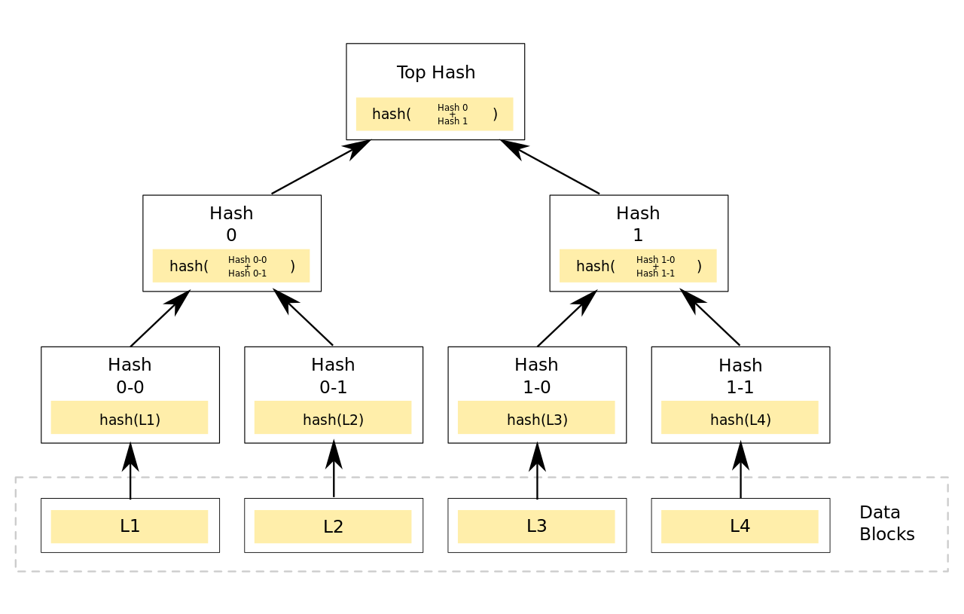
MM

Slide 6
Quadtree
Quadtrees are trees used to efficiently store data of points on a two-dimensional space. In this tree, each node has at most four children. We can construct a quadtree from a two-dimensional area using the following steps:
Divide the current two dimensional space into four boxes.
If a box contains one or more points in it, create a child object, storing in it the two dimensional space of the box.
If a box does not contain any points, do not create a child for it.
Recurse for each of the children.

Slide 7
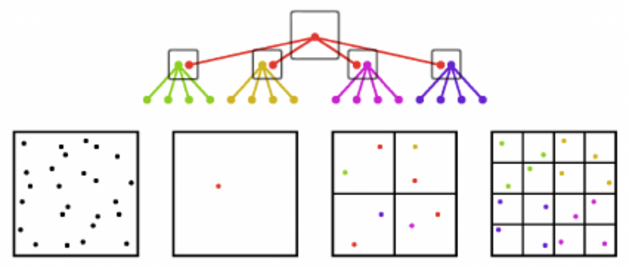
Quadtree

Slide 8
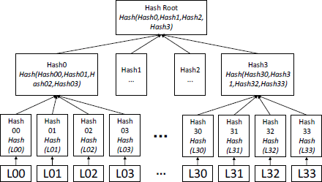
Merkle Quad-Tree

Slide 9
Versions
Version 1 – Two sets of four strings(With one string differing in the sets ) were supplied as data blocks to two trees of level 1. Code was able to find the data-block that was different.
Version 2 – Learnt about the “imagehash” python library. Used two sets of four images(with one pair differing) to two trees of level 1. Code was able to identify the pair of images that was diferent. It was assumed that the four images were pieces of a bigger image.
Version 3 –Learnt about “image_slicer” python library. The code was supplied with two images that was slightly different. The code was able to point out which piece was different.
Version 4 – There was no image output till now.Image output was introduced in this version. The piece that was identified as different was converted into grayscale(To highlight the different piece) and the pieces were joined. This is the version where the product got it’s look. We were still working at level 1 tree.
Version 5 –We expanded the levels of the trees to 3 .ie Divided the image into 64 pieces. Increasing the accuracy of the product.
Version 6 - Expansion of levels to four, i.e., the image was divided into 256 pieces .

Slide 10
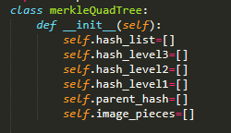
The Code
Defining the class merkleQuadTree with the following attributes

Slide 11
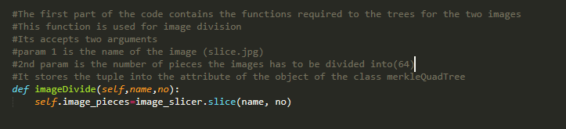
imageDivide function is used to divide the image into ‘no’ number of pieces and store the objects of the pieces of the image in the image_pieces attribute

Slide 12
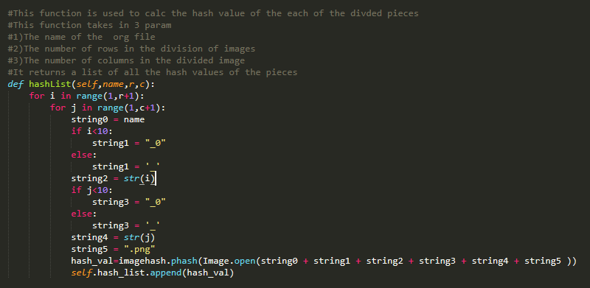
hashList function is used to find the hashes of all the 256 pieces of the image and store it in the hash_list attribute

Slide 13
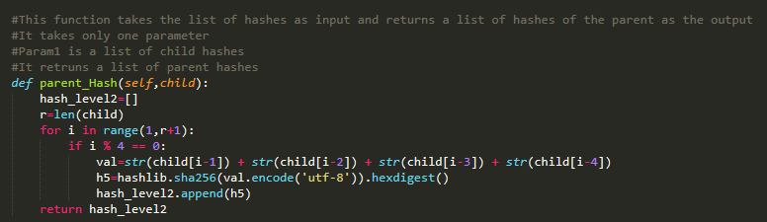
Parent_Hash function is used to find the hashes of the parents of the child nodes and return a list of parent hashes.

Slide 14
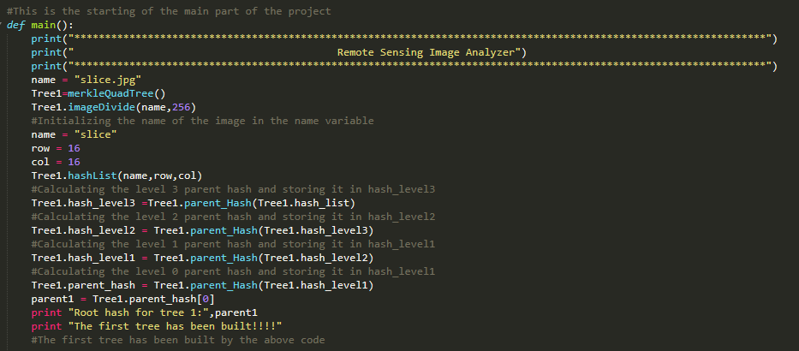
This part of the code is used to make the merkle quad tree from the image supplied.

Slide 15
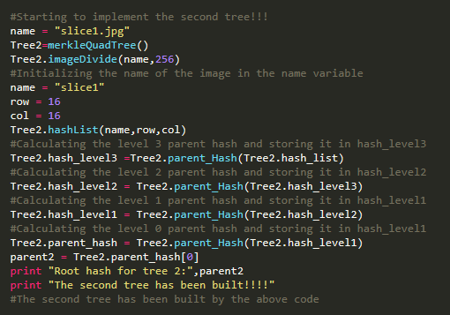
This part of the code is used to build a merkle quad tree from the second supplied image.

Slide 16
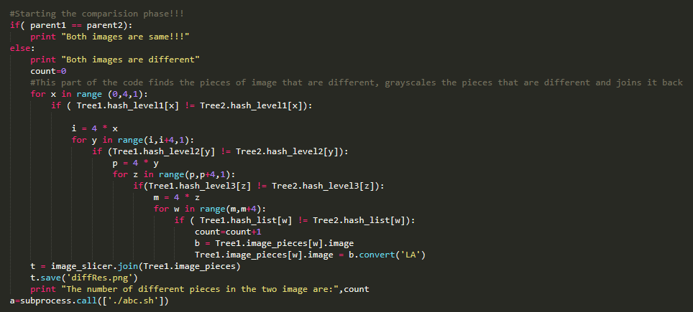
This part of the code is used to find the different pieces of the two images and convert them to grayscale and join them back to form the diffRes.png image

Slide 17
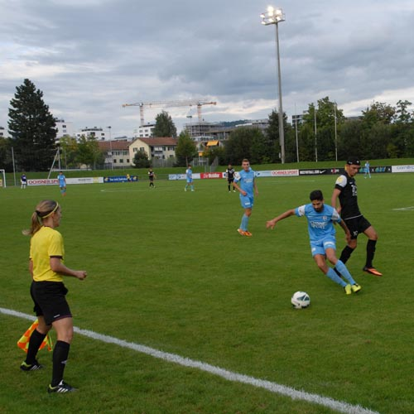

Can you spot the difference between the two images?

Slide 18

The third pole is missing!
The surrounding area in the image is highlighted in Grayscale!

Slide 19
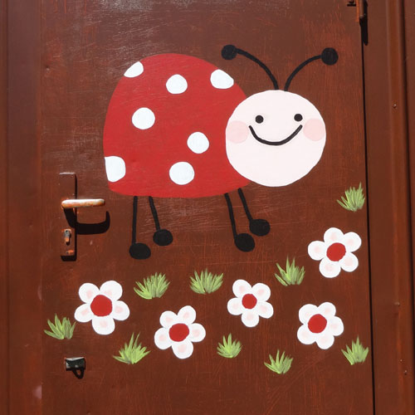

Another one!

Slide 20
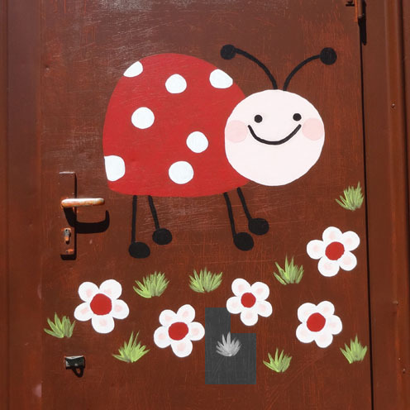
A patch of grass is missing. Did you spot it?!

Slide 21
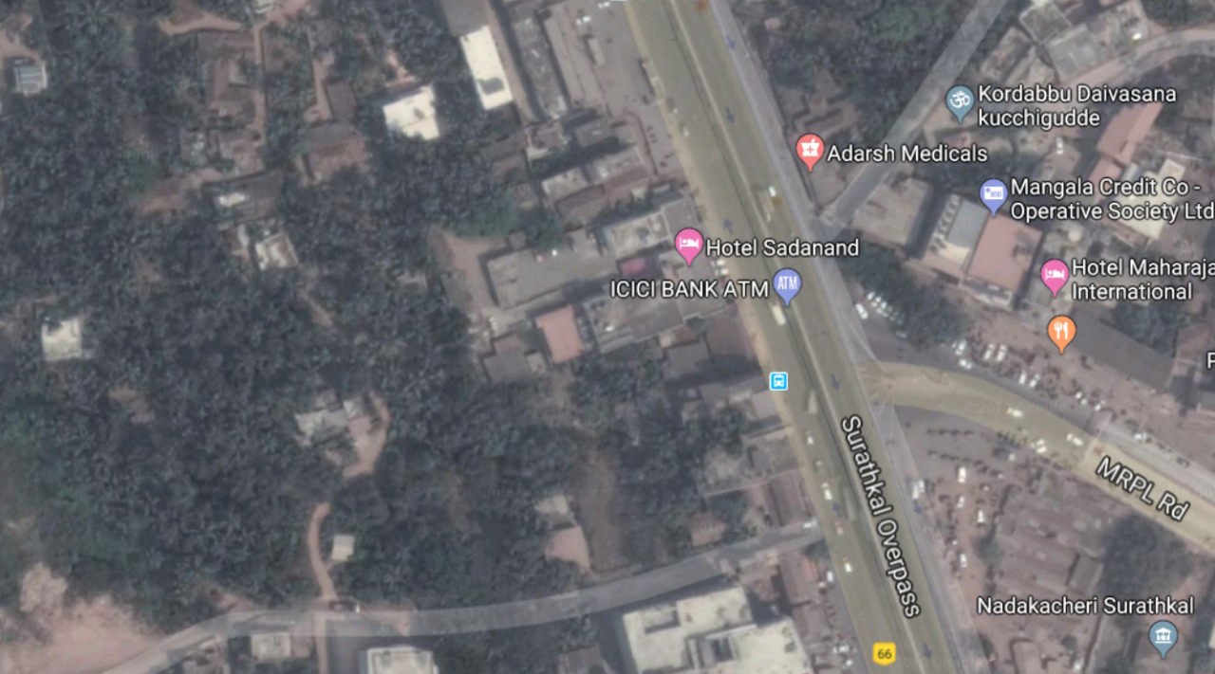
Main application:Remote Sensing Image Analysis
First Image

Slide 22
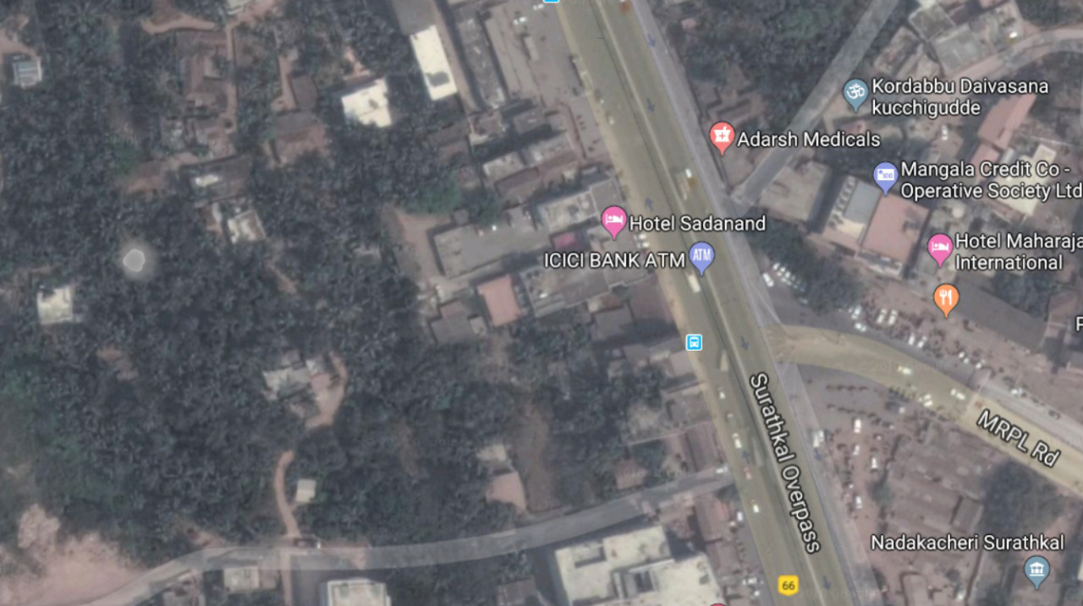
Second Image

Slide 23
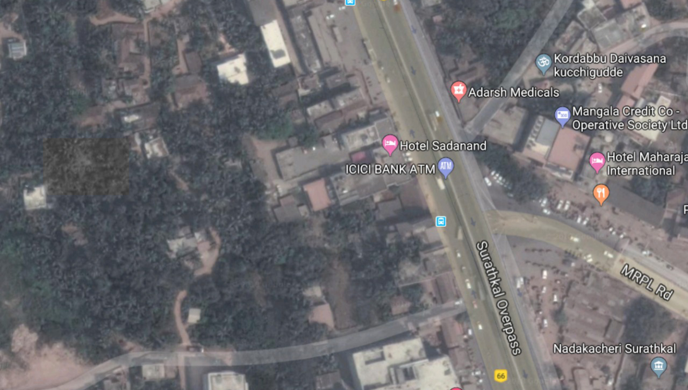
Output

Slide 24
Future Improvements
Accuracy can be improved by increasing the levels of the Merkle Quadtree.
The code can be improvised to account for weather changes.

Slide 25
Limitations
The code can work only on images which are of the same size.
The highlighted portion of images cannot be identified when the images are completely black and white.

Slide 26
References
https://ieeexplore.ieee.org/document/8128423
https://pypi.org/project/ImageHash/
https://pypi.org/project/image_slicer/
https://docs.python.org/2/library/hashlib.html
https://stackoverflow.com/questions/3777301/how-to-call-a-shell-script-from-python-code
https://stackoverflow.com/questions/12201577/how-can-i-convert-an-rgb-image-into-grayscale-in-python

Slide 27
Thank You!!!

