Slide 1

Student Assignment Similarity Analyzer
2520030257-Praneeth Gadila
2520030096 – Guru Kiran Matray
2520030275 – Kunal Shahane

Slide 2
Abstract & Problem Statement
ABSTRACT
    A Java-based system for detecting plagiarism and similarity in student TXT/PDF assignments.
    Automatically compares each new submission with all previous assignments.
    Uses String Algorithms and Dynamic Programming to detect exact and modified copied content.
    Generates similarity percentages and identifies the most similar submissions.
PROBLEM STATEMENT
  Manual comparison of multiple assignments is time-consuming and difficult to scale.
  Students may modify copied content through word changes, insertions, deletions, or transpositions.
  An automated system is needed to efficiently compare submissions and flag suspicious similarities.
  The system classifies assignments using a 10% similarity threshold: ≤10% Original, >10% Copied.

Slide 3
Description
  Java-based console application for detecting assignment similarity and plagiarism.
  Accepts TXT and PDF assignment files.
  Extracts and preprocesses text from submitted documents.
  Uses TF-IDF and Cosine Similarity to calculate document similarity.
  Compares new assignments with previously submitted reference documents.
  Generates a similarity percentage for each comparison.
  Classifies assignments as Original or Copied using a predefined threshold.
  Demonstrates practical application of Data Structures & Algorithms.
  Technologies: Java 17+, Apache PDFBox, TF-IDF, Cosine Similarity.

Slide 4
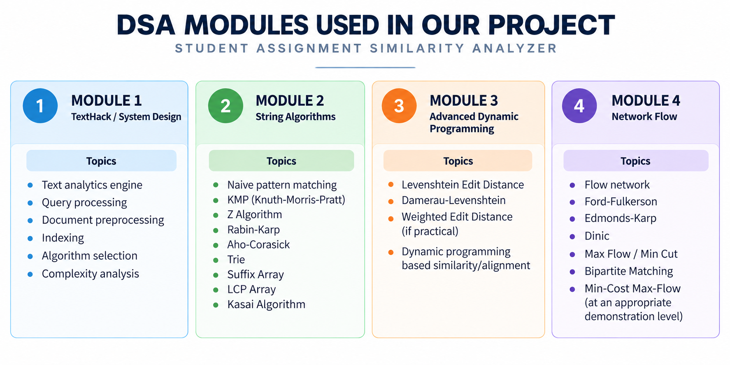
CO-Wise topics involved

Slide 5
Tools, Technologies & Expected Outcome
Tools & Technologies
  Language: Java
  GUI: Java Swing
  IDE: Visual Studio Code
  File Formats: TXT & PDF
  PDF Processing: Apache PDFBox
  String Algorithms: Naïve, KMP, Z-Function, Rabin-Karp, Aho-Corasick
  Suffix Algorithms: Suffix Array, LCP & Kasai
  Dynamic Programming: Levenshtein, Wagner-Fischer, Damerau-Levenshtein
  Similarity: TF-IDF & Cosine Similarity
  Data Structures: Trie, HashMap, Arrays, Lists

Slide 6
Tools, Technologies & Expected Outcome
Expected Outcome
  Automatic comparison with all previous assignments.
  Accurate identification of exact and modified copied content.
  Pairwise similarity percentage for every previous submission.
  Identification of the highest-similarity assignment.
  Automatic Original/Copied classification using the 10% threshold.
  Reduced manual plagiarism checking and improved scalability for large numbers of submissions.

Slide 7
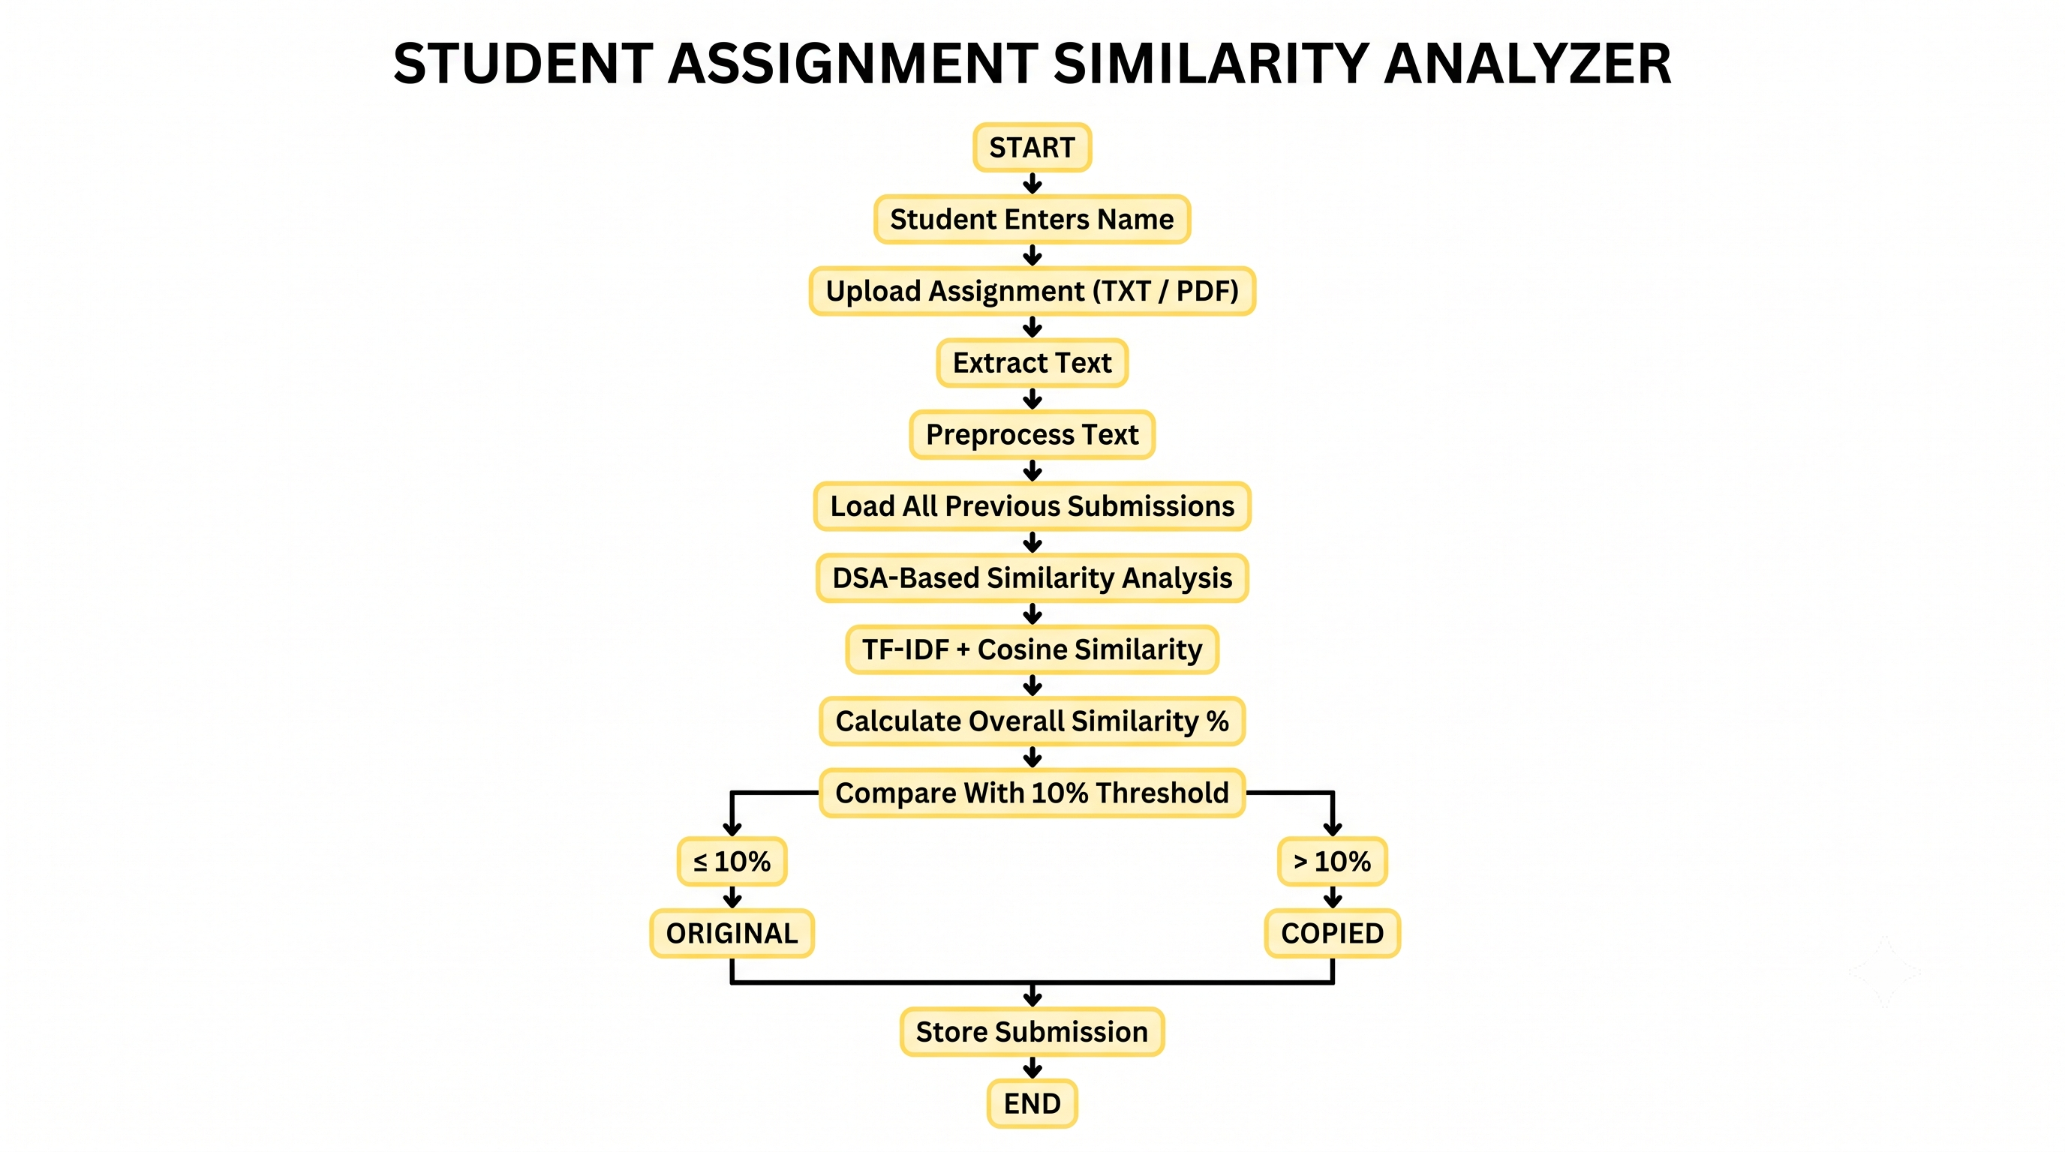
Workflow

Slide 8
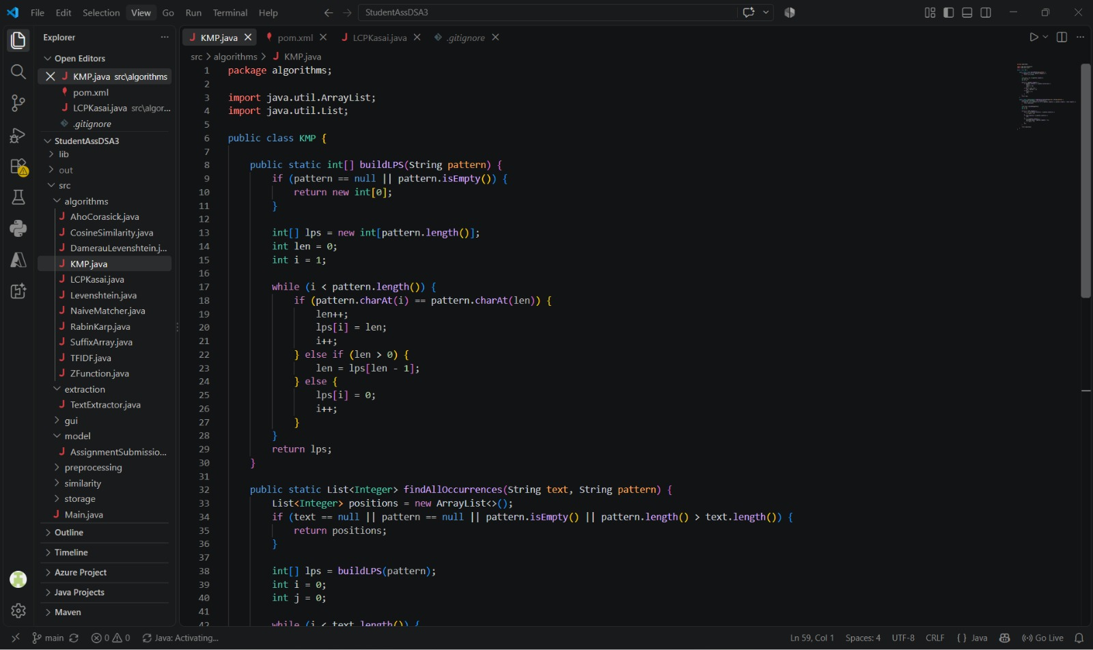
Code implementation

Slide 9
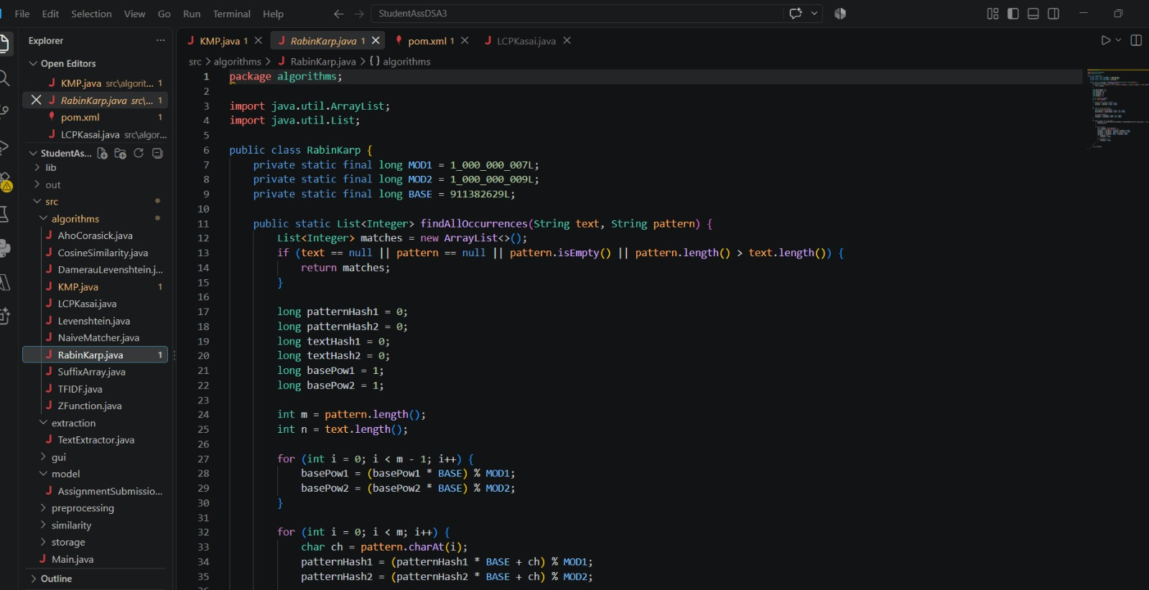
Code implementation

Slide 10
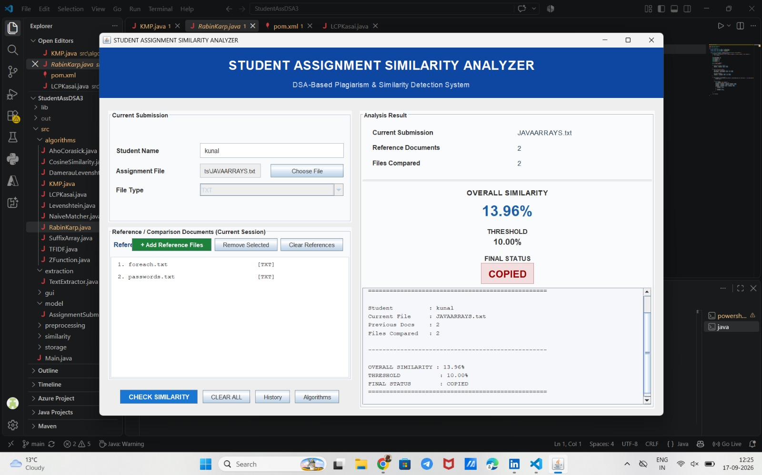
Output

Slide 11
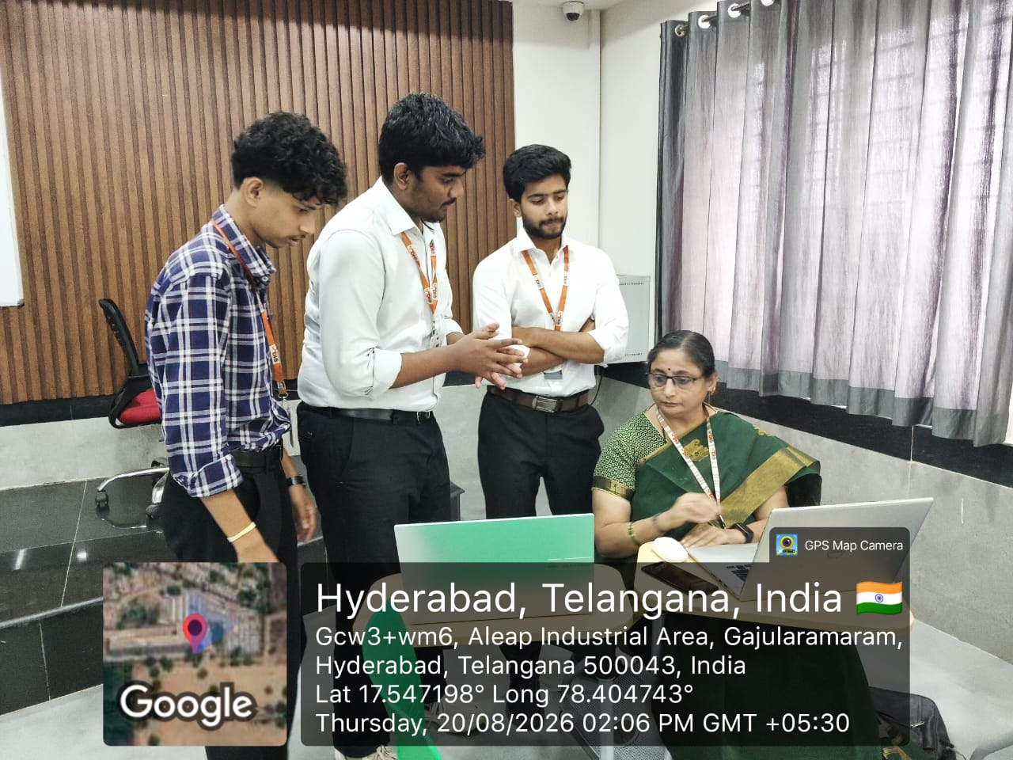
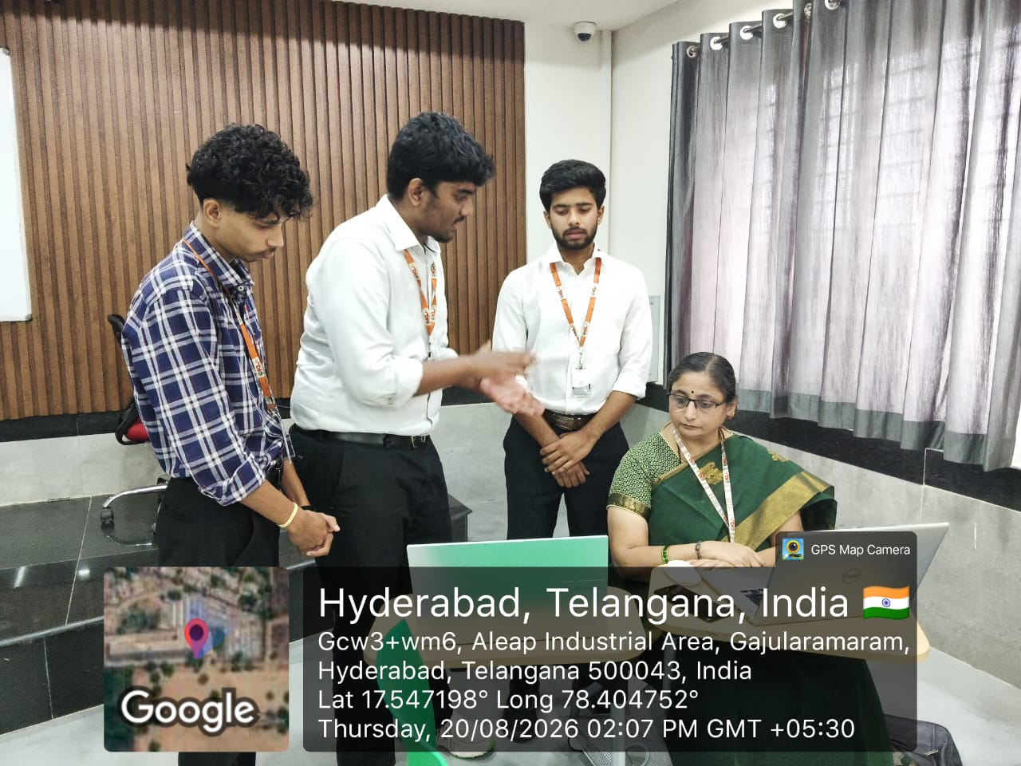
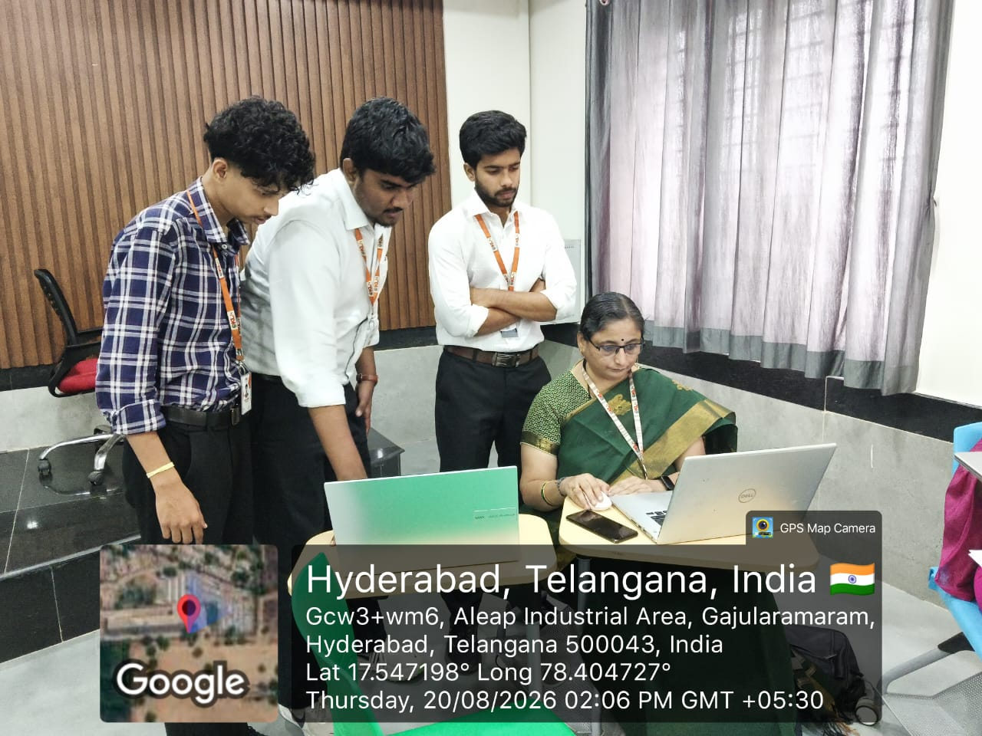
Geotag images

