Slide 1
CSE 522 & 410J Lecture 21 November 12, 2020

Slide 2
Object-Oriented Concepts
Java Memory Management
JUnit Testing
Contracts & Aspects
Java Reflection
OO Requirements
Use-Case Driven Design
Unified Modeling Language
Towards Web Services
SOAP and ReST
Spring Tool Suite

Slide 3
AOP: Aspect-Oriented Programming
An aspect is a cross-cutting concern of an application, e.g., logging, tracing, as well as contract checking.
Intertwining the cross-cutting concern with the main logic of the application goes against separation of concerns.
AspectJ is a Java extension for defining aspects. In AspectJ, an aspect is a unit of modularity, similar to a class.
An AspectJ aspect consists of two important constructs:
point cuts and advice. A point cut comprises a set of join points, each of which is a well-defined execution point.

Slide 4
Outline of an Aspect
public aspect AspectName {
…declare fields …
pointcut pc_1(arg_types) : point_cut_expression
before (arg_types) : pc_1(arg_names) {… Java code… }
after(arg_types) : pc_1(arg_names) {… Java code… }
…
pointcut pc_n(arg_types) : point_cut_expression
before (arg_types) : pc_n(arg_names) {… Java code… }
after(arg_types) : pc_n(arg_names) {… Java code… }
…declare methods …
}

Slide 5
Compilation Methodology
Java
code
AspectJ
aspects
AspectJ
Weaver
Woven code
in Java
Woven code can be compiled by Java compiler and executed.

Slide 6
Join Points and Advice
Advice code
executed at
each Join Point
Join Points
Java Program Execution

Slide 7
Example: Tracing
We can develop an AspectJ tracer for functions:
- by printing out the inputs to the functions and their output, and
- indenting function calls to clarify the nesting of function calls.
The pointcut will refer to the arguments of function calls.

Slide 8
Tester Class for Tracing
class TracerExamples {
public static void main(String[] args) {
Func obj = new Func();
obj.test1(); System.out.println("---");
obj.test2(); System.out.println("---");
obj.test3(); System.out.println("---");
}
}
class Func {
public void test1() { fact(5); }
public void test2() { gcd(30, 140); }
public void test3() { isprime(37); }
public int fact(int n) {
if (n == 0) return 1; else return n*fact(n-1);
}
public int gcd(int x, int y) {
return x > y ? gcd(x-y, y) :
x < y ? gcd(x, y-x) : x;
}

Slide 9
Tester Class (continued)
public boolean isprime(int n) {
int sq;
sq = isqrt(n);
return isprime2(n, sq, 2);
}
public int isqrt(int n) {
int sq, lo, hi;
hi = 1;
while (hi * hi < n)
hi = hi + 1;
lo = hi - 1;
if (n - lo * lo < hi * hi - n)
sq = lo;
else sq = hi;
return sq;
}
public boolean isprime2(int n, int sq, int i) {
if (i > sq) return true;
else if ((n / i) * i == n) return false;
else return isprime2(n, sq, i + 1);
}
}

Slide 10
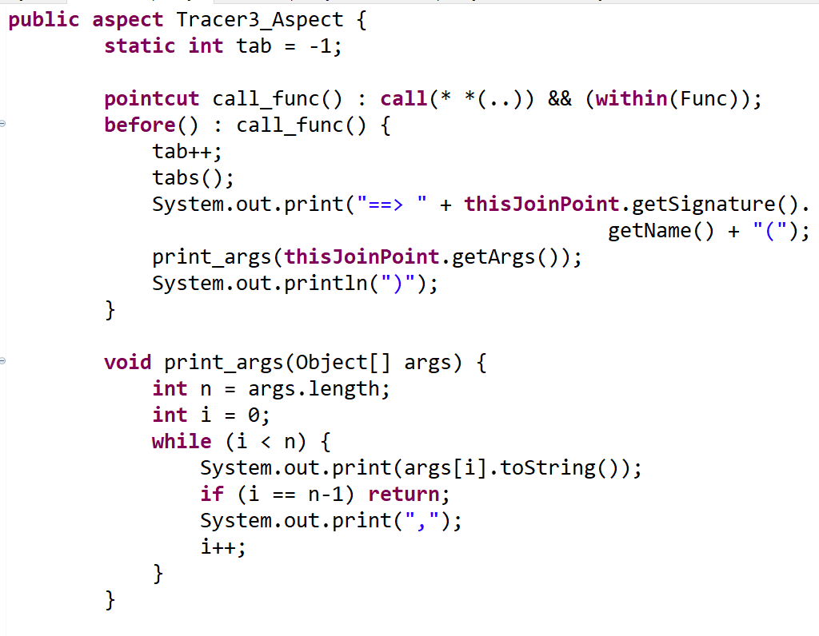
Tracer Aspect for Functions
“Match any function in class Func"
Before
Advice
“get all the
arguments”
“convert each
argument value
to String”

Slide 11
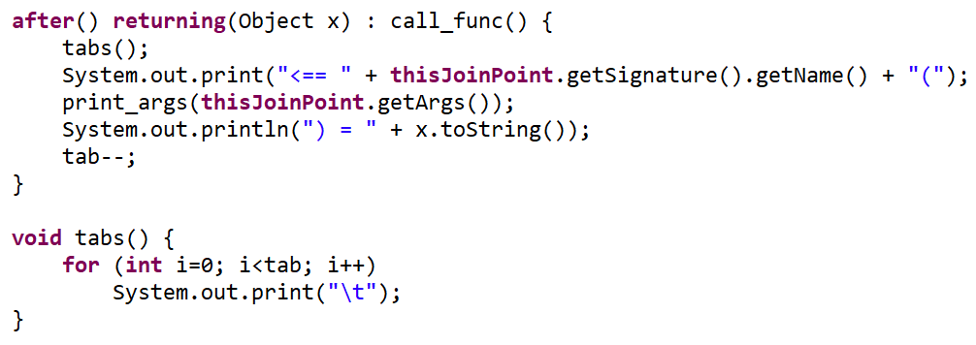
Tracer Aspect (continued)
After Advice
In the After Advice note that the result type is specified as
Object and it is converted to String for printing. This will
give meaningful values for simple types but not for arrays
and other object references.

Slide 12
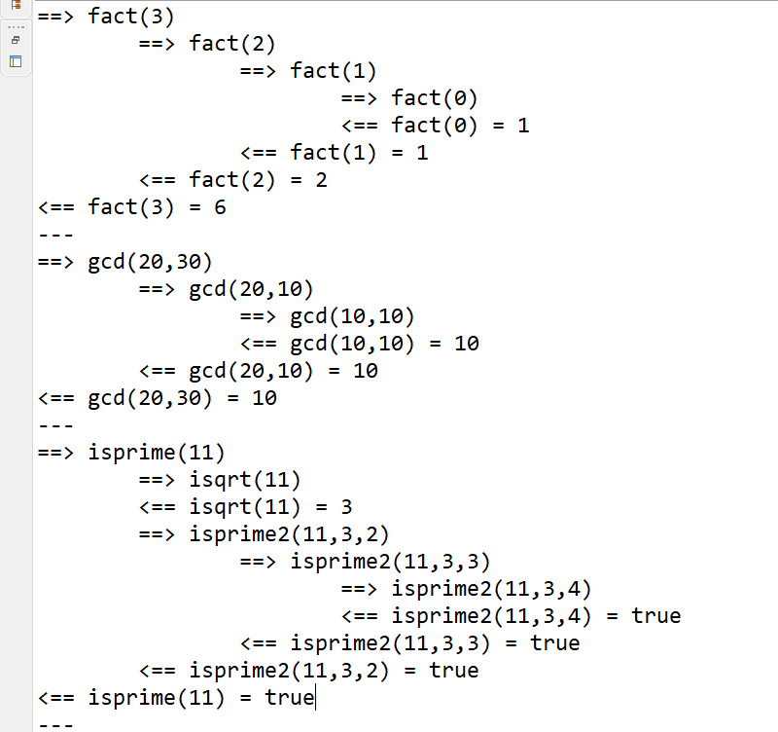
Console Output

Slide 13
Common Types of Point Cuts
When a method body executes:
execution(int Func.fact(int))
execution(* *(..))
When a method is called:
call(int Func.fact(int)
call(* *(..))
When a method call has arguments:
args(a)
args(a, b)
When the target object is of type MyStack
target(MyStack)
When the executing code belongs to class Func
within(Func)

Slide 14
Point Cut Expressions
Point cuts can be combined with &&, || and !.
pointcut call_fact(int n) :
call(int Func.fact(int)) && args(n)
pointcut call_multiple_funcs() :
call(* *(..)) &&
(within(Func) || within(Test))
pointcut recursive_calls_on_fact(int n) :
call(int Func.fact(int)) && args(n) &&
withincode(int Func.fact(int));
More examples at AspectJ website.

Slide 15
Types of Advice in AspectJ
The two main forms of advice at a pointcut are:
before (arg_types) : pc(arg_names) {… Java code… }
after(arg_types) : pc(arg_names) {… Java code… }
Example:
pointcut call_fact(int n) :
call(int Func.fact(int)) && args(n);
before(int n) : call_fact(n) { … }
after(int n) returning(int result) : call_fact(n) { … }
}

Slide 16
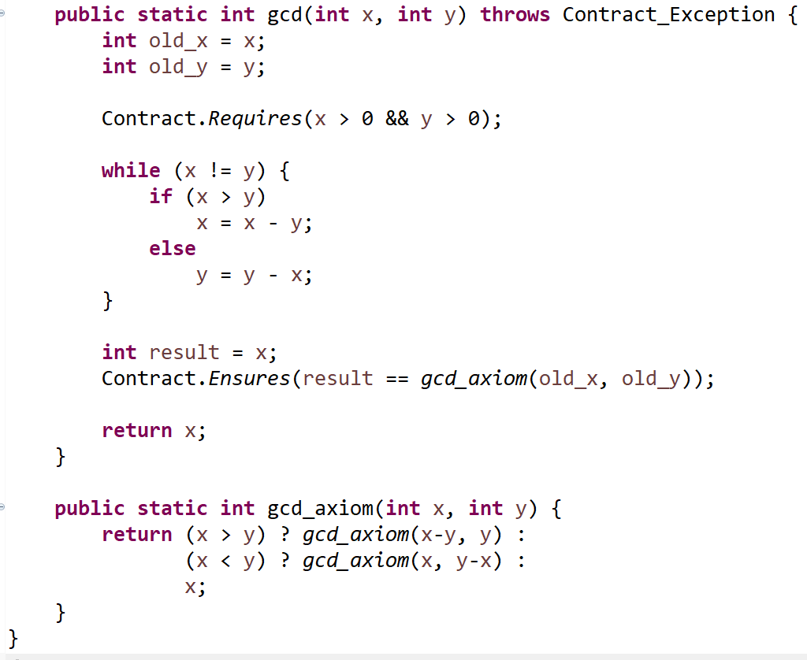
Implementing Contracts
Can we separate
gcd code from contract code?
Lecture 19
slide #9

Slide 17
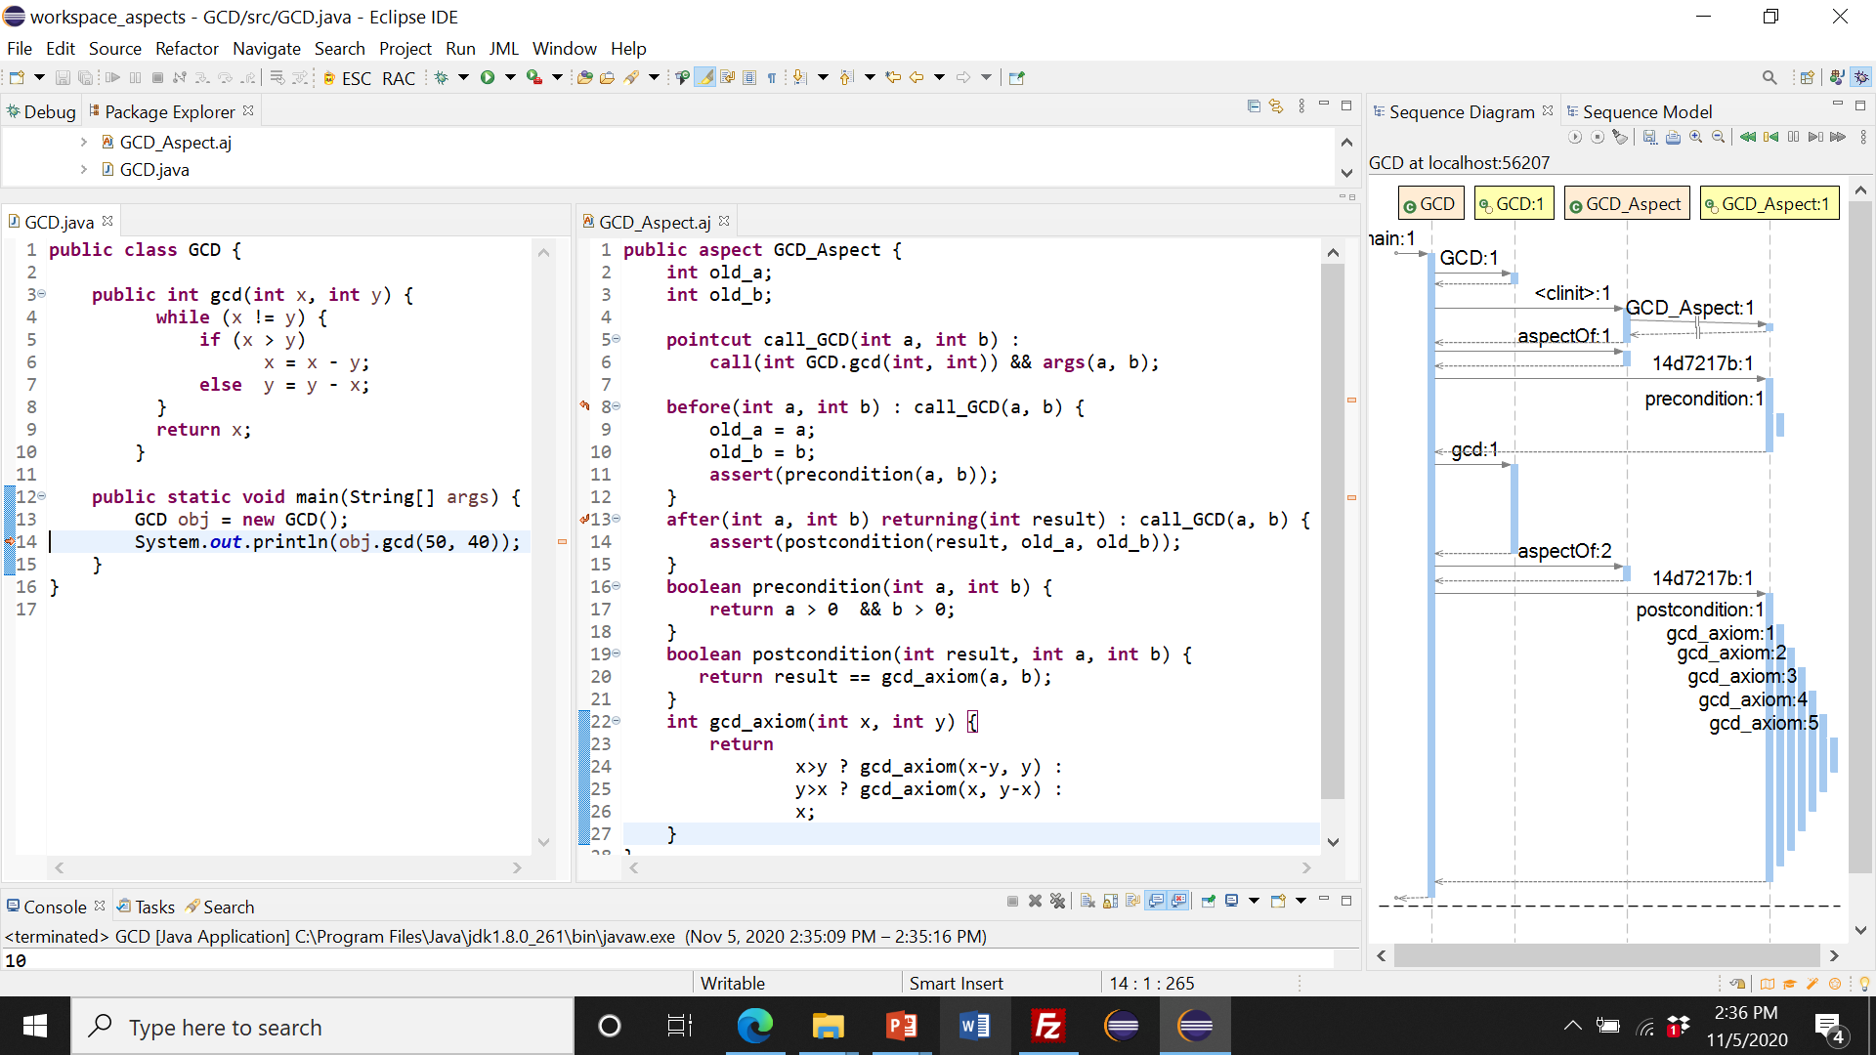
Contracts as Aspects
GCD aspect
GCD code
Contract code

Slide 18
BubbleSort Program
class Sort {
public void bubbleSort(int[] a) {
boolean flag = true;
for (int j = a.length - 1; j > 0 && flag; j--) {
flag = false;
for (int i = 0; i < j; i++)
if (a[i] > a[i + 1]) {
swap(a, i, i + 1);
flag = true;
}
if (!flag) break;
}
}
void swap(int[] a, int i, int j) {
int temp = a[i];
a[i] = a[j];
a[j] = temp;
}
}

Slide 19
Contracts for BubbleSort
public void bubbleSort(int[] a) throws Exception {
int[] old_a = a.clone();
Contract.Requires(a != null);
...bubbleSort Code ...
Contract.Ensures(ordered(a) && rearranged(old_a,a));
}
void swap(int[] a, int i, int j) throws Exception {
int[] old_a2 = a.clone();
Contract.Requires(i >= 0 && i < a.length &&
j >= 0 && j < a.length);
...swap code ...
Contract.Ensures(a[i] == old_a2[j] &&
a[j] == old_a2[i]);
}

Slide 20
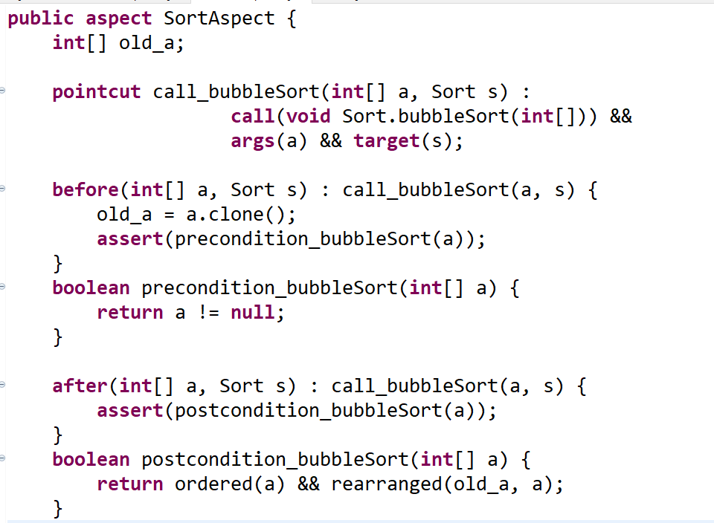
BubbleSort Contracts as Aspects

Slide 21
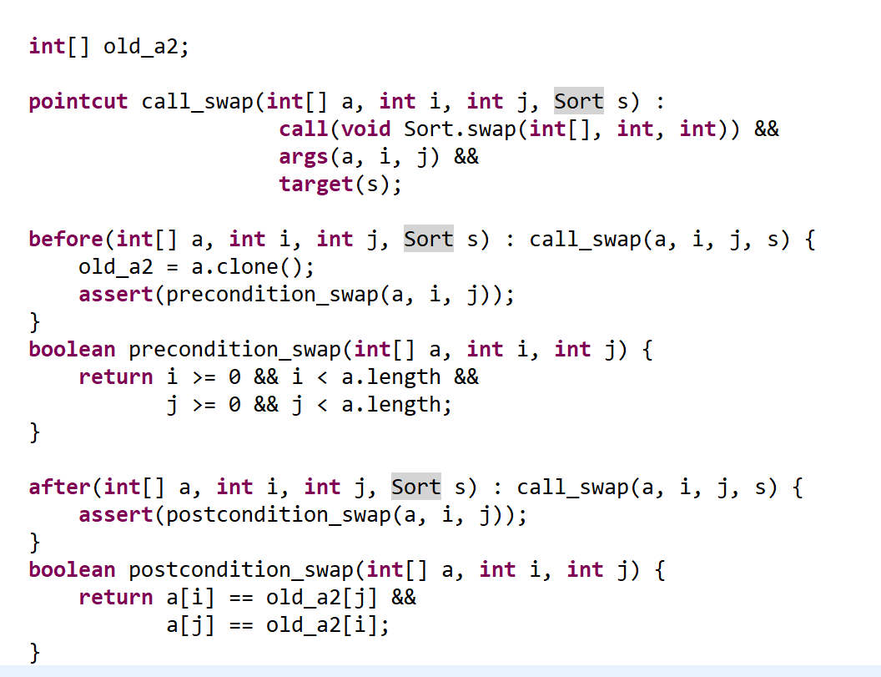
Swap Contracts as Aspects

Slide 22
Notes on BubbleSort Aspect
The “old array” can be saved in the before advice of both pointcuts: call_bubbleSort and call_swap.
The cloning of the arrays can also be done in before advice.
Strictly speaking, we need two different “old arrays”, one for bubbleSort and one for swap. But we will get correct results with just one “old array”.

Slide 23
Concluding Remarks
AspectJ provides an easy-to-use set of constructs
for implementing cross-cutting concerns in
a clean, modular way for Java.
The applications of aspects are mainly utilities
such as logging, tracing, debugging, contract
checking, etc.
We will have a problem in A4 Part 3 exploring the
“contracts as aspects” idea.

Slide 24
Java Reflection
Through its Reflection primitives, Java provides
the ability to dynamically inspect and modify the
details and behavior of any object at execution time.
This capability is crucial in the implementation of
aspects. It is also used extensively in the
implementation of the JIVE system.
Let’s briefly see the Java Reflection primitives …

Slide 25
Test Case for Reflection
import java.lang.reflect.Method;
import java.lang.reflect.Field;
import java.lang.reflect.Constructor;
public class Reflection_Example {
private String s;
public Reflection_Example() { s = "CSE522"; }
public void m1() {
System.out.println(“String = " + s);
}
public void m2(int n) {
System.out.println(“Number = " + n);
}
}

Slide 26
class Demo {
public static void main(String args[]) throws Exception {
Reflection_Example obj = new Reflection_Example();
Class c = obj.getClass();
System.out.println(“Class is " + c.getName());
Constructor cons = c.getConstructor();
System.out.println(“Constructor is " + cons.getName());
System.out.println(“Public methods of class are : ");
Method[] methods = c.getMethods();
for (Method method:methods)
System.out.println(method.getName());
Also lists the
methods of class
Object

Slide 27
Method method1 = c.getDeclaredMethod("m1");
Method method2 = c.getDeclaredMethod("m2", int.class);
Field field = c.getDeclaredField("s");
field.setAccessible(true);
field.set(obj, "HELLO");
method1.invoke(obj);
method2.invoke(obj, 522);
}
}

Slide 28
Console Output
The name of class is Reflection_Example
The name of constructor is Reflection_Example
The public methods of class are :
m1
m2
wait
wait
wait
equals
toString
hashCode
getClass
notify
notifyAll
The string is HELLO
The number is 522
These methods are
inherited from
class Object

Slide 29
More on Reflection
The Oracle website has a good article on Reflection:
https://www.oracle.com/technical-resources/articles/java/javareflection.html
Reflection is useful for dynamic inspection and
analysis, but it does come with a performance cost
and hence should be used sparingly.

Slide 30
Towards a Systematic Design of Object-Oriented Software

Slide 31
Waterfall Model of Software Development
Requirements
Assumes
Linear Flow
of Development
Analysis & Design
Implementation
Test
Deployment

Slide 32
Iterative Model of Development
It is based on evolving executable prototypes, not documentation.
It accommodates changes to requirements with less disruption.
It involves the user/customer throughout the process
It is risk-driven: implement the riskiest use-case first.
It is planned, managed, predictable
Notes:
45
If anything, the iterative life cycle requires more planning and more thought all along the way. The difference is that instead of doing all of the detailed planning up front, it is done in a distributed fashion, a little at a time along the way, when enough information is available to make the planning worthwhile.

Slide 33
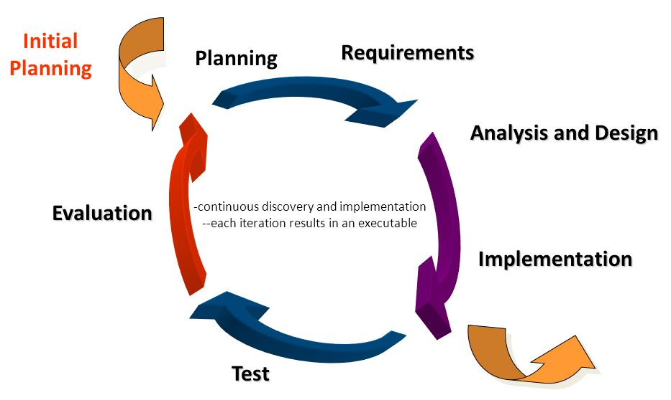
Iterative Model of Development
Picture taken from the web: Gustavus Adolphus College
Notes:
51

Slide 34
Three Important Features of Iterative Model
Continuous integration
Not done in one lump near delivery date
Frequent, executable releases
Some internal; some delivered
Address risks through demonstrable progress
Progress measured in products, not documentation or engineering estimates
Notes:
46
These three characteristics are what make the iterative life cycle particularly attractive to managers. The iterative approach provides managers with more accurate information with which to plan and manage the project.

Slide 35
Guidelines for Writing Project Description
Domain vocabulary
- Define main entities and functionalities.
Example: University Course Registration
Entities: course, student, faculty, etc.
Functionalities: create a course, register for course, drop a course, generate class listing, …
Actors: those who perform an operation, e.g. registrar

Slide 36
Guidelines for Writing Project Description (Cont’d)
Need for consistent and complete domain vocabulary
- Avoid imprecise, redundant, ambiguous terminology.
Can discuss performance, usability, and reliability criteria:
operating environment
space/time requirements
user-friendliness
fault tolerance, robustness

Slide 37
Guidelines for Writing Project Description (Cont’d)
Do NOT discuss implementation issues, e.g., data-structures, algorithms, design patterns, target implementation language (C++, Java, etc).
If you wish to discuss implementation issues, this should be clearly separated from the main body of the project description and provided as an appendix.
Next we will see a few brief project descriptions, to provide some guidance. A figure may be included if this will help to clarify the relationships between entities.

Slide 38
Project Description for
ATM Transactions
From the book, “Object-Oriented Modeling and Design, by James Rumbaugh et al

Slide 39
Project Description

Slide 40
Nouns ~ Entities

Slide 41
Verb Phrases ~ Use Cases

