Slide 1

Flow Strategies and Process Design
Designed and Created By Praneet
Roll No 2302570049

Slide 2

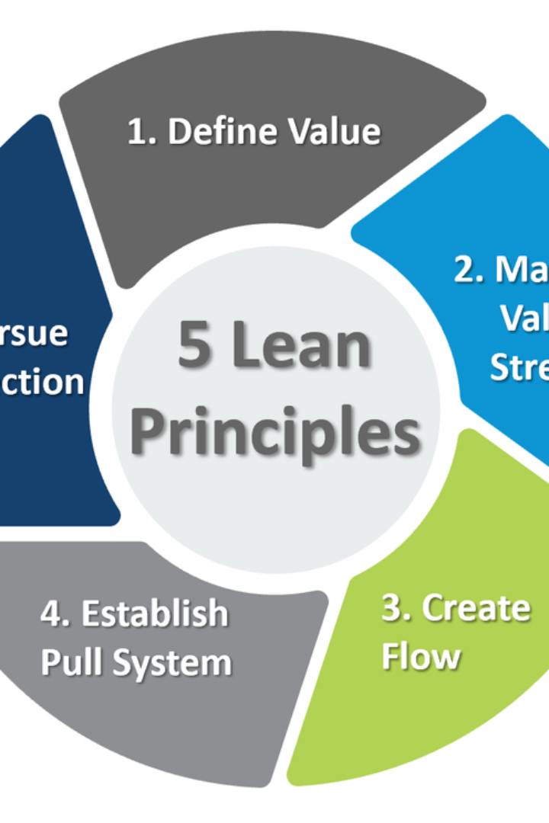
Flow Strategies and Process Design
Exploring lean processing and operations, cellular manufacturing, and (re-)design of work systems.
https://youtu.be/UBSdMqO4lBk?si=Sht593Z0xsjVHnI2

Slide 3

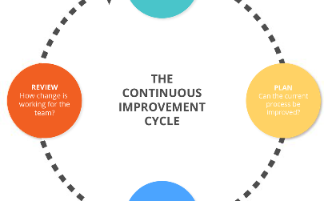
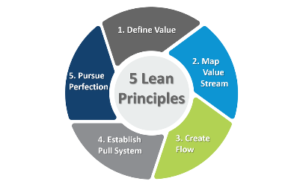
https://youtu.be/38y33HYYoQE?si=MSBdGzzu7Rdxa3bZ
Lean Processing
Efficiency Enhancement
Streamlined Workflows
Continuous Improvement
Optimizing processes to reduce waste and enhance productivity.
Implementing strategies for smooth and efficient workflow management.
Embracing a culture of continuous improvement and waste reduction.

Slide 4
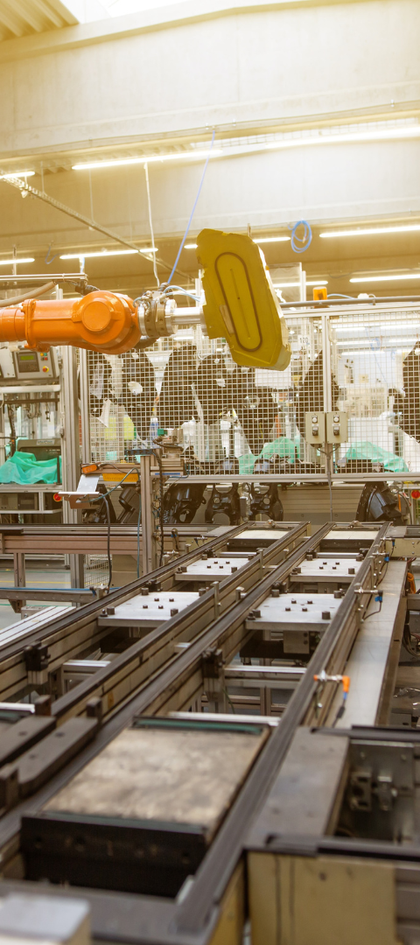
https://youtu.be/u38l1tV5lkc?si=4cBAaOWOnLlaUxve
Cellular Manufacturing
1
Workstation Efficiency
2
Enhanced Flexibility
Organizing machinery and equipment to optimize production.
Adapting to changes by reconfiguring cells for varying production needs.
3
Reduced Lead Times
Minimizing lead times through efficient cellular arrangement.

Slide 5
https://youtu.be/fKd5Wlfg8lk?si=vh0s7dVFwLWlJ_uY
Work Measurement
Time Standards
Performance Evaluation
Process Optimization
Establishing precise time standards for conducting tasks.
Identifying opportunities for process improvement through accurate measurement.
Assessing employee performance and process efficiency.

Slide 6
https://youtu.be/Ic_El2DkpjA?si=NT3YQoiRO3gbsRDE
Aggregate Production Planning
Resource Allocation
Inventory Management
Integrated Strategies
Distributing resources effectively to meet production targets.
Maintaining optimal inventory levels to support production demands.
Aligning production planning with sales and marketing goals.
Planning for labor, raw materials, machinery, and other essentials.
Creating a cohesive plan that accounts for market trends and customer demand.
Strategizing to reduce excess inventory and associated costs.

Slide 7



Link - https://youtu.be/n6c6hjptUbg?si=gdTnyXTgik0reuHx
Scheduling: Flow Shop and Job Shop
Flow Shop
Job Shop
Optimizing production sequences for efficient, high-volume manufacturing.
Customizing production schedules to accommodate unique project requirements.

Slide 8

Link - https://youtu.be/3Sx96vWfF8w?si=CluIopEgUkjXm8fX
Management of Quality
1
Quality Assurance
Implementing strategies to ensure high-quality outputs and customer satisfaction.
2
Continuous Monitoring
Adopting measures for ongoing assessment and improvement of quality processes.
3
Employee Training
Investing in employee training to uphold quality standards and practices.

Slide 9
Link - https://youtu.be/JExh2DhqCG0?si=3JKPwDtmxA38PfYq
Strategic Planning for Production Design
3
5
2M
Efficiency Ratios
Process Enhancements
Employee Utilization
Optimizing workflows and operations for greater efficiency.

Slide 10
References
https://youtu.be/UBSdMqO4lBk?si=Sht593Z0xsjVHnI2
https://youtu.be/38y33HYYoQE?si=MSBdGzzu7Rdxa3bZ
https://youtu.be/u38l1tV5lkc?si=4cBAaOWOnLlaUxve
https://youtu.be/fKd5Wlfg8lk?si=vh0s7dVFwLWlJ_uY
https://youtu.be/Ic_El2DkpjA?si=NT3YQoiRO3gbsRDE
https://youtu.be/n6c6hjptUbg?si=gdTnyXTgik0reuHx
https://youtu.be/JExh2DhqCG0?si=3JKPwDtmxA38PfYq

Slide 11

Thank You

