Slide 1

Nature, Evolution and Scope of Production and Operations Management
Designed and Created By Praneet
Roll No 2302570049

Slide 2

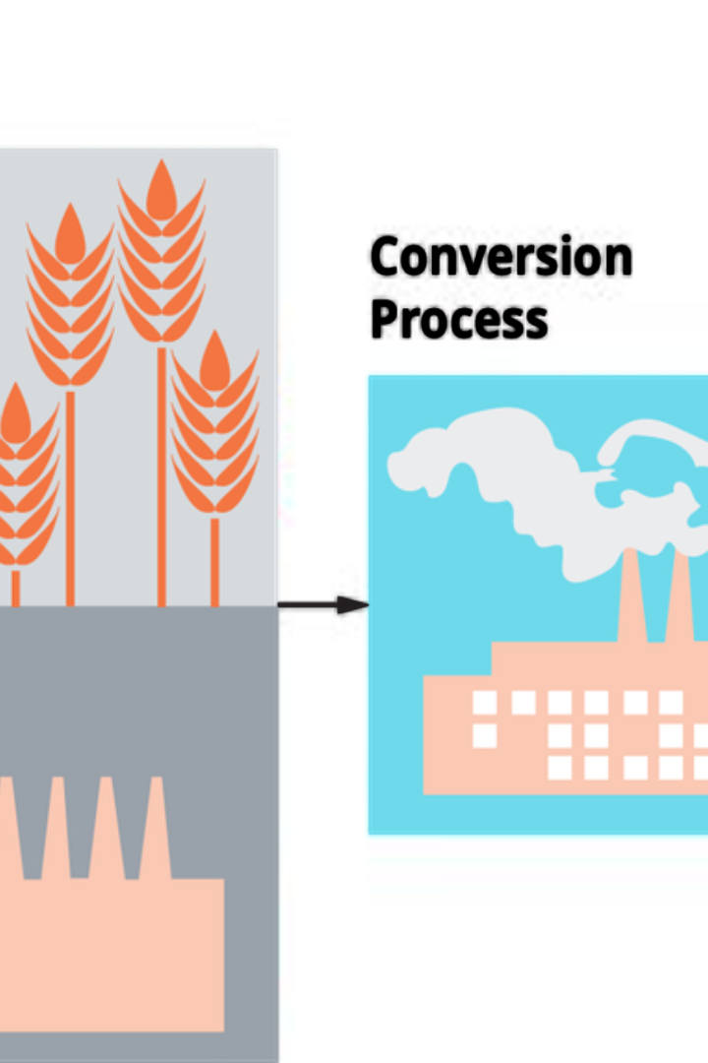
Link - https://youtu.be/8ZUs4pt1sRk?si=PdhNa73xok8EN1Mv
Nature, Evolution and Scope of Production and Operations Management
Production and Operations Management involves overseeing the process of transforming resources into goods or services. It encompasses concepts of efficiency, quality, and sustainability.

Slide 3
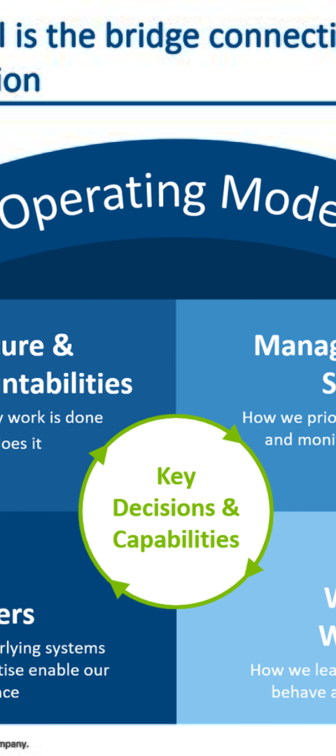
Link - https://youtu.be/QXzIxnIPRMw?si=QUm55GNOVL8iJhB_
Operations as a Competitive Strategy
1
Efficiency
2
Lean Principles
Streamlining processes to reduce costs and improve productivity.
Implementing techniques to eliminate waste and optimize operations.
3
Agility
Adapting quickly to market changes and customer demands.

Slide 4
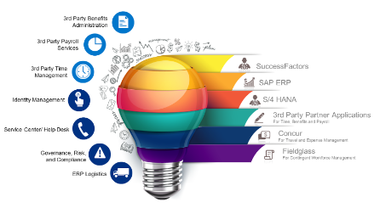
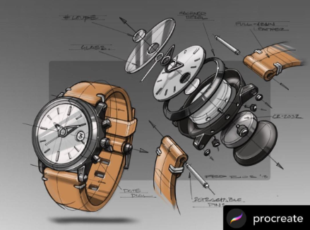

Link - https://youtu.be/j501HN3IlqI?si=vXcYDtp8Zj1Ie5B6
Product and Service Design Factors and Issues
Functionality
Aesthetics
Sustainability
Designing products/services to meet specific user needs.
Considering the visual appeal and emotional impact of the design.
Integrating eco-friendly materials and production processes.

Slide 5
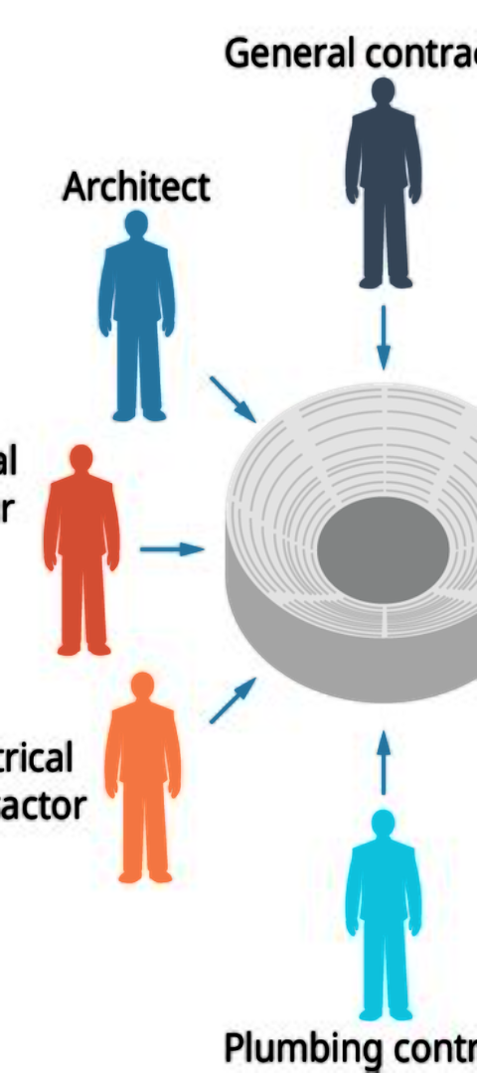
Link - https://youtu.be/DiAMdJaEG9k?si=c0ApMnwSRJvgqZUN
Facility Location: Planning and Analysis
Accessibility
Cost Efficiency
Strategically locating facilities for convenient access to suppliers and markets.
Analyzing and minimizing transportation and operational costs.
Market Demand
Evaluating locational factors based on consumer demand and distribution networks.

Slide 6
Link - https://youtu.be/8fiANopZV6A?si=Yc-soLtsnQZtY6yZ
SMART Goals in Operations Management
1
Specific
2
Measurable
Setting clear and unambiguous objectives for each aspect of operation.
Defining criteria to track progress and evaluate goal achievement.
3
Achievable
4
Time-bound
Establishing realistic objectives based on available resources and capabilities.
Assigning deadlines to ensure goals are accomplished within a specified timeframe.

Slide 7

Link - https://youtu.be/6vGczbn26jE?si=GvoArCmEvcUwgxk7
Resources for Leadership Development
1
Mentors
Guidance from experienced industry professionals.
2
Real-World Experiences
Practical learning gained from hands-on projects and challenges.
3
Continuous Learning
Access to books, courses, and workshops for skill enhancement.

Slide 8



Link - https://youtu.be/3Sx96vWfF8w?si=PFpPOOIiTj5hnsMM
Quality Management in Operations
Standardization
Performance Metrics
Continuous Improvement
Implementing consistent processes to maintain product/service quality.
Using KPIs to measure and improve operational performance.
Embracing Kaizen principles for ongoing enhancement of processes.

Slide 9
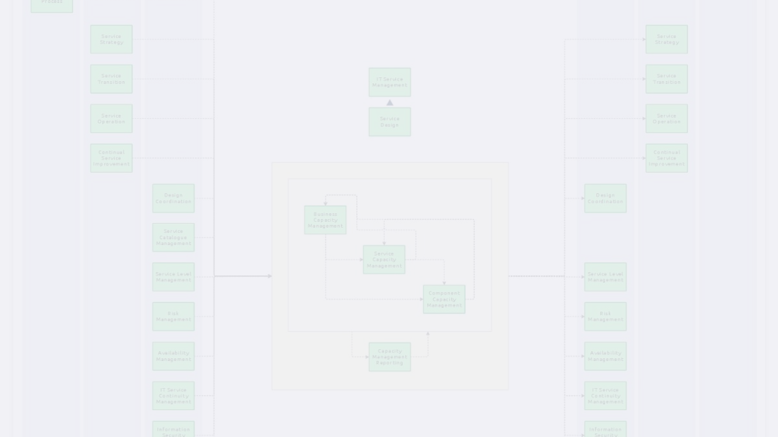



Link - https://youtu.be/9JWhdJL9f0Y?si=qIteaXcmH5Bd97z9
Capacity Planning and Management
Forecasting Demand
Optimizing Resources
Scalability
Predicting future capacity requirements based on market trends.
Efficiently allocating machinery, labor, and space to meet demand.
Designing systems capable of adapting to changing production needs.

Slide 10
References
Link - https://youtu.be/8ZUs4pt1sRk?si=PdhNa73xok8EN1Mv
Link - https://youtu.be/QXzIxnIPRMw?si=QUm55GNOVL8iJhB_
Link - https://youtu.be/j501HN3IlqI?si=vXcYDtp8Zj1Ie5B6
Link - https://youtu.be/DiAMdJaEG9k?si=c0ApMnwSRJvgqZUN
Link - https://youtu.be/8fiANopZV6A?si=Yc-soLtsnQZtY6yZ
Link - https://youtu.be/6vGczbn26jE?si=GvoArCmEvcUwgxk7
Link - https://youtu.be/3Sx96vWfF8w?si=PFpPOOIiTj5hnsMM
Link - https://youtu.be/9JWhdJL9f0Y?si=qIteaXcmH5Bd97z9

Slide 11

Thank You

