Slide 1


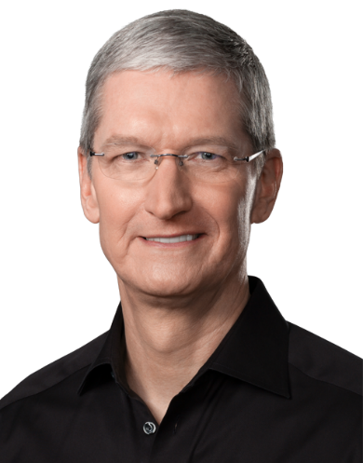
INTEGRATION OF INFORMATION TECHNOLOGY IN
APPLE'S BUSINESS MODEL

Slide 2

Introduction
Apple's History with Technology
Information Technology
in Apple's Business Model
Contents
Apple's Ecosystem
Apple's Future with Information Technology
Conclusion

Slide 3
INTRODUCTION
Apple Inc. is a globally recognized technology company that has consistently demonstrated the strategic integration of Information Technology into its business operations. This integration has been pivotal in propelling Apple to the pinnacle of the technology industry, contributing to its innovation, brand loyalty, and financial success.

Slide 4
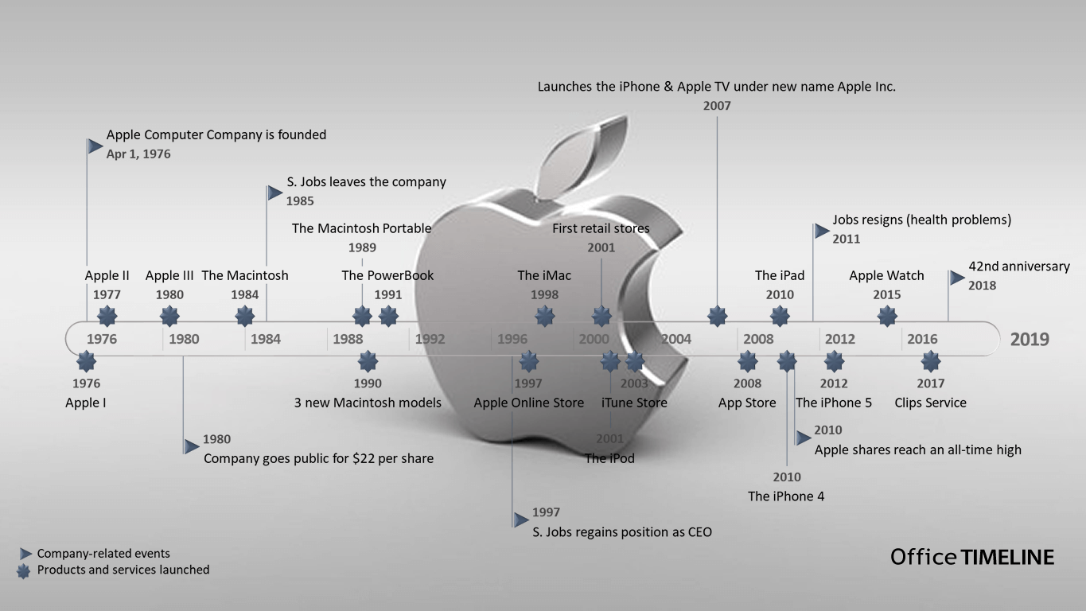
APPLE'S HISTORY WITH TECHNOLOGY.
Apple is a leader in the technology industry, known for its innovative and revolutionary products.
One of its earliest successes was the Macintosh, which introduced the graphical user interface to the masses and revolutionized personal computing.
By focusing on innovation and user experience, Apple has become a leader in the technology industry and continues to shape the future of technology.

Slide 5
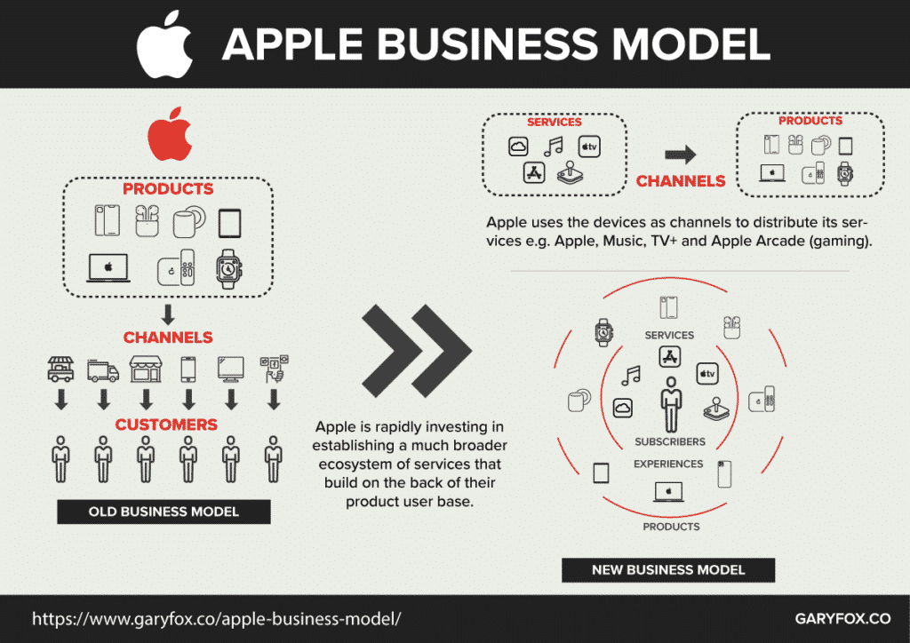
INFORMATION TECHNOLOGY IN APPLE'S BUSINESS MODEL.
APPLE'S RELIANCE ON INFORMATION TECHNOLOGY
Apple uses technology to streamline operations, improve customer experience, and increase efficiency.
For example, Apple uses RFID technology to manage inventory and track product movement in its retail stores.
Apple also uses mobile devices such as iPads for point-of-sale transactions.
Apple uses technology to improve the customer experience, such as through Siri and Apple Pay.
0
03
04

Slide 6
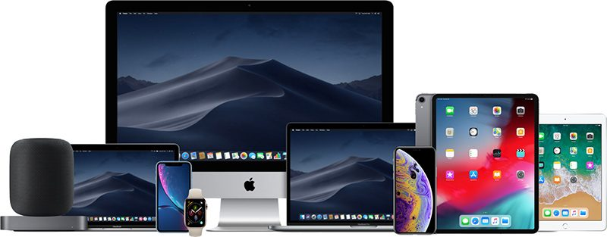
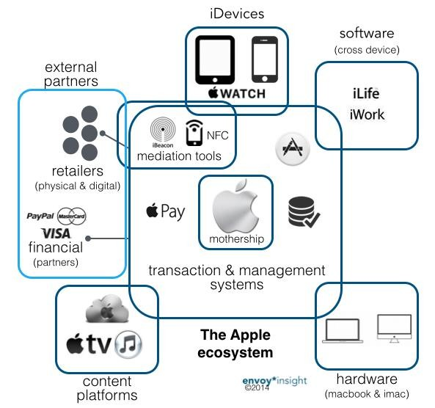
APPLE'S ECOSYSTEM
Apple's ecosystem integrates hardware, software, and services to provide a superior user experience.
Apple devices work seamlessly with Apple software, creating a cohesive experience.
This ecosystem allows for easy data synchronization and a consistent user interface.
Information technology is critical for developing software that communicates with hardware in real-time, providing a smooth user experience.

Slide 7
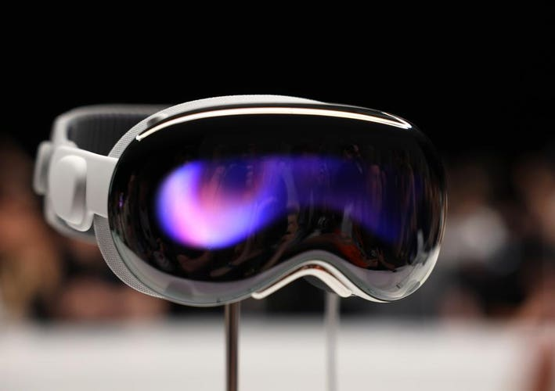
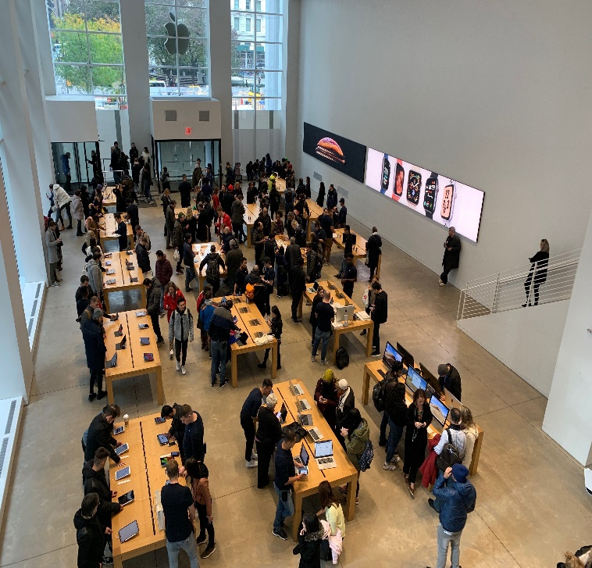
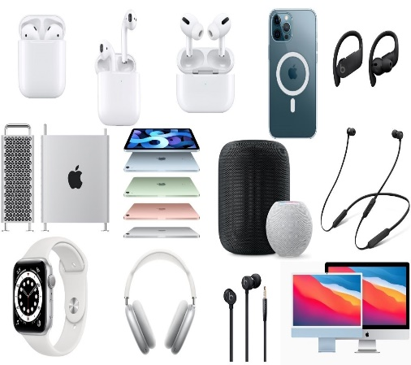
APPLE'S FUTURE WITH INFORMATION TECHNOLOGY
AR & A.I For
Customer Experience
Interaction With Product
Apple Devices
Apple is using AR and AI to improve the customer experience.
AR will allow customers to interact with products and services in a more immersive way.
AI will enable more personalized and intuitive interactions with Apple devices, and could also be used to improve healthcare.

Slide 8
CONCLUSION
In conclusion, we have seen how Apple's business model has been successful due to its integration of information technology. By leveraging data analytics, artificial intelligence, and other technologies, Apple has been able to improve its operations and customer experience, leading to increased market share and competitiveness.
It is clear that integrating information technology into your own business can bring similar benefits. By embracing technology, you can streamline your operations, gain valuable insights into your customers, and ultimately grow your business. So don't hesitate to explore the possibilities that technology can offer.

Slide 9

Thank You
PRANEET (GROUP LEADER & CREATIVE DIRECTOR)
(2302570049)
NOYAL (SPEAKER & PRESENTER)
(2302570023)
Designed & Created
by Praneet

