Slide 1
R Project Predictive Analysis of Anime Data (Movie / Web series)
Created By
Pranab Kumar Paul

Slide 2
Aims and Objectives
The main objectives of this project is to create a Linear Regression Business model from the "Anime" data in R & Predict the Rating.
Find the Significant Variables, Interpretations and giving useful business recommendations.

Slide 3
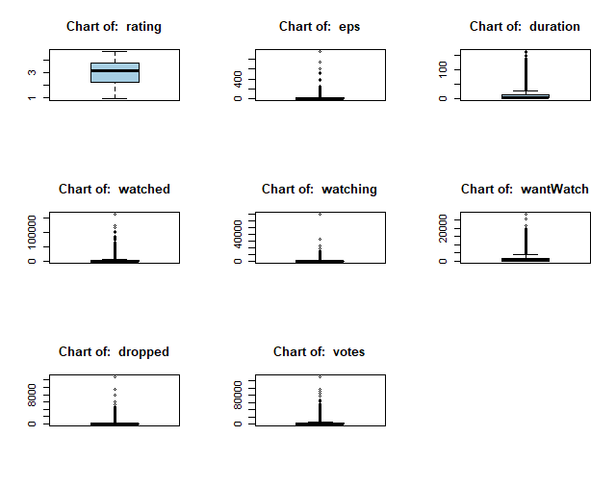
Univariate Analysis
Boxplot
We need outlier treatment for each continuous columns except the target column.

Slide 4
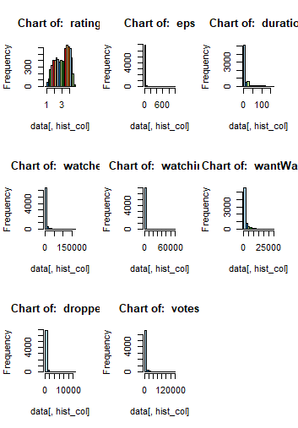
Univariate Analysis
Histogram
As we can see from this histogram plot that each and every continuous columns are highly positively skewed except “Rating” column. So, we need log transform to make those data normally distributed which will help us to increase the accuracy of the model.

Slide 5
Bivariate Analysis
Correlation Test:- After log transformation we have found---- "watched" ,"watching" ,“WantWatch“,"dropped" ,"votes" columns are strongly correlated with the target variable column.
Annova Test:- “MediaType” & “ongoing” categorical columns are strongly correlated with “Rating” column.(cause, p-Vaue<0.05)

Slide 6
Significant Variables
Among the 15 Independent variables, the variables which were found to be most significant in final model are as follows:
Watched : The number of users who completed watching it.
MediaType: Format of publication of the anime releases (Movie/TV/TV special).

Slide 7
Interpretations of the variables
The variables which are found to be significant are discussed one by one as follows:

Slide 8

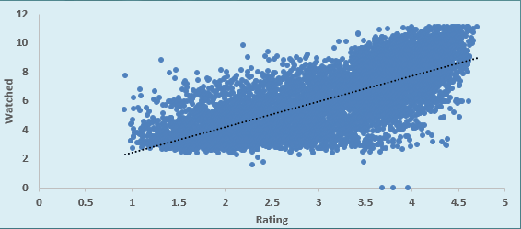
Watched vs Rating
It has been observed from this curve that “Rating” is increasing with increase of “Watched”. So, these two columns are positively correlated. Increasing rate of Watched help to increase the rating of the anime series which makes it more popular than others.

Slide 9
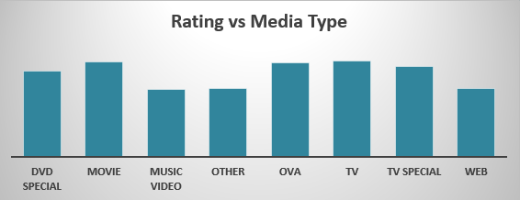
Media Type vs Rating
Movie, Tv, Tv Special are the significant category of MediaType as per final model. These types have more rating value and popularity than others.

Slide 10
Results Obtained
It was found from MAPE (Mean and Median error percentage) that our regression model is predicting the outcome 81.19%(Mean) & 87.77%(Median) accurately and error percentage is varying from 13% to 19% which is pretty good for prediction model.
The R-square value is found to be 0.5542 and adjusted R-square value is 0.5538. As these values are between 0.5 to 0.95, so this is good predictive model.

Slide 11
Business Recommendation
For better rating, it is required to focused on movie type - Movie, Tv, Tv-Special as this categories are famous to maximum audience.
Over the past few years audience change there way of watching movie. Now peoples are mostly interested to watch movie in Multiplex Theater also they like web series. So we have to focus on this type of platform to release Animation type of movie.
We have to launch the teaser of Animation type of movie on social media platform for better reach among public.

Slide 12
Thank You

