Slide 1
Autogen
Pranab Paul

Slide 2
What is AutoGen
An open-source framework designed by Microsoft Research’s AI Frontiers Lab to build AI agent systems. It simplifies the creation and orchestration of event-driven, distributed agentic applications, enabling multiple LLMs and SLM’s, tools, and advanced multi-agent design patterns.
AutoGen supports scenarios where multiple agents interact with each other to complete complex tasks autonomously or with human oversight.
The event-driven and distributed architecture makes it suitable for workflows that require long-running autonomous agents that collaborate across information boundaries with variable degrees of human involvement.
AutoGen currently supports C# and Python.

Slide 3
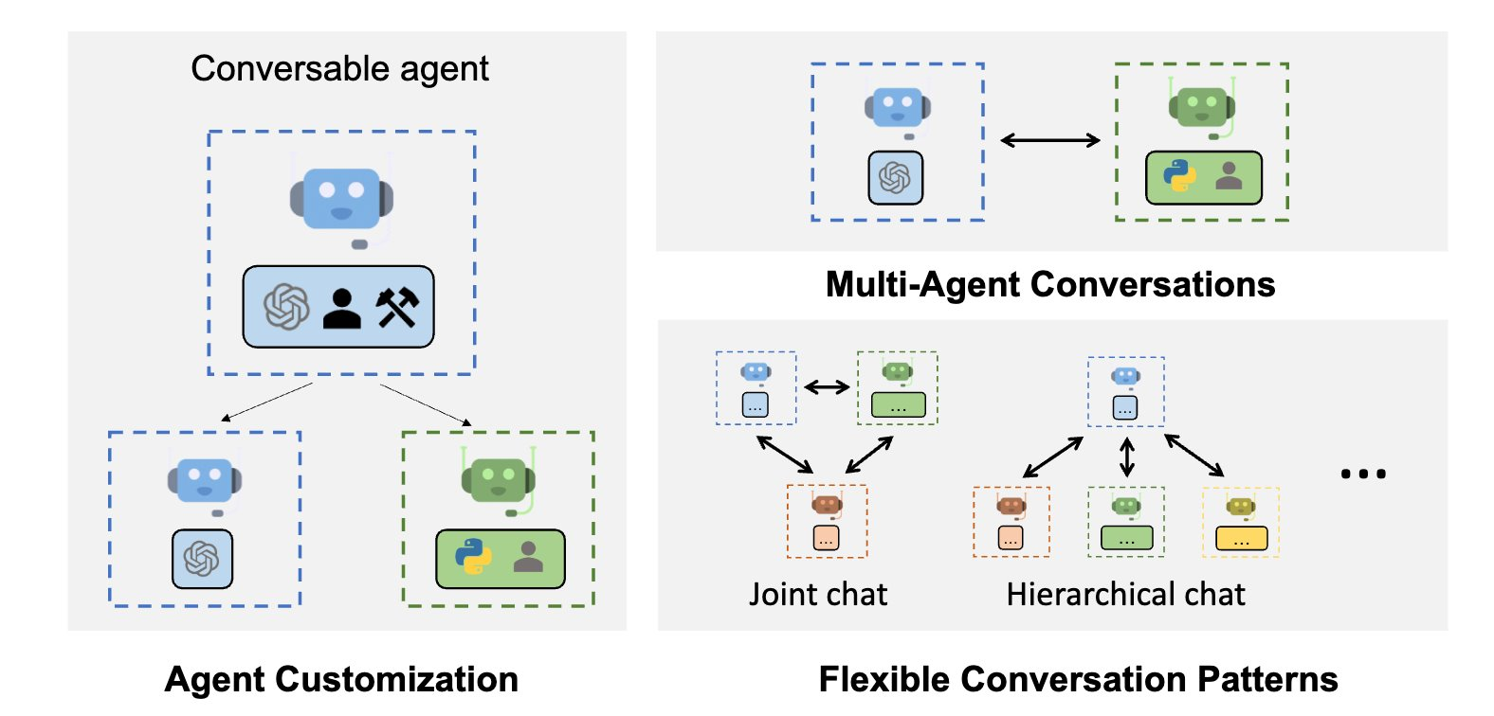
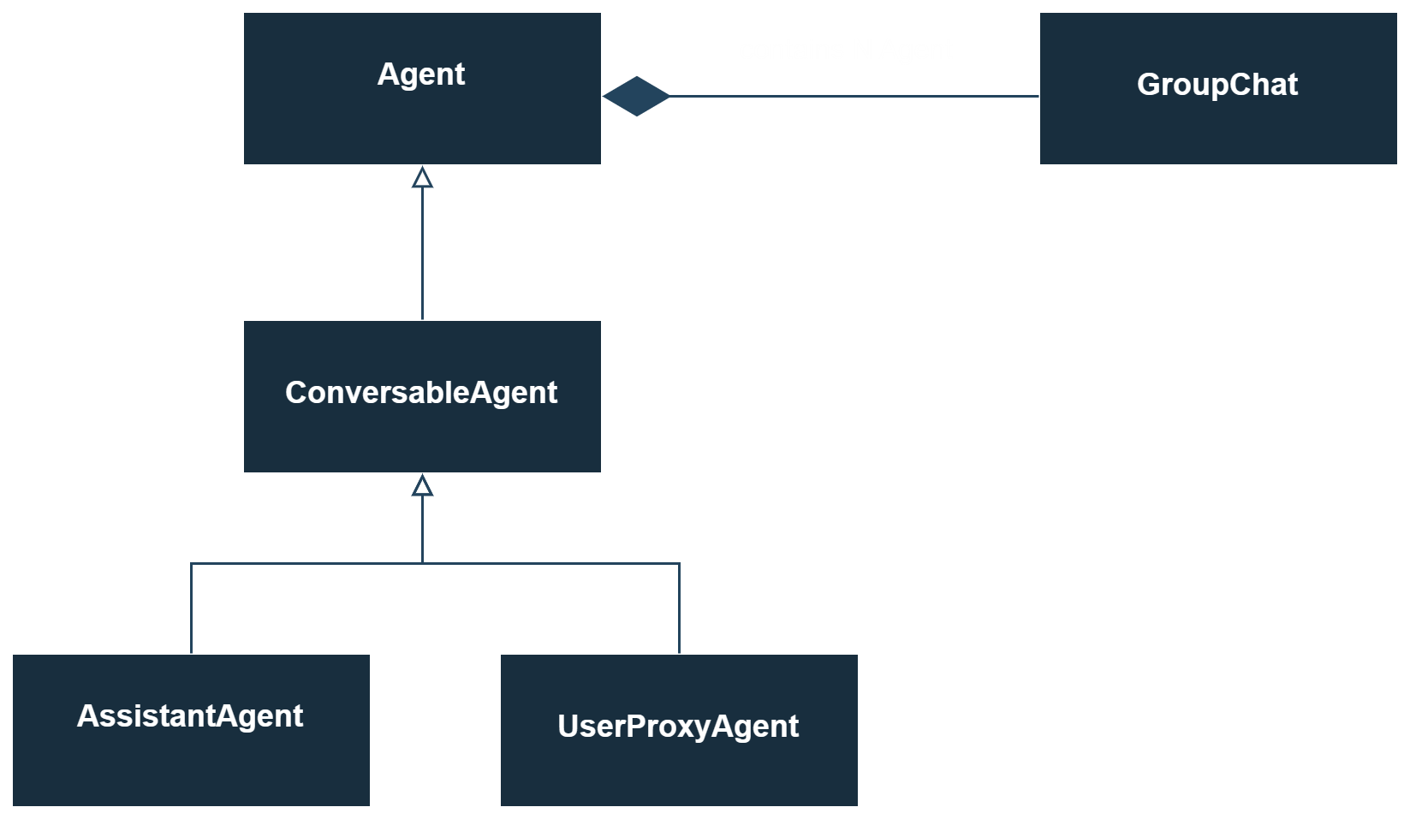

AutoGen concepts
Customizable and conversable agents:​
AutoGen uses a generic design of agents that can leverage LLMs, human inputs, tools, or a combination of them ​​
Conversation programming:​
defining a set of conversable agents with specific capabilities and roles​
programming the interaction behavior between agents via conversation centric computation and control. ​
AutoGen | AutoGen (microsoft.github.io)
Notes:
Autogen was created from Microsoft Research Team and is a python library to simplify creation of multi-agent workflows
spinoff from FLAML project on Mar 29, 2023

Slide 4
Autogen Libraries
AutoGen 0.4, the project will have three main libraries:
Core - the building blocks for an event-driven agentic system.
AgentChat - a task-driven, high-level API built with core, including group chat, code execution, pre-built agents, and more. This is the most similar API to AutoGen 0.2 and will be the easiest API to migrate to.
Extensions - implementations of core interfaces and third-party integrations (e.g., Azure code executor and OpenAI model client).

Slide 5
Autogen Advantages
AutoGen 0.4 embraces the actor model of computing to support distributed, highly scalable, event-driven agentic systems. This approach offers many advantages, such as:
Composability. Systems designed in this way are more composable, allowing developers to bring their own agents implemented in different frameworks or programming languages and to build more powerful systems using complex agentic patterns.
Flexibility. It allows for the creation of both deterministic, ordered workflows and event-driven or decentralized workflows, enabling customers to bring their own orchestration or integrate with other systems more easily. It also opens more opportunities for human-in-the-loop scenarios, both active and reactive.
Debugging and Observability. Event-driven communication moves message delivery away from agents to a centralized component, making it easier to observe and debug their activities regardless of agent implementation.
Scalability. An event-based architecture enables distributed and cloud-deployed agents, which is essential for building scalable AI services and applications.

Slide 6
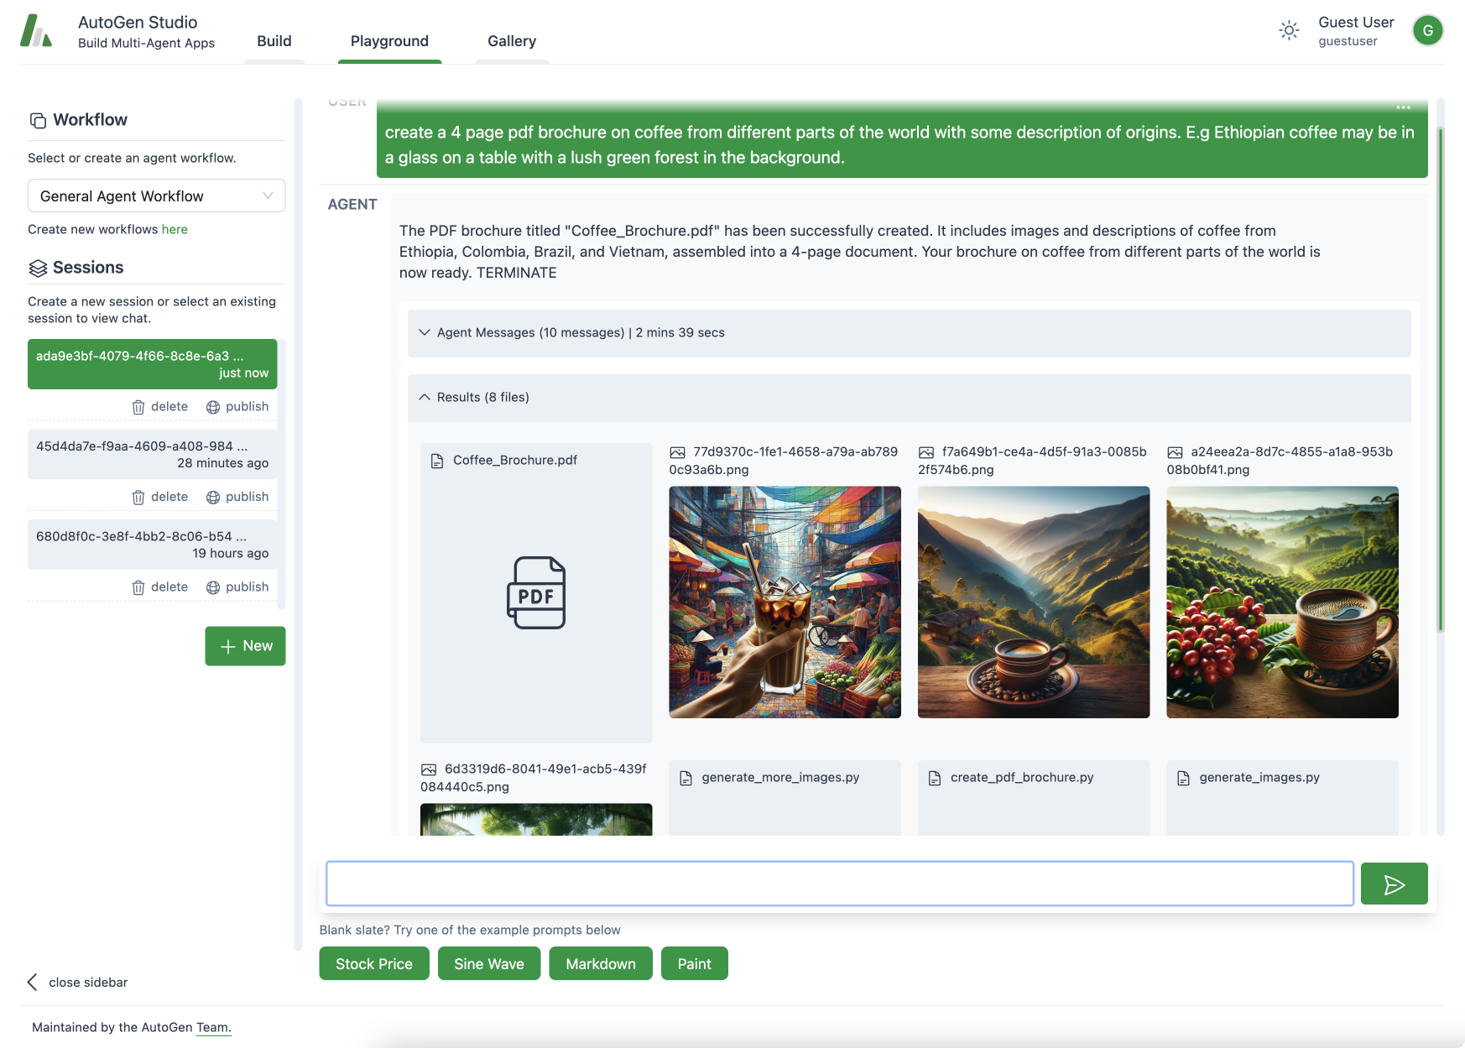
Autogen Studio

