Slide 1
Comparative Study of Countries
(Pranali Vinit Chindarkar)
File created on: 5/19/2022 5:40:42 AM

Slide 2
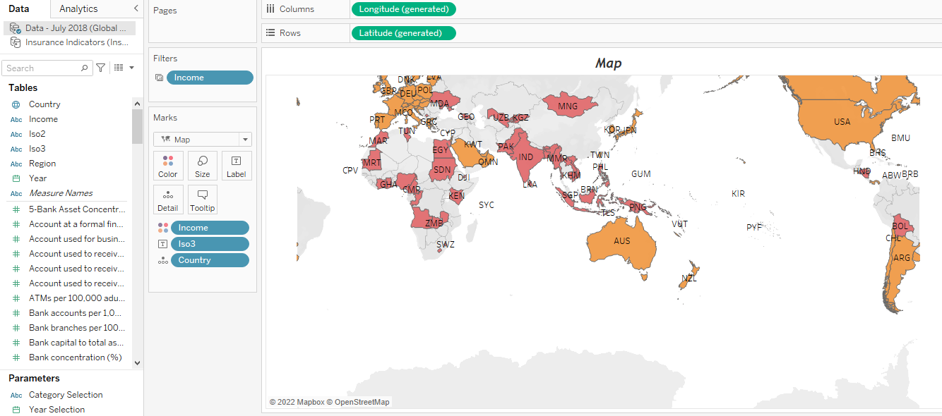

Slide 3
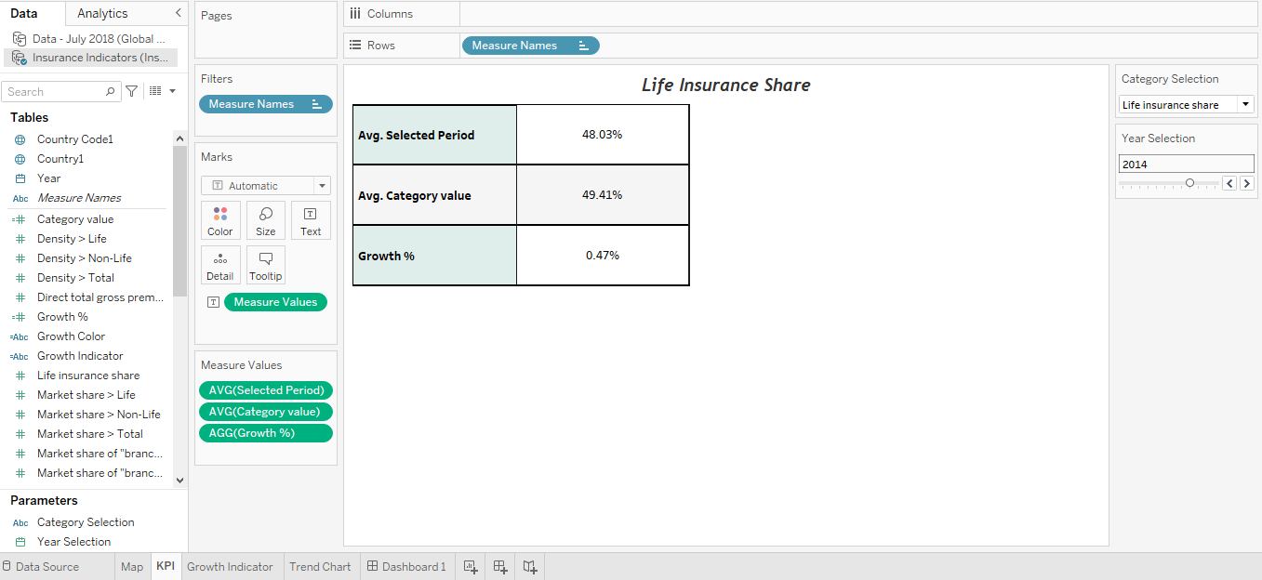

Slide 4
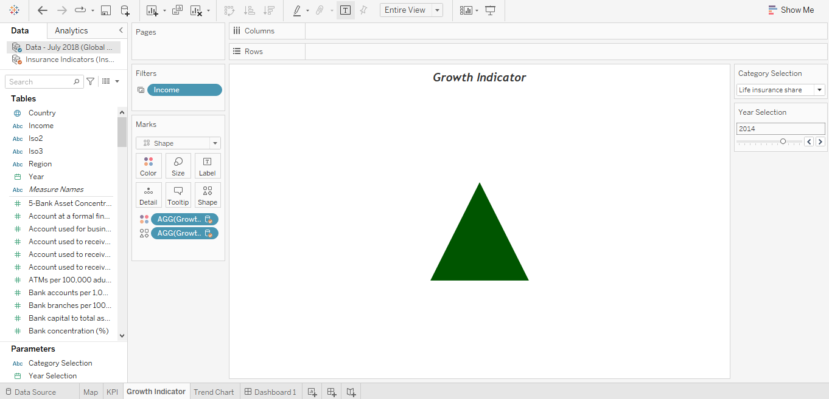

Slide 5
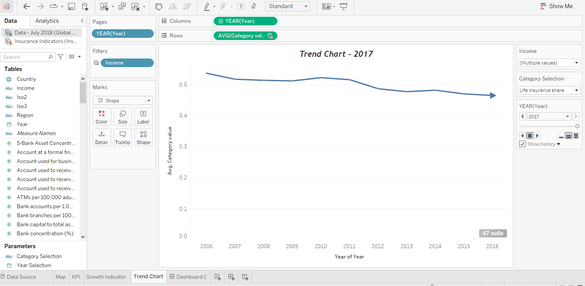

Slide 6
