Slide 1
CUTE 3 PRESENTATION
Presented By:
Shreya Reddy

Slide 2
Contents
Objective
Data Exploration
Data Preprocessing
Approaches
Model Building
Results

Slide 3
Objective
To predict whether a transaction is fraudulent or not to aid Coral bank's internal team to monitor and alarm in case of a fraudulent transaction .

Slide 4
Dataset Exploration
Dimensions:
Train:244285 x 29
Test:104693 x 28(Excluding target)
Attributes and their types:
Target variable :‘target' (Type: numeric)
num_var_(1 ,2,4,....7) (Type:numeric)
cat_var_(2,….18)(Type: factor)
cat_var_(19…22)(Type: numeric)

Slide 5
Dataset Exploration
Class | Proportion
0 | 0.8929202
1 | 0.1070798

Slide 6
Data Preprocessing
Removed columns with near zero variance (reduced to 29 variables)
Missing values check
Train(118577)
Test(50796)
Central imputation
Drop ‘transaction_id’ attribute.(reduced to 28 variables)
Split data into train and validation.(70:30 ratio)

Slide 7
Data Preprocessing
Type conversions
Binning :Convert higher level categorical variables.
Smoting

Slide 8
Approaches
Smoting 700:100
Smoting 900:100
Selected the categorical variables with levels less than 53
Binning into 26 levels.
Reduced train sample size.

Slide 9
Model Building
Pre processing | Model
Smote 900:100+Binning | Naïve Bayes
Smote 900:100+Binning | Logistic Regression
Smote 900:100+Binning | Decision Tree c5.0
Smote 900:100+Binning | Decision Tree c5.0 + 5 trials
Smote 900:100+Binning | Decision Tree rpart
Smote 900:100+Binning | Decision Tree rpart + optimum cp
Smote 900:100+Binning | Random Forest
Binning | Xg-Boost + reg: Logistic
Binning+10% data | GBM
Binning+10% data | Ada-Boost
Smote 900:100 +5% data | SVM
Binning | Xg-boost + binary:logitraw
 | Stacking

Slide 10
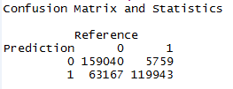

Logistic Regression
Train:
Validation

Slide 11
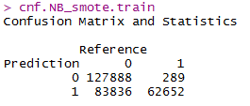
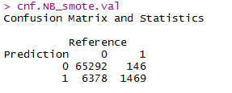
Naïve Bayes
Train:
Validation:

Slide 12
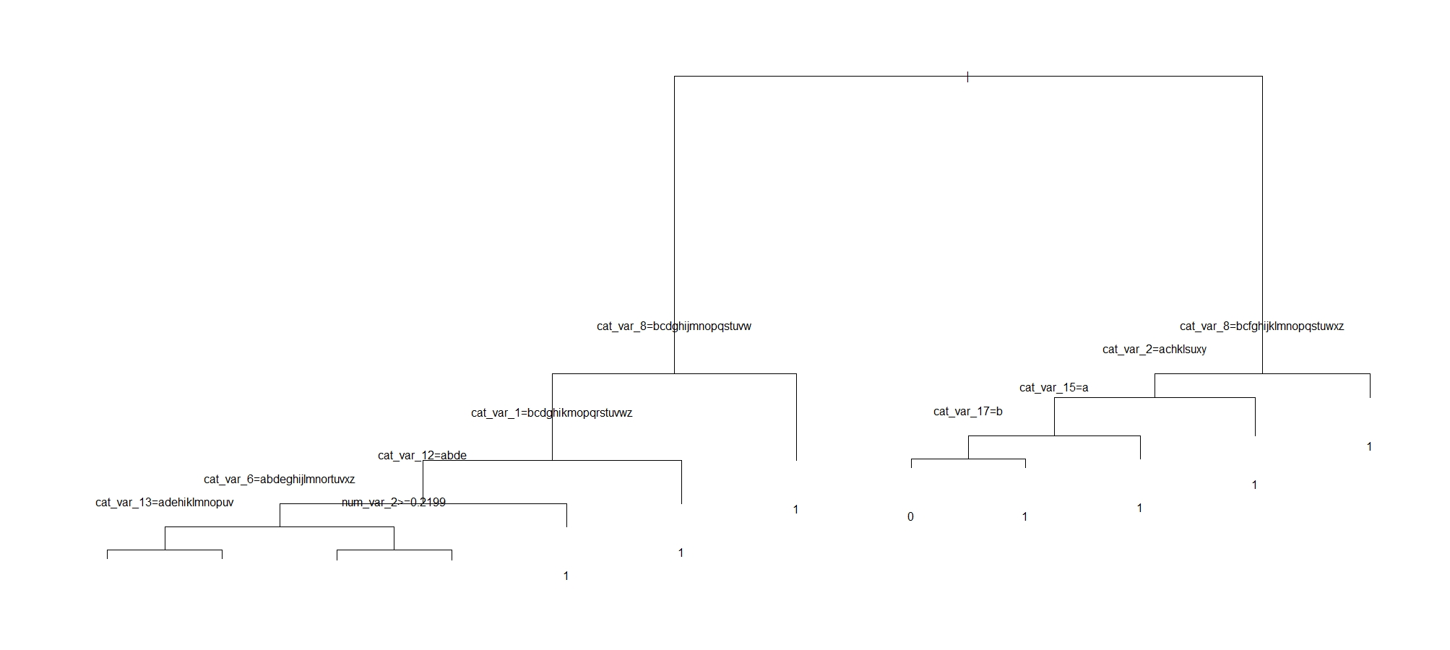
Decision Trees rpart

Slide 13
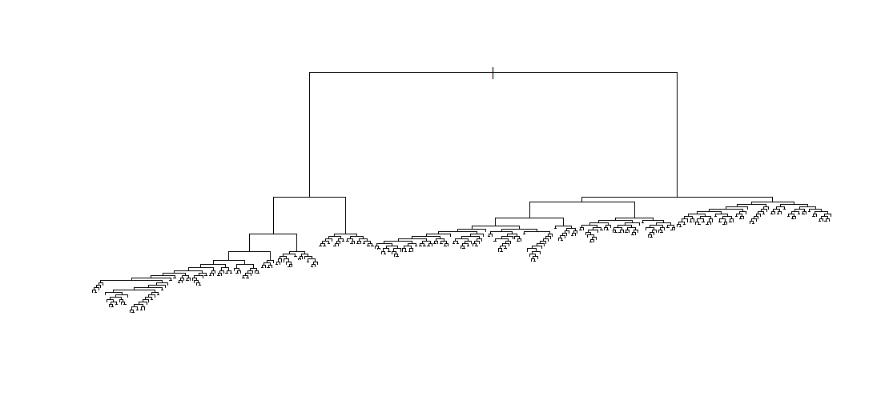
Decision Trees rpart-Optimum cp

Slide 14
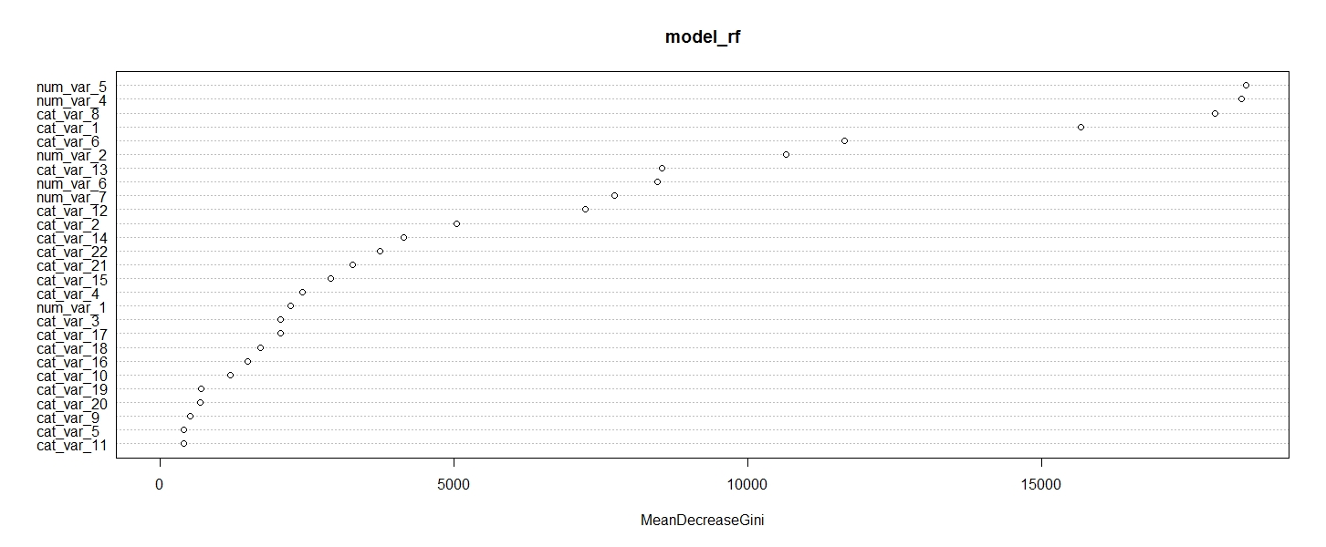
Random Forest

Slide 15
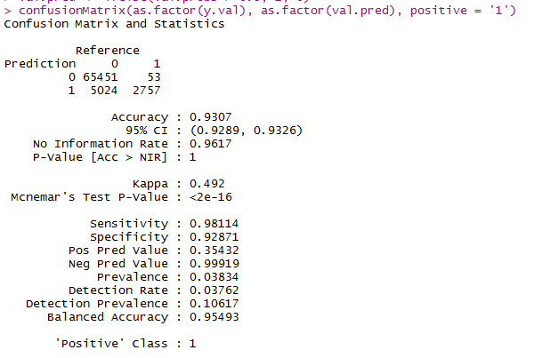
Xgboost

Slide 16
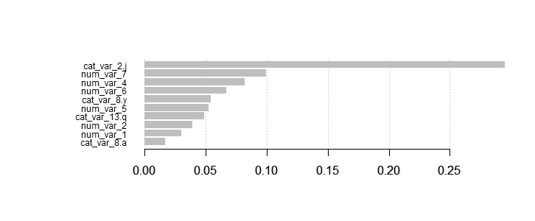
Xgboost

Slide 17
Stacking
Models | Score
Decision Tree : C 50 | 0.27
Decision Tree : C 50 +5 trials | 0.24
Decision Tree: rpart | 0.2
Decision Tree: rpart + optimum cp | 0.21
Random Forest | 0.21
Combined Model | Score
Stacking | 0.31

Slide 18
Results
Model | F1 score on test
Naïve Bayes | 0.29
Logistic Regression | 0.31
Decision Tree c5.0 | 0.27
Decision Tree c5.0 + 5 trials | 0.24
Decision Tree rpart | 0.24
Decision Tree rpart + optimum cp | 0.21
Random Forest | 0.21
SVM | 0.31
Xg-Boost + reg: Logistic | 0.5
Xg-boost + binary:logitraw | 0.41
GBM | 0.45
Ada-Boost | 0.45
Stacking | 0.31

